Slide 1
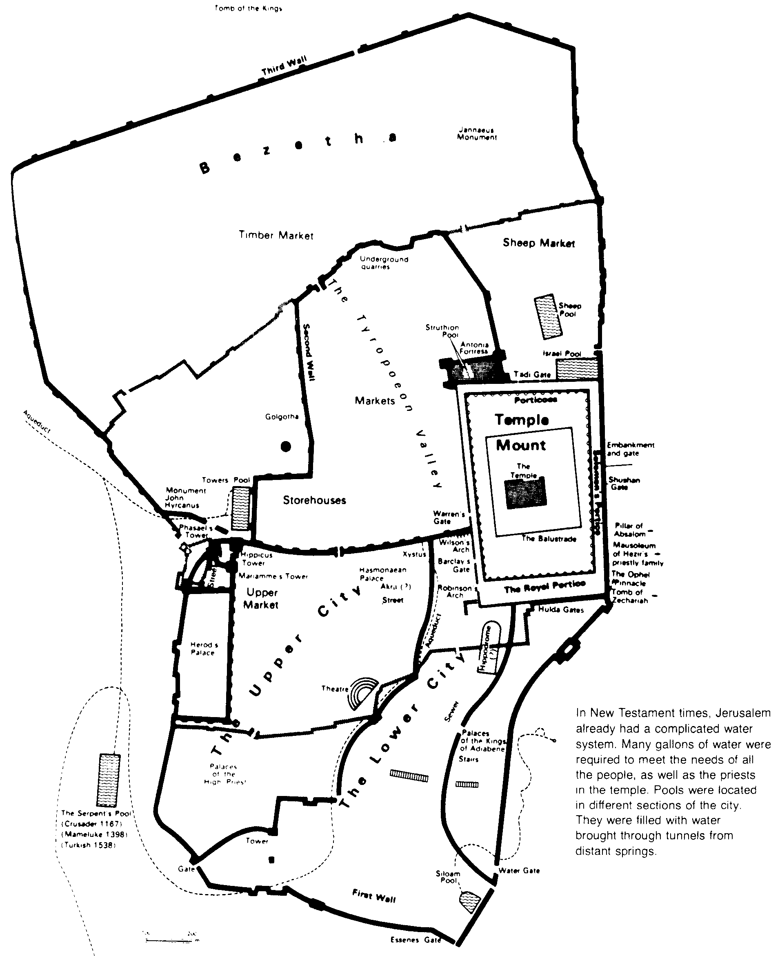
New
Testament Introduction
Dr. Rick Griffith • Jordan Evangelical Theological Seminary • BibleStudyDownloads.org

Slide 2
List in order all the books of the New Testament
22
The Gospels
History
Matthew
Mark
Luke
John
Acts
Letters by Paul
1 Thessalonians
2 Thessalonians
1 Corinthians
2 Corinthians
Philippians
Ephesians
Colossians
1 Timothy
Romans
Galatians
2 Timothy
Philemon
Titus
General Letters
Prophecy
Hebrews
1 Peter
2 Peter
1 John
2 John
3 John
James
Jude
Revelation
Notes:
What overall observations can you make in your small group for the NT?
• There are 5 parts to the NT (grouped by category)
• 4 versions of Christ's life but only one of the church
• Most the NT are letters (especially by Paul)
• 6 of Paul's 13 letters are to people he wrote twice (follow-up for Cor., Thess., & Tim.)
• 2 groupings (general epistles & gospels) named after their authors while Paul's after their recipients

Slide 3
Parallel OT & NT Structure
20a
Foundation
Past
Present
Future
OT
Torah
History
Wisdom
Prophecy
NT
Gospels
Acts
Epistles
Revelation
Erich Zenger, Einleitung in das Alte Testament (Stuttgart: W. Kohlehammer, 1995), 34; cited in Gregory Goswell, "Two Testaments in Parallel: The Influence of the Old Testament on the Structuring of the New Testament Canon," JETS 56 (2013): 461.

Slide 4

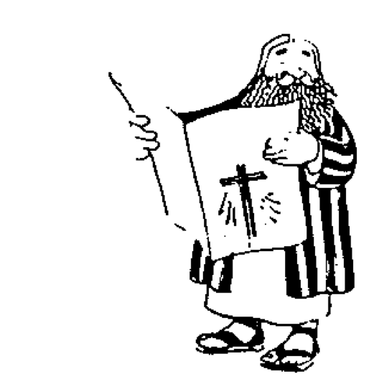




The New Testament “Building”
21
Paul's Letters to Pastors
 | 1 Timothy | 2 Timothy | Titus |  | Philemon
Paul's Letters to Churches | 2 Thessalonians |  |  |  | Revelation | General Letters
 | 1 Thessalonians |  |  |  | Jude
 | Colossians |  |  |  | 3 John
 | Philippians |  |  |  | 2 John
 | Ephesians |  |  |  | 1 John
 | Galatians |  |  |  | 2 Peter
 | 2 Corinthians |  |  |  | 1 Peter
 | 1 Corinthians |  |  |  | James
 | Romans |  |  |  | Hebrews
 | Acts
 | Matthew | Mark |  | Luke | John
Historical Books
Adapted from Walk Thru the Bible
Notes:
What overall observations on the NT can you make from this diagram?
Gospels and Acts form the primary and secondary foundations of the NT.
On the historical foundation are two pillars of 9 books each.
Paul's letters to churches in the left pillar all fit into Acts.
Paul didn't write any inspired letters to churches after Acts.
Pauline letters are named after recipients while General after authors (except Hebrews)
The four gospels are named after their authors.
Every book that ends in "ns" is Pauline
All Pastoral Epistles begin with "T”
______
General Epistles came after Acts (except James).
Each of the 2 pillars begin with a foundational book: Romans & Hebrews (also their longest).
Both pillars also end up in books that primarily deal with eschatology: 2 Thess and Revelation.
Instruction to the leaders comprise only 4 books (i.e., the NT addresses the average Christian).
Only 4 NT books are written to an individual (i.e., the NT is corporate, not individualistic).
Each 1st of multiple letters (1-2 Cor., 1-2 Thess., etc.) is longer & more theologically significant.
The “building” is chronologically clockwise.
________
Three sections all have 9 books: 9 Historical/Pastoral + 9 Pauline + 9 General.
Audiences of the Pauline column had more Jews than the Gentile readers of the General column.
Pauline letters addressed early Christians when eyewitnesses to Jesus lived but General letters mostly addressed second generation believers.
The NT foundation rests on books about the life of Christ, as Jesus is the focus of the NT.
----- Meeting Notes (20/1/18 15:07) -----
Acts bridge

Slide 5
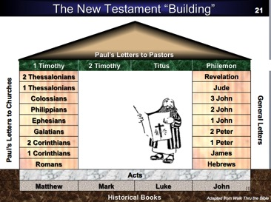
Observations on NT Structure
21
Gospels and Acts are the primary and secondary historical and theological foundations of the NT.
The four gospels are named after their authors.
The historical/theological foundation has two pillars built on it that comprise 9 books each.
Paul’s letters to churches in the left pillar all fit into Acts chronologically.
Paul wrote no letters to churches after Acts.
Pauline letters are named after recipients while General letters after authors (except Hebrews)
Every book that ends in "ans" is Pauline.
All Pastoral Epistles begin with "T" (1-2 Tim.; Tit.)

Slide 6
Observations on NT Structure
21
General Epistles came after Acts (except James).
Each of the 2 pillars begin with a foundational book: Romans & Hebrews (also their longest).
Both pillars also end up in books that primarily deal with eschatology: 2 Thess and Revelation.
Instruction to the leaders comprise only 4 books (i.e., the NT addresses the average Christian).
Only 4 NT books are written to an individual (i.e., the NT is corporate, not individualistic).
Each 1st of multiple letters (1-2 Cor., 1-2 Thess., etc.) is longer & more theologically significant.
The “building” is chronologically clockwise.

Slide 7
Observations on NT Structure
21
Three sections all have 9 books: 9 Historical/Pastoral + 9 Pauline + 9 General.
Paul's audiences were both Jews & Gentiles but the General letters had Jews alone in Hebrews & James though the church was more Gentile then.
Pauline letters addressed early Christians when eyewitnesses to Jesus lived but General letters mostly addressed second generation believers.
The NT foundation rests on books about the life of Christ, as Jesus is the focus of the NT.
Acts bridges the gospels to the epistles.

Slide 8
EACH NT BOOK IN THREE WORDS
33
HISTORY
of Christ
EXPERIENCE
of Church
PROPHECY
of Future
Matthew – Messiah for Jews
Mark – Messiah Is Servant
Luke – Likeness of Man
John – Jesus Is God
Rom. –Righteousness of God
1 Cor. – Church Problems Solved
2 Cor. – Clearing Paul's Reputation
Gal. – Gospel of Liberty
Eph. – Exaltation in Christ
Phil. – Priority of Unity
Col. – Church's Ascended Head
1 Thes. – Triumph before Return
2 Thes. – Tribulation before Return
1 Tim. – Trust in Timothy
2 Tim. – Teach the Church
Titus – Truthless Teachers Denounced
Phile. – Pardon of Onesimus
Revelation – Revelation of Future
History of Church
Acts – Apostles of Church
Heb. – Hasten to Maturity
James – Jews' Belief Behaves
1 Peter – Patience in Trials
2 Peter – Purge False Teachers
1 John – Joy in Fellowship
2 John – Judge False Teachers
3 John – Joy of Hospitality
Jude – Judgment on Apostates
Terry Hall, Bible Panorama, 158

Slide 9
Authors of the New Testament
13
Name | Nationality | Home Town | Occupation | Relation-ships | Chapters Written | Verses Written | Books Written
Matthew | Jew | Capernaum | Tax Collector | Apostle of Jesus Christ | 28 | 1,071 | Gospel of Matthew
Mark | Jew / Roman | Jerusalem | Missionary | Disciple of Peter | 16 | 678 | Gospel of Mark
Luke | Greek | Antioch | Physician | Disciple of Paul | 52 | 2,158 | Gospel of Luke Acts
John | Jew | Bethsaida or Capernaum | Fisherman | Apostle of Jesus Christ | 50 | 1,414 | Gospel of John 1 John 2 John 3 John Revelation
Notes:
The NT has 9 authors—or 8 if Paul wrote Hebrews.
——————————
LC-00-NTS Backgrounds-11
NS-00-NT Intro-9

Slide 10
Authors of the New Testament
13
Name | Nationality | Home Town | Occupation | Relation-ships | Chapters Written | Verses Written | Books Written
Paul | Jew | Tarsus | Tentmaker | Apostle of Jesus Christ | 87 (100)* | 2,033 (2,336)* | Romans 1 Corinthians 2 Corinthians Galatians Ephesians Philippians Colossians Philemon 1 Thessalonians 2 Thessalonians 1 Timothy 2 Timothy Titus (Hebrews?)
*Indicates total if Hebrews is assigned to Paul.
Notes:
The NT has 9 authors—or 8 if Paul wrote Hebrews.
——————————
LC-00-NTS Backgrounds-12
NS-00-NT Intro-10

Slide 11
Authors of the New Testament
13
Name | Nationality | Home Town | Occupation | Relation-ships | Chapters Written | Verses Written | Books Written
James | Jew | Nazareth | Carpenter? | Brother of Jesus Christ | 5 | 108 | James
Peter | Jew | Bethsaida | Fisherman | Apostle of Jesus Christ | 8 | 166 | 1 Peter 2 Peter
Jude | Jew | Nazareth | Carpenter? | Brother of Jesus Christ | 1 | 25 | Jude
Notes:
The NT has 9 authors—or 8 if Paul wrote Hebrews.
——————————
LC-00-NTS Backgrounds-13
NS-00-NT Intro-11

Slide 12

New Testament Chronology

Slide 13
The Gospels
48
Matthew
Mark
Luke
John
Bible Visual Resource Book, 177
The word "Gospel" comes from the Old English "God-spell." It translates the Greek word for "good news."
In antiquity king's heralds announced "glad tidings" of the king's birthday throughout the cities of the realm.
It has the same meaning in our New Testament. The four Gospels announce the glad tidings about Jesus.
The ancient world knew of history, poetry, prophecy and letters. But a "gospel" was new to them.
Here, inspired writers gave more than just history. They also created faith (John 20:30-31) by proclaiming the good news that, just as the OT had promised, God had sent His Messiah to the world.

Slide 14
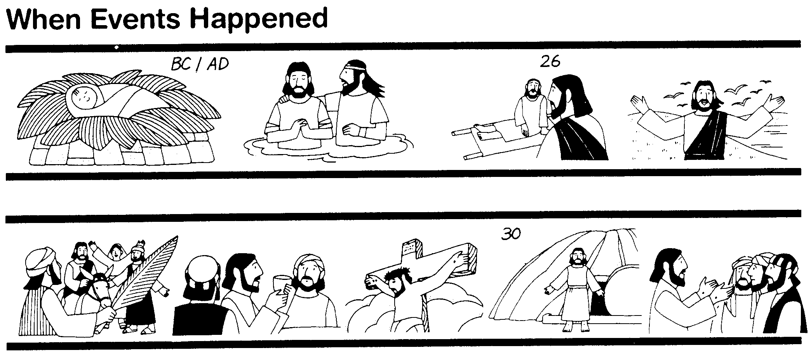
The Synoptics
Why are there four Gospels? Perhaps for the same reason different descriptions of a finely cut jewel would appeal to different people. Matthew describes one facet of the life of Christ, Mark another, Luke a third, and John completes the picture.
48
Matthew
Mark
Luke
John
These three Gospels are so much alike that they are called Synoptic (syn, "together with"; optic, "seeing"; thus "see together"). They all view Christ's life from an historical lens while John dwells more on the inner meaning of Jesus' life and teachings.
When Events Happened
Bible Visual Resource Book, 177

Slide 15
Synoptic Similarities
49
NIV Study Bible, 1471
Matthew, Mark and Luke are noticeably similar, while John is quite different.
How do the first three Gospels agree?
  Language
  Material they include
  General order of the events and sayings from Christ's life
The math facts:
  91 percent of Mark is found in Matthew
  53 percent of Mark is found in Luke
Such agreement raises questions as to the origin of the Synoptic Gospels. Did the authors rely on a common source? Were they interdependent?

Slide 16



"A FINISHED PORTRAIT OF THE
LORD JESUS CHRIST"
51a
From "The Bible…Basically" Seminar…
AS SEEN THROUGH FOUR DIFFERENT LENSES
STUDY HELP #21
13
2
Notes:
Using Study Help #21, through this large picture frame…
we're going to create a graphic representation called
//// A FINISHED PORTRAIT OF THE LORD JESUS CHRIST… but…
//// …we're going to compose that portrait through four different literary lenses as the completed image develops.

Slide 17
Each Gospel Writer Had:
51a
• His specific audience
• His unique presentation of the person of Jesus Christ
• His foundational purpose for writing his Gospel
• His own date of writing
14
4
Notes:
From each Gospel writer…
//// …we'll discover the specific audience for his writings…
//// …with his unique presentation of the person of Jesus Christ…
//// …suggesting a foundational purpose communicated through the text of his Gospel…
//// …followed by the scholars' estimate of the date of each writing.

Slide 18
FOUR INDIVIDUAL PORTRAITS…
51a
1
2
3
4
15
Notes:
Now, please…in your imagination…insert four smaller picture frames into the larger one. In each frame install four lines. As we fill them in we'll have some specific information about the purpose and function of each of the four Gospels. The individual "sub-frames" are designated 1 through 4.

Slide 19
FRAMING THE GOSPELS…
51a
1
MATTHEW
2
MARK
3
LUKE
4
JOHN
16
3
Notes:
Each of the frames now gets its name... MATTHEW in the first...
//// MARK, second...
//// LUKE, third...and finally, the fourth…
//// JOHN, the names of the Gospels in the order of their appearance in the New Testament canon...the official collection of Biblical writings.

Slide 20
THE AUDIENCES FOR THE GOSPELS…
51a
1
MATTHEW
2
MARK
TO:
JEWS
TO:
ROMANS
3
LUKE
4
JOHN
TO:
GREEKS
TO:
CHURCH
17
4
Notes:
Now comes an idea endorsed by Biblical scholars around the world…having to do with the audiences TO WHICH each Gospel was written.
For instance…
//// MATTHEW penned his work specifically toward his brothers and sisters in the Jewish audience. He makes repeated references to a regnant Jesus, seeing him as the Messiah and the King of the Chosen People.
//// For MARK, his work is widely regarded as directed toward the Romans, then occupying his native land and into the farther parts of the ancient world. MARK is brief, to the point. And, in fact, repeatedly he uses such term as "straightway" in early translations…all in a get-the-job-done mentality, which characterized the Roman way of thinking and doing things.
//// While LUKE, the physician, is the highly intellectual Greek who accompanied Paul on his tours. For LUKE, his Gospel audience was the Greeks, and in other words, to the Gentile world in general.
Also as the author of The Acts, Luke set down for all time a detailed account of the development of the early church and its wide-spread missionary ministries, to which he was a witness.
//// Finally, we come to the gospel of JOHN, whose audience differs markedly from the first three. John is written directly to UNBELIEVERS, AND REACHING THEM THROUGH THE COMMUNICATION CHANNEL OF THAT NEW ORGANISM, THE CHURCH. In fact, when you read John's gospel, you are struck with the fact that his work carries with it a somewhat mystical quality, certainly not the quick, even terse recounting of facts as we find in Mark's Gospel. John's audience –– the Church itself, the members of the new Organism, bathed in the redemptive love of Christ –– receives his brilliant articulation of the impact of the coming of the Holy Spirit, now –after the Day of Pentecost -- having taken up permanent residence in the heart of each new believer.
So there are four individual audiences to which the Gospels were specifically directed at the time of their writing. That one insight, alone, gives a new way to categorize and individualize the Gospel writings.

Slide 21
…PORTRAYING JESUS AS…
51a
2
1
2
1
MATTHEW
MARK
TO:
JEWS
TO:
ROMANS
AS:
KING
AS:
SERVANT
4
3
4
3
JOHN
LUKE
JOHN
GREEKS
CHURCH
TO:
TO:
CHURCH
TO:
TO:
AS:
GOD/MAN
AS:
GOD
18
4
Notes:
Another question: How does each Gospel portray The Lord as a Man and as Immanuel, "God With Us?"
//// For MATTHEW...Christ is seen as King of the Jews. Repeatedly Matthew describes how Jesus is the fulfillment of Old Testament Scripture. Matthew makes wide use of Jewish terminology of royalty.
//// For MARK...He is seen as the Servant of all...some say the Suffering Servant, and traditionally associated with an audience in Rome and among the widespread Roman world.
//// LUKE sees Christ as the God-Man -- truly God and truly Man. Luke shows the Gentiles that Christ is the perfect man to which they aspired.
//// Finally, John's Gospel. Clearly and above all else...JOHN portrays Christ as God Himself. JOHN uses his pen to communicate the mystery and the power of the Messiah. Why? Because John experienced a particular closeness to the Master, one that was apparently unique among the disciples. Remember too that this was this same JOHN who was destined to see and write down the great End-Times vision we know as The Revelation.

Slide 22
THE MESSAGE IN A NUTSHELL…
51a
1
MATTHEW
2
MARK
TO:
JEWS
TO:
ROMANS
AS:
KING
AS:
SERVANT
WHAT
HE:
WHAT
HE:
SAID
DID
3
LUKE
4
JOHN
TO:
GREEKS
TO:
CHURCH
AS:
GOD/MAN
AS:
GOD
WHAT
HE:
WHAT
HE:
FELT
MEANT
19
5
Notes:
Here is a last set of interesting ideas, with thanks to some anonymous believer who developed them years ago.
//// Call it "the message in a nutshell." Question: what is the one single word that might characterize the message of each Gospel?
//// For MATTHEW...that book tells us what Jesus Christ SAID.
//// MARK tells us what He DID.
//// LUKE shows us clearly what the Messiah FELT.
//// And JOHN, with enormous clarity, tells us what Christ MEANT!
What he SAID...what He DID...what He FELT...and what He MEANT!
These single-word ideas help us to tightly focus on the remarkable differences that exist among the Gospel writings. For many Bible readers, such distinctives are unfamiliar territory.

Slide 23
THAT STRANGE SOUNDING WORD…
51a
SYNOPTIC:
1
MATTHEW
2
MARK
TO:
JEWS
TO:
ROMANS
AS:
KING
AS:
SERVANT
WHAT
HE:
SAID
WHAT
HE:
DID
SYNOPTIC:
"TO SEE TOGETHER"
"TO
SEE TOGETHER"
3
LUKE
TO:
GREEKS
AS:
GOD/MAN
WHAT
HE:
FELT
20
3
Notes:
Now comes that word that's a strange one to many...
//// SYNOPTIC…meaning…
//// … "TO SEE TOGETHER"…add these words to that triangle shape on your study help.
//// It is a term from Greek roots that means seeing a group of things together... from the same general perspective. One word that, again, helps organize and categorize the enormous factual base that makes up our Bible.

Slide 24
THE SYNOPTICS: "TO SEE TOGETHER"
51a
1
MATTHEW
2
MARK
TO:
JEWS
TO:
ROMANS
AS:
KING
AS:
SERVANT
WHAT
HE:
SAID
WHAT
HE:
DID
∑
3
LUKE
4
JOHN
TO:
GREEKS
CHURCH
TO:
AS:
GOD/MAN
AS:
GOD
WHAT
HE:
FELT
WHAT
HE:
MEANT
21
1
Notes:
Follow the arrows as they link together the gospels of MATTHEW, MARK and LUKE. Again…you'll notice that JOHN is not among them. Those three are the so-called SYNOPTIC Gospels...THEY ARE SEEN TOGETHER...in that these works take on that ground-level view of the human history of Jesus Christ just as he walked about Palestine in the days of his ministry. The Man…and his Mission among his People.
//// On the other hand…the Gospel of John –– seen here with the familiar mathematical SUMMA sign –– represents the summation of all that Jesus Christ MEANT –– the sum of all that he preached and demonstrated –– both publicly and privately. Seeing the Lord clearly as God Himself, John raises our spiritual horizon in ways that the first three gospels do not.

Slide 25
OVERLAPS IN THE GOSPELS
51b
1
MATTHEW
2
MARK
7% unique!
Baptism
Lord's Supper
Birth
Genealogy
5000 fed
Passion
3
LUKE
4
JOHN
92% unique!
16
Notes:
Each of the Gospels say things that the others don't...
//// MATTHEW was believed by the early church to have written first...
//// MARK shares a lot of material with Matthew, such as Christ's baptism and supper...
//// LUKE also has much overlap with Matthew and Mark, such as Christ's baptism and supper—but only Matthew and Luke record Christ's birth and genealogy. However, the fourth…
//// JOHN, stands alone in terms of its material. Only 8% of it repeats stories from the others—such as the feeding of the 5000, and, of course, His death and resurrection.
//// But the remaining 91% of JOHN you will find only in JOHN.

Slide 26
JOHN: SUMMING UP THE MESSAGE
51a
1
MATTHEW
2
MARK
TO:
JEWS
TO:
ROMANS
AS:
KING
AS:
SERVANT
WHAT
HE:
SAID
∑
WHAT
HE:
DID
3
LUKE
4
JOHN
TO:
GREEKS
TO:
CHURCH
AS:
GOD/MAN
AS:
GOD
WHAT
HE:
FELT
WHAT
HE:
MEANT
22
Notes:
So, in summation, then…John wrote to UNBELIEVERS THROUGH THAT NEW ORGANISM, THE CHURCH, envisioning Christ as God Himself…
But what did John SAY that Jesus meant in his preaching?

Slide 27

The Synoptic Problem
49
Matthew, Mark & Luke in a nutshell:
How do we explain their similarities?
How do we explain their differences?

Slide 28
Marcan Priority Diagrammed
51
51
Mark
661
1068
1149
500
350
Matthew
Luke
Numbers indicate the verses in each proposed source
235
333
Q
564
M
L

Slide 29

Dating the Synoptic Gospels
49
Adapted from the NIV Study Bible, 1431
MARK
MATTHEW
LUKE
MARK
MATTHEW
LUKE
ASSUMPTION A:
ASSUMPTION B:
Matthew and Luke used Mark as a source
Matthew and Luke did not use Mark as a source
View #1
View #1
Mark written in the 50s or early 60s
Mark could have been written anytime between 50 and 70
(1) Matthew written in late 50s or the 60s
View #2
(2) Luke written 59-63
Mark written 65-70
View #2
(1) Matthew written early 50s (see Matthew notes)
Mark written 65-70
(1) Matthew written in the 70s
(2) Luke written 59-63 (see Luke notes)
(2) Luke written in the 70s
Taught in this class

Slide 30
Solutions to the Synoptic Problem
49
Questions like these constitute what is known as the Synoptic Problem. Several solutions have been advanced:
The use of oral tradition. Some have thought that tradition had become so stereotyped that it provided a common source from which all the Gospel writers drew.
The use of an early Gospel. Some have postulated that the Synoptic authors all had access to an earlier Gospel, now lost.
The use of written fragments. Some have assumed that written fragments had been composed concerning various events from the life of Christ and that these were used by the Synoptic authors.
Mutual dependence. Some have suggested that the Synoptic writers drew from each other with the result that what they wrote was often very similar.
NIV Study Bible, 1431

Slide 31
Solutions to the Synoptic Problem
49
The use of two major sources. The most common view currently is that Mark and a hypothetical document, called Quelle (German for "source") or Q, were used by Matthew and Luke as sources for most of the materials included in their Gospels.
The priority and use of Matthew. Another view suggests that the other two Synoptics drew from Matthew as their main source.
A combination of most of the above. This theory assumes that the authors of the Synoptic Gospels made use of oral tradition, written fragments, mutual dependence on other Synoptic writers or on their Gospels, and the testimony of eyewitnesses.
NIV Study Bible, 1431

Slide 32
Two-Source Hypothesis
50
Q
AD 50
Mark
AD 65
Matthew
Luke

Slide 33
Four-Source Hypothesis
50
M
Jerusalem
AD 60-65
Mark
Rome
AD 65
Q
Antioch
AD 50
L
Caesarea
Proto-Luke
Matthew
Antioch
AD 85
Luke
Caesarea, Corinth?
AD 60, AD 80
Antiochene
Tradition
Source of
Luke 1-2

Slide 34
When I Think They Were Written…
52
1
MATTHEW
2
MARK
TO:
JEWS
TO:
ROMANS
The A.D.40s
A.D. 64-68
AS:
KING
AS:
SERVANT
WHAT
HE:
WHAT
HE:
SAID
DID
3
LUKE
4
JOHN
GREEKS
CHURCH
A.D. 57-59
A.D. 69 AFTER THE SYNOPTICS
TO:
TO:
AS:
GOD/MAN
AS:
GOD
WHAT
HE:
WHAT
HE:
FELT
MEANT
27
4
Notes:
Now…what about the dates of the writing of these crucial documents? And here we are left to our best scholarly guesses. There will ALWAYS be argument here. But some of the best guesses, based on decades of academic research and study are these – in suggested order…
//// MATTHEW…composed sometime during the A.D. 40s…
//// LUKE is suggested as next, between the years A.D. 57 and 59 A.D…
//// Mark…in the next decade…between 64 and 68…
//// and finally…John's Gospel…around A.D. 69….but certainly after the Synoptics were set down. Again, you will always find disagreement on these dates. However, these dates are from the research of well-known Christian scholars and teachers.

Slide 35

Date Options for John's Gospel
109
Authorship is easier to determine than when John wrote. Three periods have been proposed for the date of the Gospel:
Late First Century
Second Century
Before AD 70
33
Christ's
Death
70
Temple
Destroyed
95
John's
Death

Slide 36
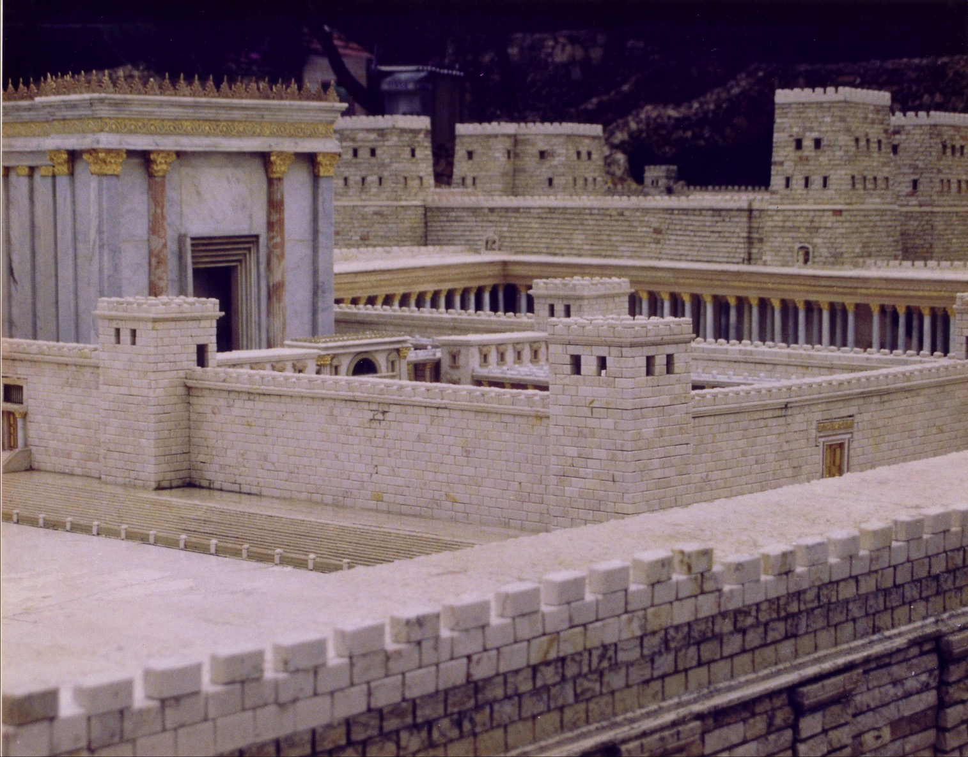
The Temple Stood Until AD 70

Slide 37
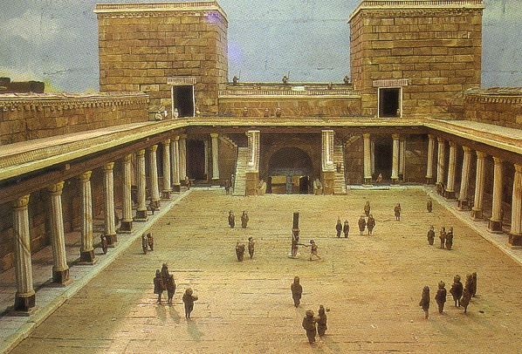
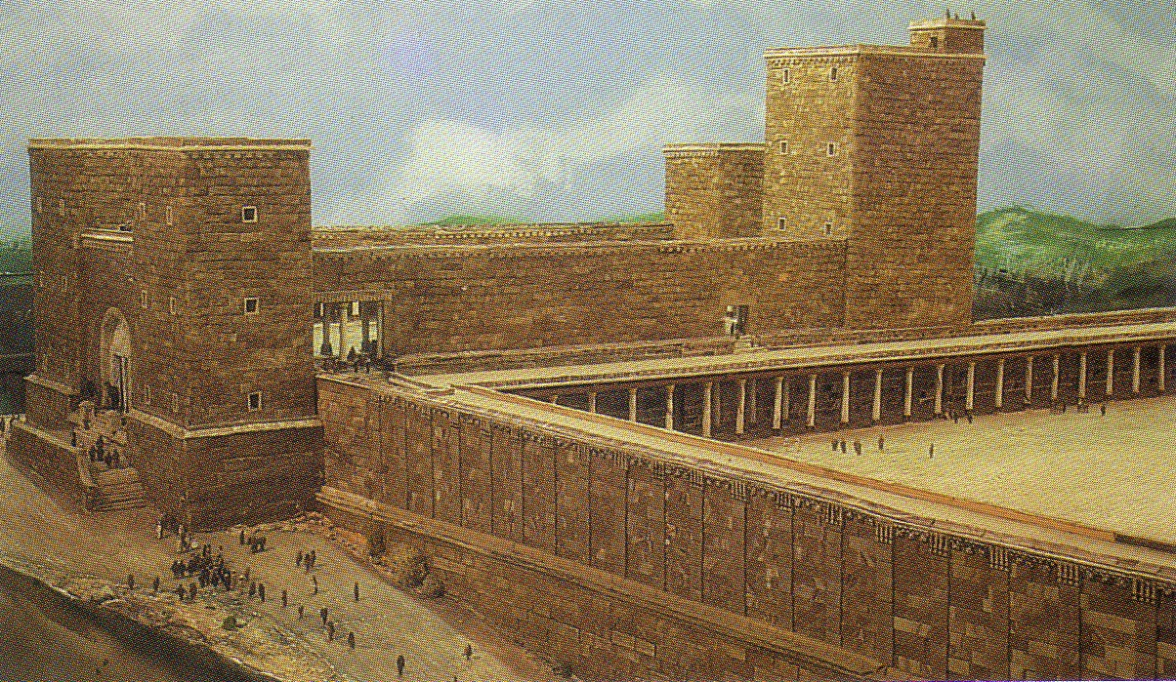
Antonia Fortress

Slide 38
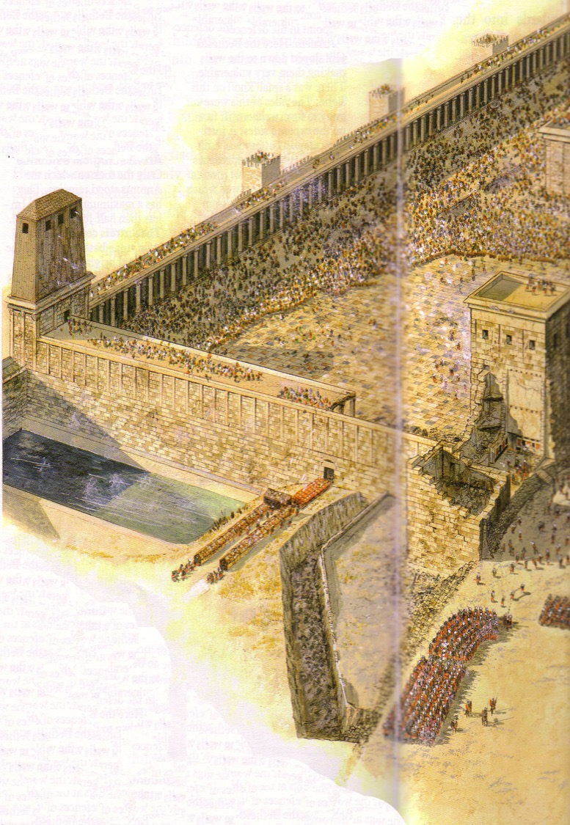
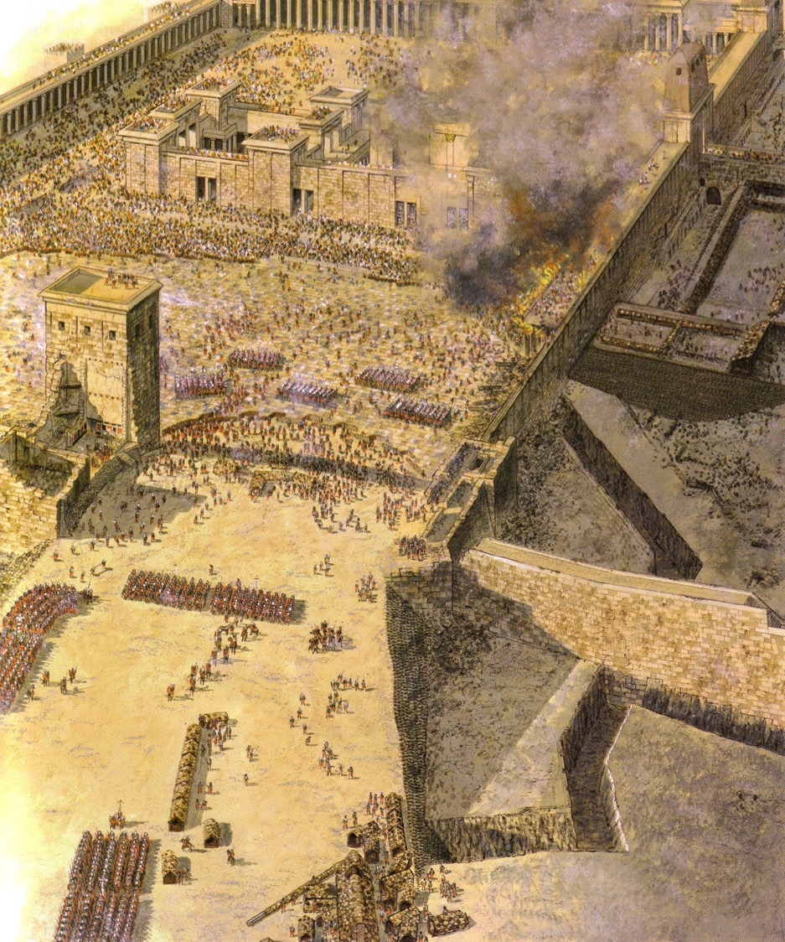
Temple Assault
Sept AD 70
Sheep Pool

Slide 39
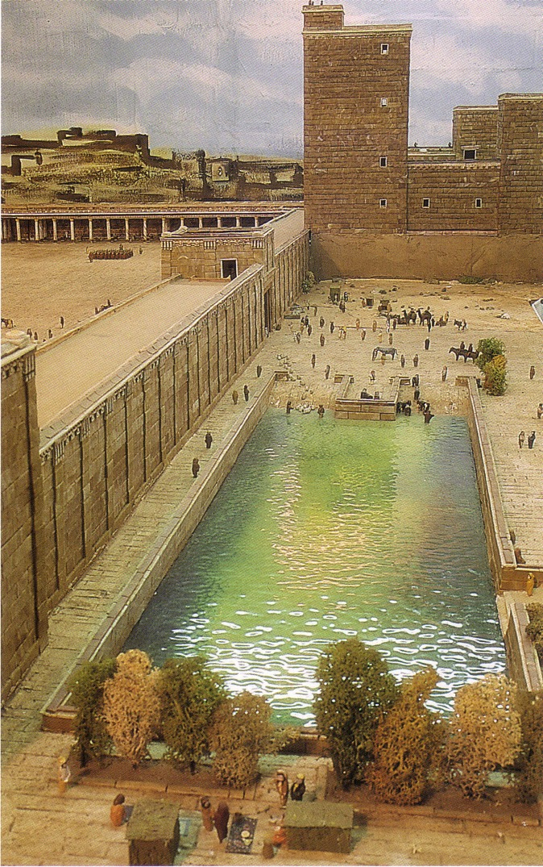
The Pool of Israel
(Sheep Pool south of Pool of Bethesda)

Slide 40
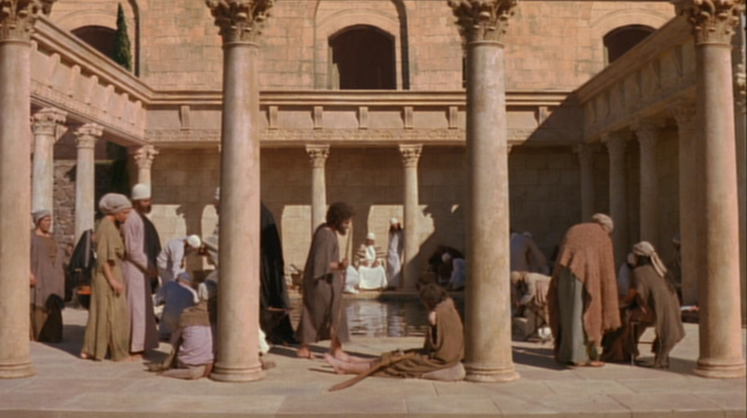
Pool of Bethesda
"Now there is in Jerusalem near the Sheep Gate a pool… called Bethesda…"
John 5:2

Slide 41
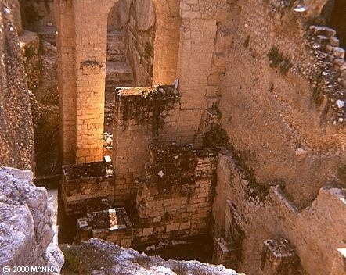
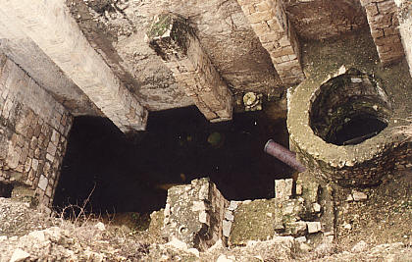
Pool of Bethesda
"Now there is in Jerusalem near the Sheep Gate a pool… called Bethesda…"
John 5:2

Slide 42
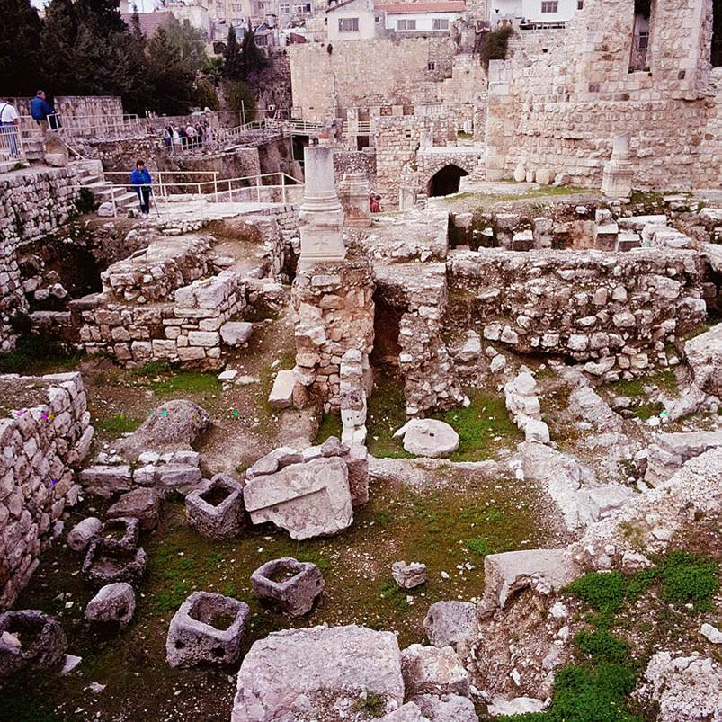
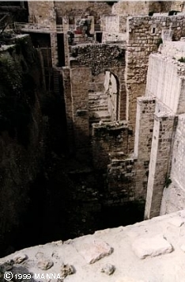
Pool of Bethesda Ruins

Slide 43
The Fours Gospels Compared
52
 | Matthew | Mark | Luke | John
Job before Saved | Tax Collector | None (Youth) | Medical Doctor | Fisherman
Race | Jew | Jew | Gentile | Jew
Office and / or Spiritual Gift | Apostle | Service or Pastoring | Service or Teaching | Apostle
Readers:
Ethnically | Jews | Roman | Gentile (Greek) | World
Interest | Signs (1 Cor. 1:22) |  | Wisdom (1 Cor. 1:22)
Spiritually | Unbelievers | Believers | Unbelievers | Unbelievers
Primary Need | Messiahship and Kingdom Offer | Model in Suffering (exhorts discipleship) | Universality (and kingdom expansion) | Deity
Notes:
_________
NS-00-NT Introduction-40
NS-01-Matt1-14-slide 56
NS-02-Mark1-8-slide 40
NS-03-Luke1-12-slide 30
NS-04-John1-12-slide 72

Slide 44
The Four Gospels Compared
52
 | Matthew | Mark | Luke | John
Date Written | 40s | 64-68 | 57-59 | late 60s
Place Written | Antioch or Syria | Rome | Caesarea or Rome | Ephesus
Place Sent | Palestine | Rome | To Theophilus | Asia, etc.
Jesus is… | King of Israel (Messiah) | Suffering Servant (Deity) | Ideal Man (Messiah) | Son of God (Deity)
Key Verse | 21:5 | 10:45 | 19:10 | 20:31
Themes | Law | Power | Grace | Glory
Literary Emphasis | Sermons | Miracles | Parables | Allegories
Arrangement | Topical | Chronological | Chronological | Topical
Genealogy | Abraham to Joseph | None | Adam to Mary | None
Notes:
_________
NS-00-NT Introduction-41
NS-01-Matt1-14-slide 57
NS-02-Mark1-8-slide 41
NS-03-Luke1-12-slide 31
NS-04-John1-12-slide 73

Slide 45
The Four Gospels Compared
52
 | Matthew | Mark | Luke | John
Scope | Birth to Resurrection | Ministry to Resurrection | Ministry to Resurrection | Ministry to Resurrection
Tone | Prophetic | Pastoral | Historical | Spiritual
Christ's Words | 60% | 42% | 50% | 50%
Chapters | 28 | 16 | 24 | 21
Verses | 1068 | 661 | 1149 | 878
Verses per Chap. | 38 | 41 | 48 | 42
OT Quotations | 53 | 36 | 25 | 20
OT Allusions | 76 | 27 | 42 | 105
OT References | 129 | 63 | 67 | 125
Unique Material | 42% | 7% | 59% | 92%
Broad Division | ------------------- Synoptic Gospels ------------------- |  |  | Supplemental Gospel
Notes:
_________
NS-00-NT Introduction-42
NS-01-Matt1-14-slide 58
NS-02-Mark1-8-slide 42
NS-03-Luke1-12-slide 32
NS-04-John1-12-slide 72

Slide 46

How Well Do You Know the Life of Christ?
How Well Do You Know the Life of Christ?
53
4
Guest at Wedding
Can you number these events in chronological order?
6
Interview with Nicodemus
3
Enemy's 3 Temptations
7
Message on Mount
1
Birth in Bethlehem
5
Housecleaning the Temple (1st time)
10
Washing Disciples' Feet
8
Parables of Kingdom
2
Carpenter in Nazareth
9
Tomb of Lazarus
Terry Hall, Bible Panorama, 121

Slide 47
NT Overview
38
124
39-41
"To the remotest part of the earth" (Acts 1:8)
Acts 9 13 14 15 16 18 21 27 28
Apr 48-
Sep 49
1
Galatia
Apr 50-
Sep 52
2
Aegean
Spr 53-
May 57
3
Asia
Feb 60-
Mar 62
1
Rome
Spr 62-
Fall 67
4
Spain
Aut 67-
Spr 68
2
Rome
Summer 35-
37
Damascus
Antioch
May 57-
Aug 59
Trials
Fall 49
The
Council
Spring 68
Expansion of Church
35 48 49 50 52 53 57 60 62 67 68 95
Matt
Luke
Acts
Mark
John
Gal
1 Thess
1 Cor
Eph
1 Tim
2 Tim
Jude
James
2 Thess
2 Cor
Col
Titus
Heb
1 John
Romans
Philem
1 Pet
2 John
Gospels & Acts
Phil
2 Pet
3 John
Pauline Epistles
1234
Journeys
Rev
General Epistles
Rome
Imprisonments
No Animations

Slide 48
NT Book Key Words
24
Date | Book | Key Word | Paul's Life | Key Doctrine
40s | Matthew | Kingdom |  | Ecclesiology
44-47 | James | Works |  | Soteriology
49 | Galatians | Justification | 1st journey | Soteriology
51 | 1 Thessalonians | Rapture | 2nd journey | Eschatology
51 | 2 Thessalonians | Tribulation | 2nd journey | Eschatology
56 | 1 Corinthians | Sanctification | 3rd journey | Ecclesiology
56 | 2 Corinthians | Apostleship | 3rd journey | Ecclesiology
56-57 | Romans | Righteousness | 3rd journey | Soteriology
57-59 | Luke | Sovereignty I |  | Missiology

Slide 49
NT Book Key Words
24
Date | Book | Key Word | Paul's Life | Key Doctrine
60 | Ephesians | Unity | 1st imprisonment | Christology (Head)
61 | Colossians | Deity | 1st imprisonment | Christology (God)
61 | Philemon | Forgiveness | 1st imprisonment | Christology (Reconciler)
62 | Philippians | Attitude | 1st imprisonment | Christology (Example)
62 | Acts | Sovereignty II |  | Missiology
62 | 1 Timothy | Order | 4th journey | Ecclesiology
64 | 1 Peter | Suffering |  | Eschatology
64 | 2 Peter | Knowledge |  | Eschatology
64-68 | Mark | Discipleship |  | Eschatology

Slide 50
NT Book Key Words
24
Date | Book | Key Word | Paul's Life | Key Doctrine
66 | Titus | Conduct | 4th journey | Ecclesiology
67 | 2 Timothy | Doctrine | 2nd imprisonment | Ecclesiology
67-68 | Hebrews | Superiority |  | Christology
c. 69 | John | Belief |  | Soteriology
75 | Jude | Pretenders |  | Eschatology
85-95 | 1 John | Love |  | Soteriology
85-95 | 2 John | Limits |  | Missiology
85-95 | 3 John | Missionaries |  | Missiology
95-96 | Revelation | Triumph |  | Eschatology

Slide 51
25
67
Message Statements for the New Testament Books
Subject + Purpose = Message
What the book says Why it says it Main (Big) Idea (Theme) (Reason) (Summary Statement)
Matthew
Matthew proves Jesus is the Messiah so that the unbelieving Jews will trust Him.
Matthew also explains that the earthly kingdom is delayed because Israel rejected Christ as their king.
This explanation is to convince the believing Jews that Christ's present kingdom authority resides in the church.

Slide 52
25
Message Statements for the New Testament Books
Subject + Purpose = Message
What the book says Why it says it Main (Big) Idea
(Theme) (Reason) (Summary Statement)
Mark
Mark presents in a pastoral concern selected events about Christ, the Son of God (deity) who serves as the model Suffering Servant, to exhort persecuted Roman believers to true discipleship for Christ.
Notes:
NTS Overview slide 39

Slide 53
Message Statements for the New Testament Books
25
Luke
Luke presents the sovereignly directed progress of the kingdom message from the Jewish rejection of Christ as Messiah to Gentile acceptance to confirm the faith of Gentile believers by affirming Him as Savior of believing Gentiles as well as Jews.
John
John proves Jesus to be the Son of God (deity) made man through selected signs and discourses of Christ to convince unbelieving Gentiles to believe in Him and receive eternal life.
Acts
Luke presents God's sovereignly directed progress of the kingdom message from Jerusalem Jews to Roman Gentiles in early church history in order to prove God as responsible for His Church and to exhort believers to witness everywhere.

Slide 54
Message Statements for the New Testament Books
25
Romans
Paul expounds the righteousness of God which requires that justification be only by faith in Christ and not by works of the Law in order to solve conflicts between Jewish and Gentile believers at Rome before his soon arrival.
1 Corinthians
Paul explains the proper functioning of the church in response to reports about the Corinthians' divisions, disorders, and doctrinal difficulties to assure that the church makes its positional sanctification practical.
2 Corinthians
Paul defends his apostleship against attacking false teachers to assure both the Corinthians' doctrinal foundation and their promise to give to Jerusalem saints, thus providing an example of respect for and giving to church leaders today.

Slide 55
Message Statements for the New Testament Books
26
Galatians
Paul defends his apostleship and justification by faith to the South Galatian churches to counter false teaching by Judaizers so that the Galatians would not live by a legalistic system based upon the Law.
Ephesians
Paul explains God's mystery—the unity of Jews and Gentiles in the Church who are equal positionally—to exhort these two groups at Ephesus to live worthy of this calling through a unified love for one another as a testimony to the world.
Philippians
Paul exhorts the believers at Philippi to imitate Christ's attitude that they might stand firm in a joyful, humble, and peaceful dependence upon Christ's adequacy to combat problems with disunity and false teaching in the church.

Slide 56
Message Statements for the New Testament Books
26
Colossians
Paul instructs the Colossian church in the supremacy and deity of Christ and exhorts practical outworking of this doctrine in order to fight a syncretistic heresy threatening the life and ministry of the church.
1 Thessalonians
Paul prepares the Thessalonians for the rapture by defending his motives for starting the church (to silence accusations of greed) and instructing the believers (to strengthen the church's doctrinal and relational foundation so it can continue to grow).
2 Thessalonians
Paul corrects the persecuted Thessalonians' misconception that the day of the Lord (Tribulation) had already begun to exhort perseverance among the disheartened and industry among the idle to help them stand firm in correct doctrine despite false teachers.

Slide 57
Message Statements for the New Testament Books
26
1 Timothy
Paul exhorts Timothy to courageously guard his personal life, doctrine, and local church order in order to preserve the ministry of the Ephesian church against ascetic and speculative false teachers.
2 Timothy
Paul exhorts Timothy to faithfully practice and preach the Word despite hardship in order to encourage him to persevere against false teaching and apostasy.
Titus
Paul exhorts Titus to organize the Cretan churches by appointing qualified elders and teaching respectable behavior as the natural result of salvation by grace in order to defeat opposers by word and deed (conduct).

Slide 58
Message Statements for the New Testament Books
26
Philemon
Paul requests the Christian slave owner, Philemon, for forgiveness for his runaway but repentant slave, Onesimus, whom Paul lead to Christ and sent back to Philemon for restatement as Christian brother to teach how to forgive and be forgiven.
Hebrews
An unknown author shows Hebrew believers the superiority of Christ as High Priest and the superiority of Christianity over Judaism to exhort them to endure persecution rather than return to their former life under Judaism.
James
James exhorts early Jewish believers throughout the Roman Empire that Christian faith is shown through works that they might replace their hypocrisy with good deeds in maturity and holiness.

Slide 59
Message Statements for the New Testament Books
27
1 Peter
Peter encourages north Asia Minor believers to suffer properly for Christ as holy, submissive, and selfless witnesses motivated by Christ's example and the hope of future glory to help them be people who attract others to hear their message.
2 Peter
Peter reminds north Asian believers of their knowledge of the characteristics and future destruction of false teachers and of the grace of Jesus Christ in order to combat false teaching and stimulate growth in godliness.
1 John
John writes a general letter encouraging his readers to obey God's commands by loving others in order to protect them from early Gnosticism which denied either Christ's deity or humanity.

Slide 60
Message Statements for the New Testament Books
27
2 John
John exhorts limitations to love for a Christian woman and her children who show hospitality to missionaries but need warning not to extend the same to false teachers to warn against aiding the spread of destructive heresies.
3 John
John encourages Gaius to continue supporting missionaries such as Demetrius despite opposition from Diotrephes (a godless leader who opposes supporting them) to help the church to see its responsibility to finance God's work.
Jude
Jude warns Christians at large of pretenders—unbelievers who have infiltrated their churches masking themselves as Christians but perverting the truth by their lifestyles of license—in order to defend the holiness of the church.

Slide 61
Message Statements for the New Testament Books
27
Revelation
God discloses through John the sovereignty of Jesus Christ in His ultimate future triumph to encourage believers to persevere despite internal compromise and external opposition.

Slide 62
THEMES OF NEW TESTAMENT BOOKS
35
Matthew tells of Christ the King; But Mark shows Jesus serving. In Luke He's the Son of man; But in John He's God plus man. Acts records the church witness; Romans tells God's righteousness. Corinth church needs correction; Paul defends his position. Free from Law, says Galatians; Saved by grace, says Ephesians. Rejoice, says Philippians; Christ is Head in Colossians. Thessalonians both say, Christ is coming any day. Two times Paul wrote Timothy, Be faithful in ministry. | Teach the truth, Paul told Titus; Philemon: treat slave like us. In Hebrews Christ is better, James a practical letter. Peter says to be patient; Of falsehood not tolerant. John first writes of fellowship; But to falsehood do not slip. Third John says help true preachers; But Jude warns of false teachers. John saw Christ in a vision, Which gave him Revelation. CHORUS: Yes, read your Bible. Yes, read your Bible. Yes, read your Bible. It's all about Jesus!
(This may be sung to the tune of "Jesus Loves Me.")

Slide 63
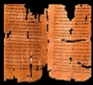
Clearing History
36
The New Testament Canon During the First Four Centuries
H. Wayne House
Acceptance of the Four Gospels Before Nicaea
Individuals
Canons
Translations
Origen (185-254)
Didache (120-150)
Papias (130-140)
Pseudo-Barnabas (70-130)
Clement of Rome (95-97)
Polycarp (110-150)
Justin Martyr (150-155)
Irenaeus (130-202)
Hermas (115-140)
Marcion (140)
Cyril of Jerusalem (315-386)
Tatian Diatesseron (170)
Old Latin (150-170)
Muratonian (170)
Barococcio (206)
Old Syriac (200)
X= Citation
or allusion
Apostolic (300)
O= Named
as authentic
Matthew
Mark
Luke
John
O
O
O
X
X
X
X
X
O
X
X
O
O
O
O
X
X
X
O
X
X
O
O
O
O
O
O
O
X
X
X
O
X
X
O
O
O
O
O
O
O
O
X
X
X
O
O
X
O
O
O
O
O
O
O
Gospel of Thomas
AD 50-140
Gospel of Judas
AD 170?
1st Cent.
AD 325
Council of Nicaea
Geisler & Nix, Introduction to the Bible (Chicago: Moody, 1968)
Notes:
This is found in H. Wayne House, Chronological & Background Charts to the New Testament, It is also the last page of the notes for this seminar. The point here is that our four gospels were consistently cited whereas "Brown's Gnostic gospels" were likely not even written until the second century (even if Thomas appeared as early as AD 40 it was still deemed heretical).

Slide 64
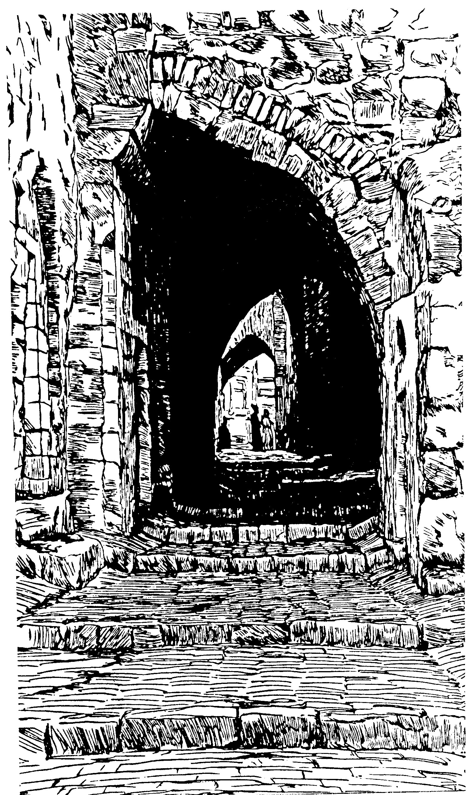
New
Testament
Chronology

Slide 65
Dating the Birth of Christ
56
Date of Birth: ca. December 5 BC/January 4 BC
Jesus was born between these two dates:
Census of Quirinius/Cyrenius (Luke 2:1-5)
Death of
Herod the Great
(Matt. 2:1; Luke 1:5)
6 BC
29 March-11 April
4 BC
Harold W. Hoehner, Chronological Aspects of the Life of Christ (Zondervan, 1977), 114

Slide 66
Dating the Start of Christ's Ministry
56
Commencement of Ministry: ca. Autumn AD 29
Jesus probably began his ministry between these two dates:
15th YEAR OF THE REIGN OF TIBERIUS*
(Luke 3:1-3)
19 August
AD 28
31 December
AD 29
*Reckoned from either the Julian Calendar or Tiberius Regnal Year
Harold W. Hoehner, Chronological Aspects of the Life of Christ (Zondervan, 1977), 114

Slide 67
The Duration of Christ's Ministry
56
Autumn AD 29 – 3 April AD 33 (3.5 Years)
John alone notes three Passovers
Therefore, Christ's ministry was at least 2.5 years
Commencement of Christ's Ministry
Passover #1
April 7,
AD 30
Passover #2
Passover #3
April 25,
AD 32
Passover #4
April 3,
AD 33
Autumn
AD 29
John 2:13, 23
Unstated by John
Mark 2:23-28
Luke 6:1-5
Matthew 12:1-8
John 6:4
John 11:55–12:1
Harold W. Hoehner, Chronological Aspects of the Life of Christ (Zondervan, 1977), 114
Notes:
Christ's 3½ year ministry spanned four Passovers. However, the Synoptics mention only one Passover (#2 on this timeline), which could give the impression of only a year-old ministry. John fills in the details, though, by showing three other Passovers not mentioned by Matthew, Mark, or Luke.

Slide 68
Chronology of Jesus & Acts
38a
4 BC
1 BC
AD 1
14
29
30
33
35
Jesus
Born
–1 year–
Tiberius
Crowned
15th Yr.
Tiberius
–
John &
Jesus
Jesus
Died
Paul
Believed
"In the 15th year of Tiberius… John preached" (Luke 3:1)
32-33 years
"Now Jesus himself was about 30 years old when he began his ministry" (Luke 3:23)

Slide 69
Age of Jesus
When He Began His Ministry
38a
"Now Jesus himself was about 30 years old when he began his ministry" (Luke 3:23)
1yr
3 yrs
28 / 29 years
4 3 2 1 1 2 3 4 5 6 7 8 …………………………………….……………….…………………… 26 27 28 29
BC AD
3 + 1 + 28 = 32 years (Non-inclusive of AD 29)
3 + 1 + 29 = 33 years (Inclusive of AD 29)
Adapted from Michele Ang (NT Survey student, SBC, 2006)

Slide 70
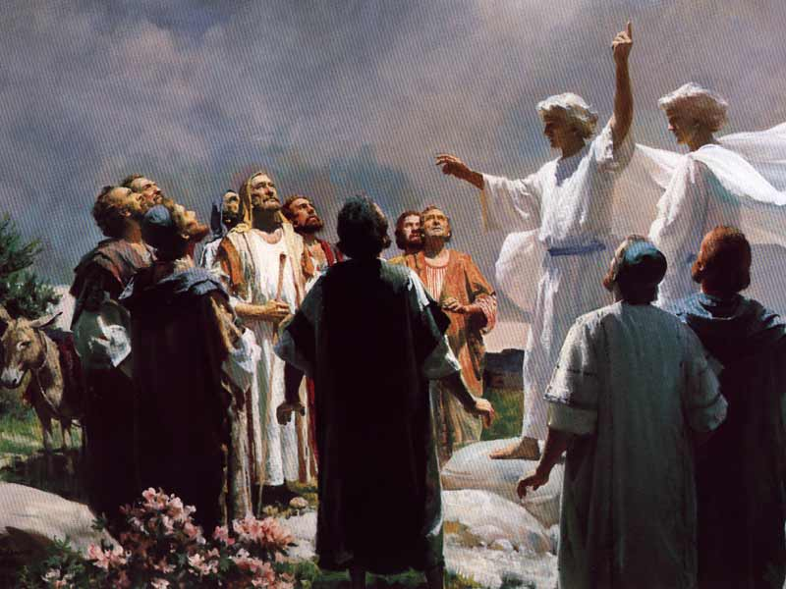
Acts
The Start of Church History
Dr. Rick Griffith • Jordan Evangelical Theological Seminary • BibleStudyDownloads.org
Notes:
Ascension: Angels said

Slide 71
Key Word
56
39
Sovereignty II
Acts

Slide 72
Theme
23
Universal Savior Proclaimed in Sovereign Kingdom Progress
Acts

Slide 73
Key Verse
56
"But you will receive power when the Holy Spirit comes on you; and you will be my witnesses in Jerusalem, and in all Judea and Samaria, and to the ends of the earth" (1:8).
Acts

Slide 74
Summary & Application
Acts
120
Summary Statement
The reason to witness everywhere is because God has directed the progress of the kingdom message to all people since early church history
Application
How is God extending his kingdom message through you?
How are you fitting into His overall purpose to spread the gospel throughout the entire earth?

Slide 75

Kingdom Statement
27b
The kingdom message expands from its reception by Jews in Jerusalem (1:1–6:7) to Judeans and Samaritans (6:8–8:40) to Gentiles in Rome (chaps. 9–28) in many “progress reports” (2:47; 6:7; 8:40; 9:31; 12:24; 16:5; 19:20; 28:30-31; also possibly 2:41; 4:31; 5:42; 8:25, etc.) to show believers that God will grow his church, not man.
Acts

Slide 76

Covenant
27b
Jesus has sent the Holy Spirit to form the church (1:8; 2:14-18, 33, 38-39; 10:44-47), so believers should repent and be baptized to join this new covenant community called the church (2:21, 38; 3:19; 10:43, 47-48; 17:30; 26:20).
Acts

Slide 77

Redemption
27b
The universal appeal for salvation through the gospel is stressed (1:8; 28:30-31) in this book that records over 80 geographical locations–more than any other New Testament book.
Acts

Slide 78

Prophecy
(Lord, Deity)
27b
Jesus fulfilled the OT prophecies (2:30; 3:19, 24; 10:43; 26:6-7, 22), especially in his miracles (2:22; 10:38), death according to God’s purposes (2:23; 3:13-15, 18; 4:11; 10:39; 26:23), resurrection (2:24, 31-32; 3:15, 26; 10:40-41; 17:31; 26:23), and exaltation to God’s throne as Lord (2:25-29, 33-36; 3:13; 10:36) until he returns (3:20-21; 10:42; 17:31; cf. NTS, 137).
Acts

Slide 79
Book Chart (Top)
Acts
120
Universal Savior Proclaimed in Sovereign Kingdom Progress
Jerusalem
Judea and Samaria
Uttermost Part
1:1–6:7
6:8–8:40
Chapters 9–28
Jews
Samaritans
(mixed breeds)
Gentiles
AD 33-35
(2 years)
AD 35
(a few months)
AD 35-62
(27 years)

Slide 80
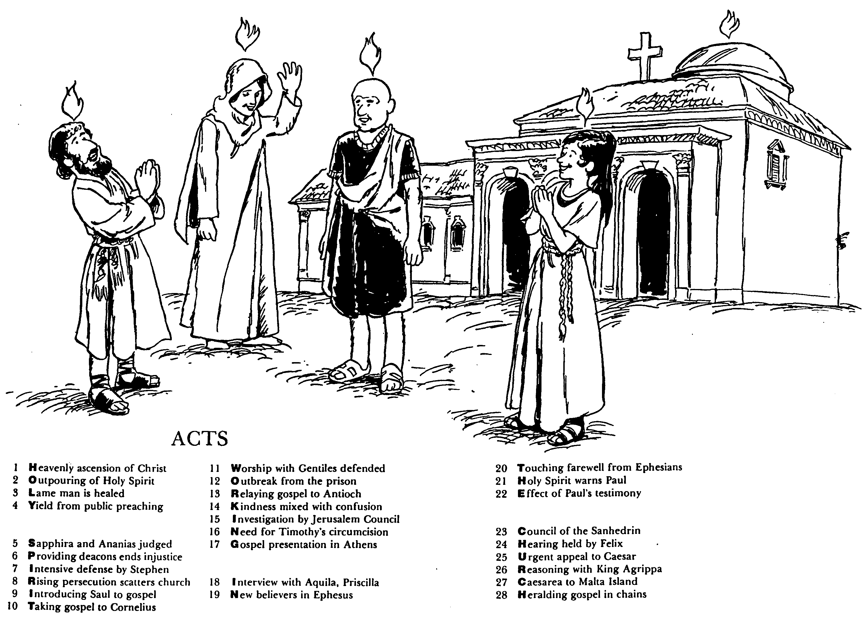

ACTS
Barry Huddleston, The Acrostic Bible
1 基督被接升天
2 圣灵的浇灌
3 瘸腿的人得治愈
4 群众讲道的结果
5 撒非拉和亚拿尼亚被审判
6 拣选执事解决不义
7 司提反强烈的申辩
8 教会受逼迫而分散
9 扫罗接受福音
10 福音传给哥尼流
11 辩解与外族人同赞美
12 逃出监狱
13 福音传到安提阿
14 慈爱与混乱混合了
15 耶路撒冷会议调查
16 对提摩太的割礼的需要
17 在雅典的宣教
18采访与亚居拉，百基拉
19 在以弗所的新信徒
20 以弗所的感人告别
21 圣灵警告保罗
22 保罗见证带来的后果
23 公议会的会议
24 在腓力斯前受审
25 向凯撒的迫切上诉
26 与亚基帕王辩解
27 从该撒利亚到马尔他岛
28 Translation

Slide 81

The Book of Acts in 3 Minutes
(TheChurchatBrookHills.mp4)
131e

Slide 82
What to Do?
131e
Which practices in Acts and the rest of the NT should we do today? Please take the quiz.

Slide 83
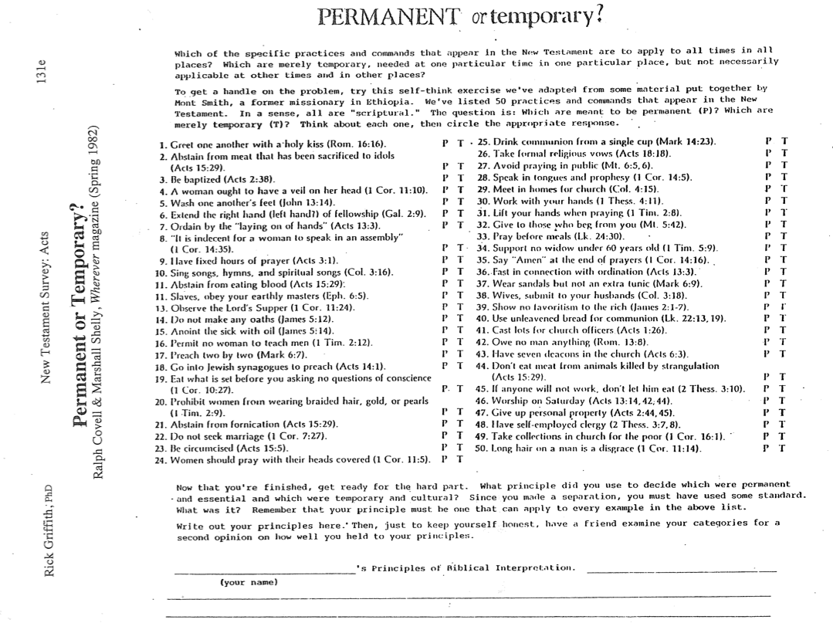
What to Do?
131e
Now for the hard part…

Slide 84

Paul's First & Second Missionary Journeys
138-39

Slide 85
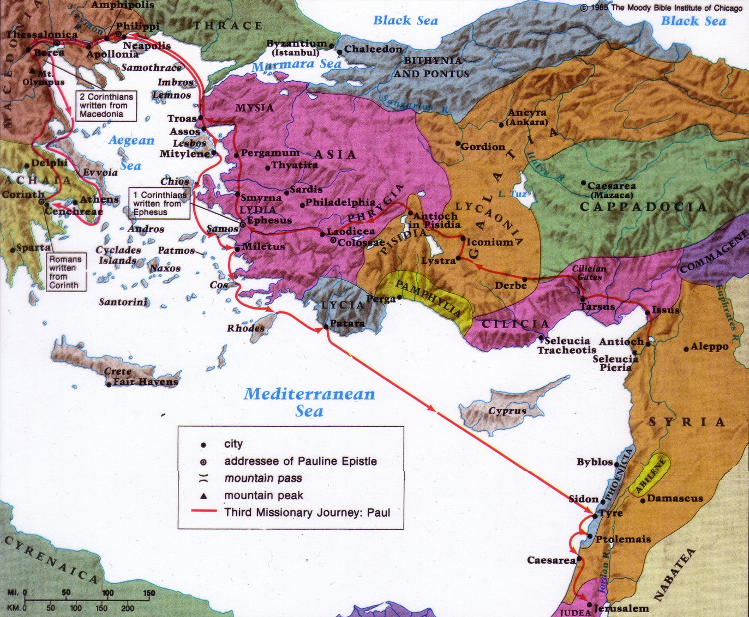
Paul's Third Missionary Journey
140

Slide 86
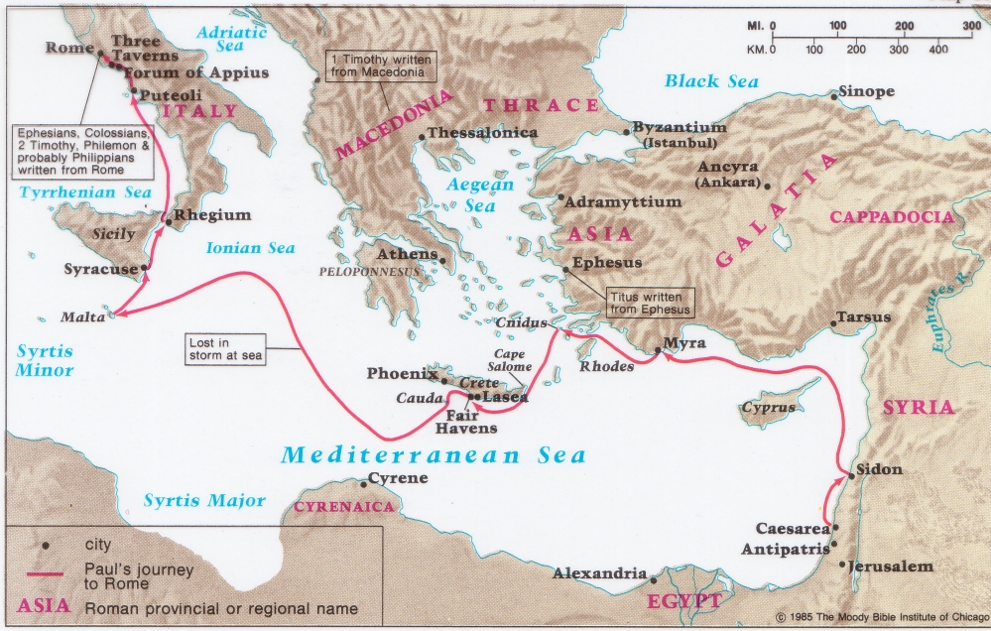
Paul's Fourth Missionary Journey
141
219

Slide 87

Prison Epistle Christology
201a
 | Christ as… | Focus | Explanation
Ephesians | Head | Unity of Christ | Christ breaks down barriers between believers
Philippians | Example | Attitude of Christ | Christ models how to handle difficulty
Colossians | God | Deity of Christ | Christ is superior to human philosophies
Philemon | Reconciler | Forgiveness of Christ | Christ reconciles believers to God and one another

Slide 88
Applying the Prison Epistles
202
Epistle | 1st Century Problem | 21st Century Problem | Solution (Theme)
Ephesians | Jew-Gentile Conflicts ("Weism") | Chinese Only Baptist Only Adults Only | Realize Christian Unity (4:3)
Philippians | Persecution Prison Death | Ministry Inconvenience - time, sleep - recreation | Imitate Christ's Attitude (2:5)
Colossians | Denying Christ's Deity | New Age Cults | Proclaim His Deity (2:9)
Philemon | Master/Slave ("Meism") | Forgive Boss / Employee / Others | Reconcile the Relationship (vv. 17-18)

Slide 89
How Do You Respond to Trials?
201
You say… | Strategy | Temperament | Epistle
"I'm right!" | Push through | Choleric | Ephesians
"Why me?" | Depression | Melancholy | Philippians
"I'll just get through" | Compromise | Sanguine | Colossians
"It'll pass" | Ignore it | Phlegmatic | Philemon

Slide 90
NT Overview (Books & Key Words)
38
124
39-41
"To the remotest part of the earth" (Acts 1:8)
Acts 9 13 14 15 16 18 21 27 28
Apr 48-
Sep 49
1
Galatia
Apr 50-
Sep 52
2
Aegean
Spr 53-
May 57
3
Asia
Feb 60-
Mar 62
1
Rome
Spr 62-
Fall 67
4
Spain
Aut 67-
Spr 68
2
Rome
Summer 35-
37
Damascus
Antioch
May 57-
Aug 59
Trials
Fall 49
The
Council
Spring 68
Expansion of Church
35 48 49 50 52 53 57 60 62 67 68 95
Matt
Kingdom
Luke
Sov 1
Acts
Sov 2
Mark
Disciple
John
Believe
Gal
Justify
1 Thess
Rapture
1 Cor
Eph
Unity
1 Tim
Order
2 Tim
Doctrine
Jude
Sanctify
Pretenders
James
Works
2 Thess
2 Cor
Col
Deity
Titus
Conduct
Heb
Super
1 John
Tribulation
Apostle
Love
Romans
Philem
1 Pet
Suffering
2 John
Righteous
Forgive
Limits
Gospels & Acts
Phil
Attitude
2 Pet
3 John
Knowledge
Mission
1234
Journeys
Rev
Pauline Epistles
Triumph
General Epistles
Rome
Imprisonments
Books by Category & Key Words

Slide 91
NT Overview (Pauline Books + Key Words)
38
124
39-41
"To the remotest part of the earth" (Acts 1:8)
Acts 9 13 14 15 16 18 21 27 28
Apr 48-
Sep 49
1
Galatia
Apr 50-
Sep 52
2
Aegean
Spr 53-
May 57
3
Asia
Feb 60-
Mar 62
1
Rome
Spr 62-
Fall 67
4
Spain
Aut 67-
Spr 68
2
Rome
Summer 35-
37
Damascus
Antioch
May 57-
Aug 59
Trials
Fall 49
The
Council
Spring 68
Expansion of Church
35 48 49 50 52 53 57 60 62 67 68 95
Matt
Kingdom
Luke
Sov 1
Acts
Sov 2
Mark
Disciple
John
Believe
Gal
Justify
1 Thess
Rapture
1 Cor
Eph
Unity
1 Tim
Order
2 Tim
Sanctify
Doctrine
2 Thess
2 Cor
Col
Deity
Titus
Tribulation
Apostle
Conduct
Romans
Philem
Righteous
Forgive
Gospels & Acts
Phil
Attitude
Pauline Epistles
1234
Journeys
Rome
Imprisonments
Pauline Books + Key Words

Slide 92
NT Overview (Key Words)
38
124
39-41
"To the remotest part of the earth" (Acts 1:8)
Acts 9 13 14 15 16 18 21 27 28
Apr 48-
Sep 49
1
Galatia
Apr 50-
Sep 52
2
Aegean
Spr 53-
May 57
3
Asia
Feb 60-
Mar 62
1
Rome
Spr 62-
Fall 67
4
Spain
Aut 67-
Spr 68
2
Rome
Summer 35-
37
Damascus
Antioch
May 57-
Aug 59
Trials
Fall 49
The
Council
Spring 68
Expansion of Church
35 48 49 50 52 53 57 60 62 67 68 95
Matt
Kingdom
Luke
Sov 1
Acts
Sov 2
Mark
Disciple
John
Believe
Gal
Justify
1 Thess
Rapture
1 Cor
Eph
Unity
1 Tim
Order
2 Tim
Doctrine
Jude
Sanctify
Pretenders
James
Works
2 Thess
2 Cor
Col
Deity
Titus
Conduct
Heb
Super
1 John
Tribulation
Apostle
Love
Romans
Philem
1 Pet
Suffering
2 John
Righteous
Forgive
Limits
Gospels & Acts
Phil
Attitude
2 Pet
3 John
Knowledge
Mission
1234
Journeys
Rev
Pauline Epistles
Triumph
General Epistles
Rome
Imprisonments
Key Words

Slide 93
NT Overview (History Key Words)
38
124
39-41
"To the remotest part of the earth" (Acts 1:8)
Acts 9 13 14 15 16 18 21 27 28
Apr 48-
Sep 49
1
Galatia
Apr 50-
Sep 52
2
Aegean
Spr 53-
May 57
3
Asia
Feb 60-
Mar 62
1
Rome
Spr 62-
Fall 67
4
Spain
Aut 67-
Spr 68
2
Rome
Summer 35-
37
Damascus
Antioch
May 57-
Aug 59
Trials
Fall 49
The
Council
Spring 68
Expansion of Church
35 48 49 50 52 53 57 60 62 67 68 95
Matt
Kingdom
Luke
Sov 1
Acts
Sov 2
Mark
Disciple
John
Believe
Gospels & Acts
1234
Journeys
Rome
Imprisonments
History Key Words

Slide 94
NT Overview (Pauline Key Words)
38
124
39-41
"To the remotest part of the earth" (Acts 1:8)
Acts 9 13 14 15 16 18 21 27 28
Apr 48-
Sep 49
1
Galatia
Apr 50-
Sep 52
2
Aegean
Spr 53-
May 57
3
Asia
Feb 60-
Mar 62
1
Rome
Spr 62-
Fall 67
4
Spain
Aut 67-
Spr 68
2
Rome
Summer 35-
37
Damascus
Antioch
May 57-
Aug 59
Trials
Fall 49
The
Council
Spring 68
Expansion of Church
35 48 49 50 52 53 57 60 62 67 68 95
Matt
Kingdom
Luke
Sov 1
Acts
Sov 2
Mark
Disciple
John
Believe
Gal
Justify
1 Thess
Rapture
1 Cor
Eph
Unity
1 Tim
Order
2 Tim
Sanctify
Doctrine
2 Thess
2 Cor
Col
Deity
Titus
Tribulation
Apostle
Conduct
Romans
Philem
Righteous
Forgive
Gospels & Acts
Phil
Attitude
Pauline Epistles
1234
Journeys
Rome
Imprisonments
Pauline Key Words

Slide 95
NT Overview (Missionary Key Words)
38
124
39-41
"To the remotest part of the earth" (Acts 1:8)
Acts 9 13 14 15 16 18 21 27 28
Apr 48-
Sep 49
1
Galatia
Apr 50-
Sep 52
2
Aegean
Spr 53-
May 57
3
Asia
Feb 60-
Mar 62
1
Rome
Spr 62-
Fall 67
4
Spain
Aut 67-
Spr 68
2
Rome
Summer 35-
37
Damascus
Antioch
May 57-
Aug 59
Trials
Fall 49
The
Council
Spring 68
Expansion of Church
35 48 49 50 52 53 57 60 62 67 68 95
Matt
Kingdom
Luke
Sov 1
Acts
Sov 2
Mark
Disciple
John
Believe
Gal
Justify
1 Thess
Rapture
1 Cor
Sanctify
2 Thess
2 Cor
Tribulation
Apostle
Romans
Righteous
Gospels & Acts
Pauline Epistles
1234
Journeys
Rome
Imprisonments
Pauline Missionary Key Words

Slide 96
NT Overview (Missionary + Key Words)
38
124
39-41
"To the remotest part of the earth" (Acts 1:8)
Acts 9 13 14 15 16 18 21 27 28
Apr 48-
Sep 49
1
Galatia
Apr 50-
Sep 52
2
Aegean
Spr 53-
May 57
3
Asia
Feb 60-
Mar 62
1
Rome
Spr 62-
Fall 67
4
Spain
Aut 67-
Spr 68
2
Rome
Summer 35-
37
Damascus
Antioch
May 57-
Aug 59
Trials
Fall 49
The
Council
Spring 68
Expansion of Church
35 48 49 50 52 53 57 60 62 67 68 95
Matt
Kingdom
Luke
Sov 1
Acts
Sov 2
Mark
Disciple
John
Believe
Gal
Justify
1 Thess
Rapture
1 Cor
Sanctify
2 Thess
2 Cor
Tribulation
Apostle
Romans
Righteous
Gospels & Acts
Pauline Epistles
1234
Journeys
Rome
Imprisonments
Pauline Missionary + Key Words

Slide 97
NT Overview (Key Words)
38
124
39-41
"To the remotest part of the earth" (Acts 1:8)
Acts 9 13 14 15 16 18 21 27 28
Apr 48-
Sep 49
1
Galatia
Apr 50-
Sep 52
2
Aegean
Spr 53-
May 57
3
Asia
Feb 60-
Mar 62
1
Rome
Spr 62-
Fall 67
4
Spain
Aut 67-
Spr 68
2
Rome
Summer 35-
37
Damascus
Antioch
May 57-
Aug 59
Trials
Fall 49
The
Council
Spring 68
Expansion of Church
35 48 49 50 52 53 57 60 62 67 68 95
Matt
Kingdom
Luke
Sov 1
Acts
Sov 2
Mark
Disciple
John
Believe
Gal
Justify
1 Thess
Rapture
1 Cor
Eph
Unity
1 Tim
Order
2 Tim
Doctrine
Jude
Sanctify
Pretenders
James
Works
2 Thess
2 Cor
Col
Deity
Titus
Conduct
Heb
Super
1 John
Tribulation
Apostle
Love
Romans
Philem
1 Pet
Suffering
2 John
Righteous
Forgive
Limits
Gospels & Acts
Phil
Attitude
2 Pet
3 John
Knowledge
Mission
1234
Journeys
Rev
Pauline Epistles
Triumph
General Epistles
Rome
Imprisonments
Key Words

Slide 98
NT Overview (by Category)
38
124
39-41
"To the remotest part of the earth" (Acts 1:8)
Acts 9 13 14 15 16 18 21 27 28
Apr 48-
Sep 49
1
Galatia
Apr 50-
Sep 52
2
Aegean
Spr 53-
May 57
3
Asia
Feb 60-
Mar 62
1
Rome
Spr 62-
Fall 67
4
Spain
Aut 67-
Spr 68
2
Rome
Summer 35-
37
Damascus
Antioch
May 57-
Aug 59
Trials
Fall 49
The
Council
Spring 68
Expansion of Church
35 48 49 50 52 53 57 60 62 67 68 95
Matt
Luke
Acts
Mark
John
Gal
1 Thess
1 Cor
Eph
1 Tim
2 Tim
Jude
James
2 Thess
2 Cor
Col
Titus
Heb
1 John
Romans
Philem
1 Pet
2 John
Gospels & Acts
Phil
2 Pet
3 John
Pauline Epistles
1234
Journeys
Rev
General Epistles
Rome
Imprisonments
By category

Slide 99
NT Overview (History)
38
124
39-41
"To the remotest part of the earth" (Acts 1:8)
Acts 9 13 14 15 16 18 21 27 28
Apr 48-
Sep 49
1
Galatia
Apr 50-
Sep 52
2
Aegean
Spr 53-
May 57
3
Asia
Feb 60-
Mar 62
1
Rome
Spr 62-
Fall 67
4
Spain
Aut 67-
Spr 68
2
Rome
Summer 35-
37
Damascus
Antioch
May 57-
Aug 59
Trials
Fall 49
The
Council
Spring 68
Expansion of Church
35 48 49 50 52 53 57 60 62 67 68 95
Matt
Luke
Acts
Mark
John
Gospels & Acts
1234
Journeys
Rome
Imprisonments
Gospels & Acts

Slide 100
NT Overview (Paul's Letters)
38
124
39-41
"To the remotest part of the earth" (Acts 1:8)
Acts 9 13 14 15 16 18 21 27 28
Apr 48-
Sep 49
1
Galatia
Apr 50-
Sep 52
2
Aegean
Spr 53-
May 57
3
Asia
Feb 60-
Mar 62
1
Rome
Spr 62-
Fall 67
4
Spain
Aut 67-
Spr 68
2
Rome
Summer 35-
37
Damascus
Antioch
May 57-
Aug 59
Trials
Fall 49
The
Council
Spring 68
Expansion of Church
35 48 49 50 52 53 57 60 62 67 68 95
Matt
Luke
Acts
Mark
John
Gal
1 Thess
1 Cor
Eph
1 Tim
2 Tim
2 Thess
2 Cor
Col
Titus
Missionary
Pastoral
Romans
Philem
Gospels & Acts
Phil
Pauline Epistles
1234
Journeys
Prison
Rome
Imprisonments
Pauline Epistles + Categories
Notes:
We may suppose that it takes a long time for heresies to develop, but the New Testament teaches otherwise. Within a generation of Christ's life, many false systems developed. Paul writes in the AD 60s just prior to his beheading that many had fallen into the snare of deceptive teaching.
Yet nearly all of Paul's writings responded to a heresy. This means that he took false doctrine seriously, in contrast to the church or our day in many circumstances.
Paul wrote while traveling, imprisoned, or to key leaders.
_______________
Common-488
NS-00-NT Introduction-97
NS-03-Luke1-12-slide 65
NS-06-Rom1-2-slide 16
NS-07-1Cor1-9-slide 23

Slide 101
NT Overview (General Epistles)
38
124
39-41
"To the remotest part of the earth" (Acts 1:8)
Acts 9 13 14 15 16 18 21 27 28
Apr 48-
Sep 49
1
Galatia
Apr 50-
Sep 52
2
Aegean
Spr 53-
May 57
3
Asia
Feb 60-
Mar 62
1
Rome
Spr 62-
Fall 67
4
Spain
Aut 67-
Spr 68
2
Rome
Summer 35-
37
Damascus
Antioch
May 57-
Aug 59
Trials
Fall 49
The
Council
Spring 68
Expansion of Church
35 48 49 50 52 53 57 60 62 67 68 95
Matt
Luke
Acts
Mark
John
Gal
1 Thess
1 Cor
Eph
1 Tim
2 Tim
Jude
James
2 Thess
2 Cor
Col
Titus
Heb
1 John
Romans
Philem
1 Pet
2 John
Gospels & Acts
Phil
2 Pet
3 John
Pauline Epistles
1234
Journeys
Rev
General Epistles
Rome
Imprisonments
By General Epistle

Slide 102
NT Overview (General + Key Words)
38
124
39-41
"To the remotest part of the earth" (Acts 1:8)
Acts 9 13 14 15 16 18 21 27 28
Apr 48-
Sep 49
1
Galatia
Apr 50-
Sep 52
2
Aegean
Spr 53-
May 57
3
Asia
Feb 60-
Mar 62
1
Rome
Spr 62-
Fall 67
4
Spain
Aut 67-
Spr 68
2
Rome
Summer 35-
37
Damascus
Antioch
May 57-
Aug 59
Trials
Fall 49
The
Council
Spring 68
Expansion of Church
35 48 49 50 52 53 57 60 62 67 68 95
Matt
Kingdom
Luke
Sov 1
Acts
Sov 2
Mark
Disciple
John
Believe
Gal
Justify
1 Thess
Rapture
1 Cor
Eph
Unity
1 Tim
Order
2 Tim
Doctrine
Jude
Sanctify
Pretenders
James
Works
2 Thess
2 Cor
Col
Deity
Titus
Conduct
Heb
Super
1 John
Tribulation
Apostle
Love
Romans
Philem
1 Pet
Suffering
2 John
Righteous
Forgive
Limits
Gospels & Acts
Phil
Attitude
2 Pet
3 John
Knowledge
Mission
1234
Journeys
Rev
Pauline Epistles
Triumph
General Epistles
Rome
Imprisonments
General Epistles + Key Words

Slide 103
NT Overview (Chronological)
38
124
39-41
"To the remotest part of the earth" (Acts 1:8)
Acts 9 13 14 15 16 18 21 27 28
Apr 48-
Sep 49
1
Galatia
Apr 50-
Sep 52
2
Aegean
Spr 53-
May 57
3
Asia
Feb 60-
Mar 62
1
Rome
Spr 62-
Fall 67
4
Spain
Aut 67-
Spr 68
2
Rome
Summer 35-
37
Damascus
Antioch
May 57-
Aug 59
Trials
Fall 49
The
Council
Spring 68
Expansion of Church
35 48 49 50 52 53 57 60 62 67 68 95
Matt
Luke
Acts
Mark
John
Gal
1 Thess
1 Cor
Eph
1 Tim
2 Tim
Jude
James
2 Thess
2 Cor
Col
Titus
Heb
1 John
Romans
Philem
1 Pet
2 John
Gospels & Acts
Phil
2 Pet
3 John
Pauline Epistles
1234
Journeys
Rev
General Epistles
Rome
Imprisonments
Chronological
Notes:
See the NT development chronologically in relation to the book of Acts, Paul's four journeys, and Paul's two imprisonments in Rome. See how many observations you can make here. For example:
Acts was written in the middle of the gospels chronologically.
Paul's letters came before the General Epistles almost 100%, except for James.
Half of the NT was written in the AD 60s, which also was the most intensely persecuted decade.
What other things do you observe?
_______________
Common-487
NS-00-NT Introduction-100

Slide 104
The General Epistles
"Unto the uttermost part of the earth …" (Acts 13-28)
13 14 15 16 18 19 21 22 28
Apr 48-Sep 49
1
Galatia
Apr 50-Sep 52
2
Macedonia
Achaia
Greece
Spr 53-May 57
3
Asia
Feb 60-Mar 62
1
Rome
Aut 67-Spr 68
2
Rome
Autumn 49
Jerusalem
Council
May 57-Aug 59
Trials
Spr 62-Aut 67
Freedom from
Bonds
Spring 68
Expansion of Church
48 49 50 53 57 60 62 67 68 95
Galatians
1 Thess
1 Corinth
Ephesians
1 Tim
2 Tim
1 John
Ephesus
85-95
2 Thess
2 Corinth
Colossians
Titus
James
Jerusalem?
45-50?
Romans
Philemon
1 Peter
Rome
64
Hebrews
Unknown
67
2 John
Ephesus
85-95
Philippians
2 Peter
Rome
64
Jude
Unknown
67-68
3 John
Ephesus
85-95
Rev
Patmos
95-96
July 64
2 Sep 70

Slide 105
Paul's Epistles in Mostly Scriptural Order
Foundational | Prison | Prophetic | Pastoral
Romans 1 Corinthians 2 Corinthians Galatians | Ephesians Philippians Colossians Philemon | 1 Thessalonians 2 Thessalonians | 1 Timothy 2 Timothy Titus
Christ & the Cross | Christ & the Church | Christ & the Second Coming | Christ & the Congregation
Soteriology | Christology | Eschatology | Ecclesiology
TEXT
Adapted from The Pastoral Epistles © John Stevenson 2010 • https://slideplayer.com/slide/6106093/
Notes:
This order follows the NT except Philemon is moved from the end of the Pauline Epistles after Titus to complete the Prison Epistles after Colossians.
But one could argue that Philemon was a pastoral letter since it deals with a pastoral situation that needed reconciliation.
On the other hand, Paul wrote Philemon in Rome during Paul's first imprisonment, so it is a Prison Epistle in this sense.
In the end, I do not know who has explained the reasoning for the order of Paul's letters.
Note that combining the four Foundational and two Prophetic Epistles gives us the six Missionary Epistles.
___________
Common-435
NS-00-NT Introduction-102
NS-06-Pauline Epistles-4
NS-10-Prison Epistles-3
NS-15-Pastoral Epistles-15

Slide 106
Black

Slide 107


NT Survey link at BibleStudyDownloads.org
Get this presentation for free!
Notes:
NT Survey (ns)

