Slide 1

New Testament Survey
Syllabus
Dr. Rick Griffith • Jordan Evangelical Theological Seminary • BibleStudyDownloads.org

Slide 2

Introduce Yourself!
Name
Country
Programme
Family
Church
Ministry Goal

Slide 3

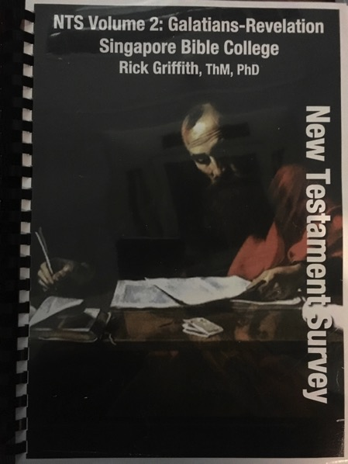
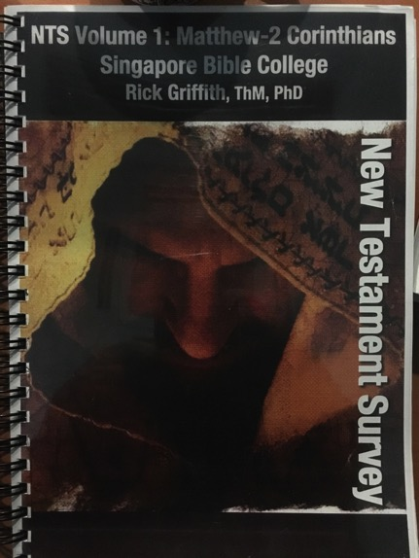
Notes Options
Digital at BibleStudyDownloads NTS link
(Free)
Printed
($20 each)

Slide 4
NTS Sign Up List
Name | HP | Email | Reading |  | Project & Language
 |  |  | A: IBS | B: ENT | 1: NTS | 2: TBB | 3: Teach | 4: Paper
X | X | X | X
X | X | X |  | X | X
X | X | X |  | X |  | X
X | X | X |  | X |  |  | X
X | X | X |  | X |  |  |  | X
Name | Email | Degree | Project

Slide 5


Our People
Susan teaches church women
Notes:
I also lead the woman's Precept Bible study at our church

Slide 6

PRECEPT LADIES BIBLE STUDY ON
HEBREWS
USA • Singapore • New Zealand • Holland

Slide 7

Thailand • Mongolia • Myanmar • Indonesia
Susan teaches SBC student wives also
Notes:
INTERVIEWER: And Susan, what ministries has the Lord granted you?
SUSAN: I have been teaching the wives of leaders at SBC. These 5 women come from 5 different nations!
SUSAN: I also lead the woman's Bible study at our church

Slide 8
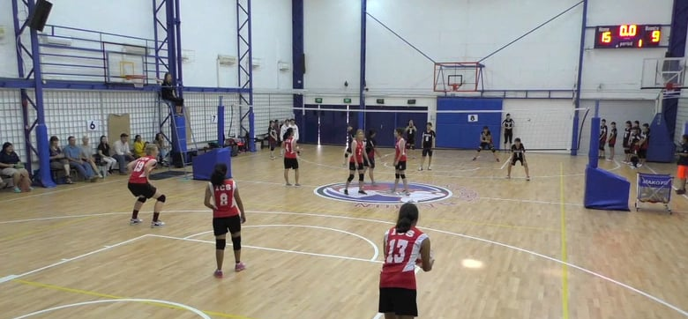
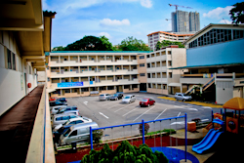
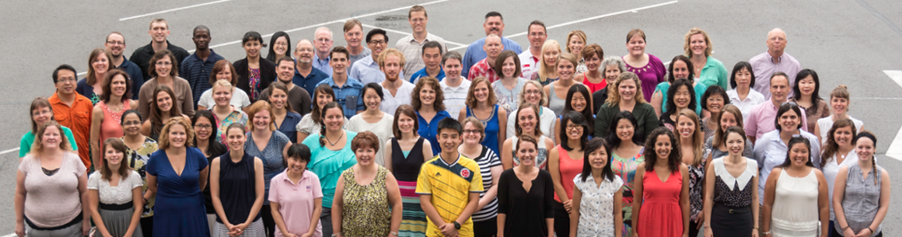
International Community School
(est. 1993)

Slide 9




ICS now has 480 students!
UK
SWEDEN
KOREA
SWITZERLAND
JAPAN
ITALY
USA
THAILAND
INDIA
MEXICO
ICS
VENUZELA
INDONESIA
BRAZIL
SOUTH AFRICA
AUSTRALIAN

Slide 10
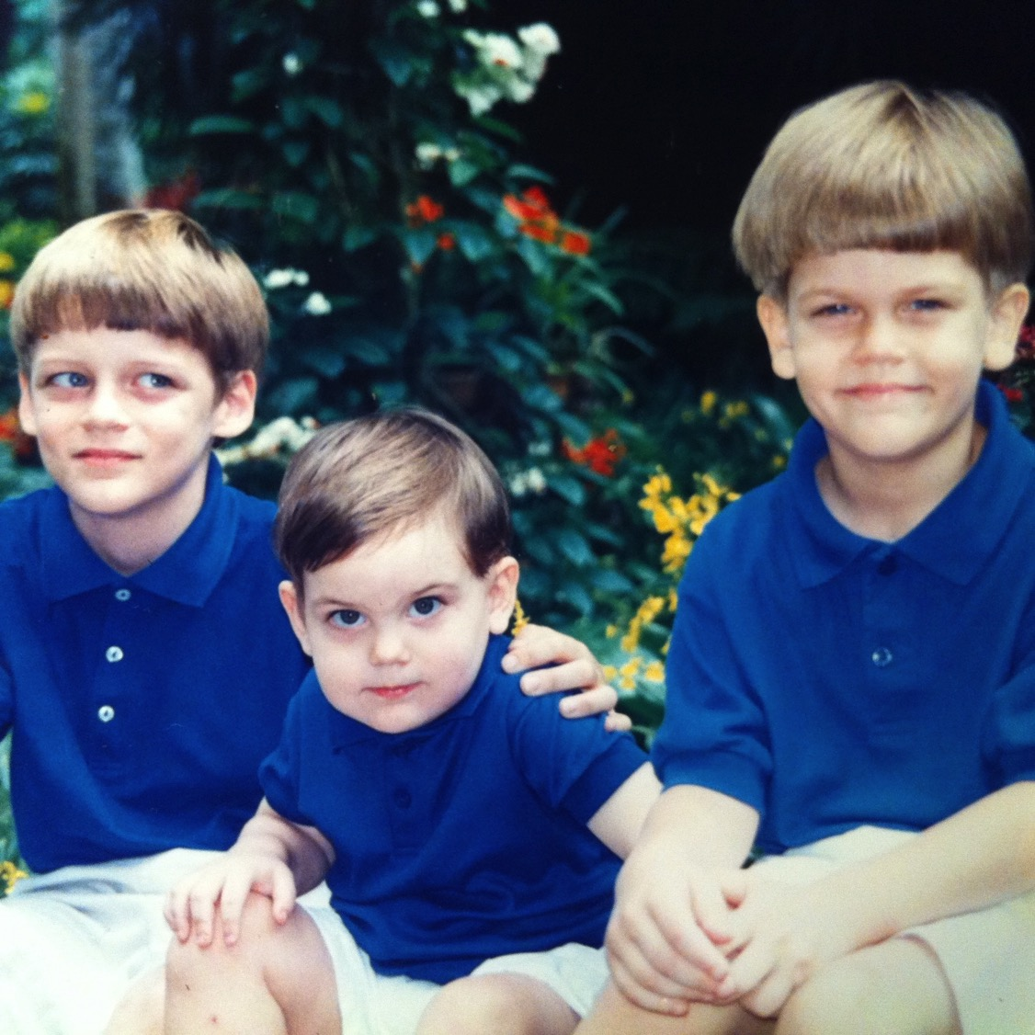
Our Three Sons

Slide 11
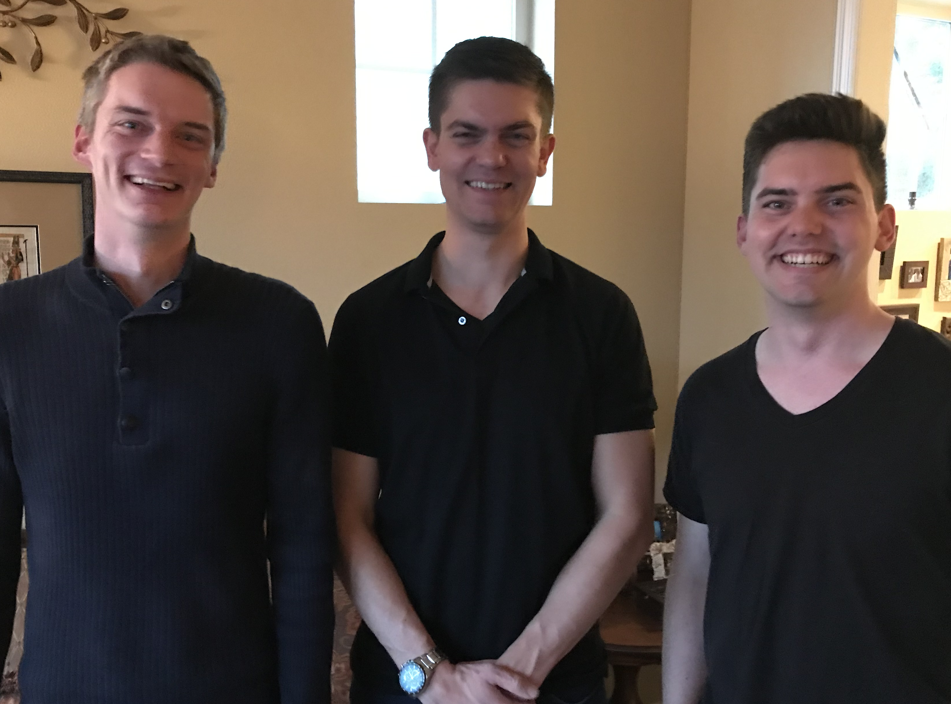
Our Three Sons

Slide 12
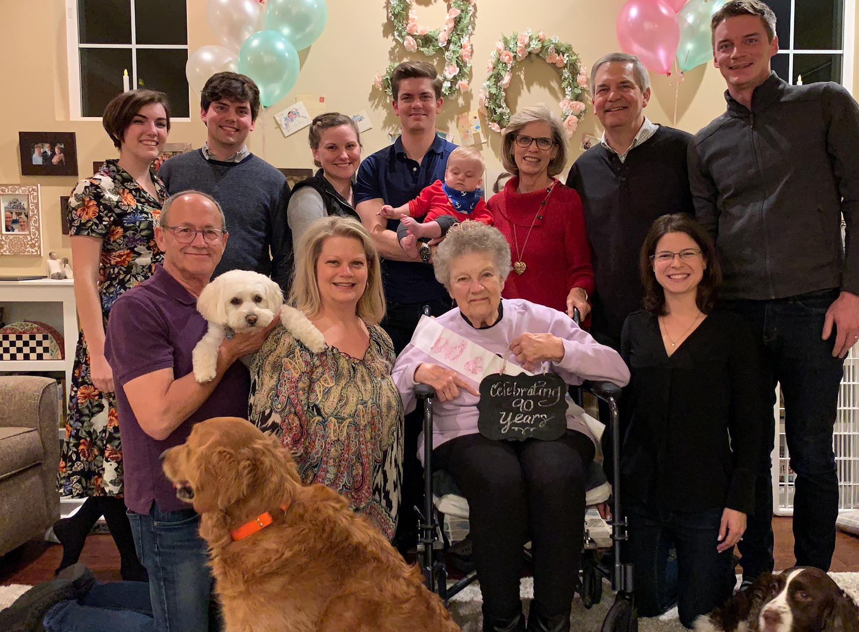
The Griffiths
28 Nov 2019
2020
Rick & Susan
John & Chloe
(29)
Kurt & Cara (35)
Stephen, Katie & Jesse (32)

Slide 13
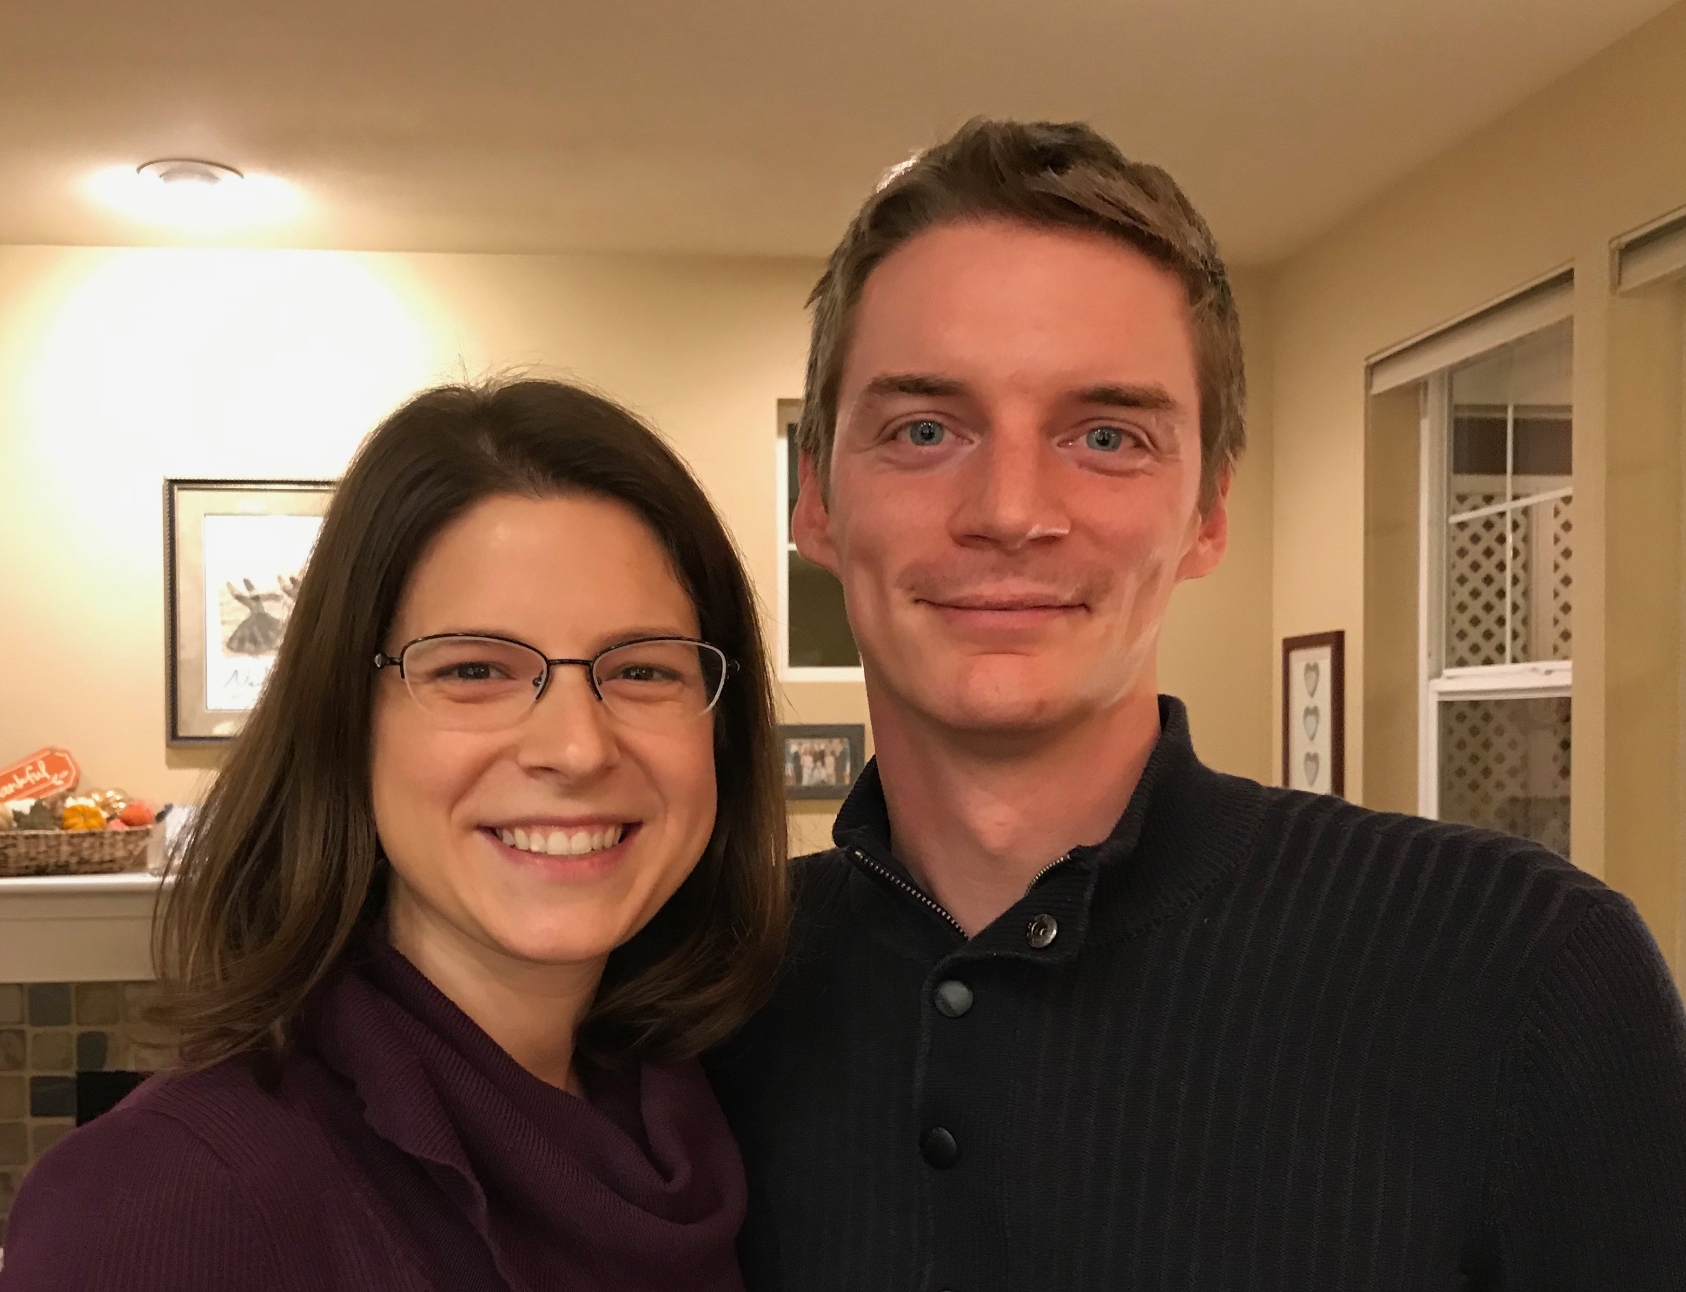
Kurt (35) & Cara own their HR consulting business near Seattle
Notes:
Kurt and his wife Cara are in Seattle

Slide 14

KURT & CARA OWN TANDEM MOTION

Slide 15
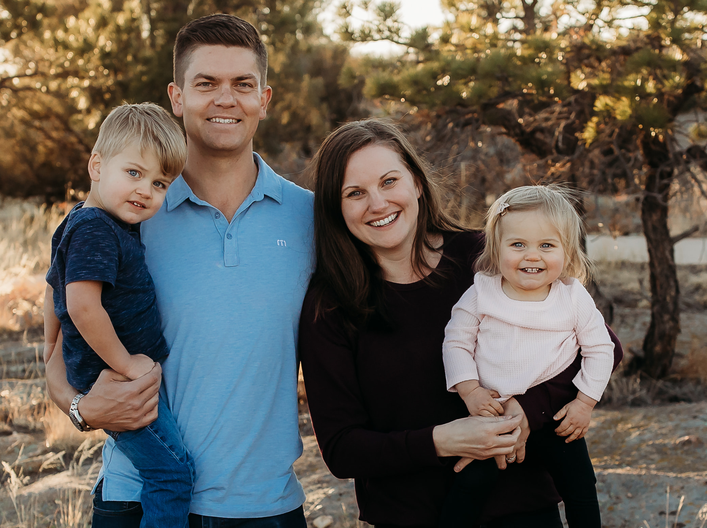
Stephen, Katie, Jesse & Norah in Denver
Notes:
Our granddaughter joined the family on 31 July 2021 but why would God take us now? I don’t know.

Slide 16

4-year-old grandson Jesse

Slide 17
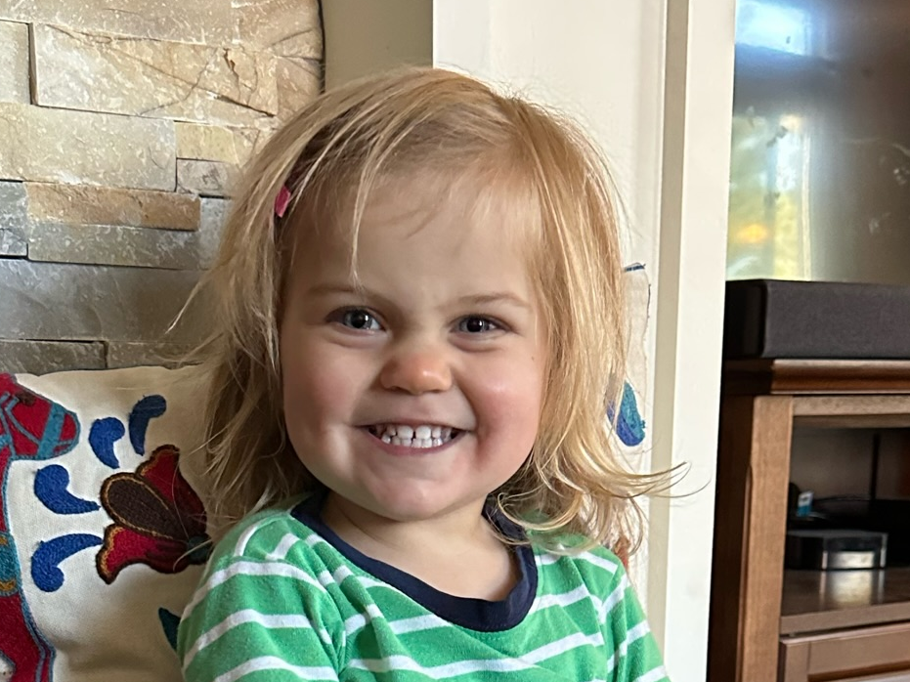
2-year-old granddaughter Norah

Slide 18
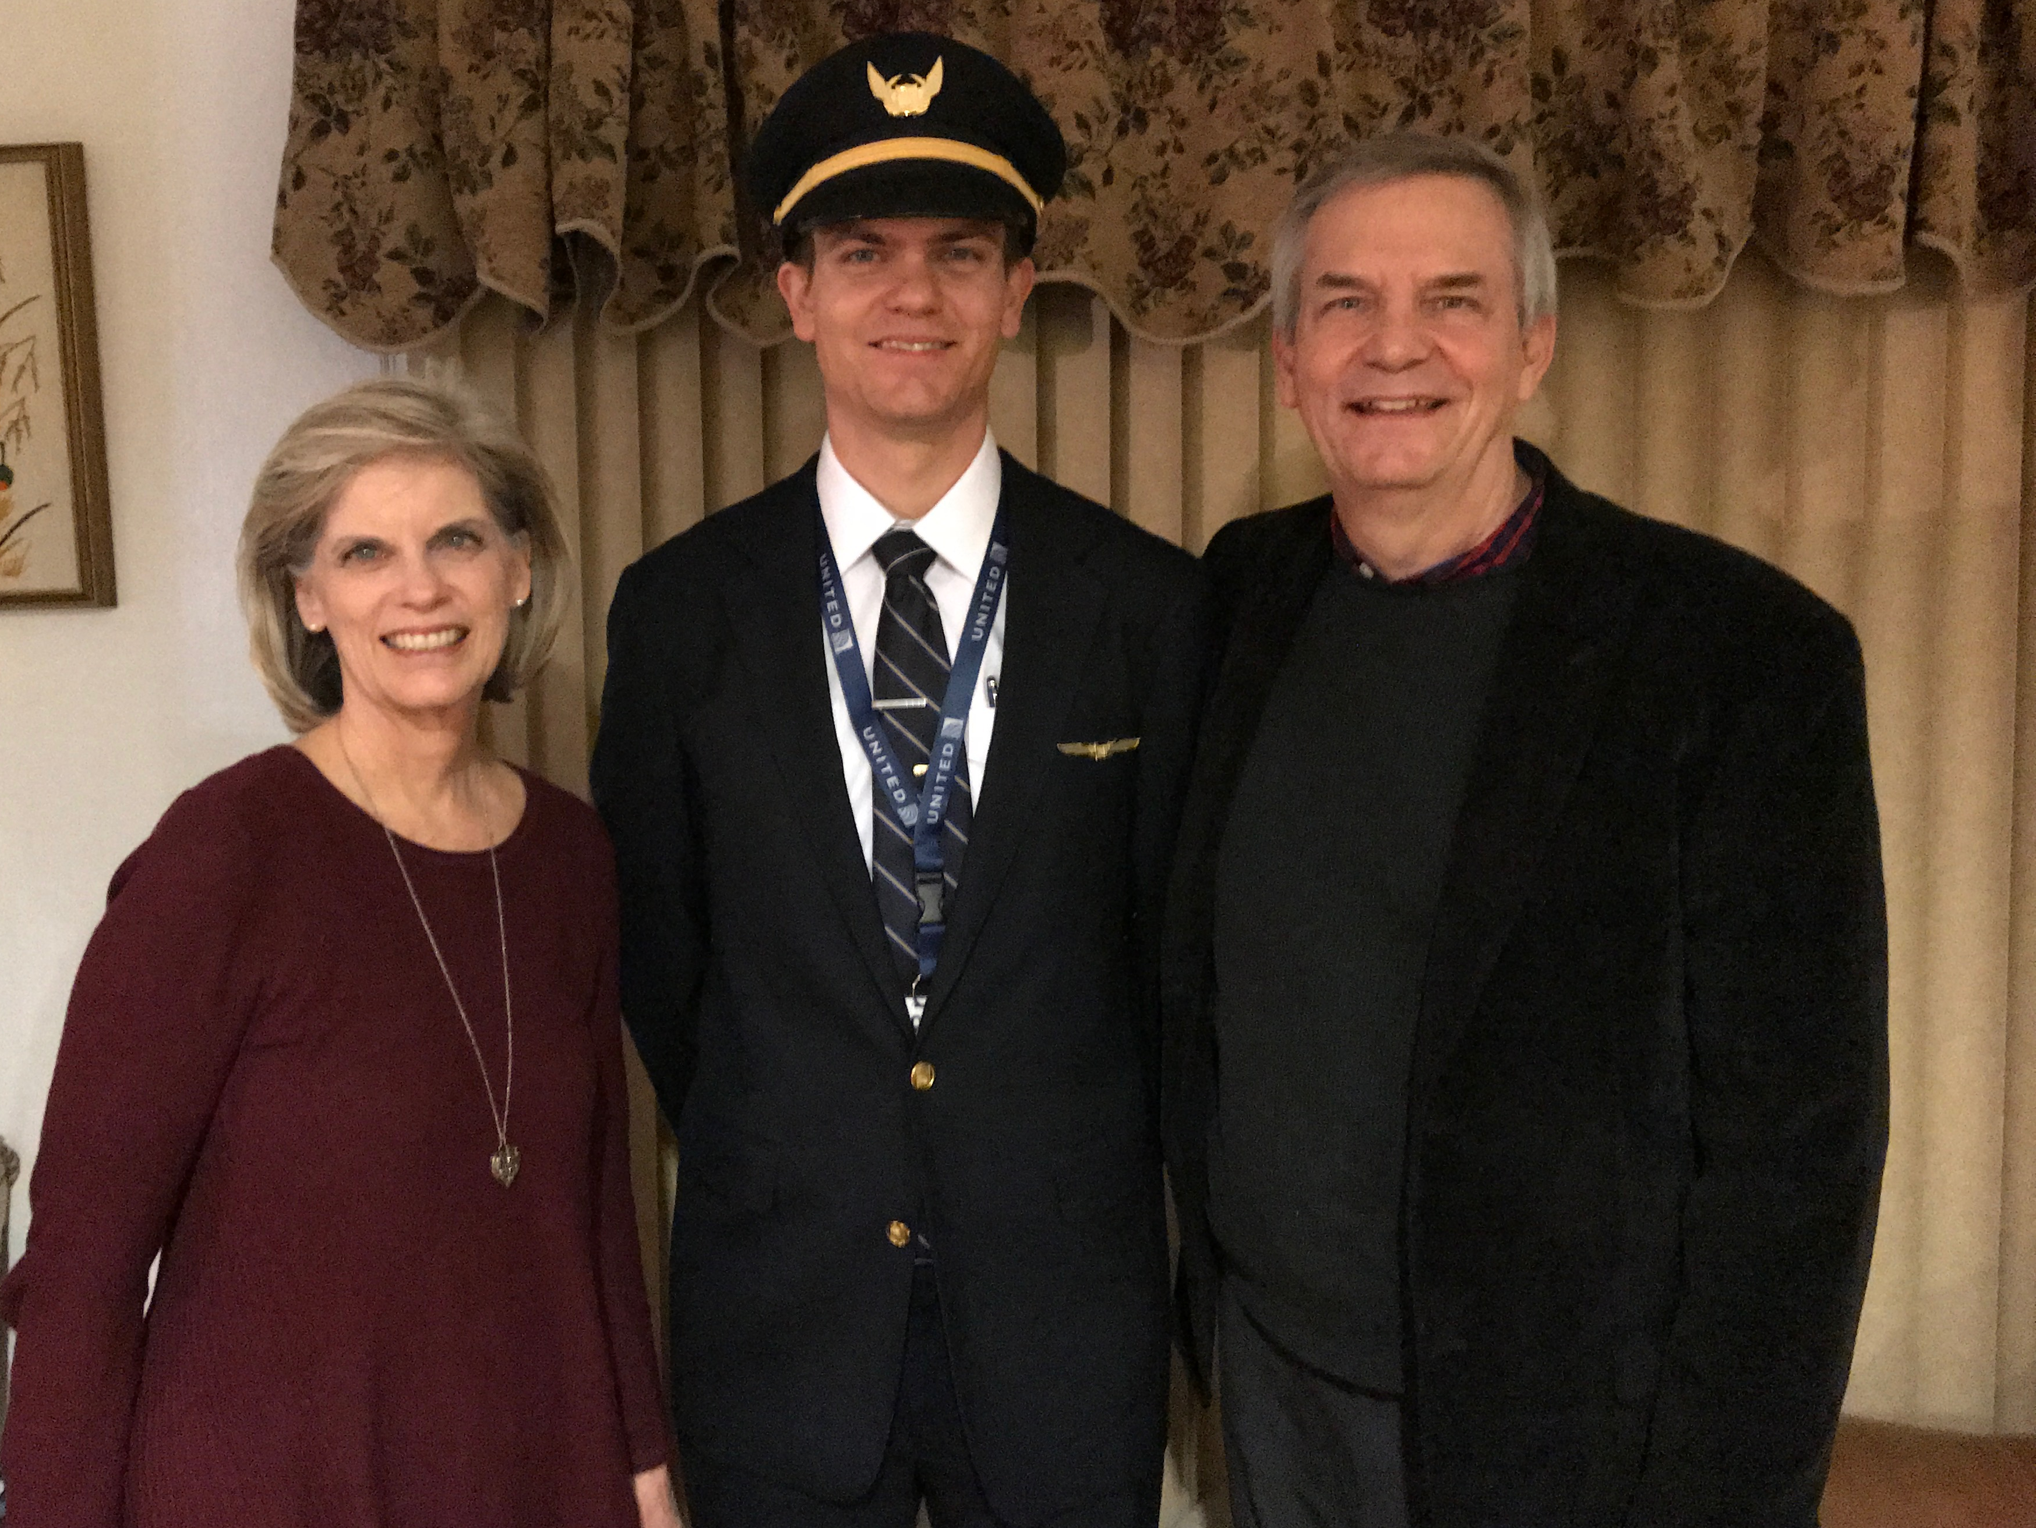
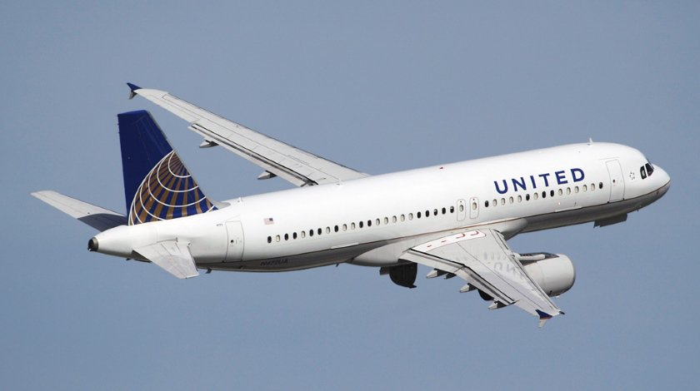
Stephen (32) trains United B777 pilots in Denver
6
Notes:
Stephen and his wife Katie in Boise

Slide 19
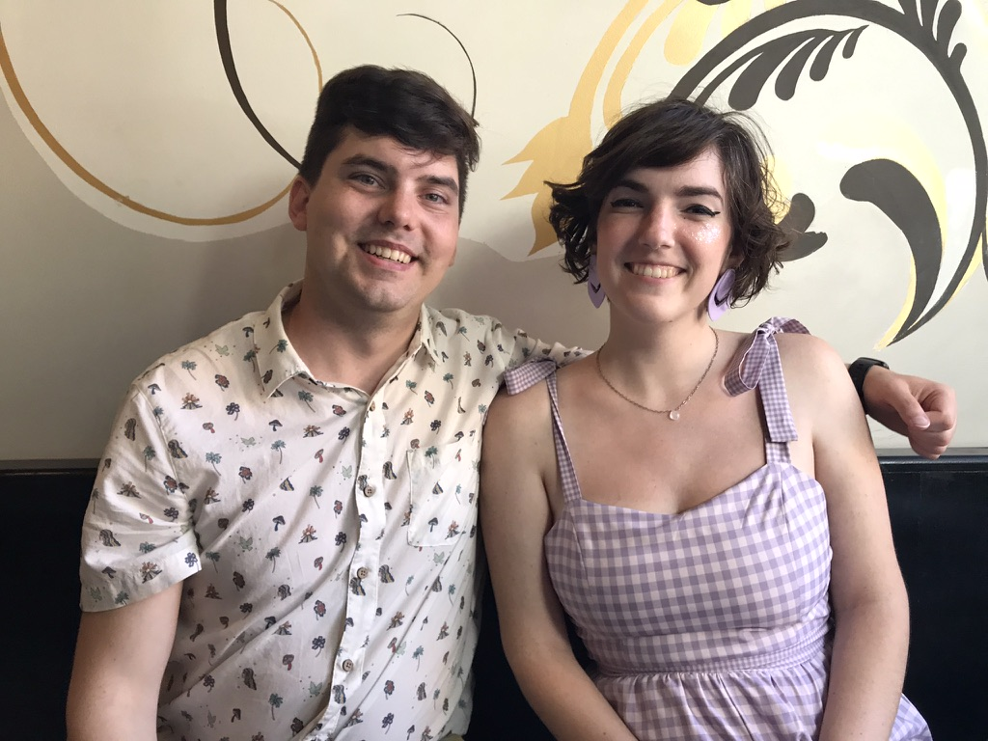
John (31) married Chloe in Pasadena, California in 2022
8
Notes:
John does graphics and Chloe is earning her Masters in Library Science.
___________
Common-70

Slide 20


John’s Design Website

Slide 21
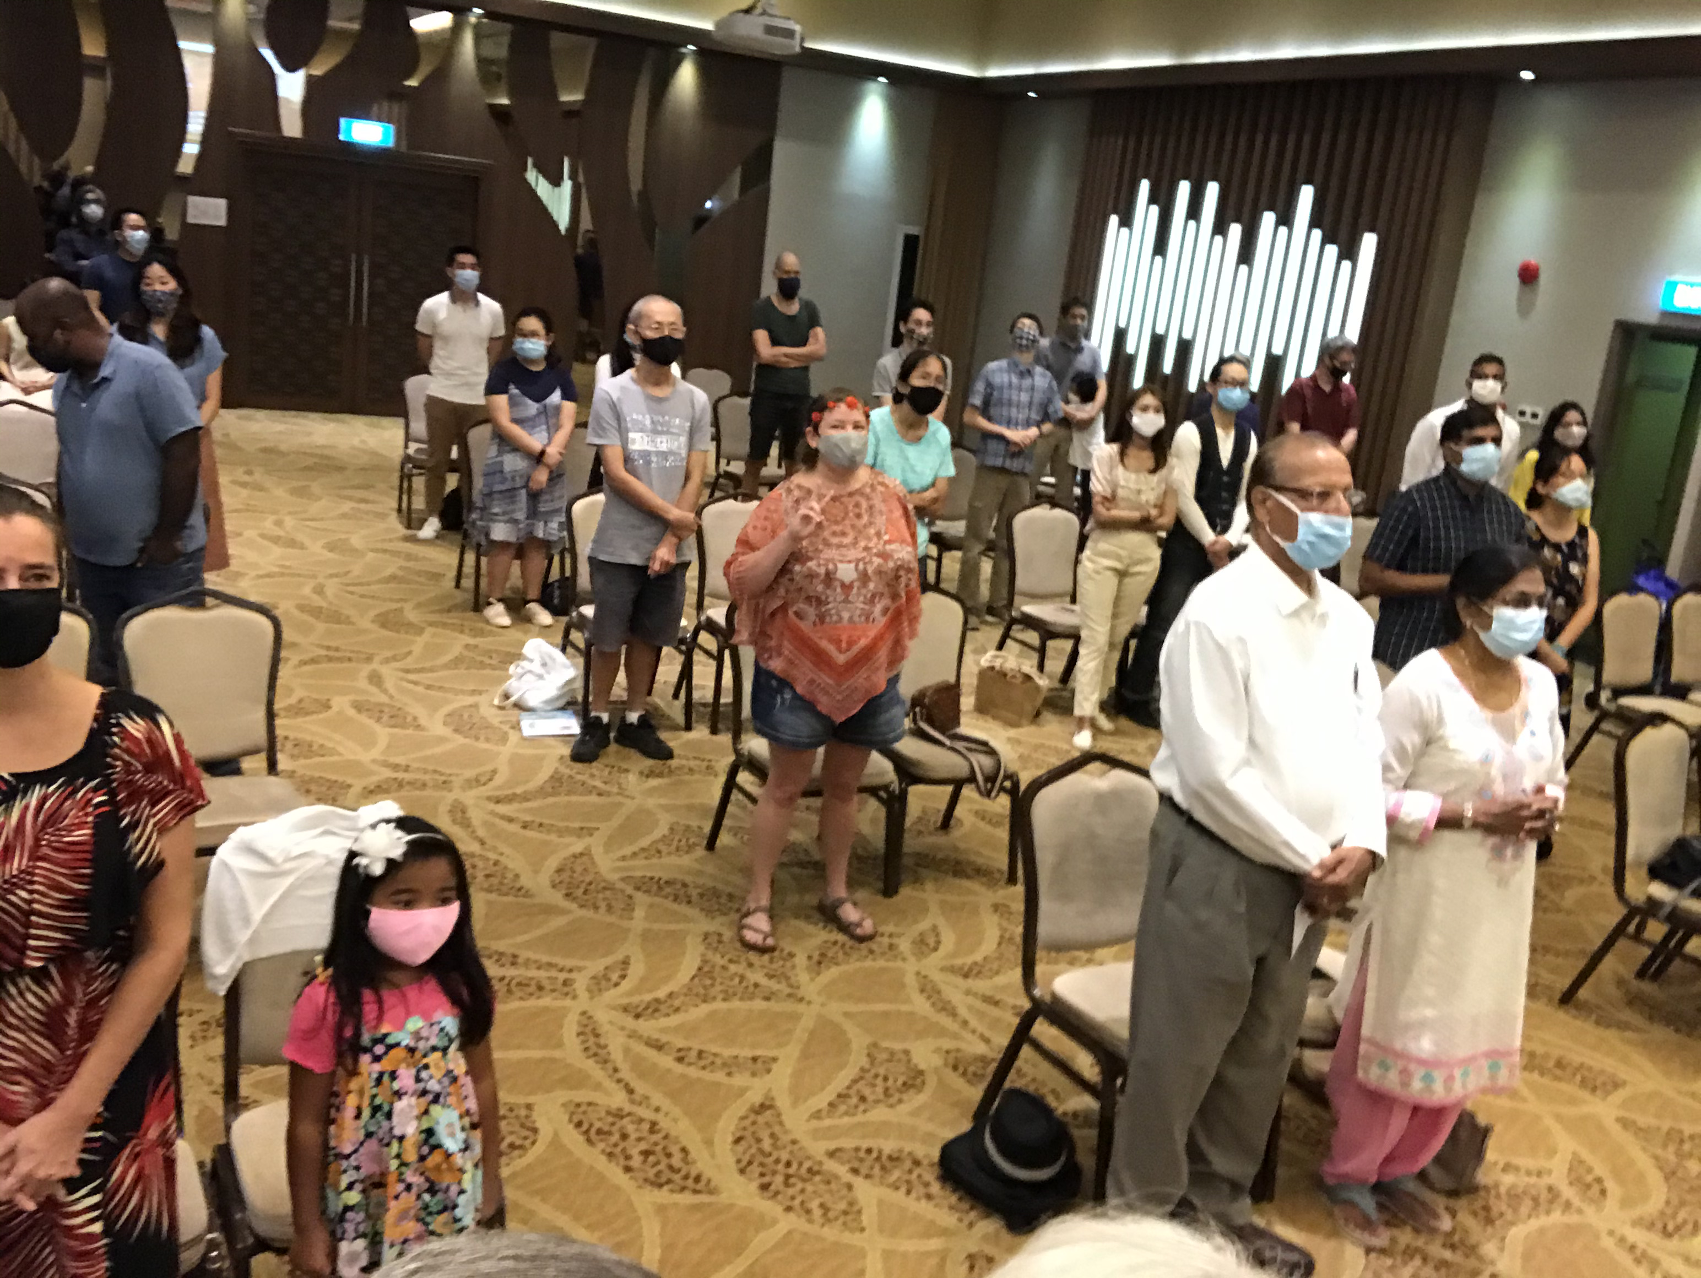
Our People
9
June 2021
90 people from 16 nations

Slide 22


Crossroads People • June 2021
UK
UNITED KINGDOM
RUSSIA
NETHERLANDS
MONGOLIA
ITALY
FRANCE
KOREA
HONG KONG
LEBANON
EGYPT
JAPAN
CHINA
MYANMAR
GERMANY
TAIWAN
CANADA
INDIA
USA
THAILAND
ETHIOPIA
MALAYSIA
ZIMBABWE
SOUTH AFRICA
PHILIPPINES
SINGAPORE
INDONESIA
CIC
AUSTRALIA
NEW ZEALAND
KENYA
Notes:
We actually have about 20% Indian at CIC, thanks to St. Thomas, who overcame his initial reluctance to witness for Jesus in India.
Our June 2021 church of 90 people stem from 16 different countries around the world: Australia (David & Fiona), China (Jianji), Egypt (Tamara), France (Valentin), Korea (Grace Kim), India (Cynthia), Indonesia (Rena), Kenya (Jacqueline Ngare), Nepal (Joshua Limbu), Netherlands (Toes), Singapore (Albina), South Africa (Melody Hertenberger), Taiwan (Maple), Thailand (Mae), UK (James & Gabi), USA (Jim & Jacqui).
This does not include people who have recently attended only once:
Nor does it include missionaries living back in their countries but still are members of CIC: Maple (Taiwan), Budmaa (Mongolia)
Previous: Canada (Gloria Lee), Ethiopia (Lele), Malaysia (Aston, Naomi), Netherlands (Dies & Desiree), Philippines (Micah), South Africa (Melody),

Slide 23

Our People
9
SBC students serve at church
Notes:
One special joy is mentoring my students who serve with us at church and led ministries to youth, children, home groups, and the worship team.

Slide 24
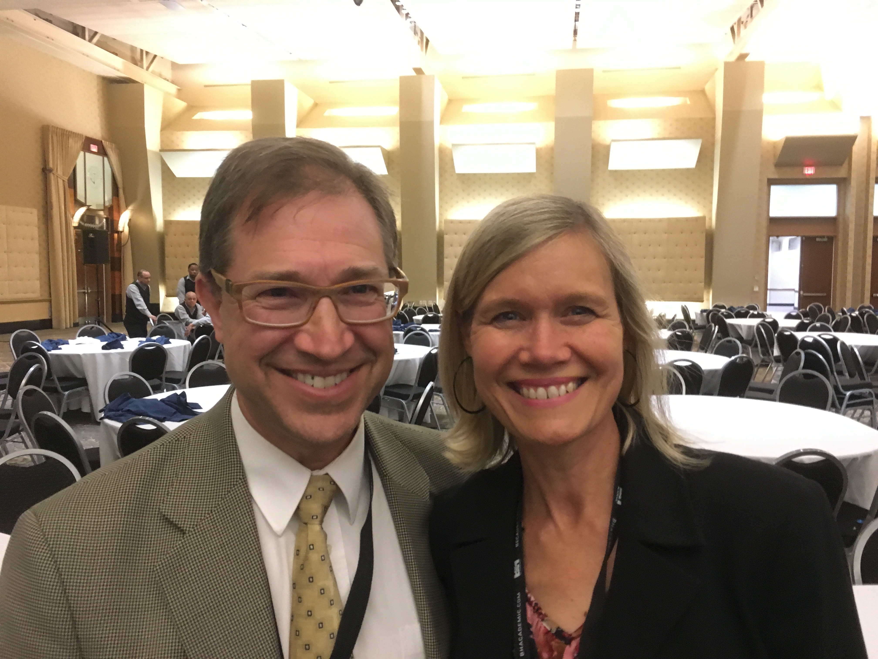
Our People
9
Jim & Jacqui Harmeling

Slide 25
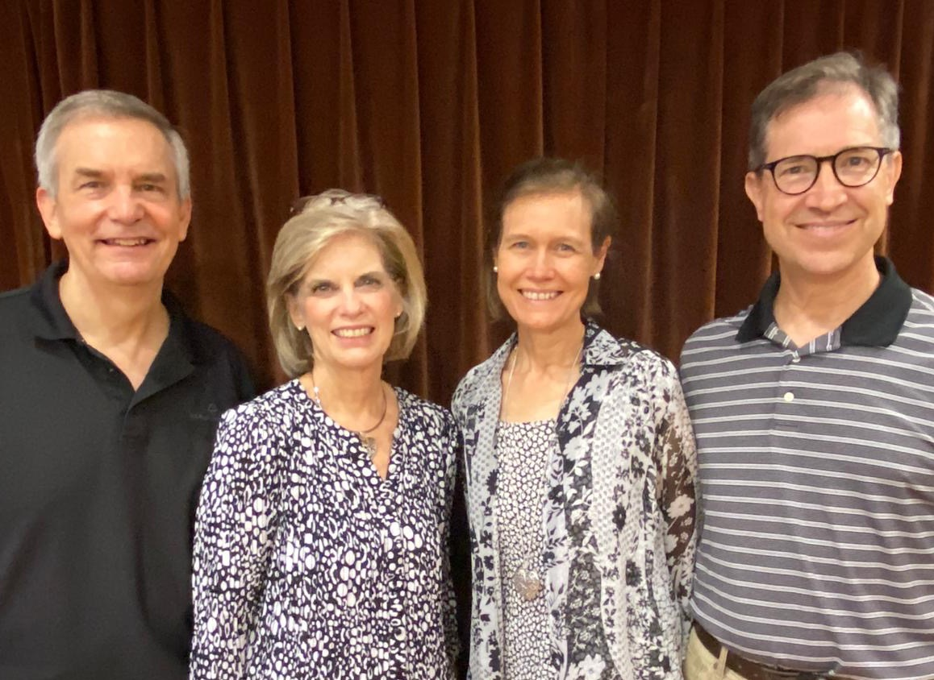
Rick & Susan
2006-2021
Jim & Jacqui
2019-2021
Notes:
We are passing the baton to the Harmelings, who have been with us nearly two years now.

Slide 26

SINGAPORE BIBLE COLLEGE
9
Notes:
I've served as a seminary professor with 30 other faculty at Singapore's largest training school: Singapore Bible College

Slide 27
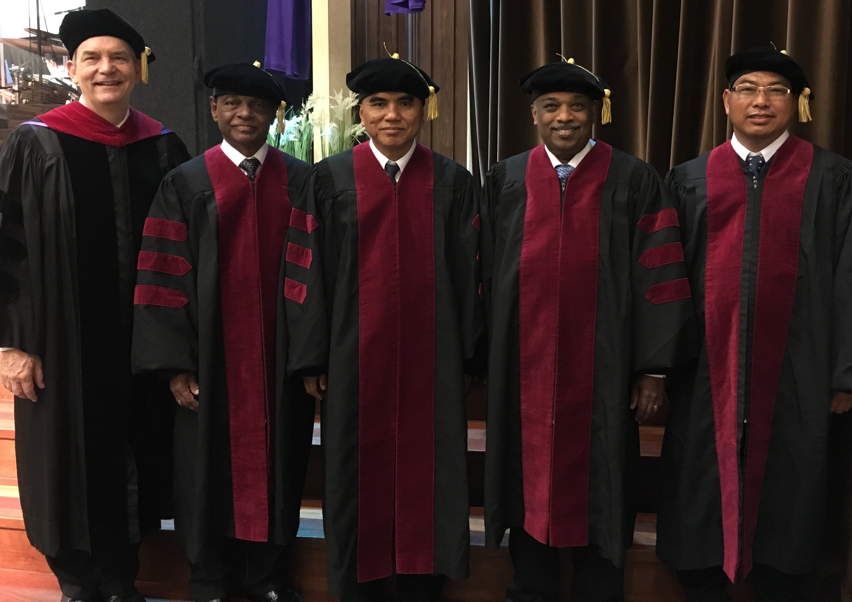
I direct the SBC Doctor of Ministry studies (DMin)
Notes:
I'm also the director of the doctoral program at SBC that trains about 80 seminary professors and pastors throughout Asia in English and Chinese. Generallly each year about 5 of them received their Doctor of Ministry degree.

Slide 28
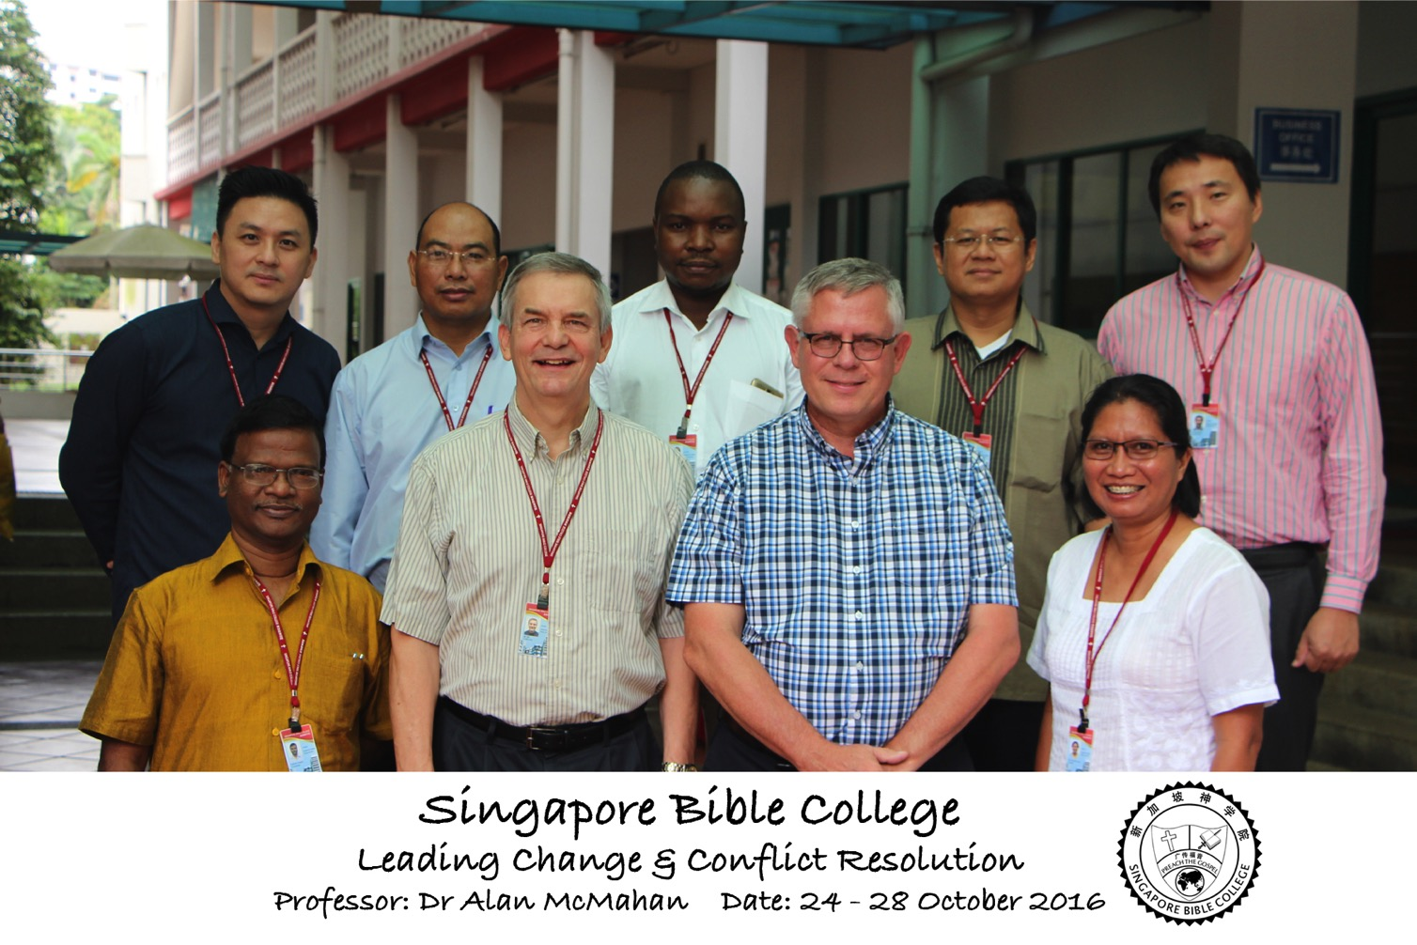
Leading Change & Conflict Resolution
(Dr. Alan McMahan Oct 2016)

Slide 29
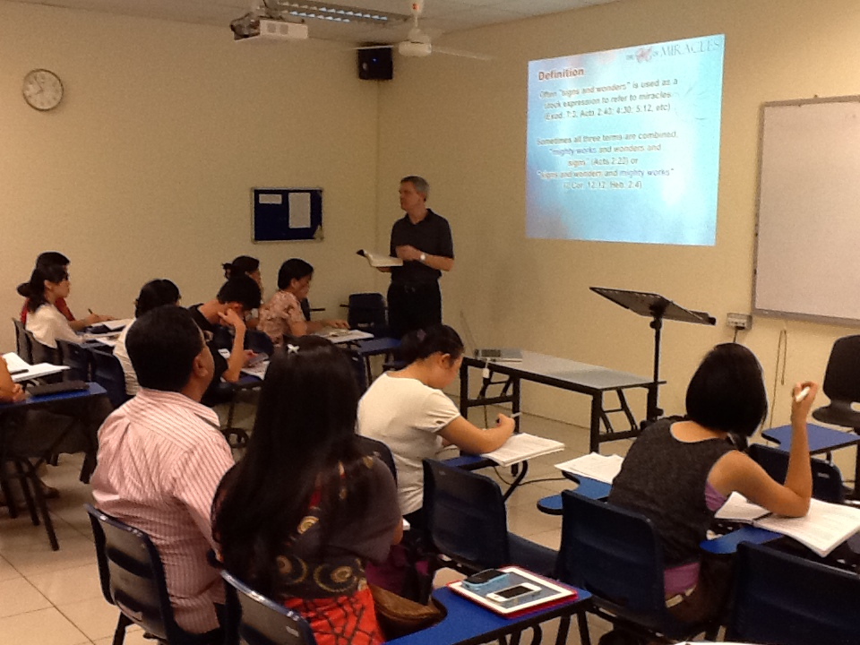
Singapore Bible College Students
9
Notes:
Most of these students are first-generation Christians eager to share the gospel with their own people!

Slide 30
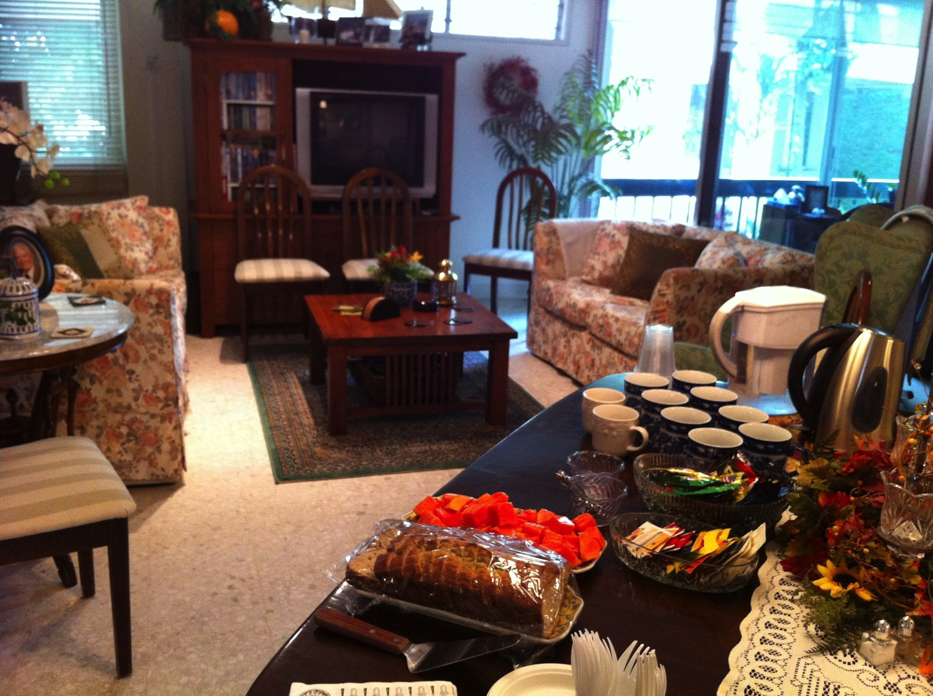
Our Singapore Bible College Apt.
9
Notes:
Our Wednesday pattern to set up the table for our Pastoral Care Group that comes up to our apartment on campus.

Slide 31
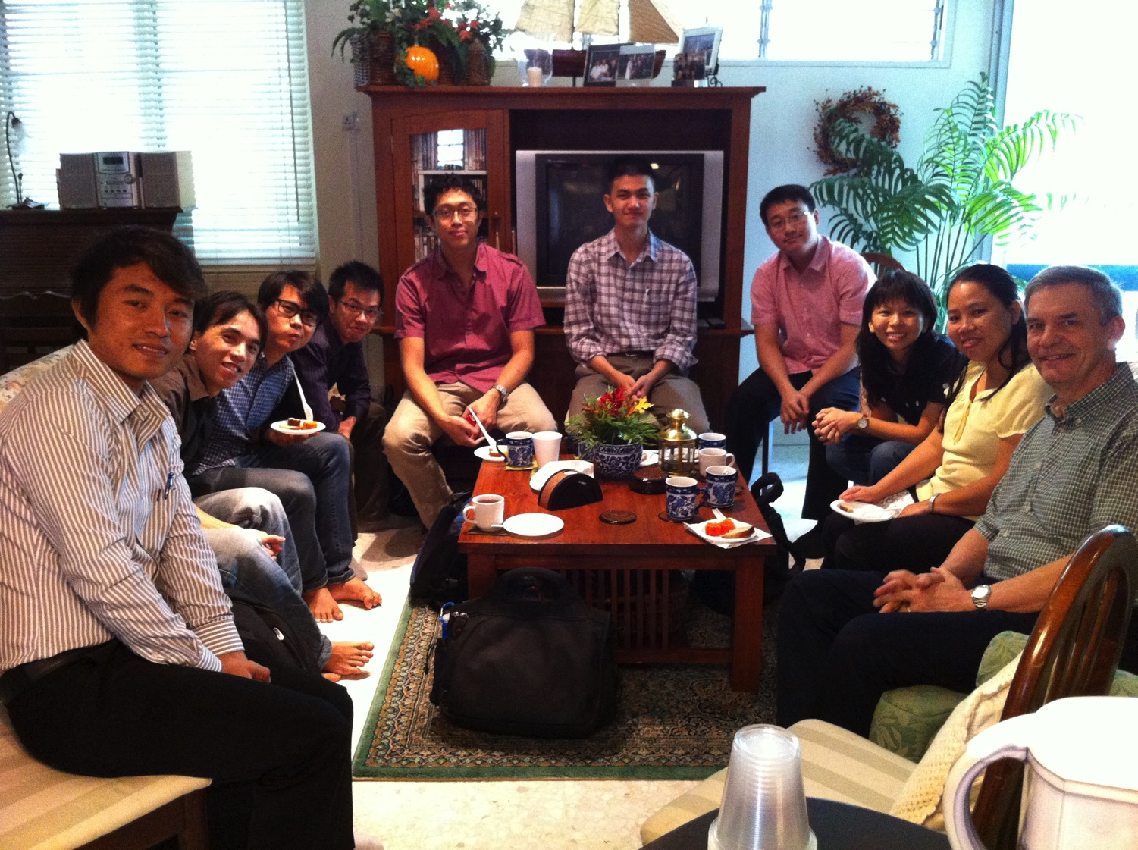
SBC Pastoral Care Group
9
Notes:
Our Pastoral Care Group has 9 students from Myanmar, Vietnam, Singapore, and Hong Kong.

Slide 32
Courses Taught Since 1991
(English • Indonesian • Chinese)
Survey • The Bible…Basically
OT NT Bible Study
Backgrounds • Research & Writing
OT NT Geography
Theology • Creation • Jesus
Church • Spirit • Salvation • Future
Preaching
Homiletics 1 Homiletics 2
Notes:
I get to teach these leaders every book of the Bible in survey courses, plus backgrounds to both the OT and NT, six areas of theology, and how to preach.
___________
Common-75

Slide 33

Our Mission Organization…

Slide 34
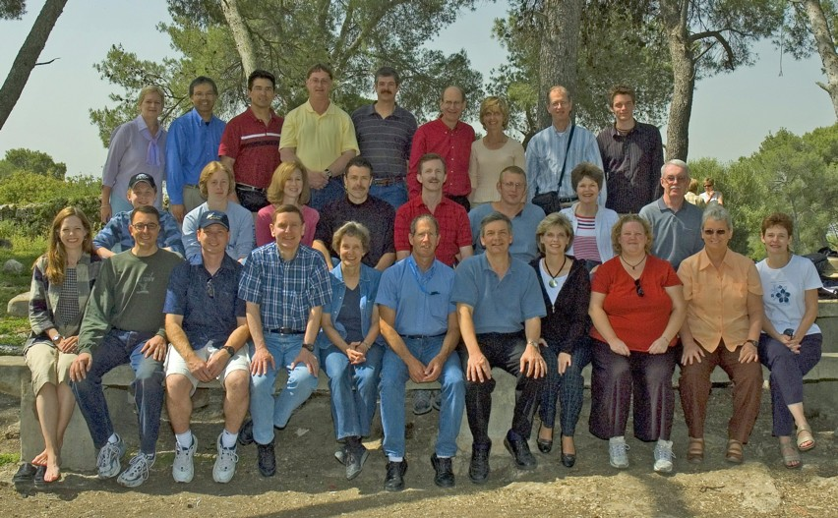
WorldVenture Seminary Professors in Israel

Slide 35
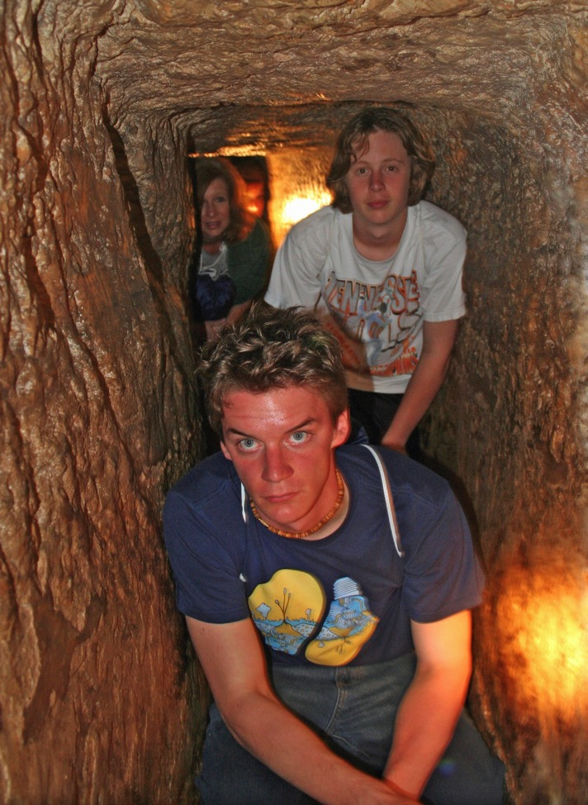
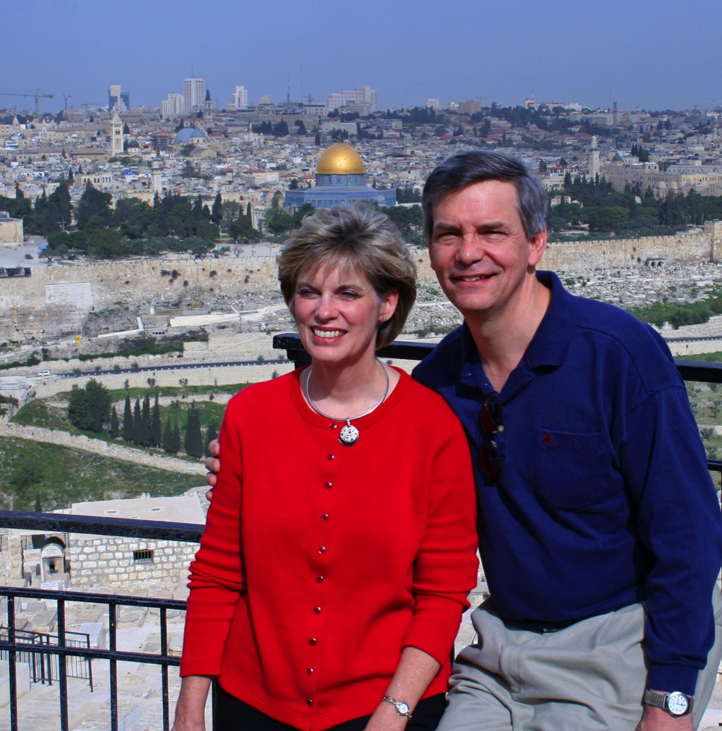
Susan & Rick at Mount of Olives
Kurt in
Hezekiah's Tunnel

Slide 36
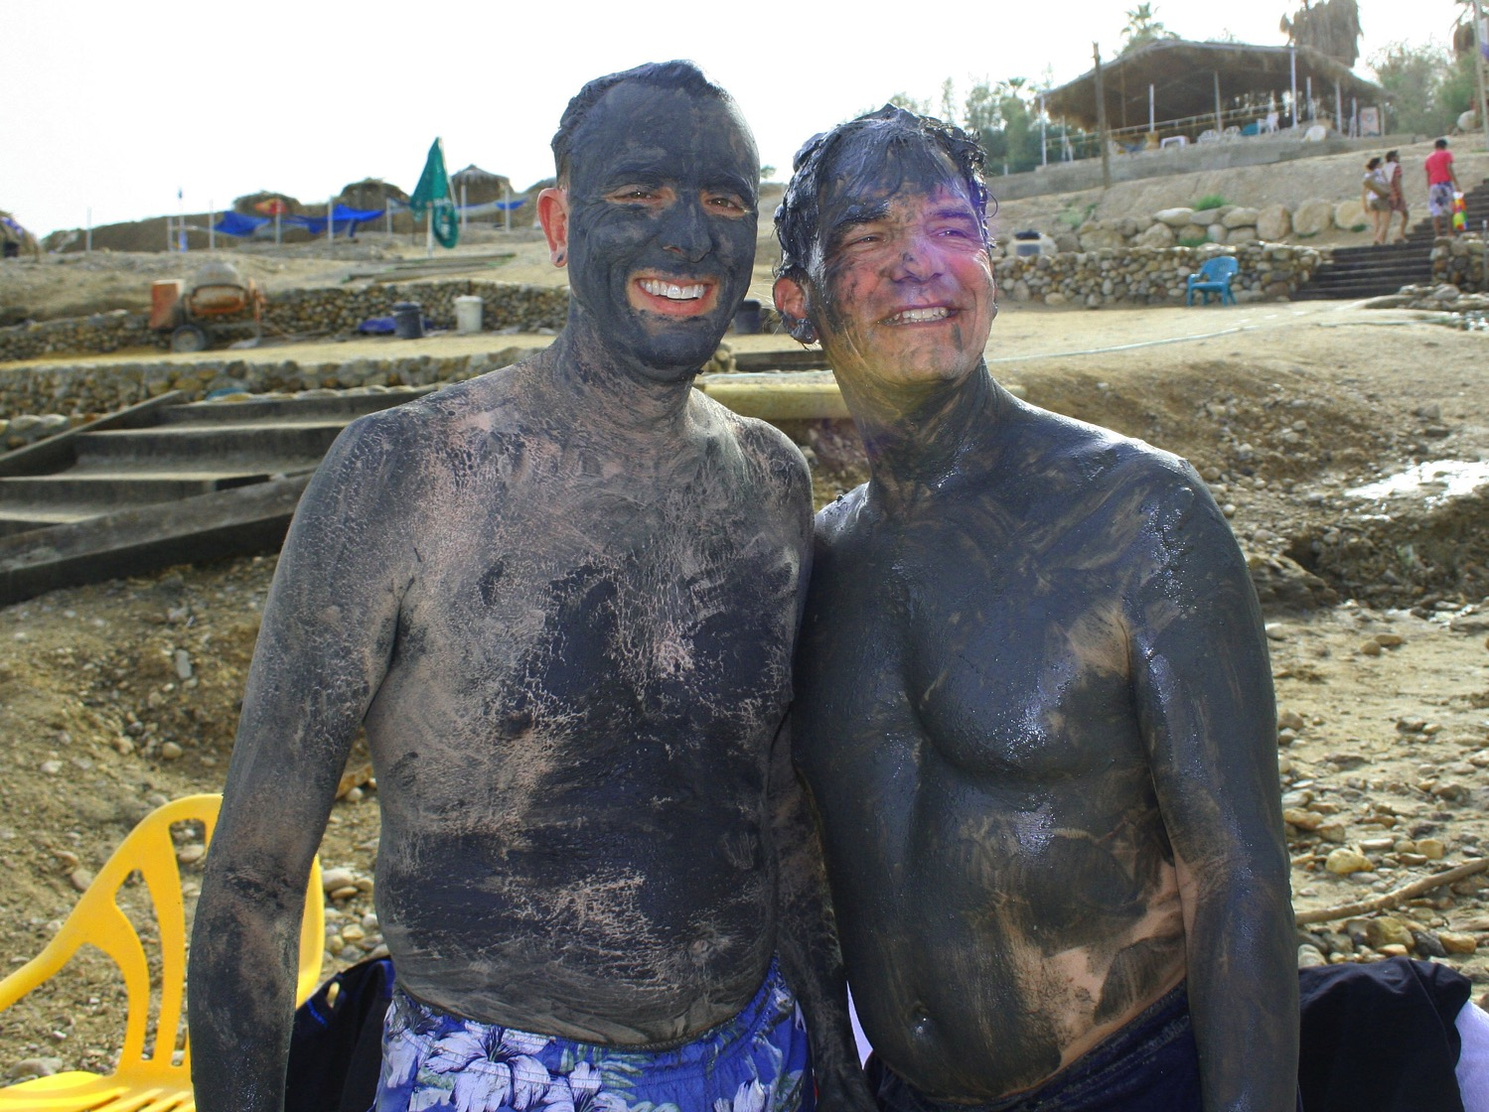
Dead Sea Mud

Slide 37
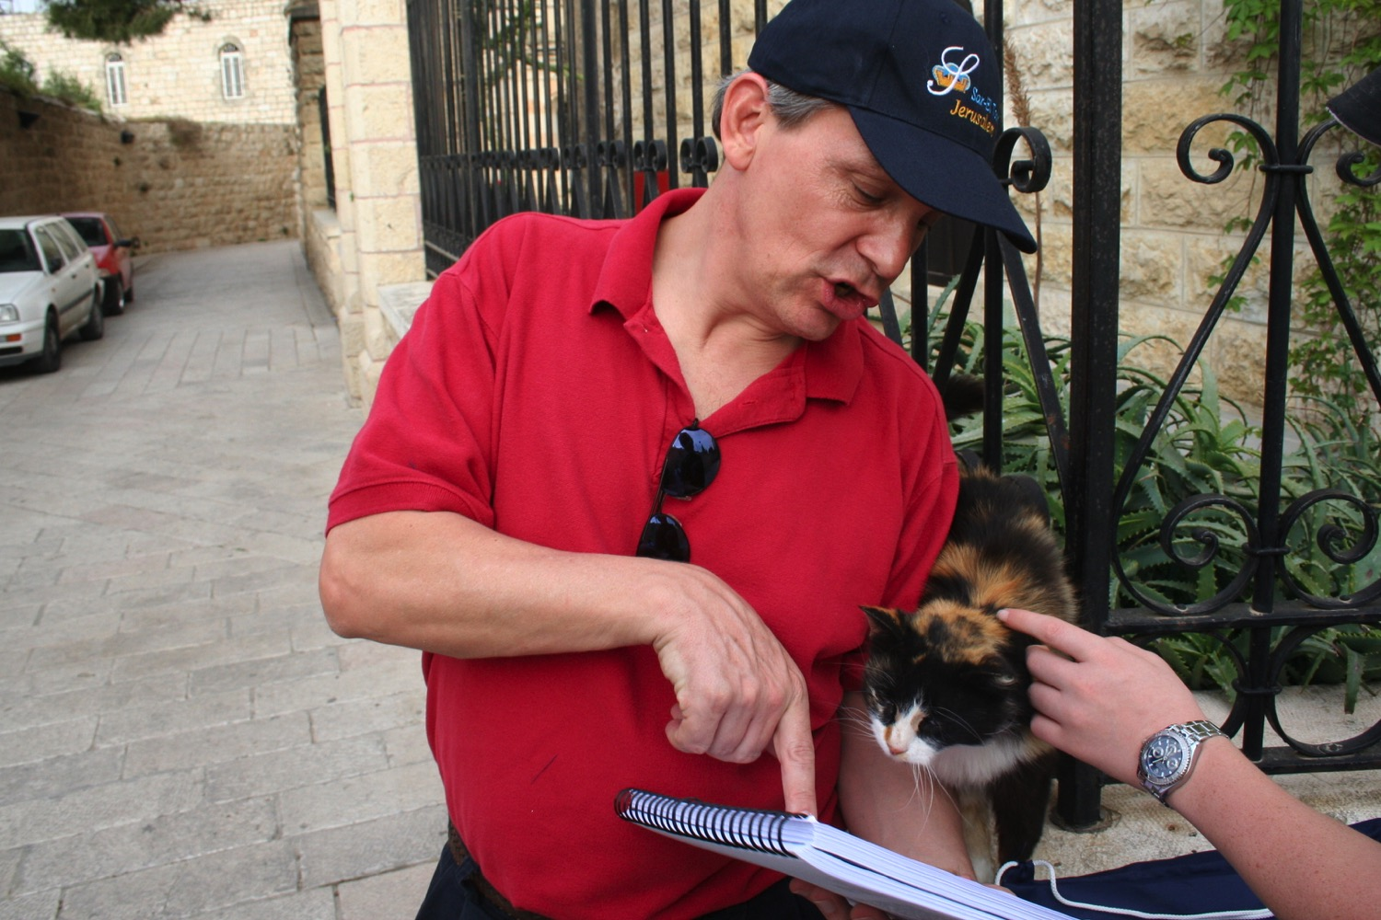
"Preach to every creature" (Mark 16:15)

Slide 38
Ministries God Gave Us
WorldVenture Singapore field leader
Singapore Bible College professor
Biblical Education by Extension teacher

Slide 39

Assignment File System

Slide 40

TBB

Slide 41

TBB Vision

Slide 42

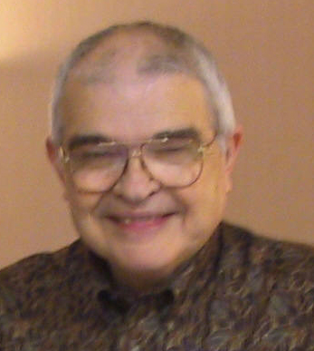
Dr John Fryman
Dr. John Fryman
Author of The Bible…Basically 10-Hour Seminar
Fort Worth, Texas
BibleBasically.org
©2004 TBBMI
8.0.01.
04

Slide 43

English

Slide 44

Burmese
Lai S
iangtho…Abulpi
A Presentation of The Bible…Basically Ministries International Inc. Fort Worth, Texas
www.biblebasically.com
©2004 TBBMI
8.0.01.
04

Slide 45


French
LA BIBLE…
EN BASE
Une Présentation du Ministère Internationale de La Bible… En Base Inc. Fort Worth, Texas
www.biblebasically.com
©2006 TBBMI
8.0.01.
04
©2004 TBBMI
9.6.01.

Slide 46
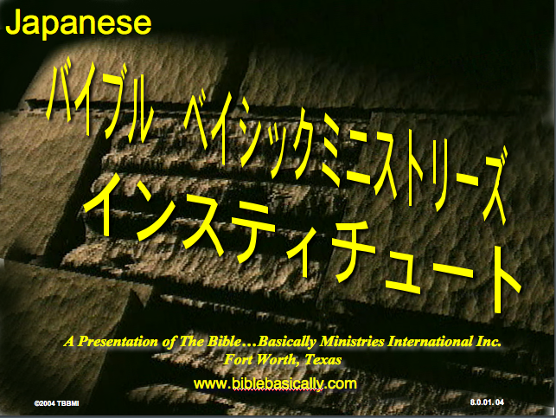
Japanese
バイブル ベイシックミニストリーズ
インスティチュート
A Presentation of The Bible…Basically Ministries International Inc. Fort Worth, Texas
www.biblebasically.com
©2004 TBBMI
8.0.01.
04
Notes:
Japanese title slide

Slide 47

Khmer (Cambodian)
mUldæanRKwH>>>
énRBHKm<IIr
karbgðaj[sÁal;nUvRBHKm<Ir>>> EdlCamUldæanRKw³ kñúg B½n§kic©shKmnGnþrCati GayGinsIu.
Fort Worth, Texas
www.biblebasically.com
©2004 TBBMI
8.0.01.
04

Slide 48

Korean
성경은 …
기본적으로
A Presentation of The Bible…Basically Ministries International Inc. Fort Worth, Texas
www.biblebasically.com
7.5.01.
©2003 TBBMI
04

Slide 49

Malay
Alkitab…
Dasar
Presentasi dari The Bible…Basically Ministries International Inc. Fort Worth, Texas
www.biblebasically.com
©2004 TBBMI
8.0.01.
04

Slide 50

Mao (India)
Bible…
Amolo Leino
Bible…Ngashankakhuina Ministries International Inc. pashina semkashok Fort Worth, Texas
www.biblebasically.com
©2004 TBBMI
8.0.01.
04

Slide 51
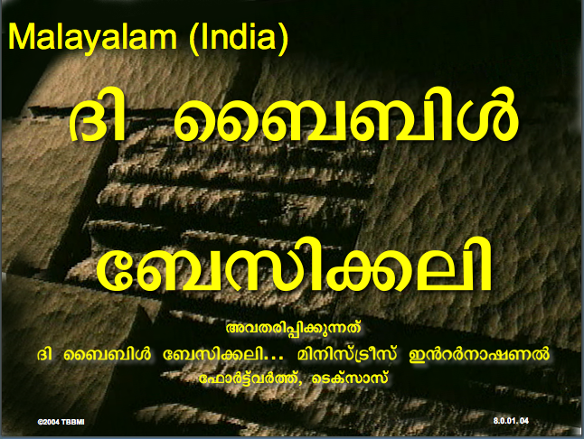
Malayalam (India)
Æß èÌÌßZ
çÌØßAÜß
¥ÕÄøßMßAáKÄí Æß èÌÌßZ çÌØßAÜß… ÎßÈßØíd¿àØí §aVÈÞ×ÃW çËÞVGíÕVJí, æ¿µíØÞØí
©2004 TBBMI
8.0.01.
04

Slide 52
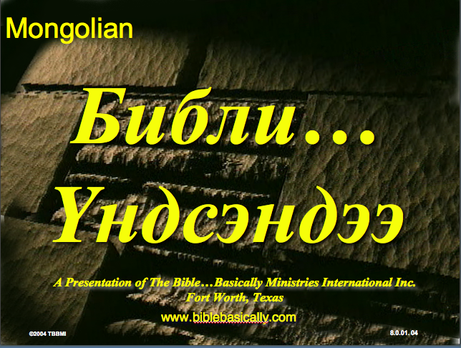
Mongolian
Библи…
Үндсэндээ
A Presentation of The Bible…Basically Ministries International Inc. Fort Worth, Texas
www.biblebasically.com
©2004 TBBMI
8.0.01.
04

Slide 53

Nepali
afOan======
cfwf/e[\t
A Presentation of The Bible…Basically Ministries International Inc. Fort Worth, Texas
www.biblebasically.com
8.0.01.
©2004 TBBMI
04

Slide 54
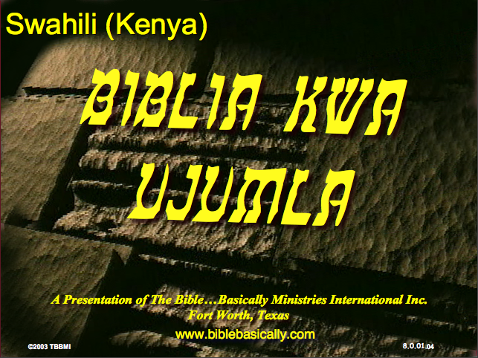
Swahili (Kenya)
biblia kwa ujumla
A Presentation of The Bible…Basically Ministries International Inc. Fort Worth, Texas
www.biblebasically.com
8.0.01.
©2003 TBBMI
04

Slide 55

Tagalog (Philippines)
Ang Biblia . . . Pinasimple
A Presentation of The Bible…Basically Ministries International Inc. Fort Worth, Texas
www.biblebasically.com
©2004 TBBMI
8.0.01.
04
Notes:
PLEASE PUT THE TITLE AND SUBTITLES INTO YOUR NATIONAL LANGUAGE AND LEAVE THE WEBSITE UNCHANGED

Slide 56

Tangkhul (India)
Bible…
Ngashankakhui
Bible…Ngashankakhuina Ministries International Inc. pashina semkashok Fort Worth, Texas
www.biblebasically.com
©2004 TBBMI
8.0.01.
04

Slide 57

Tamil (Sri Lanka/India)
jpUkiwapd;…
mbg;gil
A Presentation of The Bible…Basically Ministries International Inc. Fort Worth, Texas
www.biblebasically.com
©2004 TBBMI
8.0.01.
04

Slide 58
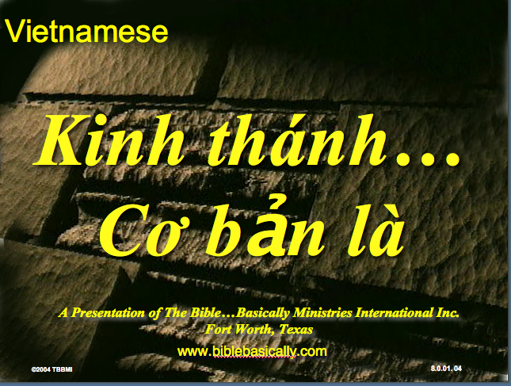
Vietnamese
Kinh thánh…
Cơ bản là
A Presentation of The Bible…Basically Ministries International Inc. Fort Worth, Texas
www.biblebasically.com
©2004 TBBMI
8.0.01.
04

Slide 59
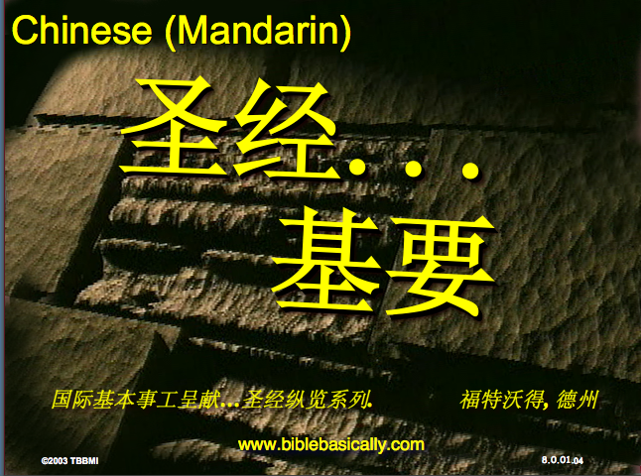
Chinese (Mandarin)
圣经...
基要
国际基本事工呈献…圣经纵览系列. 福特沃得, 德州
www.biblebasically.com
8.0.01.
©2003 TBBMI
04

Slide 60
الكتاب المقدس بشكل أساسي

Slide 61
PowerPoint (945 slides)
Student Workbook (100 pages)
Teacher Script (400 pages)
TBB Materials
Completed in
English • Chinese • Hindi • Indonesian • Korean • Malay • Mongolian • Russian • Spanish
A Presentation of The Bible…Basically Ministries International Inc. Fort Worth, Texas
www.biblebasically.org
©2004 TBBMI
8.0.01.
04

Slide 62
YOUR
BIBLE FILE
7
C
7
S
J
Handbook pg. 8-14
39
Notes:
Now let's think again about a filing cabinet. This will be YOUR BIBLE FILE! Here is a look ahead to where we are going in this study.

Slide 63
10 File Folders
7
1
2
3
C
4
5
6
7
7
8
S
9
10
J
Handbook pg. 8-14
41
Notes:
As a starting point, begin thinking about 10 file folders in a filing cabinet.
You are going to organize your own Bible File into a collection of these ten mental file folders.
Very soon you'll be applying labels to each of those 10 file folders. So…now to begin…and…

Slide 64
Opening Up
"Your Bible File"
7
7
7
7
7
7
7
7
C
7
J
C
S
J
C
S
J
C
S
J
S
Handbook pg. 8-14
4
42
Notes:
We begin right here...with the single number…. 7.
That's our mental anchor point. Simply the number 7 with that all-important dash through the stem.
//// Next step...surround that number with three alphabet letters. Set them firmly in place in your mind:
C 7 S J
Repeat the letter group aloud several times as you embed it in your mind... Because this is the very core of the Bible's organization and time-line flow:
//// "C 7 S J....
//// C 7 S J....
//// C 7 S J...etc."

Slide 65
Opening Up
"Your Bible File"
7
7
= 4+3
Handbook pg. 8-14
2
43
Notes:
Now...about that European style '7'.
//// You'll remember that it has a dash through its stem... That's an important reminder — a mind clue. Keep it mentally handy. That small dash divides the length of the 7's stem into two parts. So, ask yourself the question: "What two numbers does 7 easily split into?"
//// One possible answer…and the right one…is: 4 and 3.

Slide 66
C 4 3 S J
7
Opening Up
"Your Bible File"
C 4 3 S J
C 4 3 S J
Handbook pg. 8-14
1
44
Notes:
So, in the C 7 S J formula, by changing the 7 to a 4 and a 3, we have
C 4 3 S J.
As before, repeat that changed sequence aloud several times to help it hold tightly in your mind for easy recall.
//// C 4 3 S J.

Slide 67
5 Key Words or Phrases:
7
C = CREATION
4 = PEOPLE
3 = SOCIETIES
S = SILENCE
J = JESUS
Handbook pg. 8-14
5
45
Notes:
Now, based on C 4 3 S J, we enlarge that idea into five key words or phrases. They will become the foundation of your mental Bible File. Here they are…say them aloud…
//// C = CREATION
//// 4 = 4 PEOPLE
//// 3 = 3 SOCIETIES
//// S = SILENCE
//// J = JESUS.
And that's an organizational plan for the entire Bible! Those five words and phrases create an abbreviated outline map of the entire Bible's basic design.

Slide 68
5 Key Words or Phrases:
7
C = CREATION
4 = PEOPLE
3 = SOCIETIES
S = SILENCE
J = JESUS
Handbook pg. 8-14
6
46
Notes:
Once again...aloud…
//// C = CREATION
//// 4 = 4 PEOPLE
//// 3 = 3 SOCIETIES
//// S = SILENCE
//// J = JESUS.
We will now go back through the phrases, expanding them still farther.
//// CREATION,
of course, remains at the top of the list naturally…because the Bible story itself begins right there.

Slide 69
5 Key Words or Phrases:
7
C = CREATION
4 = PEOPLE
3 = SOCIETIES
S = SILENCE
J = JESUS
Handbook pg. 8-14
47
Notes:
We then take the next phrase from the list:
4 PEOPLE.

Slide 70
THE 4 PEOPLE ARE:
7
ABRAHAM
JOSEPH
MOSES
JOSHUA
Handbook pg. 8-14
5
48
Notes:
Let's break apart "4 PEOPLE" into 4 specific people, in this order:
//// ABRAHAM
//// JOSEPH
//// MOSES
//// JOSHUA
It's helpful to remember the word order by repeating several times the first-letter order of the words:
//// "A-J-M-J ... A-J-M-J ... etc."

Slide 71
A Judge Must Judge
7
A
JUDGE
MUST
JUDGE!
Handbook pg. 8-14
49
Notes:
How can you remember the order of those letters and the names?
This simple sentence..."A JUDGE MUST JUDGE." The first letters of each word: AJMJ and then you have it.

Slide 72
THE 4 PEOPLE ARE:
7
A BRAHAM
A
J OSEPH
JUDGE
M OSES
MUST
J OSHUA
JUDGE
Handbook pg. 8-14
8
50
Notes:
Just remember to repeat the four names aloud to yourself several times until you feel the rhythm of the words:
//// "ABRAHAM,
//// JOSEPH,
//// MOSES and
//// JOSHUA."
And here again is that mental tool…
//// A
//// JUDGE
//// MUST
//// JUDGE.

Slide 73
Creation to Joshua
7
CREATION
ABRAHAM
JOSEPH
MOSES
JOSHUA
Handbook pg. 8-14
5
51
Notes:
So, from the top of the list we now can say:
//// CREATION
//// ABRAHAM
//// JOSEPH
//// MOSES
//// JOSHUA
This step completes the main FOUR PEOPLE of your new Bible File. Of course, there are dozens of other Biblical characters, but these are the only ones we are using to build the Bible File right now. Repeat the four names aloud several times until they are firmly set mentally.

Slide 74
5 Key Words or Phrases:
7
C = CREATION
4 = PEOPLE
3 = SOCIETIES
S = SILENCE
J = JESUS
Handbook pg. 8-14
52
Notes:
The next phrase of that beginning list is:
3 SOCIETIES.

Slide 75
A R C
7
Handbook pg. 8-14
2
53
Notes:
Another memory tool now…what do you call
//// that red section of the perimeter of a circle?
//// It's called an "arc," spelled A-R-C. Those letters, then, remind you of the first letters of 3 KINDS OF SOCIETIES.

Slide 76
THE 3 SOCIETIES ARE:
7
ANARCHY
ROYALTY
CAPTIVITY
Handbook pg. 8-14
6
54
Notes:
The three societies are…
//// ANARCHY
//// ROYALTY
//// CAPTIVITY.
As before, please repeat that word order several times.
ANARCHY, ROYALTY, CAPTIVITY...
ANARCHY, ROYALTY, CAPTIVITY.
And the mental tool here:
//// A
//// R
//// C.

Slide 77
OT Review
7
CREATION
ABRAHAM
JOSEPH
MOSES
JOSHUA
ANARCHY
ROYALTY
CAPTIVITY
Handbook pg. 8-14
55
Notes:
Now we add the 3 SOCIETIES group to the others, and we have:
CREATION
ABRAHAM
JOSEPH
MOSES
JOSHUA
ANARCHY
ROYALTY
CAPTIVITY

Slide 78
To Review…
7
7
TO REVIEW...
C 7 S J
C 4 3 S J
Handbook pg. 8-14
3
56
Notes:
To review the entire sequence so far…
Beginning with the single number
//// 7....
leading to…
//// C 7 S J...
which becomes...
//// C 4 3 S J.
These numbers and letters are then used to develop a mental list of TEN WORDS that will form a dependable mental outline of the entirety of Scripture.

Slide 79
The Basics
7
CREATION
4 PEOPLE
3 SOCIETIES
SILENCE
JESUS
Handbook pg. 8-14
57
Notes:
C 4 3 S J is then expanded into:
CREATION
4 PEOPLE
3 SOCIETIES
SILENCE
JESUS.

Slide 80
The Last Two Folders
7
CREATION
ABRAHAM
JOSEPH
MOSES
JOSHUA
ANARCHY
ROYALTY
CAPTIVITY
SILENCE
JESUS
Handbook pg. 8-14
2
58
Notes:
Then further expanded into:
CREATION
ABRAHAM
JOSEPH
MOSES
JOSHUA
ANARCHY
ROYALTY
CAPTIVITY.
Finally, now, we add: //// SILENCEand//// JESUS.

Slide 81
Your New Mental "Bible File"
CREATION
CREATION
ABRAHAM
ABRAHAM
ABRAHAM
ABRAHAM
JOSEPH
ABRAHAM
MOSES
JOSEPH
JOSHUA
ANARCHY
MOSES
ROYALTY
CAPTIVITY
JOSHUA
SILENCE
JESUS
ANARCHY
ROYALTY
CAPTIVITY
SILENCE
JESUS
Handbook pg. 8-14
59
11
Notes:
Now it's time mentally to apply those ten words as labels to ten mental folders in your new Bible File –
//// right up there in your head. That mental picture might look something like this. And there they are...
//// CREATION//// ABRAHAM//// JOSEPH//// MOSES//// JOSHUA//// ANARCHY//// ROYALTY//// CAPTIVITY//// SILENCE…and…//// JESUS.
Now it's organized in a neat and orderly package in your mind --- ready for recall and use as you need it. Now just a few more
examples to drive home the point...

Slide 82
Membuka
"Arsip Alkitab Anda"
7
7
7
7
7
7
C S Y
C S Y
C S Y
C S Y
Buku Panduan hlm. 8-14
40
4

Slide 83
Membuka
"Arsip Alkitab Anda"
7
7
= 4+3
Buku Panduan hlm. 8-14
41
2

Slide 84
Membuka
"Arsip Alkitab Anda"
7
C 4 3 S Y
C 4 3 S Y
Buku Panduan hlm. 8-14
42
1

Slide 85
5 Kata Kunci atau Ungkapan:
7
C = CIPTAAN
4 = TOKOH
3 = KOMUNITAS
S = SENYAP
Y = YESUS
Buku Panduan hlm. 8-14
43
5

Slide 86
5 Kata Kunci atau Ungkapan:
7
C = CIPTAAN
4 = TOKOH
3 = KOMUNITAS
S = SENYAP
Y = YESUS
Buku Panduan hlm. 8-14
45

Slide 87
4 TOKOH tsb adalah:
7
A BRAHAM
Y USUF
M USA
Y OSUA
Buku Panduan hlm. 8-14
46
5

Slide 88
AYMY
7
ANUGERAH
YANG
MENAKJUBKAN
YA !
Buku Panduan hlm. 8-14
47

Slide 89
5 Kata Kunci atau Ungkapan:
7
C = CIPTAAN
4 = ORANG
3 = KOMUNITAS
S = SENYAP
Y = YESUS
Buku Panduan hlm. 8-14
50

Slide 90

KAKAP
7
K
A
K
A
P
Buku Panduan hlm. 8-14
53
2
Notes:
Alat pengingat yang lainnya adalah …
//// Ini ikan apa?
//// Benar, ikan “KAKAP"
//// Kita lihat disini ada 2 huruf K, kita mau buang 1 huruf K-nya
//// Huruf A juga ada 2, kita buang lagi huruf A yang double
//// Sekarang yang tersisa adalah A-K-P
//// Ikan KAKAP-nya tidak dibutuhkan lagi, kita kembali ke laut saja..
Sisa tiga huruf ini A-K-P, huruf-huruf ini akan membantu anda mengingatkan huruf pertama pada tiga 3 MACAM KOMUNITAS.

Slide 91
KE 3 KOMUNITAS ADALAH:
7
A NARKI
K ERAJAAN
P EMBUANGAN
Buku Panduan hlm. 8-14
52
6

Slide 92

Singapore Bible College Students
USA
MONGOLIA
JAPAN
KOREA
CHINA
HONG KONG
MYANMAR
INDIA
THAILAND
VIETNAM
PHILIPPINES
MALAYSIA
SINGAPORE
SBC
INDONESIA
Notes:
These faithful leaders are from about 25 countries who come to us in Singapore for masters and doctoral-level training. We train them to build into others back in their home countries.

Slide 93

"in the beginning"
Gen. 1:1
An Introduction to Genesis

Slide 94

"pada mulanya"
Gen. 1:1
Pengenalan kitab Kejadian

Slide 95
"起初"
Gen. 1:1
创世记导论

Slide 96

Days of Creation
33
Void
Formless
Forming
Filling
Day 4: Sun, moon & stars arranged
Day 1: Light
Day 2: Water & air separated
Day 5: Fish & fowl
Day 3: Land & sea separated
Day 6: Animals & man
Genesis 1:3-31

Slide 97
Days of Creation in Bahasa Indonesian
Hari-hari penciptaan
64
Kosong
Tidak berbentuk
Dibentuk
Diisi
Hari 4: Matahari, bulan & bintang diatur
Hari 1: Terang
Hari 2: Air &
udara dipisahkan
Hari 5: Ikan & unggas
Hari 3: Darat & laut dipisahkan
Hari 6: Binatang & manusia
Kejadian 1:3-31

Slide 98
六天的创造
空虚
64
充满
混沌
形成
第四天: 太阳，月亮与众星摆列在天
第一天: 光
第二天:
水与空气分开
第五天: 鱼与雀鸟
第三天:
旱地与海分开
第六天: 动物与人
创世记 1:3-31

Slide 99


NT Survey link at BibleStudyDownloads.org
Get this presentation for free!
Notes:
Student translation since 2003 with 700 translators has resulted in Bible teaching and study materials—mostly PowerPoint—in 49 languages! All a teacher needs to do is to click on a file and it downloads for free to teach any book of the Bible and many other subjects.
NT Survey (ns)

Slide 100

BibleStudyDownloads.org
7
Notes:
My SBC teaching has resulted in Bible teaching and study materials—mostly PowerPoint—in 49 languages! All a teacher needs to do is to click on a file and it downloads for free to teach any book of the Bible and many other subjects.

Slide 101
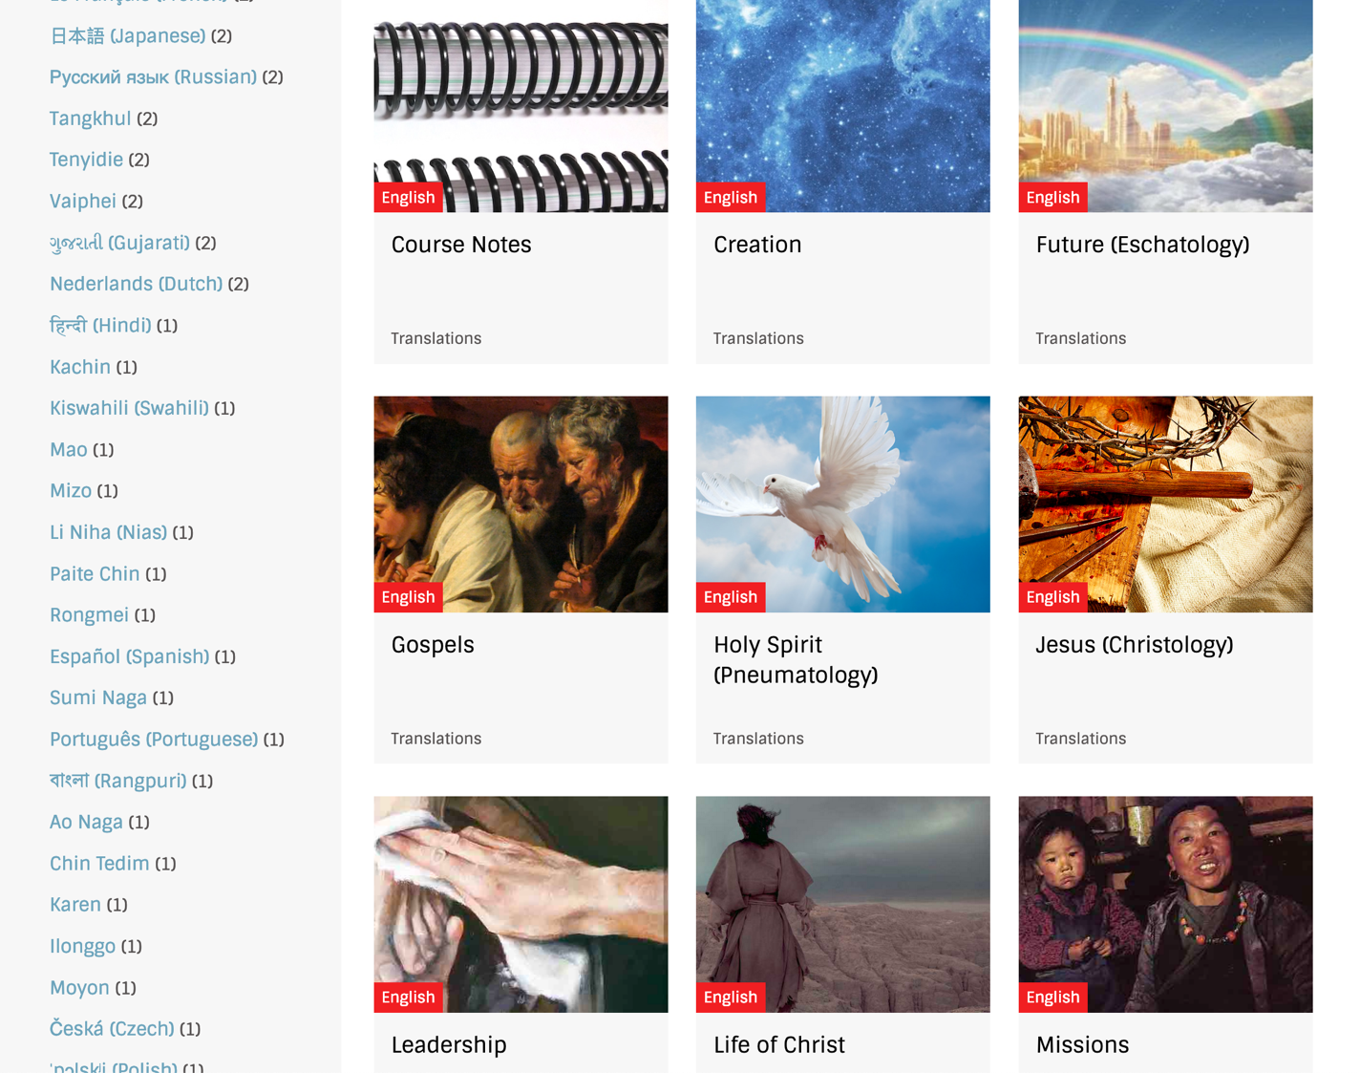
BibleStudyDownloads.org
7
Notes:
My SBC teaching has resulted in Bible teaching and study materials—mostly PowerPoint—in 49 languages! All a teacher needs to do is to click on a file and it downloads for free to teach any book of the Bible and many other subjects.

Slide 102
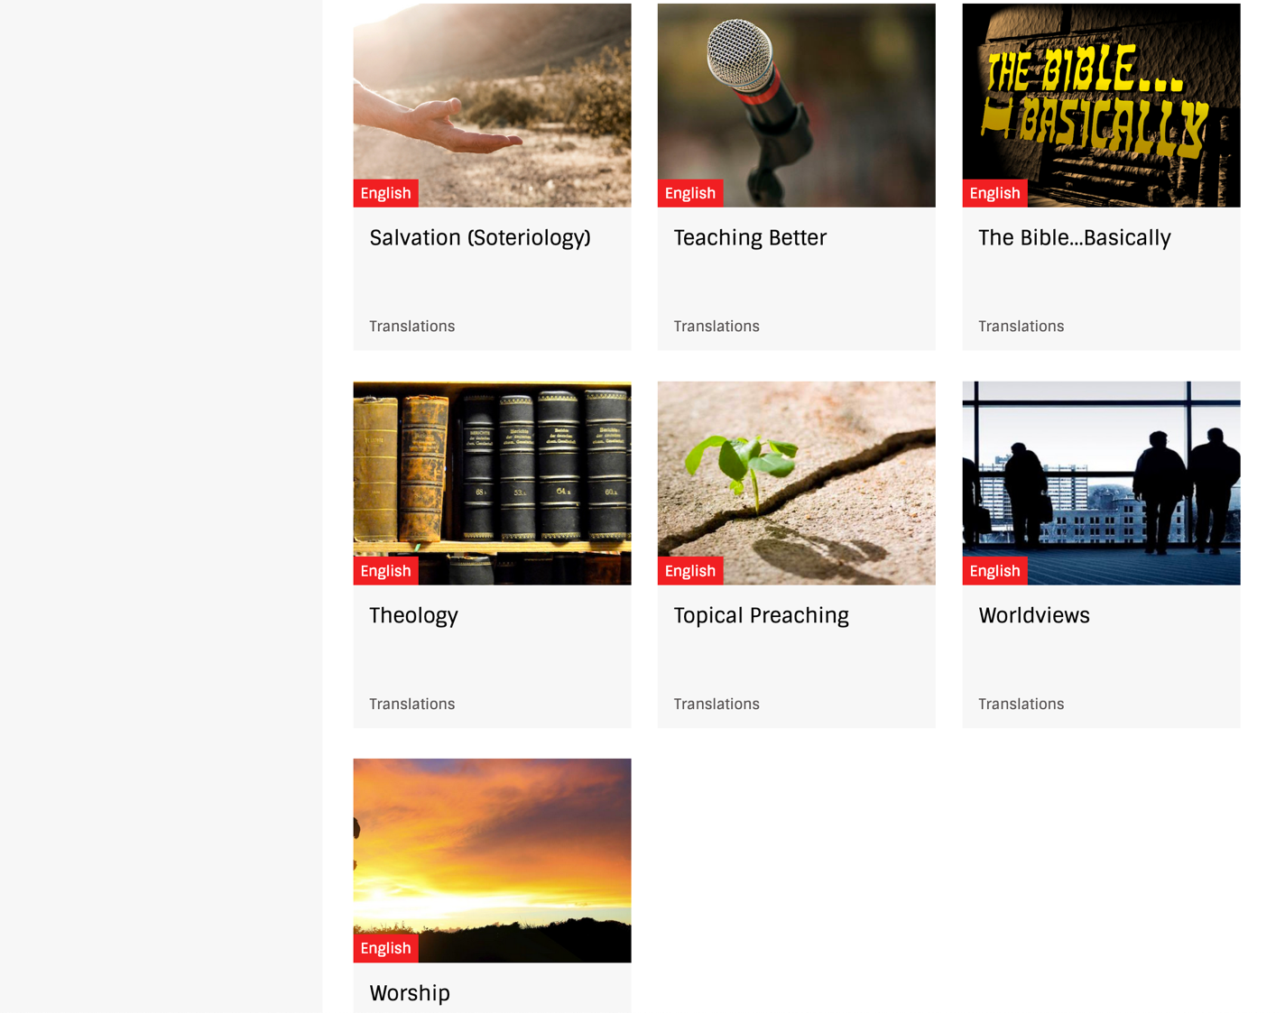
BibleStudyDownloads.org
7
Notes:
My SBC teaching has resulted in Bible teaching and study materials—mostly PowerPoint—in 49 languages! All a teacher needs to do is to click on a file and it downloads for free to teach any book of the Bible and many other subjects.

Slide 103
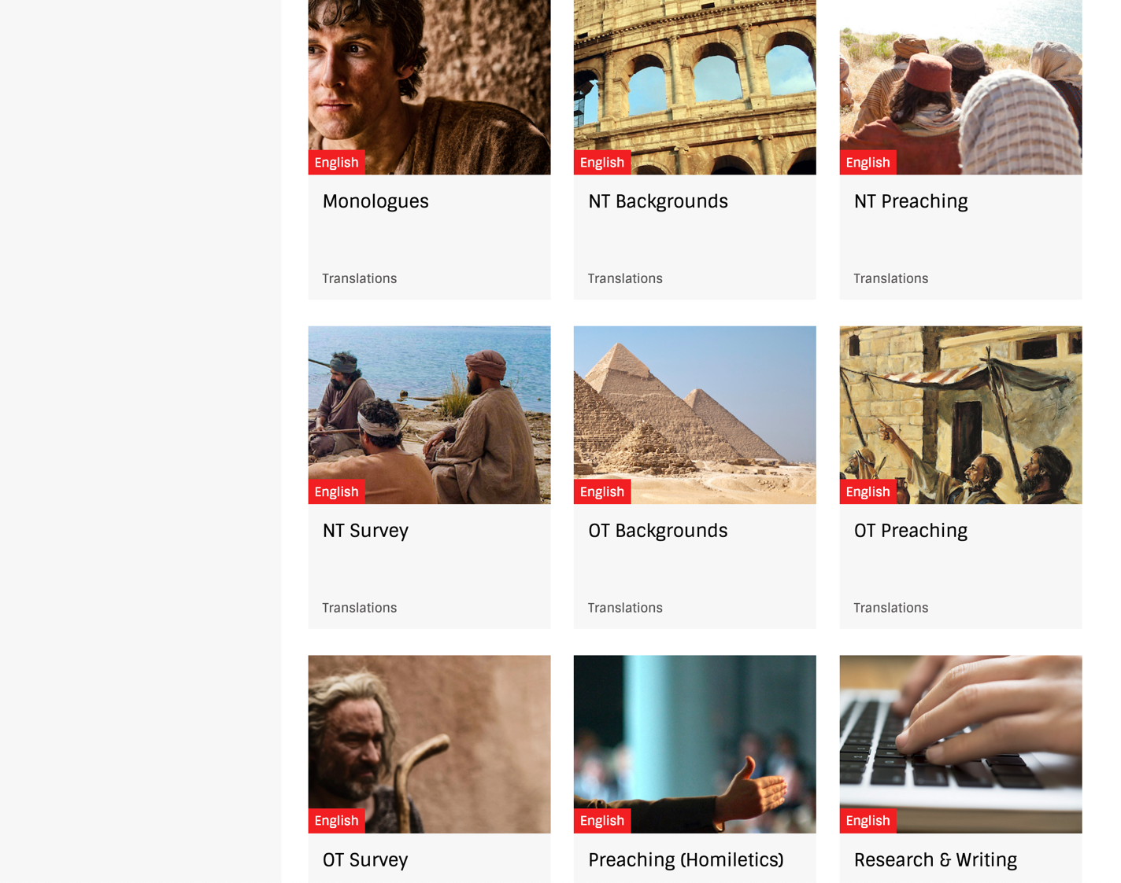
BibleStudyDownloads.org
7
Notes:
My SBC teaching has resulted in Bible teaching and study materials—mostly PowerPoint—in 49 languages! All a teacher needs to do is to click on a file and it downloads for free to teach any book of the Bible and many other subjects.

Slide 104
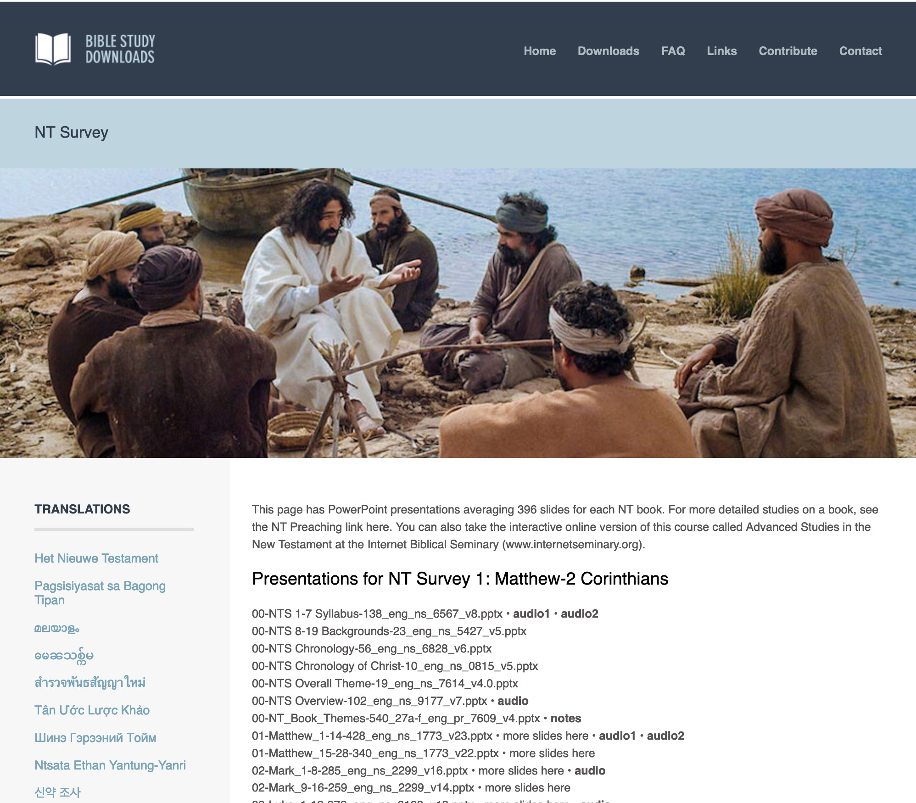
BibleStudyDownloads.org
7
English
Notes:
My SBC teaching has resulted in Bible teaching and study materials—mostly PowerPoint—in 49 languages! All a teacher needs to do is to click on a file and it downloads for free to teach any book of the Bible and many other subjects.

Slide 105
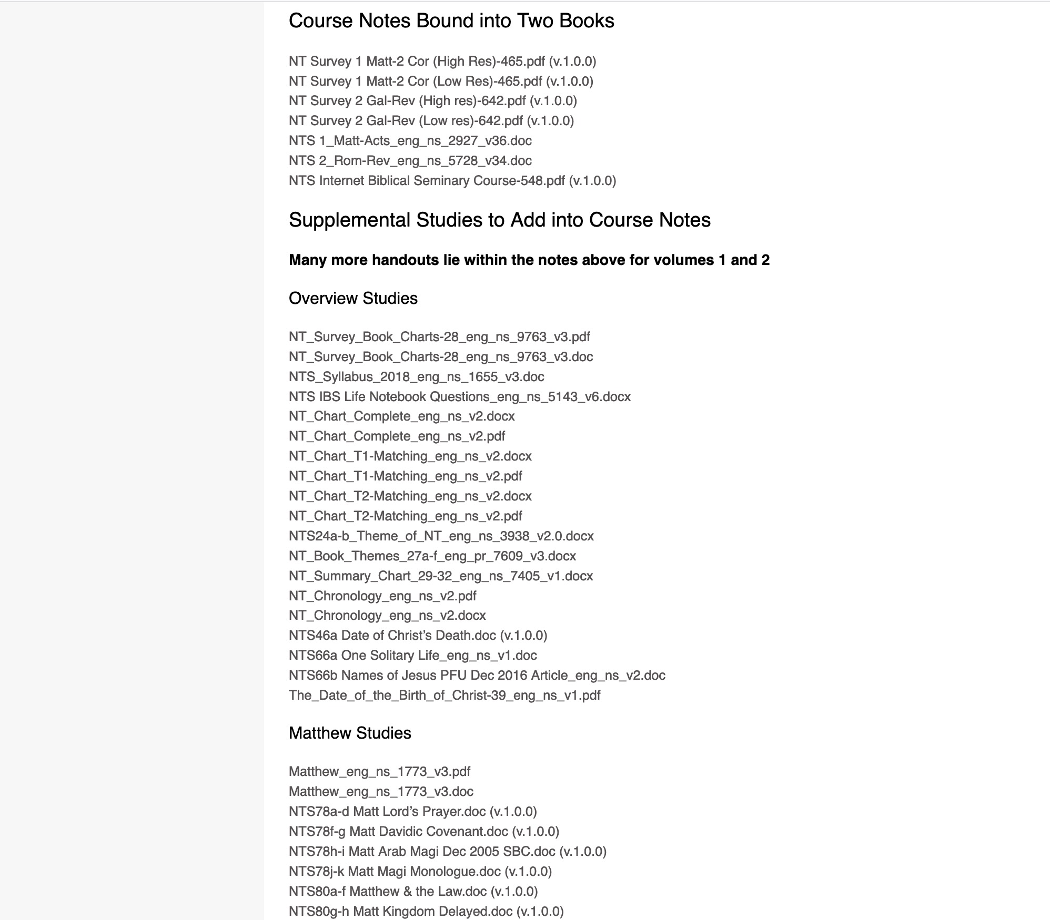
BibleStudyDownloads.org
7
NT Survey
Class Notes
Notes:
My SBC teaching has resulted in Bible teaching and study materials—mostly PowerPoint—in 49 languages! All a teacher needs to do is to click on a file and it downloads for free to teach any book of the Bible and many other subjects.

Slide 106
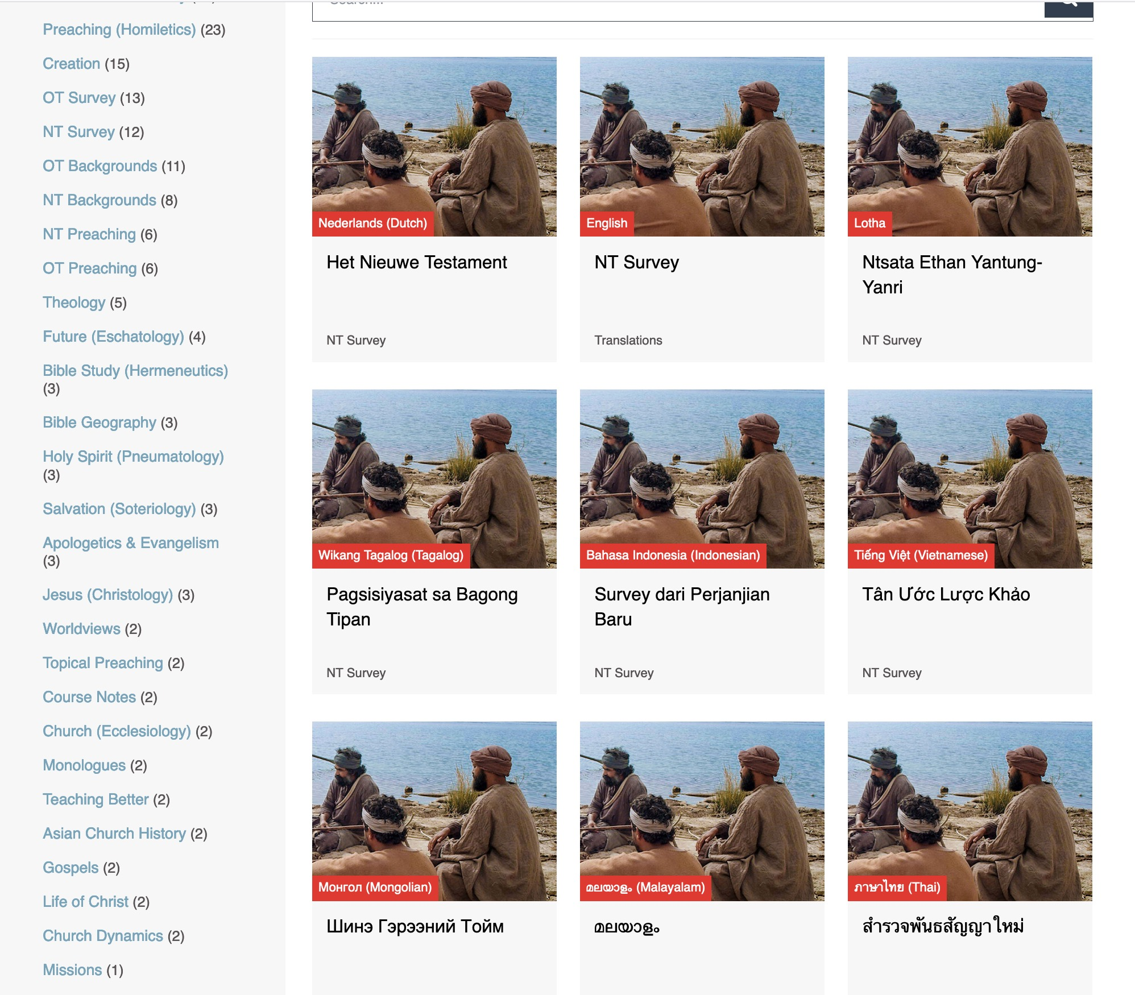
BibleStudyDownloads.org
7
Translations
Notes:
Here are 9 languages featured.

Slide 107
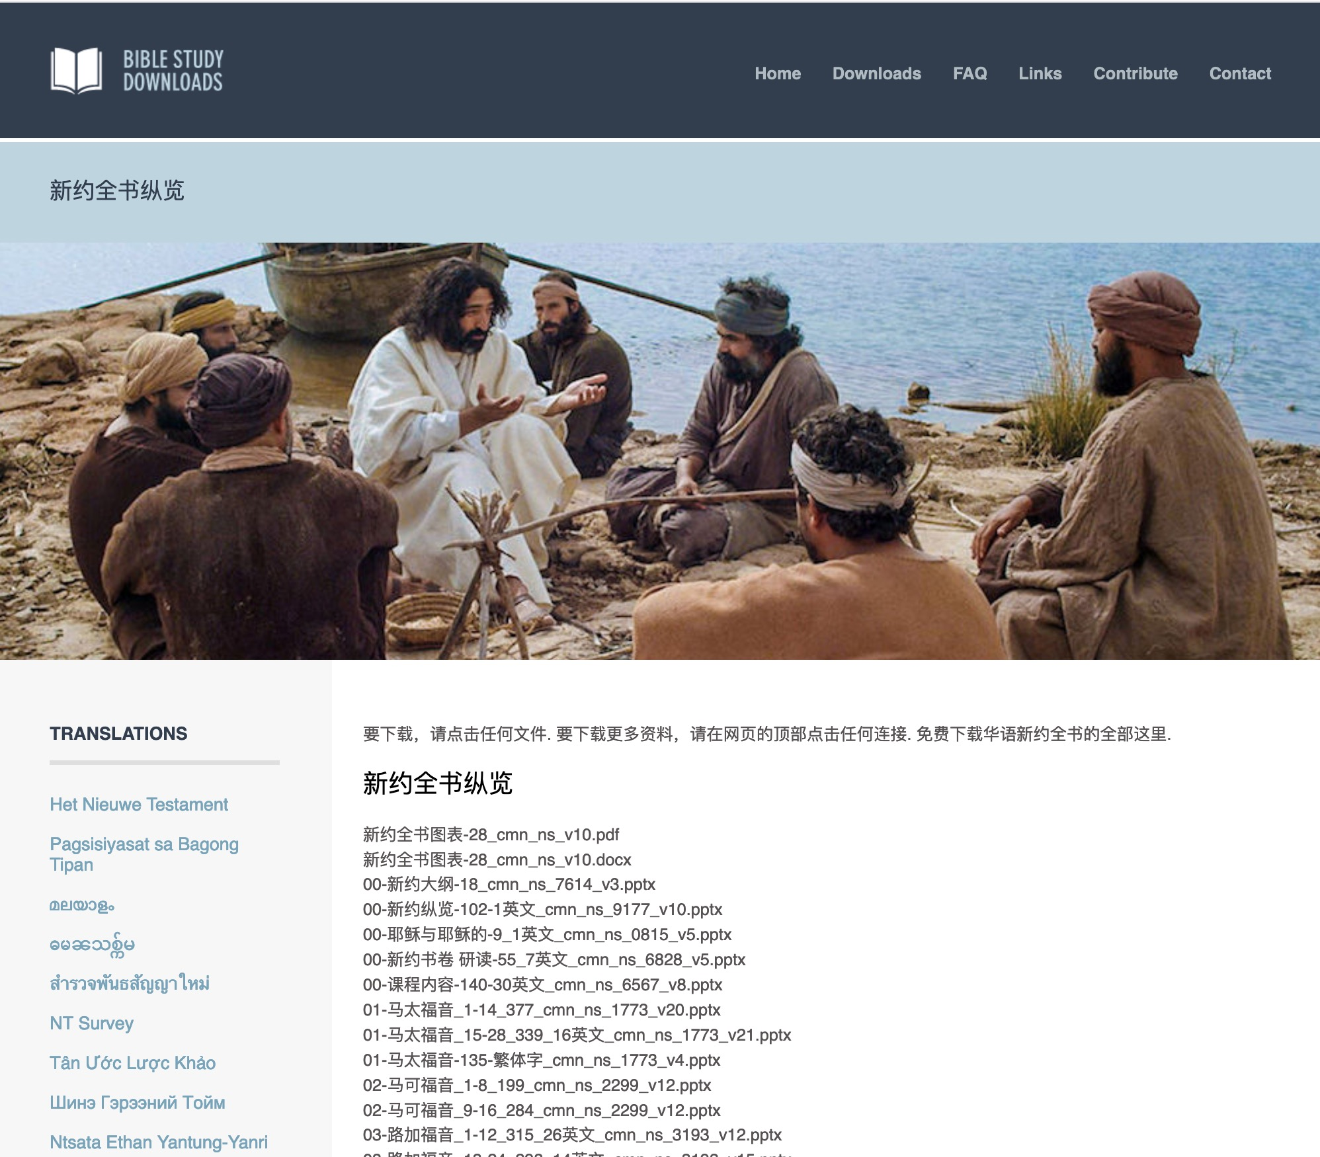
Chinese
7
01-马太福音_1-14_377_cmn_ns_1773_v20.pptx
Notes:
Chinese downloads include more than 37,000 slides as of Jan 2020.

Slide 108
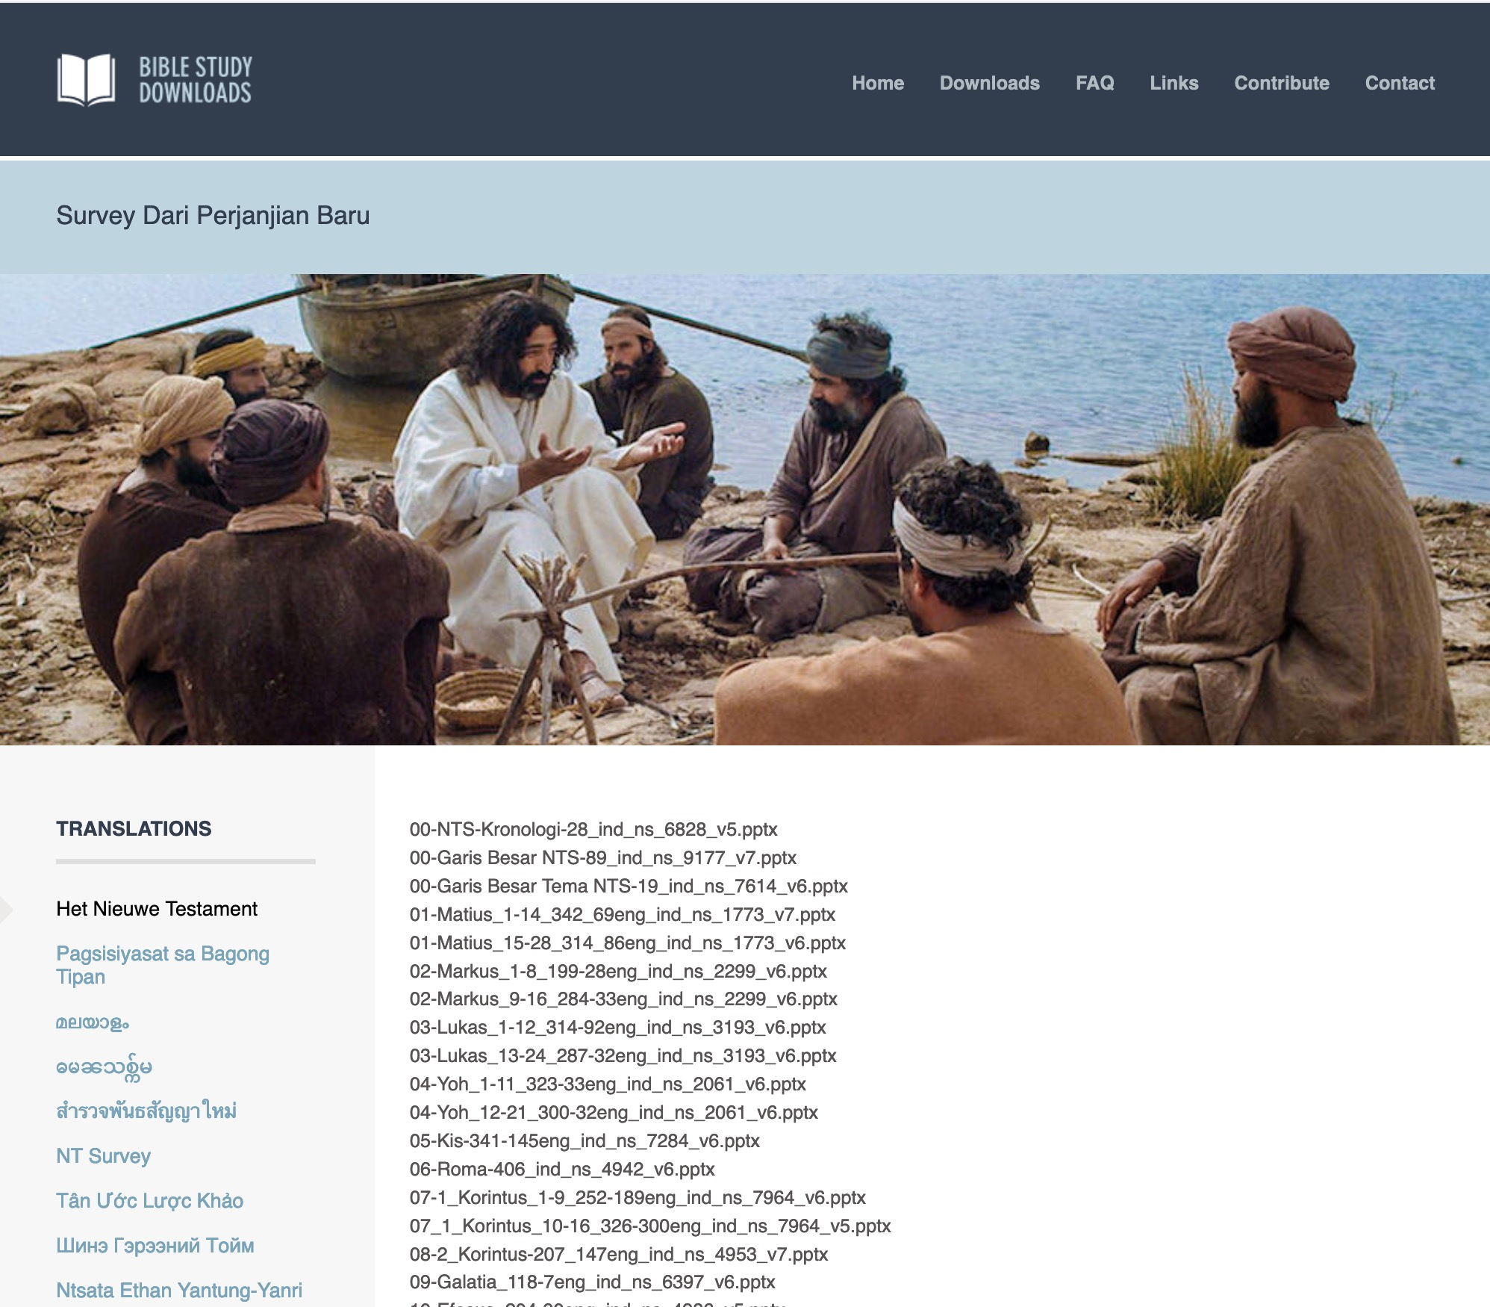
Indonesian
7
Notes:
Indonesian downloads include more than 14,000 slides as of Jan 2020.

Slide 109
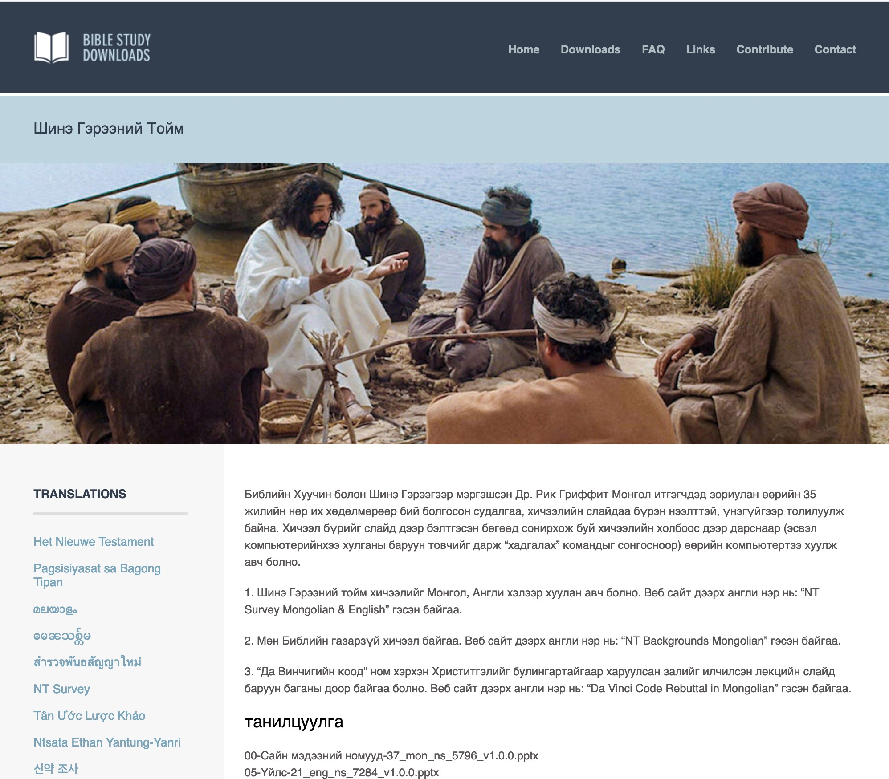
Mongolian
7
Notes:
Mongolian downloads include more than 3,000 slides as of Jan 2020.

Slide 110
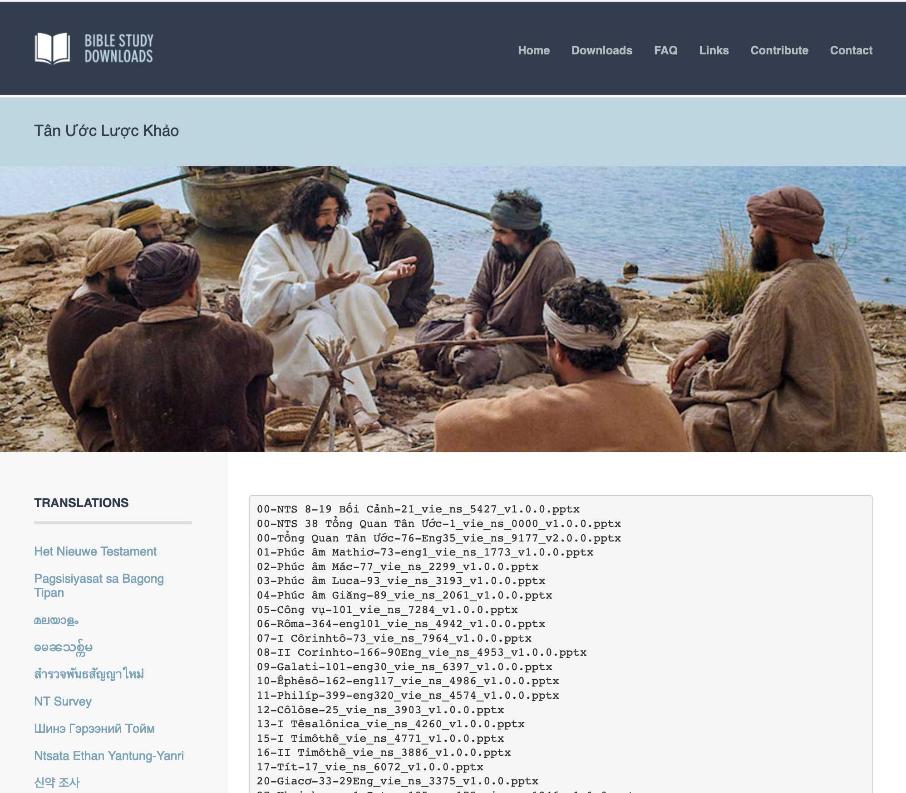
Vietnamese
7
Notes:
Vietnamese downloads include more than 8,000 slides as of Jan 2020.

Slide 111
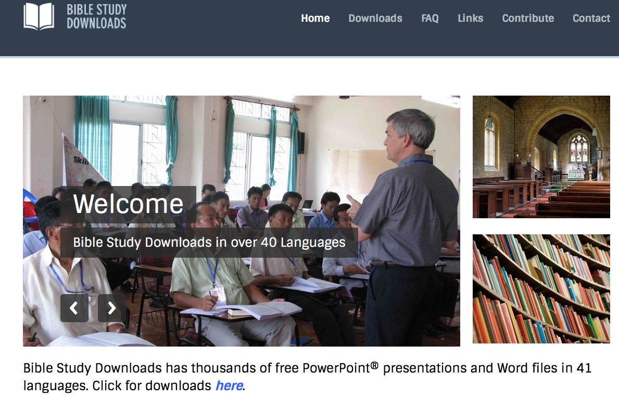
BibleStudyDownloads.org
7
Notes:
This has resulted in Bible teaching and study materials—mostly PowerPoint—in 42 languages! All a teacher needs to do is to click on a file and it downloads for free to teach any book of the Bible and many other subjects.

Slide 112
Ministries God Gave Us
WorldVenture Singapore field leader
Singapore Bible College Bible & preaching professor
Singapore Bible College Doctor of Ministry director
Adjunct Professor teaching in 12 nations
The Bible…Basically translation director
BibleStudyDownloads.org web author
Crossroads International Church pastor-teacher

Slide 113
Teaching 1997-2021
MONGOLIA
JORDAN
KOREA
CHINA
NEPAL
MYANMAR
INDIA
THAILAND
VIETNAM
MALAYSIA
SRI LANKA
SINGAPORE
SBC
INDONESIA
Notes:
From 1997-Dec 2020 God has seen fit to grant me the privilege to train pastors in 12 other countries on 73 trips. Often pastors in the US team-teach with me on these trips. To help the poor, I avoid the wealthy countries where listeners can pay an honorarium but instead raise the funds to pay my own way and then teach for free.

Slide 114
Course Description
1
A survey of the message of each of the 27 New Testament books,
their relationships to each other,
introductory issues (author, date, occasion, uniqueness, etc.) and
factors in the first century church (e.g. chronology and history) that influenced the life and ministry of the early church as well as affect the mission of the church today

Slide 115
Course Objectives
1
By the end of this course the student will be able to…
A. State the author, date, origin, recipients, occasion, characteristics, relevance and argument of all 27 NT books.
B. Place each of the NT books in chronological order in conjunction with the Book of Acts, Roman history, and Jewish history.
C. Teach the basic content of the course in English and/or prepare for this in one's native language.
D. Know from experience the value of Internet learning to know how to learn from the net.

Slide 116

Internet Advantages
7
Interest
Better Learning
Equipping Others
Saves Time

Slide 117
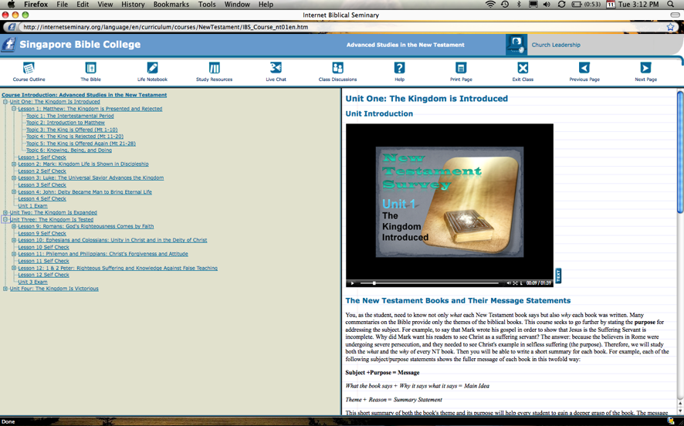

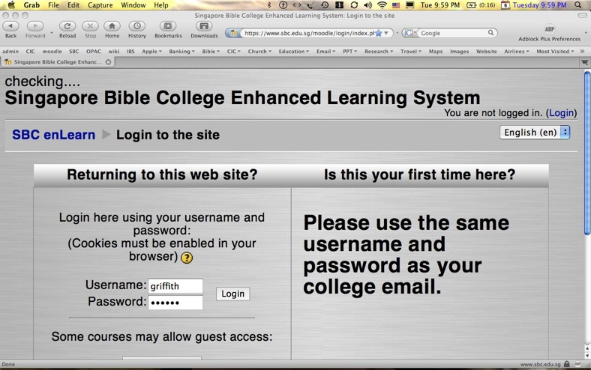
Our Three Websites
Internet Biblical Seminary
(Reading)
BibleStudyDownloads.org
(Downloads)
SBC Moodle
(Quizzes)

Slide 118
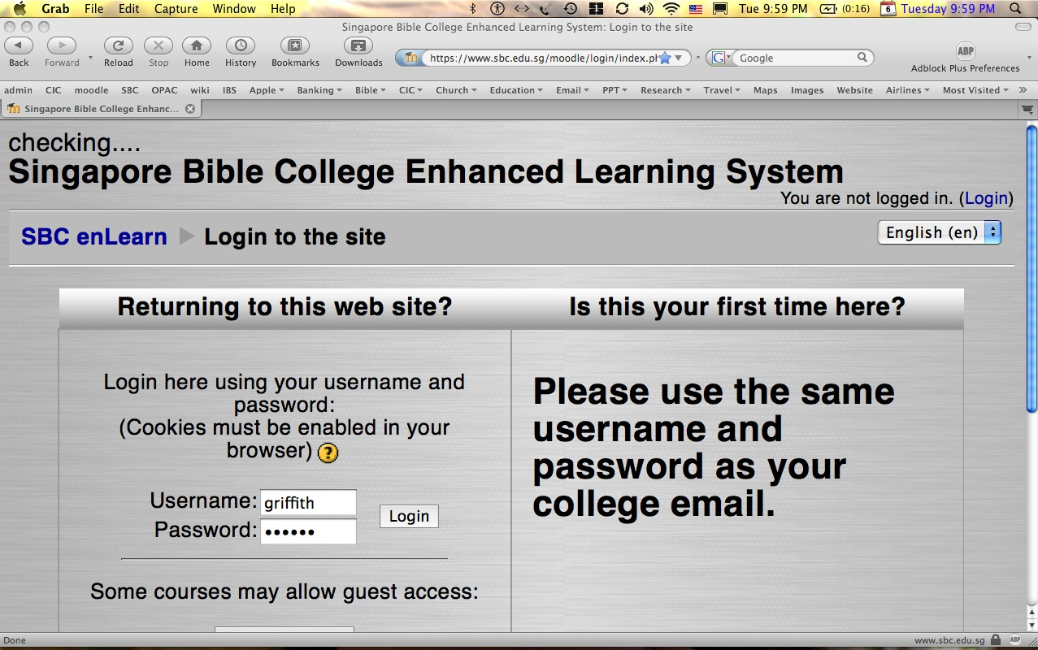
How to Get on Moodle…
1
Log on at sbc.edu.sg/moodle/login/index.php
Type your SBC email address
Type your SBC password
Click on the NT Survey course
Take your quiz or post a message

Slide 119


All Quizzes and Exams are Closed Book!
Quizzes are over the reading.
Exams are over the notes.
Notes:
Quizzes are over the reading.
Exams are over the course notes.

Slide 120

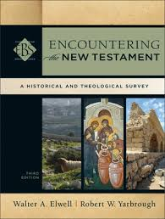
MPrep/BCM/GDC/MAC (3-hour) Requirements
1-3
Readings (25%) 15 hrs.
Quizzes (25%) 5 hrs.
Project (25%) 15 hrs.
Final Exam (25%) 5 hrs.

Slide 121
GDCS
(2-credit hour) Requirements
1-3
Readings (33%) 15 hrs.
Project (33%) 15 hrs.
Final Exam (33%) 5 hrs.

Slide 122

Advantages
1-3
More comprehensive
Interactive
Variety vs. reading books in other courses
IBS
Reading
Decision
Other viewpoints
No wireless needed
More backgrounds in chapter 2
ENT

Slide 123
Project Decision Flowchart
1-3
IBS
Life Notebook
Reading
Decision
Project
Decision
Translate
ENT
Teach
Write Paper

Slide 124
NTS Sign Up List
Name | HP | Email | Reading |  | Project & Language
 |  |  | A: IBS | B: ENT | 1: NTS | 2: TBB | 3: Teach | 4: Paper
X | X | X | X
X | X | X |  | X | X
X | X | X |  | X |  | X
X | X | X |  | X |  |  | X
X | X | X |  | X |  |  |  | X
Name | Email | Degree | Project

Slide 125
Other Matters
7
Copying Class Notes
Contacting Me
At SBC box L19 or office phone (6559-1513)
Home address is Block 2-302
Mobile number: 9113-7090
My office hours are after chapel (Wed, Thur & Fri)
E-mail: griffith@sbc.edu.sg
Let's have lunch too!

Slide 126
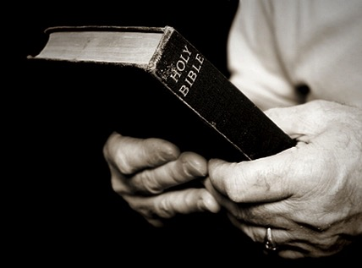
Course Design
7
Sequence (Scriptural)
  used by Jensen, Guthrie, Wilkinson & Boa, class notes

Slide 127
The New Testament Bookshelf
22
The Gospels
History
Matthew
Mark
Luke
John
Acts
Letters by Paul
1 Thessalonians
2 Thessalonians
1 Corinthians
2 Corinthians
Philippians
Ephesians
Colossians
1 Timothy
Romans
Galatians
2 Timothy
Philemon
Titus
General Letters
Prophecy
Hebrews
1 Peter
2 Peter
1 John
2 John
3 John
James
Jude
Revelation
Notes:
What overall observations can you make in your small group for the NT?
• There are 5 parts to the NT (grouped by category)
• 4 versions of Christ's life but only one of the church
• The shortest English book names in the NT are the gospels (except Matt.) and Jude
• 21 of the NT writings are letters (especially by Paul)—i.e., the NT speaks to life experience
• 6 of Paul's 13 letters are to people he wrote twice (1-2 Cor., 1-2 Thess., 1-2 Tim.)
• Any NT book ending in "ans" is by Paul (and is one of the first 8 in the canonical order)
• 2 groupings (general epistles & gospels) named after their authors while Paul's after their recipients

Slide 128






The New Testament “Building”
21
Paul''s Letters to Pastors
 | 1 Timothy | 2 Timothy | Titus |  | Philemon
Paul’s Letters to Churches | 2 Thessalonians |  |  |  | Revelation | General Letters
 | 1 Thessalonians |  |  |  | Jude
 | Colossians |  |  |  | 3 John
 | Philippians |  |  |  | 2 John
 | Ephesians |  |  |  | 1 John
 | Galatians |  |  |  | 2 Peter
 | 2 Corinthians |  |  |  | 1 Peter
 | 1 Corinthians |  |  |  | James
 | Romans |  |  |  | Hebrews
 | Acts
 | Matthew | Mark |  | Luke | John
Historical Books
Adapted from Walk Thru the Bible
Notes:
What overall observations on the NT can you make from this diagram?
Gospels and Acts form the primary and secondary foundations of the NT.
On the historical foundation are two pillars of 9 books each.
Paul's letters to churches in the left pillar all fit into Acts.
Paul didn't write any inspired letters to churches after Acts.
Pauline letters are named after recipients while General after authors (except Hebrews)
The four gospels are named after their authors.
Every book that ends in "ns" is Pauline
All Pastoral Epistles begin with "T”
______
General Epistles came after Acts (except James).
Each of the 2 pillars begin with a foundational book: Romans & Hebrews (also their longest).
Both pillars also end up in books that primarily deal with eschatology: 2 Thess and Revelation.
Instruction to the leaders comprise only 4 books (i.e., the NT addresses the average Christian).
Only 4 NT books are written to an individual (i.e., the NT is corporate, not individualistic).
Each 1st of multiple letters (1-2 Cor., 1-2 Thess., etc.) is longer & more theologically significant.
The “building” is chronologically clockwise.
________
Three sections all have 9 books: 9 Historical/Pastoral + 9 Pauline + 9 General.
Audiences of the Pauline column had more Jews than the Gentile readers of the General column.
Pauline letters addressed early Christians when eyewitnesses to Jesus lived but General letters mostly addressed second generation believers.
The NT foundation rests on books about the life of Christ, as Jesus is the focus of the NT.
----- Meeting Notes (11/1/18 20:47) -----
Depicts growth in maturity

Slide 129

Observations on NT Structure
21
Gospels and Acts are the primary and secondary historical and theological foundations of the NT.
The four gospels are named after their authors.
The historical/theological foundation has two pillars built on it that comprise 9 books each.
Paul's letters to churches in the left pillar all fit into Acts chronologically.
Paul wrote no letters to churches after Acts.
Pauline letters are named after recipients while General letters after authors (except Hebrews)
Every book that ends in "ns" is Pauline.
All Pastoral Epistles begin with "T" (1-2 Tim.; Tit.)

Slide 130
Observations on NT Structure
21
General Epistles came after Acts (except James).
Each of the 2 pillars begin with a foundational book: Romans & Hebrews (also their longest).
Both pillars also end up in books that primarily deal with eschatology: 2 Thess and Revelation.
Instruction to the leaders comprise only 4 books (i.e., the NT addresses the average Christian).
Only 4 NT books are written to an individual (i.e., the NT is corporate, not individualistic).
Each 1st of multiple letters (1-2 Cor., 1-2 Thess., etc.) is longer & more theologically significant.
The “building” is chronologically clockwise.

Slide 131
Observations on NT Structure
21
Three sections all have 9 books: 9 Historical/Pastoral + 9 Pauline + 9 General.
Paul's audiences were both Jews & Gentiles but the General letters had Jews alone in Hebrews & James though the church was more Gentile then.
Pauline letters addressed early Christians when eyewitnesses to Jesus lived but General letters mostly addressed second generation believers.
The NT foundation rests on books about the life of Christ, as Jesus is the focus of the NT.

Slide 132
Course Design
7
Sequence (Scriptural)
  used by Jensen, Guthrie, Wilkinson & Boa, class notes
Author (Biographical)
  used by Hiebert (vols. 1, 3)

Slide 133
Authors of the New Testament
13
Name | Nationality | Home Town | Occupation | Relation-ships | Chapters Written | Verses Written | Books Written
Matthew | Jew | Capernaum | Tax Collector | Apostle of Jesus Christ | 28 | 1,071 | Gospel of Matthew
Mark | Jew / Roman | Jerusalem | Missionary | Disciple of Peter | 16 | 678 | Gospel of Mark
Luke | Greek | Antioch | Physician | Disciple of Paul | 52 | 2,158 | Gospel of Luke Acts
John | Jew | Bethsaida or Capernaum | Fisherman | Apostle of Jesus Christ | 50 | 1,414 | Gospel of John 1 John 2 John 3 John Revelation

Slide 134
Authors of the New Testament
13
Name | Nationality | Home Town | Occupation | Relation-ships | Chapters Written | Verses Written | Books Written
Paul | Jew | Tarsus | Tentmaker | Apostle of Jesus Christ | 87 (100)* | 2,033 (2,336)* | Romans 1 Corinthians 2 Corinthians Galatians Ephesians Philippians Colossians Philemon 1 Thess. 2 Thess. 1 Timothy 2 Timothy Titus (Hebrews?)
*Indicates total if Hebrews is assigned to Paul.

Slide 135
Authors of the New Testament
13
Name | Nationality | Home Town | Occupation | Relation-ships | Chapters Written | Verses Written | Books Written
James | Jew | Nazareth | Carpenter? | Brother of Jesus Christ | 5 | 108 | James
Peter | Jew | Bethsaida | Fisherman | Apostle of Jesus Christ | 8 | 166 | 1 Peter 2 Peter
Jude | Jew | Nazareth | Carpenter? | Brother of Jesus Christ | 1 | 25 | Jude

Slide 136
Course Design
7
Sequence (Scriptural)
  used by Jensen, Guthrie, Wilkinson & Boa
Author (Biographical)
  used by Hiebert (vols. 1, 3)
Content (Theological)
  used by Hiebert (vol. 2)

Slide 137
NT Book Key Words
24
Date | Book | Key Word | Paul's Life | Key Doctrine
40s | Matthew | Kingdom |  | Ecclesiology
44-47 | James | Works |  | Soteriology
49 | Galatians | Justification | 1st journey | Soteriology
51 | 1 Thessalonians | Rapture | 2nd journey | Eschatology
51 | 2 Thessalonians | Tribulation | 2nd journey | Eschatology
56 | 1 Corinthians | Sanctification | 3rd journey | Ecclesiology
56 | 2 Corinthians | Apostleship | 3rd journey | Ecclesiology
56-57 | Romans | Righteousness | 3rd journey | Soteriology
57-59 | Luke | Sovereignty I |  | Missiology

Slide 138
NT Book Key Words
24
Date | Book | Key Word | Paul's Life | Key Doctrine
60 | Ephesians | Unity | 1st imprisonment | Christology (Head)
61 | Colossians | Deity | 1st imprisonment | Christology (God)
61 | Philemon | Forgiveness | 1st imprisonment | Christology (Reconciler)
62 | Philippians | Attitude | 1st imprisonment | Christology (Example)
62 | Acts | Sovereignty II |  | Missiology
62 | 1 Timothy | Order | 4th journey | Ecclesiology
64 | 1 Peter | Suffering |  | Eschatology
64 | 2 Peter | Knowledge |  | Eschatology
64-68 | Mark | Discipleship |  | Eschatology

Slide 139
NT Book Key Words
24
Date | Book | Key Word | Paul's Life | Key Doctrine
66 | Titus | Conduct | 4th journey | Ecclesiology
67 | 2 Timothy | Doctrine | 2nd imprisonment | Ecclesiology
67-68 | Hebrews | Superiority |  | Christology
c. 69 | John | Belief |  | Soteriology
75 | Jude | Pretenders |  | Eschatology
85-95 | 1 John | Love |  | Soteriology
85-95 | 2 John | Limits |  | Missiology
85-95 | 3 John | Missionaries |  | Missiology
95-96 | Revelation | Triumph |  | Eschatology

Slide 140
Course Design
7
Sequence (Scriptural)
  used by Jensen, Guthrie, Wilkinson & Boa
Author (Biographical)
  used by Hiebert (vols. 1, 3)
Content (Theological)
  used by Hiebert (vol. 2)
Time (Chronological)
  used by Tenney
  We will follow this method after studying the gospels and Acts to see the books in their historical context.

Slide 141
NT Overview
38
124
39-41
"To the remotest part of the earth" (Acts 1:8)
Acts 9 13 14 15 16 18 21 27 28
Apr 48-
Sep 49
1
Galatia
Apr 50-
Sep 52
2
Aegean
Spr 53-
May 57
3
Asia
Feb 60-
Mar 62
1
Rome
Spr 62-
Fall 67
4
Spain
Aut 67-
Spr 68
2
Rome
Summer
35-37
Damascus
Antioch
May 57-
Aug 59
Trials
Fall 49
The
Council
Spring 68
Expansion of Church
35 48 49 50 52 53 57 60 62 67 68 95
Matt
Luke
Acts
Mark
John
Gal
1 Thess
1 Cor
Eph
1 Tim
2 Tim
Jude
James
2 Thess
2 Cor
Col
Titus
Heb
1 John
Romans
Philem
1 Pet
2 John
Gospels & Acts
Phil
2 Pet
3 John
Pauline Epistles
1234
Journeys
Rev
General Epistles
Rome
Imprisonments
No Animations
Notes:
----- Meeting Notes (1/18/11 09:05) -----
All 3 categories in 40s regarding Jews
Gospels spread out with Acts between 1-2 and 3-4
Pauline (1) only to AD 68, (2) to Pastors later & (3) before General
Journey # same as # of books in that journey
Shorter journeys have less letters
Asia reached before Europe

Slide 142
Black
1
4
2
5
3
6

Slide 143

NT Survey link at BibleStudyDownloads.org
Get this presentation for free!

