Slide 1
Be Reputable
Titus
Dr. Rick Griffith • Crossroads International Church Singapore
BibleStudyDownloads.org

Slide 2
Pastor Jarrid Wilson Harvest Christian Fellowship Riverside, California

Slide 3
Another Pastor…
Notes:
To add to the many US pastors who have already taken their own lives in recent years, megachurch pastor and mental health advocate Jarrid Wilson died by suicide on Monday (9 Sep 2019). He served at Harvest Christian Fellowship in California with Greg Laurie, a popular evangelical leader.

Slide 4
Struggles are Real
It's been said that 1 in every 4 pastors struggles with depression. Lifeway Research reveals that the number of pastors diagnosed with clinical depression was double the national average. Forty five percent sought advice from their family doctor regarding stress and anxiety issues. Nearly one-fourth of all pastors (23 percent) acknowledge having "personally struggled with mental illness," and half of those pastors say the illness has been diagnosed.
—Charisma News 29 Aug 2018—
Notes:
YEAR IN REVIEW: Wife of Beloved Pastor Who Committed Suicide Speaks Out
1:00PM EDT 8/29/2018 Jessilyn Lancaster
https://www.charismanews.com/us/72893-wife-of-beloved-pastor-who-committed-suicide-speaks-out

Slide 5
Are Christians any better off?
Notes:
It makes one wonder if Christianity really works, doesn’t it? Of course, we know Jesus truly changes lives, but it makes me sad to see so many who don’t see that reality in their lives. So what the problem, then? Pastor Wilson got caught up in false teaching—the lie that he and his family would be better off if he was dead instead of alive.

Slide 6
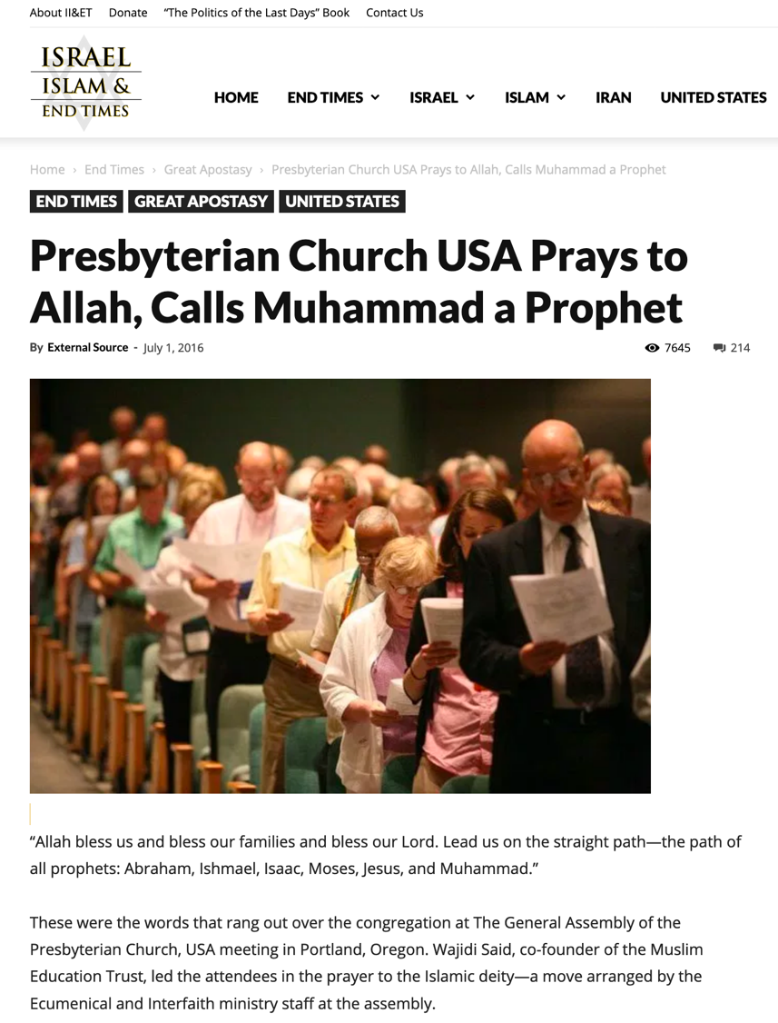
False Teaching
“Allah, bless us and bless our families and bless our Lord. Lead us on the straight path—the path of all the prophets: Abraham, Ishmael, Isaac, Moses, Jesus and Muhammad.”
Notes:
One key problem is the false teaching all around us. In 2016, the Presbyterian Church USA even prayed to Allah…
—————————
https://israelislamandendtimes.com/presbyterian-church-usa-prays-to-allah-calls-muhammad-a-prophet/?utm_campaign=shareaholic&utm_medium=facebook&utm_source=socialnetwork&fbclid=IwAR2mraG6FYMzzkflfKLhp5eHjvzjgyYMNRTYjuSwVgOV6CD9xLqtETAsXao
Accessed 14 July 2019

Slide 7
False Teaching Today
God heals all with real faith?
Wealth is our divine right?
Lord’s Supper healing?
Notes:
We see false teaching even closer to home with churches right here who teach that God heals all who have real faith—and that God is obligated to make us wealthy—and that taking the Lord’s Supper will lead to healing! So how do we respond in such an environment?

Slide 8
Key Word
241
Conduct
Titus
Notes:
Paul’s letter to Titus tells us that a key proper response to false teaching is our conduct—

Slide 9
Theme
23
Sound Conduct Against Opposition
Titus

Slide 10
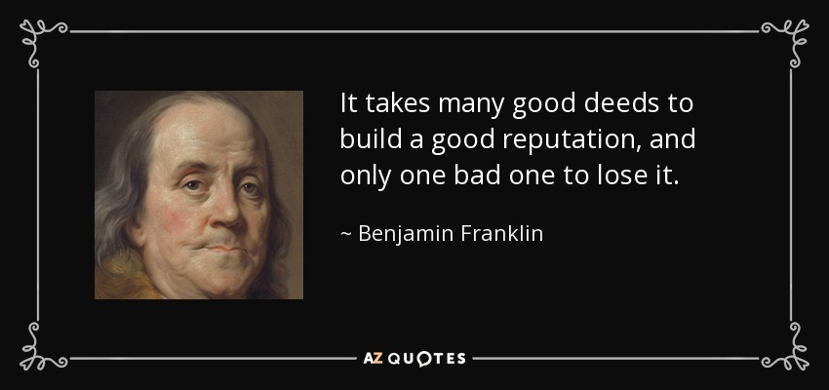
Be Reputable
It takes many good deeds to build a good reputation, and only one bad one to lose it.
—Benjamin Franklin
Notes:
In short, as my message title indicates, “Be Reputable.” Ben Franklin noted aptly…

Slide 11
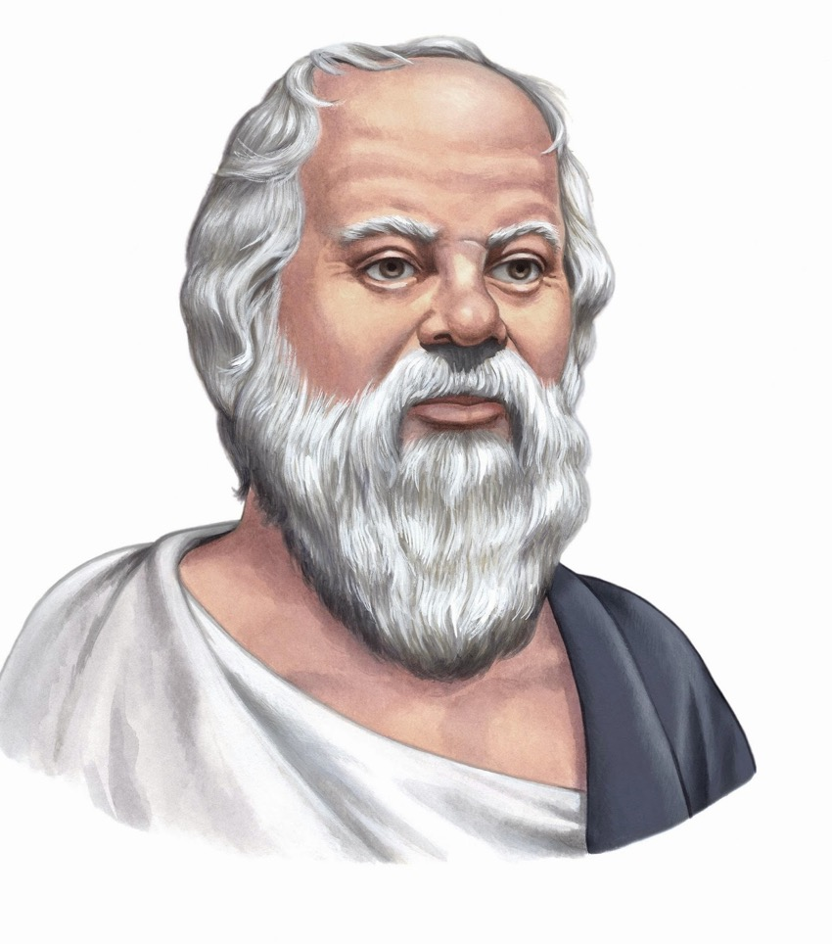
Reputation
The way to gain a good reputation is to endeavor to be what you desire to appear.
—Socrates
Notes:
So what happens when we actually do this?

Slide 12
Results of Reputable Conduct
“that the word of God may not be reviled” (Titus 2:5)
“that an opponent may be put to shame, having nothing evil to say about us” (Titus 2:8)
“adorn the doctrine of God our Savior” (Titus 2:10)
Notes:
In Paul’s letter to Titus, we see many results of reputable conduct…

Slide 13
Key Word / Verse
Titus
241
Key Word
Conduct
Key Verse
"This is a trustworthy saying. And I want you to stress these things, so that those who have trusted in God may be careful to devote themselves to doing what is good. These things are excellent and profitable for everyone" (Titus 3:8).
Notes:
Here is another fantastic result of good conduct!

Slide 14
Character is who you really are. Reputation is who others think you are.
How’s your reputation? Are you known by unbelievers as a follower of Jesus?
Do you wish everyone in this church had the same reputation that you have?
How well does your reputation show the love of the Lord Jesus?
Notes:
So how are you doing at this?

Slide 15
How can we be reputable in the midst of so much false teaching today?
Notes:
How can we stand true to the Lord with so many heresies plaguing the church?

Slide 16
NT Overview (Paul's Letters)
38 124 39-41
“To the remotest part of the earth” (Acts 1:8)
Acts 9 13 14 15 16 18 21 27 28
Apr 48- Sep 49
1 Galatia
Apr 50- Sep 52
2 Aegean
Spr 53- May 57
3 Asia
Feb 60- Mar 62
1 Rome
Spr 62- Fall 67
4 Spain
Aut 67- Spr 68
2 Rome
Summer 35- 37
Damascus Antioch
May 57- Aug 59
Trials
Fall 49
The
Council
Spring 68
Expansion of Church
35 48 49 50 52 53 57 60 62 67 68 95
Matt
Luke
Acts
Mark
John
Gal
1 Thess
1 Cor
Eph
1 Tim
2 Tim
2 Thess
2 Cor
Col
Titus
Missionary
Pastoral
Romans
Philem
Gospels & Acts
Phil
Pauline Epistles
1234
Journeys
Prison
Rome
Imprisonments
Pauline
Notes:
We are reaching the end of our study of Paul’s letters with only 2 Timothy left.
——————————
Observations about chronology:
Gospels not written first but throughout NT era
Evangelistic letters preceded pastoral
Rough letter (Galatians) preceded smoother ones

Slide 17
Pastoral Epistles
1 Timothy
Titus
2 Timothy
1 Timothy = personal, urgent, doctrinal emphasis
Titus = less urgent, practical emphasis
2 Timothy = personal, urgent, focus on the Word
Notes:
These last three letters of Paul are called the Pastoral Epistles.
They show the most advanced theology of local church life and shepherding the flock—but this makes sense since Paul and the church had learned much in the previous 30 years since the church had begun.
Sadly, most NT scholars today do not believe that Paul wrote these letters and many date them in the second century. I guess they think that Paul was a slow learner!

Slide 18
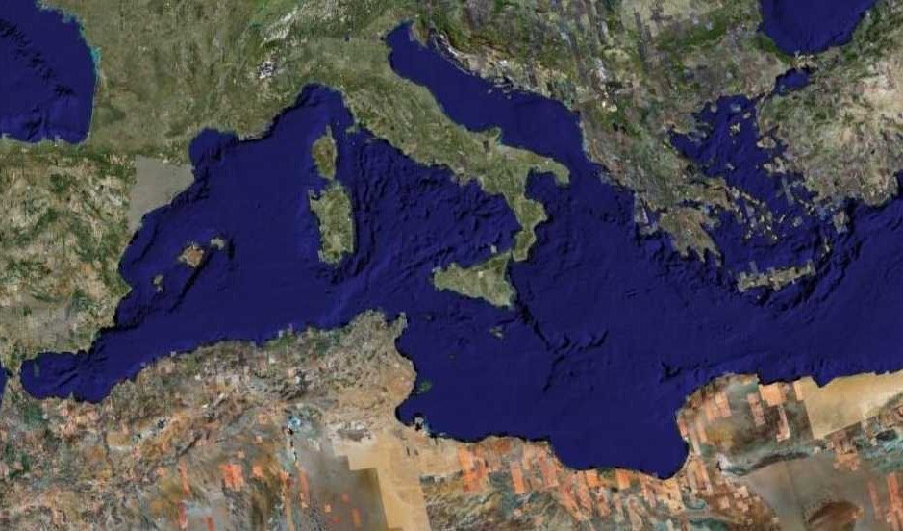
Fourth Missions Trip
1-2 Timothy & Titus After Acts
Spring 62 – Fall 67
Notes:
Paul had finished reaching the Eastern Roman Empire by the time he wrote Titus—and even had just returned from Spain.
—————
Freedom from Imprisonment Spring 62–Fall 67
Paul in Ephesus and Colosse (Timothy left at Ephesus) Spring–Summer 62
Peter travels to Rome 62
Paul in Macedonia late summer 62-winter 62/63
1 Timothy written from Macedonia to Timothy in Ephesus Fall 62
Paul in Asia Minor Spring 63-Spring 64
Paul in Spain (anticipated in Rom. 15:24) Spring 64-Spring 66
Christians persecuted by Nero; Peter martyred Summer 64
Paul in Crete (Titus left there; Tit 1:5) early Summer 66
Paul in Asia Minor Summer- Fall 66
Titus written from Asia Minor to Titus in Crete Summer 66
Paul in Nicopolis (Tit 3:12) Winter 66/67
Paul in Troas (2 Tim 4:13), Macedonia and Greece Spring– Fall 67
Second Roman Imprisonment Fall 67–Spring 68
Paul arrested and brought to Rome Fall 67
2 Timothy written from Rome to Timothy in Ephesus Fall 67
Paul beheaded Spring 68

Slide 19
GRACE
Paul’s post-Acts journeys
Ephesus
"For this reason I left you in Crete, that you would set in order what remains and appoint elders in every city as I directed you" (Titus 1:5 NAU).
Sound Doctrine –––––– Healthy Teaching
Letter to Titus
False Teacher
Island of Crete
Notes:
After leaving Paul in Crete with newly planted church, he told him in 1:5, "For this reason I left you in Crete, that you would set in order what remains and appoint elders in every city as I directed you."

Slide 20
Crete was beautiful but had a poor reputation
Notes:
So how could the believers there live out the Christian life in such a pagan place?

Slide 21
How can we be reputable in the midst of so much false teaching today?
3 ways in Titus…
Notes:
And how can we stand true to the Lord with so many heresies plaguing the church?

Slide 22
Summary Chart
Titus
241
Sound Conduct Against Opposition
Sound Conduct Against Opposition
Appoint Elders
Appoint Elders
Set Things in Order
Set Things in Order
Prevent False Doctrine
Prevent False Doctrine
Practice True Doctrine
Practice True Doctrine
Elders vs. False Teachers
Elders vs. False Teachers
Conduct
for Various Groups
Conduct
for Various Groups
Grace
Leads to Godliness
Grace
Leads to Godliness
Chapter 1
1
2:1-10
2:1-10
2:11–3:15
2:11–3:15
Organize
Organize
Teach
Teach
Grace
Grace
Truth Leads to Godliness
1:1-4
Truth leads to godliness
1:1-4
Elders
1:5-16
Elders
1:5-16
Older Men
2:1-2
Older Men
2:1-2
Older Women
2:4-5
Older Women
2:4-5
Younger Women
2:4-5
Younger Women
2:4-5
Younger
Men
2:6-8
Younger
Men
2:6-8
Slaves
2:9-10
Slaves
2:9-10
Educates
2:11-15
Educates
2:11-15
Empowers
3:1-2
Empowers
3:1-2
Motivates
3:3-8
Motivates
3:3-8
Protects
3:9-11
Protects
3:9-11
Concl.
3:12-15
Relates
3:12-15
Asia Minor to Crete
Asia Minor to Crete
Summer AD 66
Summer AD 66
Notes:
(So what’s the first way Paul shares that we can we be reputable in the midst of so much false teaching today? It starts with the leadership where Paul says to…)

Slide 23
I. Have godly elders teach truth.
Titus 1
Notes:
Sound doctrine silences error.

Slide 24
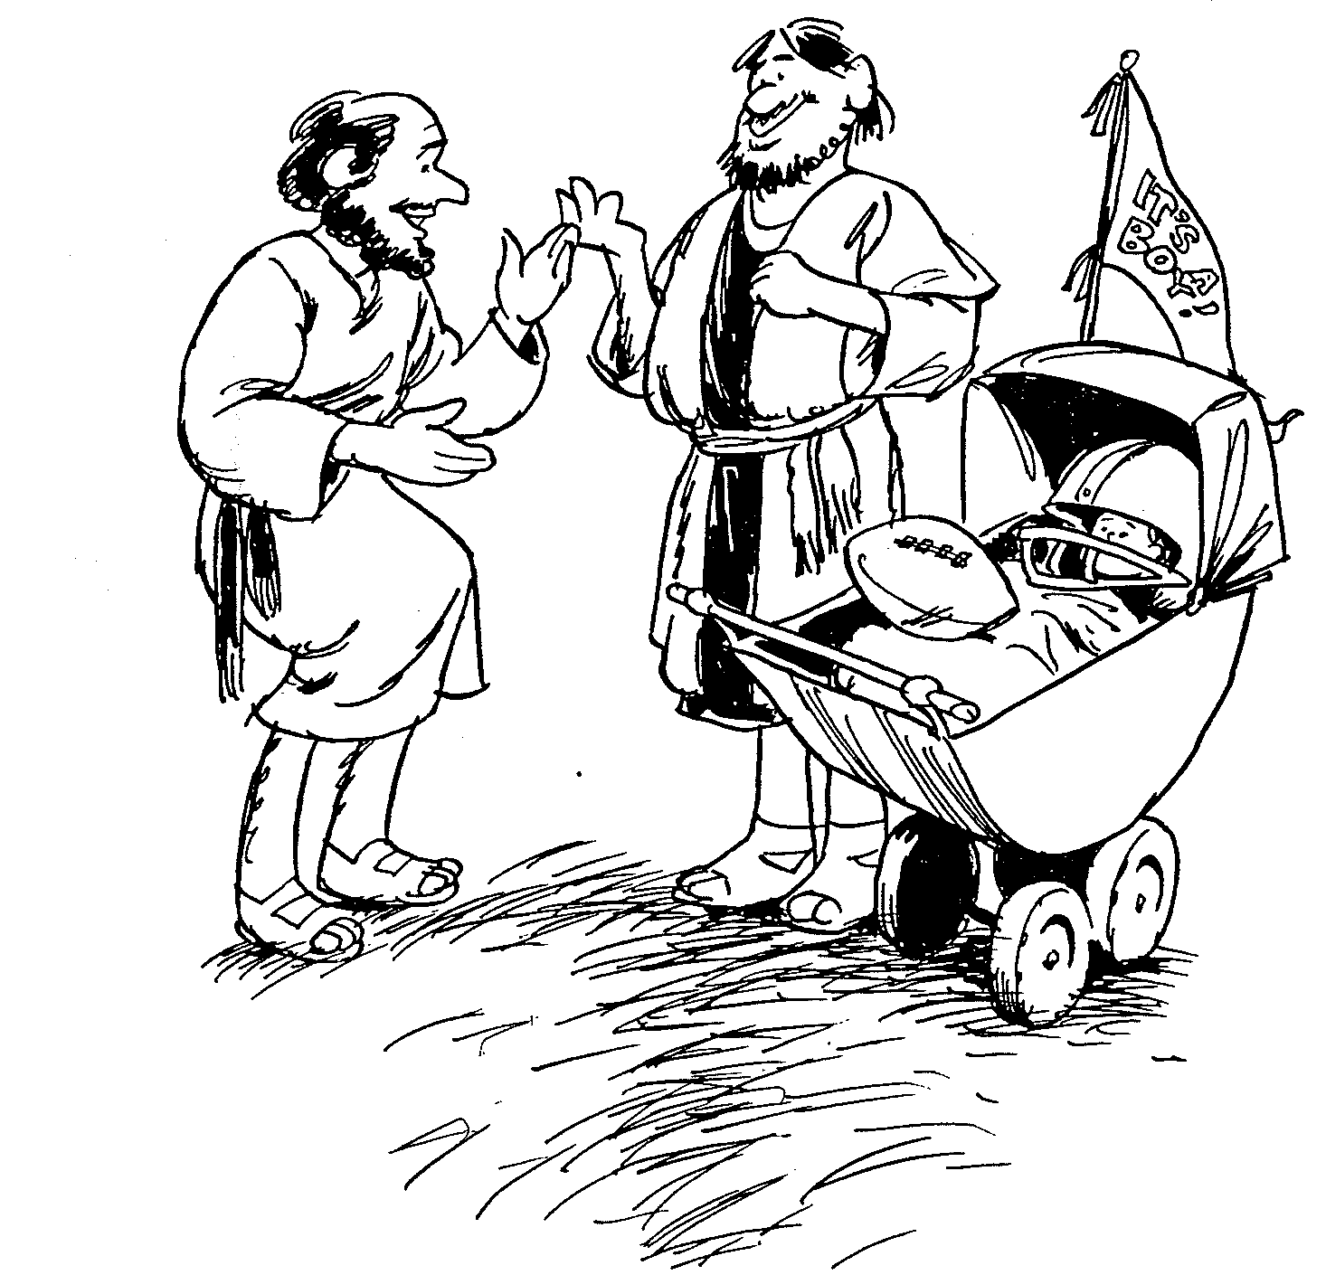
TITUS
1
2
3
Sound doctrine silences error
Order life to doctrine
Never shun good deeds
Barry Huddleston, The Acrostic Bible

Slide 25
Slides on Titus 1

Slide 26
¹ This letter is from Paul, a slave of God and an apostle of Jesus Christ. I have been sent to proclaim faith to those God has chosen and to teach them to know the truth that shows them how to live godly lives.
Titus 1:1 (NLT)
Notes:
Paul greets Titus that truth leads to godliness amidst pagans (1:1-4).

Slide 27
⁵ I left you on the island of Crete so you could complete our work there and appoint elders in each town as I instructed you.
⁶ An elder must live a blameless life. He must be faithful to his wife, and his children must be believers who don’t have a reputation for being wild or rebellious.
Titus 1:5-6 (NLT)

Slide 28
⁷ A church leader is a manager of God’s household, so he must live a blameless life. He must not be arrogant or quick-tempered; he must not be a heavy drinker, violent, or dishonest with money.
Titus 1:7 (NLT)

Slide 29
⁸ Rather, he must enjoy having guests in his home, and he must love what is good. He must live wisely and be just. He must live a devout and disciplined life.
Titus 1:8 (NLT)

Slide 30
⁹ He must have a strong belief in the trustworthy message he was taught; then he will be able to encourage others with wholesome teaching and show those who oppose it where they are wrong.
Titus 1:9 (NLT)

Slide 31
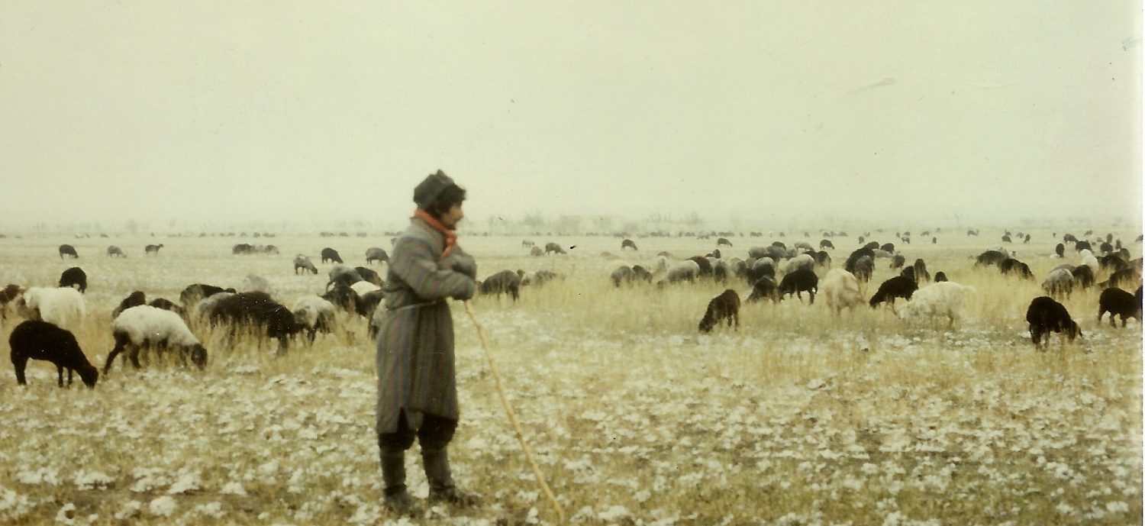
Church Leaders
Presbuteros = elderly person; wiser person
Episkopos = overseer; manager; director
Notes:
Two key concepts come together in two terms for church leaders. They are called presbuteros or elders because they are typically among the oldest and most mature members. They are also deemed episkopos or overseers as they manage or direct the affairs of the church.

Slide 32
NOT THIS
arrogant
quick-tempered
drunkard
violent
greedy for gain
THIS INSTEAD
hospitable
lover of good
self-controlled
upright
holy
disciplined

Slide 33
¹⁰ For there are many who are insubordinate, empty talkers and deceivers, especially those of the circumcision party. ¹¹They must be silenced, since they are upsetting whole families by teaching for shameful gain what they ought not to teach.
Titus 1:10-11 (ESV)

Slide 34
¹² One of the Cretans, a prophet of their own, said, “Cretans are always liars, evil beasts, lazy gluttons.” ¹³ This testimony is true. Therefore rebuke them sharply, that they may be sound in the faith,
Titus 1:12-13 (ESV)

Slide 35
¹⁴ not devoting themselves to Jewish myths and the commands of people who turn away from the truth. ¹⁵ To the pure, all things are pure, but to the defiled and unbelieving, nothing is pure; but both their minds and their consciences are defiled.
Titus 1:14-15 (ESV)

Slide 36
¹⁶ They profess to know God, but they deny him by their works. They are detestable, disobedient, unfit for any good work.
Titus 1:16 (ESV)

Slide 37
Elder-Congregation Dynamics
E l d e r s
C o n g r e g a t i o n
L
O
V
E
Regard
themselves as
servants
Regard
them as
leaders
Notes:
Having seen the structure, it is vital that the dynamics be understood.

Slide 38
I. Have godly elders teach truth.
Titus 1
Notes:
Sound doctrine silences error.

Slide 39
How can we be reputable in the midst of so much false teaching today?
Notes:
(How else can we be reputable in the midst of so much false teaching today? Well, godliness actually looks different in the various stages of life since each stage has unique temptations. So in chapter 2 Paul says you can be reputable when you…)

Slide 40
Slides on Titus 2

Slide 41
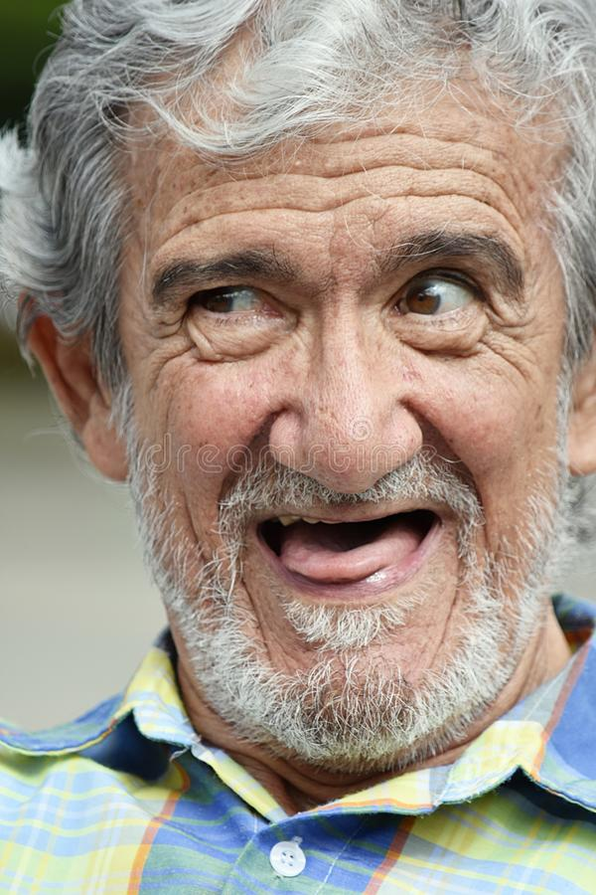
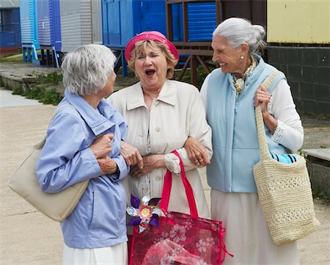
II. Act your age.
Titus 2:1-10
Notes:
Order life to doctrine.

Slide 42
TITUS
1
2
3
Sound doctrine silences error
Order life to doctrine
Never shun good deeds
Barry Huddleston, The Acrostic Bible

Slide 43
Older Men
Sober-minded
Dignified
Self-controlled
Sound in faith, love, steadfastness

Slide 44
¹ But as for you, teach what accords with sound doctrine. ² Older men are to be sober-minded, dignified, self-controlled, sound in faith, in love, and in steadfastness.
Titus 2:1-2 (ESV)

Slide 45
Older Men
Sober-minded
Dignified
Self-controlled
Sound in faith, love, steadfastness
Older Women
Reverent
Not slanderers
Not addicted to wine
Train younger women

Slide 46
³ Older women likewise are to be reverent in behavior, not slanderers or slaves to much wine. They are to teach what is good
Titus 2:3 (ESV)

Slide 47
Older Men
Sober-minded
Dignified
Self-controlled
Sound in faith, love, steadfastness
Older Women
Reverent
Not slanderers
Not addicted to wine
Train younger women
Younger Women
Love husbands & children
Self-controlled
Pure
Working at home
Submissive to husbands

Slide 48
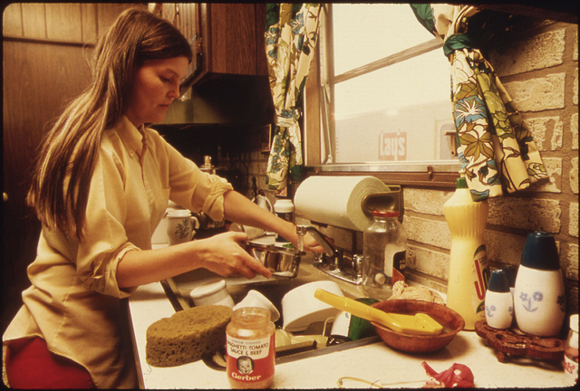
"Workers at home" (Titus 2:4-5 NLT)
"These older women must train the younger women to love their husbands and their children, ⁵to live wisely and be pure, to work in their homes, to do good, and to be submissive to their husbands. Then they will not bring shame on the word of God."

Slide 49
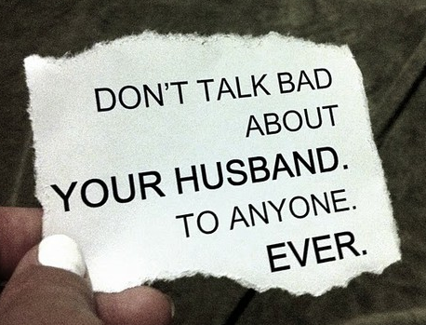
"Submit to husband" (Titus 2:4-5 NLT)
These older women must train the younger women to love their husbands and their children, ⁵to live wisely and be pure, to work in their homes, to do good, and to be submissive to their husbands. Then they will not bring shame on the word of God.
Don’t talk bad about your husband. To anyone.
Husbands must not talk bad about their wives either!
Ever.
Notes:
Translators use the text boxes and then drag them over.

Slide 50
Older Men
Sober-minded
Dignified
Self-controlled
Sound in faith, love, steadfastness
Older Women
Reverent
Not slanderers
Not addicted to wine
Train younger women
Younger Men
Self-controlled
Good works
Integrity
Dignity
Sound speech
Younger Women
Love husbands & children
Self-controlled
Pure
Working at home
Submissive to husbands

Slide 51
⁶ Likewise, urge the younger men to be self-controlled. ⁷ Show yourself in all respects to be a model of good works, and in your teaching show integrity, dignity, ⁸ and sound speech that cannot be condemned, so that an opponent may be put to shame, having nothing evil to say about us.
Titus 2:6-8 (ESV)

Slide 52
⁹ Bondservants are to be submissive to their own masters in everything; they are to be well-pleasing, not argumentative, ¹⁰ not pilfering, but showing all good faith, so that in everything they may adorn the doctrine of God our Savior.
Titus 2:9-10 (ESV)

Slide 53
How can we be reputable in the midst of so much false teaching today?
Notes:
How can we stand true to the Lord with so many heresies plaguing the church?

Slide 54
I. Have godly elders teach truth.
Titus 1
Notes:
Sound doctrine silences error.

Slide 55
II. Act your age.
Titus 2:1-10
Notes:
Order life to doctrine.

Slide 56
III. Let grace bring godliness.
Titus 2:11–3:15
Notes:
Never shun good deeds

Slide 57
TITUS
1
2
3
Sound doctrine silences error
Order life to doctrine
Never shun good deeds
Barry Huddleston, The Acrostic Bible

Slide 58
III. Let grace bring godliness.
God's grace educates believers how to choose godliness over ungodliness (2:11-15).
Titus 2:11–3:15
Notes:
Never shun good deeds

Slide 59
¹¹ For the grace of God has appeared, bringing salvation for all people, ¹² training us to renounce ungodliness and worldly passions, and to live self-controlled, upright, and godly lives in the present age,
Titus 2:11-12 (ESV)

Slide 60
¹³ waiting for our blessed hope, the appearing of the glory of our great God and Savior Jesus Christ,
Titus 2:13 (ESV)

Slide 61
¹⁴ who gave himself for us to redeem us from all lawlessness and to purify for himself a people for his own possession who are zealous for good works.
Titus 2:14 (ESV)

Slide 62
¹⁵ Declare these things; exhort and rebuke with all authority. Let no one disregard you.
Titus 2:15 (ESV)

Slide 63
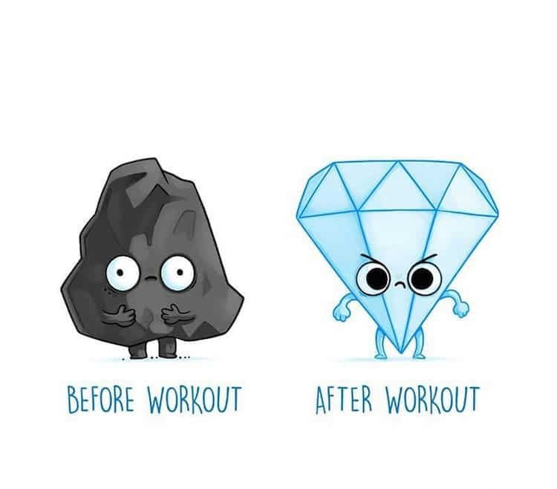
BEFORE WORKOUT
AFTER WORKOUT

Slide 64
Healthy churches focus on Christ as the source of their transformation
(Titus 2:11-15)
Before Christ
After Christ
Deceptive
Pleasure loving
Godly
Self-controlled
Pure

Slide 65
Slides on Titus 3

Slide 66
III. Let grace bring godliness.
God's grace educates believers how to choose godliness over ungodliness (2:11-15).
God's grace empowers gracious behavior before all people (3:1-2).
Titus 2:11–3:15
Notes:
Never shun good deeds

Slide 67
¹ Remind them to be submissive to rulers and authorities, to be obedient, to be ready for every good work, ² to speak evil of no one, to avoid quarreling, to be gentle, and to show perfect courtesy toward all people.
Titus 3:1-2 (ESV)

Slide 68
III. Let grace bring godliness.
God's grace educates believers how to choose godliness over ungodliness (2:11-15).
God's grace empowers gracious behavior before all people (3:1-2).
God's grace motivates good works in response to God’s mercy (3:3-8).
Titus 2:11–3:15
Notes:
Never shun good deeds

Slide 69
³ For we ourselves were once foolish, disobedient, led astray, slaves to various passions and pleasures, passing our days in malice and envy, hated by others and hating one another. ⁴ But when the goodness and loving kindness of God our Savior appeared,
Titus 3:-3-4 (ESV)

Slide 70
⁵ he saved us, not because of works done by us in righteousness, but according to his own mercy, by the washing of regeneration and renewal of the Holy Spirit, ⁶ whom he poured out on us richly through Jesus Christ our Savior, ⁷ so that being justified by his grace we might become heirs according to the hope of eternal life.
Titus 3:5-7 (ESV)

Slide 71
⁸ The saying is trustworthy, and I want you to insist on these things, so that those who have believed in God may be careful to devote themselves to good works. These things are excellent and profitable for people.
Titus 3:8 (ESV)

Slide 72
III. Let grace bring godliness.
God's grace educates believers how to choose godliness over ungodliness (2:11-15).
God's grace empowers gracious behavior before all people (3:1-2).
God's grace motivates good works in response to God’s mercy (3:3-8).
God's grace protects from division where argumentative saints are disciplined (3:9-11).
Titus 2:11–3:15
Notes:
Never shun good deeds

Slide 73
⁹ But avoid foolish controversies, genealogies, dissensions, and quarrels about the law, for they are unprofitable and worthless.
Titus 3:9 (ESV)

Slide 74
¹⁰ As for a person who stirs up division, after warning him once and then twice, have nothing more to do with him, ¹¹ knowing that such a person is warped and sinful; he is self-condemned.
Titus 3:10-11 (ESV)

Slide 75
III. Let grace bring godliness.
God's grace educates believers how to choose godliness over ungodliness (2:11-15).
God's grace empowers gracious behavior before all people (3:1-2).
God's grace motivates good works in response to God’s mercy (3:3-8).
God's grace protects from division where argumentative saints are disciplined (3:9-11).
God’s grace relates to people with warmth and diligence (3:12-15).
Titus 2:11–3:15
Notes:
Never shun good deeds

Slide 76
¹² When I send Artemas or Tychicus to you, do your best to come to me at Nicopolis, for I have decided to spend the winter there. ¹³ Do your best to speed Zenas the lawyer and Apollos on their way; see that they lack nothing.
Titus 3:12-13 (ESV)

Slide 77
¹⁴ And let our people learn to devote themselves to good works, so as to help cases of urgent need, and not be unfruitful.
¹⁵ All who are with me send greetings to you. Greet those who love us in the faith.
Grace be with you all.
Titus 3:14-15 (ESV)

Slide 78
How can we be reputable in the midst of so much false teaching today?
Notes:
How can we stand true to the Lord with so many heresies plaguing the church?

Slide 79
I. Have godly elders teach truth.
Titus 1
Notes:
Sound doctrine silences error.

Slide 80
II. Act your age.
Titus 2:1-10
Notes:
Order life to doctrine.

Slide 81
III. Let grace bring godliness.
Titus 2:11–3:15
Notes:
Never shun good deeds

Slide 82
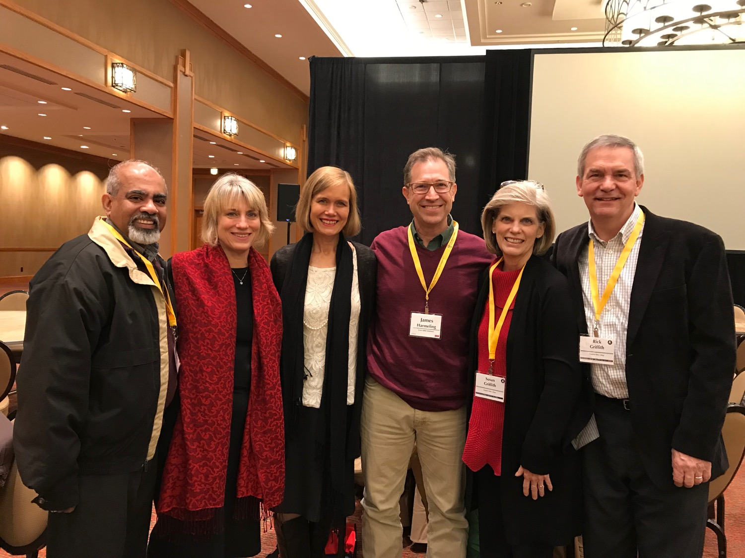
Main Idea
Titus
Our elders must teach respectable conduct based on God’s grace.
Notes:
Our leaders need to see the unmerited favor Jesus gives—and then humbly instruct how that should result in an honorable lifestyle.

Slide 83
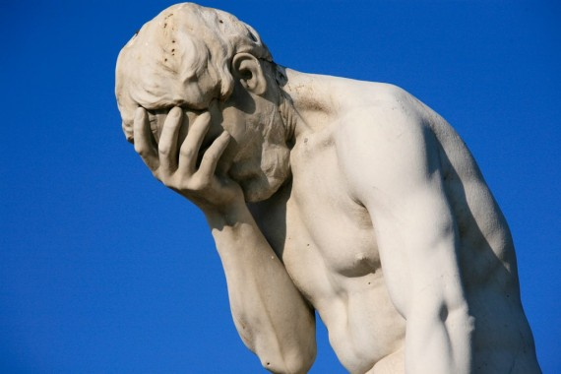
The Central Issue in Titus: Does your life look any better than the life of a non-Christian?
241

Slide 84
How to live?
Charles R. Swindoll, Contagious Christiantiy, 47
Notes:
Text

Slide 85
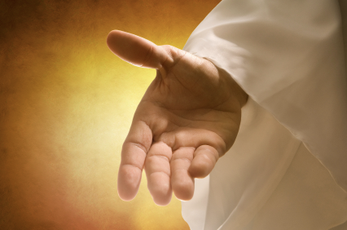
Make sure that you have received the salvation God freely offers you (Titus 2:11 NLT).
"For the grace of God has been revealed, bringing salvation to all people."
Charles R. Swindoll, Contagious Christiantiy, 47

Slide 86
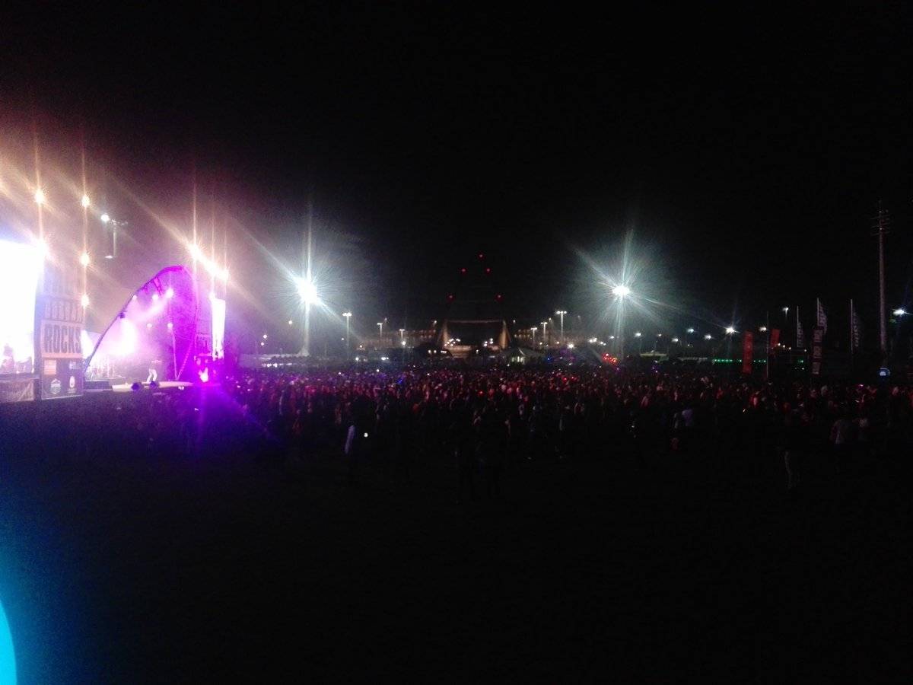
Continue to resist a corrupt lifestyle (Titus 2:12a NLT).
"And we are instructed to turn from godless living and sinful pleasures."
Charles R. Swindoll, Contagious Christiantiy, 47

Slide 87
Older Men
Sober-minded
Dignified
Self-controlled
Sound in faith, love, steadfastness
Older Women
Reverent
Not slanderers
Not addicted to wine
Train younger women
Younger Men
Self-controlled
Good works
Integrity
Dignity
Sound speech
Younger Women
Love husbands & children
Self-controlled
Pure
Working at home
Submissive to husbands

Slide 88
Live in a sensible, godly manner (Titus 2:12b-13 NLT).
"We should live in this evil world with wisdom, righteousness, and devotion to God, ¹³while we look forward with hope to that wonderful day when the glory of our great God and Savior, Jesus Christ, will be revealed."
Charles R. Swindoll, Contagious Christiantiy, 47

Slide 89
Do you need to read a good book on grace?
241

Slide 90
Black

Slide 91
NT Preaching link at BibleStudyDownloads.org
Get this presentation for free!
Notes:
NT Preaching (np)

