Slide 1
Adorning the Gospel
Building Healthy Churches that Display God’s Power
S t u d i e s i n T i t u s
Preached by Dr. Jim Harmeling on Titus 1:5-9 at Crossroads International Church Singapore • cicfamily.com Uploaded by Dr. Rick Griffith • Singapore Bible College Thousands of files in 49 languages for free at BibleStudyDownloads.org

Slide 2
Healthy churches develop godly leaders
T i t u s 1 : 5 - 9
Godly leaders strengthen the church (v. 5)

Slide 3
Acts 20:28-32
²⁸ Pay careful attention to yourselves and to all the flock, in which the Holy Spirit has made you overseers, to care for the church of God, which he obtained with his own blood. ²⁹ I know that after my departure fierce wolves will come in among you, not sparing the flock;³⁰ and from among your own selves will arise men speaking twisted things, to draw away the disciples after them. ³¹ Therefore be alert, remembering that for three years I did not cease night or day to admonish every one with tears. ³² And now I commend you to God and to the word of his grace, which is able to build you up and to give you the inheritance among all those who are sanctified.

Slide 4
1 Peter 5:1-5
¹ So I exhort the elders among you, as a fellow elder and a witness of the sufferings of Christ, as well as a partaker in the glory that is going to be revealed: ² shepherd the flock of God that is among you, exercising oversight, not under compulsion, but willingly, as God would have you; not for shameful gain, but eagerly; ³ not domineering over those in your charge, but being examples to the flock. ⁴ And when the chief Shepherd appears, you will receive the unfading crown of glory. ⁵ Likewise, you who are younger, be subject to the elders. Clothe yourselves, all of you, with humility toward one another, for “God opposes the proud but gives grace to the humble.”

Slide 5
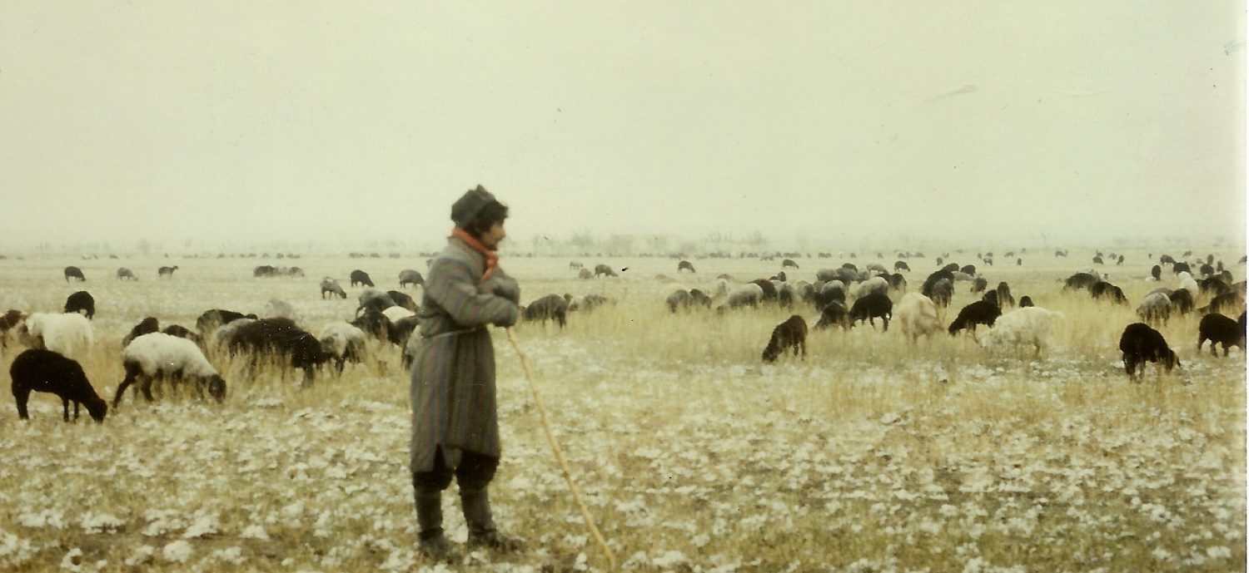
Church Leaders
Presbuteros = elderly person; wiser person
Episkopos = overseer; manager; director

Slide 6
Healthy churches develop godly leaders
T i t u s 1 : 5 - 9
Godly leaders strengthen the church (v. 5)
Godly leaders set a standard for transformed living (vs. 6-9)
A standard for living at home (6)
A standard for living in public (7-8)

Slide 7
NOT THIS
arrogant
quick-tempered
drunkard
violent
greedy for gain
THIS INSTEAD
hospitable
lover of good
self-controlled
upright
holy
disciplined

Slide 8
Healthy churches develop godly leaders
T i t u s 1 : 5 - 9
Godly leaders strengthen the church (v. 5)
Godly leaders set a standard for transformed living (vs. 6-9)
A standard for living at home (6)
A standard for living in public (7-8)
A standard for teaching and doctrine (9)

Slide 9
Black

Slide 10
NT Preaching • BibleStudyDownloads.org
Get this presentation for free!

