Slide 1

Be Accepting
Romans
Dr. Rick Griffith • Crossroads International Church Singapore
BibleStudyDownloads.org

Slide 2
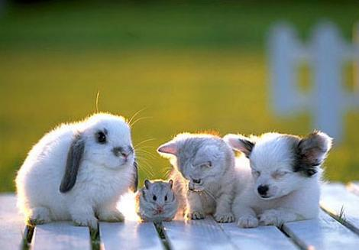
We accept others when we are young.

Slide 3
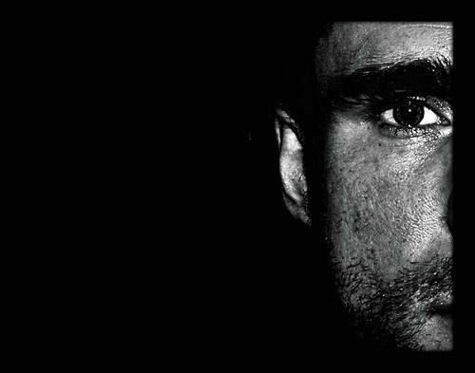
Too often we don’t accept people different from us.
Notes:
Too often we don’t accept people different from us. Do you agree?
Need: How accepting are you of those most different from you in this room?
Are you OK with Matt dressing differently than me?
Is it OK that Andrew has more pigment in his skin?
Do you accept that Miriam does not any spiciness in her food?
Can you accept Lele as the only one from Africa?

Slide 4

Why accept one another?
Notes:
Subject: Why must we accept one another? We certainly are different from each other, but that doesn’t need to divide us. What reasons can we give to be tolerant—or patient—or long-suffering—or accommodating with each other?
Of course, I am not speaking about things the Scripture clearly calls sin. I hope we don’t ever put up with and accept sin in one another.
But we certainly do need to accept unchangeable traits. Today we will see reasons to accept one another at our core being that cannot change.

Slide 5
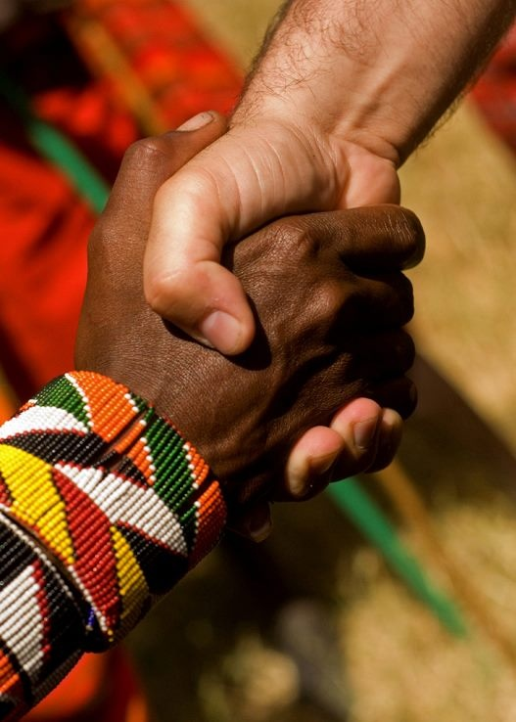
Accept One Another As Christ Has Accepted You
The Theme of Romans Based on Romans 15:7
Dr. Andrew Spurgeon
NT Professor, Singapore Bible College
Notes:
I am indebted to my co-preacher here at Crossroads who preached a whole series in 2018 on Romans. I have taught this book nearly 40 times, but Andrew helped me see things in a new light! He has won me over to see the theme of the book relating to the need in the body for us to accept one another based on Romans 15:7.

Slide 6

Theme
“Accept one another just as Christ has accepted us for the glory of God”
(Rom 15:7)

Slide 7
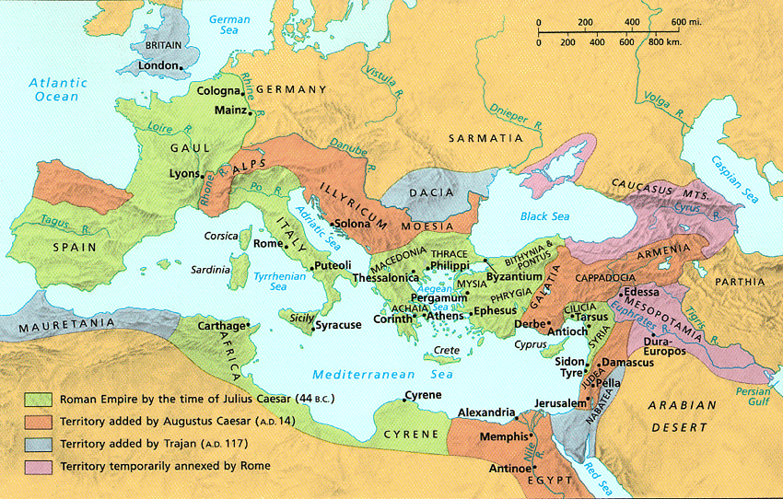
THE ROMAN EMPIRE
12
Notes:
Background: The two main groups at the church at Rome struggled to accept each other.
Jews had previously led the church but were kicked out of the city by the emperor Claudius in AD 49.
However, Claudius died and a new emperor named Nero came to the throne five years later in AD 54, so Jews (including Christian Jews) were free to return.
The re-entrance of the Jews into the church brought difficulties as the Gentiles had become the leaders during the Jewish absence. They did things a bit different.
So Paul wrote them to help them to accept one another.

Slide 8
NT Overview (Paul's Letters)
143
38
124
39-41
"To the remotest part of the earth" (Acts 1:8)
Acts 9 13 14 15 16 18 21 27 28
Apr 48-
Sep 49
1
Galatia
Apr 50-
Sep 52
2
Aegean
Spr 53-
May 57
3
Asia
Feb 60-
Mar 62
1
Rome
Spr 62-
Fall 67
4
Spain
Aut 67-
Spr 68
2
Rome
Summer 35-
37
Damascus
Antioch
Romans is the last of the missionary epistles but first in our NT order of epistles
May 57-
Aug 59
Trials
Fall 49
The
Council
Spring 68
Expansion of Church
35 48 49 50 52 53 57 60 62 67 68 95
Matt
Luke
Acts
Mark
John
Gal
1 Thess
1 Cor
Eph
1 Tim
2 Tim
2 Thess
2 Cor
Col
Titus
East
Missionary
Pastoral
Romans
Philem
Phil
West
Gospels & Acts
1234
Journeys
Prison
Pauline Epistles
Rome
Imprisonments
Pauline
Notes:
By the time Paul wrote Romans, he had seen the church planting movement reach the eastern part of the Empire! He notes this in Romans 15.

Slide 9
Why accept one another?
145
Equal Righteousness
1:1-17
Notes:
We get God’s righteousness equally by faith in Christ (1:1-17).
[Holiness comes the same for all of us—by simply trusting Jesus, we are forgiven.]

Slide 10

Righteousness in Romans
145
Theme | Needed | Provided | Imparted | Proved | Applied | Dissem-inated
Intro 1:1-17 | Condem-nation 1:18– 3:20 | Justifi-cation 3:21– 5:21 | Sanctifi-cation 6–8 | Election 9–11 | Trans-form-ation 12:1– 15:13 | Propa-gation 15:14– 16:27
Start | Sin | Salva-tion | Set Apart | Sove-reignty | Service | Send
Notes:
We will take the “fast track” through Paul’s letter to the Romans today and see seven reasons must we accept one another! I don’t normally have a seven-part sermon, so that’s too much, just think of chapters 1–11 as Paul’s theology and Romans 12–16 as the application.

Slide 11
Message & Romans 1
God is angry at the
Gentiles who reject him

Slide 12
The Theme of Romans
145
¹⁶I am not ashamed of the gospel, because it is the power of God for the salvation of everyone who believes: first for the Jew, then for the Gentile.
¹⁷For in the gospel a righteousness from God is revealed, a righteousness that is by faith from first to last, just as it is written: "The righteous will live by faith."
Don't be ashamed of the gospel because it works! It alone makes us righteous!

Slide 13
Why accept one another?
145
SIN
Needed
in Condemnation
1:18–3:20
Equal Righteousness
1:1-17
Notes:
We need God's righteousness since we’re all condemned by sin (1:18–3:20).
[We don’t all have the same number of sins, but we all have the same destination—hell.]

Slide 14

We need to be saved

Slide 15

God's Wrath (Romans 1:18-20)
155e
pt. a
The Reality (18a)
The Reason (18b-20a)
The Result (20b)

Slide 16


Why You Are Without Excuse (Romans 1:20)
WHY YOU ARE
WITHOUT
EXCUSE
ROMANS 1:20
Notes:
Please translate the text at the left and then drag everything over this slide so no English shows. Make sure the fonts remain.

Slide 17

Romans 1:20
155e
Person who is Limitless
Person who is Supernatural
For since the creation of the world God's invisible qualities-- his eternal power and divine nature-- have been clearly seen, being understood from what has been made, so that men are without excuse (NIV).
For since the creation of the world God's invisible qualities-- his eternal power and divine nature-- have been clearly seen, being understood from what has been made, so that men are without excuse (NIV).

Slide 18

Why God is Angry at Gentiles
(Rom. 1:21-32)
155e
e.1)b]
Ignore God (21-23)
God gave them over
Impurity (24)
Idolatry (25)
God gave them over
Homosexuality (26-27)
God gave them over
Depravity (28-32)

Slide 19
Romans 2:1–3:8
God is angry at the
self-righteous and Jews too

Slide 20

God Despises Human Pride
Notes:
www.schambach.org/

Slide 21

All Are Guilty Before God
152

Slide 22

All Are Under Sin
^{10b} "No one is righteous—
not even one.
¹¹ No one is truly wise;
no one is seeking God.
¹² All have turned away;
all have become useless.
No one does good,
not a single one (Pss 14:1-3; 53:1-3–Greek version).
¹³ "Their talk is foul, like… stench from an open grave.
Their tongues are filled with lies."
"Snake venom drips from their lips" (Ps 5:9 Gr.; 140:3).
¹⁴ "Their mouths are full of cursing and bitterness" (Ps 10:7 Gr. version).
¹⁵ "They rush to commit murder.
¹⁶ Destruction and misery always follow them.
¹⁷ They don't know where to find peace" (Isa 59:7-8).
¹⁸ "They have no fear of God at all."
  (Rom 3:10b-18 NLT)
155e
e.1)c]

Slide 23
Romans 3:21-31
God's righteousness is provided through justification by faith

Slide 24
Why accept one another?
145
SIN
Needed
in Condemnation
1:18–3:20
Equal Righteousness
1:1-17
Provided
in Justification
3:21–5:21
SALVATION
Notes:
God provided righteousness equally in the justification of all who trust Christ (3:21–5:21).
[When we place our faith in Jesus, God amazingly gives us all the same verdict: “not guilty.”]

Slide 25
Now for Some
Theological Words in Romans
155h
Righteousness
(3:21)
Holiness or perfection inherent for God yet imputed (applied) to us in Christ

Slide 26

Faith (3:22)
155h
Trust or reliance on Christ's atonement on the cross as the sinless substitute to pay the sinner's penalty due to God

Slide 27


"It is finished"
155h
Justification (3:24)
God's act of declaring us "not guilty" for our sins, making us right with him
Legal
Paid
in Full
Justice (3:25-26)
The fairness of God where He punishes sin in an individual himself or in a Sinless Substitute (Jesus Christ)

Slide 28
Romans 4
153
Justification by faith
is illustrated

Slide 29
In Other Words…
153
Salvation has
ALWAYS been through faith alone!

Slide 30
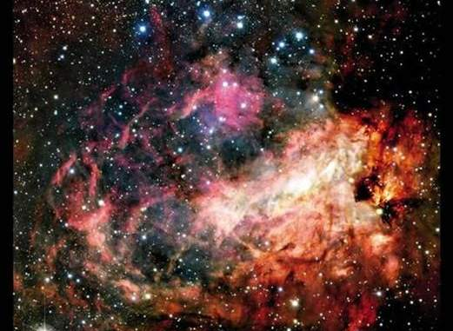
Genesis 15:5-6
153
Creation
[God took Abraham] outside and said, "Look up at the heavens and count the stars--if indeed you can count them." Then he said, "So shall your offspring be."
Abram believed the LORD, and he credited it to him as righteousness.

Slide 31
Romans 5
Righteousness through imputation gives assurance

Slide 32

Romans 5:1
153
A VERSE TO REMEMBER
"Therefore, since we have been made right in God's sight by faith, we have peace with God because of what Jesus Christ our Lord has done for us"

Slide 33
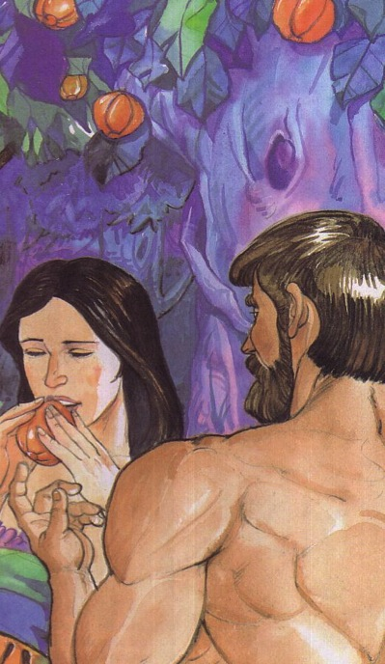
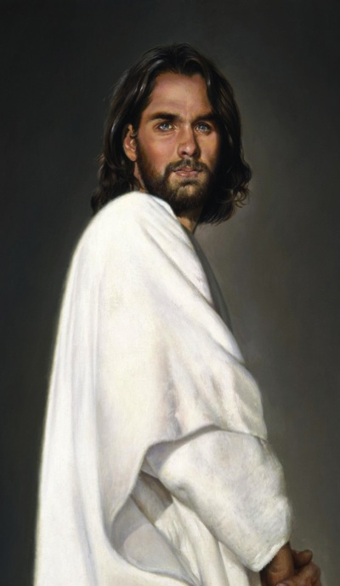
Adam versus Christ
Romans 5:12-21
1 Cor. 15:22
1 Cor. 15:45-49

Slide 34
Romans 5:8-21
155j
What we have as Adam's children
What we have as God's children
Adam gave us…
Christ gives us…
Ruin 5:9
Rescue 5:8
Sin 5:12, 15, 21
Righteousness 5:18
Death 5:12, 16, 21
Eternal life 5:17, 21
Separation from God 5:18
Relationship with God 5:11, 19
Disobedience 5:12, 19
Obedience 5:19
Judgment 5:18
Deliverance 5:10, 11
Law 5:20
Grace 5:20

Slide 35
Why accept one another?
145
SIN
Needed
in Condemnation
1:18–3:20
Equal Righteousness
1:1-17
Provided
in Justification
3:21–5:21
SALVATION
Imparted
in Sanctification
6–8
SET APART
Notes:
God's righteousness imparted sanctification equally to us all (Rom 6–8).
[We all have the same access to progressively grow in holiness to be like Christ.]

Slide 36
Romans 6
154a
Righteousness is imparted in sanctification through positional identification with Christ

Slide 37
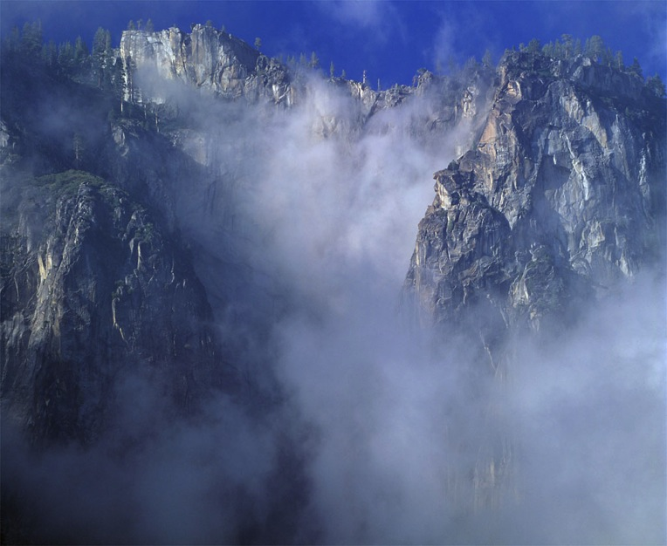
Contrasts Between
Justification and Sanctification
155k
JUSTIFICATION
"Not guilty"
Legal Standing
Once for all time
Entirely God's work
Perfect in this life
Same in all Christians
SANCTIFICATION
"Set apart"
Internal condition
Continuous throughout life
We cooperate with God
Not perfect in this life
Different levels

Slide 38
Righteousness Imparted in Sanctification (Rom. 6–8)
154
How does the blood of Christ apply to us?
Chapter 6
New Basis
––
Identification

Slide 39

"Shall we go on sinning that grace may increase?"
(6:1)
154a

Slide 40
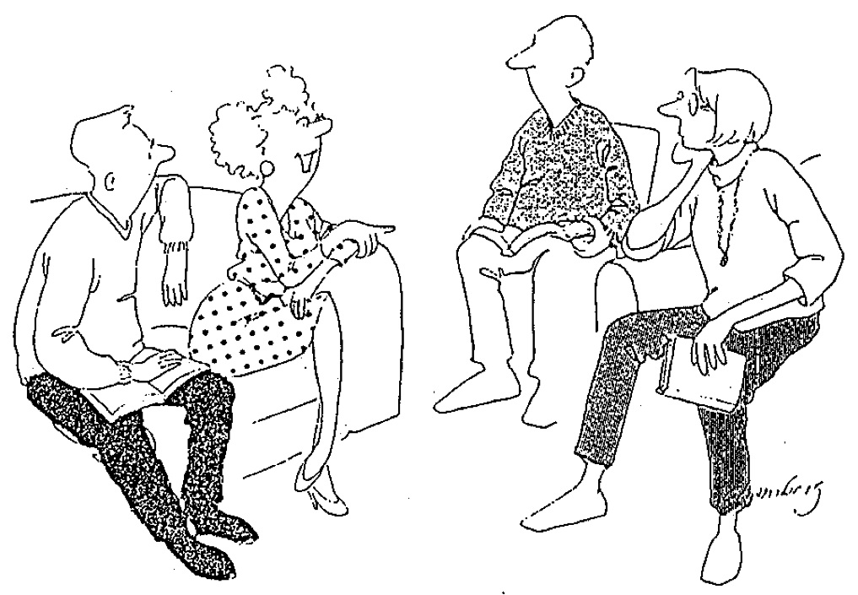
Dying to Sin (6:2)
155k
"Well, I haven't exactly DIED to sin,
but I did feel kind of faint once."

Slide 41



INSTRUMENTS of Righteousness
Romans 6:13
Notes:
Please translate the text at the left and then drag everything over this slide so no English shows. Make sure the fonts remain.

Slide 42
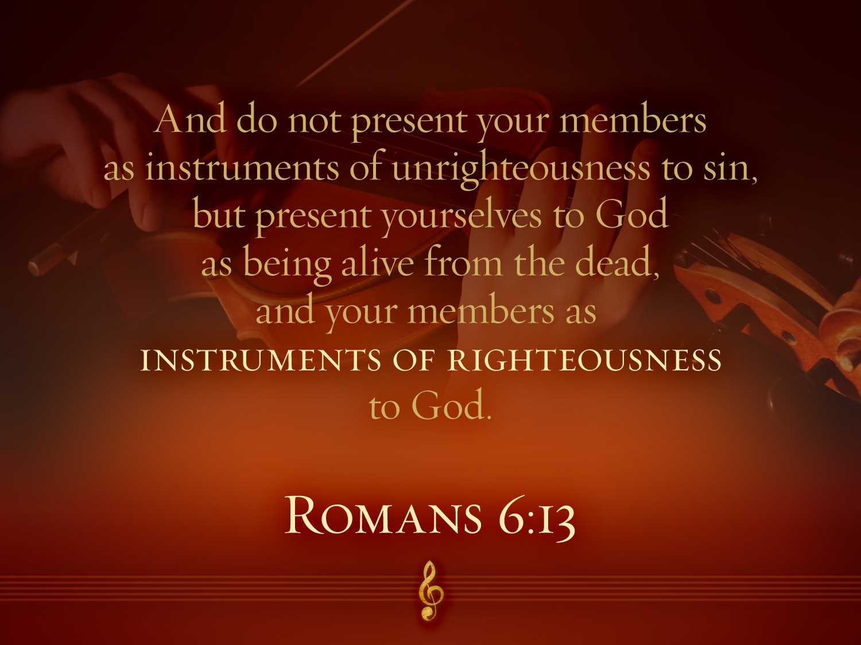

Romans 6:13
"And do not present your members as instruments of unrighteousness to sin, but present yourselves to God as being alive from the dead and your members as INSTRUMENTS OF RIGHTEOUSNESS to God."

Slide 43
Romans 7
Believers are free from the Law

Slide 44
Righteousness Imparted in Sanctification (Rom. 6–8)
154
How does the blood of Christ apply to us?
"As a wife is no longer married to her husband when he dies, so a Christian is no longer under the Law"
(John A. Witmer, "Romans," in BKC, 2:465).
Chapter 6
New Basis
––
Identification
Chapter 7
New Relationship
––
Freedom

Slide 45
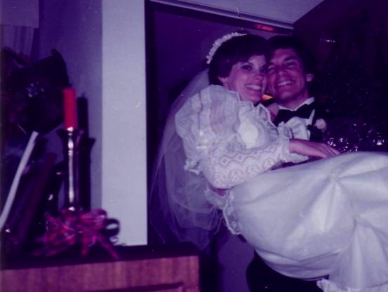
Marriage:
30 December 1983
Notes:
I married her and took her to Dallas Seminary a few days later. Three years later our first son was born on his grandpa's 70th birthday, so we named him Kurt in honor of Susan's father. I also pastored a church, had a ministry to international students, and served as a chaplain.

Slide 46
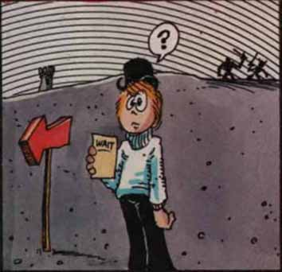

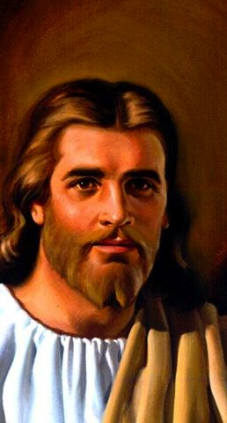
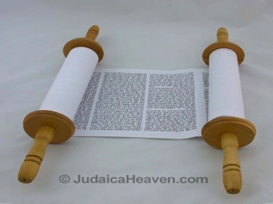
What "Marriages" (7:1-6)?
154a
The Law
Our "BC" Marriage
(Rom. 7:1-4a)
Our "AD" Marriage
(Rom. 7:4b-6)
Notes:
We are the bride who used to be married to the law (BC = Before Christ)
But we died in Christ, and thus are now released from that Law.
Now we are married to Christ (7:4) in our AD state (After Death).

Slide 47
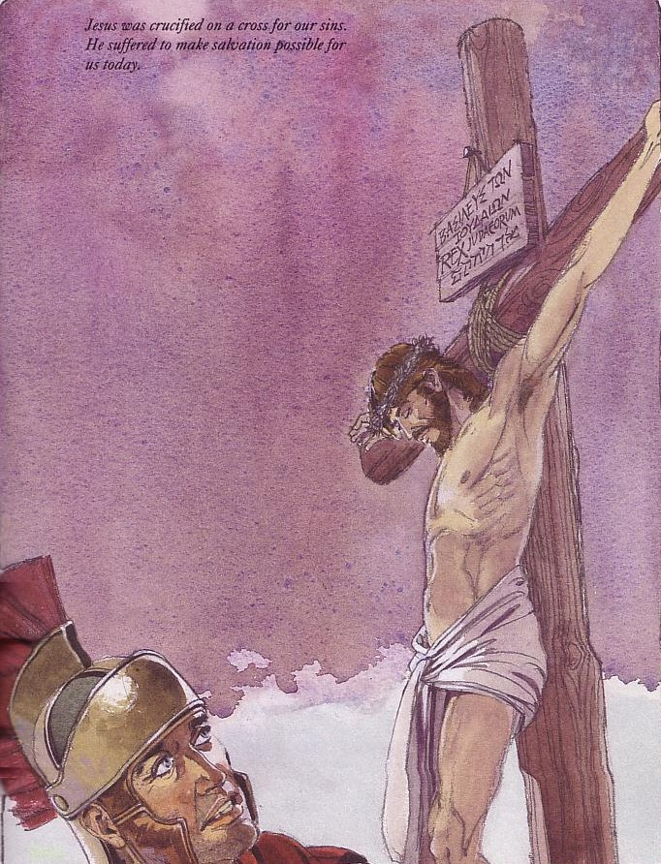
Christ's death (and our death with Him) frees us from "marriage" to the Law since now we are "married" to Christ (Rom. 7:4, 6)
154a

Slide 48

In your small group...
154a
In what ways do believers today still try to live by the Mosaic law?
Sabbath observance
Food laws
Tithing
Not charging Christians interest
Circumcision

Slide 49
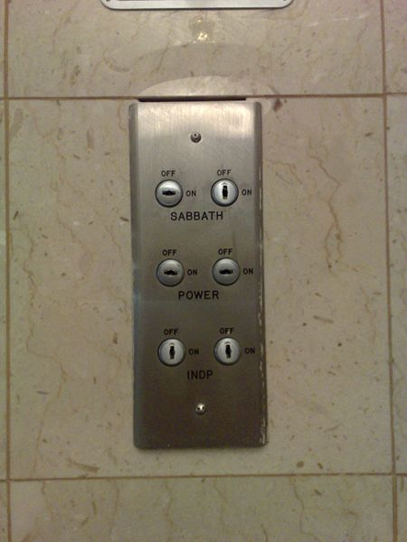
Our Sabbath Lift in Galilee
We arrived at our hotel on the Sabbath, so it would not stop at our floor. Instead, we carried our luggage for two floors by hand in celebration of the day of rest!
Notes:
On my 2007 trip that I led to Israel, the lift was turned on to the Sabbath setting, meaning that it stopped only every fourth floor.

Slide 50
Victory in the Christian Life
154a
"Paul does not view Christian living as
victory apart from any conflict
or as conflict apart from any victory. Instead, he sees the Christian life as a life of victory amid conflict."
"Paul & His Epistles: Life and Teachings of Paul,"
NT Survey (Moody Online Study Guide), p. 7 (emphasis mine)

Slide 51
Romans 8
154b
Power in Sanctification is through the Holy Spirit

Slide 52
Righteousness Imparted in Sanctification (Rom. 6–8)
154
How does the blood of Christ apply to us?
Chapter 6
New Basis
––
Identification
Chapter 7
New Relationship
––
Freedom
Chapter 8
New Power
––
Spirit

Slide 53

No Condemnation (8:1)!
154b

Slide 54
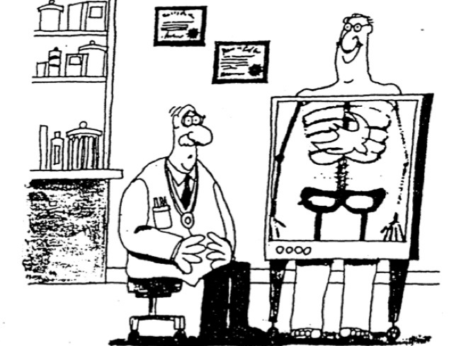
"…those who do not have the Spirit of Christ living in them do not belong to him at all" (Rom. 8:9)

Slide 55
Two Types of Inheritance
"Now if we are children, then we are heirs—heirs of God and co-heirs with Christ, if indeed we share in his sufferings in order that we may also share in his glory"
(Rom. 8:17 NIV).
= Salvation
= Reward

Slide 56
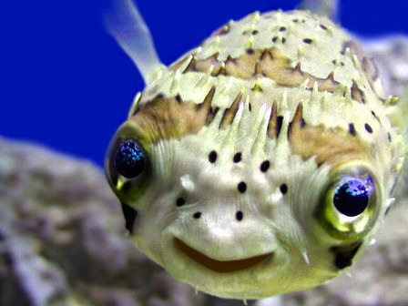
Romans 8:19-21
"The creation waits in eager expectation for the sons of God to be revealed. . . The creation itself will be liberated from its bondage to decay and brought into the glorious freedom of the children of God."

Slide 57

³¹ What then shall we say to these things?
If God is for us, who can be against us?
Romans 8:31-39

Slide 58
³² He who did not spare his own Son
but gave him up for us all,
how will he not also with him graciously give us all things?
Romans 8:31-39

Slide 59
³³ Who shall bring any charge against God's elect?
It is God who justifies.
Romans 8:31-39

Slide 60
³⁴ Who is to condemn? Christ Jesus is the one who died—more than that, who was raised—who is at the right hand of God, who indeed is interceding for us.
Romans 8:31-39

Slide 61
³⁵ Who shall separate us from the love of Christ? Shall tribulation, or distress, or persecution, or famine, or nakedness, or danger, or sword?
Romans 8:31-39

Slide 62
³⁶ As it is written,
“For your sake we are being killed all the day long;
we are regarded as sheep to be slaughtered.”
Romans 8:31-39

Slide 63
³⁷ No, in all these things we are more than conquerors through him who loved us.
Romans 8:31-39

Slide 64
³⁸ For I am sure that neither death nor life, nor angels nor rulers, nor things present nor things to come, nor powers,
Romans 8:31-39

Slide 65
³⁹ nor height nor depth, nor anything else in all creation, will be able to separate us from the love of God in Christ Jesus our Lord.
Romans 8:31-39

Slide 66
Why accept one another?
145
SIN
Needed
in Condemnation
1:18–3:20
Equal Righteousness
1:1-17
Provided
in Justification
3:21–5:21
SALVATION
Vindicated
in Election
9–11
Imparted
in Sanctification
6–8
SELECTION
SET APART
Notes:
God vindicated his righteousness in Israel’s election and Gentile salvation (Rom 9–11).
[God called Jews to salvation—maybe the most unbelieving nation—so God must be righteous!]

Slide 67
Romans 9
154c
Righteousness was revealed in God's sovereign choice of Israel

Slide 68

"Israel" always means ethnic seed of Jacob (9:1-5)
155v
"For not all who are descended from Israel are Israel" (9:6)
≠ "Israel" refers to believing Gentiles?!?!
= Not all Jews believe

Slide 69
Romans 10
154c
Righteousness is revealed in Israel rejecting God
(not vice versa)

Slide 70


Is There a Future for National Israel?
155q

Slide 71
Summary of Romans 9–11
154d
9:1-29 | 9:30–10:21 | 11:1-36
Israel's past | Israel's present | Israel's future
God elected Israel | Israel rejects God | God will reject Israel only partially and temporarily
Israel's failure is not due to God's unfaithfulness | Israel's failure is due to rejecting her Messiah | Israel's failure will be neither total in scope nor final
A Jewish remnant has been preserved by God | Only a small Jewish remnant accepts Him now | Yet this remnant will grow into an entire believing nation
Gentiles have also become elect of God in Christ | Gentiles are now becoming saved by faith in Christ | Gentiles should not be proud over blessings that Jews reject
Divine side | Human side | Divine results
God's election | Man's responsibility | God's mercy
Human unbelief cannot eradicate God's promises because they are based on the principle of sovereign election | However, God's election in sovereign grace to fulfill His Word does not eradicate human responsibility for unbelief | Ultimately, God's election will be justified in the salvation of the Jewish nation alive when Christ returns

Slide 72
Romans 11
154d
Righteousness will be revealed in Israel's future restoration

Slide 73
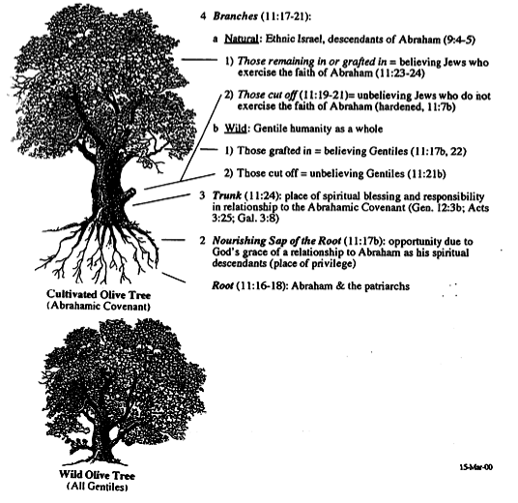

Gentile Engrafting
Branches (11:17-21)
155q
a. Natural: Ethnic Israel (9:4-5)
1) Remaining/Grafted = Believing (11:23-24)
2) Cut off = Unbelieving (11:19-21)
b. Wild: Gentile humanity
1) Grafted = Believing (11:17b, 22)
2) Cut off = Unbelieving (11:21b)
Trunk (11:24)
Sap (11:17b)
Root (11:16-18)
Cultivated Olive Tree
(Abrahamic Covenant)
Wild Olive Tree
(All Gentiles)

Slide 74
Why accept one another?
145
SIN
Needed
in Condemnation
1:18–3:20
Applies in Transformation
12:1–15:13
Equal Righteousness
1:1-17
Provided
in Justification
3:21–5:21
SUBMISSION & SENSITIVITY
SALVATION
Vindicated
in Election
9–11
Imparted
in Sanctification
6–8
SELECTION
SET APART
Notes:
Righteousness applies equally in our life transformation (12:1–15:13).
[None of us has unfair privilege to become like Jesus—all have the same opportunity of holiness.]

Slide 75
Romans 12
154e
Righteousness is applied in transformed living

Slide 76
Righteousness That Transforms in Romans 12–13
145
In the Church
(Ch. 12)
In the Society
(Ch. 13)

Slide 77

Romans 12:1
154e
"Offer your body as a
living sacrifice…"

Slide 78


ROMANS 12:2
And do not be conformed to this world,
but be transformed by the renewing of your mind,
that you may prove what is that good
and acceptable and perfect will of God.

Slide 79
Romans 13
Righteousness shows in submission to government and in love for the saints

Slide 80

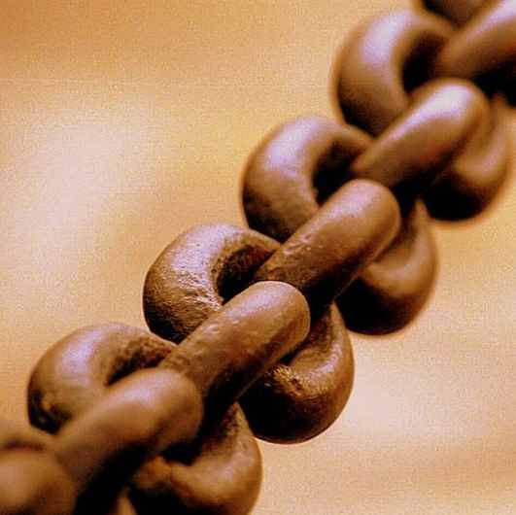
Submit to Government (13:1-7)
154e
Reasons we respect gov't (1-5)
Reasons we pay taxes (6-7)
Notes:
----- Meeting Notes (1/27/11 12:37) -----
REASONS TO RESPECT GOVERNMENT (1-5):
They are servants of God (1-2, 4, 6)
Rebelling against the government is rebelling agianst God (2a)
Rebellion brings punishment (2b-3)
Submission obeys our conscience (5)
REASONS TO PAY TAXES (6-7):
We must support God's servants (6a)
Authorities work full time (6b)

Slide 81
Romans 14:1–15:13
Righteousness transforms our ways of handling different convictions

Slide 82
Black & White
Practices the Bible says are always wrong
Practices the Bible says are always right
Idolatry
Adultery
Murder
Coveting
Contentment
Obedience
Prayer
Purity

Slide 83
Gray Areas
155aa
Practices not forbidden in the Bible over which Christians disagree

Slide 84
Gray Area Examples
155aa
Accepting gifts with the left hand
Being a Democrat (or Republican!)
Buying a Mac (or Windows) computer
Celebrating Christmas or Easter
Celebrating Good Friday
Celebrating Lent
Celebrating Palm Sunday
Changing to a "Christian" name
Chinese New Year giving of hong baos

Slide 85
Should we follow someone else's conscience?

Slide 86
Why should we give up our rights in gray matters?

Slide 87

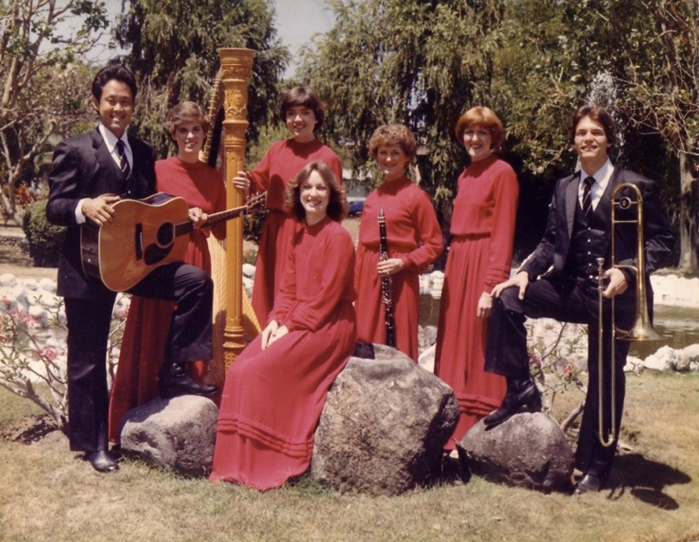

Love
Music
Drinking

Slide 88
Romans 15:14–16:23
154f
Righteousness is disseminated by propagating the gospel

Slide 89
Romans 15:28-29
²⁸ As soon as I have delivered this money and completed this good deed of theirs,
I will come to see you on my way to Spain.
²⁹ And I am sure that when I come, Christ will richly bless our time together.

Slide 90
Paul's Next Mission Field: Spain (15:23-29)
154f

Slide 91


YOU are needed!
Women's Ministry Team
Men's Ministry Team
Missions & Evangelism
Coordinator for Ushers/Greeters
Youth Sponsors & assistant (woman)
PPT design
Set-up, Take down (e.g. signs)
Home group leaders
Worship leader
Notes:
God could raise up some really gifted person, but he rarely works that way. Instead, he uses plain ole' regular people like you and me in his work—especially in giving!

Slide 92
Slides on
Romans 16

Slide 93
For Righteousness Disseminated it Takes…
154f
Money (15:14-33)
People (16:1-24)
God (16:25-27)
Building Bridges to Propagate the Gospel

Slide 94
Why accept one another?
Notes:
The reason we should be accommodating with each other in the church is because holiness comes the same way for us all—by simple trust in Jesus.

Slide 95
Why accept one another?
145
SPREADING
SIN
Disseminated in Propagation
15:14–16:27
Needed
in Condemnation
1:18–3:20
Applies in Transformation
12:1–15:13
Equal Righteousness
1:1-17
Provided
in Justification
3:21–5:21
SUBMISSION & SENSITIVITY
SALVATION
Vindicated
in Election
9–11
Imparted
in Sanctification
6–8
SELECTION
SET APART
Notes:
We get God’s righteousness equally by faith in Christ (1:1-17).
We need God's righteousness since we’re all condemned by sin (1:18–3:20).
God provided righteousness equally in the justification of all who trust Christ (3:21–5:21).
God's righteousness imparted sanctification equally to us all (Rom 6–8).
God vindicated his righteousness in Israel’s election and Gentile salvation (Rom 9–11).
Righteousness applies equally in our life transformation (12:1–15:13).
Righteousness must be disseminated in propagating the gospel by us all (15:14–16:27).
[God’s holiness is worth telling others about—and we each have equal opportunity to witness.]

Slide 96
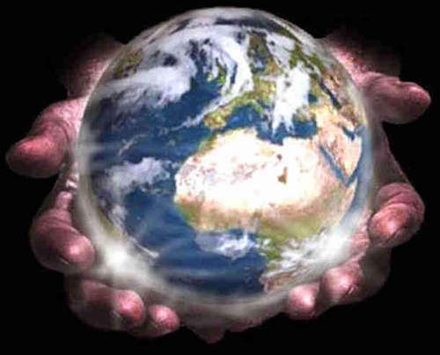
Main Idea of Romans
We accept each other because God’s righteousness comes to us equally.

Slide 97
Accept others. How?
      Have you received God’s forgiveness offered freely by trusting Christ?
      If so, are you seeing yourself clearly—that is, humbly?
      Or do you think yourself better than someone else? Who?
      Which Christian are you not accepting? How can you better accept that person?

Slide 98
Black

Slide 99


NT Preaching • BibleStudyDownloads.org
Get this presentation and script for free!

