Slide 1
New Year Resolutions
Romans 6:1–14
Preached by Andrew B. Spurgeon at Crossroads International Church Singapore • cicfamily.com Uploaded by Dr. Rick Griffith • Singapore Bible College Thousands of files in 49 languages for free at BibleStudyDownloads.org

Slide 2
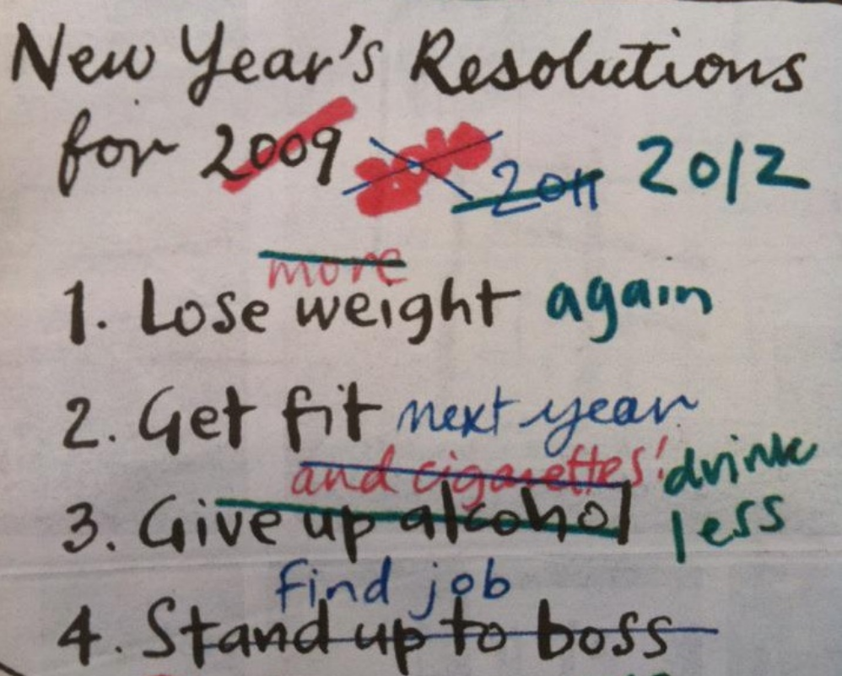

Slide 3
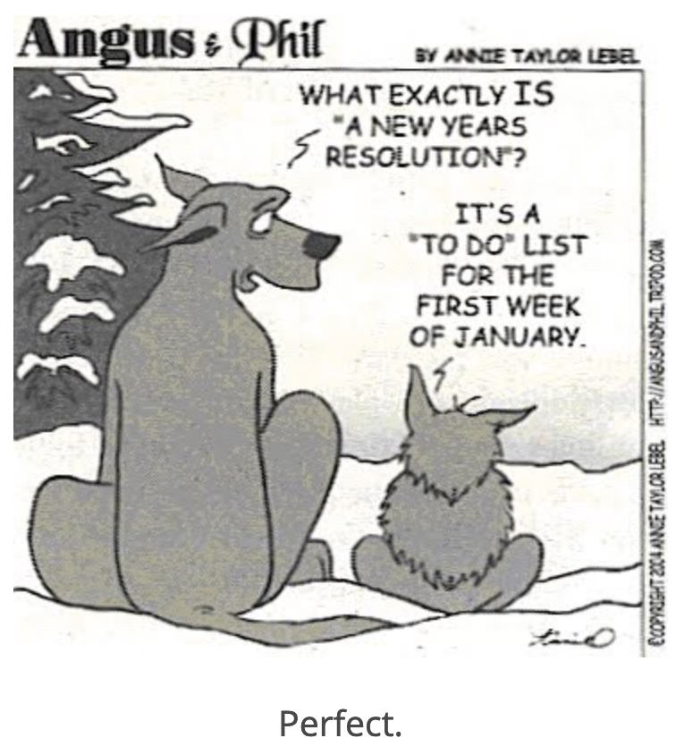

Slide 5
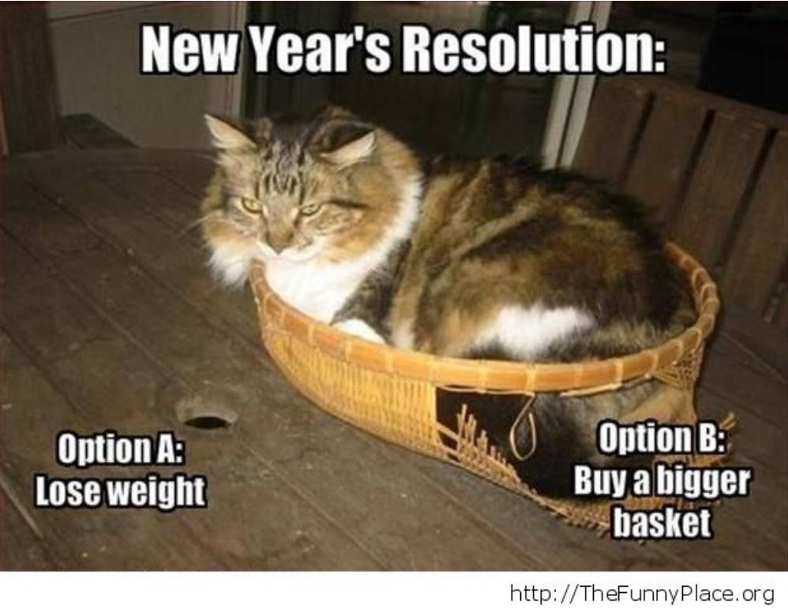

Slide 6
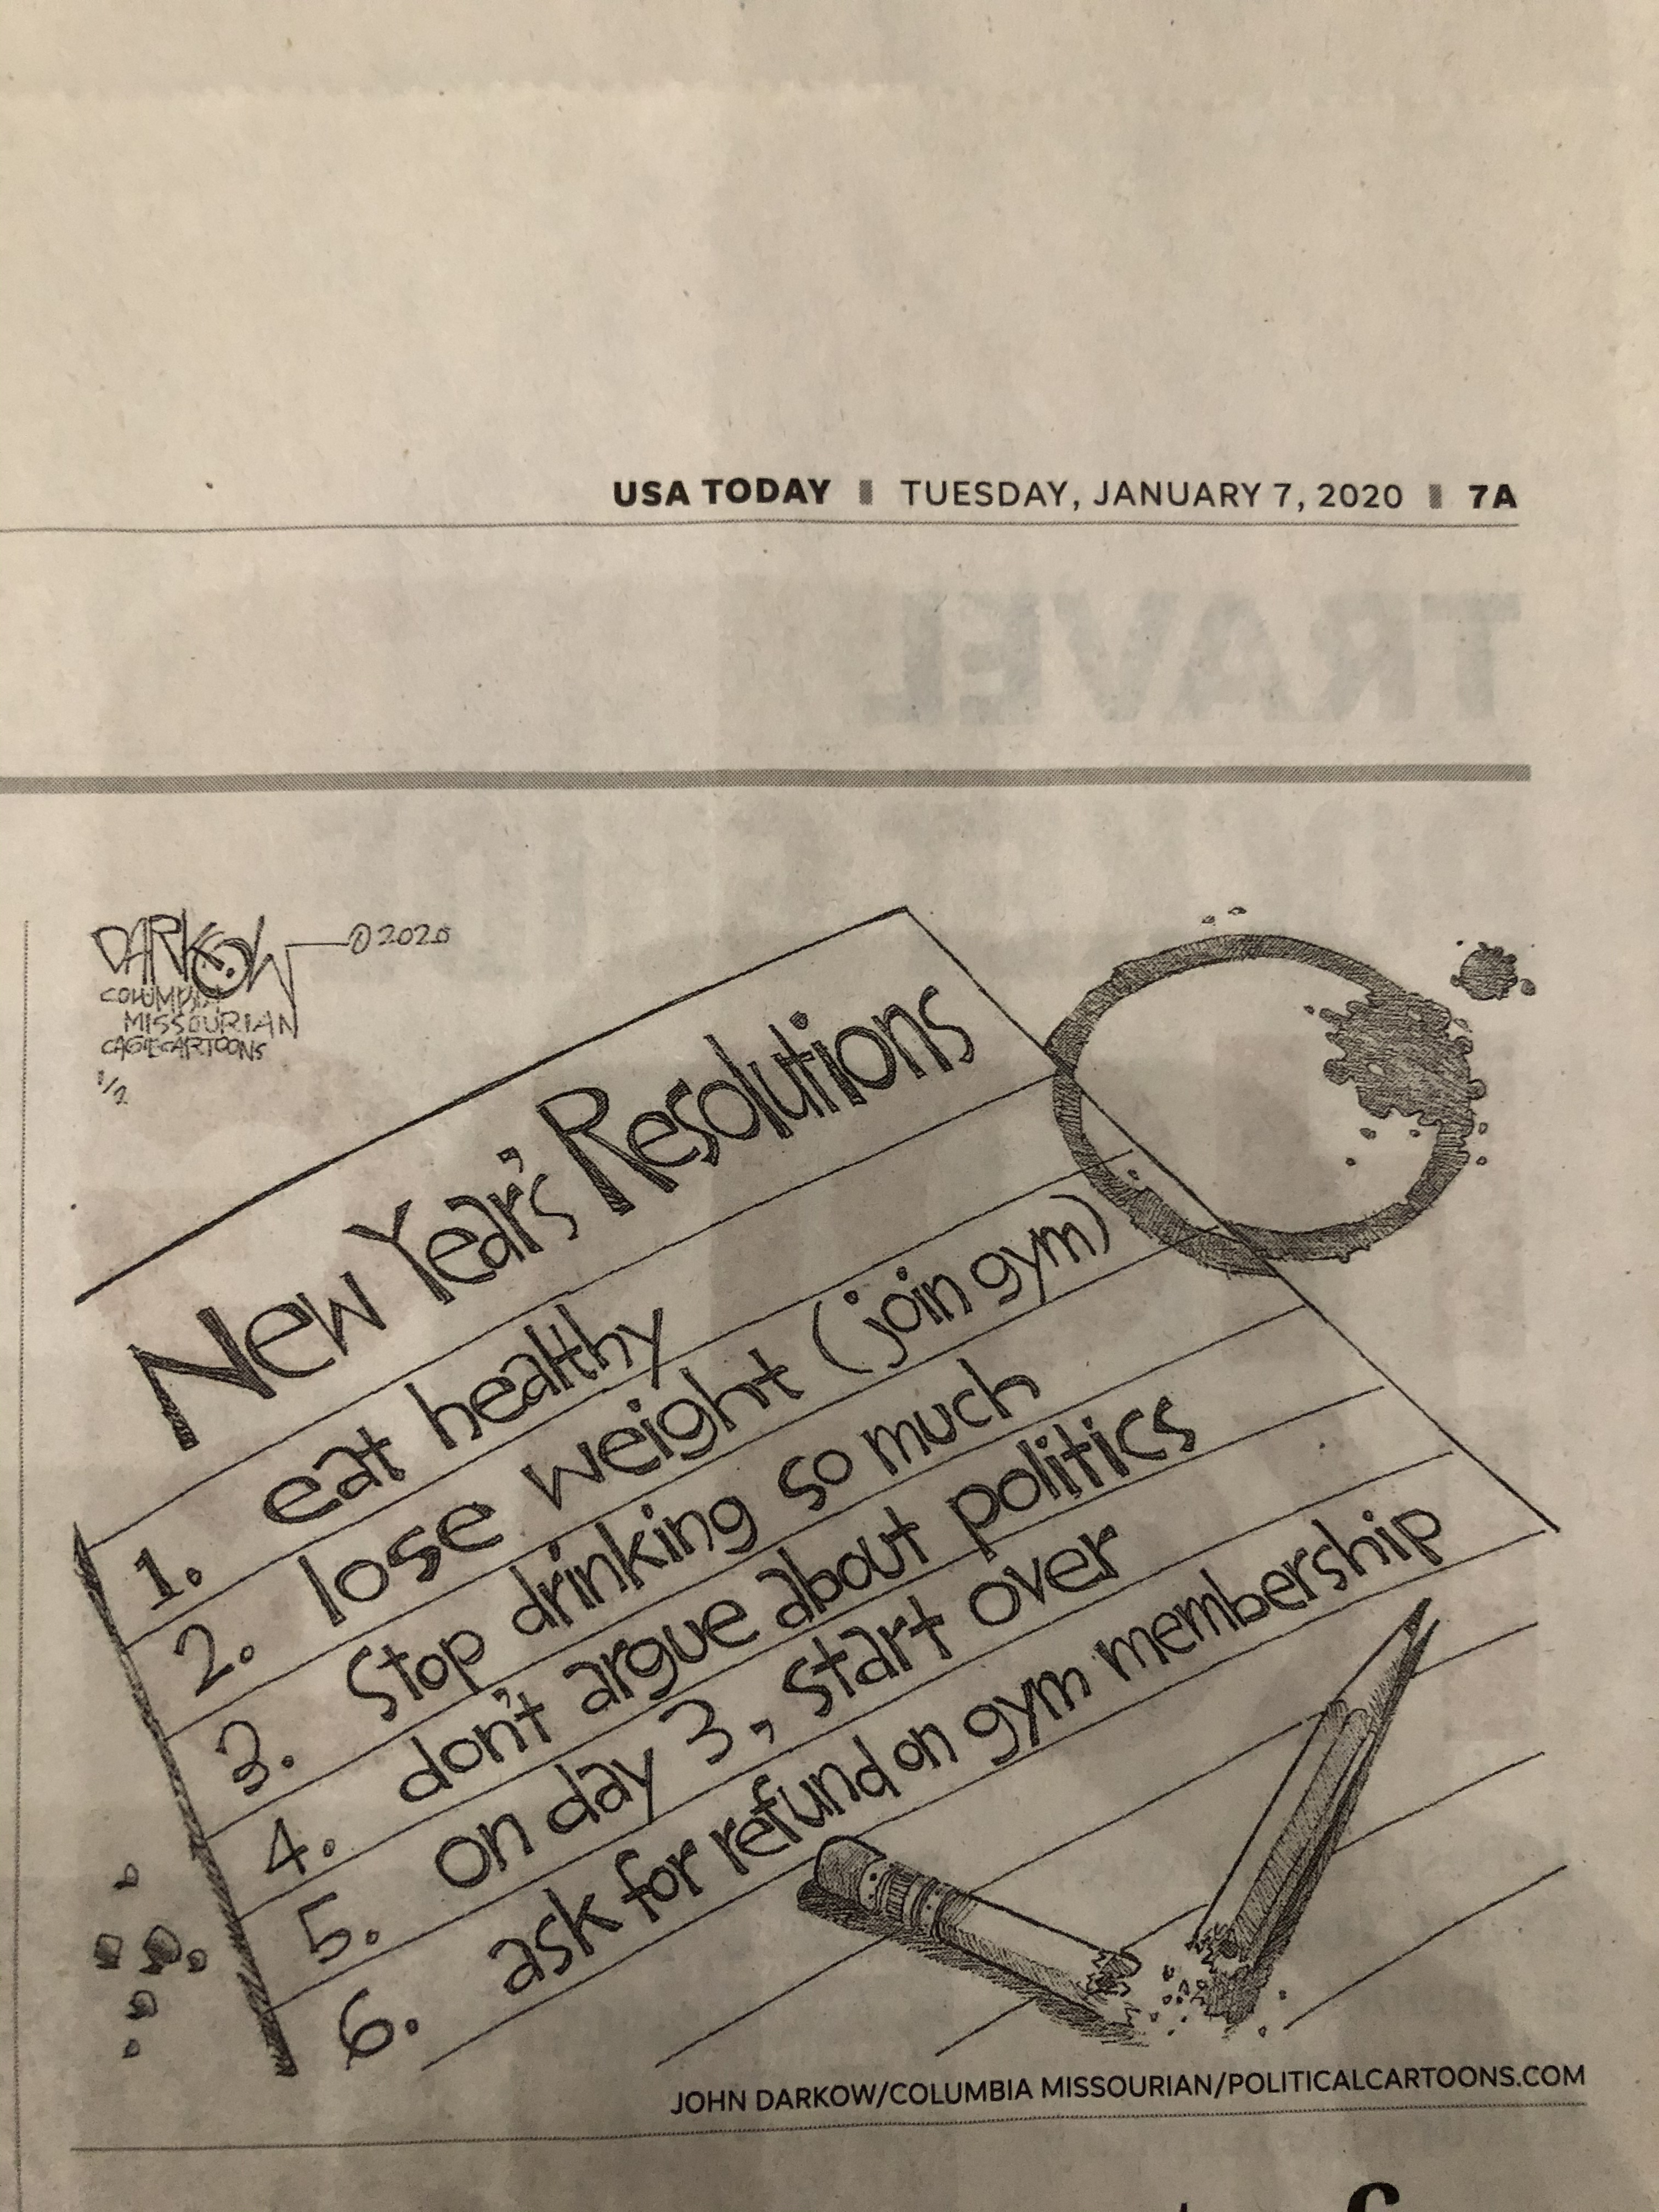

Slide 7
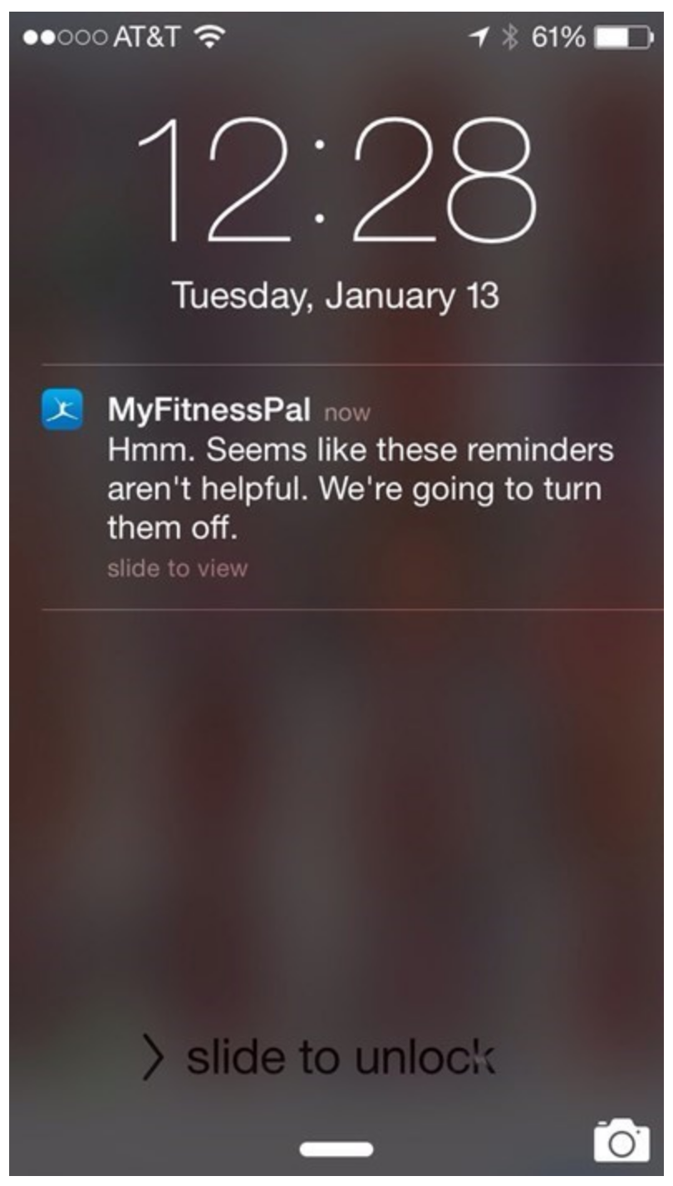

Slide 9
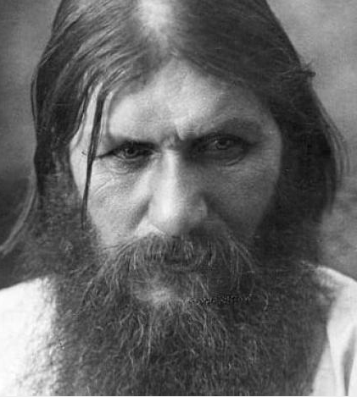
New Year Resolutions
Romans 6:1–14
Let’s keep sinning since God’s grace keeps forgiving! (6:1)
Grigori Yefimovich Rasputin (1869–1916), a Russian monk, taught “the only way to reach God was through sinful acts” & “when Christians consciously sin together, the sin’s power over them is nullified”

Slide 10
New Year Resolutions
Romans 6:1–14
Martin Luther (1483–1546) tells a story of Johann Tetzel selling indulgences . . . “After collecting a large sum of money, Tetzel was preparing to leave town for Rome. A nobleman approached him and asked if he could purchase an indulgence for a future sin. Tetzel sold him one. Outside of town, the nobleman beat and robbed Tetzel. He then told Tetzel this was the sin for which he bought the indulgence.”

Slide 11
New Year Resolutions
Romans 6:1–14
“For certain individuals . . . have secretly slipped in among you. They are ungodly people, who pervert the grace of our God into a license for immorality” (Jude 4)

Slide 12
New Year Resolutions
Romans 6:1–14
Some Christians too think, “As long as we confess our sins, it’s okay that we keep sinning.”
But should we? The answer is “No” – “What shall we say, then? Shall we go on sinning so that grace may increase? By no means!” (6:1–2 NIV)

Slide 13
New Year Resolutions
Romans 6:1–14 (Shall we keep sinning?)
I. Who are we?
II. What are we to do?
III. Who should we imitate?

Slide 14
New Year Resolutions
Romans 6:1–14 (Shall we keep sinning?)
I. Who are we?
II. What are we to do?
III. Who should we imitate?

Slide 15
New Year Resolutions
Who are we? (6:2–8)
People who are no longer under sin’s rule (6:2)
Freed in the actions of another, vicariously (6:3–5)
Baptized/associated with him (v. 3–5; Acts 19:3; 1 Cor 10:2)
Died with him (v. 4–5)
Buried with him (v. 4)
Resurrected with him (v. 4, 5)
A new person = not under sin’s tyranny = alive! (6:6–8)

Slide 16
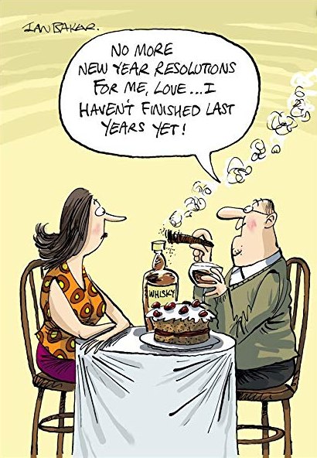

Slide 17
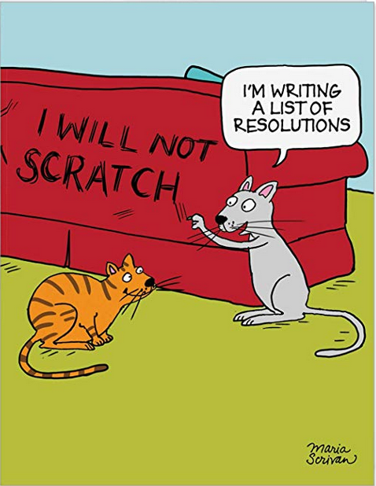

Slide 20
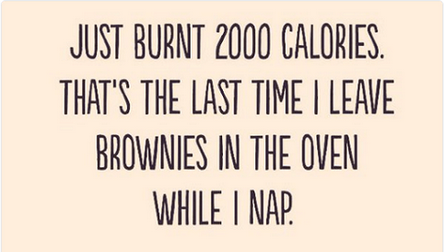

Slide 21
New Year Resolutions
Romans 6:1–14 (Shall we keep sinning?)
I. Who are we?
II. What are we to do?
III. Who should we imitate?

Slide 22
New Year Resolutions
What are we to do? (6:12–14)
Since we are no longer under sin’s rule (6:2), we shouldn’t let sin rule us or boss us around! (6:12)
Not-vicariously (6:3–5), but deliberate decision/action that we ourselves do (6:13)
Not subject our organs [tongue, mind, eyes] to sin (v. 13a)
But present ourselves to God (v. 13b)
Not make too many rules (v. 14)

Slide 23
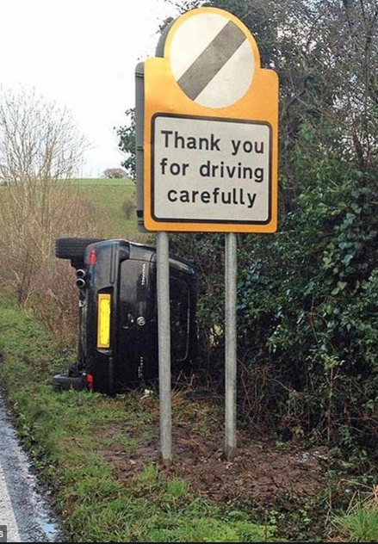

Slide 24
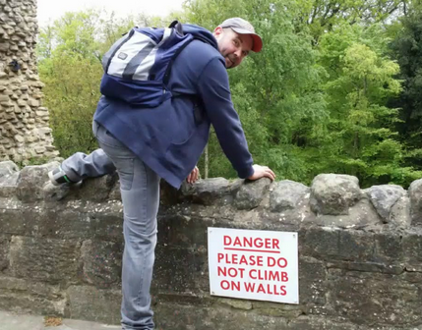

Slide 25
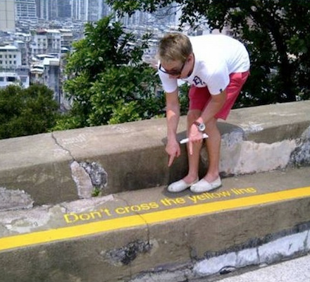

Slide 26
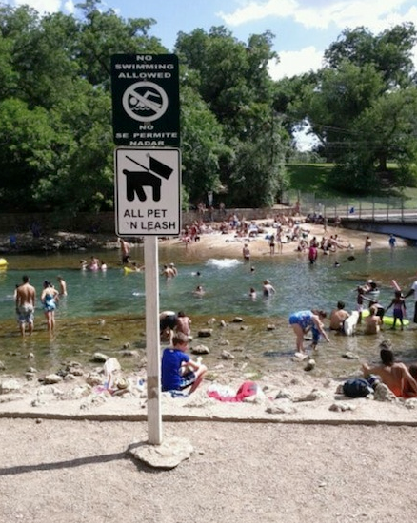

Slide 27
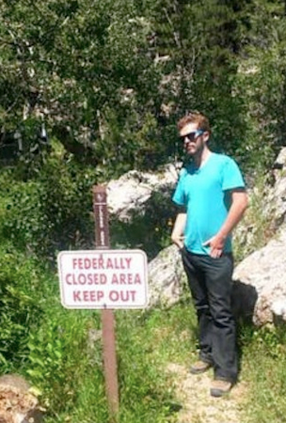

Slide 28
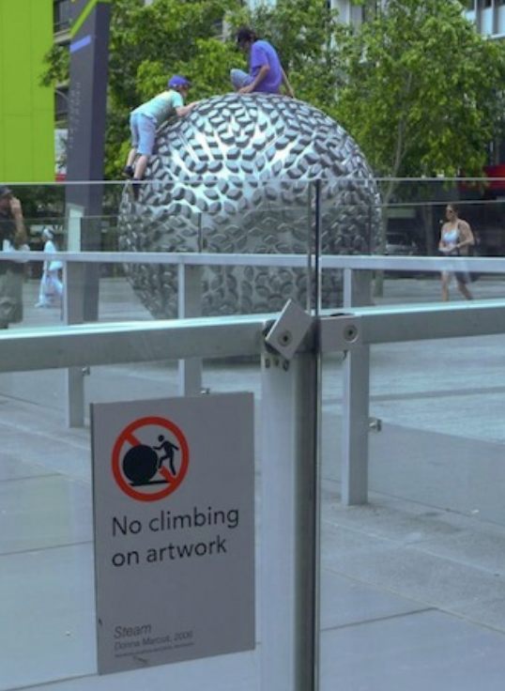

Slide 29
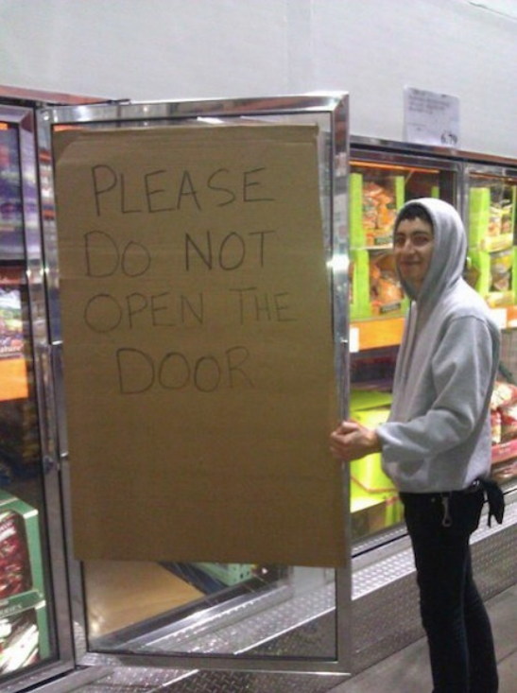

Slide 30
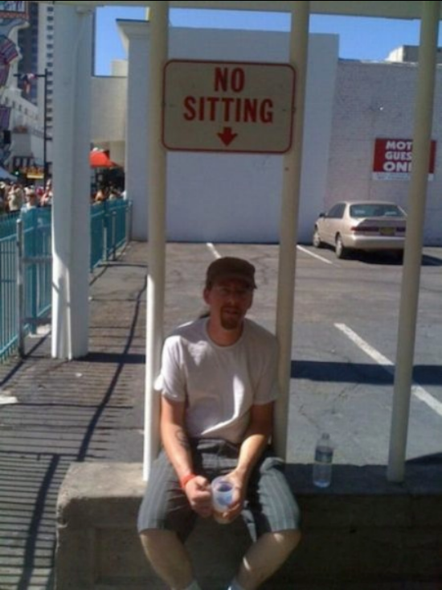

Slide 32
New Year Resolutions
Romans 6:1–14
“Since you died with Christ . . . Why . . . do you submit to this world’s rules: ‘Do not handle! Do not taste! Do not touch!’? These rules . . . are based on merely human commands and teachings. Such regulations indeed have an appearance of wisdom, with their self-imposed worship, their false humility and their harsh treatment of the body, but they lack any value in restraining sensual indulgence” (Col 2:20–23)

Slide 33
New Year Resolutions
Romans 6:1–14
If we can’t make rules, then what are we to do?
Imitate

Slide 35
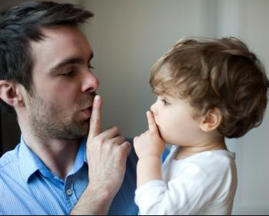

Slide 36
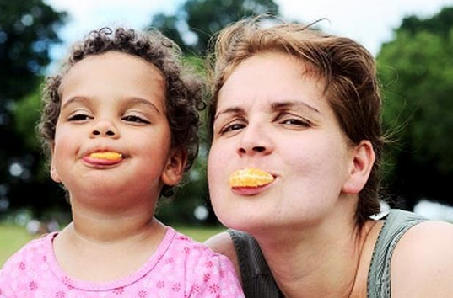

Slide 38
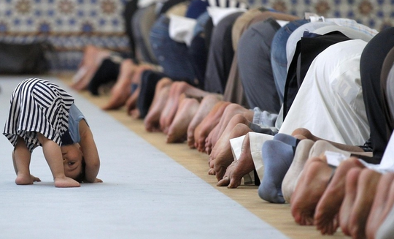

Slide 39
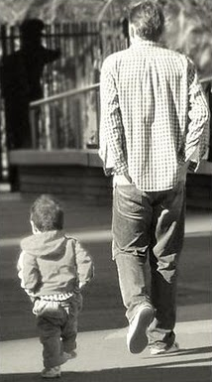

Slide 40
New Year Resolutions
Romans 6:1–14 (Shall we keep sinning?)
I. Who are we?
II. What are we to do?
III. Who should we imitate?

Slide 41
New Year Resolutions
Who should we imitate? (6:9–11)
The Messiah – Jesus Christ (6:9a)
He doesn’t let death rule him; once-in-for-all (6:9b, 10a)
The life he lives – he lives only for God (6:10b)
So should we: die [break-off any relationship] to sin; living for God, in/with Christ Jesus (6:11)

Slide 42
New Year Resolutions
Who should we imitate? (6:9–11)
What does “living for God” looks like?
[Not letting sin and death rule us or boss us around]
Offering our bodies as a living sacrifice (12:1)
Transforming our minds to think God-thoughts (12:2)
Showing a sincere love towards one another (12:9)
Honoring and respecting our bosses [governments] (13:7)
Accepting one another as Christ has accepted us – without racial, social, political, and gender biases (15:7)
Ultimately . . . Imitating Christ Jesus

Slide 43
New Year Resolutions
Romans 6:1–14 (Shall we keep sinning?) NO!
I. Who are we? A new person
II. What are we to do? Live for God (without rules!)
III. Who are we to imitate? Jesus Christ – WWJD

Slide 44
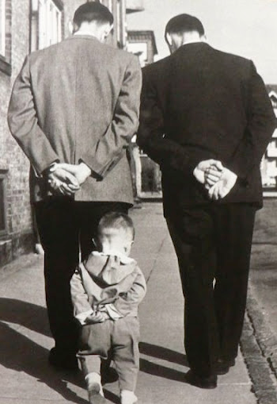
New Year Resolutions
Who should we imitate? (6:9–11)
“Very truly I tell you, the Son can do nothing by himself; he can do only what he sees his Father doing, [and] whatever the Father does the Son also does” (John 5:19, NIV)
Jesus imitates the Father . . . and we imitate him

Slide 45
New Year Resolutions
Romans 6:1–14 (Shall we keep sinning?) NO!
I. Who are we? A new person
II. What are we to do? Live for God (without rules!)
III. Who are we to imitate? Jesus Christ – WWJD

Slide 46
Black

Slide 47
NT Preaching link at BibleStudyDownloads.org
Get this presentation and notes for free!

