Slide 1
Crouching Sin and Hidden Victory
Romans 6:1–23
Preached by Andrew B. Spurgeon at Crossroads International Church Singapore • cicfamily.com Uploaded by Dr. Rick Griffith • Singapore Bible College Thousands of files in 44 languages for free at BibleStudyDownloads.org

Slide 2
Cain and Abel (Gen 4:1–12)
Cain and Abel’s offerings . . .

Slide 3
Cain and Abel (Gen 4:1–12)
God said to Cain, “Why are you angry? Why is your face downcast? If you do what is right, will your offering be not accepted? But if you do not do what is right”

Slide 4
Cain and Abel (Gen 4:1–12)
“Sin is crouching at your doors; it desires to have you, but you must master it.”

Slide 5
Cain and Abel (Gen 4:1–12)
Definition of sin: “But if you do not do what is right sin is crouching at you” (Gen 4:7).
“Knowing what is good to do and not doing it is sin” (Jam 4:17)
Every act that doesn’t come from the assurance of the conscience is sin (Rom 14:23).

Slide 6
Cain and Abel (Gen 4:1–12)
Definition of sin: Not doing what you certainly know is right to do (Gen 4:7; Rom 14:23; Jam 4:17).
This certainty comes from God and his word, the Bible.

Slide 7
Crouching Sin and Hidden Victory
Romans 6:1–23

Slide 8
Background
Paul has been talking about the “grace” of God in terms of gospel which is . . .
Christ centered (1:1–17)
For everyone (1:18—3:20)
Based on faith (3:21–5:21)

Slide 9
Background
One verse summarizes this “grace” of God
“God demonstrated his love for us this way — while we were sinners, Christ died for us” (Rom 5:8)

Slide 10
Background
Consequences of the grace are:
“We have peace with God” (5:1)
“We will be saved from the coming wrath” (5:9)
Whereas Adam brought us sin and death; Christ brings us righteousness and life (5:12–19)

Slide 11
Law versus Grace (5:20–21)
“The law came to increase sin. Where sin increased, grace increased.”
“Just as sin reigned so also grace reigns” (5:20–21).

Slide 12
Grace and Sin (6:1–23)
Where sin increases, grace increases.
Oh wow! Shall I then keep on sinning so grace will keep on working? (6:1)

Slide 14
Grace and Sin (6:1–23)
“Shall we keep on sinning so grace will keep on working?”
NO!

Slide 15
Grace and Sin (6:1–23)
NO, because
1. We died to sin; so, we cannot live in sin (6:2–14)
2. We are slaves to righteousness (6:15–23)

Slide 16
1. We died to sin; so, we can’t live in sin (6:2–14)

Slide 17
1. Dead to Sin (6:1–14)
When did I die to sin? Seems like it is working in me every day.
At baptism (i.e., identification with Christ) — just as Christ died and was raised for the glory of God, we to die and live for a new life (6:3–4)

Slide 18
1. Dead to Sin (6:1–14)
At baptism — our identification with the old man (Adam) is cut off; we have been crucified with Christ, buried, and resurrected — no longer a slave to sin (6:5–7); Just as Christ lives for God, we to live for God (6:8–10)
This is the theory!

Slide 19
1. Dead to Sin (6:1–14)
But the practice . . .
1. Know you are dead to sin and alive to God (6:11)
2. Don’t let sin rule your body to fulfill its evil desires (6:12)
3. Don’t offer your organs to sin, but to God (6:13)

Slide 20
1. Dead to Sin (6:1–14)
Those who are under “grace” are not subject to sin’s rule (6:14).
This is a change of loyalty/kingdom.

Slide 21
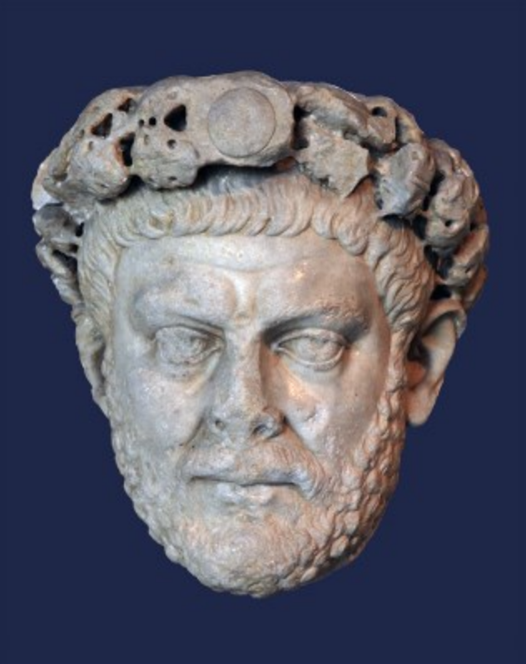
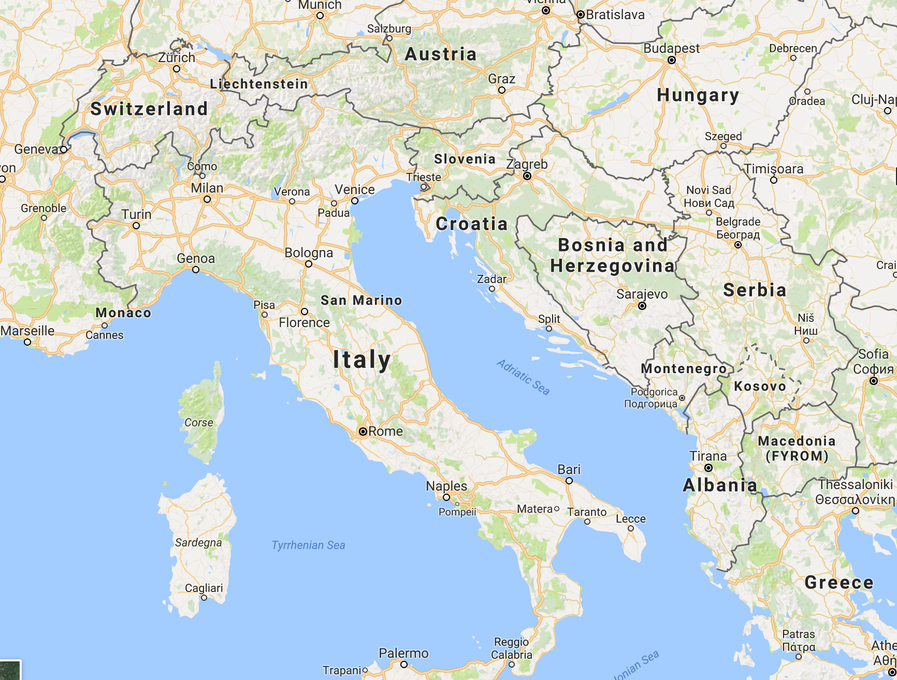
Diocletian, Roman Emperor, AD 244–321
A former slave that didn’t submit to his slavery but became a warrior and an emperor!

Slide 22
2. We are slaves to righteousness (6:15–23)

Slide 23
2. Slaves to Righteousness (6:16–23)
General Principle of servitude: “you serve your master”
Spiritually: A person is a slave to sin that leads to death or a slave to obedience that leads to righteousness (6:16)

Slide 24
2. Slaves to Righteousness (6:16–23)
“Thanks be to God who took we who were once slaves to sin and made us obey the ‘passed on teachings’ (gospel) so that we are set free from sin but made as slaves to righteousness.”
Obeying the gospel = being slaves to righteousness.

Slide 25
2. Slaves to Righteousness (6:16–23)
“You have been set free from sin and have becomes slaves of righteousness” (6:18)
“So, offer your organs to righteousness that leads to holiness” (6:19)

Slide 26
2. Slaves to Righteousness (6:16–23)
Life before Christ
- shame and death
Life after Christ
- holiness and eternal life (6:21–22)
Wages of sin was death; Gift of God is eternal life in Christ Jesus Christ (6:23)

Slide 27
Grace and Sin (6:1–23)
“Shall we keep on sinning so grace will keep on working?”
NO!

Slide 28
Grace and Sin (6:1–23)
NO, because
1. We died to sin; so, we cannot live in sin (6:2–14)
2. We are slaves to righteousness (6:15–23)

Slide 29
Grace and Sin (6:1–23)
Now, we know the theory
- we are not slaves to sin
- we are slaves to righteous acts
But, how do we practice such a life?

Slide 31
Grace and Sin (6:1–23)
How did those kids do what they did?
They believed they could
They practiced faithfully

Slide 32
Grace and Sin (6:1–23)
The same is true of us:
We believe sin no longer has power over us (because of Christ’s work)
And we constantly practice acts of righteousness

Slide 33
Grace and Sin (6:1–23)
E.g., Covetousness (Rom 7)
We first believe we no longer need what the world says we need;
And, we constantly give away what we don’t need.

Slide 34
Grace and Sin (6:1–23)
Jesus’s example (Matt 4:2–4)
He first stated from the Bible that he didn’t need the food (Matt 4:4);
And, he didn’t make his own food but waited for God’s angels to provide him food (Matt 4:11).

Slide 35
Grace and Sin (6:1–23)
Gal 5:19–21 lists some sins: “Immorality, impurity, idolatry, discord, hatred, envy, jealousy, debauchery, witchcraft, fits of rage, selfish ambition, dissensions, factions, drunkenness, orgies, and the like.” and says, “Those who belong to Christ Jesus have crucified the flesh with its passions and desires” (Gal 5:24)

Slide 36
Grace and Sin (6:1–23)
Then Paul lists Spirit’s results (fruit) in a Christian’s life: “love, joy, peace, patience, kindness, goodness, faith, gentleness, and self-control” (5:23)
—Acts of Righteousness

Slide 37
Grace and Sin (6:1–23)
1. Sin no longer has power over us.
2. We are dedicated to doing good.

Slide 38
Conclusion
Sin is crouching at our doors; it desires to have us, but we must master it.

Slide 39
Conclusion
We master it by committing to do what is right.
Love, joy, peace, patience, kindness, goodness, faith, gentleness, and self-control.

Slide 40
Black

Slide 41
NT Sermons link at BibleStudyDownloads.org
Get this presentation and notes for free!

