Slide 1
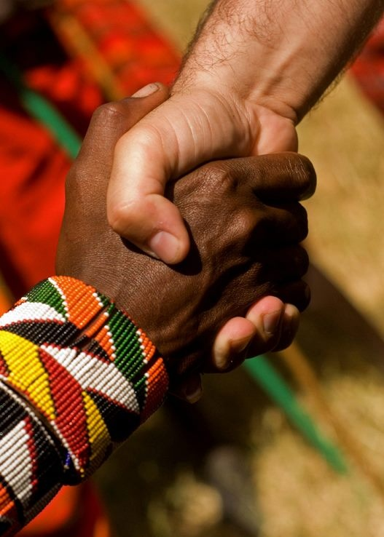
Death & Resurrection
Romans 5
Preached by Andrew B. Spurgeon at Crossroads International Church Singapore • cicfamily.com Uploaded by Dr. Rick Griffith • Singapore Bible College Thousands of files in 44 languages for free at BibleStudyDownloads.org

Slide 2
Theme
“Accept one another just as Christ has accepted us for the glory of God” (Rom 15:7)

Slide 3
Theme
The Gospel About the Son, who is David’s son and resurrected from the dead (Son of God); we obey | The Need for the Gospel Whether sinner, saint, privileged, or a human, we all need the gospel | The Gospel Explained How God proves himself as upright (righteous); Why is it based on faith-alone and what is faith?
1:1–17 | 1:18–3:20 | 3:21–5:21

Slide 4
The Gospel
The Gospel is the birth announcement of King David’s son, who resurrected from the dead and is the Son of God, Jesus Christ. Those who believe in him have salvation.

Slide 5
Objection 1
But, I don't need the Gospel!
I am not a sinner.

Slide 6
Objection 2
But, I don't need the Gospel!
I am a saint!

Slide 7
Objection 3
But, I don't need the Gospel!
I am privileged.

Slide 8
Objection 4
But, I don't need the Gospel!
I am not “totally depraved.”

Slide 9
Paul’s Answer
Whether we are “sinners,” “saints,” “privileged,” or “mere human” — we are in need of the Gospel of Jesus Christ.

Slide 10
The Righteousness of God
1. God is upright because salvation rests on faith (1:17), i.e., apart from the law (3:21) although testified by the law and the prophets (3:21)

Slide 11
The Righteousness of God
2. God is upright because salvation is by the faithfulness of Jesus Christ (3:22)

Slide 12
The Righteousness of God
3. God is upright because salvation is offered to everyone who believes, without distinction—all have sinned (3:22–23)

Slide 13
The Righteousness of God
4. God is upright because salvation is a free gift based on God’s grace and redemption that is in Christ Jesus (3:24)

Slide 14
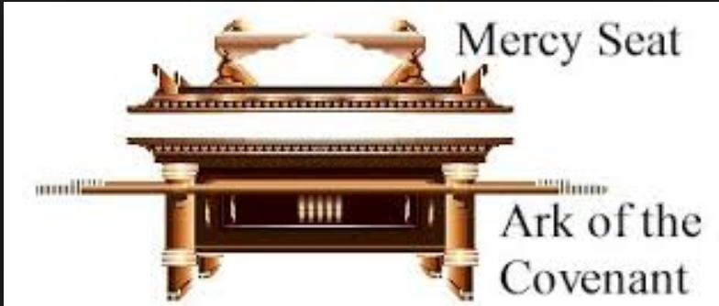
The Righteousness of God
5. God is upright because he appointed Jesus as the “mercy seat” because of Jesus’ faithfulness, in his blood—demonstrations of his uprightness (3:25a)

Slide 15
The Righteousness of God
6. God is upright because he overlooked [through Jesus’ work] sins committed beforehand (3:25b)

Slide 16
The Righteousness of God
7. God is upright because in his patience he demonstrates his uprightness in the present time, that is, by being the Judge and the one who justifies people by Jesus’ faithfulness (3:25b)

Slide 17
Forefathers Testify
Forefathers Testify to a faith-based Salvation
Abraham (Rom 4:1–6)
David (Rom 4:7–8)
Abraham (Rom 4:9–22)

Slide 18
Faith-Based Salvation
Abraham (4:17b)
What did Abraham believe?
“God gives life to the dead and calls into being things that are not.”

Slide 19
Faith-Based Salvation
What Must We Believe?
Believe in him, i.e., God who raised Jesus, our Lord, from the dead (Rom 4:24)
Believe that the Lord “was handed over for our trespasses and raised for our righteousness” (Rom 4:25)

Slide 20
The Resurrection
The Gospel included the resurrection of Jesus Christ.
Our faith included the resurrection of Jesus Christ.

Slide 21
“Let me ask you guys a question.” “Shoot.” “What if there were no tomorrow?” “No tomorrow? That would mean there’ll be no consequences . . . We could do whatever we wanted." "That’s true. We could do whatever we want.”

Slide 22
The Resurrection
Let me ask you a question:
What if there is no resurrection?
We could all do whatever we wanted. There will be no consequences.

Slide 23
The Resurrection
Story of Two Adams (Rom 5:12–21)
First Adam brought sin, death, and condemnation (5:12–14, 16)
Second Adam brought gift/grace, life, and “uprightness” (5:15–21)

Slide 24
The Resurrection
What if there is no resurrection?
We can all do whatever we wanted. There will be no consequence.
But, there is Resurrection! Everyone will be raised from the dead. There will be consequences.

Slide 25
The Resurrection
So, how is this good news?
Those who receive the grace/gift of salvation that is in Jesus Christ’s death and resurrection “have peace with God” (Rom 5:1, 6–11)

Slide 26
The Resurrection
While we were weak, Christ died for us, the un-reverent people (5:6)
While we were sinners, Christ died for us (5:7–8)
While we were enemies, Christ reconciled us to God (5:10–11)

Slide 27
The Resurrection
Now that we are reconciled to God, made upright with God, we are saved from upcoming wrath (5:9), we have peace with God (5:1)

Slide 28
The Resurrection
So, what should we do?
We gain access by faith into this great salvation (5:2)
We boast in the hope and glory of God (5:3, 12)
We endure sufferings, knowing the result (5:4–5)

Slide 29
Black

Slide 30
NT Sermons link at BibleStudyDownloads.org
Get this presentation and notes for free!

