Slide 1
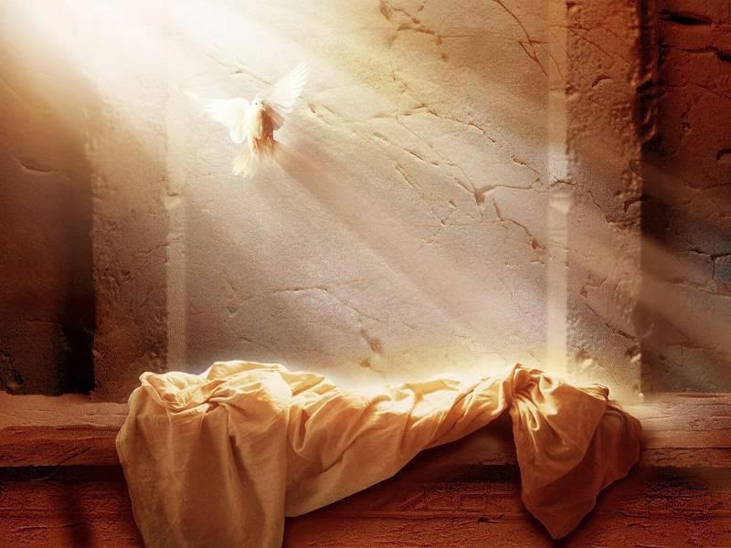
Resurrection Implications
Romans 4:25; 6:10-11
& Other Passages
Dr. Rick Griffith, Crossroads International Church Singapore
cicfamily.com & BibleStudyDownloads.org

Slide 2

Christmas & Easter
Notes:
My two hardest times to preach are Christmas and Easter. You know why? Unpredictable speakers are more interesting, but at these two holidays everyone already knows what I’m going to say!

Slide 3
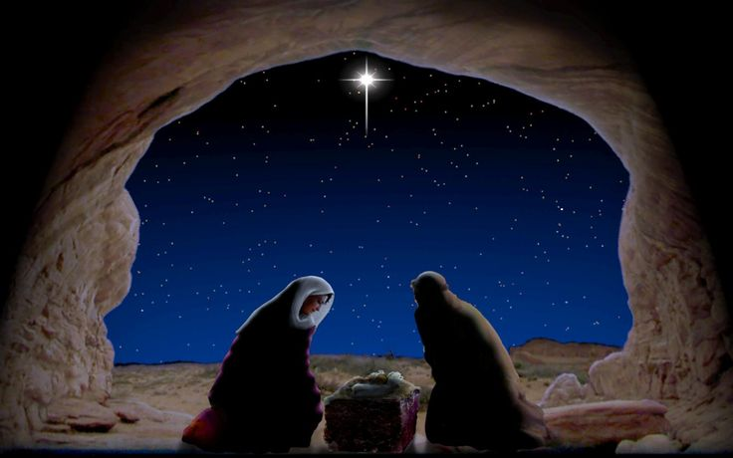
Christmas
Notes:
At Christmas everyone knows how I’m going to come out—against Herod and for the Baby Jesus, against Zechariah’s disbelief and for Mary’s simple faith, etc.

Slide 4
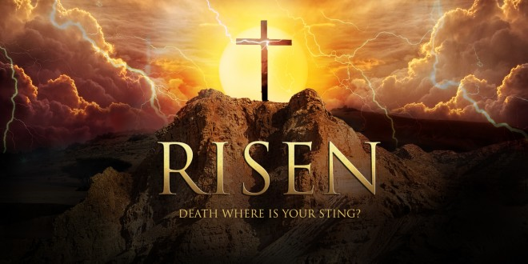
Subject?
Notes:
And when Easter comes everyone knows that I’m going to be for the resurrection of Christ and against the soldiers and religious leaders who tried to cover it up.

Slide 5
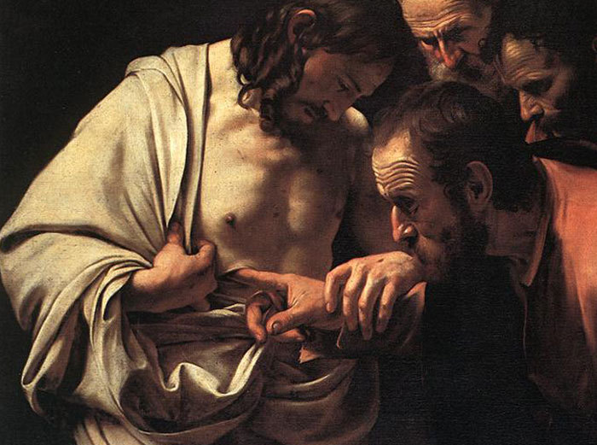
What do I say to the majority of us who already believe?
Notes:
So what do I say to most of us who already believe in the resurrection of Christ?

Slide 6
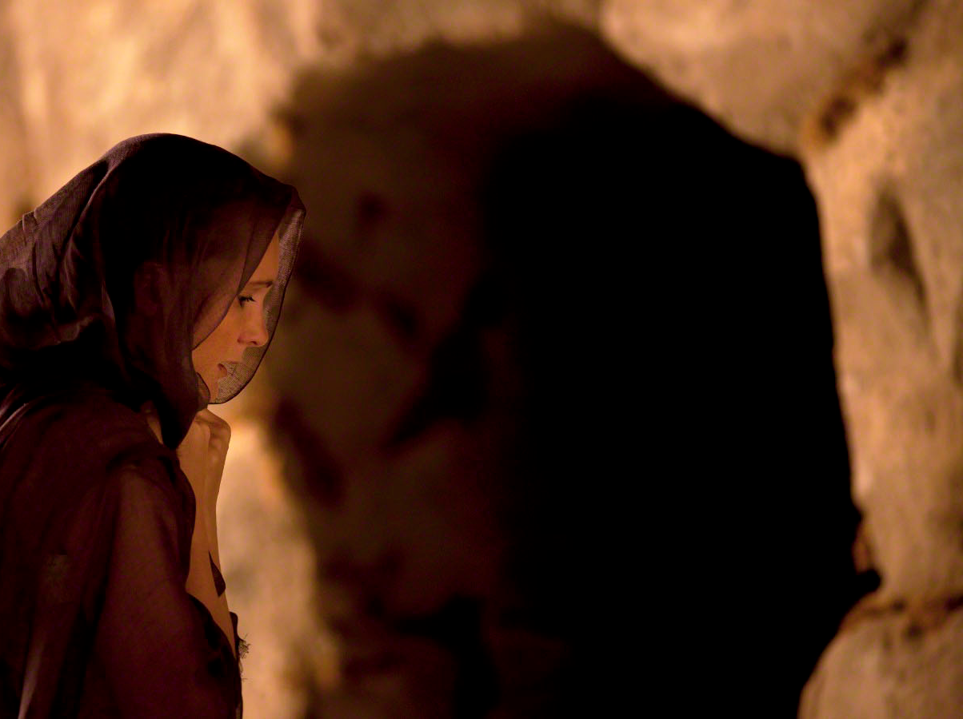
"Early on the first day of the week, while it was still dark, Mary Magdalene went to the tomb and saw that the stone had been removed from the entrance"
(John 20:1).
Notes:
This year I’m not going to explain how Christ’s resurrection came about.

Slide 7
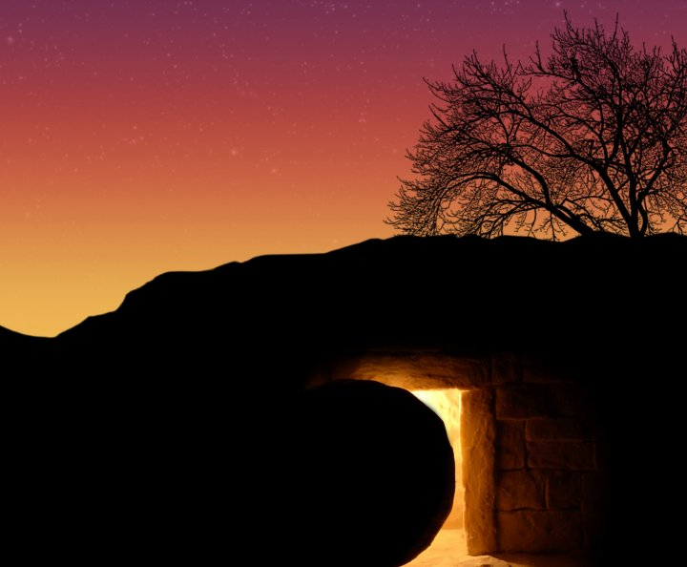
How did Jesus rise?
Notes:
I’m also not going to try to prove His resurrection for you.

Slide 8
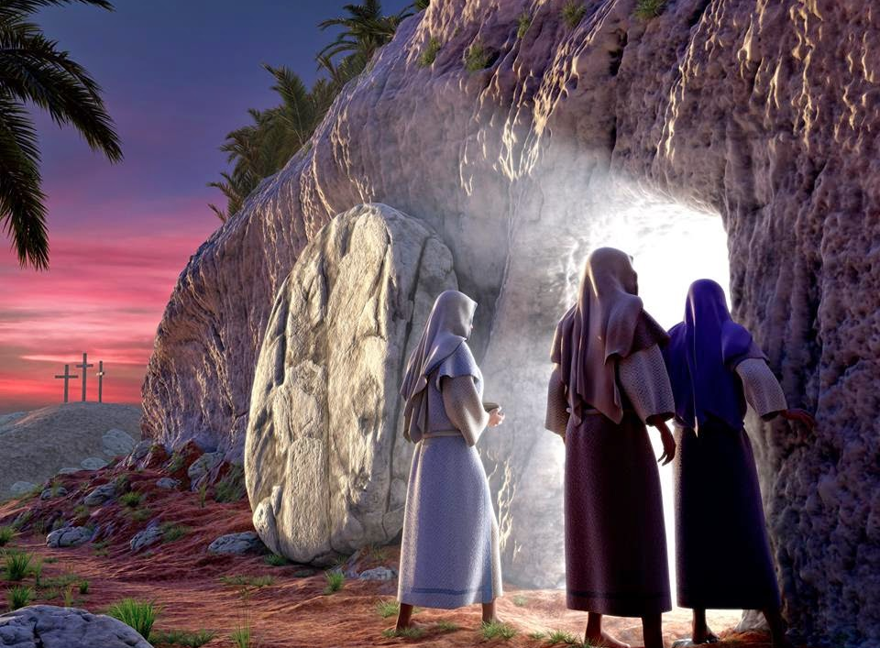
Jesus Rose:
So What?
Notes:
Instead of explaining the story or proving it, this year we’ll look at the implications of this great event.

Slide 9
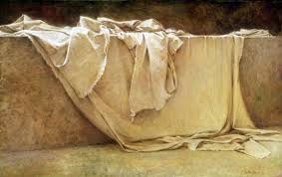
Why is the resurrection important to you?
Notes:
Do you believe Jesus rose again? What does it mean to you? Tell the person next to you why His resurrection is important to you in the next 30 seconds…

Slide 10
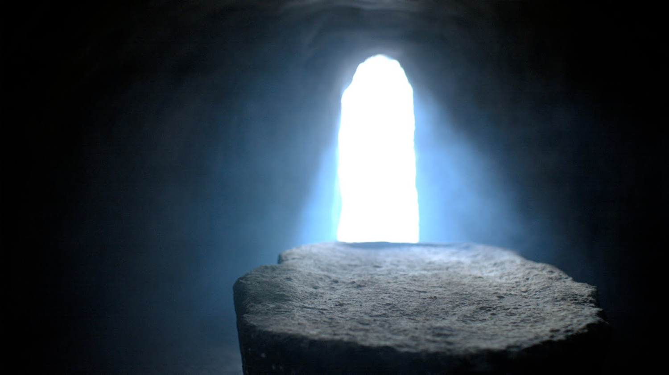
So what difference does Christ's resurrection make in your life ?
Notes:
So what difference does Christ’s resurrection make in your life?
Well, let’s see how…

Slide 11
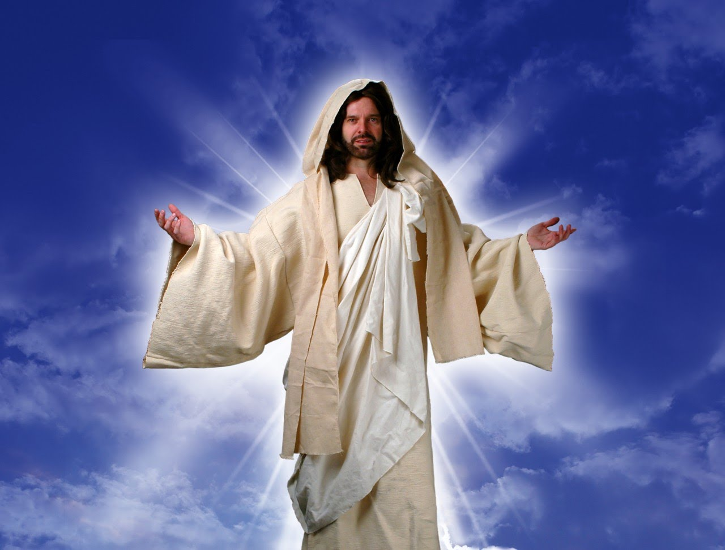
I. Christ's resurrection impacts you in many ways!
Notes:
Jesus being alive isn’t just a theological truth but a very practical reality in our lives.

Slide 12
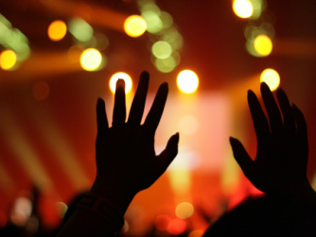
A. Christ's resurrection gives you a new day of worship.
Notes:
You know why we worship on Sunday? Only because Jesus rose from the dead!

Slide 13
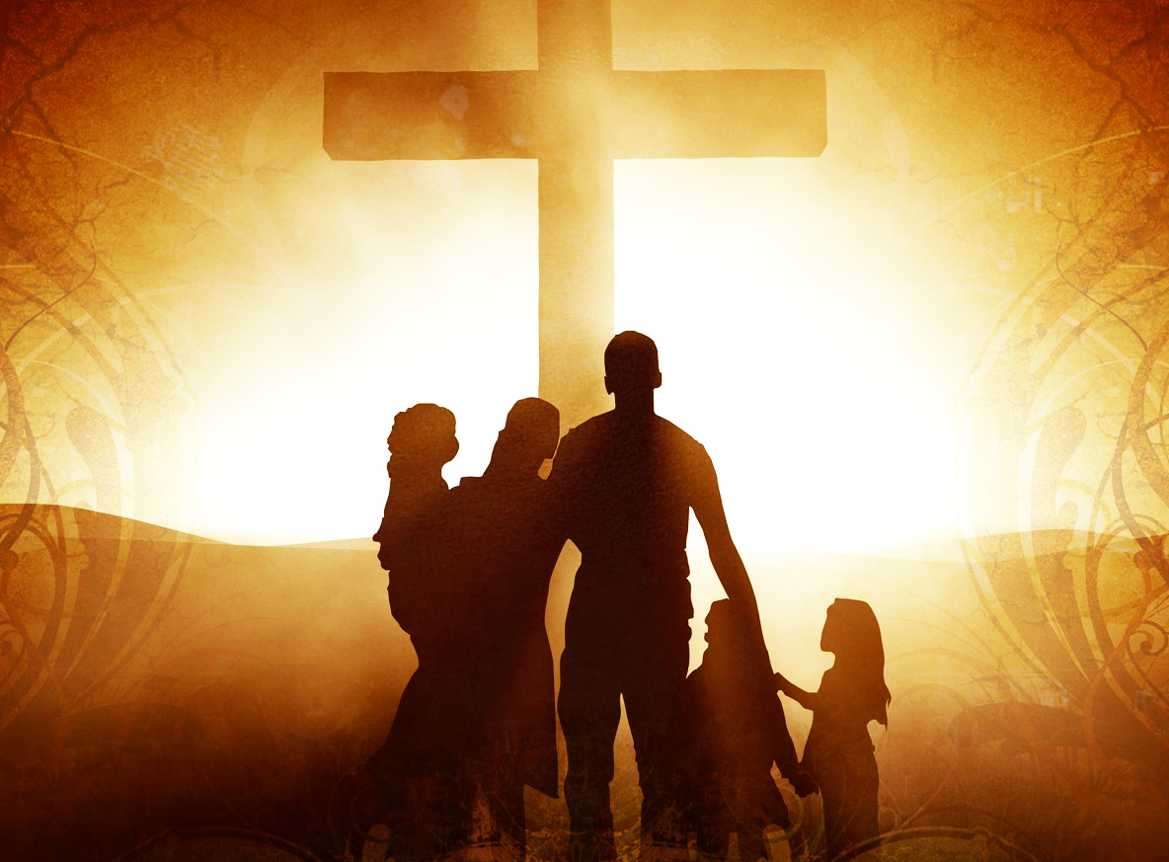
Why do we have Sunday off work for worship?

Slide 14
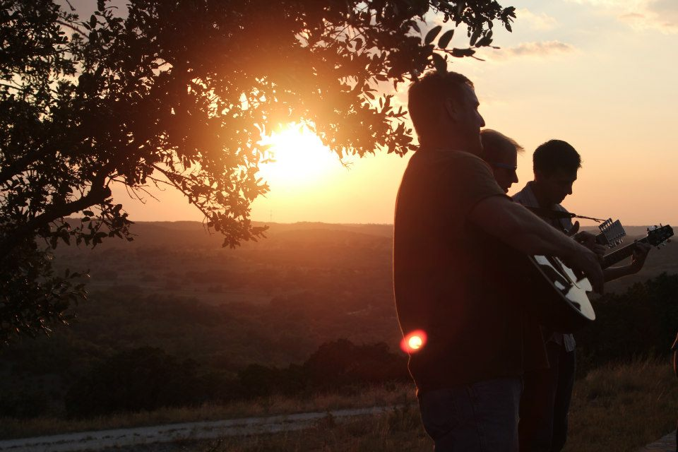
Easter Sunrise Service
Notes:
Maybe you’ve thought that we celebrate Easter on a Sunday because of the resurrection. True, but actually every Sunday is a celebration of the resurrection!

Slide 15
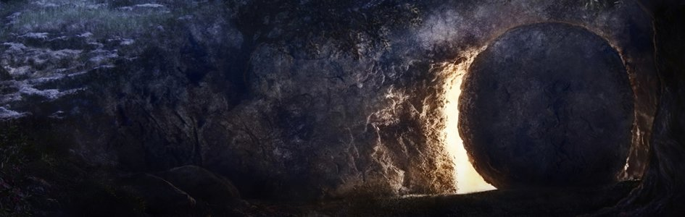
"Early on the first day of the week, while it was still dark, Mary Magdalene went to the tomb and saw that the stone had been removed from the entrance"
(John 20:1).
Notes:
Jesus rose on the first day of the week—Sunday. John writes

Slide 16
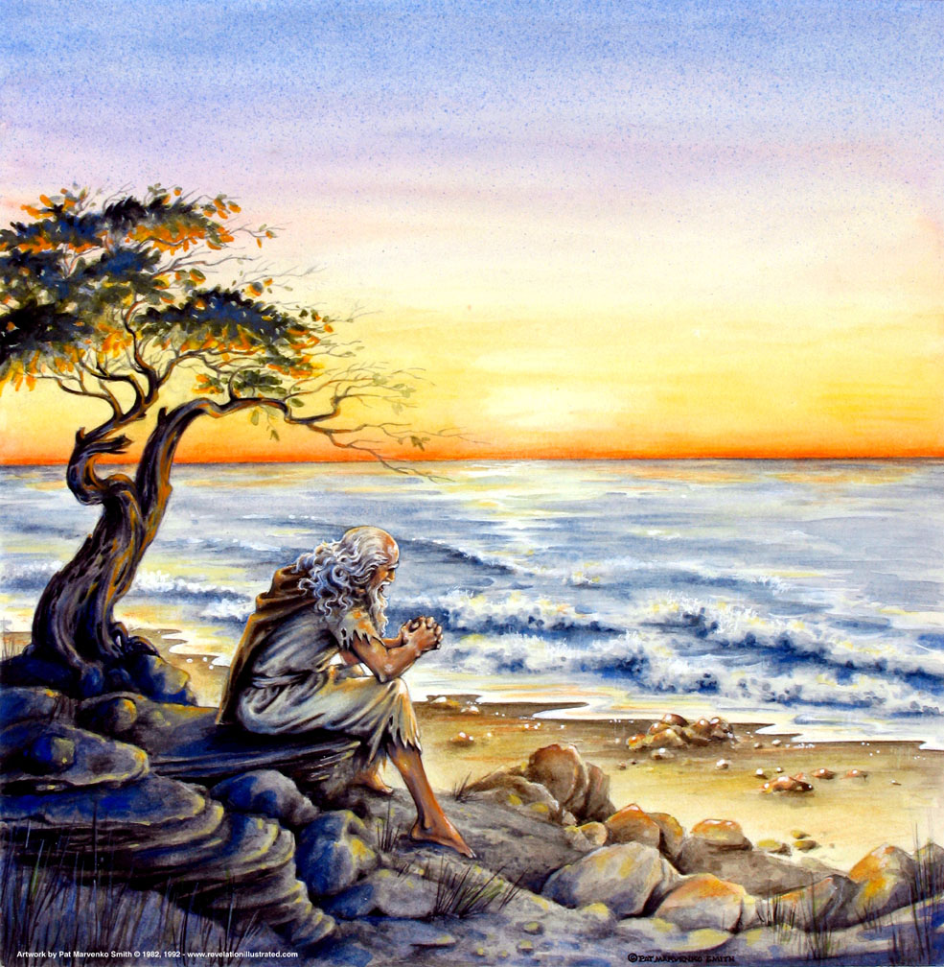
"…on the Lord's day…"
(Revelation 1:10)
319
Sunday!
Notes:
Since then Christians have gathered to worship on this day called "the Lord’s day" as the book of Revelation was revealed to John on what day?
• Sunday!

Slide 17
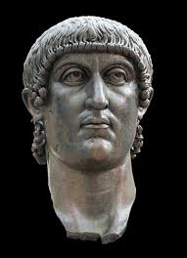

Sunday Rest by Constantine
Notes:
In fact, in the fourth century under the emperor Constantine Sunday also became a day of rest.

Slide 18
First Sunday Law Enacted by Emperor Constantine – March AD 321
"On the venerable Day of the Sun let the magistrates and people residing in cities rest, and let all workshops be closed. In the country, however, persons engaged in agriculture may freely and lawfully continue their pursuits; because it often happens that another day is not so suitable for grain-sowing or for vine-planting; lest by neglecting the proper moment for such operations the bounty of heaven should be lost."
Notes:
Constantine originally designated the pagan "Day of the Sun" a weekly holiday…

Slide 19
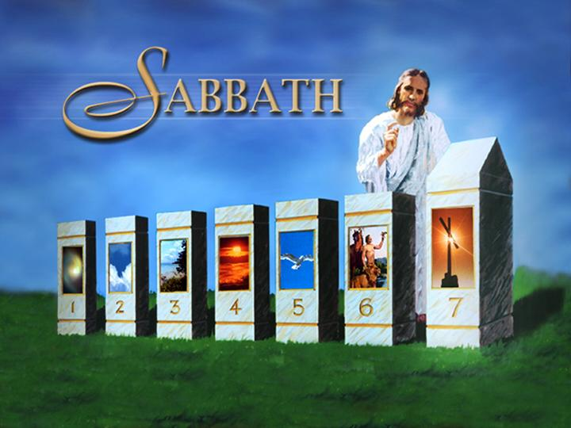
Pope Sylvester I (314-335) Decreed the Transfer of Sabbath Rest to Sunday
Sabbath Rest
SundayRest
Notes:
…but the pope at that time transferred the rest day from Saturday to Sunday.
_______
Source: Sabbath and Sunday in Early Christianity, by Robert L. Odom, © 1977 by the Review and Herald Publishing Association (An Adventist publishing house), pages 247-248.; cited by http://biblelight.net/sunday.htm accessed 26 March 2016

Slide 20
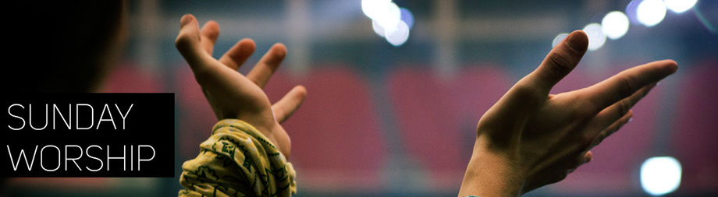
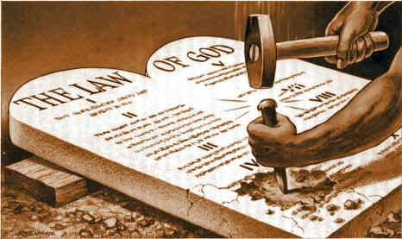
SUNDAY WORSHIP
?
Notes:
Seventh-Day Adventists see us as chipping out Sabbath worship…

Slide 21
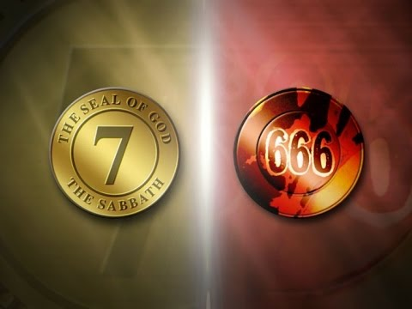
Sabbath or Sunday?
Notes:
…since they see Sunday worship as the Mark of the Beast.

Slide 22
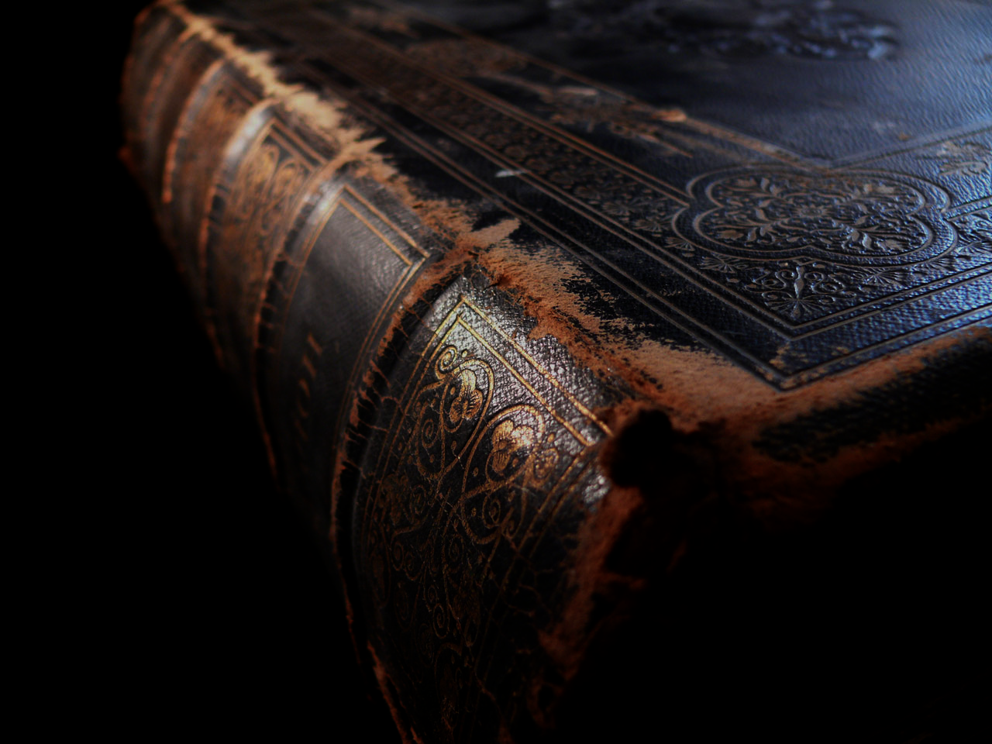
What does the Bible say about the Sabbath and Sunday?

Slide 23
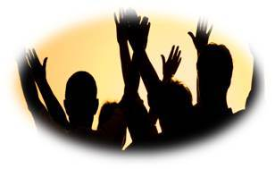
The NT Supports Sunday Worship

Slide 24
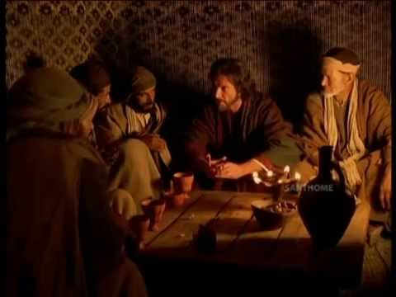
"On the first day of the week, we gathered with the local believers to share in the Lord's Supper” (Acts 20:7 NLT).
"This is the clearest verse in the New Testament which indicates that Sunday was the normal meeting day of the apostolic church…"
Notes:
Paul waited until Sunday in Troas for the church to worship (Acts 20:7).
"This is the clearest verse in the New Testament which indicates that Sunday was the normal meeting day of the apostolic church" (Stanley Toussaint, "Acts," in The Bible Knowledge Commentary, 2:412-13).

Slide 25
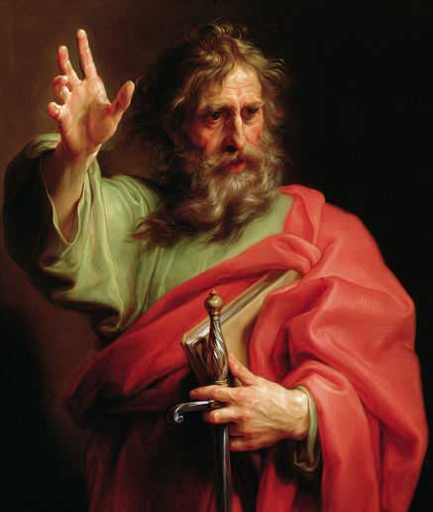
"Paul stayed in Troas for seven days (v. 6) and the church met on the first day of the week…Probably the church met at night because most people had to work during the day. Because Paul was leaving them, possibly for the final time, he prolonged his discourse until midnight" (Stanley Toussaint, "Acts," The Bible Knowledge Commentary, 2:412-13).
Notes:
”…Paul stayed in Troas for seven days (v. 6) and the church met on the first day of the week…Probably the church met at night because most people had to work during the day. Because Paul was leaving them, possibly for the final time, he prolonged his discourse until midnight" (Stanley Toussaint, "Acts," in The Bible Knowledge Commentary, 2:412-13).

Slide 26
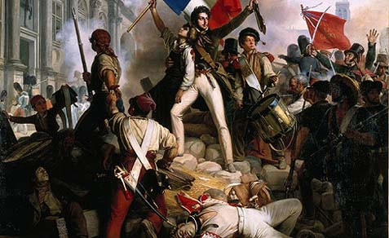
French Revolution (1789–1799)
Notes:
During the French Revolution atheistic politicians began to despise Sunday…

Slide 27
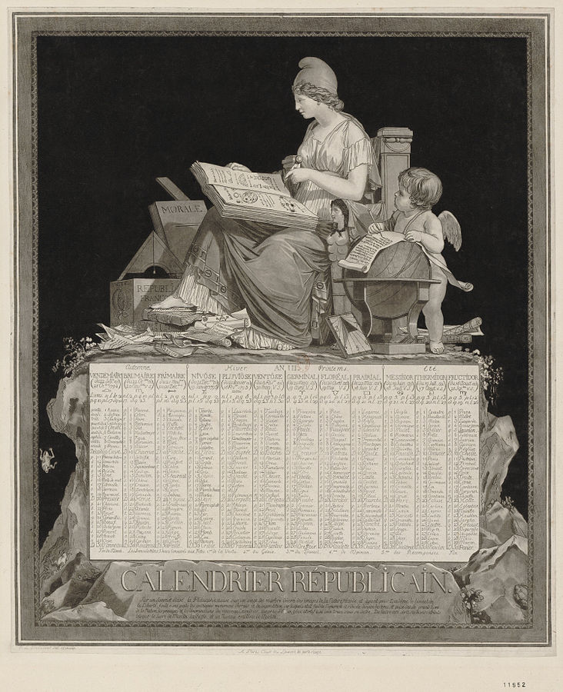
French Republican Calendar (1793–1805)
Notes:
…so the whole country was forced into months with three 10-day cycles. People worked nine days, and then had the tenth day off.
The infidel Voltaire was prominent in this, saying, "We cannot destroy Christianity until we first destroy the Christian Sabbath."
The change was disastrous! Horses that worked for ten days without rest just broke down in the street. Tan 6204 The plan was abandoned after only 12 years.
___________
https://en.wikipedia.org/wiki/French_Republican_Calendar

Slide 28
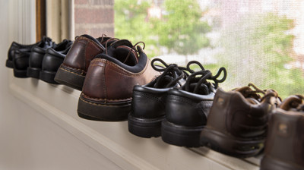
Take Your Rest
Notes:
Now many nations of the world acknowledge His resurrection by making Sunday the day of rest. That's why you have today off!

Slide 29
I. Christ's resurrection impacts us in many ways!
Notes:
So how does Christ’s resurrection affect us?

Slide 30
A. Christ's resurrection gives you a new day of worship.

Slide 31
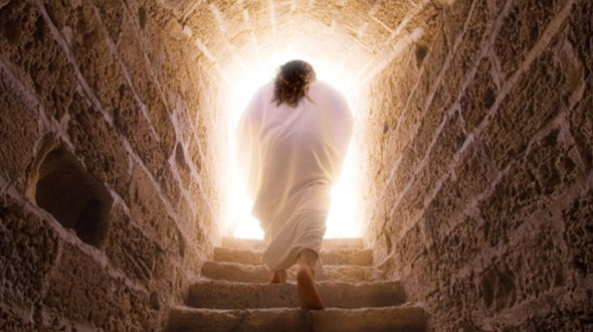
B. Christ's resurrection proves that Jesus taught truth.
Notes:
Since Christ’s empty tomb validates His claims, you have believed facts.

Slide 32
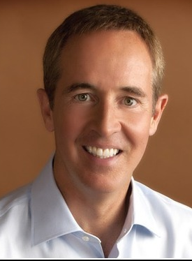
"If a man can predict his own death and resurrection, and pull it off, I just go with whatever that man says"
—Andy Stanley—

Slide 33
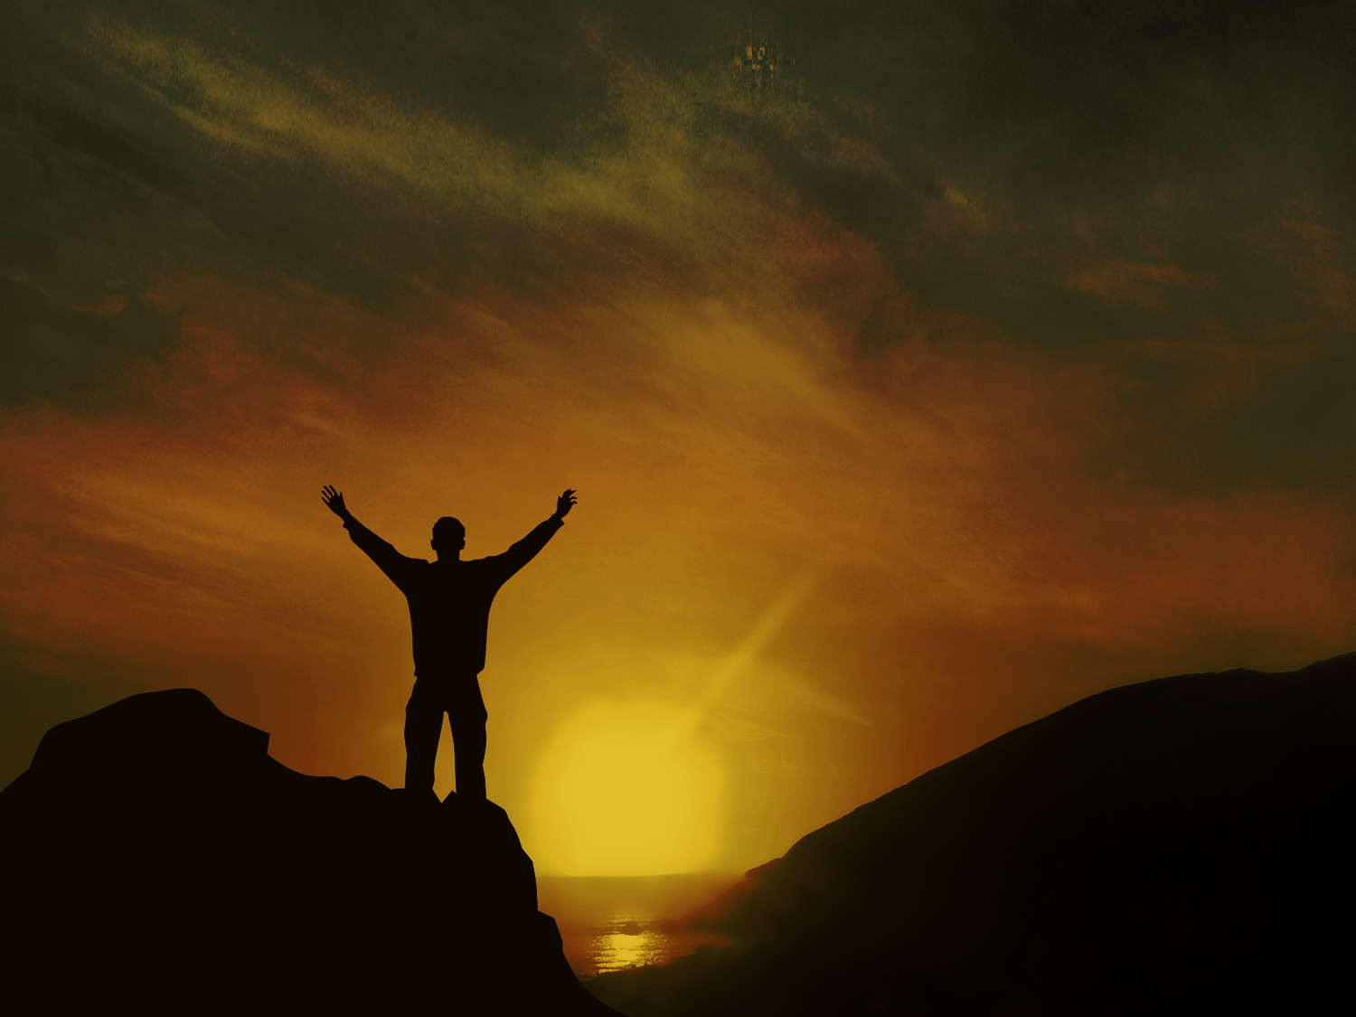
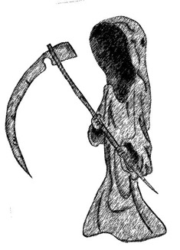
What's the Difference?
Dead
Buddha
Mohammed
Marx
Alive

Slide 34
What's the Difference?
"He was seen by Peter and then by the Twelve. ⁶After that, he was seen by more than 500 of his followers at one time, most of whom are still alive, though some have died. ⁷Then he was seen by James and later by all the apostles."
Dead
Jesus
Alive
Buddha
Mohammed
Marx
1 Cor 15:5-7

Slide 35
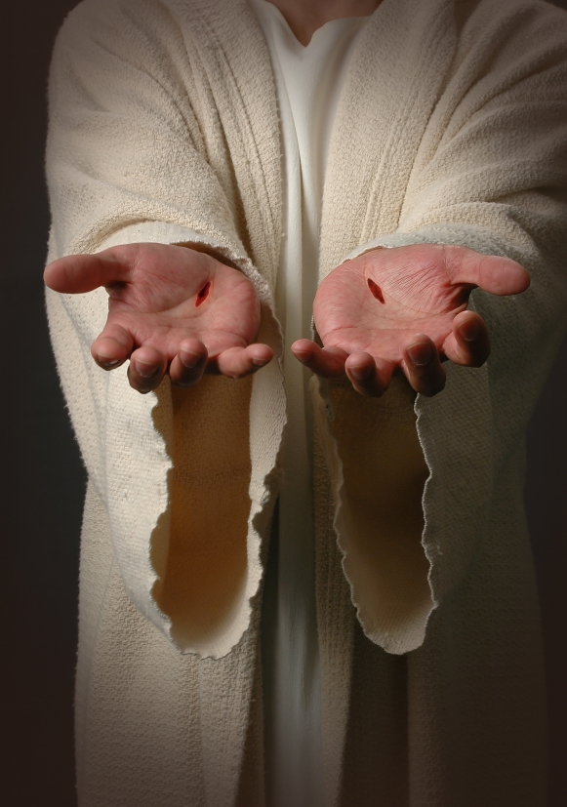
"God has raised this Jesus to life, and we are all witnesses of the fact… Therefore let all Israel be assured of this: God has made this Jesus, whom you crucified, both Lord and Christ"
(Acts 2:32, 36)
Notes:
Peter noted on the day the church started that since Christ rose from the dead, He is called "Lord"
By defeating death, Jesus proved that He was God, and since God is truth, Christ also is truth. So we can trust what Jesus had to say.

Slide 36
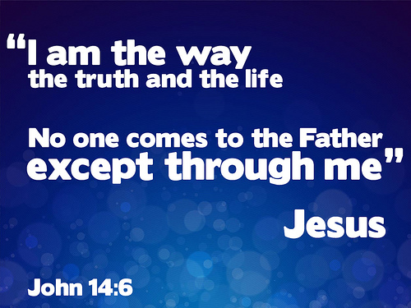
John 14:6
Notes:
And what did He say? Jesus made one of His most profound statements in John 14:6—"I am the way, the truth, and the life. No one comes to the Father but by me."

Slide 37
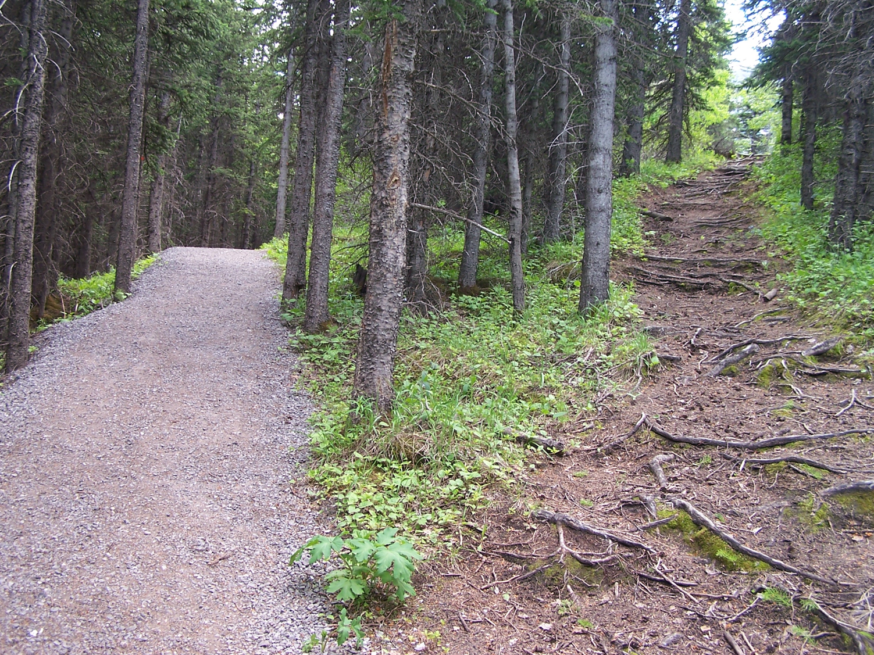
Fork in the Road
Notes:
"A man from another major religion became a Christian in Africa. Some of his friends asked him, 'Why have you become a Christian?' He answered, 'Well, it’s like this. Suppose you were going down the road and suddenly the road forked in two directions, and you didn't know which way to go, and there at the fork in the road were two men, one dead and one alive—which one would you ask which way to go?'" (Story by Dr. Seamands in Warren Webster, April 1980, HIS, 13)

Slide 38
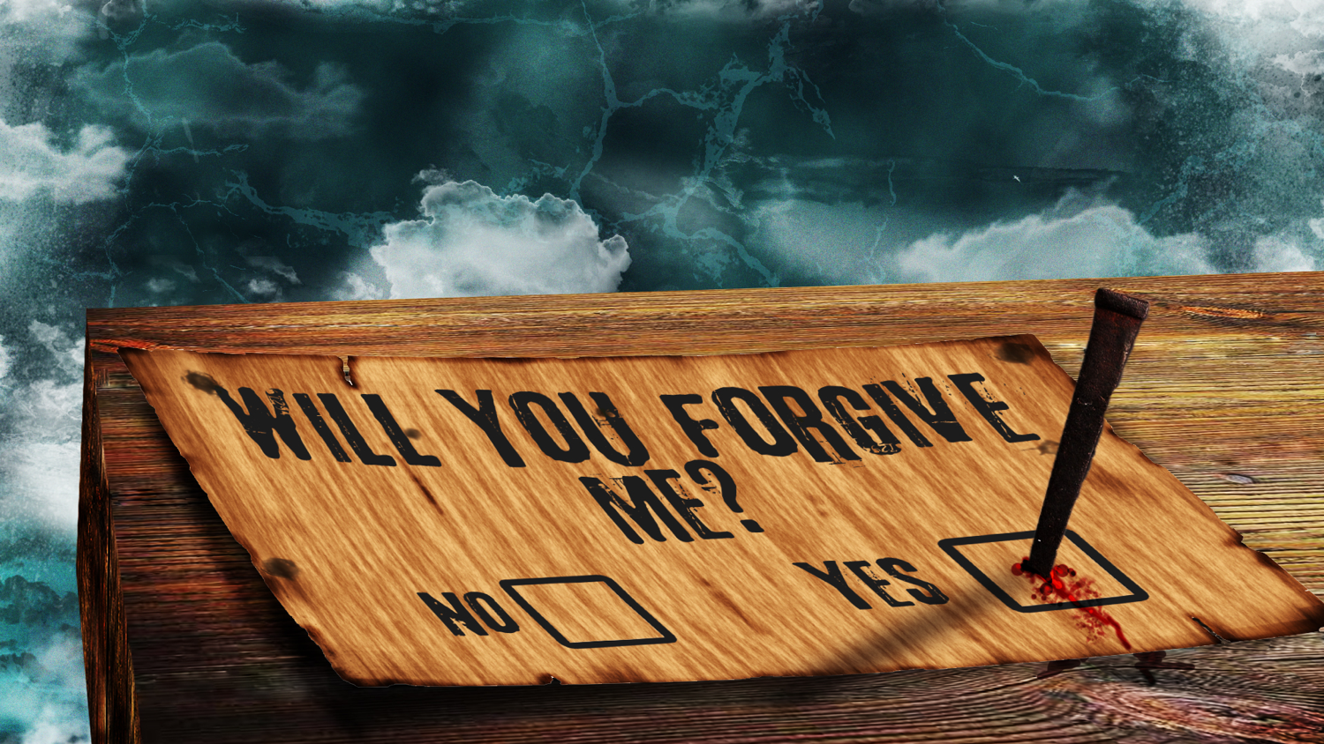
C. Christ's resurrection gives you forgiveness.
Notes:
Your sins are really forgiven in Christ since only God can forgive sin.

Slide 39
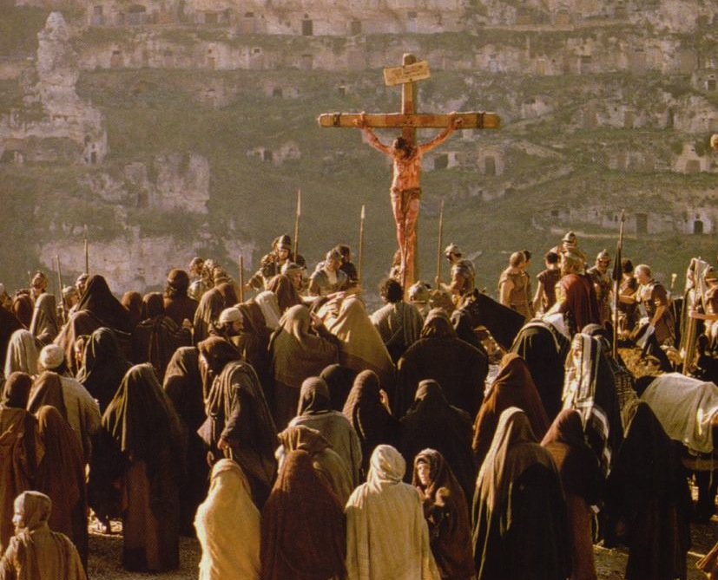
"God will credit righteousness—for us who believe… He was delivered over to death for our sins…" (Rom. 4:24-25)
Notes:
Jesus died for our sins and was raised for our justification (Rom. 4:25)

Slide 40
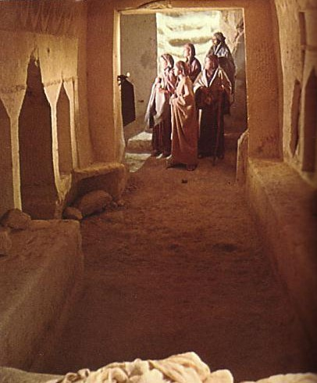
"…and was raised to life for our justification"
(Rom. 4:25)
Notes:
Jesus died for our sins and was raised for our justification (Rom. 4:25)

Slide 41
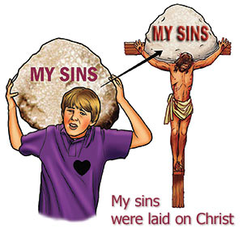
Atonement
Notes:
God in effect said to Jesus, "I approve of your sacrifice for sins, so there is no more penalty for sin that anyone else needs to make."

Slide 42


"It is finished"
155h
Justification (3:24)
God's act of declaring us "not guilty" for our sins, making us right with him
Legal
Justice (3:25-26)
The fairness of God where He punishes sin in an individual himself or in a Sinless Substitute (Jesus Christ)
Paid
in Full
Notes:
That’s what "justification" means: no more penalty, not guilty

Slide 43
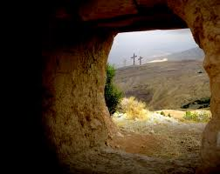
"Christ's death was the payment for sin…
…and His resurrection the receipt!"
— W. H. Griffith Thomas

Slide 44
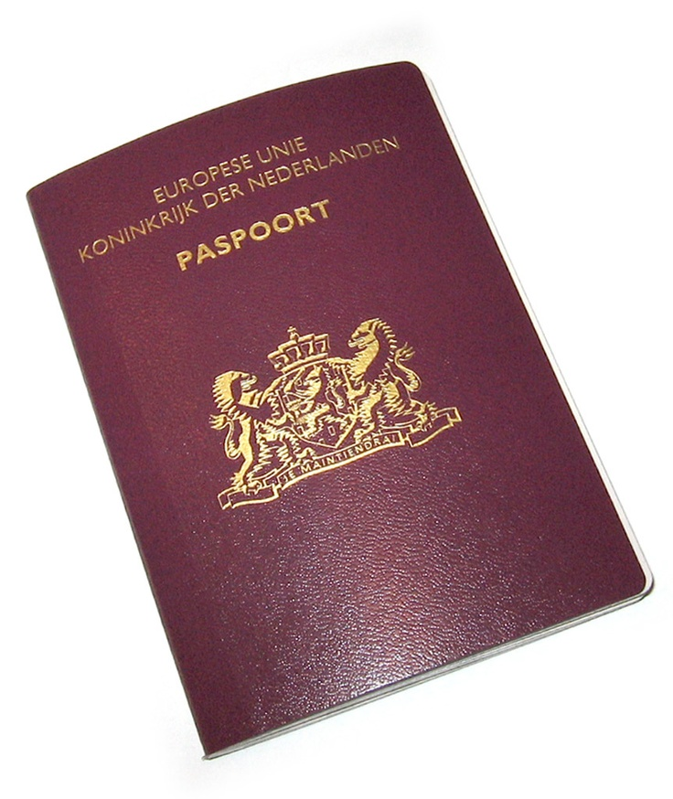
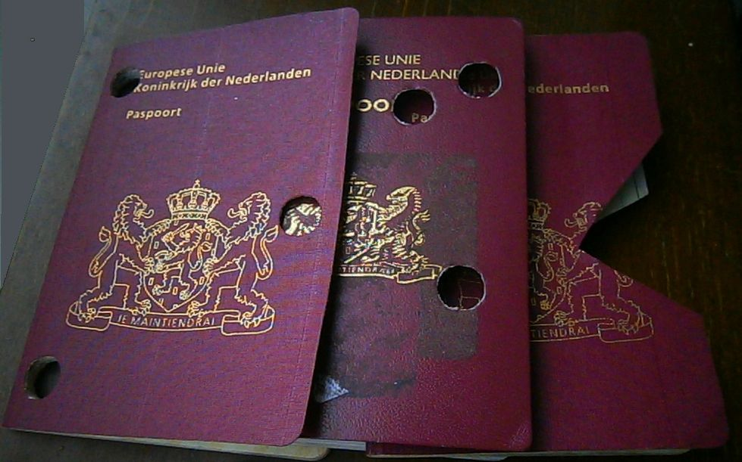
Passports
Notes:
It’s like the expiry of your old passport, riddled with holes.
• The fact that your past is gone is verified when you get the new passport—complete with all the rights granted to you as a citizen

Slide 45
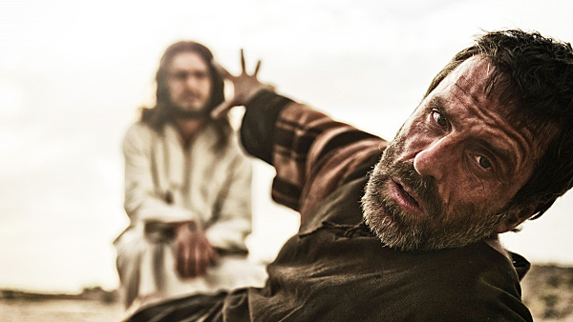
Christ's resurrection greatly affects our standing with God.

Slide 46
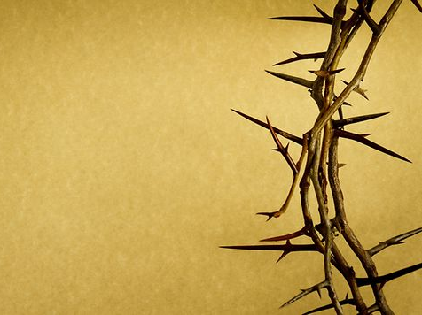
"And if Christ has not been raised, your faith is futile; you are still in your sins. Then those also who have fallen asleep in Christ are lost. If only for this life we have hope in Christ, we are to be pitied more than all men"
(1 Cor. 15:17-19).

Slide 47
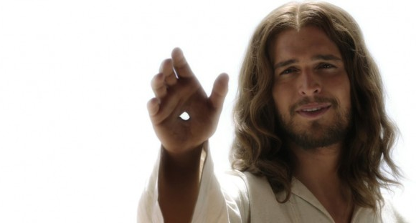
He is Alive!
Notes:
By rising from the dead, Christ showed he can conquer death. Which religious or political leader has ever died and come back to life? The one that can defeat death is the one that can forgive sin!

Slide 48
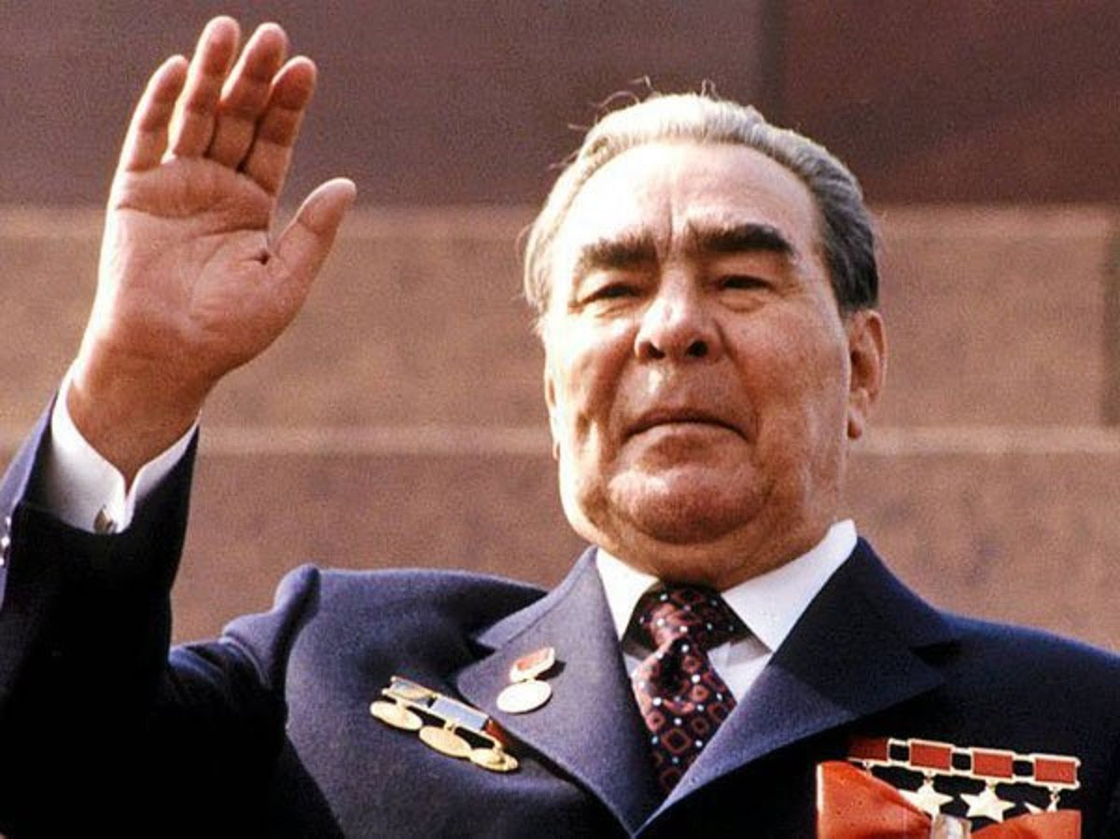
Leonid Brezhnev (1906-1982)
Notes:
At the 1982 funeral of former Soviet leader Leonid Brezhnev was a silent protest by Brezhnev's widow.

Slide 49
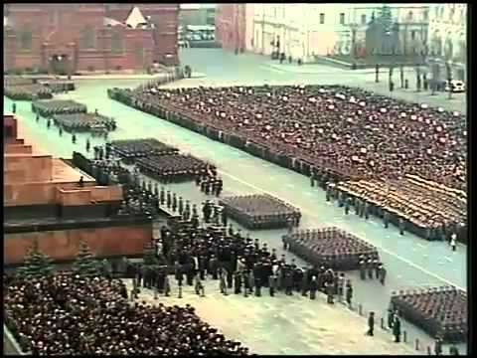
Leonid Brezhnev
Notes:
At the end of the elaborate state funeral, his widow stood motionless by the coffin until seconds before it was closed.

Slide 50
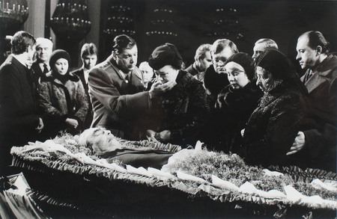
Leonid Brezhnev
Notes:
Then, just as the soldiers touched the lid, Brezhnev's wife performed an act of great courage and hope, a gesture that must surely rank as one of the most profound acts of civil disobedience ever committed: She reached down and made the sign of the cross on her husband's chest.
_____
http://timewgod.tumblr.com/post/13972115739/lend-me-your-hope-for-a-while
Accessed 26 March 2016

Slide 51
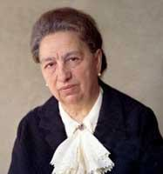
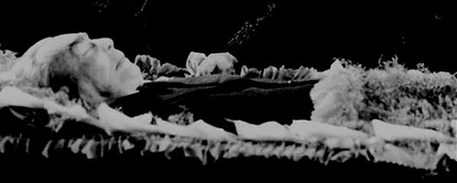
Leonid Brezhnev
Notes:
There in the citadel of secular, atheistic power, the wife of the man who had run it all hoped that her husband was wrong. She hoped that there was another life, and that that life was best represented by Jesus who died on the cross, and that the same Jesus might yet have mercy on her husband (Gary Thomas, in CT, October 3, 1994, p. 26).
__________
http://timewgod.tumblr.com/post/13972115739/lend-me-your-hope-for-a-while
Accessed 26 March 2016

Slide 52

"All praise to God, the Father of our Lord Jesus Christ. It is by his great mercy that we have been born again, because God raised Jesus Christ from the dead. Now we live with great expectation"
(1 Pet 1:3 NLT).
Notes:
In contrast, we now are "born again" in newness of life

Slide 53
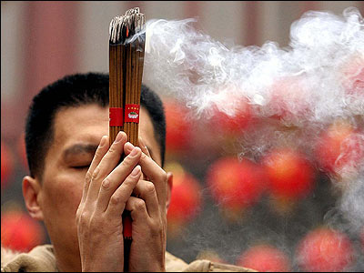
People all around us fear they have no forgiveness
Notes:
People all around us fear they have no forgiveness.
Why do those living near us use joss sticks and pray to idols of stone and wood? Because of fear—fear they don’t appease even those who loved them in this life!

Slide 54

"My home is just beyond."
Notes:
But Christ removes the fear of not being forgiven. Wow! Praise Him for that! A little girl lived near a cemetery and often had to walk through it after dark. When someone asked, "Are you ever afraid?"
• She said, "Oh, no. My home is just beyond." She had the assurance of her home nearby, so no fear.
Just like us. Being forgiven gives us the assurance that we will see His face!
And forgiveness reminds me of another benefit of His resurrection…

Slide 55

D. Christ's resurrection gives you victory over sin in your life.
Notes:
Since Jesus had power over sin in His resurrection, so do we!

Slide 56

Dead to Sin
Notes:
Christ’s resurrection allows us to count ourselves dead to sin (Rom. 6:10-11).

Slide 57

You are a slave to whatever controls you
Romans 6:16; 2 Peter 2:19; John 8:34
Notes:
Ever wonder why unbelievers do dumb things—throw away a marriage, gamble away their hard-earned money or risk their life in reckless sex?

Slide 58


NO LONGER A SLAVE TO SIN
Notes:
It’s because they really don’t have a choice—they are slaves to sin.

Slide 59

"When he died, he died once to break the power of sin. But now that he lives, he lives for the glory of God. ¹¹So you also should consider yourselves to be dead to the power of sin and alive to God through Christ Jesus"
(Rom. 6:10-11 NLT).
dead
in sin
dead
to sin
buried
Notes:
Christ’s resurrection delivers us from being dead in sin to burying that way of life so we can be dead to sin!
• Jesus in his resurrection broke the power of sin over us

Slide 60

Dead to Sin
Notes:
But sin no longer has control over believers in the resurrection (Rom. 6:14)!

Slide 61

Dying to Sin (Rom. 6:2)
155k
"Well, I haven't exactly DIED to sin,
but I did feel kind of faint once."
Notes:
Don’t be like the lady who said, "Well, I haven't exactly DIED to sin, but I did feel kind of faint once."

Slide 62



INSTRUMENTS of Righteousness
Romans 6:13
Notes:
We can still sin, so we must consider ourselves dead to it!
________
Please translate the text at the left and then drag everything over this slide so no English shows. Make sure the fonts remain.

Slide 63


Romans 6:13 NLT
"Do not let any part of your body become an instrument of evil to serve sin. Instead, give yourselves completely to God, for you were dead, but now you have new life. So use your whole body as an instrument to do what is right for the glory of God"
Notes:
Use your instrument for its purpose.

Slide 64


No Longer a Slave to Sin
Everyone is a slave but a believer is…
NO LONGER A SLAVE
TO SIN
Romans 6:14a
"Sin is no longer your master…"
Notes:
Don’t let sin be your master anymore!
_____
Please translate the text at the left and then drag everything over this slide so no English shows. Make sure the fonts remain.

Slide 65

"Sin doesn't make us bad. Sin makes us dead. The gospel doesn't make us better. The gospel makes us alive."
—Louie Giglio—

Slide 66

"For sin shall not be your master, because you are not under law, but under grace" (Rom. 6:14).
Notes:
This is not due to following any new law but because we are now under grace!

Slide 67

E. Christ's resurrection will give you a new body in the future.

Slide 68

Many hate their body now.
Notes:
We definitively need new bodies!

Slide 69

Many hate their body now.
Notes:
We sometimes pretend we don’t…

Slide 70

A New Body!
"Listen, I tell you a mystery:
We will not all sleep, but we will all be changed—"
1 Corinthians 15:51 NIV

Slide 71

We will not all sleep…
Notes:
This is sometimes a bit taken out of context!

Slide 72
A New Body!
"Listen, I tell you a mystery:
We will not all sleep, but we will all be changed—"
"in a flash, in the twinkling of an eye, at the last trumpet. For the trumpet will sound, the dead will be raised imperishable, and we will be changed."
1 Corinthians 15:51-52 NIV

Slide 73

We will get our glorified body at Christ’s return
Notes:
No, this verse means that we shall not all die since the bodies of every one of us will be changed in an instant

Slide 74

What will our bodies be like?

Slide 75
"Dear friends, now we are children of God, and what we will be has not yet been made known. But we know that when he appears, we shall be like him, for we shall see him as he is" (1 John 3:2)
Notes:
Well, the Bible says that we shall be like Him (1 John 3:2).

Slide 76

The Appearance
"Peace to you."
(Luke 4:36)
Notes:
While the disciples met behind locked doors, Jesus was able to walk through walls after His resurrection (Luke 24:36).
• Jesus was able to disappear after His resurrection (Luke 24:31).

Slide 77

The walk to Emmaus
"Then their eyes were opened and they recognized him, and he disappeared from their sight"
(Luke 24:31).
Notes:
While the disciples met behind locked doors, Jesus was able to walk through walls after His resurrection (Luke 24:36).
• Jesus was able to disappear after His resurrection (Luke 24:31).

Slide 78

A New Body!
Notes:
You see, Christ is the "firstfruits" of all who will also be resurrected (1 Cor. 15:20). Just as the first ripened crop shows what the rest of the harvest will be like, so will our bodies be like Jesus’ at our resurrection. Someday when these tombs open you will receive a glorified body—because Jesus did.

Slide 79
I. Christ's resurrection impacts you in many ways!
Notes:
So do you see how practical the resurrection of Christ is for us?

Slide 80

Sunday
Truth
Forgiveness
Victory
Glorified Bodies
Christ's Resurrection Gives You:
Notes:
We have only looked at five ways—His resurrection gives us a new day of worship, truth to believe, forgiveness and victory over sin, and it will ultimately give us a new body like His. But maybe you still say, "So what?"

Slide 81

THE RISEN CHRIST
II. How should you live in
light of these truths?
Notes:
1 Corinthians 15:58 gives three ways to respond to the truth about the resurrection…

Slide 82

1 Corinthians 15:58
"Therefore, my dear brothers, stand firm. Let nothing move you. Always give yourselves fully to the work of the Lord, because you know that your labor in the Lord is not in vain."
Notes:
Let’s read it!

Slide 83
Believe Christ is Alive
"Therefore, my dear brothers, stand firm. Let nothing move you. Always give yourselves fully to the work of the Lord, because you know that your labor in the Lord is not in vain."
Notes:
Some of the Corinthians doubted the resurrection of Christ—and of their own bodies!
Perhaps someone here also has doubts.
Let me assure you that there is more proof for the resurrection of Christ than any other event of ancient history. Study it yourself!
Most of those who have tried to disprove it have become believers in a risen Christ!
(Only after you stand firm in this resurrection belief then can you …)

Slide 84
Serve Christ Fully
"Therefore, my dear brothers, stand firm. Let nothing move you. Always give yourselves fully to the work of the Lord, because you know that your labor in the Lord is not in vain."
Notes:
I can see why people would give half-hearted commitment to a dead religious leader.
But can we be half-hearted for one who defeated death itself? He deserves our lives!
John G. Paton was a 19th century Scottish missionary to the South Seas. When it was learned that the people that he was going to evangelise were cannibals, one well-meaning church member moaned to him, "The cannibals, the cannibals! You will be eaten by the cannibals!"
He answered, "I confess to you that if I can live and die serving my Lord Jesus Christ, it makes no difference to me whether my body is eaten by cannibals or worms—for in that Great Day of Resurrection, my body will rise as fair as yours in the likeness of our risen Redeemer! "(Green, 303).
Paul’s third exhortation is to…

Slide 85
Work for Rewards
"Therefore, my dear brothers, stand firm. Let nothing move you. Always give yourselves fully to the work of the Lord, because you know that your labor in the Lord is not in vain."
Notes:
Perhaps it sounds strange that I would encourage you to serve Christ for rewards. But that’s exactly what the verse says!
We get rewarded in the more mundane and temporary things of this life—like work. Why should we think that Christ will not reward our service for Him? Certainly He is more generous than your boss!
So what is God’s message for us this Easter day? Simply that…

Slide 86

Main Idea
Christ’s resurrection gives you lots of benefits
so serve Him and He will reward you
Notes:
Jesus being alive impacts your life with tremendous blessings—so live for Him and he will repay you!

Slide 87

How to Know the Risen Lord...
Admit you've done wrong
Believe Jesus died for you
Confess Him as Saviour
Notes:
Maybe you haven’t really considered the resurrection until today.
People may have told you that you can have a personal relationship with Jesus—and that never made sense to you until today. Perhaps you’ve thought like I used to, "Jesus died 2000 years ago—so how can I know Him?"
Well, friend, you can know Him! He is as alive today as He was that first Easter morning—and He wants you to know Him personally.
Here’s what you need to do—as simple as A-B-C:
• Admit you are a sinner who wants to turn from your sin.
• Believe that when Jesus died on the cross He didn’t die for His own sins but for yours.
• Confess to Him right now that you want Him to save you from the penalty of sin.

Slide 88

A Prayer to Trust Christ:
Lord Jesus, I believe you died for me and are alive today. Thank you for forgiving my sins. Change me into the kind of life you want me to be. Amen.
Notes:
If you prayed that prayer could we ask you to come forward afterward and greet one of us up front so we can help you further?

Slide 89

Nikolai Bukharin (1888-1938)
"He is risen!"
"He is risen indeed!"
Notes:
In the early 1920s the Communist leader Nikolai Bukharin was sent from Moscow to Kiev to address an anti-God rally. For an hour he abused and ridiculed the Christian faith until it seemed as if the whole structure of belief was in ruins. Then questions were invited. An Orthodox church priest rose and asked to speak. He turned, faced the people, and gave the Easter greeting,
• "He is risen!" Instantly the assembly rose to its feet and the reply came back loud and clear,
• "He is risen indeed!"
May I greet you this way and hear your response? I’ll say it and you respond.
He is risen!
He is risen indeed!
__________
(George Sweeting story in Today in the Word, September 1989, p. 8)

Slide 90
Black

Slide 91


NT Sermons link at biblestudydownloads.org
Get this presentation and script for free!

