Slide 1
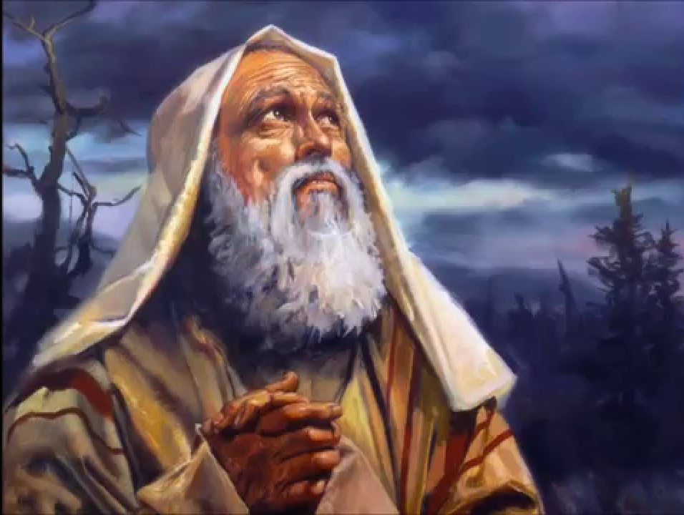
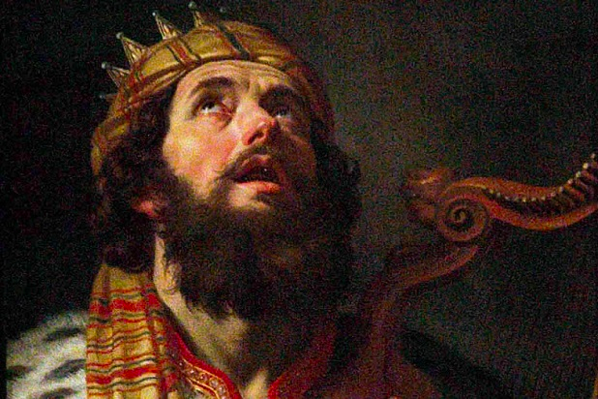
Abraham & David Testify to Faith
Romans 4
Preached by Andrew B. Spurgeon at Crossroads International Church Singapore • cicfamily.com Uploaded by Dr. Rick Griffith • Singapore Bible College Thousands of files in 44 languages for free at BibleStudyDownloads.org

Slide 2
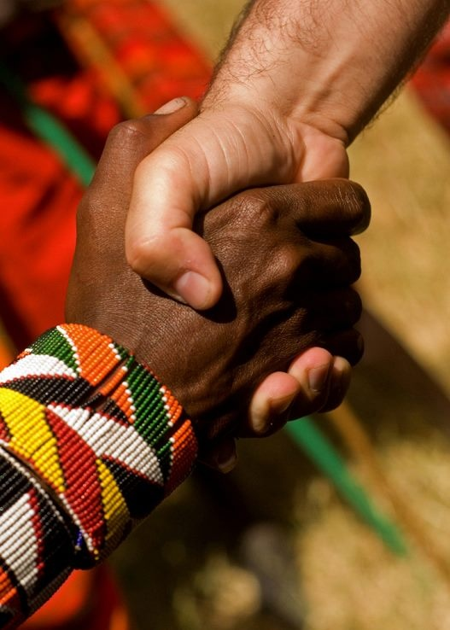
Accept One Another
Series on the Book of Romans

Slide 3
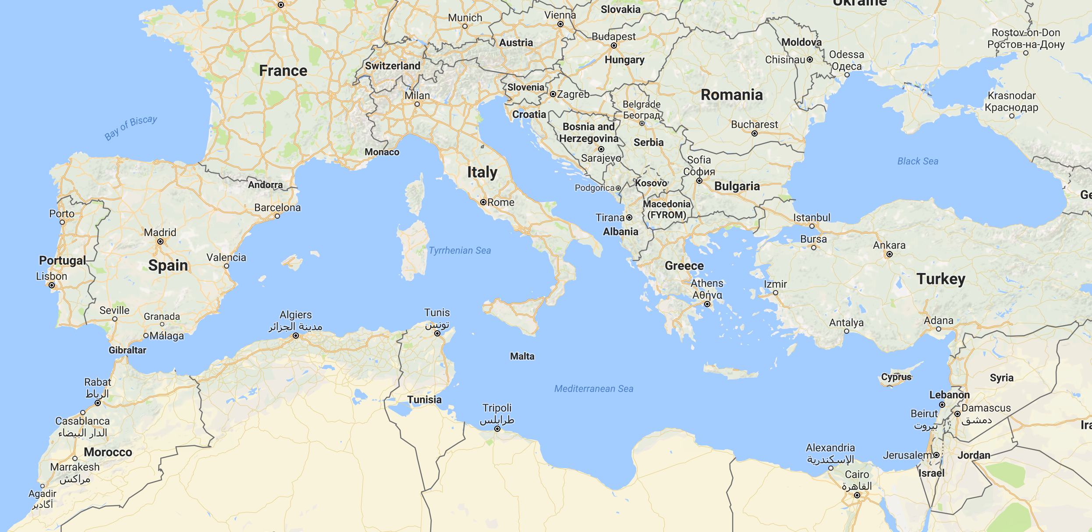

Slide 4
Theme
“Accept one another just as Christ has accepted us for the glory of God” (Rom 15:7)

Slide 5
Theme
The Gospel About the Son, who is David’s son and resurrected from the dead (Son of God); we obey | The Need for the Gospel Whether sinner, saint, privileged, or a human, we all need the gospel | The Gospel Explained How God proves himself as upright (righteous); Why is it based on faith-alone and what is faith?
1:1–17 | 1:18–3:20 | 3:21–5:21

Slide 6
Gospel
What did it mean to the early hearers?
* A Birth Announcement
*A Victory Proclamation
*And it required a response

Slide 7
Gospel
What did it mean to the early hearers?
A Son, of Davidic lineage
Son of God, resurrection from the dead
We put our faith in him

Slide 8
Theme
The Gospel About the Son, who is David’s son and resurrected from the dead (Son of God); we obey | The Need for the Gospel Whether sinner, saint, privileged, or a human, we all need the gospel | The Gospel Explained How God proves himself as upright (righteous); Why is it based on faith-alone and what is faith?
1:1–17 | 1:18–3:20 | 3:21–5:21

Slide 9
Objection 1
But, I don't need the Gospel!
I am not a sinner.

Slide 10
Objection 2
But, I don't need the Gospel!
I am a saint!

Slide 11
Objection 3
But, I don't need the Gospel!
I am privileged.

Slide 12
Objection 4
But, I don't need the Gospel!
I am not “totally depraved.”

Slide 13
Paul’s Answer
“There is no one righteous; not even one; there is no one who understands, no one who seeks God. All have turned away . . . There is no fear of God before their eyes” (3:10–18).

Slide 14
Conclusion
Whether we are “sinners,” “saints,” “privileged,” or “mere human” — we are in need of the Gospel of Jesus Christ, Davidic son, resurrected from the dead.

Slide 15
Theme
The Gospel About the Son, who is David’s son and resurrected from the dead (Son of God); we obey | The Gospel Needed Whether sinner, saint, privileged, or a human, we all need the gospel | The Gospel Explained How God proves himself as upright (righteous); Why is it based on faith-alone and what is faith?
1:1–17 | 1:18–3:20 | 3:21–5:21

Slide 16
Righteousness of God
“uprightness”
= the quality of being honest, responsible, moral (Cambridge)
=The condition or quality of being honorable or honest; rectitude (Oxford)

Slide 17
Righteousness of God
What is “righteousness”?
Lot’s Story (Gen 19:19)
“Behold, your servant [Lot] has found mercy from you and greatness of your uprightness by sparing my life”
“uprightness”

Slide 18
Righteousness of God
What is “righteousness”?
Abraham’s Story (Gen 20:5)
Abimelek to God: “Lord will you destroy an innocent nation? Did he not say to me, ‘She is my sister’ . . . I took her with a clean heart and an upright hand”
“uprightness”

Slide 19
Righteousness of God
What is “righteousness”?
Jacob’s Story (Gen 30:33)
“My uprightness will testify for me in the future . . . any goat that is not speckled or spotted or lamb that is not dark-colored will be considered stolen”
“uprightness”

Slide 20
Righteousness of God
“uprightness”
= the quality of being honest, responsible, moral (Cambridge)
=The condition or quality of being honorable or honest; rectitude (Oxford)

Slide 21
Righteousness of God
Paul refers to God’s righteousness = uprightness three times in these opening chapters: 1:17; 3:21; 3:22
So, how is God upright?

Slide 22
Righteousness of God
Is God upright?
What steps did he take to redeem his creation?
Romans 3:21–31

Slide 23
Righteousness of God
1. God is upright because salvation rests on faith (1:17), i.e., apart from the law (3:21) although testified by the law and the prophets (3:21)

Slide 24
Righteousness of God
2. God is upright because salvation is by the faithfulness of Jesus Christ (3:22)

Slide 25
Righteousness of God
3. God is upright because salvation is offered to everyone who believes, without distinction—all have sinned (3:22–23)

Slide 26
Righteousness of God
4. God is upright because salvation is a free gift based on God’s grace and redemption that is in Christ Jesus (3:24)

Slide 27
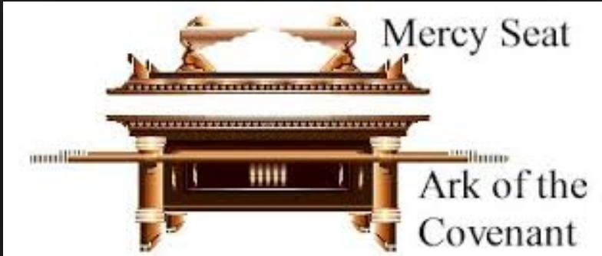
Righteousness of God
5. God is upright because he appointed Jesus as the “mercy seat” because of Jesus’s faithfulness, in his blood—demonstrations of his uprightness (3:25a)

Slide 28
Righteousness of God
6. God is upright because he overlooked [through Jesus’s work] sins committed beforehand (3:25b)

Slide 29
Righteousness of God
7. God is upright because in his patience he demonstrates his uprightness in the present time, that is, by being the Judge and the one who justifies people by Jesus’s faithfulness (3:25b)

Slide 30
Righteousness of God
“This is our message: God, in Christ, is reconciling the world unto himself, not counting their transgressions against them” (2 Cor 5:19).

Slide 31
Theme
The Gospel About the Son, who is David’s son and resurrected from the dead (Son of God); we obey | The Need for the Gospel Whether sinner, saint, privileged, or a human, we all need the gospel | The Gospel Explained How God proves himself as upright (righteous); Why is it based on faith-alone and what is faith?
1:1–17 | 1:18–3:20 | 3:21–5:21

Slide 32
Righteousness of God
1. God is upright because salvation rests on faith (1:17), i.e., apart from the law (3:21) although testified by the law and the prophets (3:22)

Slide 33
Righteousness of God
Forefathers Testify
Abraham (Rom 4:1–6)
David (Rom 4:7–8)
Abraham (Rom 4:9–22)

Slide 34
Righteousness of God
Abraham (4:1–5)
Abraham discovered the difference between “wages” and “gifts”—wages are earned by work; gifts are not earned but trusted (by faith)

Slide 35
Righteousness of God
Abraham (4:1–5)
So, Abraham trusted God for his “gift”; and God accepted his trust and rewarded him.
Since God rewarded him, Abraham had nothing to boast.

Slide 36
Righteousness of God
Abraham (4:5)
Abraham left a great lesson: “To the one who doesn’t try on his/her own, but trusts God to consider him/her ‘upright, God does!”

Slide 37
Righteousness of God
David (4:6–8)
David too attests to that: “Blessed are those whose transgressions are forgiven and sins are covered; Blessed are those whose sins God doesn’t count against them.”

Slide 38
Righteousness of God
Abraham (4:9–15)
Such a blessedness is not only for the Jews or not only for the Gentiles; it’s for both—because it’s faith-based.
Abraham was uncircumcised when he received the promise.

Slide 39
Righteousness of God
Abraham (4:16–17a)
Since promise and fulfilment were based on faith, those without the law could easily be merited as much as those within the law—anyone with faith like that of Abraham’s faith.

Slide 40
Righteousness of God
Abraham (4:17b)
What did Abraham believe? (or, What is faith like Abraham’s?)
“God gives life to the dead and calls into being things that are not.”

Slide 41
Righteousness of God
Abraham (4:18–21)
How far did Abraham believe?
Against all hope
Without wavering in his faith
Strengthened in faith
Fully persuaded in God’s power

Slide 42
Righteousness of God
Abraham (4:22)
Such a faith (un-weakening, unwavering, growing strong, and fully persuaded) was his “uprightness”—what God accepted and rewarded

Slide 43
Righteousness of God
Abraham (4:23)
Abraham’s story wasn’t written for his behalf; it was written for our behalf—for us to understand what kind of faith God rewards!

Slide 44
Righteousness of God
Abraham (4:17b)
What did Abraham believe?
“God gives life to the dead and calls into being things that are not.”

Slide 45
Righteousness of God

Slide 46
Righteousness of God
What Must We Believe?
Believe in him, i.e., God who raised Jesus, our Lord, from the dead (Rom 4:24)
Believe that the Lord “was handed over for our trespasses and raised for our righteousness” (Rom 4:25)

Slide 47
Righteousness of God
Abraham (4:17b)
What did Abraham believe?
“God gives life to the dead and calls into being things that are not.”

Slide 48
Righteousness of God
Sarah (Heb 11:11)
“And by faith even Sarah, who was past childbearing age, was enabled to bear children because she considered him faithful who had made the promise.”

Slide 49
Righteousness of God
What Must We Believe?
Believe in him, i.e., God who raised Jesus, our Lord, from the dead (Rom 4:24)
Believe that the Lord “was handed over for our trespasses and raised for our righteousness” (Rom 4:25)

Slide 50
NT Sermons link at BibleStudyDownloads.org
Get this presentation and notes for free!

