Slide 1
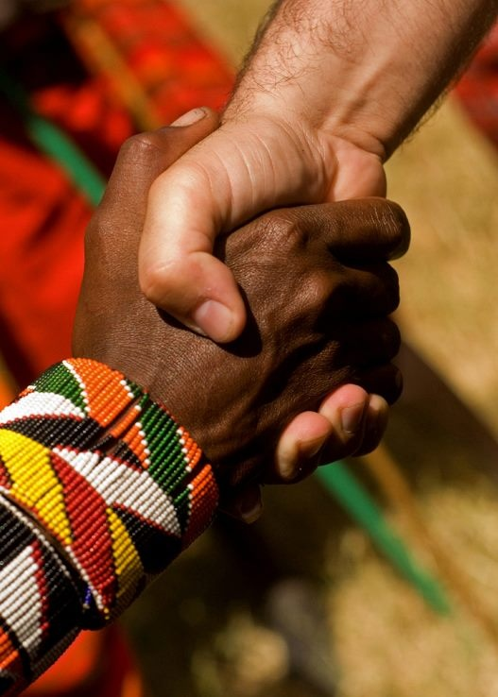
Accept One Another
The Book of Romans
Preached by Andrew B. Spurgeon at Crossroads International Church Singapore • cicfamily.com Uploaded by Dr. Rick Griffith • Singapore Bible College Thousands of files in 44 languages for free at BibleStudyDownloads.org

Slide 2
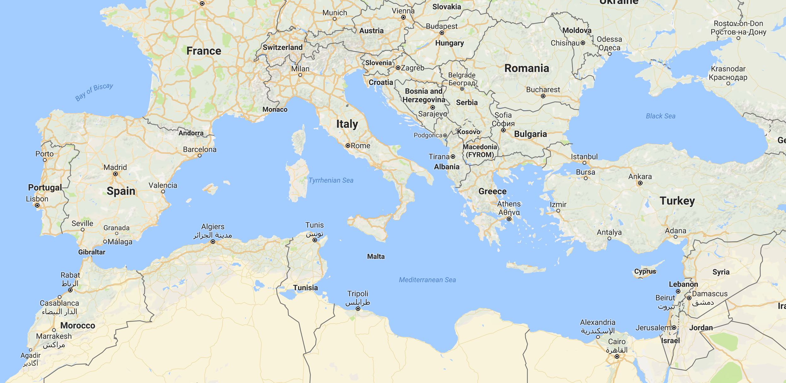

Slide 3
Theme
“Accept one another just as Christ has accepted us for the glory of God” (Rom 15:7)

Slide 4
Gospel
What did it mean to the early hearers?
* A Birth Announcement
*A Victory Proclamation
*And it required a response

Slide 5
Gospel
What did it mean to the early hearers?
A Son, of Davidic lineage
Son of God, resurrection from the dead
We put our faith in him

Slide 6
Objection 1
But, I don't need the Gospel!
I am not a sinner

Slide 7
Objection 1
What’s the truth that they suppress?
The existence of God (1:19–23)
“Although they know God exists, they neither give glory to God nor thank Him” Instead, they worship gods they create (sin)

Slide 8
God's Response
So, God’s wrath is showing upon them . . . How?
God gave them over to their own desires of their hearts; they worship creatures (1:24–25)

Slide 9
God's Response
So, God’s wrath is showing upon them . . . How?
2. God gave them over to dishonorable passions; they confuse gender identities (1:26–28)

Slide 10
God's Response
So, God’s wrath is showing upon them . . . How?
3. God gave them over to thoughtless minds; they commit acts of wickedness and approve those who practice them
(1:26–32)

Slide 11
Objection 2
But, I don't need the Gospel!
I am a saint!

Slide 12
God's Response
So, what’s their crime?
Showing contempt for God’s kindness (2:4)
“God will repay each person according to what they have done” (2:5–6)

Slide 13
Objection 3
But, I don't need the Gospel!
I am privileged.

Slide 14
Objection 3
I don't need the Gospel!
I am Jewish
Torah
Circumcision

Slide 15
Paul’s Response
Torah: “Now you, if you call yourself a Jew; if you rely on the law and brag about your relationship to God” . . . But you do the same things you speak against, aren’t you dishonoring God by breaking the law? (2:17–24)

Slide 16
Paul’s Response
Circumcision: “Circumcision has value if you observe the law, but if you break the law, you have become as though you had not been circumcised” (2:25–29)

Slide 17
Objection 4
But, I don't need the Gospel!
I am not “totally depraved”

Slide 18
Paul’s Answer
“There is no one righteous; not even one; there is no one who understands, no one who seeks God. All have turned away . . . There is no fear of God before their eyes” (3:10–18)

Slide 19
Torah’s Function
Torah’s job = “every mouth may be silenced and the whole world held accountable to God” (3:19)
“Through the law we become conscious of sin” (3:20)

Slide 20
Conclusion
Whether we are “sinners,” “saints,” “privileged,” or “mere human” — we are in need of the Gospel of Jesus Christ, Davidic son, resurrected from the dead.

Slide 21
Righteousness of God
What is “righteousness”?
Lot’s Story (Gen 19:19)
“Behold, your servant [Lot] has found mercy from you and greatness of your uprightness by sparing my life”
“uprightness”

Slide 22
Righteousness of God
“uprightness”
= the quality of being honest, responsible, moral (Cambridge)
= The condition or quality of being honorable or honest; rectitude (Oxford)

Slide 23
Righteousness of God
What is “righteousness”?
Abraham’s Story (Gen 20:5)
Abimelek to God: “Lord will you destroy an innocent nation? Did he not say to me, ‘She is my sister’ . . . I took her with a clean heart and an upright hand”
“uprightness”

Slide 24
Righteousness of God
What is “righteousness”?
Jacob’s Story (Gen 30:33)
“My uprightness will testify for me in the future . . . any goat that is not speckled or spotted or lamb that is not dark-colored will be considered stolen”
“uprightness”

Slide 25
Righteousness of God
“uprightness”
= the quality of being honest, responsible, moral (Cambridge)
=The condition or quality of being honorable or honest; rectitude (Oxford)

Slide 26
Righteousness of God
“uprightness”
“For the LORD is righteous/upright, he loves justice” (Ps 11:7)
“You came down on Mount Sinai; you spoke to them from heaven. You gave them regulations and laws that are just and upright, and decrees and commands that are good” (Neh 9:13)

Slide 27
Righteousness of God
Paul refers to God’s righteousness = uprightness three times in these opening chapters: 1:17; 3:21; 3:22
So, how is God upright?

Slide 28
Righteousness of God
Is God upright?
What steps did he take to redeem his creation?
Romans 3:21–31

Slide 29
Righteousness of God
1. God is upright because salvation rests on faith (1:17), i.e., apart from the law (3:21) although testified by the law and the prophets (3:21)

Slide 30
Righteousness of God
2. God is upright because salvation is by the faithfulness of Jesus Christ (3:22)

Slide 31
Righteousness of God

Slide 32
Righteousness of God
3. God is upright because salvation is offered to everyone who believes, without distinction—all have sinned (3:22–23)

Slide 33
Righteousness of God
4. God is upright because salvation is a free gift based on God’s grace and redemption that is in Christ Jesus (3:24)

Slide 34
Righteousness of God

Slide 35
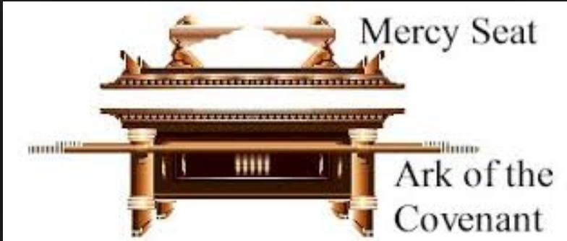
Righteousness of God
5. God is upright because he appointed Jesus as the “mercy seat” because of Jesus’s faithfulness, in his blood—demonstrations of his uprightness (3:25a)

Slide 36
Righteousness of God
6. God is upright because he overlooked [through Jesus’ work] sins committed beforehand (3:25b)

Slide 37
Righteousness of God
7. God is upright because in his patience he demonstrates his uprightness in the present time, that is, by being the Judge and the one who justifies people by Jesus’s faithfulness (3:25b)

Slide 38
Righteousness of God
“If anyone is in Christ, he/she is a new person: his/her old things have gone, he/she has become a new person. This is from God who reconciled us to himself through Christ.”
“This is our message: God, in Christ, is reconciling the world unto himself, not counting their transgressions against them” (2 Cor 5:17–19).

Slide 39
Righteousness of God
Conclusion: No chance for anyone to boast! (3:27)

Slide 40
NT Sermons link at BibleStudyDownloads.org
Get this presentation and notes for free!

