Slide 1
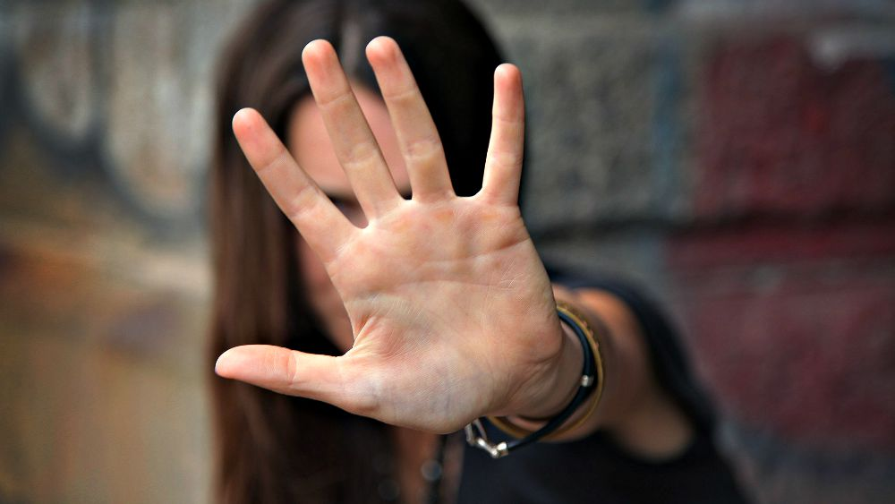
But I Don't Need the Gospel!
Romans 1:18–2:16
Preached by Dr. Andrew B. Spurgeon at Crossroads International Church Singapore • cicfamily.com Uploaded by Dr. Rick Griffith • Singapore Bible College Thousands of files in 44 languages for free at BibleStudyDownloads.org

Slide 2
Objection 1
But, I don't need the Gospel!
I am not a sinner.

Slide 3
Black
. . . I can be a good person without fear of hell-fire . . . Atheists who are out there, pretty much all the atheists I know do have a very strong moral compass . . . So the things you may consider sins, we don’t consider sin. But by and large the atheists I know are doing good even though they don’t believe in God . . . can you believe that?

Slide 4
Objection 1
But, I don't need the Gospel!
I am not a sinner.

Slide 5
Objection 1
"The wrath of God is showing from heaven upon all those who are 'irreverent to God' and 'un-straight-forward' people who suppress the truth in their 'un-straight-forwardness'"
(Rom 1:18).

Slide 6
Objection 1
the wrath of God is showing
“irreverent to God”
“un-straight-forward”
who suppress the truth in their “un-straight-forwardness”

Slide 7
Objection 1
What’s the truth that they suppress?
The existence of God (1:19–23)
“Although they know God exists, they neither give glory to God nor thank Him.” Instead, they worship gods they create (sin).

Slide 8
God's Response
So God’s wrath is showing upon them. . . How?
God gave them over to their own desires of their hearts; they worship creatures (1:24–25)

Slide 9
God's Response
So God’s wrath is showing upon them. . . How?
2. God gave them over to dishonorable passions; they confuse gender identities (1:26–27)

Slide 10
God's Response
So God’s wrath is showing upon them. . . How?
3. God gave them over to thoughtless minds; they commit acts of wickedness and approve those who practice them
(1:28–32)

Slide 11
Types of People
“irreverent to God” and “un-straight-forward” people

Slide 12
Objection 2
But, I don't need the Gospel!
I am a saint!

Slide 13
Black

Slide 14
Objection 2
“You who pass judgment on someone else, for at whatever point you judge another, you are condemning yourself, because you who pass judgment do the same things” (2:1).

Slide 15
God's Response
But, “God’s judgment against those who do such things is based on truth” (2:2).
So, those who judge others, but do the same act, will not escape God’s judgment (2:3).

Slide 16
God's Response
So, what’s their crime?
Showing contempt for God’s kindness (2:4).
“God will repay each person according to what they have done” (2:5-6).

Slide 17
God's Response
To those who seek immortality, He will give life (2:7)
To those who seek their own self and reject truth, punishment (2:8)

Slide 18
God's Response
Regardless of Jews or Gentiles (2:9–10)
“For God does not show favoritism” (2:11)
With or without law (2:12–15)

Slide 19
God's Response
God judges these hidden acts of people, today, through the gospel of Christ Jesus (2:16)

Slide 20
Summary
But, I don't need the Gospel,
I am not a sinner!
But, I don’t need the Gospel,
I am a saint!

Slide 21
Summary
But, I need the Gospel,
I am a sinner!
But, I need the Gospel,
I am not a saint!

Slide 22
NT Sermons link at BibleStudyDownloads.org
Get this presentation and notes for free!

