Slide 1
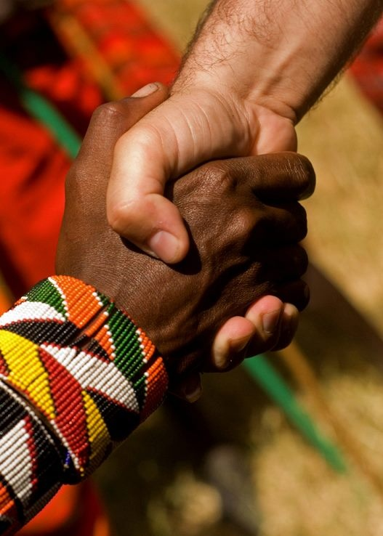
Accept One Another As Christ Has Accepted You
The Theme of Romans Based on the Gospel
Preached by Dr. Andrew Spurgeon at Crossroads International Church Singapore • cicfamily.com Uploaded by Dr. Rick Griffith • Singapore Bible College Thousands of files in 44 languages for free at BibleStudyDownloads.org

Slide 2
Romans
“Accept one another just as Christ accepted you
for the glory of God” (Rom 15:7)

Slide 3
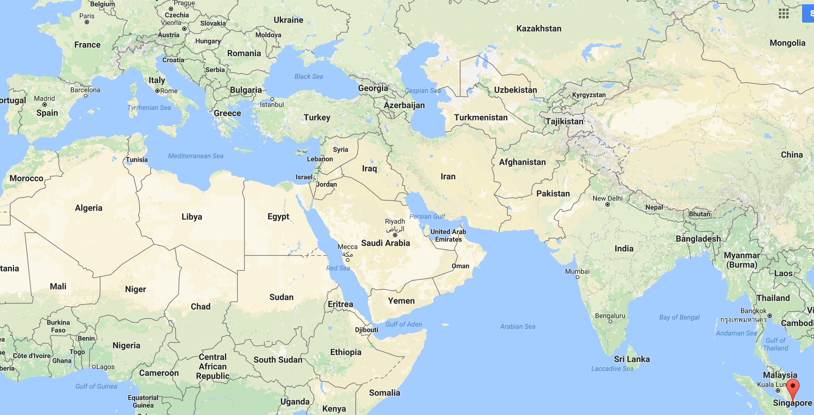

Slide 4
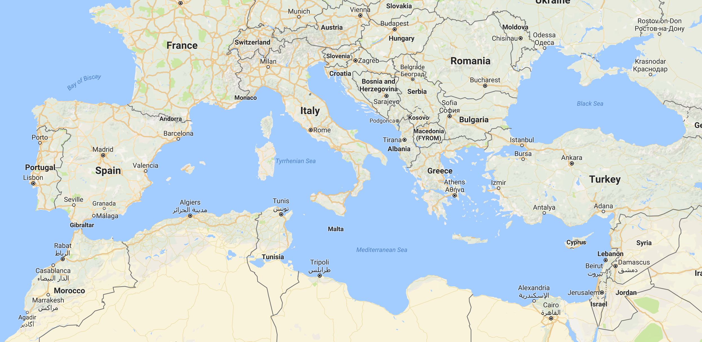

Slide 5
Gospel
So, you think you know what the gospel is?

Slide 6
The word “gospel” means “good news.” So in order for news to be good, we have to know the “bad news” first. And here it is: “you have sinned.” All sin is open rebellion against God. And the penalty is death . . .

Slide 7
Problem
Root Fallacy
Grasshopper (Grass that hops)
Butterfly (Butter that flies)
Housefly (House that flies)
Pineapple (Apple with pines)

Slide 8
Gospel . . . means the good news. It is a good news of God. And what is this good news? . . . It addresses the fact that the human heart in its own pursuit will end up empty, lonely, and destitute. . . life does not ultimately bring you satisfaction . . . we are alienated from God . . . separated from God . . . good news of the gospel is that in your own effect and by your own good works you cannot rebuild that bridge. It is God who has reached out to you and to me in the provision of his son, Jesus Christ, who is able to offer . . . to rebuild our lives . . .

Slide 9
What it meant to the early hearers
Gospel
A birth announcement
Emperor Augustus
A victory announcement
Emperor Vespasian over Vitallius

Slide 10
What did it mean to the early hearers?
Gospel
"The gospel . . . regarding his Son, who as to his earthly life was a descendant of David, and who through the Spirit of holiness was appointed the Son of God in power by his resurrection from the dead: Jesus Christ our Lord" (Rom 1:2–4)
1. Earthly life . . . (birth) . . . A descendant of David
2. Victory . . . In power by his resurrection, the Son of God

Slide 11
What it meant to the early hearers
Gospel
A birth announcement
Emperor Augustus
A victory announcement
Emperor Vespasian over Vitallius
It required a response
Of obedience/allegiance/submission

Slide 12
What did it mean to the early hearers?
Gospel
“For I am not ashamed of the gospel, because it is the power of God that brings salvation to everyone who believes: first to the Jew, then to the Gentile. For in the gospel the righteousness of God is revealed—a righteousness that is by faith from first to last, just as it is written: ‘The righteous will live by faith’” (Rom 1:16–17).

Slide 13
What did it mean to the early hearers?
The gospel is a birth announcement and a victory announcement. And it requires a response.
"The gospel . . . regarding his Son, who as to his earthly life was a descendant of David, and who through the Spirit of holiness was appointed the Son of God in power by his resurrection from the dead: Jesus Christ our Lord" (Rom 1:1–4).
"For I am not ashamed of the gospel, because it is the power of God that brings salvation to everyone who believes: first to the Jew, then to the Gentile. For in the gospel the righteousness of God is revealed—a righteousness that is by faith from first to last, just as it is written: ‘The righteous will live by faith'" (Rom 1:16–17)

Slide 14
Black

Slide 15
NT Sermons link at BibleStudyDownloads.org
Get this presentation and notes for free!

