Slide 1
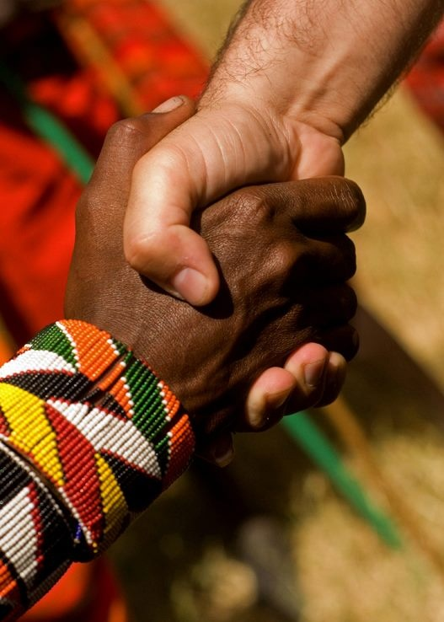
“Accept one another as Christ has accepted you” (Rom 15:7)
Romans 14:1–15:7
Preached by Andrew B. Spurgeon at Crossroads International Church Singapore • cicfamily.com Uploaded by Dr. Rick Griffith • Singapore Bible College Thousands of files in 44 languages for free at BibleStudyDownloads.org

Slide 2
Theme
“Accept one another just as Christ has accepted us for the glory of God” (Rom 15:7)

Slide 3
Summary
While we were sinners, God demonstrated his love for us by sending his son, Jesus Christ, to die for us. We who believe in him have salvation and a renewed life, where we ought to love one another, obey the government, and accept one another as Christ accepted us.

Slide 4
Chapter 15:8–33
Title: “And miles to go before we sleep”
—adapted from Robert Frost

Slide 5
Chapter 15:8–33
Stopping by Woods on a Snowy Evening

Slide 6
Chapter 15:8–33
Whose woods these are I think I know.
His house is in the village though;
He will not see me stopping here
To watch his woods fill up with snow.

Slide 7
Chapter 15:8–33
My little horse must think it queer
To stop without a farmhouse near
Between the woods and frozen lake
The darkest evening of the year.

Slide 8
Chapter 15:8–33
He gives his harness bells a shake
To ask if there is some mistake.
The only other sound’s the sweep
Of easy wind and downy flake.

Slide 9
Chapter 15:8–33
The woods are lovely, dark and deep,
But I have promises to keep,
And miles to go before I sleep,
And miles to go before I sleep.

Slide 10
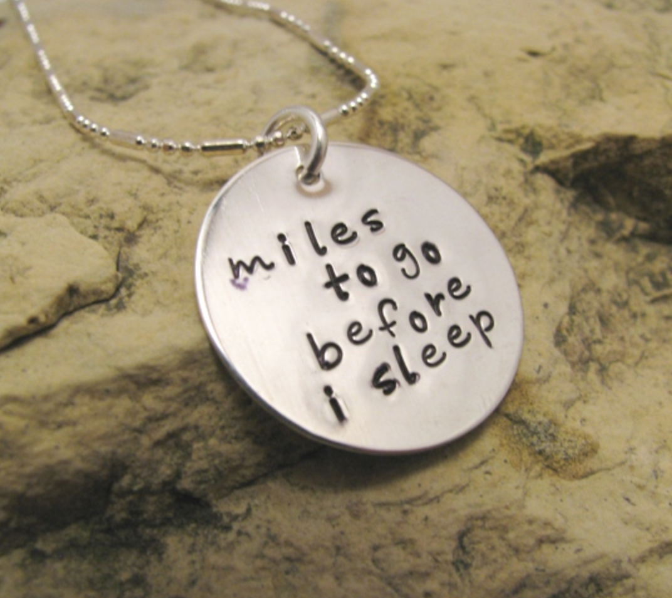
Chapter 15:8–33
Paul too thought that he had miles to go before he slept . . . (Rom 15:8–33)

Slide 11
Chapter 15:8–33
“I do not want you to be unaware, brothers and sisters, that I planned many times to come to you (but have been prevented from doing so until now) in order that I might have a harvest among you, just as I have had among the other Gentiles” (Rom 1:13)

Slide 12
Chapter 15:8–33
“I am obligated both to Greeks and Non-Greeks, both to the wise and the foolish.
That is why I am so eager to preach the gospel also to you who are in Rome”
(Rom 1:14–15)

Slide 13
Chapter 15:8–33
“I will not venture to speak of anything except what Christ has accomplished through me in leading the Nations to obey God by what I have said and done . . . So from Jerusalem all the way around to Illyricum, I have fully proclaimed the gospel of Christ” (Rom 15:18–19)

Slide 14
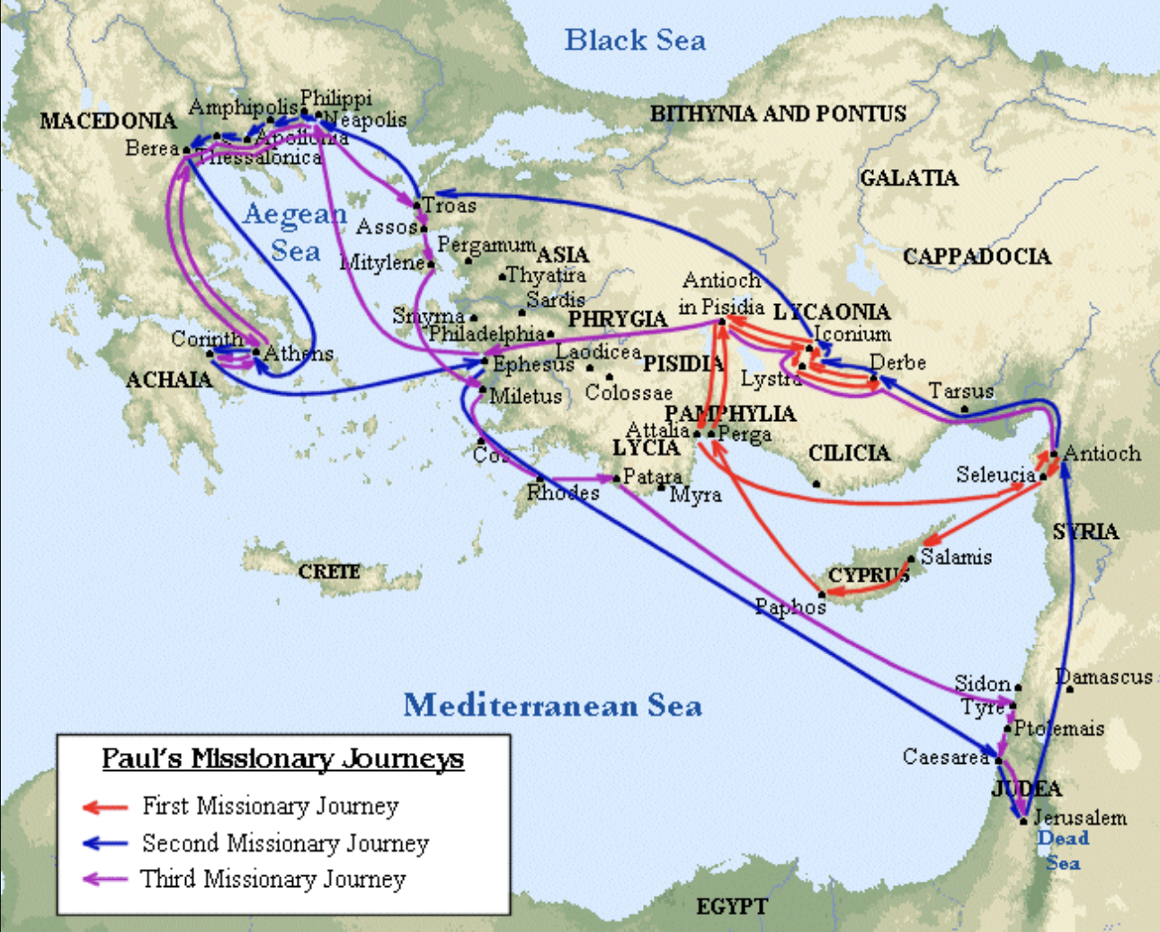
Chapter 15:8–33

Slide 15
Chapter 15:8–33
“It has always been my ambition to preach the gospel where Christ was not known, so that I would not be building on someone else’s foundation . . . This is why I have often been hindered from coming to you” (Rom 15:20, 22)

Slide 16
Chapter 15:8–33
“But now that there is no more place for me to work in these regions, and since I have been longing for many years to visit you, I plan to do so when I go to Spain” (Rom 15:23–24)

Slide 17
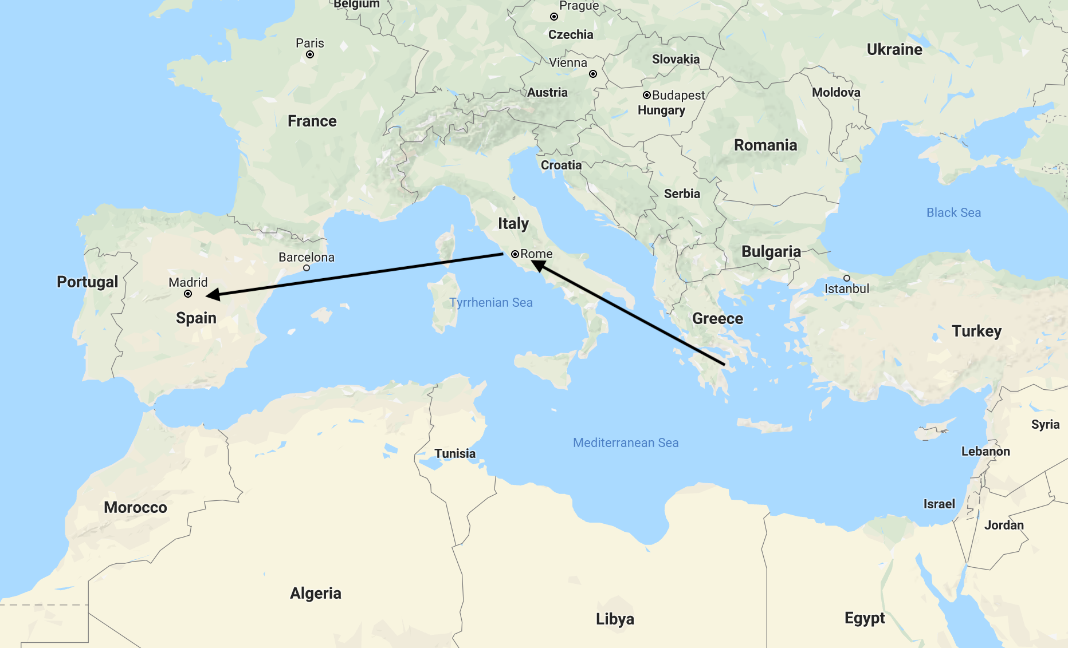
Chapter 15:8–33

Slide 18
Chapter 15:8–33
“Now, however, I am on my way to Jerusalem in the service of the Lord’s people there” (Rom 15:25a)

Slide 19
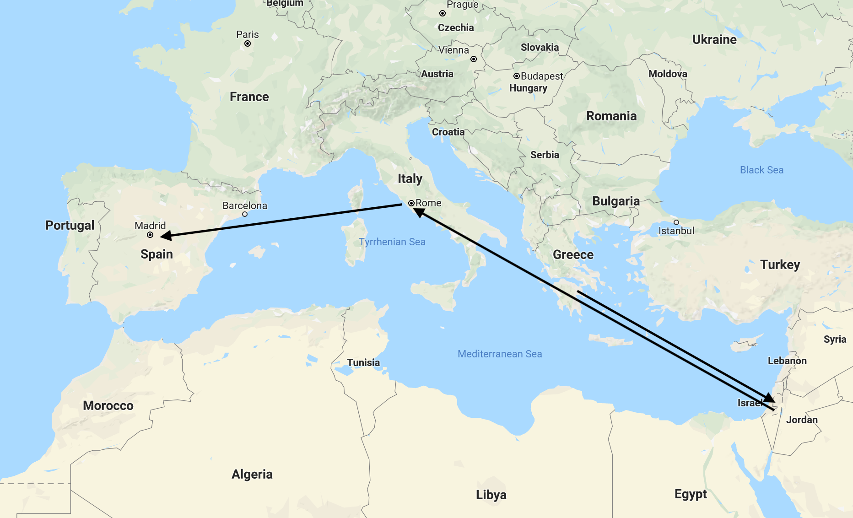
Chapter 15:8–33

Slide 20
Chapter 15:8–33
Paul’s travels weren’t easy and luxurious
“I have been in prison more frequently, been flogged more severely, and been exposed to death again and again. Five times I received from the Jews the forty lashes minus one. Three times I was

Slide 21
Chapter 15:8–33
beaten with rods, once I was pelted with stones, three times I was shipwrecked, I spent a night and a day in the open sea. I have been constantly on the move. I have been in danger from rivers, in danger from bandits, in danger from my fellow Jews, in danger from Gentiles; in danger in the city,

Slide 22
Chapter 15:8–33
in danger in the country, in danger at sea; and in danger from false believers. I have labored and toiled and have often gone without sleep; I have known hunger and thirst and have often gone without food; I have been cold and naked”
(2 Cor 11:23–27)

Slide 23
Chapter 15:8–33
So, why did Paul think that he had an obligation to keep going? Miles to go before he slept?

Slide 24
Chapter 15:8–33
Reason #1
Christ was a servant (diakonos) to the Jews and the Nations

Slide 25
Chapter 15:8–33
“I say, Christ has become a servant (diakonos) to the circumcised by the truthfulness of God in order to establish the promises to the patriarchs, and to the nations, by mercy, in order to glorify God” (15:8-9a)

Slide 26
Chapter 15:8–33
Scriptures testify . . .

Slide 27
Chapter 15:8–33
“I will declare you among the nations; I will sing your name” (Psa 18:49; Rom 15:9)
“You—nations—rejoice with his people” (Deut 32:43; Rom 15:10)

Slide 28
Chapter 15:8–33
“All nations—you praise the Lord; let all the people extol his name” (Psa 117:1; Rom 15:11)
Isaiah says, “The root of Jesse will rise up to rule the nations; in him the nations will place their hope” (Isa 11:10; Rom 15:12)

Slide 29
Chapter 15:8–33
Reason #2
Paul was Christ Jesus’s public-minister (leitourgos).

Slide 30
Chapter 15:8–33
“Although I am fully convinced, my brothers and sisters, that you are full of goodness, being filled in all knowledge, and able to teach one another . . . ” (15:14)

Slide 31
Chapter 15:8–33
“I have boldly written to you, in some matters, as a reminder, because of the grace given to me by God, since I am a public-minister (leitourgos) of Christ Jesus for the Nations” (15:16a)

Slide 32
Chapter 15:8–33
Reason #3
Christ gave Paul the priestly duty (hierourgeo) of proclaiming the gospel.

Slide 33
Chapter 15:8–33
“He gave me the priestly duty (hierourgeo) of proclaiming the gospel of God, so that the Gentiles might become an offering acceptable to God, sanctified by the Holy Spirit . . . my service to God” (15:16b, 17b)

Slide 34
Chapter 15:8–33
Why did Paul feel the obligation to spread the gospel?

Slide 35
Chapter 15:8–33
Christ was serving the nations
Paul was Christ’s public-servant
His work was a priestly service to God

Slide 36
Chapter 15:8–33
Sadly, the task is still unfinished . . .

Slide 38
Chapter 15:8–33
So, we too join the task force, knowing . . .
Christ is serving the nations,
we are his servants, and
we are doing a priestly service to God.

Slide 39
Chapter 15:8–33
The woods are lovely, dark and deep,
But I have promises to keep,
And miles to go before I sleep,
And miles to go before I sleep.

Slide 40
Chapter 15:8–33
“I am obligated both to Greeks and Non-Greeks, both to the wise and the foolish”
(Rom 1:14–15)

Slide 41
Chapter 15:8–33
Decision Time
To whom are we obligated?

Slide 42
NT Sermons link at BibleStudyDownloads.org
Get this presentation and notes for free!

