Slide 1
EXPANDING
Your Borders
Romans 15:14-33
Dr. Rick Griffith • Crossroads International Church Singapore CICFamily.com • BibleStudyDownloads.org
Notes:
I consider it a great privilege to be with you today to share some great things God is doing.

Slide 2
GROW
GROW
GROW
GROW
Notes:
Growth is important in just about every area of life.

Slide 3
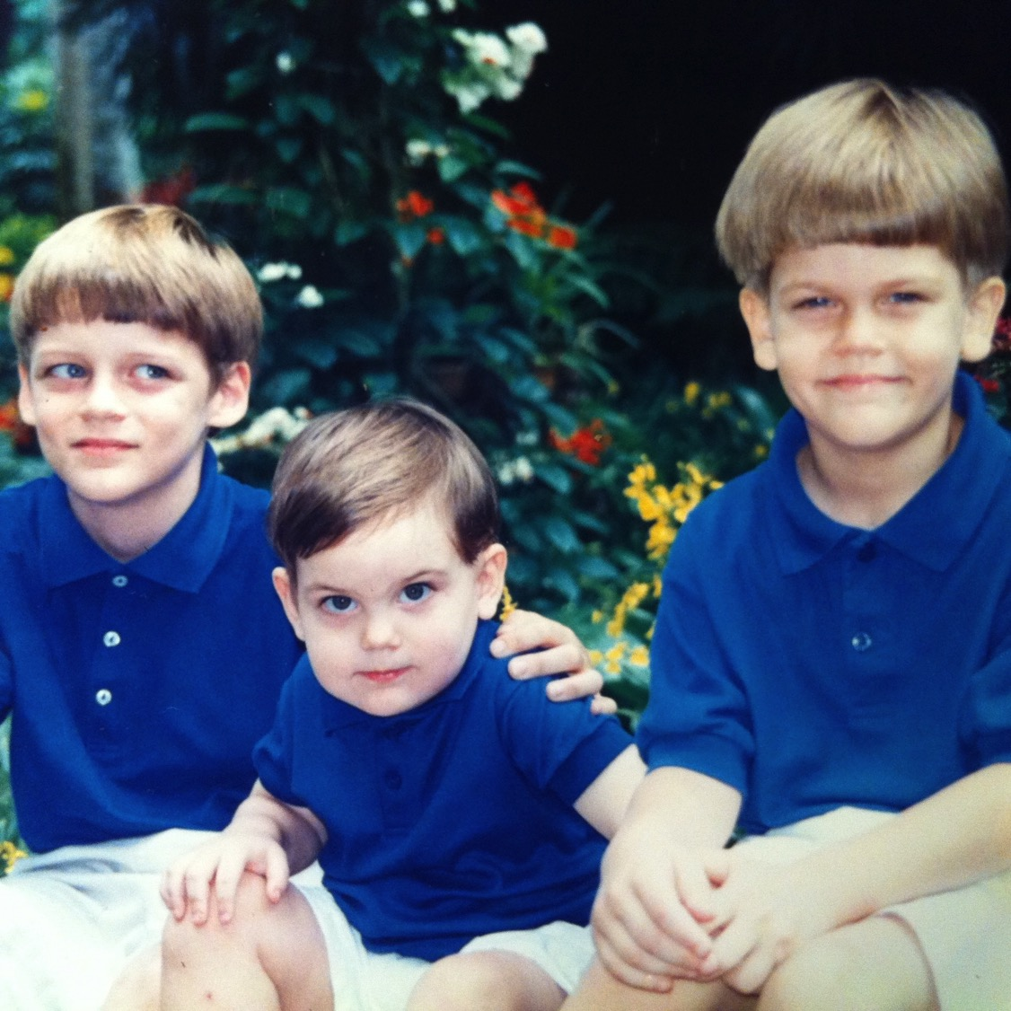
Our Three Sons
Notes:
One joy of parenting is to see kids grow.
Our sons used to look like this.

Slide 4
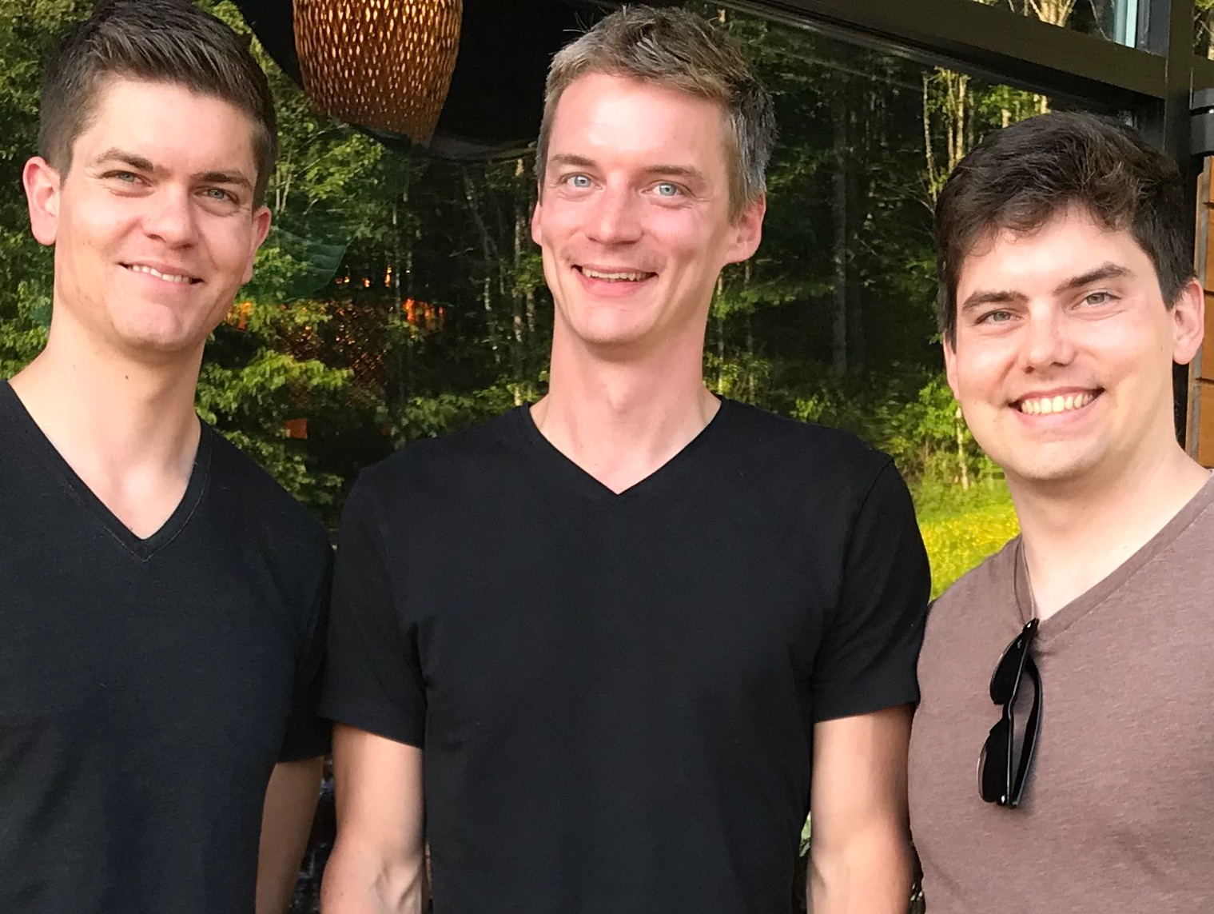
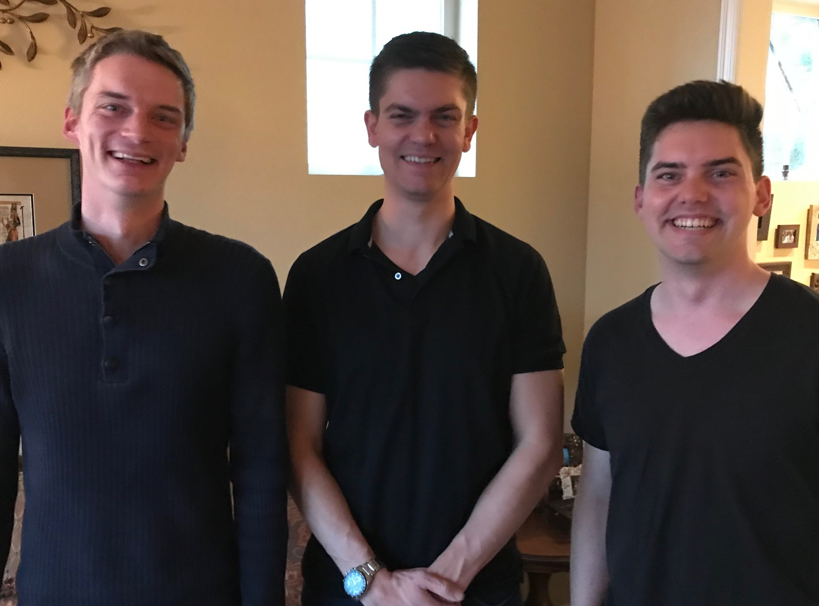
Our Three Sons
Notes:
The sons are all grown up now.
___________
Common-63

Slide 5
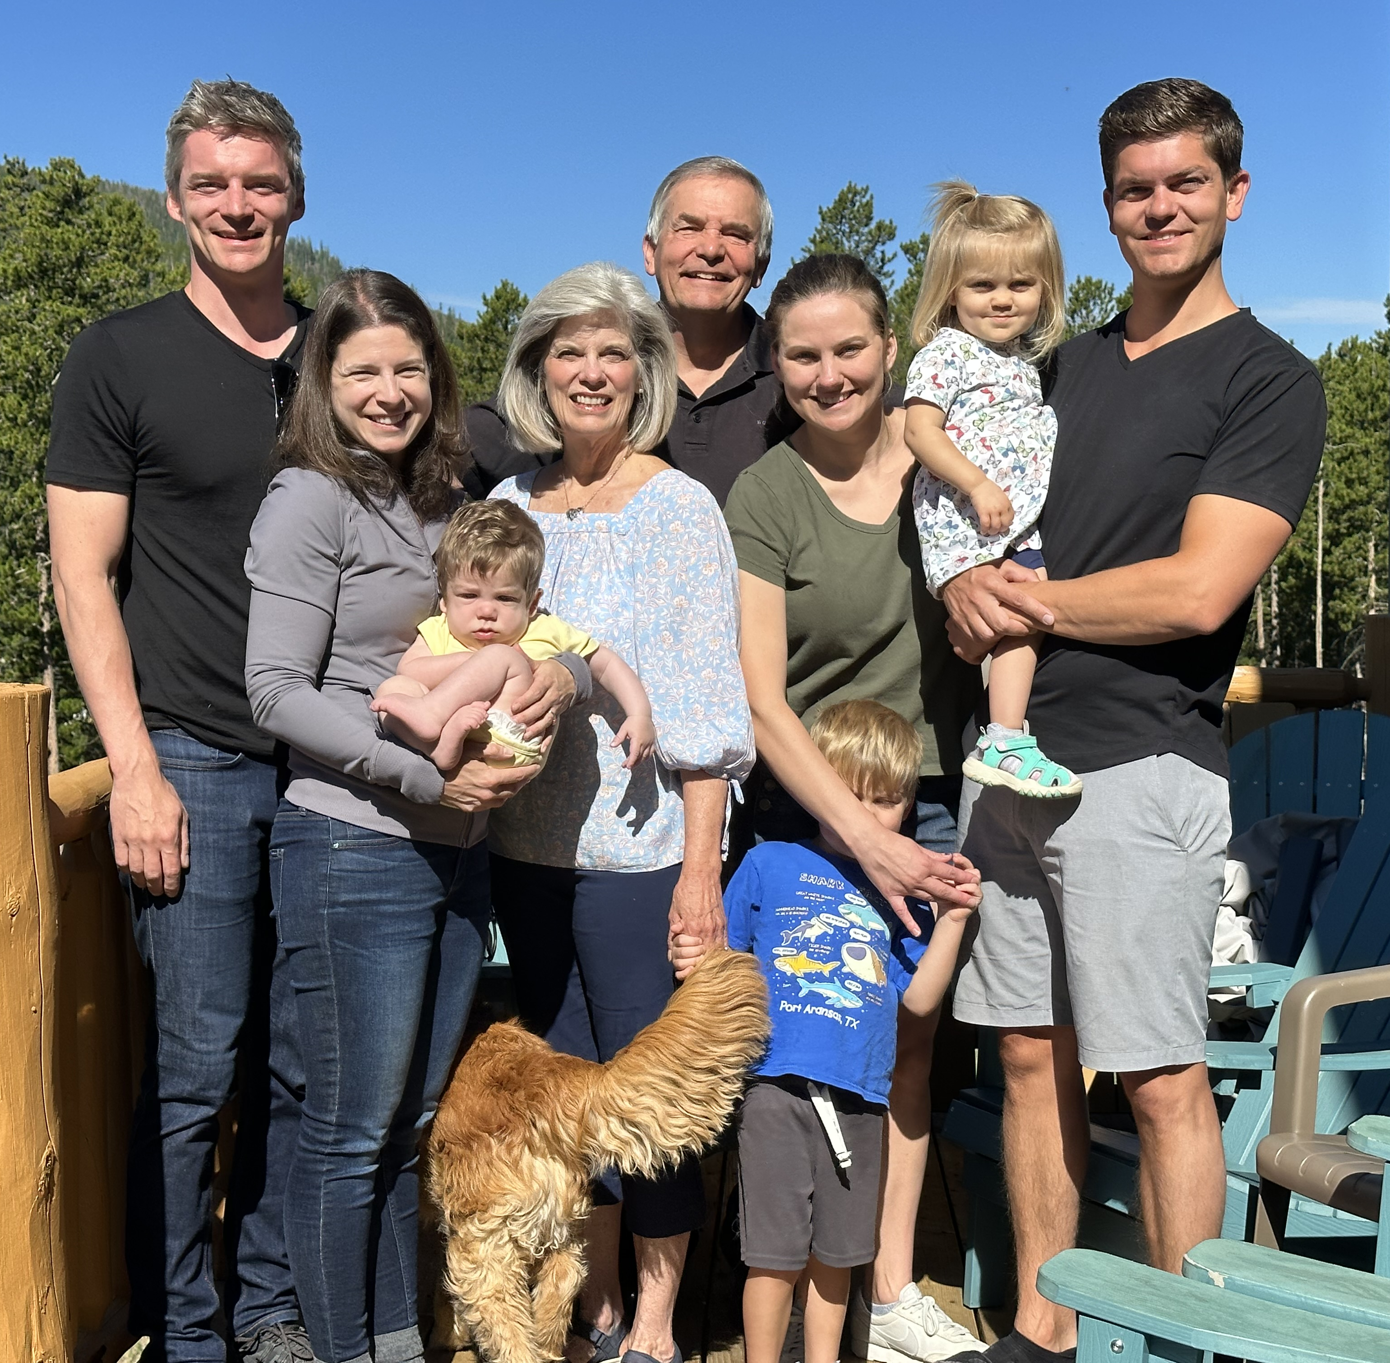
The Griffiths 2023
2023
Stephen & Katie & Jesse & Norah (35)
Kurt & Cara & Kadon (37)
John & Chloe (31)
Rick & Susan
Notes:
We now have 3 sons, 3 daughters-in-law, and 3 grandkids

Slide 6
5-year-old grandson Jesse

Slide 7
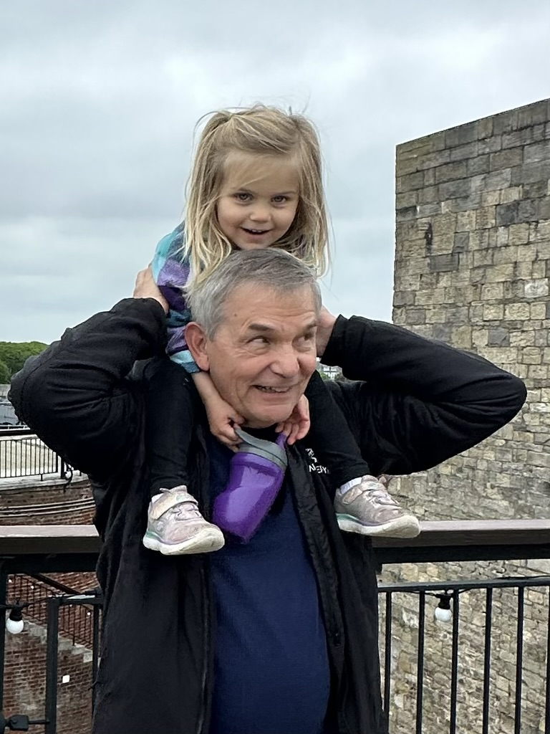
3-year-old granddaughter Norah

Slide 8
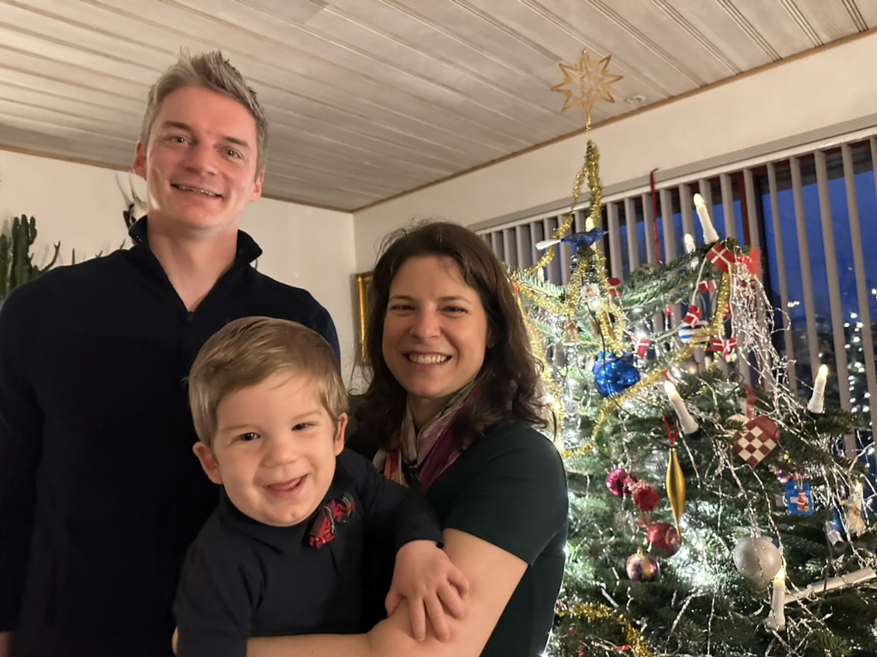
1-year-old grandson Kadon

Slide 9
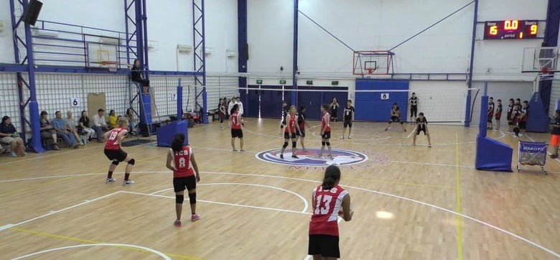
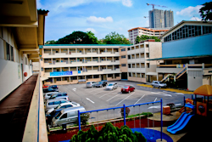
International Community School (est. 1993)
Notes:
ICS began with 16 students in 1993.
Now we have four times more teachers than we had students then.

Slide 10
ICS now has 400+ students!
UK
SWEDEN
KOREA
SWITZERLAND
JAPAN
ITALY
USA
THAILAND
INDIA
MEXICO
ICS
VENUZELA
INDONESIA
BRAZIL
SOUTH AFRICA
AUSTRALIAN
Notes:
Now there are nearly 500 students.

Slide 11
Barna Survey
Been Discipled
8%
2%
Discipled Others
Evangelical Christians
Notes:
Fortunately, people don't grow their whole lives! It's natural to stop physical growth at adulthood.
But it's sad that some believers stop growing spiritually and in service for Christ.
A survey by George Barna notes that only 8% of evangelical Christians have ever been disciplined—and only 2% have ever disciplined someone else!
Rather than expanding our borders and trusting God for new things, too often we end up atrophying.

Slide 12
Are you expanding?
Notes:
Are you expanding? I mean expanding your borders—spiritually?

Slide 13
Are you EXPANDING your borders (spiritually)?
How can we do this?
Notes:
What "new thing" are you praying for God to do in your life now?
What ministry skills are you developing to use for him?
What avenue of service are you expecting God to do in your life this year that you didn't have the capacity to expand last year?
I hope God is pinpointing an area for you where you can expand your horizons.
• That's the "what" question, but today we will explore the "how" question: How can you expand your borders spiritually?

Slide 14
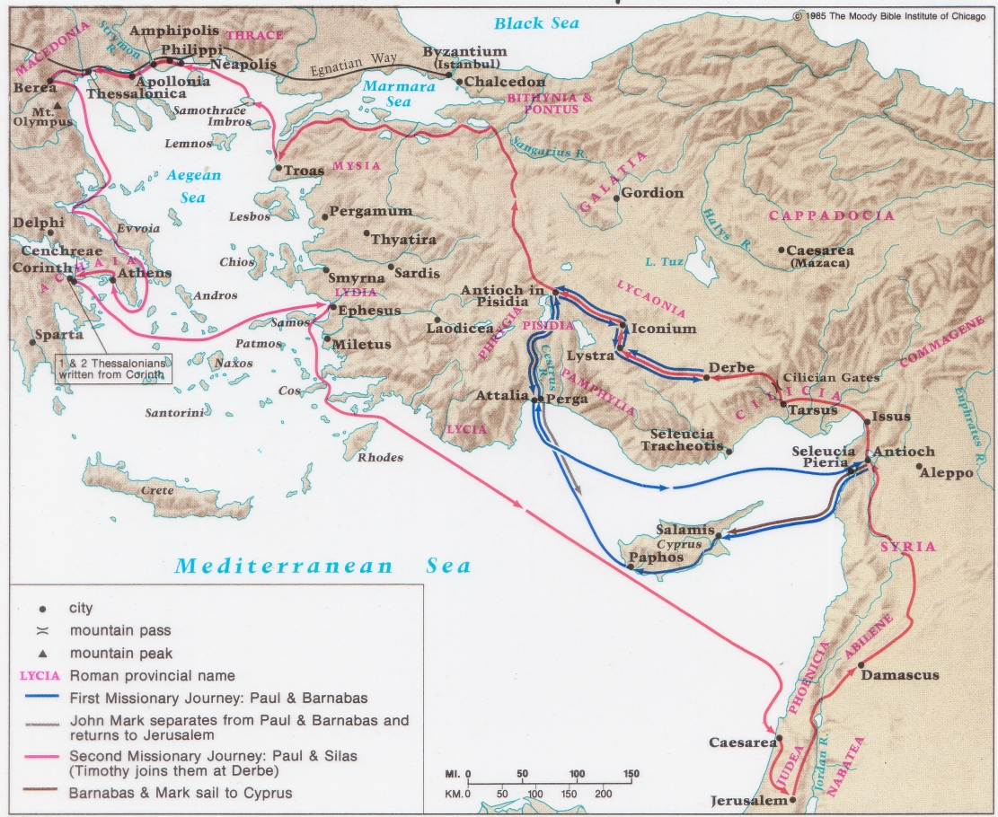
Paul's First & Second Missionary Journeys
138-39
Notes:
In the early church, by the time of today's text in Romans 15, Paul had already expanded his ministry on two missionary trips—the first highlighted in blue to Galatia in modern-day Turkey and the second trip expanded the gospel to Greece.

Slide 15
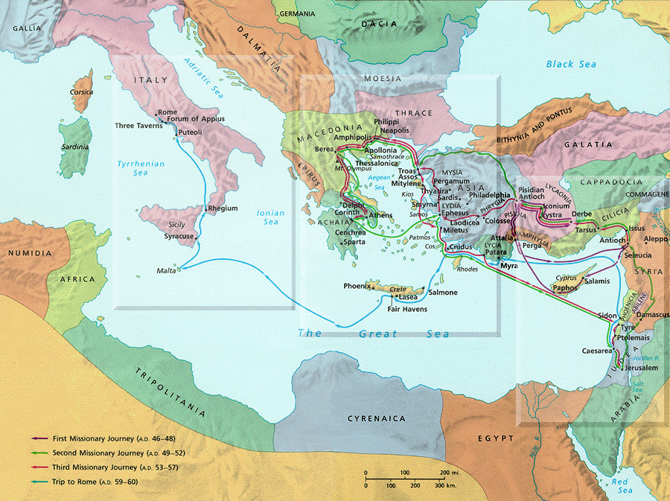
PAUL'S THIRD JOURNEY
140
Rome
Corinth
Paul's Journey 3
Notes:
Now on his third journey he writes from Corinth to the church farther west at Rome and asks for their help to expand his ministry even further. What can we learn from him that will help us expand our own borders?

Slide 16
Romans 15:14-33
Three ways to expand your borders…
I. Know God's calling for you (14-22)
Notes:
Today’s passage is Romans 15:14-33, where Paul expresses his heart to continue to expand his ministry.
In this text we’ll see three ways to expand your vision of God’s plan.
What is the first way we can expand our boundaries?
Know God’s calling for you (14-22).
Seeing God expand to new directions begins with understanding His plan for us now.

Slide 17
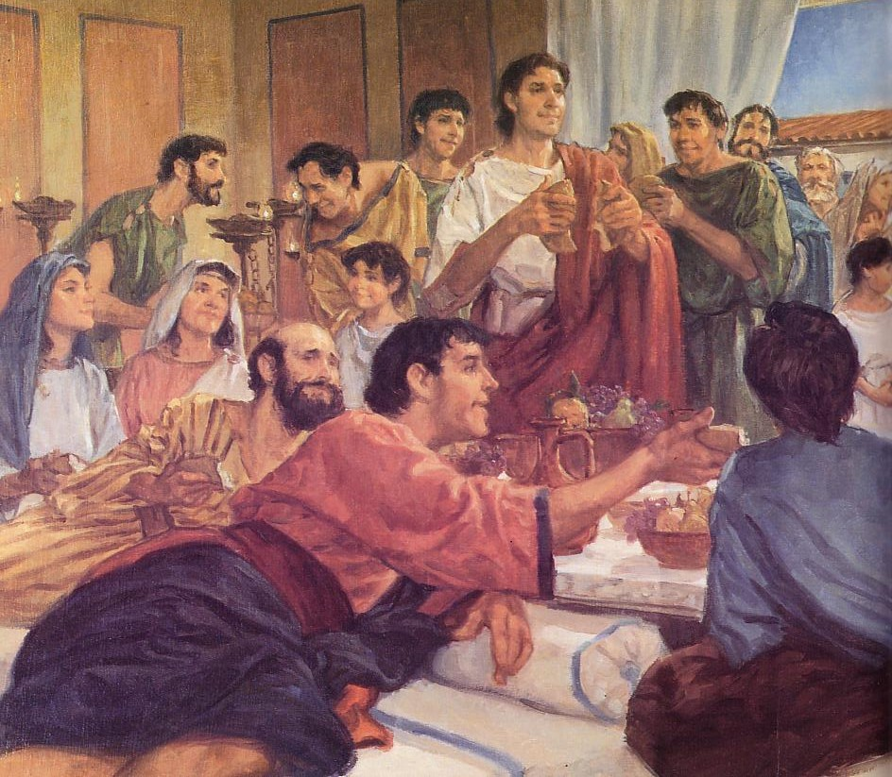
Paul's Calling: Gentiles in the Body
Notes:
Paul wanted the church to see his call to preach Christ among unreached Gentiles (Rom 15:14-22).

Slide 18
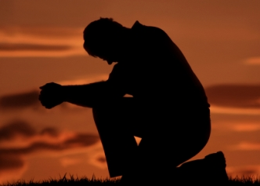
Romans 15:14-19
¹⁴ I am fully convinced, my dear brothers and sisters, that you are full of goodness. You know these things so well you can teach each other all about them. ¹⁵ Even so, I have been bold enough to write about some of these points, knowing that all you need is this reminder.
For by God's grace, ¹⁶ I am a special messenger from Christ Jesus to you Gentiles. I bring you the Good News so that I might present you as an acceptable offering to God, made holy by the Holy Spirit. ¹⁷ So I have reason to be enthusiastic about all Christ Jesus has done through me in my service to God. ¹⁸ Yet I dare not boast about anything except what Christ has done through me, bringing the Gentiles to God by my message and by the way I worked among them. ¹⁹ They were convinced by the power of miraculous signs and wonders and by the power of God's Spirit. In this way, I have fully presented the Good News of Christ from Jerusalem all the way to Illyricum (Romans 15:14-19).
Notes:
Despite the Roman’s knowledge of the gospel, Paul still reminded them (14-15a).
Paul said that God’s calling for him was to reach the Gentiles by God’s power (15b-19).

Slide 19
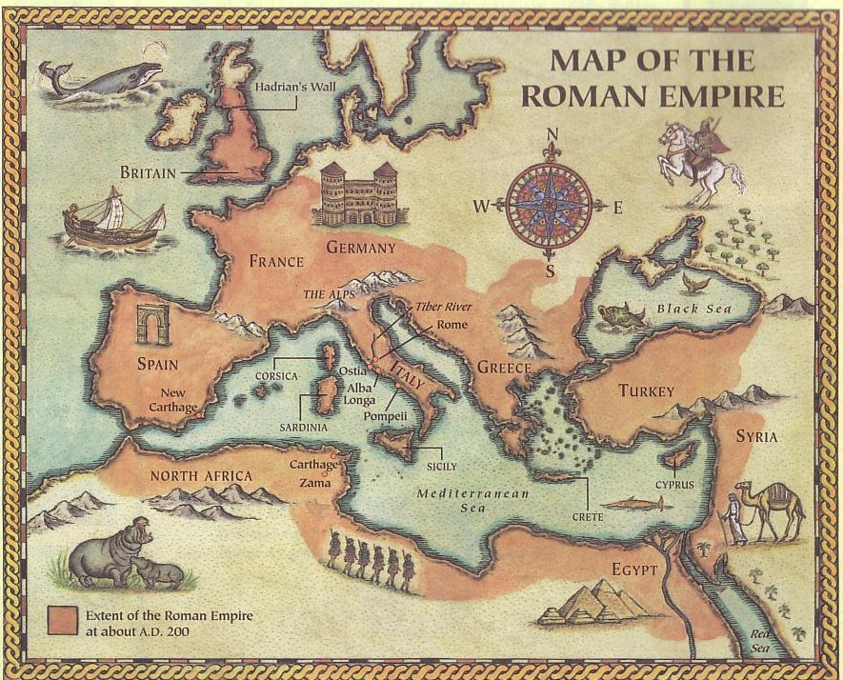
Paul's Ministry Westwards
Spain
Rome
Illyricum
Jerusalem
Notes:
Where’s Illyricum? Illyricum is in present-day Yugoslavia!
Paul had a priestly role of presenting the Gentiles to God as an offering (16)! He says that all offerings must be holy—so his desire was that all his converts would truly be set apart for God (holy).

Slide 20
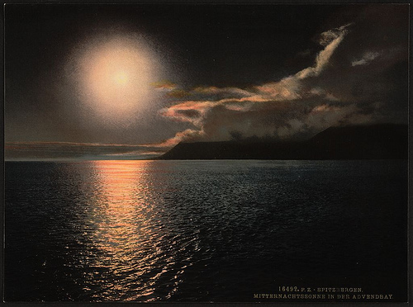
Romans 15:20-22
²⁰ My ambition has always been to preach the Good News where the name of Christ has never been heard, rather than where a church has already been started by someone else.
²¹ I have been following the plan spoken of in the Scriptures, where it says,
"Those who have never been told about him will see, and those who have never heard of him will understand."
²² In fact, my visit to you has been delayed so long because I have been preaching in these places.
––Romans 15:20-22
Notes:
Paul especially sought to fulfill OT prophecy by sharing Christ in new areas (20-22).
Does this mean that Paul hadn’t been to Rome yet? Exactly!

Slide 21
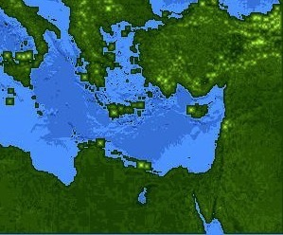
Jews at Pentecost––Acts 2:9-11
132
Rome (13)
PONTUS (7)
CAPPADOCIA (6)
ASIA (8)
PHRYGIA (9)
Parthia (1)
PAMPHILIA (10)
Mesopotamia (4)
CRETE (14)
Media (2)
Elam (3)
Jerusalem
CYRENE (12)
JUDEA (5)
ASIA––Roman Empire Provinces
Media––Parthian Empire Provinces
EGYPT (11)
Rome––Cities
CRETE––Islands
ARABIA (15)
Miles
0
200
400
600
800
1000
(1) (2) (3) etc. indicate sequence in Acts 2:9-11
Kms
0
300
600
900
1200
1500
Notes:
There were 40,000 Jews in Rome during the reign of Augustus (30 BC to AD 14), so this was a sizable minority. We do not know for sure who started the church at Rome, but it likely was some of these Jews who returned to Rome after receiving the Spirit at Pentecost in Jerusalem. They likely went back to Rome with the gospel, and now we’re picking up the account 22 years later. Praise God for pioneers who “go where no man has gone before.” It’s not wrong to build on another’s foundation, but many do this while few start things themselves.

Slide 22
Our Mission Agency
Notes:
So, Paul understood God’s calling for him—to reach Gentiles never reached before. This has helped me to reflect on my own calling…
God has called me to train Asian pastors to reach Asia.
It all started in California as a high school sophomore and new Christian when it dawned on me that my pastor was paid to study and teach the Bible—and those who paid him didn’t even feel guilty! I thought, “Wow, maybe I could teach God’s Word as a calling!”
Some 14 years later, as a PhD student at DTS and pastor in Fort Worth in 1987, God confirmed his calling for me that teaching should be my key ministry.

Slide 23
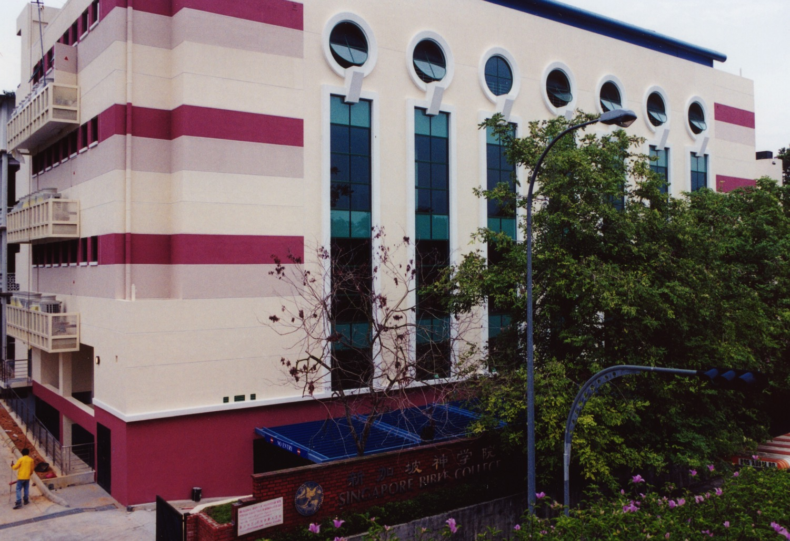
SINGAPORE BIBLE COLLEGE
9
Notes:
I served for 30 years as a seminary professor with 30 other faculty at Singapore's largest training school: Singapore Bible College

Slide 24
Singapore Bible College Students
USA
MONGOLIA
JAPAN
KOREA
CHINA
HONG KONG
MYANMAR
INDIA
THAILAND
VIETNAM
PHILIPPINES
MALAYSIA
SINGAPORE
SRI LANKA
INDONESIA
SBC
Notes:
These faithful leaders from about 25 countries came to us in Singapore for master and doctoral-level training. We trained them to build into others back in their home countries.
___________
Common-76

Slide 25
Courses Taught Since 1991
(English • Indonesian • Chinese • Arabic)
Survey • The Bible…Basically
OT NT Bible Study
Backgrounds • Research & Writing
OT NT Geography
Theology • Creation • Jesus
Church • Spirit • Salvation • Future
Preaching
Homiletics 1 Homiletics 2
Notes:
I get to teach these leaders every book of the Bible in survey courses, plus backgrounds to both the OT and NT, six areas of theology, and how to preach.
___________
Common-75

Slide 26
Teaching Ministry 1997-2017
MONGOLIA
JORDAN
KOREA
CHINA
NEPAL
MYANMAR
INDIA
THAILAND
VIETNAM
MALAYSIA
SRI LANKA
SINGAPORE
SBC
INDONESIA
Notes:
From 1997-March 2017 God has seen fit to grant me the privilege to train pastors in 12 other countries on 73 trips. Often pastors in the US team-teach with me on these trips.

Slide 27
What's your passion?
Notes:
You know, God has also called you to fulfill a passion. What’s your unique ministry call?

Slide 28
Categories of Gifts (1 Peter 4:11; Rom. 12:6-8)
Speaking | Serving
Teaching | Administering
Evangelism | Faith
Pastor-Teacher | Giving
Encouraging | Service
 | Mercy
Notes:
I really think that God’s calling relates directly with your spiritual gift—that ability God has given you to serve him (probably one of these nine listed). How many of you know your spiritual gift? If you think you do, please raise your hand.

Slide 29
Romans 15:14-33
154f
Three ways to expand your borders…
I. Know God's calling for you (14-22)
II. Support God's new directions (23-29)
Notes:
God’s plan for us always includes trusting him for new stuff—new opportunities.

Slide 30
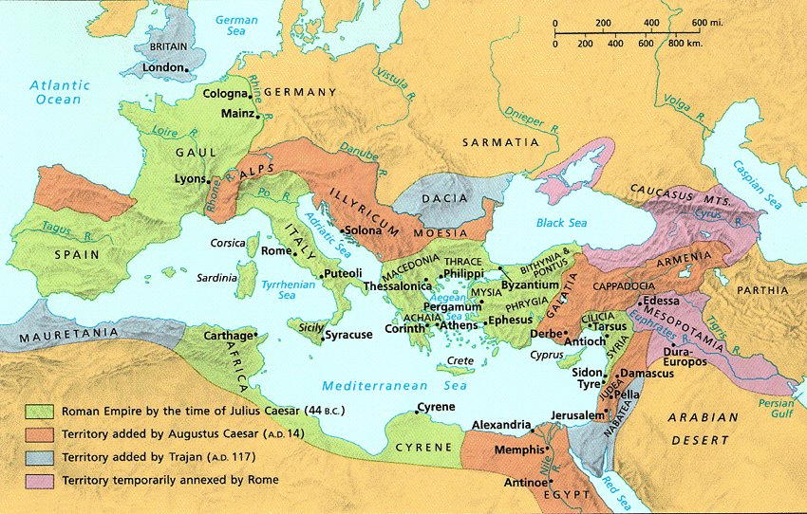
Romans 15:23-24
²³ But now I have finished my work in these regions, and after all these long years of waiting, I am eager to visit you.
²⁴ I am planning to go to Spain, and when I do, I will stop off in Rome. And after I have enjoyed your fellowship for a little while, you can provide for my journey.
Notes:
Paul shared his plan to extend his ministry to Spain to get their help (23-24).

Slide 31
Paul's Next Mission Field: Spain (15:23-29)
154f
Notes:
Why was Paul going to Spain? He had finished pioneering in the eastern Empire. Like in the time of Jonah, Spain (or Tarshish) was the very end of the known world.
Was there really “no more place for me to work in these regions” (NIV, 14:23)? No. He means that church-planting movements in the east would reach these people.
Financial help from the Romans would further his work since he’d be halfway to Spain by the time he got to Rome.
• But he would not go there immediately.

Slide 32
Romans 15:25-27
²⁵ But before I come, I must go to Jerusalem to take a gift to the believers there. ²⁶ For you see, the believers in Macedonia and Achaia have eagerly taken up an offering for the poor among the believers in Jerusalem. ²⁷ They were glad to do this because they feel they owe a real debt to them. Since the Gentiles received the spiritual blessings of the Good News from the believers in Jerusalem, they feel the least they can do in return is to help them financially.
Notes:
But first he had to bring the Gentile offering to Jerusalem to show unity with their Jewish mother church (25-27).
How did this Gentile support for Jerusalem relate to Paul’s calling to Gentiles?
He says here that he intended it to somewhat repay what the Jerusalem church had done for the Gentiles—which is interesting since it was the Antioch church—not the Jerusalem church—that sent him out to reach Gentiles.

Slide 33
Paul's Next Mission Field: Spain (15:23-29)
154f
Notes:
Paul didn't forget the needy in his passion to expand, so he had to deliver this help in person to Jerusalem.

Slide 34
Romans 15:28-29
²⁸ As soon as I have delivered this money and completed this good deed of theirs, I will come to see you on my way to Spain.
²⁹ And I am sure that when I come, Christ will richly bless our time together.
Notes:
Paul then also hoped to bless the Roman believers (28-29), and then head to Spain.

Slide 35
Paul's Next Mission Field: Spain (15:23-29)
154f
Notes:
Paul then planned on stopping off at Rome…

Slide 36
Paul's Next Mission Field: Spain (15:23-29)
154f
Notes:
…and then proceed from Rome to share the Good News in Spain.

Slide 37
New expansions for us…

Slide 38
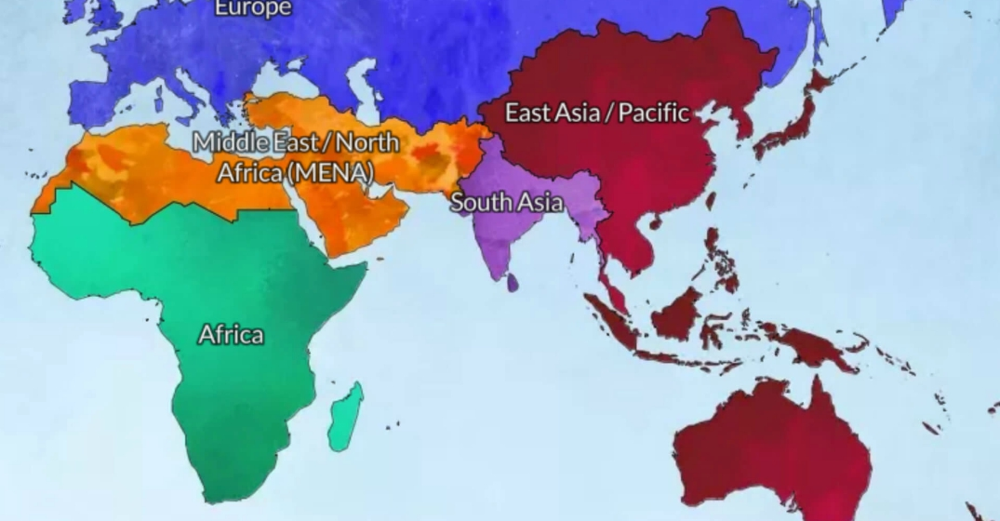
From East to West
Spain
? years
Eastern Empire
30 years
MENA
? years
East Asia
30 years
Notes:
Paul moved west to Spain, and, in like manner, God moved us west to MENA.

Slide 39
God led us from Asia to MENA in 2021
Jordan
Singapore
Notes:
So, in 2021 we shifted from Singapore to Jordan.

Slide 40
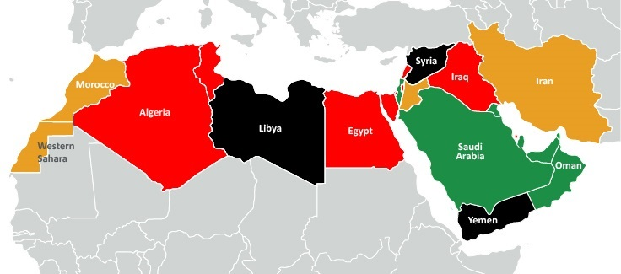
My Students from 11 Nations
Spain
Iraq
Israel
Syria
Morocco
Jordan
Egypt
Dubai
Sudan
Eritrea
Chad
Notes:
My students are now from 11 different nations based at JETS.
____________
Isaiah: Rami (Bible prof in Amman), Jackson (ST prof in Sudan), Jonathan (pastor in Chad), Habil (Hebrew prof? from Sudan in Amman), Amir (Sudanese translator in Amman), Nassef (Egypt), Ayoub (planting church and Bible college as lawyer in Casa Blanca, Morocco), Basem (Egypt), Nassar (Ramallah), Ramzi (Iraq), Dibora (Eritrea)
OT3: Osama (Jordan), Fadi (Syrian trained in Jordan at JETS but translating from Sweden while writing dissertation on Russian theologian for seminary in Belgium), Sara (English teacher in Jordan), Nagat (Egyptian Cru in Spain), Randa (CFO boarding school in Jordan), Jacklin (Jordanian reaching Syrian refugees), Adeeb (Egyptian international church in Dubai), Dani (Arabic apologist in Jordan)
Where serving:
1 Chad—Jonathan
1 Morocco—Ayoub
1 Spain—Nagat
1 Syria—Fadi
1 Dubai—Adeeb
2 Egypt—Nassef, Basem
3 Sudan—Jackson, Habil, Amir
6 Jordan—Rami, Osama, Sara, Randa, Jacklin, Dani
16

Slide 41
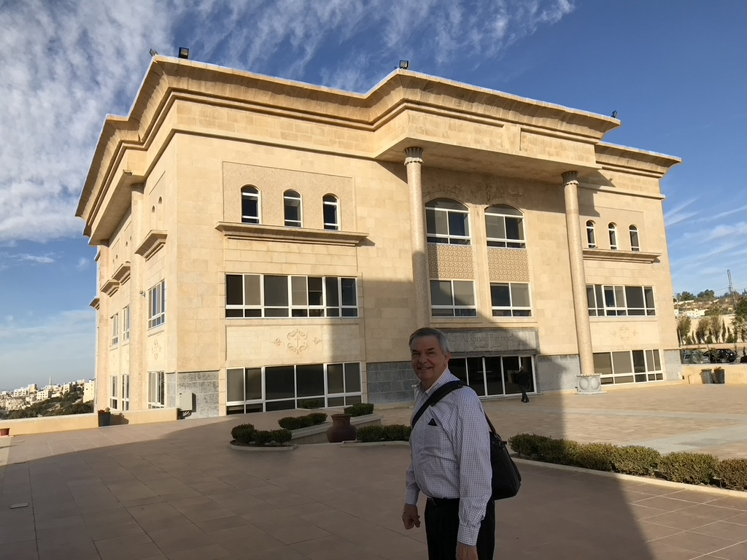
Jordan Evangelical Theological Seminary (JETS)
Notes:
I teach Bible through translation into Arabic.
______
Common-524
NS-05-Acts9-14—slide 143

Slide 42
Please get our latest prayer card
Front
Back
Notes:
Please get a prayer card and pray for us.

Slide 43
Assignment File System

Slide 44
TBB

Slide 45
TBB Vision

Slide 46
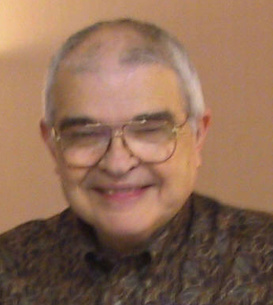
Dr John Fryman
Dr. John Fryman
Author of The Bible…Basically 10-Hour Seminar
©2004 TBBMI
8.0.01.
04

Slide 47
English

Slide 48
Burmese
Lai S iangtho…Abulpi
A Presentation of The Bible…Basically Ministries International Inc. Fort Worth, Texas
www.biblebasically.com
©2004 TBBMI
8.0.01.
04

Slide 49
French
LA BIBLE…
EN BASE
Une Présentation du Ministère Internationale de La Bible… En Base Inc. Fort Worth, Texas
www.biblebasically.com
©2006 TBBMI
8.0.01.
04
©2004 TBBMI
9.6.01.

Slide 50
Japanese
バイブル ベイシックミニストリーズ
インスティチュート
A Presentation of The Bible…Basically Ministries International Inc. Fort Worth, Texas
www.biblebasically.com
©2004 TBBMI
8.0.01.
04
Notes:
Japanese title slide

Slide 51
Khmer (Cambodian)
mUldæanRKwH>>>
énRBHKm<IIr
karbgðaj[sÁal;nUvRBHKm<Ir>>> EdlCamUldæanRKw³ kñúg B½n§kic©shKmnGnþrCati GayGinsIu.
Fort Worth, Texas
www.biblebasically.com
©2004 TBBMI
8.0.01.
04

Slide 52
Korean
성경은 … 기본적으로
A Presentation of The Bible…Basically Ministries International Inc. Fort Worth, Texas
www.biblebasically.com
7.5.01.
©2003 TBBMI
04

Slide 53
Malay
Alkitab… Dasar
Presentasi dari The Bible…Basically Ministries International Inc. Fort Worth, Texas
www.biblebasically.com
©2004 TBBMI
8.0.01.
04

Slide 54
Mao (India)
Bible…
Amolo Leino
Bible…Ngashankakhuina Ministries International Inc. pashina semkashok Fort Worth, Texas
www.biblebasically.com
©2004 TBBMI
8.0.01.
04

Slide 55
Malayalam (India)
Æß èÌÌßZ çÌØßAÜß
¥ÕÄøßMßAáKÄí Æß èÌÌßZ çÌØßAÜß… ÎßÈßØíd¿àØí §aVÈÞ×ÃW çËÞVGíÕVJí, æ¿µíØÞØí
©2004 TBBMI
8.0.01.
04

Slide 56
Mongolian
Библи… Үндсэндээ
A Presentation of The Bible…Basically Ministries International Inc. Fort Worth, Texas
www.biblebasically.com
©2004 TBBMI
8.0.01.
04

Slide 57
Nepali
afOan======
cfwf/e[\t
A Presentation of The Bible…Basically Ministries International Inc. Fort Worth, Texas
www.biblebasically.com
8.0.01.
©2004 TBBMI
04

Slide 58
Swahili (Kenya)
biblia kwa ujumla
A Presentation of The Bible…Basically Ministries International Inc. Fort Worth, Texas
www.biblebasically.com
8.0.01.
©2003 TBBMI
04

Slide 59
Tagalog (Philippines)
Ang Biblia . . . Pinasimple
A Presentation of The Bible…Basically Ministries International Inc. Fort Worth, Texas
www.biblebasically.com
©2004 TBBMI
8.0.01.
04
Notes:
PLEASE PUT THE TITLE AND SUBTITLES INTO YOUR NATIONAL LANGUAGE AND LEAVE THE WEBSITE UNCHANGED

Slide 60
Tangkhul (India)
Bible…
Ngashankakhui
Bible…Ngashankakhuina Ministries International Inc. pashina semkashok Fort Worth, Texas
www.biblebasically.com
©2004 TBBMI
8.0.01.
04

Slide 61
Tamil (Sri Lanka/India)
jpUkiwapd;… mbg;gil
A Presentation of The Bible…Basically Ministries International Inc. Fort Worth, Texas
www.biblebasically.com
©2004 TBBMI
8.0.01.
04

Slide 62
Vietnamese
Kinh thánh… Cơ bản là
A Presentation of The Bible…Basically Ministries International Inc. Fort Worth, Texas
www.biblebasically.com
©2004 TBBMI
8.0.01.
04

Slide 63
Bahasa Indonesia
Presentasi dari The Bible…Basically Ministries International Inc. Fort Worth, Texas
www.biblebasically.com
7.5.01.
©2003 TBBMI
04

Slide 64
Chinese (Mandarin)
圣经...
基要
国际基本事工呈献…圣经纵览系列. 福特沃得, 德州
www.biblebasically.com
8.0.01.
©2003 TBBMI
04

Slide 65
Arabic

Slide 66
PowerPoint (945 slides) Student Workbook (100 pages) Teacher Script (400 pages)
TBB Materials
Completed in Arabic • English • Chinese • Hindi • Indonesian • Korean • Malay • Mongolian • Russian • Spanish
©2004 TBBMI
8.0.01.
04

Slide 67
As an individual, are you supporting God's new directions?

Slide 68
YOU are needed!
Women's Ministry Team
Men's Ministry Team
Missions
Coordinator for Ushers/Greeters
Youth Sponsors & assistant (woman)
PPT design
Set-up, Take down (e.g. signs)
Home group leaders
Evangelism
Notes:
God could raise up some really gifted person, but he rarely works that way. Instead, he uses plain ole' regular people like you and me in his work—especially in giving!

Slide 69
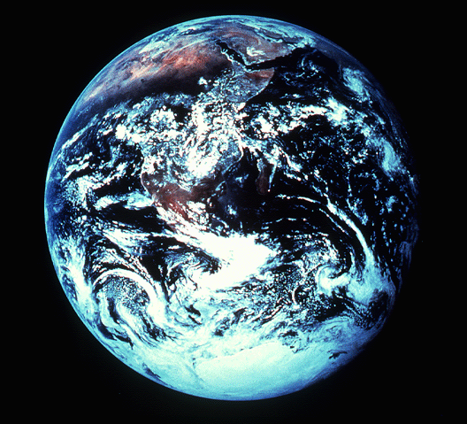
"in the beginning"
Gen. 1:1
An Introduction to Genesis

Slide 70
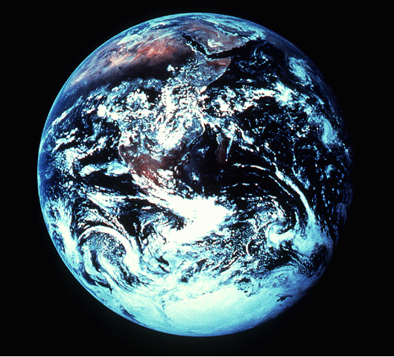
"pada mulanya"
Gen. 1:1
Pengenalan kitab Kejadian

Slide 71
"起初"
Gen. 1:1
创世记导论

Slide 72
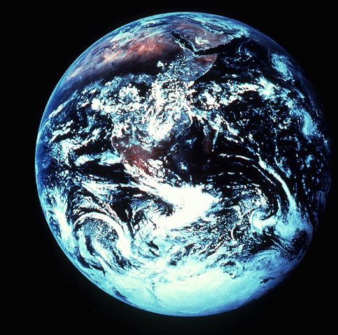
في البدء
Gen. 1:1
مقدِّمة
إلى سِفْر التكوين
Notes:
الأمر الذي أسعى إلى إنجازه هو أن أقوم بتطوير موادَّ للكتاب المقدَّس بلغتنا أوَّلاً.
What I seek to do is to develop Bible materials in our language first.
_______
Common-94

Slide 73
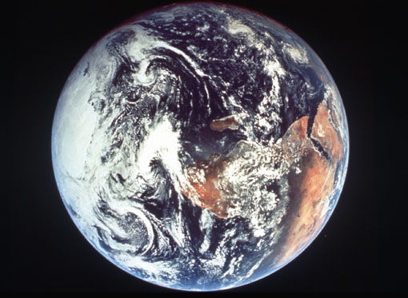
Days of Creation
33
Void
Formless
Forming
Filling
Day 4: Sun, moon & stars arranged
Day 1: Light
Day 2: Water & air separated
Day 5: Fish & fowl
Day 3: Land & sea separated
Day 6: Animals & man
Genesis 1:3-31

Slide 74
Days of Creation in Bahasa Indonesian
Hari-hari penciptaan
64
Kosong
Tidak berbentuk
Dibentuk
Diisi
Hari 4: Matahari, bulan & bintang diatur
Hari 1: Terang
Hari 2: Air & udara dipisahkan
Hari 5: Ikan & unggas
Hari 3: Darat & laut dipisahkan
Hari 6: Binatang & manusia
Kejadian 1:3-31

Slide 75
六天的创造
空虚
64
充满
混沌
形成
第四天: 太阳，月亮与众星摆列在天
第一天: 光
第二天:
水与空气分开
第五天: 鱼与雀鸟
第三天:
旱地与海分开
第六天: 动物与人
创世记 1:3-31

Slide 76
أيام الخلق
64
خالية
ملأ
خربة
تشكيل
اليوم 4: ترتيب الشمس والقمر والنجوم
اليوم 1: النور
اليوم 5: الأسماك والطيور
اليوم 2: فصْلُ الجَلَد عن المياه
اليوم 6: الحيوانات والإنسان
اليوم 3: فصْلُ البحر عن اليابسة
تكوين 1: 3-31
Notes:
مثلًا، يجب على المسيحيِّين أن يدركوا أنَّه لا يوجد في أحداث الخَلْق- الواردة في تكوين الأصحاح 1- حادثٌ بالصدفة أو تطوُّرٌ بيولوجيٌّ للكائنات الحيَّة قائمٌ على مبدأ "التجربة والخطأ إلى أن نصل إلى النموذج الصحيح"- بل الله خلَقَ بعنايةٍ شديدةٍ كلَّ شيءٍ وفق اختياره وحسْبَ إرادته. وكما هو متوقَّع، قام الله أوَّلًا بتشكيل (إعداد) العالم في ثلاثة أيَّام، ثمَّ بعْدَ ذلك مَلَأَه.
For example, Christians need to see that there is no accident or evolution of trial-and-error in Genesis 1—God carefully made everything by his choice. As expected, he formed the world for three days before he filled it.
__________
Common-97

Slide 77
NT Survey link at BibleStudyDownloads.org
Get this presentation for free!
Notes:
NT Survey (ns)

Slide 78
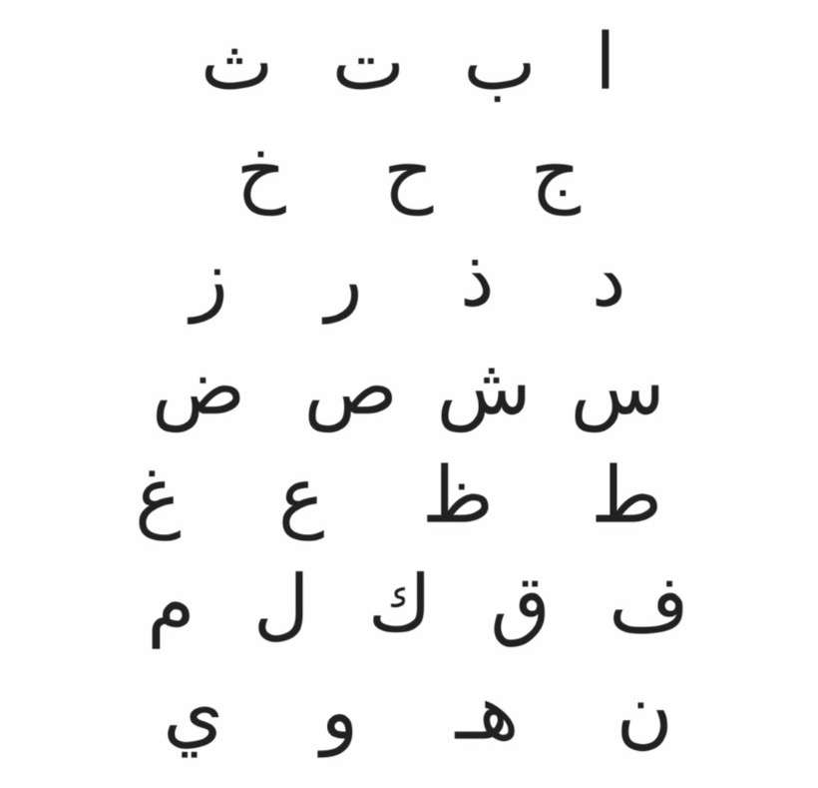
Arabic
د. ريك غريفيث
Dr. Rick Griffith
Notes:
I will need to be translated into Arabic—but I did learn this Arabic. Do you know what it says?
• Here is the translation—my name!

Slide 79
Romans 15:14-33
Three ways to expand your borders…
I. Know God's calling for you (14-22)
II. Support God's new directions (23-29)
III. Pray against opposition (30-33)

Slide 80
Romans 15:30-33
³⁰ Dear brothers and sisters, I urge you in the name of our Lord Jesus Christ to join in my struggle by praying to God for me. Do this because of your love for me, given to you by the Holy Spirit. ³¹ Pray that I will be rescued from those in Judea who refuse to obey God. Pray also that the believers there will be willing to accept the donation I am taking to Jerusalem. ³² Then, by the will of God, I will be able to come to you with a joyful heart, and we will be an encouragement to each other.
³³ And now may God, who gives us his peace, be with you all. Amen.
Notes:
Paul asked for prayer against those opposed to his ministry expansion (30-33).
Prayer was a tangible way the Romans could show they loved him (30).
He requested prayer for protection (31).
He requested prayer for expansion of the ministry of Gentiles (32-33).

Slide 81
Prayer
Protection
Expansion

Slide 82
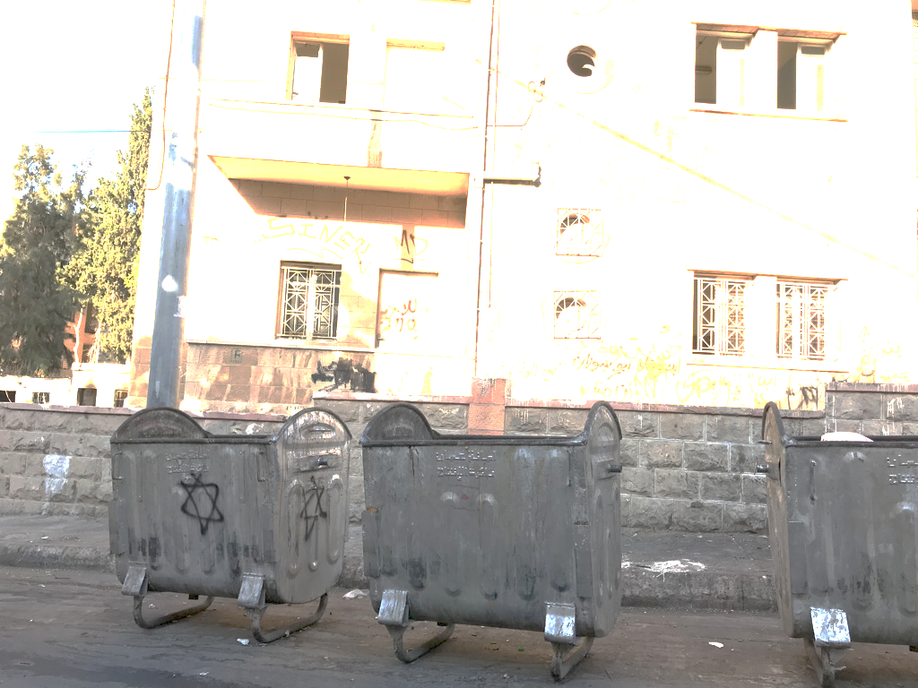
Arabs Hate Israel

Slide 83
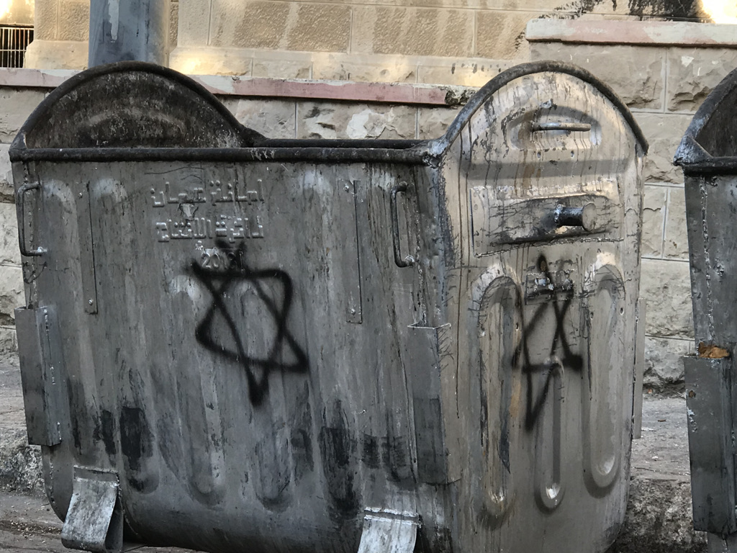
Arabs Hate Israel

Slide 84
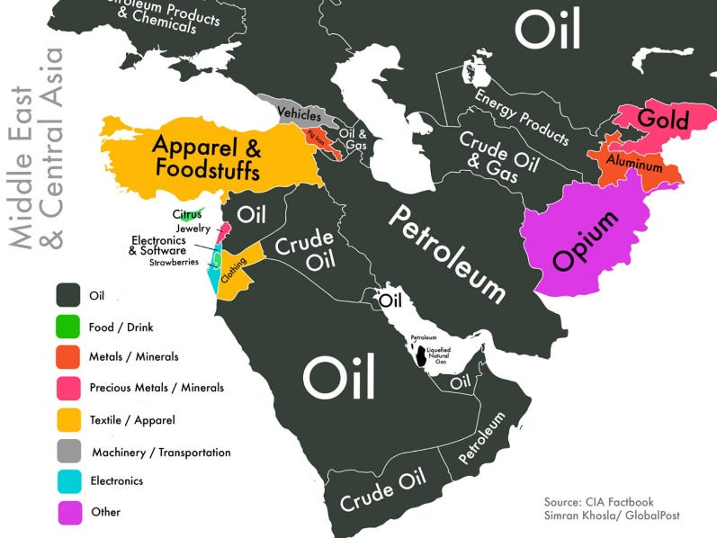
Products

Slide 85
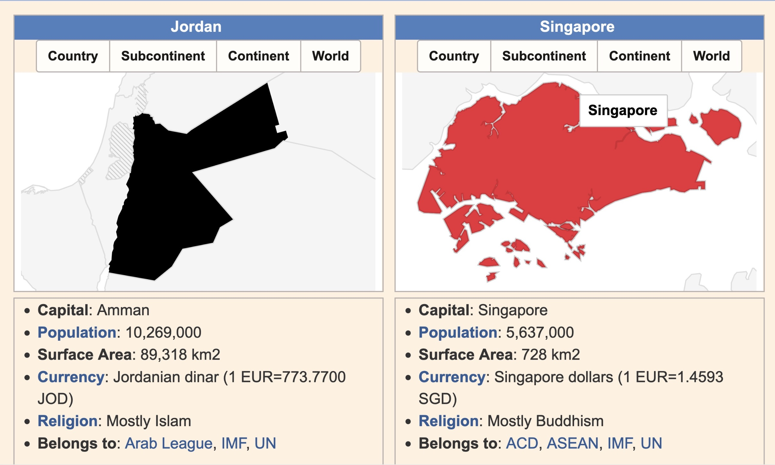
Jordan & Singapore
Population:
JO 10m
SG 5.6m
Church:
JO Sad
SG Vibrant
Imports:
SG Buddhist
JO Islam

Slide 86
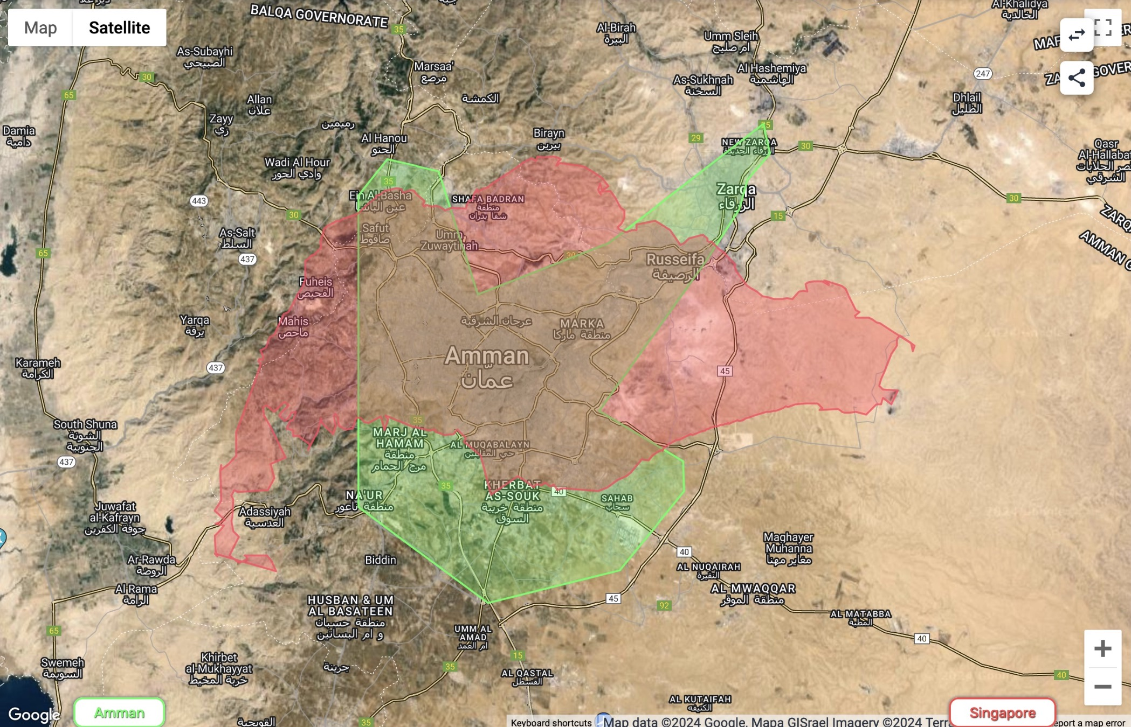
Jordan & Singapore

Slide 87
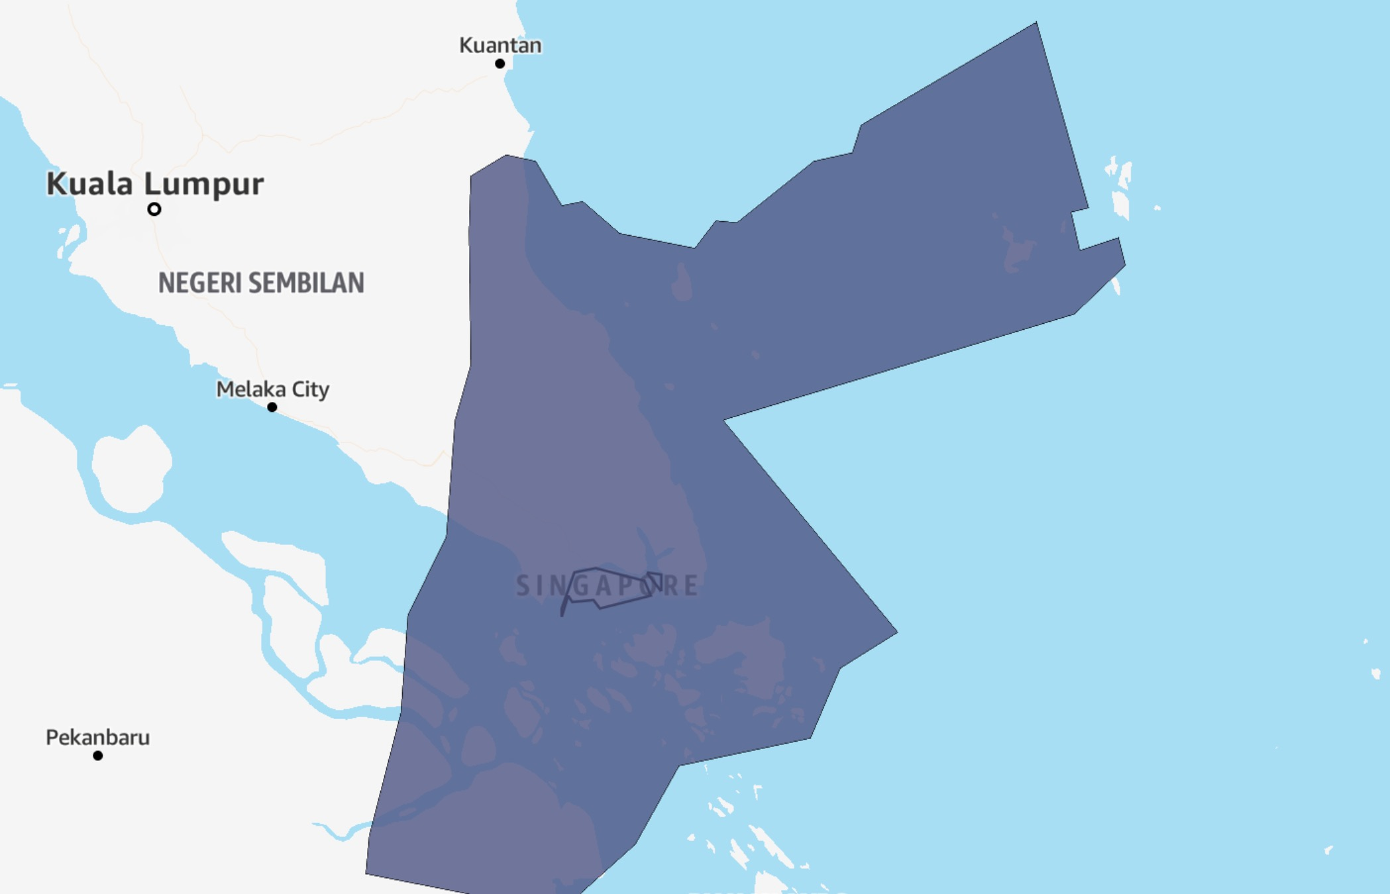
Jordan & Singapore

Slide 88
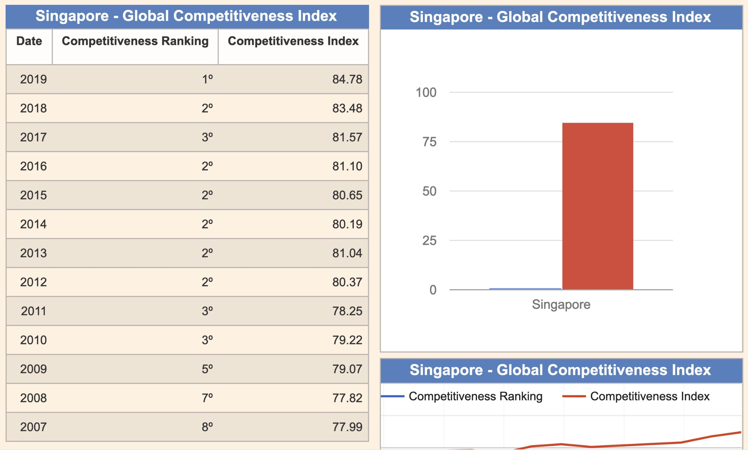
Jordan & Singapore
SG #1 in Competitiveness

Slide 89
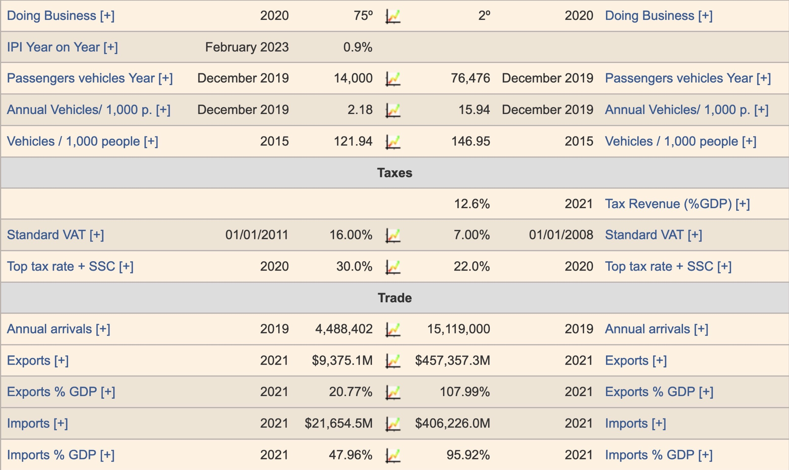
Jordan & Singapore
Doing Business:
JO #75
SG #2
Exports:
JO $9b
SG $457b
Imports:
JO $21b
SG $406b

Slide 90
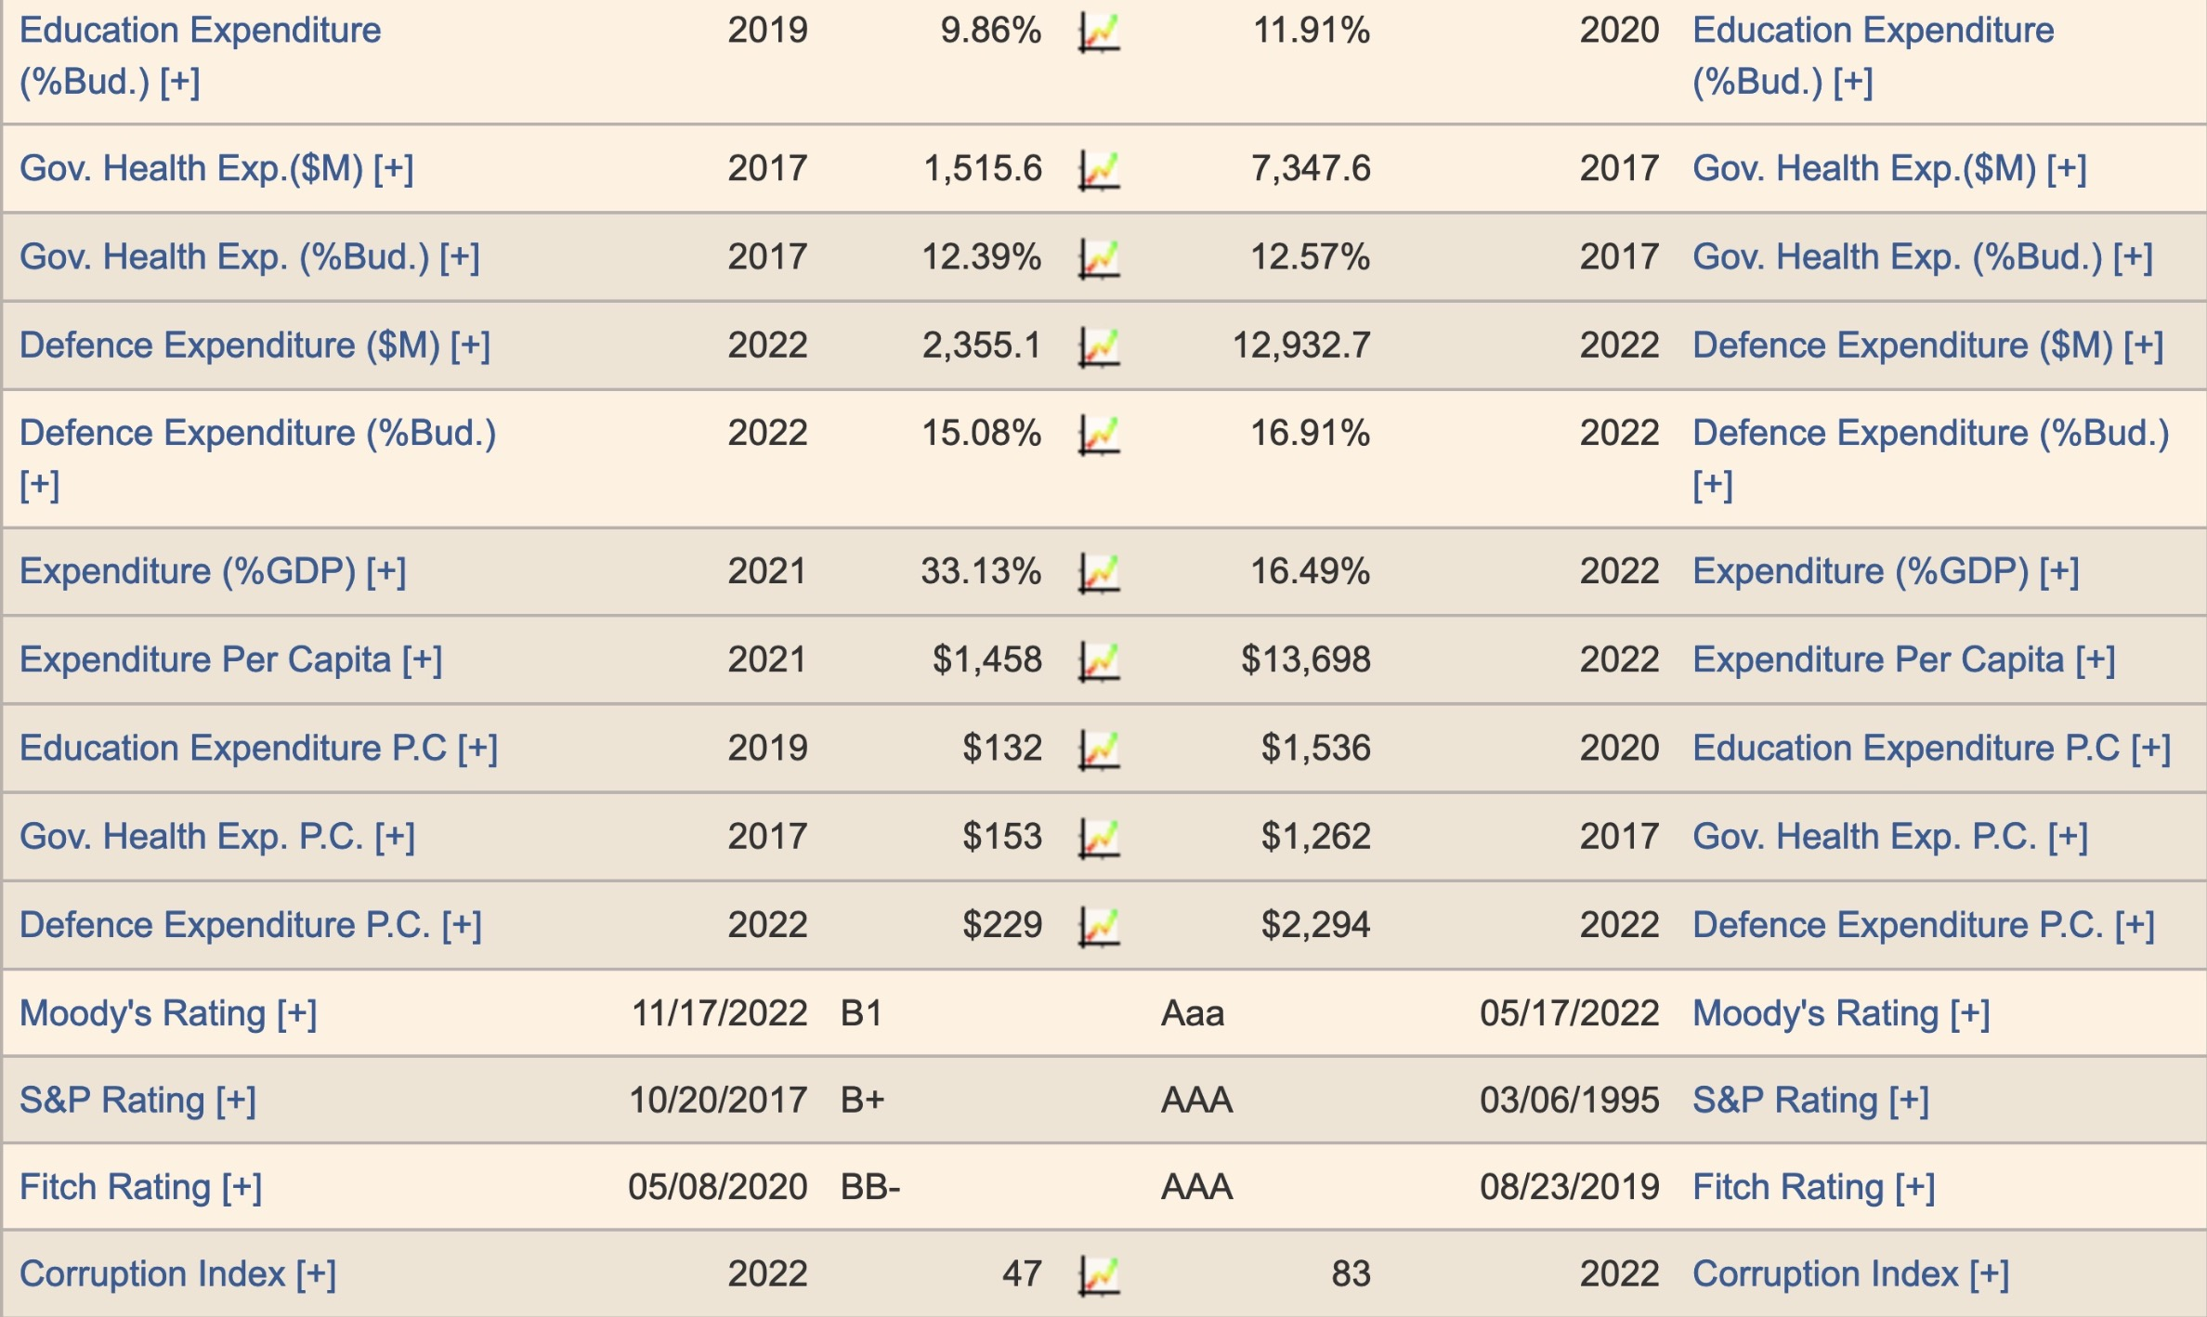
Jordan & Singapore
Defence
JO 33%
SG 16%
Per PAX:
JO $1k
SG $13k
S&P:
JO B+
SG AAA

Slide 91
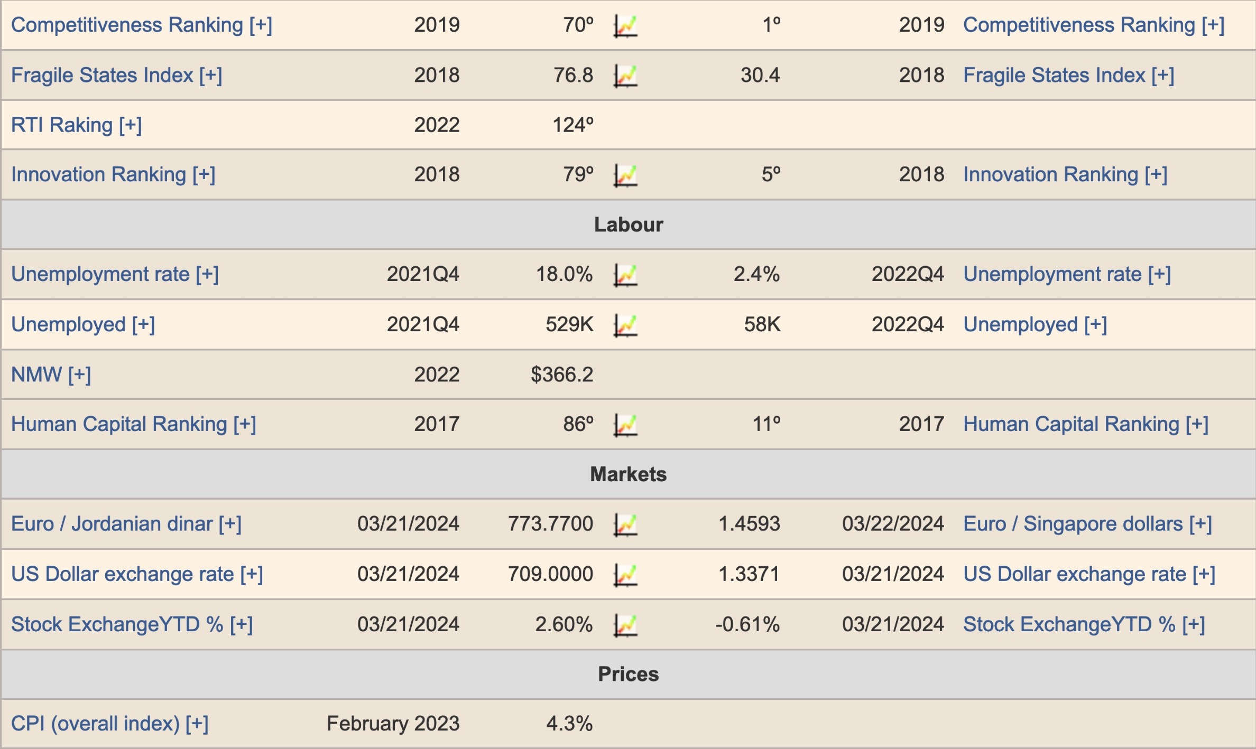
Jordan & Singapore
Unemployment:
JO 18%
SG 2%
Unemployed:
JO 529k
SG 58k

Slide 92
Our Church Vision
Love the Nations
Love the Church
Love God
Notes:
• LOVE GOD: God wants our church to trust him. Love is most important (1 Cor 13:13).
• LOVE THE CHURCH: We also need to be involved in his work: teaching, accountability groups, finances, etc.
• LOVE THE NATIONS: The heart of the Great Commission to disciple all countries is based on love for God and his people.
——————————
Common-294
BE-05-Deut-82
OP-05-Deut-71
OS-05-Deut-155, 237
OS-29-Joel-128
OS-32-Jonah-71
NS-02-Mark1-8-slide 111
NS-03-Luke1-12—slide 401
NS-06-Romans9-16-slide 172

Slide 93
Paul's Main Idea
Expand your borders by…
Knowing His call,
Supporting it, and
Praying against enemies
Notes:
Let God move you into new areas of growth by…
• Understanding his individual plan for you
• Committing yourself to that plan in time and money
• Battling on your knees against opposition

Slide 94
Romans 15:14-33
Three ways to expand your borders…
I. Know God's calling for you (14-22)
II. Support God's new directions (23-29)
III. Pray against opposition (30-33)
Notes:
In which of these three ways is God speaking to you? What will you do about it today?

Slide 95
Black

Slide 96
NT Preaching link at BibleStudyDownloads.org
Get this presentation and script for free!
Notes:
NT Preaching (np)

