Slide 1
Love and Law: Same Same or Different?
Grace Wan
28 Sep 2016

Slide 3
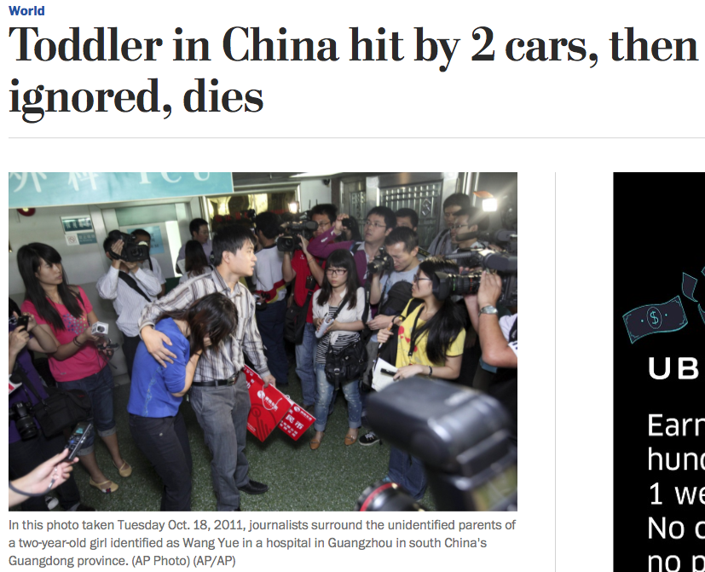

Slide 4
Romans 13:8
Owe no one anything, except to love each other, for the one who loves another has fulfilled the law.

Slide 5
We need to love continuously.
“Owe no one anything, except to love each other,”

Slide 6
Love fulfills the Law.
“for the one who loves another has fulfilled the law.”

Slide 7
Matthew 7:12
Whatever you wish that others would do to you, do also to them, for this is the Law and the Prophets.

Slide 8
“Do all the good you can, by all the means you can, in all the ways you can, in all the places you can, at all the times you can, to all the people you can, as long as ever you can.”
~John Wesley~

Slide 9
If
Even

Slide 10
Romans 13:8
Owe no one anything, except to love each other, for the one who loves another has fulfilled the law.

