Slide 1
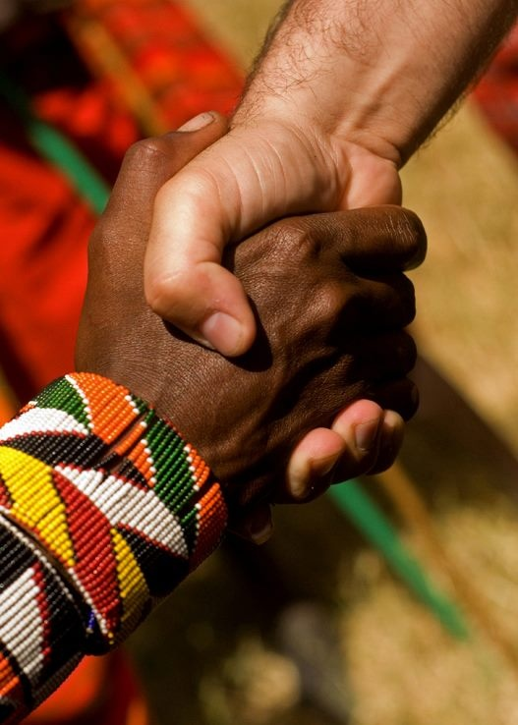
“Accept one another as Christ has accepted you” (Rom 15:7)
Romans 13:1–14
Preached by Andrew B. Spurgeon at Crossroads International Church Singapore • cicfamily.com Uploaded by Dr. Rick Griffith • Singapore Bible College Thousands of files in 44 languages for free at BibleStudyDownloads.org

Slide 2
Theme
“Accept one another just as Christ has accepted us for the glory of God” (Rom 15:7)

Slide 3
Summary
While we were sinners, God demonstrated his love for us by sending his son, Jesus Christ, to die for us. Anyone who believes in him will have salvation. Those who have this salvation have a renewed life—to love one another.

Slide 4
In Chapter 13
Question: Should we then obey Nero?

Slide 5
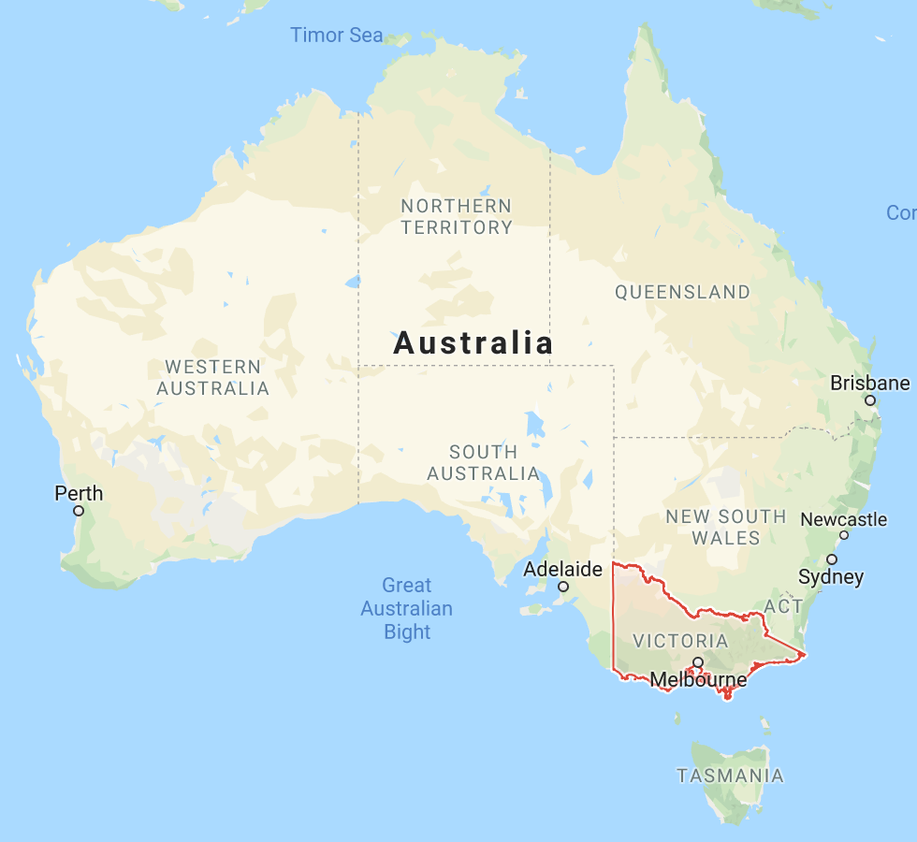
Governments!
In Victoria, Australia, it is illegal to change a light bulb unless you’re a licensed electrician.

Slide 6
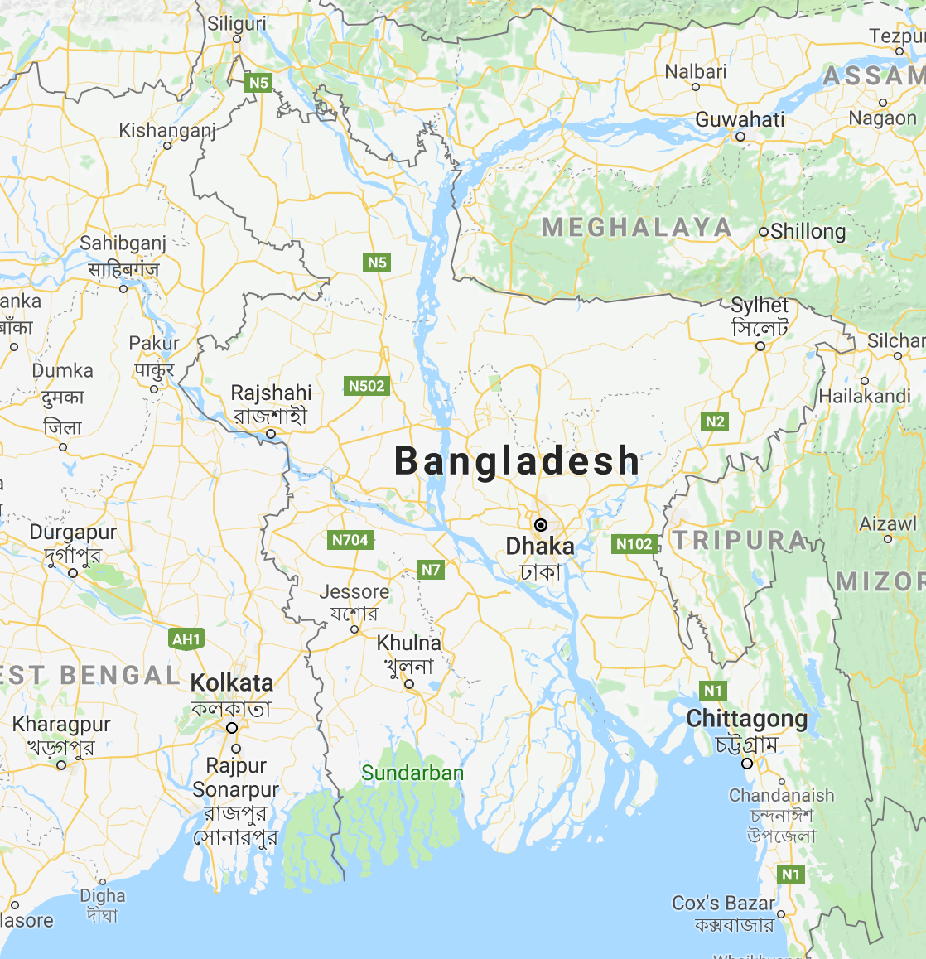
Governments!
In Bangladesh, children 15 years and older can be sent to jail for cheating on their final exams.

Slide 7
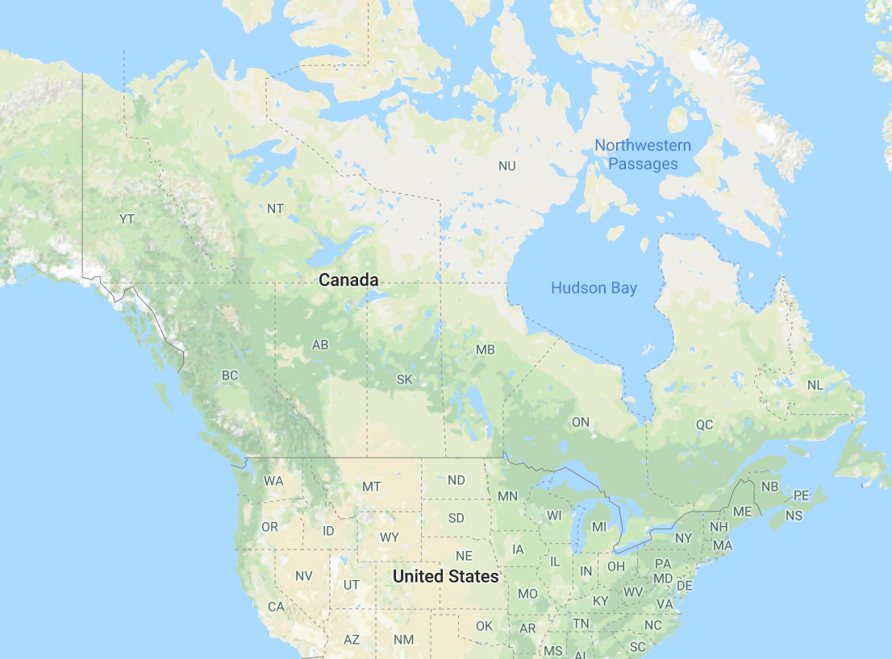
Governments!
Canada bans any comic book that portrays illegal activity.

Slide 8
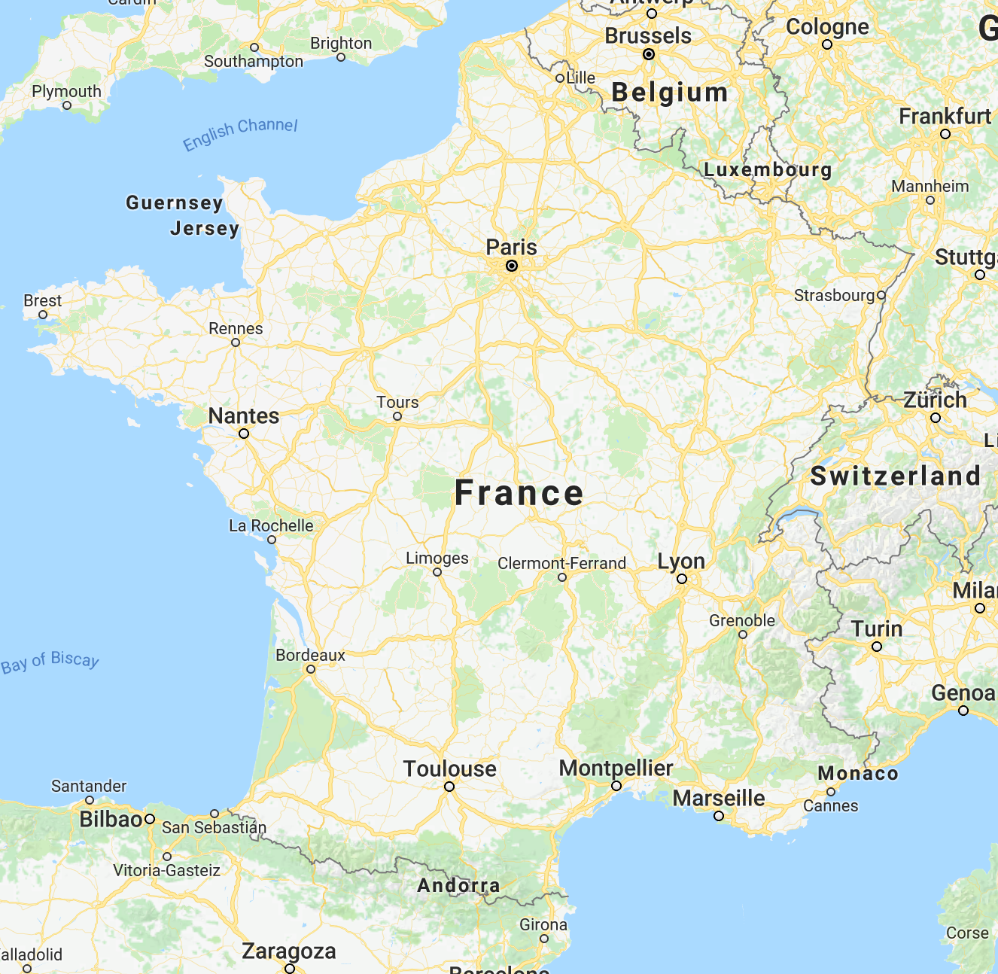
Governments!
In France, it is illegal to name pigs Napoleon.

Slide 9
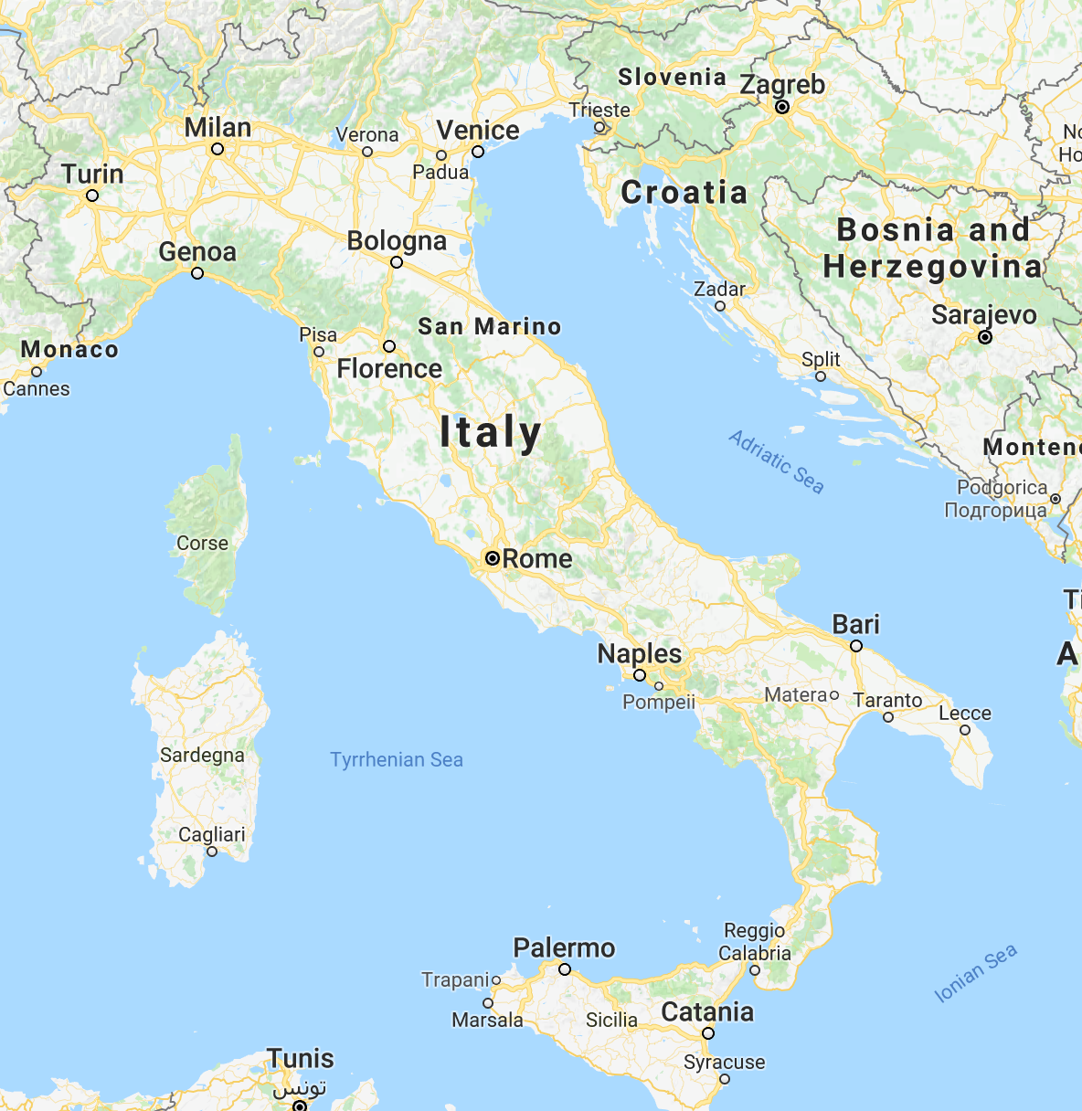
Governments!
In Turin, Italy, dog owners must take their dogs on a walk at least three times a day.

Slide 10
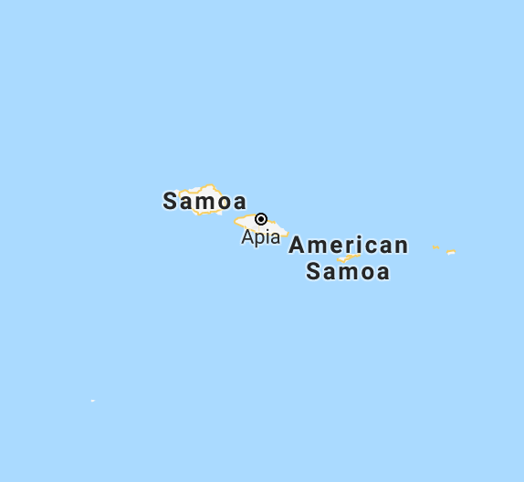
Governments!
In Samoa, it is illegal to forget one’s wife’s birthday.

Slide 11
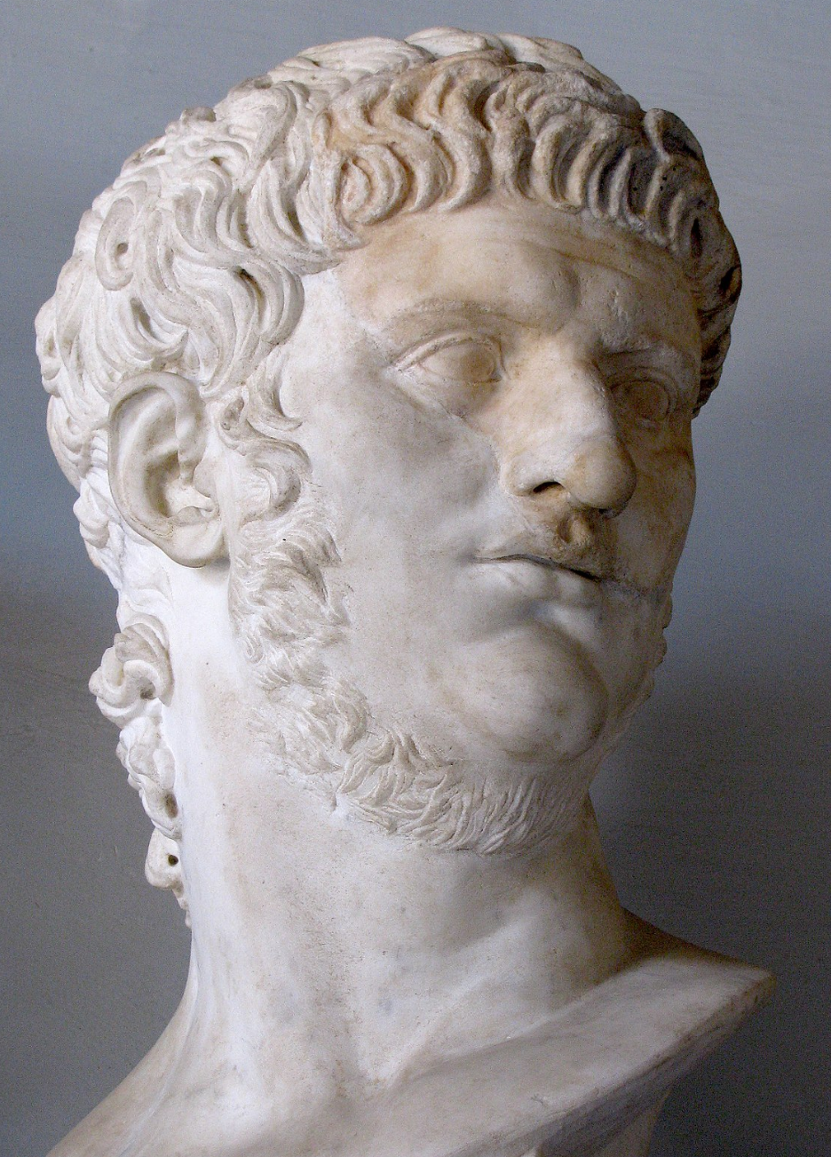
Chapter 13
Nero was the great-nephew of the Emperor Claudius who expelled the Jews from Rome. When Claudius died, Nero became the Emperor.

Slide 12
Chapter 13
So, the Christians, esp. the Jewish Christians, would have wondered, “Should we obey Nero?”

Slide 13
Chapter 13
Paul gives four reasons:

Slide 14
Chapter 13
1. Obey Nero because he is God’s servant (13:1–5)

Slide 15
Chapter 13
Every person must submit to the governing authorities since there is no authority except under God. They exist, being appointed by God (13:1).

Slide 16
Chapter 13
So, anyone who resists authority opposes the ordinance of God. And those who resist will receive judgment against themselves (13:2).

Slide 17
Chapter 13
The rulers are not a terror to those who do good but bad. If you do not wish to fear the authority, then do good and you will have praise from the authority (13:3).

Slide 18
Chapter 13
He [Nero] is God’s servant for you to do good. And if you do bad, fear, because he does not bear the sword in vain. The servant of God is the avenger of wrath to the one who does evil (13:4).

Slide 19
Chapter 13
Therefore, you must submit, not only because of the wrath but also because of the conscience (13:5).

Slide 20
Chapter 13
2. Obey Nero because you shouldn’t owe anything to anyone (13:6–8a)

Slide 21
Chapter 13
For this reason, you also must pay taxes—they [tax-collectors] are ministers of God, devoting themselves to this task (13:6).

Slide 22
Chapter 13
Give to everyone what is owed—
to the tax-collectors taxes, to the toll-persons tolls, and to the one that need to be feared fear, to the one that needs to be honored honor. Owe no-one anything (13:7-8a).

Slide 23
Chapter 13
3. Obey Nero because that’s a love-action, which fulfills the law of God (13:8b–10)

Slide 24
Chapter 13
(Owe no-one anything) except to love one another because the one who loves fulfills every other law—(13:8b).

Slide 25
Chapter 13
Whether “Do not commit adultery,” “Do not murder,” “Do not steal,” or “Do not covet.” Every other commandment is wrapped up in this one [commandment]: “Love your neighbor as yourself” (13:9).

Slide 26
Chapter 13
The love for one’s neighbor does not do harm/evil. In this way, love is the fulfillment of the law (13:10).

Slide 27
Chapter 13
4. Obey Nero because we are children of light, walking in the light and clothed in Christ (13:11–14)

Slide 28
Chapter 13
You obey, knowing the time: the hour for you to wake up from sleep is already here; now our salvation is nearer than when we believed (13:11).

Slide 29
Chapter 13
The night has gone, and the day is here. So, we put off the works of the dark, and we clothe the armor of light (13:12).

Slide 30
Chapter 13
As in day-time, we walk properly, not carousing and drunk, not immorally and sensually, not quarreling and in jealousy (13:13).

Slide 31
Chapter 13
But you clothe the Lord Jesus Christ and do not provide provision for flesh to its desires (13:14).

Slide 32
Chapter 13
Should Christians in Rome obey Emperor Nero?
Yes, because

Slide 33
Chapter 13
Nero is God’s servant.
Believers shouldn’t owe anything to anyone.
Obedience to the rulers is a love-action, which fulfills the law of God.
Believers are children of light who walk in light and are clothed in Christ.

Slide 34
Chapter 13
Application

Slide 35
Chapter 13
Government servants are God’s servants/ministers
(e.g., Nebuchadnezzar, Jer 27:6; Cyrus of Persia, Isa 44:28–25:4, as servants and even Messiah)

Slide 36
Chapter 13
Since they are God’s servants, we submit and obey since it’s the love-action, the fulfilment of the law, that we, as children of light who are clothed in Christ, ought to do.

Slide 37
Chapter 13
What if the leaders are evil?

Slide 38
Chapter 13
How evil was Nero?

Slide 39
Chapter 13
What if they are anti-Christians?

Slide 40
Chapter 13
How anti-Christians was Nero?

Slide 41
Chapter 13
What if they demand that we disobey God?

Slide 42
Chapter 13
Then, we obey God (knowing we’ll incur punishments)
Peter (Acts 5:29), midwives (Exod 1:17); Daniel, Shadrach, Meshach, and Abednego (Dan 3–6).

Slide 43
Chapter 13
Obey the authorities, except when they demand that we disobey God.

Slide 44
Chapter 13
And, we pray for their salvation:
“I urge, then, first of all, that petitions, prayers, intercession and thanksgiving be made for all people—for kings and all those in authority—that we may live peaceful and quiet lives in all godliness and holiness. This is good, and pleases God our Savior, who wants all people to be saved and to come to a knowledge of the truth” (1 Timothy 2:1–4)

Slide 45
NT Sermons link at BibleStudyDownloads.org
Get this presentation and notes for free!

