Slide 1
CIC SUNDAY SERVICE 30TH JULY 2023
SERVE ONE ANOTHER
Preached by Matt Lyle at Crossroads International Church Singapore • CICFamily.com Uploaded by Dr. Rick Griffith • Jordan Evangelical Theological Seminary Files in many languages for free download at BibleStudyDownloads.org

Slide 2
3 Reasons why people refuse to help others
The cost to self is too high
Others are able to help
They are different from me
https://www.psychologytoday.com/sg/blog/motivate/201710/3-reasons-why-people-refuse-help-others

Slide 3
ROMANS 12:1-21

Slide 4
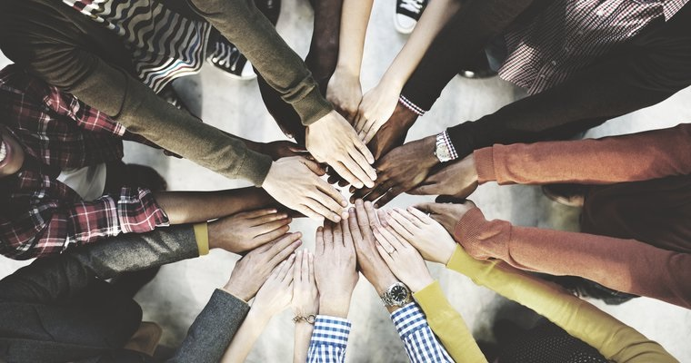

Slide 5
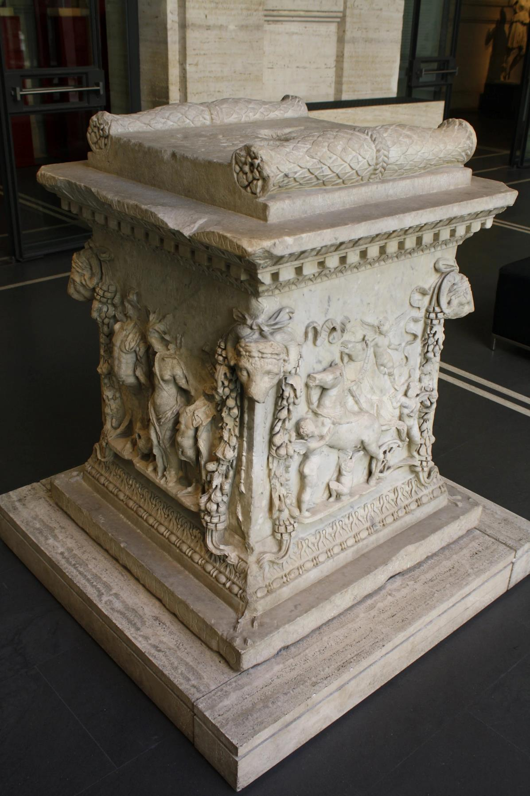
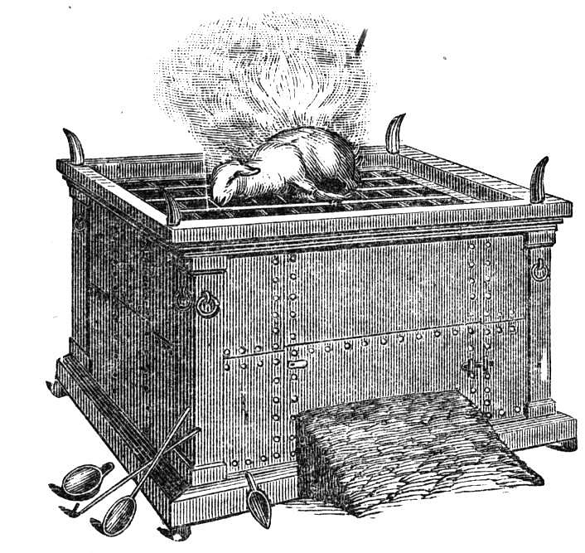

Slide 6
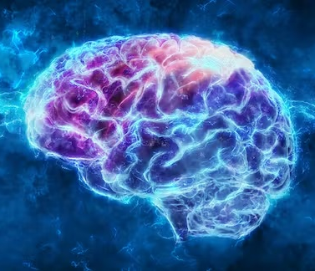
Renewing of the mind

Slide 7
For by the grace given to me I say to everyone among you not to
think of himself more highly than he ought to
think, but to
think with sober judgment, (not to be led by emotions)
each according to the measure of faith that God has assigned. (v. 3)

Slide 8
“
To himself, every man is in a sense the most important person in the world, and it always needs much grace to see what other people are, and to keep a sense of moral proportion
— James Denney
”

Slide 9
What is spiritual worship here?
True worship is always about coming together as God’s people
Spiritual worship here is about coming together in humility, considering each other in our thoughts and doing.

Slide 10
Why should we serve one another?
Serve one another because it is our spiritual worship to God (Rom 12:1-3)

Slide 11
discern what is the will of God through testing

Slide 13
let love be genuine
inside the church

Slide 14
inside the church
Rom 12:9-13
“Abhor what is evil and cling to what is good.”
“Be devoted to one another with mutual affection.”
“Honor others above yourselves.”
“Never be lacking in zeal, but keep your spiritual fervor, serving the Lord.”
“Be joyful in hope, patient in affliction, faithful in prayer.”
“Share with God’s people who are in need.”
“Practice hospitality.”

Slide 15
Why should we serve one another?
Serve one another because it is our spiritual worship to God (Rom 12:1-3)
Serve one another because it makes us one in Christ (Rom 12:4-13)

Slide 16
outside the church
Bless those who persecute you; bless and do not curse them (v. 14)
Never be wise in your own sight (v. 16b)
“Vengeance is mine, I will repay,” says the Lord (v. 19b)
To the contrary, “If your enemy is hungry, feed him; if he is thirsty, give him something to drink” (v. 20b)

Slide 17
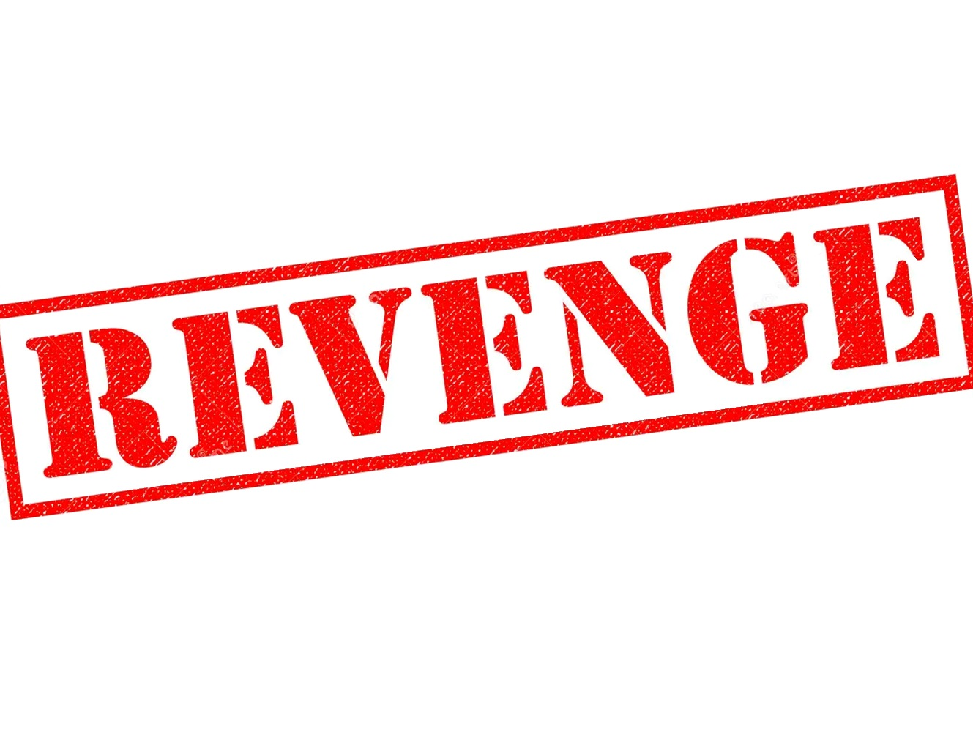
revenge
outside the church

Slide 18
outside the church
Bless those who persecute you; bless and do not curse them (v. 14)
Never be wise in your own sight (v. 16b)
“Vengeance is mine, I will repay,” says the Lord (v. 19b)
To the contrary, “If your enemy is hungry, feed him; if he is thirsty, give him something to drink” (v. 20b)

Slide 19
outside the church
Bless those who persecute you; bless and do not curse them (Rom 12:14)
I will bless those who bless you, and him who dishonors you I will curse, and in you all the families of the earth shall be blessed (Gen 12:3)

Slide 20
outside the church
Bless those who persecute you; bless and do not curse them (v. 14)
Never be wise in your own sight (v. 16b)
“Vengeance is mine, I will repay,” says the Lord (v. 19b)
To the contrary, “If your enemy is hungry, feed him; if he is thirsty, give him something to drink” (v. 20b)

Slide 21
outside the church
Never be wise in your own sight (Rom 12:16b)
Trust in the LORD with all your heart, and do not lean on your own understanding. In all your ways acknowledge him, and he will make straight your paths. Be not wise in your own eyes; fear the Lord, and turn away from evil. It will be healing to your flesh and refreshment to your bones (Prov 5:3-8)

Slide 22
outside the church
Bless those who persecute you; bless and do not curse them (v. 14)
Never be wise in your own sight (v. 16b)
“Vengeance is mine, I will repay,” says the Lord (v. 19b)
To the contrary, “If your enemy is hungry, feed him; if he is thirsty, give him something to drink” (v. 20b)

Slide 23
outside the church
“Vengence is mine, I will repay” says the Lord (Rom 12:19b)
Vengeance in mine, and recompense, for the time when their foot shall slip; for the day of their calamity is at hand, for their doom comes swiftly. For the LORD will vindicate his people and have compassion on his servants, when he sees that their power is gone and there is none remaining, bond or free (Deut 32:35-36)

Slide 24
outside the church
Bless those who persecute you; bless and do not curse them (v. 14)
Never be wise in your own sight (v. 16b)
“Vengeance is mine, I will repay,” says the Lord (v. 19b)
To the contrary, “If your enemy is hungry, feed him; if he is thirsty, give him something to drink” (v. 20b)

Slide 25
outside the church
To the contrary, “if your enemy is hungry, feed him; if he is thristy, give him something to drink” (Rom 12:20b)
If your enemy is hungry, give him bread to eat, and if he is thirsty, give him water to drink, for you will heap burning coals on his head, and the LORD will reward you (Prov 25:21-22)

Slide 26
outside the church
Bless those who persecute you; bless and do not curse them (v. 14)
Never be wise in your own sight (v. 16b)
“Vengeance is mine, I will repay,” says the Lord (v. 19b)
To the contrary, “If your enemy is hungry, feed him; if he is thirsty, give him something to drink” (v. 20b)

Slide 27
“Do not be overcome by evil, but overcome evil with good.”
— Romans 12:21

Slide 28
“Do not be overcome by evil (Resist), but overcome evil with good (church).”
— Romans 12:21

Slide 29
Why should we serve one another?
Serve one another because it is our spiritual worship to God (Rom 12:1-3)
Serve one another because it makes us one in Christ (Rom 12:4-13)
Serve one another because it’s how we overcome evil (Rom 12:14-21)

Slide 30
CIC SUNDAY SERVICE 30TH JULY 2023
SERVE ONE ANOTHER

Slide 31
Black

Slide 32
NT Preaching link at BibleStudyDownloads.org
Get this presentation and script for free!
Notes:
NT Preaching (np)

