Slide 1
To look forward to
Part 8: Rev 21
Fixing our sight on God’s revelation of the future
Preached by Dr. Jim Harmeling at Crossroads International Church Singapore • CICFamily.com Uploaded by Dr. Rick Griffith • Singapore Bible College Files in many languages for free download at BibleStudyDownloads.org

Slide 2
To look forward to
Fixing our sight on God’s revelation of the future

Slide 3
Presents?

Slide 4
Or
Presence?

Slide 5
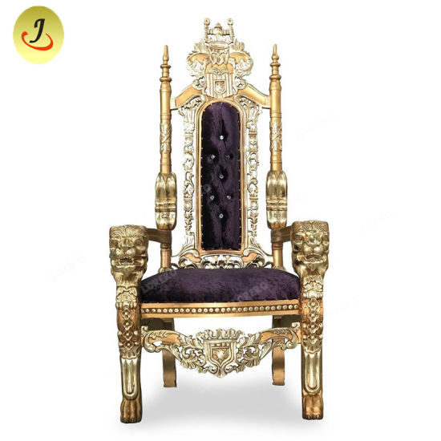
Christ
Returns
with Church
Final
Battle
Human
opponents
destroyed
Satan
released
Satan
bound
1000 years

Slide 6
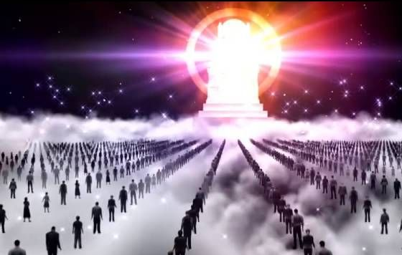
The Great White Throne Judgment

Slide 7
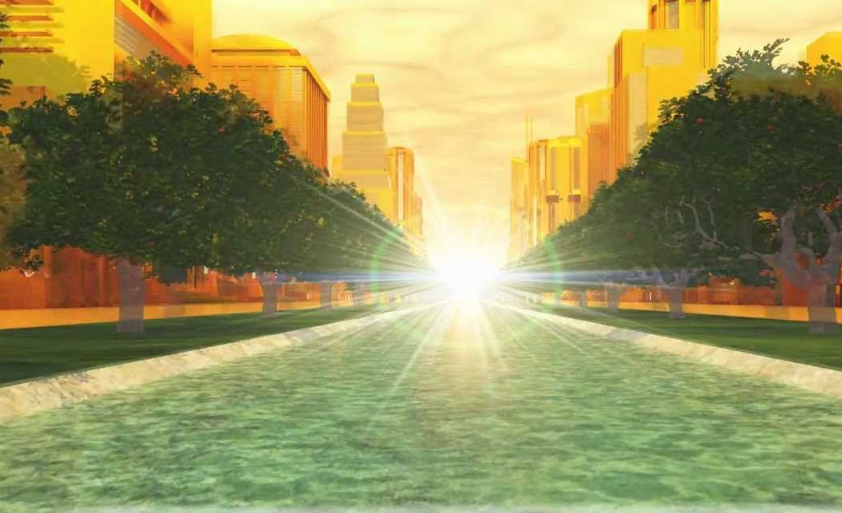
R E V E L A T I O N 2 1
New planet (1-2)

Slide 8
2 Peter 3:1-13
¹ This is now the second letter that I am writing to you, beloved. In both of them I am stirring up your sincere mind by way of reminder, ² that you should remember the predictions of the holy prophets and the commandment of the Lord and Savior through your apostles, ³ knowing this first of all, that scoffers will come in the last days with scoffing, following their own sinful desires. ⁴ They will say, “Where is the promise of his coming? For ever since the fathers fell asleep, all things are continuing as they were from the beginning of creation.”

Slide 9
⁵ For they deliberately overlook this fact, that the heavens existed long ago, and the earth was formed out of water and through water by the word of God, ⁶ and that by means of these the world that then existed was deluged with water and perished. ⁷ But by the same word the heavens and earth that now exist are stored up for fire, being kept until the day of judgment and destruction of the ungodly.
⁸ But do not overlook this one fact, beloved, that with the Lord one day is as a thousand years, and a thousand years as one day. ⁹ The Lord is not slow to fulfill his promise as some count slowness, but is patient toward you, not wishing that any should perish, but that all should reach repentance.

Slide 10
¹⁰ But the day of the Lord will come like a thief, and then the heavens will pass away with a roar, and the heavenly bodies will be burned up and dissolved, and the earth and the works that are done on it will be exposed.
¹¹ Since all these things are thus to be dissolved, what sort of people ought you to be in lives of holiness and godliness, ¹² waiting for and hastening the coming of the day of God, because of which the heavens will be set on fire and dissolved, and the heavenly bodies will melt as they burn! ¹³ But according to his promise we are waiting for new heavens and a new earth in which righteousness dwells.

Slide 11
R E V E L A T I O N 2 1
New planet (1-2)
New existence (3-4)
Renewed challenge (5-8)
New Jerusalem (9-27)

Slide 12
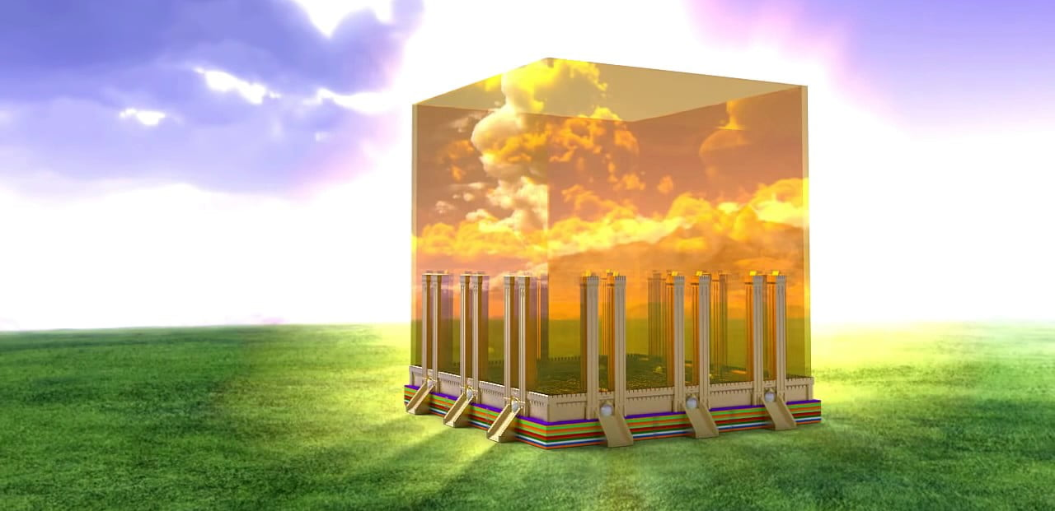
Its glory (9-11)

Slide 13
Its structure (12-14)
High walls
12 gates – 3 a side, angel at each gate, names of Israel’s 12 tribes
12 foundations – 12 names of apostles

Slide 14
Its size (15-17)
12,000 stadia = 1,400 miles; 2,200 kilometers

Slide 15
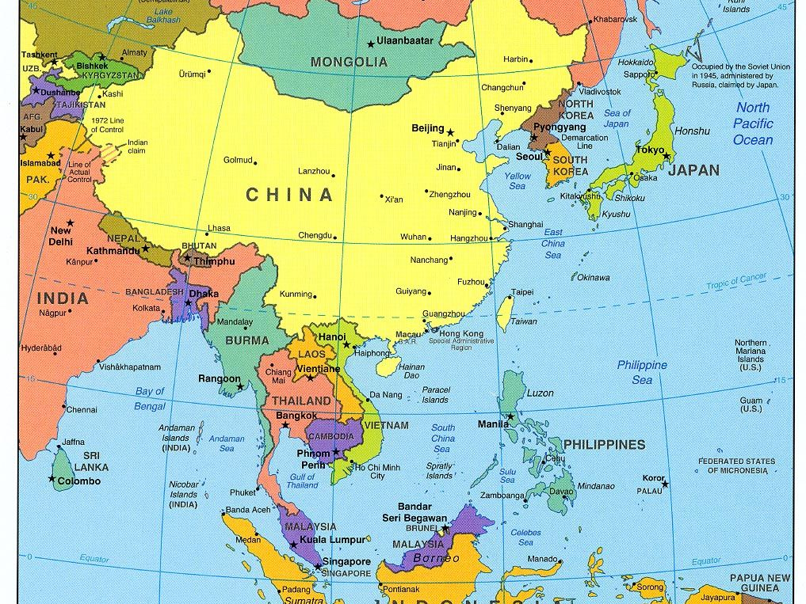
New Jerusalem

Slide 17
Its composition (18-21)
Walls – jasper, 200 ft/60 m
City – pure, transparent gold

Slide 18
Its composition (18-21)
Foundations – precious jewels (jasper, sapphire, agate, emerald, onyx, carnelian, chrysolite, beryl, topaz, chrysoprase, jacinth, amethyst)
Gates – solid pearl

Slide 19
Its occupation (22-27)
No temple
No sun
No night
No impurity

Slide 20
God dwells with His people forever

Slide 21
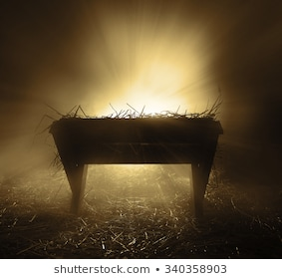

Slide 22
Black

Slide 23
NT Preaching link at BibleStudyDownloads.org
Get this presentation for free!
Notes:
The Bible…Basically (bb)

