Slide 1
To look forward to
Part 7: Rev 20:7-15
Fixing our sight on God’s revelation of the future
Preached by Dr. Jim Harmeling at Crossroads International Church Singapore • CICFamily.com Uploaded by Dr. Rick Griffith • Singapore Bible College Files in many languages for free download at BibleStudyDownloads.org

Slide 2
To look forward to
Part 7: Rev 20:7-15
Fixing our sight on God’s revelation of the future

Slide 3
Thy Kingdom Come (vs. 1-6)

Slide 4
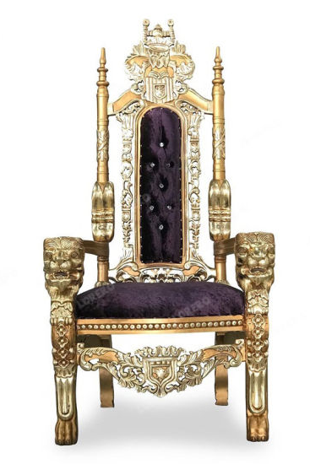
The Kingdom of God
1st coming
Jesus announces himself as king
recruiting and redeeming subjects for his kingdom
2nd coming
Jesus comes as king
ruling over subjects of his kingdom
1000 years

Slide 5
Christ
Returns
with Church
Human
opponents
destroyed
Satan
bound

Slide 6
Thy Kingdom Come (vs. 1-6)
The Final Judgment (vs. 7-15)

Slide 7
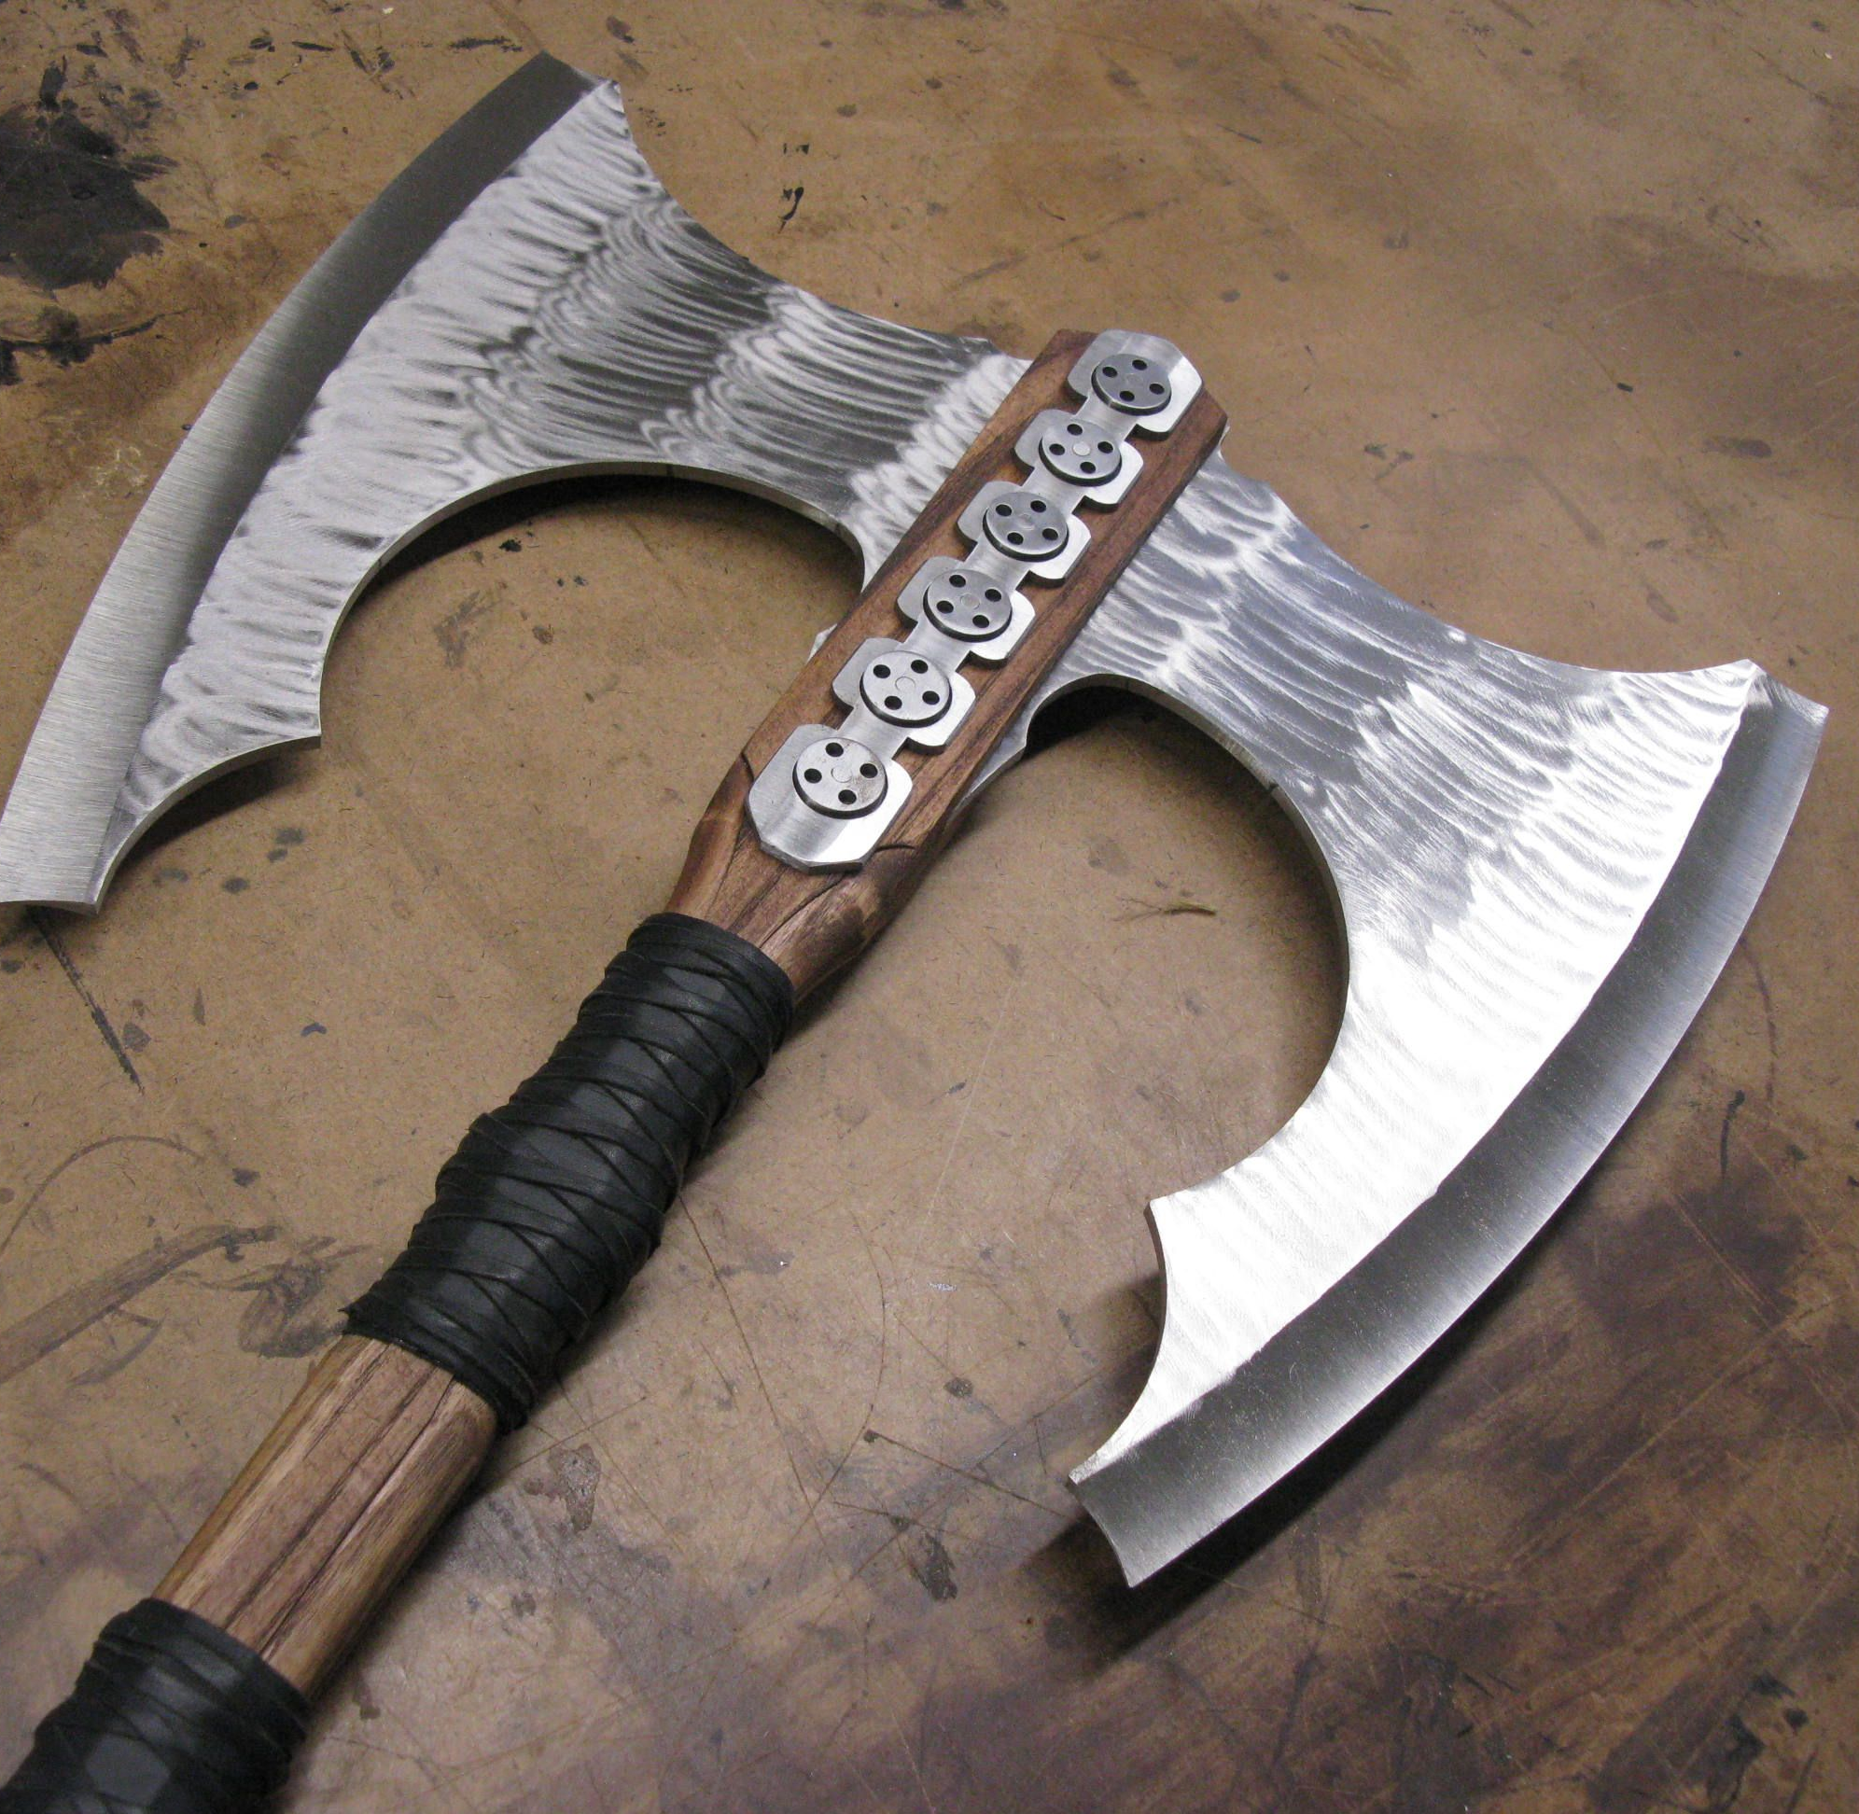
The final battle

Slide 8
Final
Battle
Satan
released
1000 years

Slide 9
The Lake of Fire

Slide 10
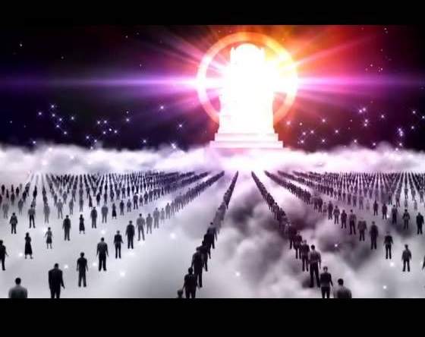
The Great White Throne Judgment

Slide 12
2 Corinthians 5:10
“For we must all appear before the judgment seat of Christ, so that each one may receive what is due for what he has done in the body, whether good or evil.”

Slide 13
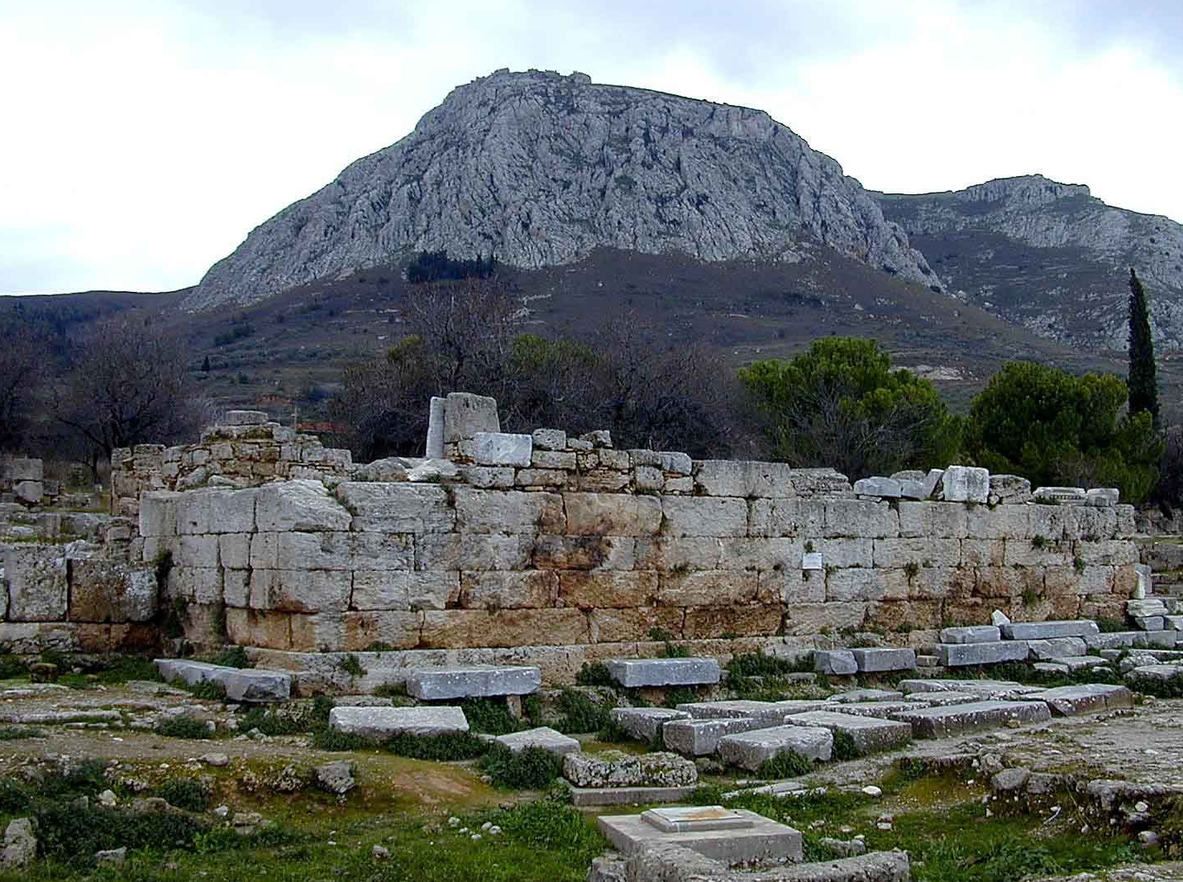

Slide 14
1 Corinthians 3:13-15
¹³ Each one's work will become manifest, for the Day will disclose it, because it will be revealed by fire, and the fire will test what sort of work each one has done. ¹⁴ If the work that anyone has built on the foundation survives, he will receive a reward. ¹⁵ If anyone's work is burned up, he will suffer loss, though he himself will be saved, but only as through fire.

Slide 15
The Great White Throne Judgment

Slide 16
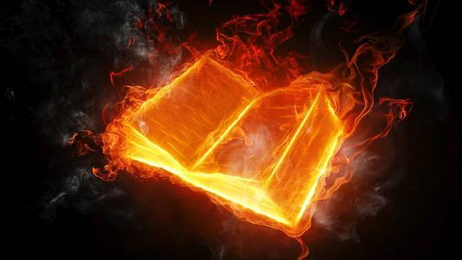
Lamb’s Book of Life

Slide 17
The books
of works

Slide 18
“And if anyone’s name was not written in the book of life, he was thrown into
the lake of fire.”

Slide 19
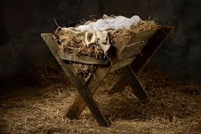
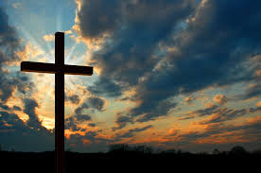
Entered our life
Redeemed our life
Judge our life

Slide 20
Black

Slide 21
New Testament Preaching link at BibleStudyDownloads.org
Get this presentation for free!
Notes:
The Bible…Basically (bb)

