Slide 1
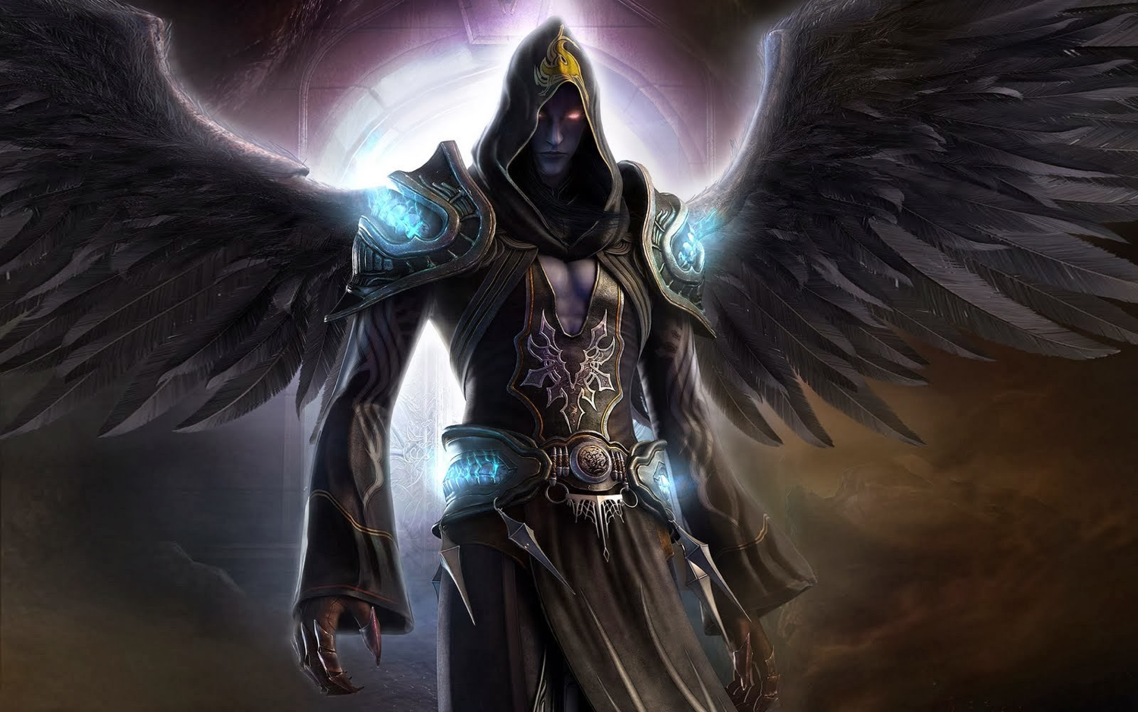
The Great Persecutor (Rev. 12)
Dr. Rick Griffith, Crossroads International Church Singapore cicfamily.com & BibleStudyDownloads.org

Slide 2
War and Remembrance

Slide 3
War and Remembrance

Slide 4
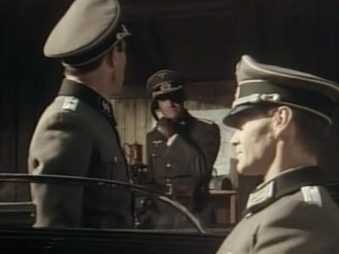
War and Remembrance

Slide 5
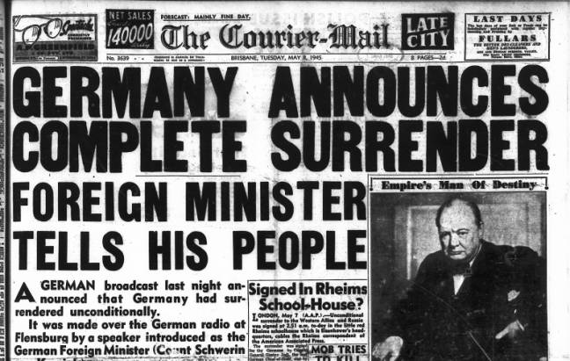
German Surrender

Slide 6
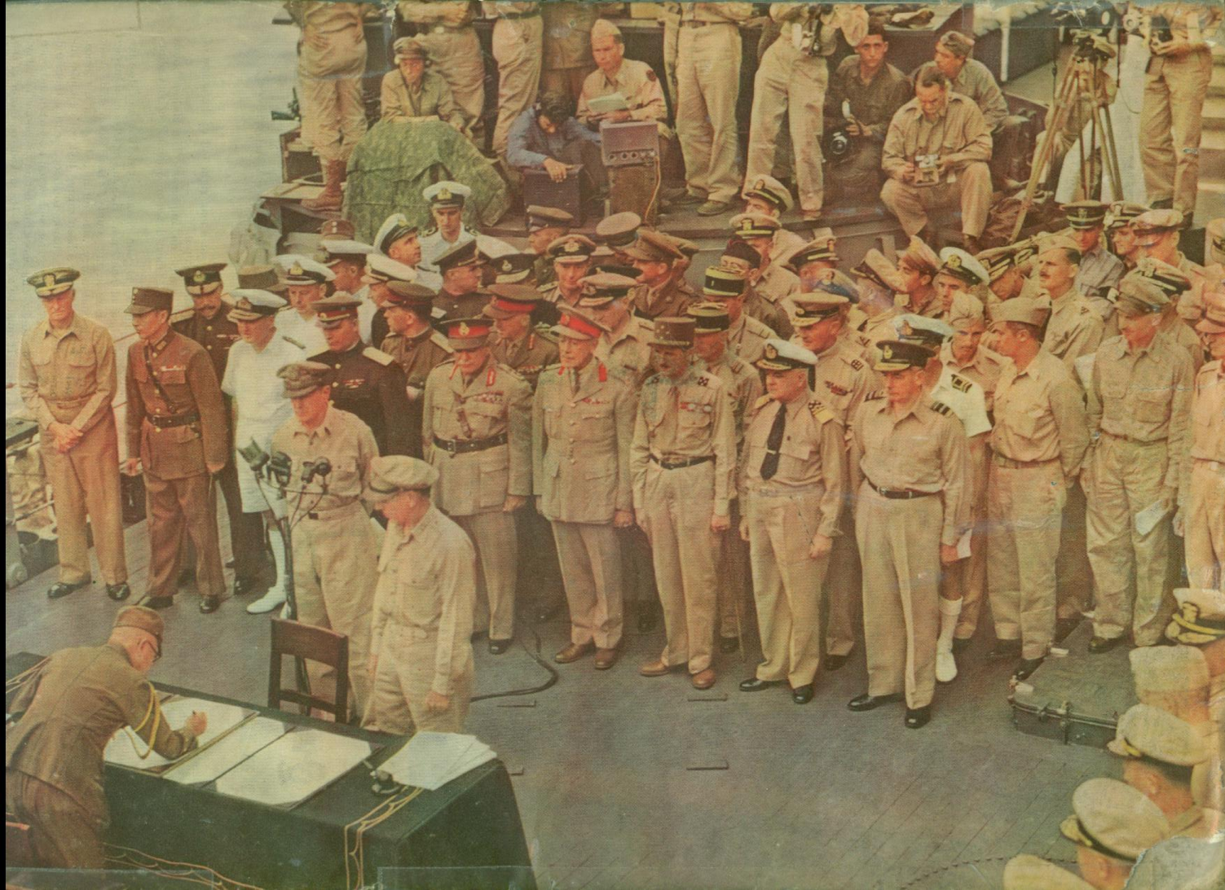
Japanese Surrender

Slide 7
Our Epic War…
Worldwide • 6000 years • Souls

Slide 8
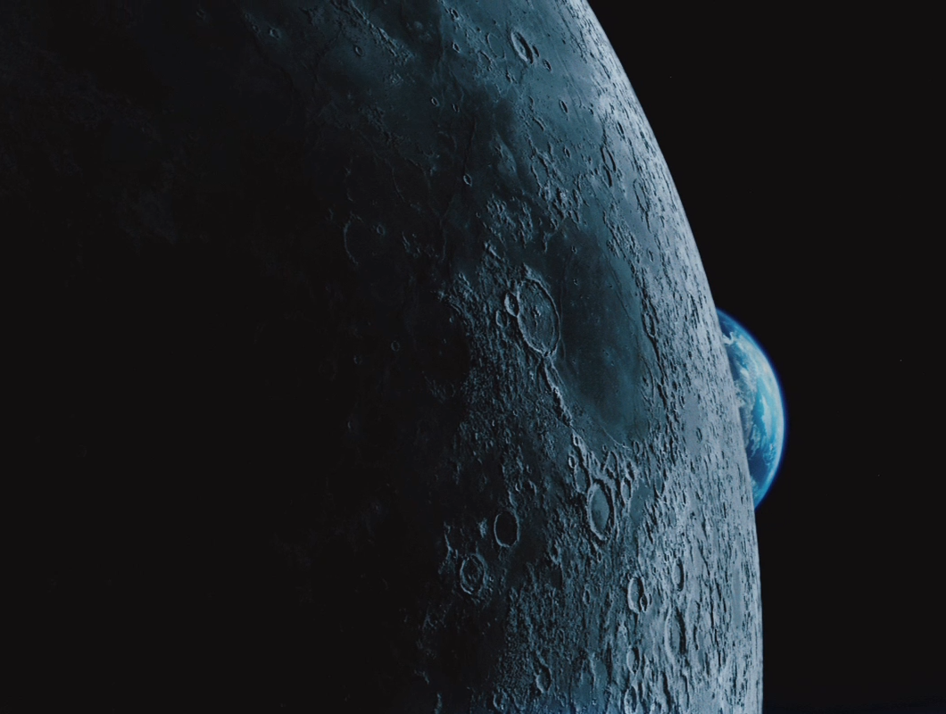
Do you feel like you are losing a lot of battles right now?
Worldly values
Civil laws
Twentys

Slide 9
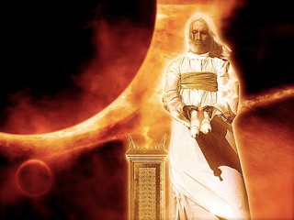
How can you be assured of Christ's victory now and in the future?

Slide 10
Content of the Judgments
337
 | SEALS | TRUMPETS | BOWLS
1 | White: conqueror | Hail & fire: 1/3 vegetation | Sores
2 | Red: war | Fire: 1/3 sea creatures | Sea to blood
3 | Black: famine | Star: 1/3 fresh water | Fresh water to blood
4 | Pale: death | Dark: 1/3 sun, moon, stars | Sun burns men
 |  | (Trumpets 5-7 are woes)
5 | Martyrs reassured | Woe #1: locusts | Beast's kingdom dark
6 | Wrath: earthquake, signs | Woe #2: Euphrates prep | Euphrates dries up
 | (144,000 sealed) | (Trump #7 = mystery)
7 | 1/2 hour silence | Woe #3: victory imminent | Earthquake & hail
H O R S E S
W O E S
Adapted from Robert Gromacki, NT Survey and H. Wayne House, Chronological & Background Charts of the NT, 19
Notes:
Correlation Between Trumpets & Bowls (Wiersbe):
1 The Judgment
2 The earth
3 The sea
4 The rivers
5 The heavens
6 Mankind—torment
7 An army
Angry nations

Slide 11
Chronology of Revelation
340
"What you have seen"
(1:19a)
Rev. 1
"What is now"
(1:19b)
Rev. 2–3
"What will take place later"
(1:19c)
Rev. 4–22
Vision of Christ
Church Age
Rapture 3:10
Tribulation
4:1 – 19:10
Second Coming
Millennium
First Half
Second Half
Eternal State
Great White Throne Judgment
Copyright 1989 Rick Griffith
Adapted from a chart by J. D. Pentecost
Notes:
The 3 main divisions of Revelation are summarized in 1:19
The 3 main cycles of judgment are squared in blue
The 4 parenthetical sections appear in parentheses within the scrolls. They do not advance the chronology but add important information that is not associated with a particular judgment.

Slide 12
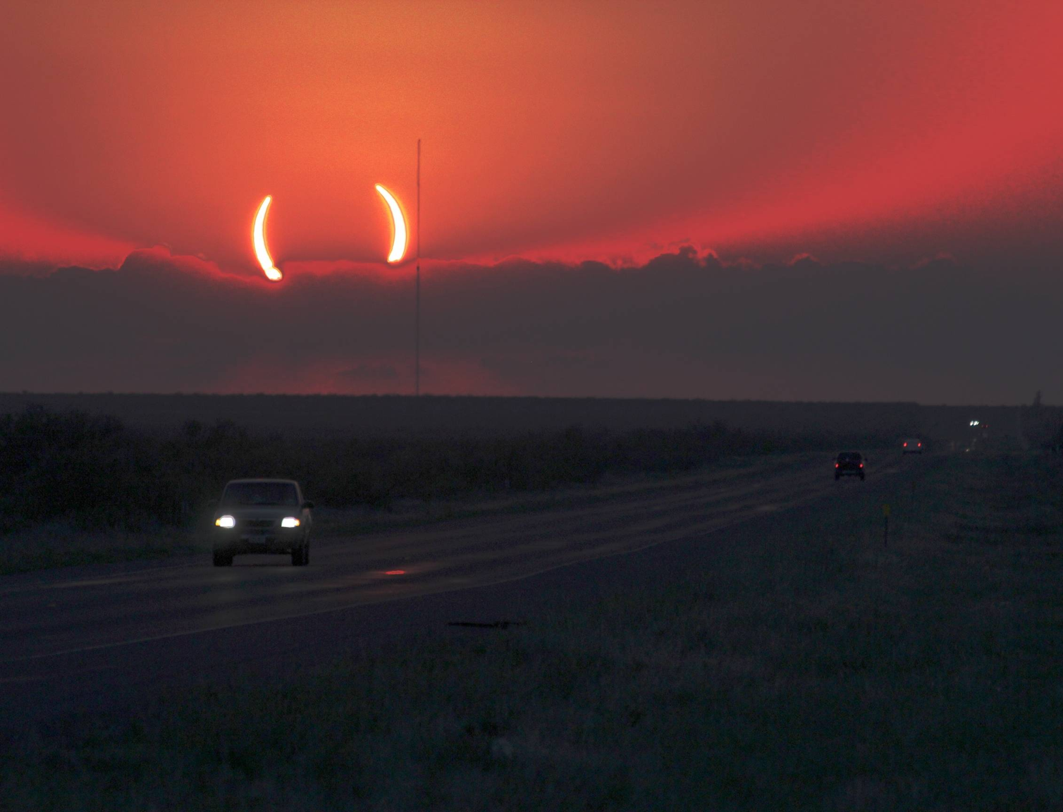
The Great Parenthesis
(
)
10–11 Witnesses
12 Satan
13–14 Henchmen

Slide 13
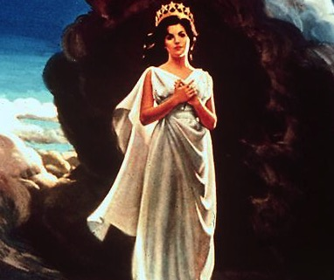
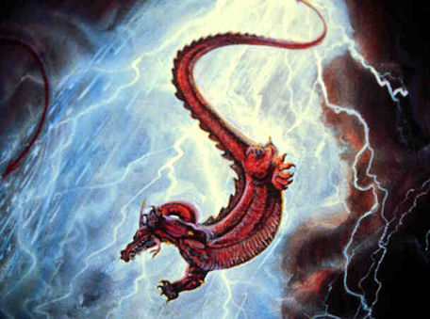
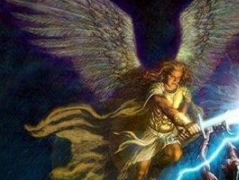
4 Characters
The Cast…

Slide 14
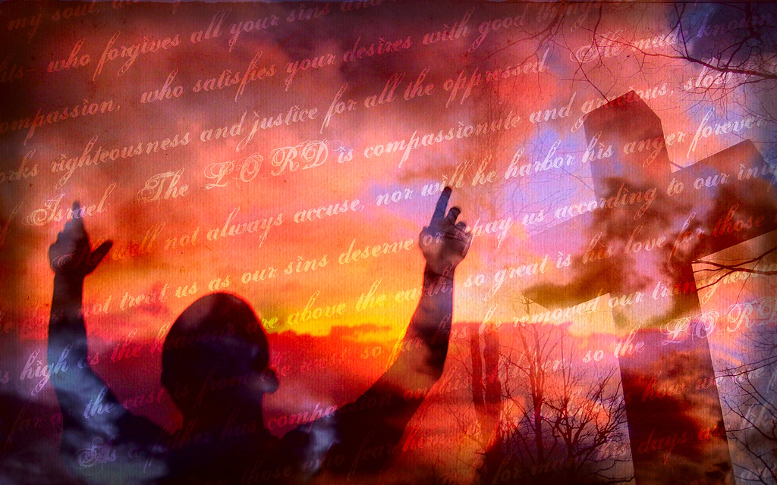
How can we live with hope?
(Rev. 12)

Slide 15
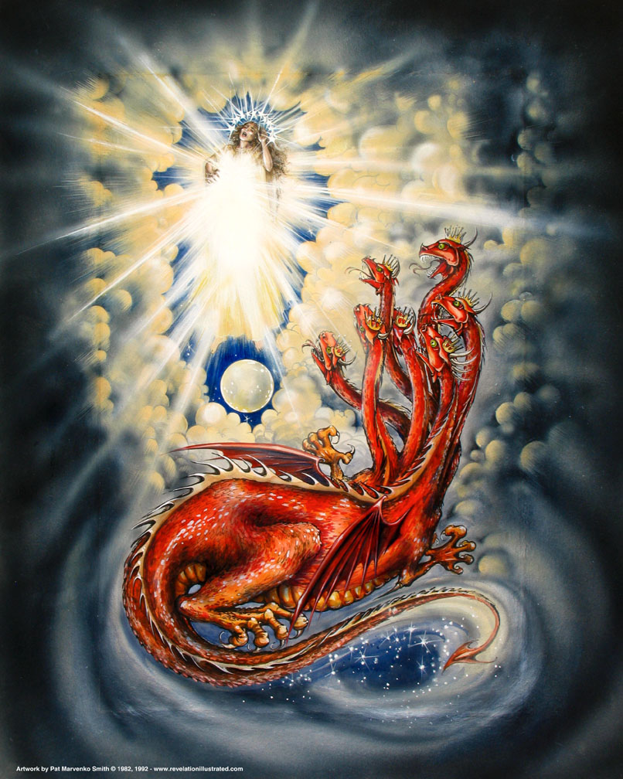
I. Israel (the woman) brought Jesus into the world with great difficulty (12:1-2).

Slide 16
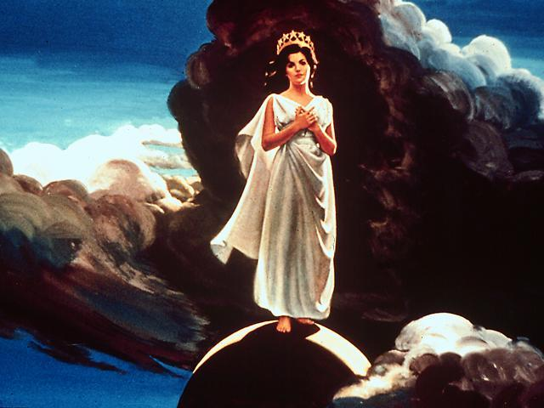
The Woman (12:1-6)
"Then I witnessed in heaven an event of great significance. I saw a woman clothed with the sun, with the moon beneath her feet, and a crown of twelve stars on her head. ²She was pregnant, and she cried out because of her labor pains and the agony of giving birth" (12:1-2 NLT).
384
Notes:
The woman is Israel, but what are the 12 stars on her head?
Genesis 37:9 compares the sons of Israel to 12 stars, 11 of which will bow down to Joseph.

Slide 17
Family Wickedness (2 Chron. 21–22)
Ethbaal
King of Sidonians
Omri
King of Israel
Asa
King of Judah (Line of David)
Jezebel
Ahab
Jehoshaphat
Ahaziah
Jehoram (Joram)
Athaliah
Jehoram
All brothers killed
(2 Ch 21:4)
All brothers killed
(2 Kings 9; 2 Ch 22:1)
Killed by Jehu
Ahaziah
All brothers killed
(2 Kings 11; 2 Ch 22:11)
Joash
Good kings in white; queen in gray italics
Notes:
It may sound confusing, but there were two kings who lived at the same time in the northern and southern kingdoms who were named Jehoram and two named also Ahaziah—Ahaziah of Israel on the left and Ahaziah of Judah on the right. In 2 Kings 11:2 (cf. 2 Chron. 22:11), we read how the Davidic line was all wiped out by the mother of Ahaziah of Judah—all except one of her grandsons named Joash. God's promise of an eternal king through David (2 Sam. 7:14) would have been unfulfilled had it not been through the courage of Jehoshebah, Ahaziah's sister, who saved the life of the infant nephew, Joash. In fact, the line dwindled to only one living descendant of David the preceding two generations also!

Slide 18
Family Righteousness (2 Kings 11)
Aaron
Priest of Israel
Asa
King of Judah (Line of David)
Jehoshaphat
Athaliah
Jehoram
Ahaziah
Unnamed Nurse
Jehoiada
Jehoshebah
Joash
Righteous in white; queen in gray italics
Notes:
In 2 Kings 11:2 (cf. 2 Chron. 22:11), we read how the Davidic line was all wiped out by the mother of Ahaziah of Judah—all except one of her grandsons named Joash. God's promise of an eternal king through David (2 Sam. 7:14) would have been unfulfilled had it not been through the courage of Jehoshebah, Ahaziah's sister and husband of Jehoiada the priest. Jehoshebah saved the life of her infant nephew, Joash, with the courageous help of his unnamed nurse who raised him for 6 years in the temple out of the murderous eye of Athaliah.

Slide 19
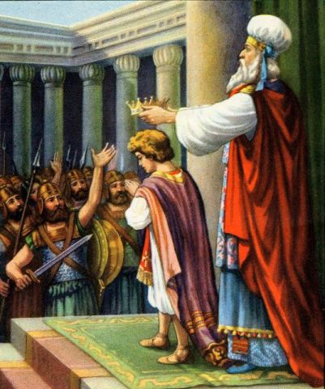
Jehoiada Crowns Joash (2 Kings 11:12; 2 Chron. 23:11)

Slide 20
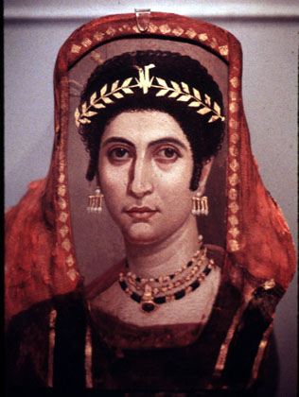
Athaliah Killed (2 Kings 15-16; 2 Chron. 23:14-15)

Slide 21
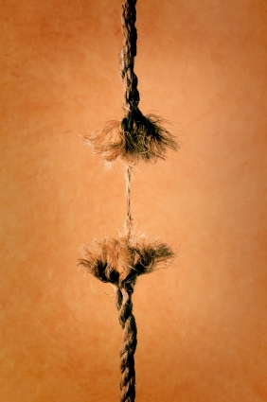
Faithful By A Thread
The Davidic rulers came down to only one man (three times!)

Slide 22
I. Israel (the woman) brought Jesus into the world with great difficulty (12:1-2).

Slide 23
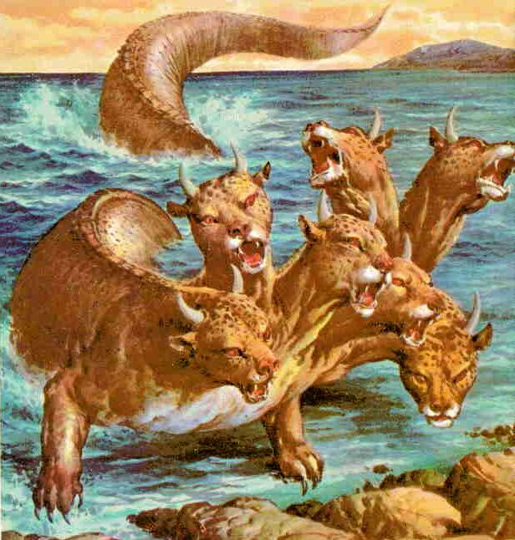
II. Satan and his demons (a dragon with stars) couldn't kill the infant Jesus (12:3-4).

Slide 24
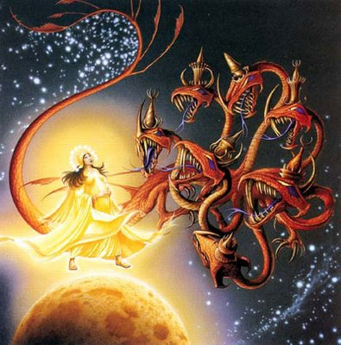
The Dragon (12:3)
384
"Then I witnessed in heaven another significant event. I saw a large red dragon with seven heads and ten horns, with seven crowns on his heads" (12:3 NLT).

Slide 25
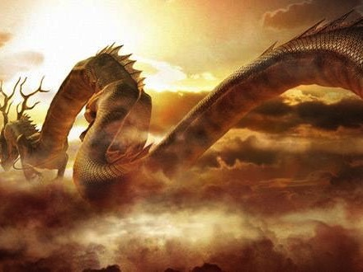
"His tail swept away one-third of the stars in the sky, and he threw them to the earth" (12:4a)
386
Notes:
What are these stars?

Slide 26
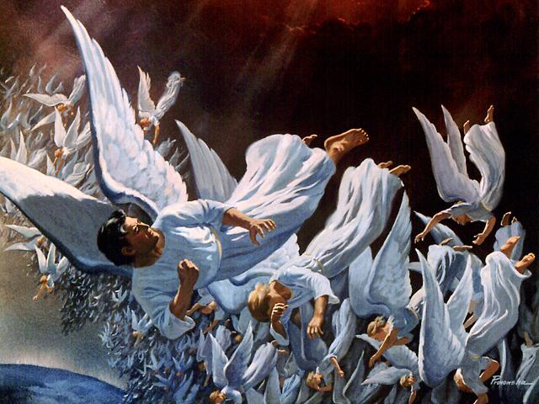
Fall of Lucifer, the Shining Star (12:7-9; cf. first time in Isa. 14:12; Ezek. 28:17)
386
"His tail swept away one-third of the stars in the sky, and he threw them to the earth" (12:4a NLT)

Slide 27
Fall of Lucifer, the Shining Star (cf. Rev. 12:7-9)
³You regard yourself as wiser than Daniel
and think no secret is hidden from you.
⁴With your wisdom and understanding you have amassed great wealth—gold and silver for your treasuries. ⁵Yes, your wisdom has made you very rich, and your riches have made you very proud" (Ezek. 28:3-5 NLT)

Slide 28
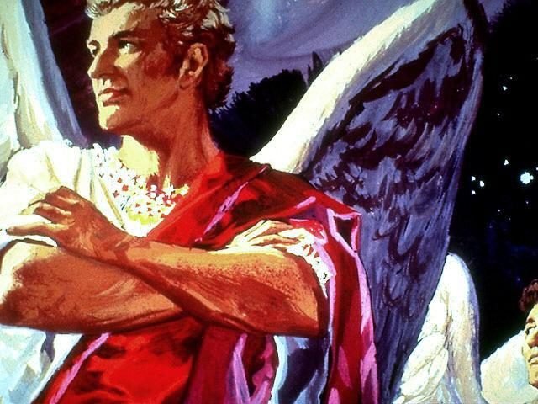
"You were the model of perfection, full of wisdom and exquisite in beauty. ¹³ You were in Eden, the garden of God… ¹⁵ "You were blameless in all you did from the day you were created until the day evil was found in you."
Satan's Pride (Ezek. 28:14-15; cf. 12:7-13)

Slide 29
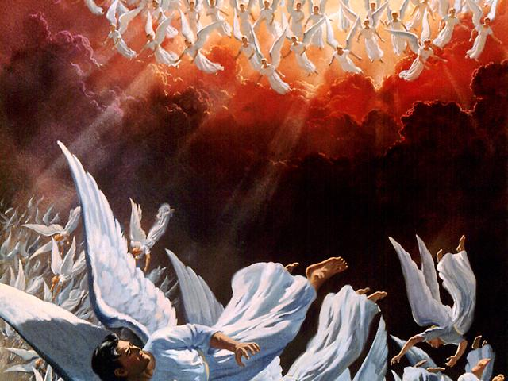
Ezekiel 28:16-17 NLT
The angels pursue
¹⁶ Your rich commerce led you to violence, and you sinned. So I banished you in disgrace from the mountain of God. I expelled you, O mighty guardian, from your place among the stones of fire. ¹⁷ Your heart was filled with pride because of all your beauty. Your wisdom was corrupted by your love of splendor. So I threw you to the ground and exposed you to the curious gaze of kings."

Slide 30
The Dragon's Opposition (12:4b NLT)
384
"He stood in front of the woman as she was about to give birth, ready to devour her baby as soon as it was born."

Slide 31
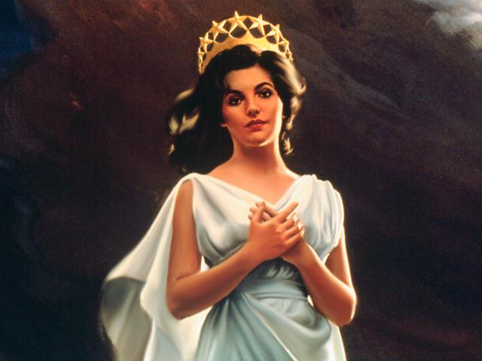
Who is the woman who bears the child to rule the nations (12:1-6)?
Some say she is the Church that brings forth Christ
384
But the Church didn't bring forth Christ!
In reality, Israel brought forth Christ

Slide 32
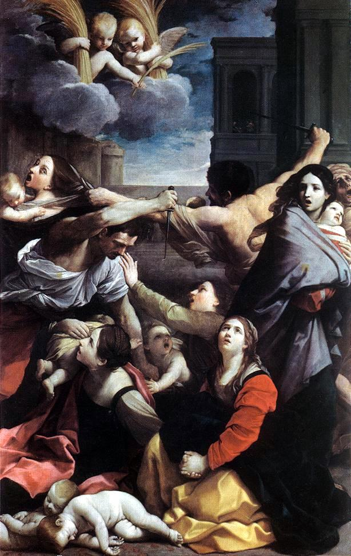
Seeking to Kill the Messiah (12:4b)
386
"He stood in front of the woman as she was about to give birth, ready to devour her baby as soon as it was born" (12:4b NLT).

Slide 33
I. Israel (the woman) brought Jesus into the world with great difficulty (12:1-2).

Slide 34
II. Satan and his demons (a dragon with stars) couldn't kill the infant Jesus (12:3-4).

Slide 35
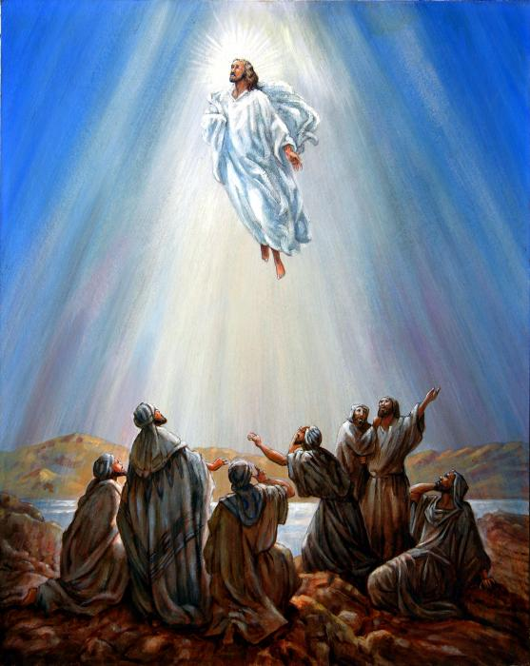
III. Jesus beat Satan at His ascension and God will protect Israel in the Tribulation (12:5-6).

Slide 36
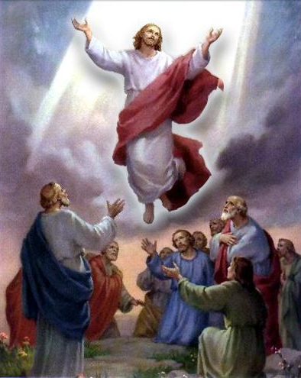
The Dragon's Opposition (12:5)
"She gave birth to a son who was to rule all nations with an iron rod. And her child was snatched away from the dragon and was caught up to God and to his throne" (12:5 NLT).
386
Notes:
Some think the "child" here is the church raptured—but this is clearly Jesus who is destined to rule the nations (Ps. 2).

Slide 37
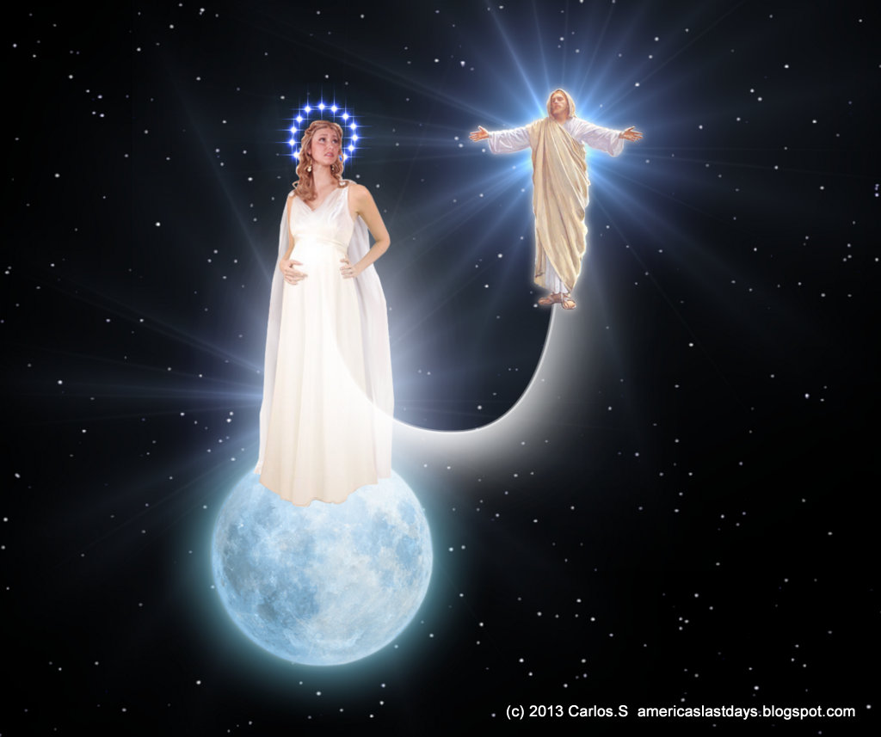
The Dragon's Opposition (12:5)
"She gave birth to a son who was to rule all nations with an iron rod. And her child was snatched away from the dragon and was caught up to God and to his throne" (12:5 NLT).
"On September 23, 2017 there will be a once in a lifetime sign in the heavens with an alignment of the planets to Virgo the virgin and Leo the lion which has never occurred since around 3 BC during the birth of the messiah Jesus."
Notes:
20 Jan 2014 Article: "On September 23, 2017 there will be a once in a lifetime sign in the heavens with an alignment of the planets to Virgo the virgin and Leo the lion which has never occurred since around 3 bc during the birth of the messiah Jesus. " "In Revelation Chapter 12 there was a great wonder in heaven a woman clothed with the sun and a moon under her feet and upon her head a crown of 12 stars and she being with child cried, travailing in birth and pained to be delivered. She bore the Man child and that child was to rule all nations with a rod of iron but as it was born he was caught up to the throne of God. and the woman fled from the Dragon 1260 days and fled again 3 1/2 years during the 7 year tribulation."
http://americaslastdays.blogspot.sg/2014/01/sign-of-woman-on-moon-september-23-2017.html accessed 8 Mar 2014

Slide 38
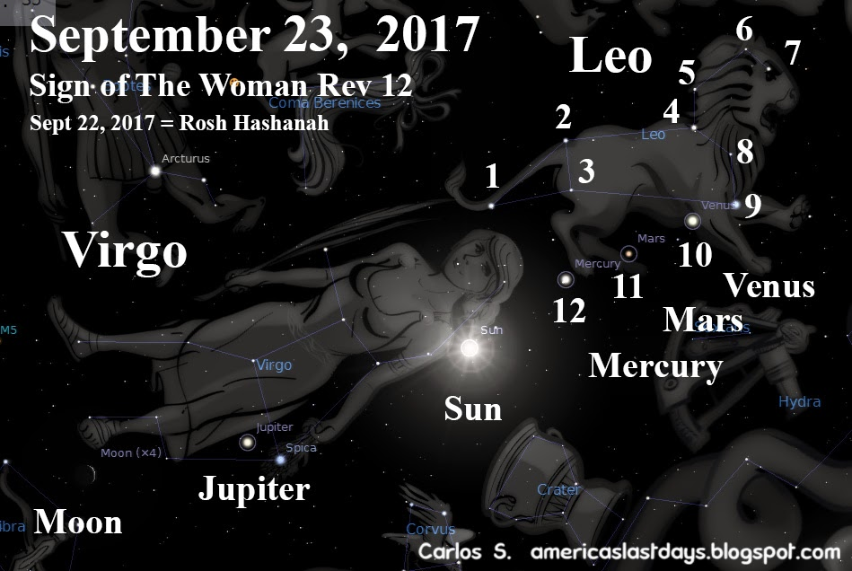
23 Sept 2017
Notes:
20 Jan 2014 Article: "On September 23, 2017 the sun will cover Virgo the virgin and the moon will be at her feet and both will align with Mercury, Venus and Mars in the 9 star constellation Leo the Lion which sits on her head creating a crown of 12 stars, Jupiter a sign of the king will then appear from her hips as if it was born from her. This is a sign of Trouble as travail coming to the church and the world in the year 2017…
The woman is the true Church this includes Jews and gentiles and there acceptance of Jesus Christ the Messiah, with the 12 tribes of Israel and the 12 disciples Jacob and his wife and the stars of heaven and believers in Christ today. She gives birth to a man child caught up to heaven which represents a group of young people that will be raptured at the beginning of the 7 year tribulation as the church flees into the wilderness for 1260 days and then 3 1/2 years from the dragon during the persecution of the saints. The Sign of the woman is announcing the return of Jesus Christ in the near future Followed by a soon coming sign of the dragon in heaven which may be an armada of Angelic alien UFOs or meteorites coming to earth forming a dragon casting 1/ 3 rd of the stars to heaven."
http://americaslastdays.blogspot.sg/2014/01/sign-of-woman-on-moon-september-23-2017.html accessed 8 Mar 2014

Slide 39
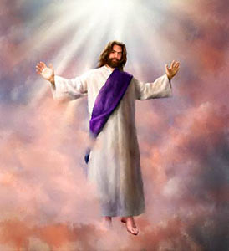
The Dragon's Opposition (12:5)
"She gave birth to a son who was to rule all nations with an iron rod. And her child was snatched away from the dragon and was caught up to God and to his throne" (12:5 NLT).

Slide 40
Chronology of the 70th "Week"
333
"And the woman fled into the wilderness, where God had prepared a place to care for her for 1260 days" (12:6 NLT).
Adapted from J. Dwight Pentecost, Dallas Theological Seminary, 1988
Middle of the Week
Sign of Son of Man Matt. 24:30
Christ's Return Complete
3½ YEARS
1290 DAYS
Dan. 12:11
30 DAYS
30 DAYS
1260 DAYS
45 DAYS
Rev. 11:3; 12:6
Dan. 12:12
3½ YEARS
3½ YEARS
Election of Beast Rev. 17:13
Covenant Made Dan. 9:27a
Covenant Broken Dan. 9:27b
2nd ADVENT
The Great Tribulation
The Tribulation

Slide 41
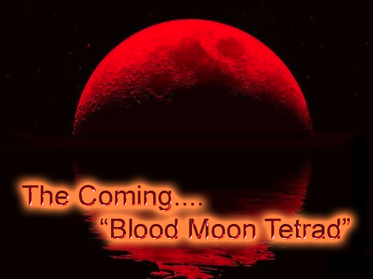
Four Blood Moons

Slide 42
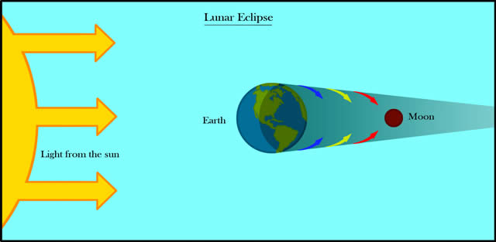
The Blood Moon
Lunar Eclipse
Earth
Moon
Light from the sun
Answers in Genesis

Slide 43
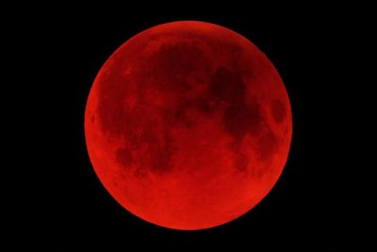
The Blood Moon
"And I will cause wonders in the heavens and on the earth—blood and fire and columns of smoke.
³¹The sun will become dark, and the moon will turn blood red before that great and terrible day of the LORD arrives" (Joel 2:31 NLT)

Slide 44
Four Blood Moons
Notes:
Mark Bilke: https://www.youtube.com/watch?v=X_d-PBMLVYs

Slide 45
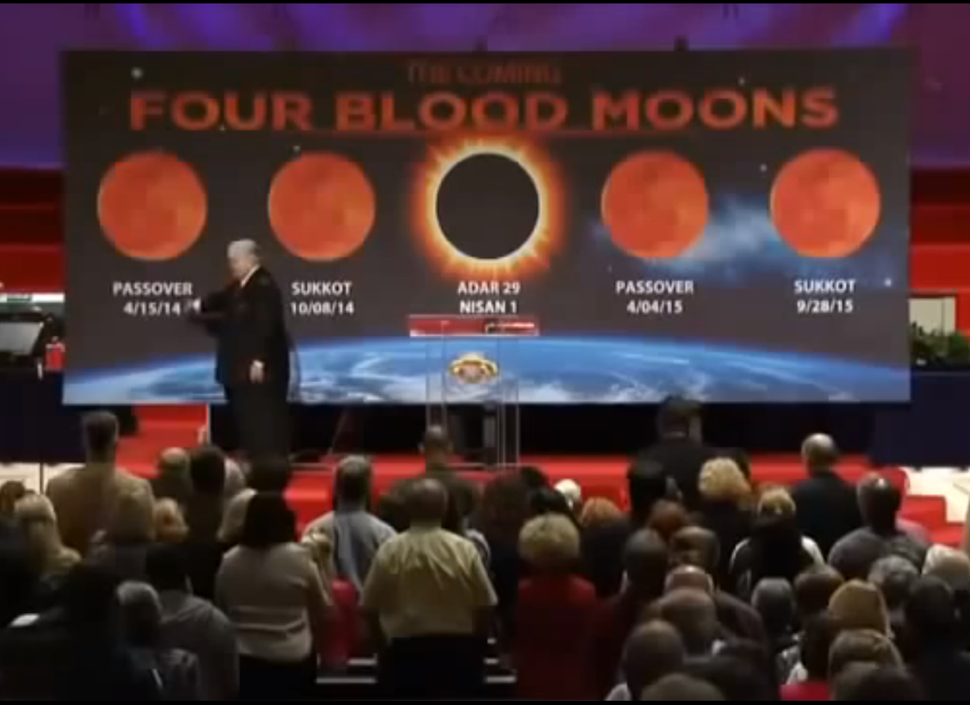
Four Blood Moons
Jewish tears followed by victory!
1493-94 (actually 1492-93): Edict of Expulsion
1949-50 (actually 1448-49): Israel Born
1967-68: Jerusalem United
2014-15: Passover-Sukkot-Passover-Sukkot
Notes:
John Hagee: https://www.youtube.com/watch?v=X_d-PBMLVYs
Chris White critique at https://www.youtube.com/watch?v=--kA2-5z2zI
He notes that the 1493-94 date is off one year from the actual 1492 date, and the 1949-50 date is off a year from the 1948 establishment of Israel. Also, 2 of the 6 tetrad occurrences had not significant events related to Israel, but these are not noted by Biltz and Hagee.

Slide 46
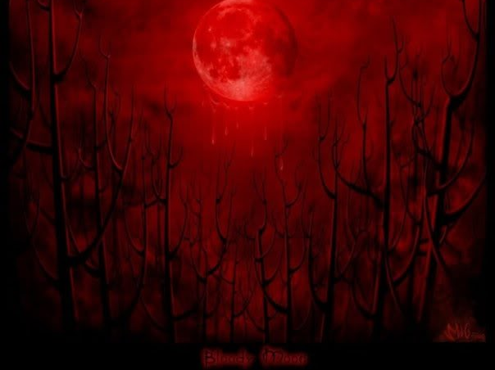
The Blood Moon
"Mark Biltz has an engaging style, and judging by the response of those in attendance in the videos, he makes a very persuasive case for his audiences. However, most of those in attendance probably know little, if anything, about the circumstances and appearance of lunar and solar eclipses, so they are easily impressed. Biltz makes two key observations. First, he notes the coincidence of these eclipses with major Jewish festivals. Second, he points out that these four eclipses are in a row (a tetrad). Admittedly, bringing together such factors is rare, though not unique, but there is no suggestion that these eclipses will be otherwise exceptional. The biblical passages that refer to the dimming of the sun (Matthew 24:29; Joel 2:31) and the moon turning to blood (Joel 2:31) speak in very apocalyptic terms, emphasizing frightening things that men experience. The timing of the eclipses that Biltz draws attention to, while interesting, falls far short of the sort of signs that will cause the heavens to shake (Matthew 24:29)"
"Will Lunar Eclipses Cause Four Blood Moons in 2014 and 2015?"
by Dr. Danny R. Faulkner • July 12, 2013
http://www.answersingenesis.org/articles/2013/07/12/lunar-eclipses-cause-blood-moons
Notes:
For another critiques, see also Chris White at https://www.youtube.com/watch?v=--kA2-5z2zI
He notes that the 1493-94 date is off one year from the actual 1492 date, and the 1949-50 date is off a year from the 1948 establishment of Israel. Also, 2 of the 6 tetrad occurrences had not significant events related to Israel, but these are not noted by Biltz and Hagee.

Slide 47
I. Israel (the woman) brought Jesus into the world with great difficulty (12:1-2).

Slide 48
II. Satan and his demons (a dragon with stars) couldn't kill the infant Jesus (12:3-4).

Slide 49
III. Jesus beat Satan at His ascension and God will protect Israel in the Tribulation (12:5-6).

Slide 50
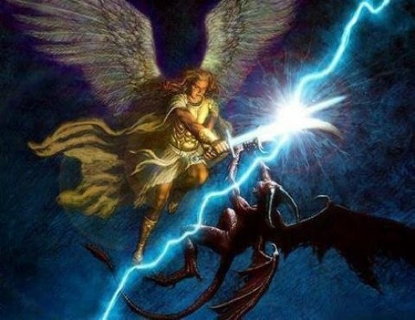
IV. Michael will cast Satan from heaven but he won't destroy Israel in the Tribulation (12:7-18).

Slide 51
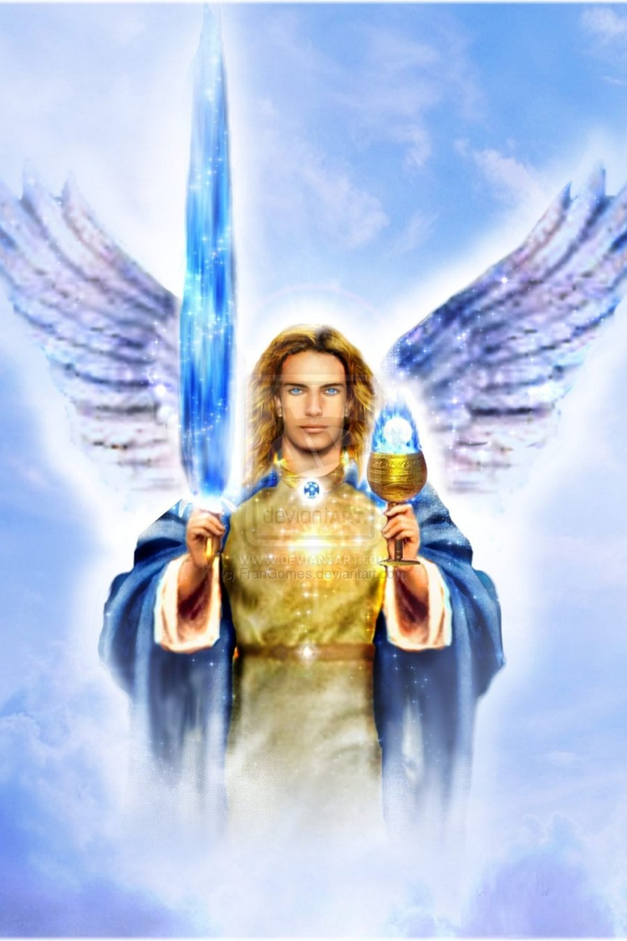
"Then there was war in heaven. Michael and his angels fought against the dragon and his angels" (12:7 NLT).
386

Slide 52
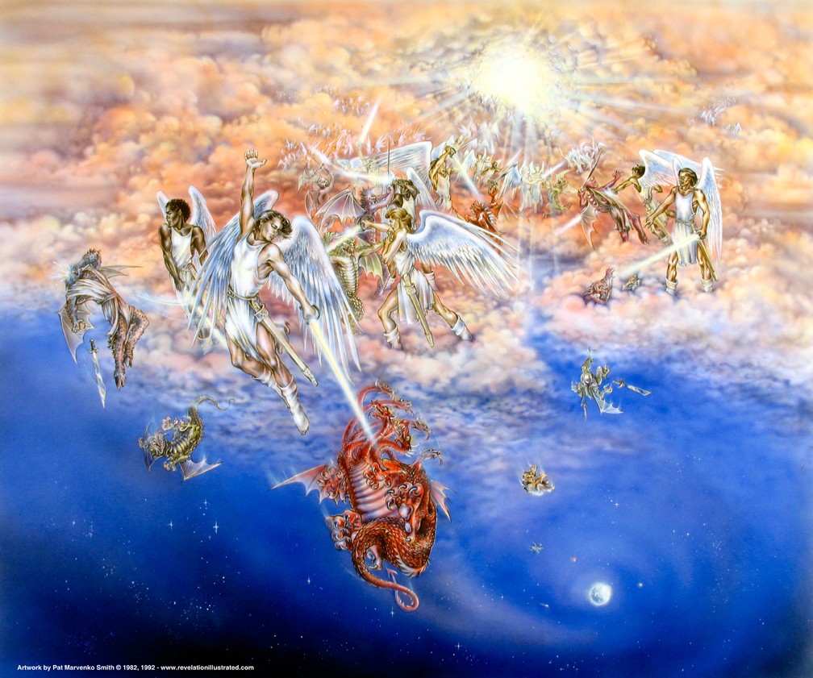
Satan cast down (12:7-13)
"And the dragon lost the battle, and he and his angels were forced out of heaven" (12:8 NLT).

Slide 53
"This great dragon—the ancient serpent called the devil, or Satan, the one deceiving the whole world— was thrown down to the earth with all his angels" (12:9 NLT)
386

Slide 54
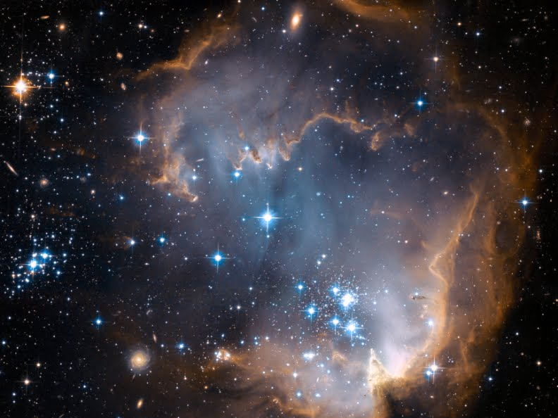
Heaven's Praise! (11:10 NLT)
"Then I heard a loud voice shouting across the heavens, 'It has come at last—salvation and power and the Kingdom of our God, and the authority of his Christ. For the accuser of our brothers and sisters has been thrown down to earth—the one who accuses them before our God day and night.'"

Slide 55
Heaven's Praise! (11:11 NLT)
"¹¹And they have defeated him by the blood of the Lamb and by their testimony. And they did not love their lives so much that they were afraid to die."

Slide 56
Heaven's Praise! (11:12 NLT)
"¹²Therefore, rejoice, O heavens! And you who live in the heavens, rejoice! But terror will come on the earth and the sea, for the devil has come down to you in great anger, knowing that he has little time."

Slide 57
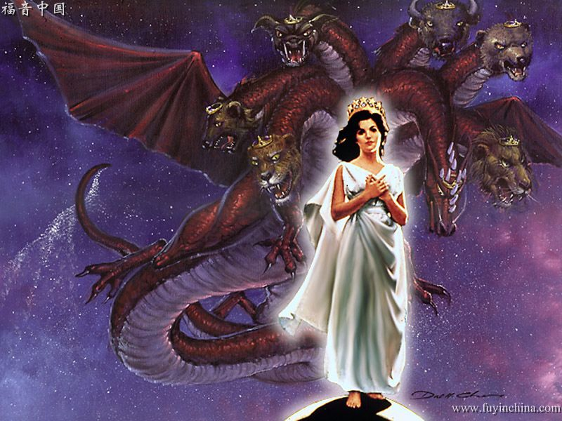
"When the dragon realized that he had been thrown down to the earth, he pursued the woman who had given birth to the male child" (12:13 NLT)
386

Slide 58
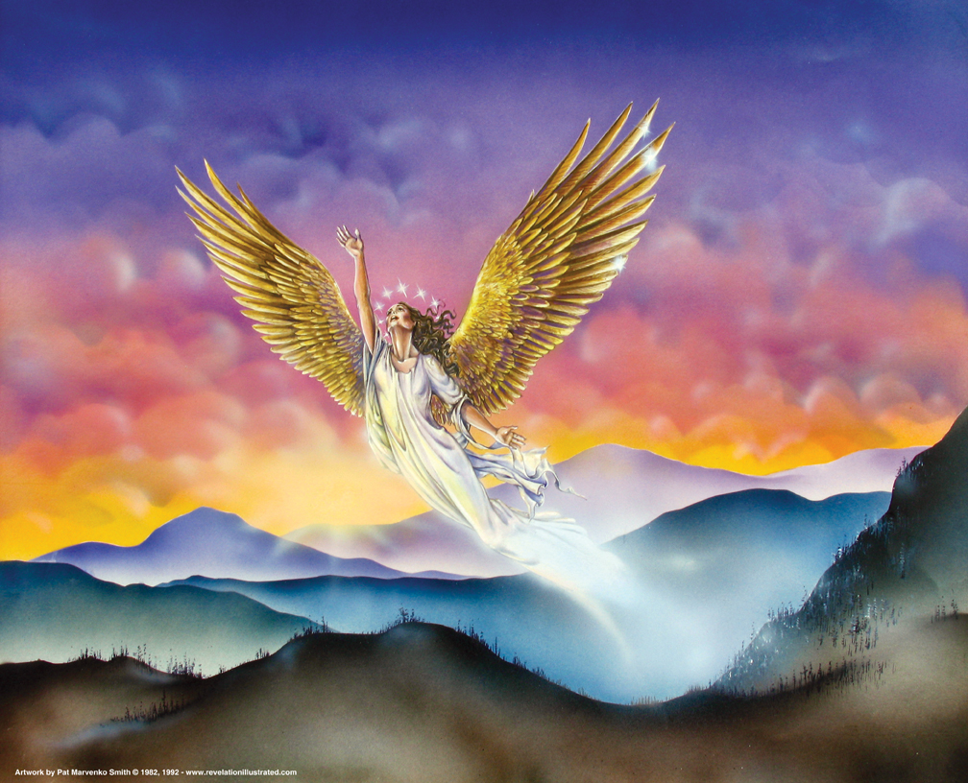
"There she would be cared for and protected from the dragon for a time, times, and half a time" (12:14 NLT)
"But she was given two wings like those of a great eagle so she could fly to the place prepared for her in the wilderness."

Slide 59
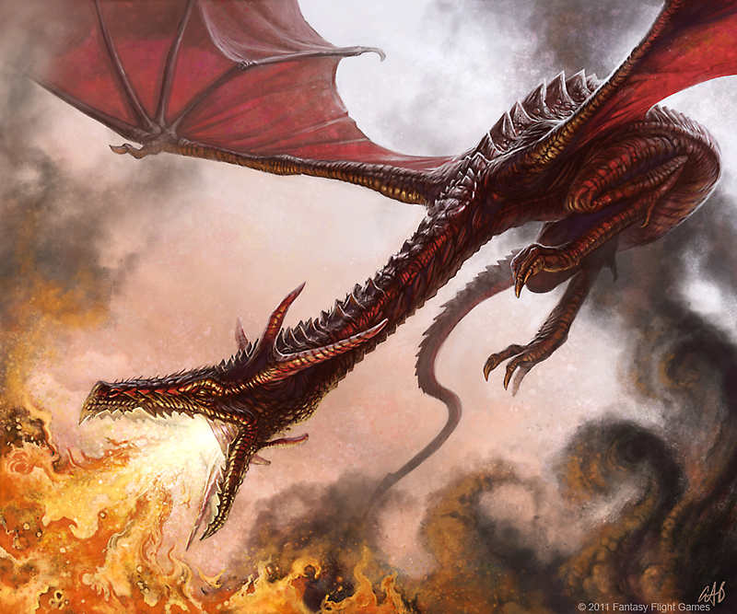
Dragons normally spew fire
386

Slide 60
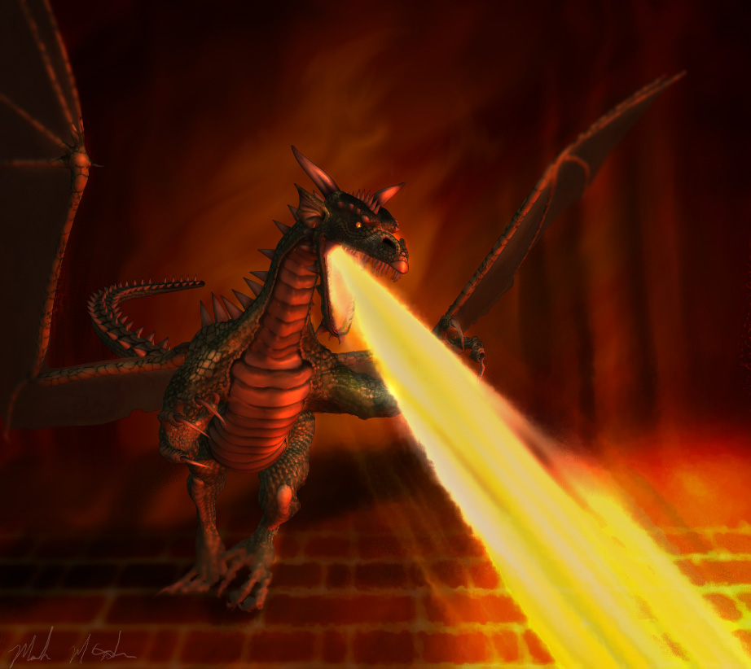
Dragons normally spew fire
386

Slide 61
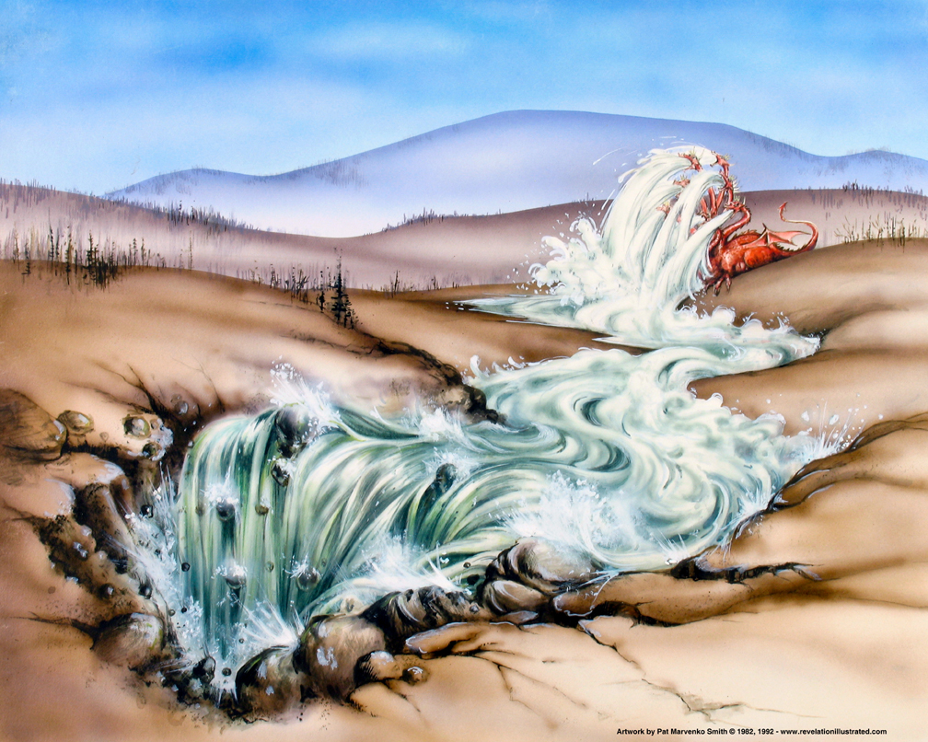
"Then the dragon tried to drown the woman with a flood of water that flowed from his mouth" (12:15 NLT)

Slide 62
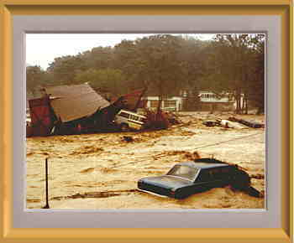
Flood
386
Notes:
But this dragon will spew water from his mouth!

Slide 63
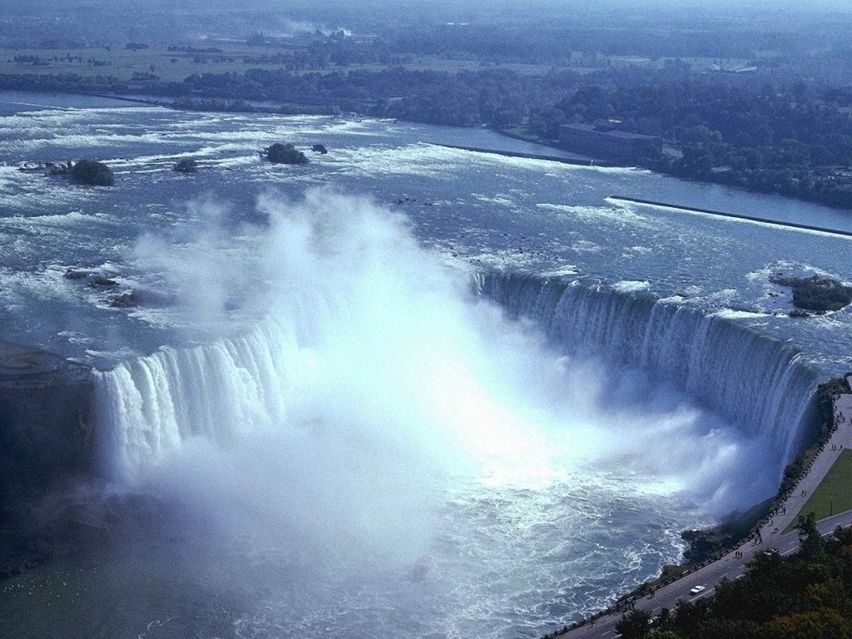
"But the earth helped her by opening its mouth and swallowing the river that gushed out from the mouth of the dragon" (12:16 NLT)
386

Slide 64
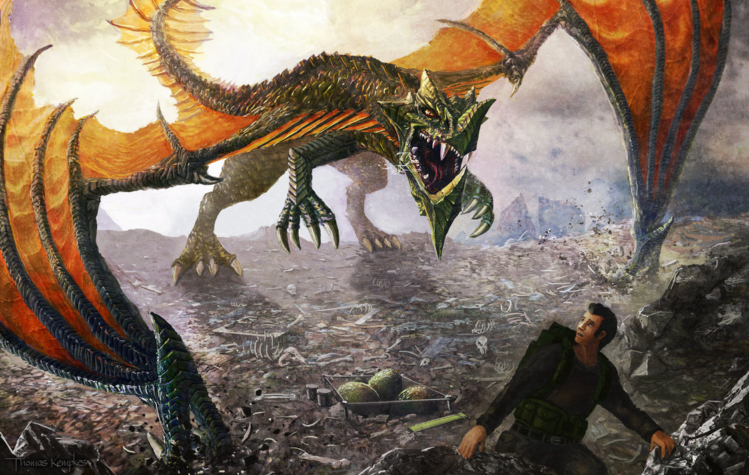
"And the dragon was angry at the woman and declared war against the rest of her children—all who keep God's commandments and maintain their testimony for Jesus" (12:17 NLT)
386

Slide 65
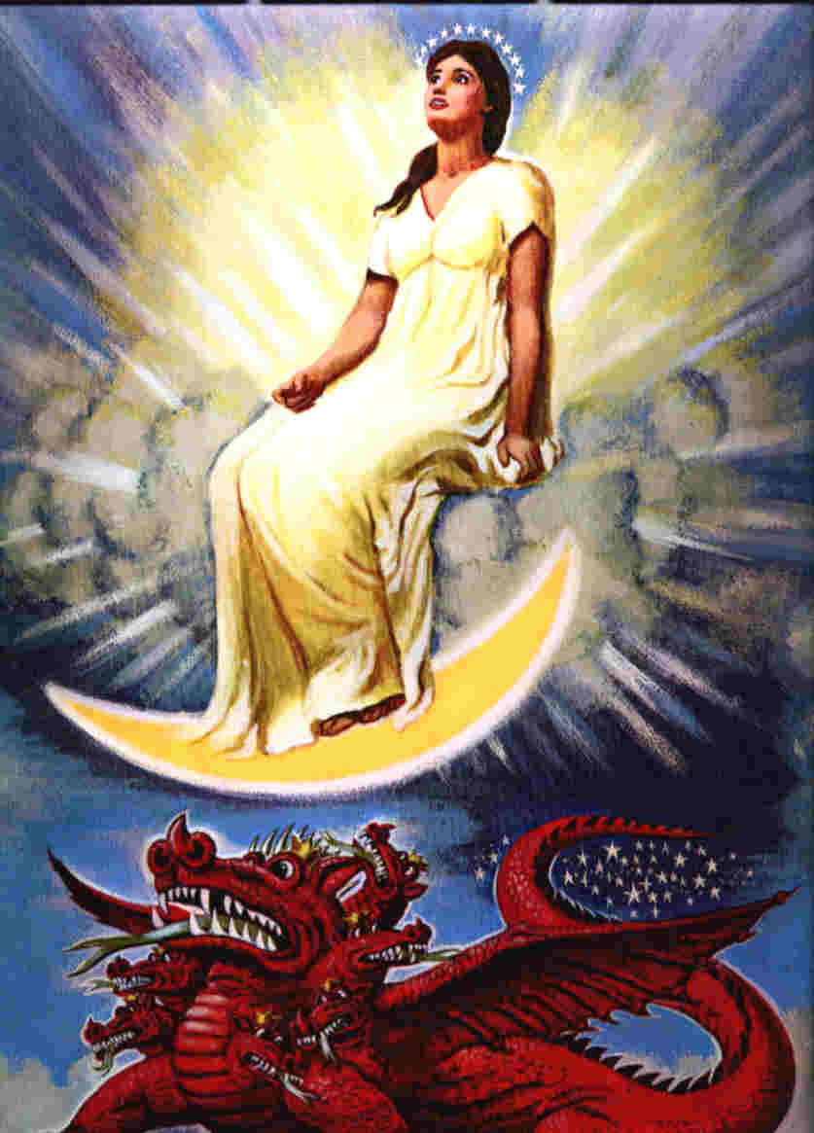
"'Two-thirds of the people in the land will be cut off and die,' says the LORD. But one-third will be left in the land" (Zech. 13:8 NLT).
386

Slide 66
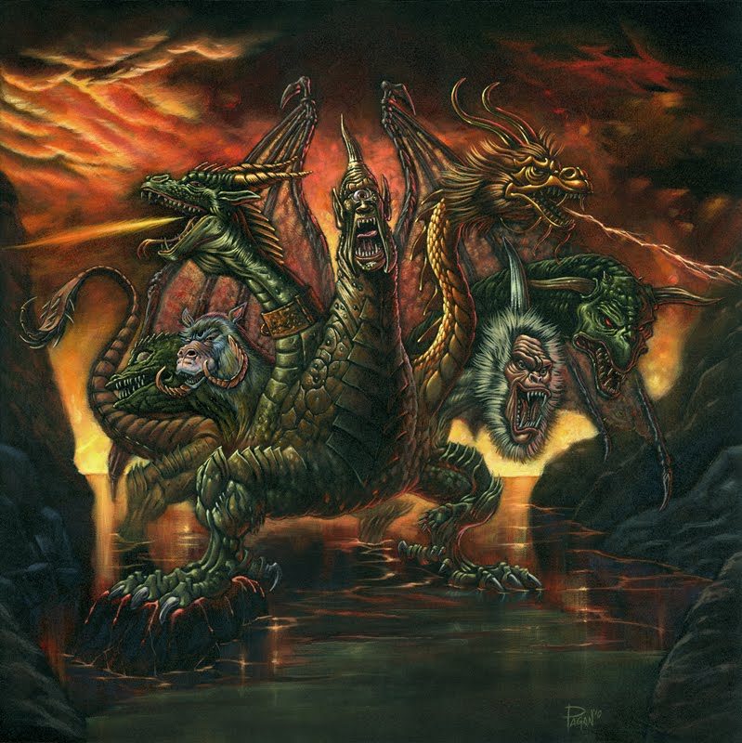
"Then the dragon took his stand on the shore beside the sea" (12:18 NLT)
386

Slide 67
Some think Jews will escape to Petra in the Esau's land of Edom during Antichrist's pursuit
OT Survey
444
598d
Jacob
Israel
Esau
Edom

Slide 68
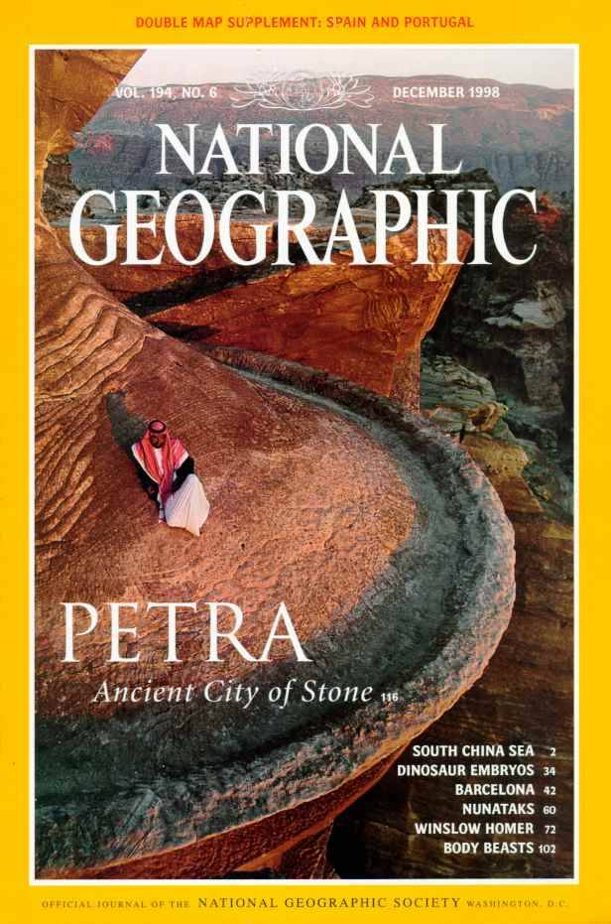
National Geographic has several articles on Petra back to 1907
Here's Dec. 1998

Slide 69
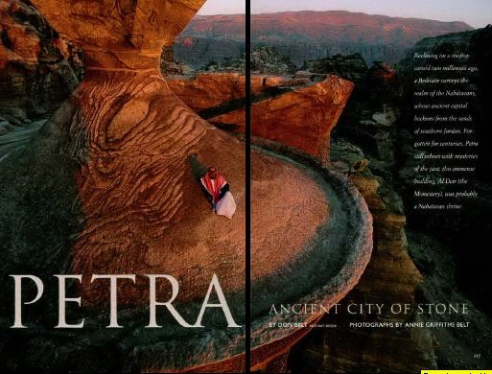
Petra Article Front Page

Slide 70
Imagine living in this terrain!

Slide 71
The Siq (pronounced "seek")
OTS 598c
The only entrance to Petra
Water Course

Slide 72
Water channels were buried for centuries

Slide 73
Exit of the Siq
OTS 598b

Slide 74
Dark Siq Exit

Slide 75
The Treasury
OTS 598b

Slide 76
From atop the Treasury

Slide 77
Nabataean engineers ingeniously collected the mere 6 inches of annual rainfall.

Slide 78
Nabatean tombs east of the city center

Slide 79
"The pride of your heart has deceived you, you who live in the clefts of the rock, in your lofty dwelling, who say in your heart, 'Who will bring me down to the ground?'" (Obadiah 3)
OTS 598c
Notes:
Ironically, the place of Edomite pride may very well become the place of Israel's protection in the coming days!

Slide 80
How can we live with hope?
(Rev. 12)

Slide 81
Summing Up Revelation 12
In Satan's epic war against Israel, Jesus and us… Jesus wins!

Slide 82
Uhh, Satan?

Slide 83
The Great Accuser
367
Revelation 12

Slide 84
The Revelation of Jesus Christ

Slide 85
4 Characters
The Cast…

Slide 86
Jesus Wins!
Series on Revelation

Slide 87
We Win!
If Jesus wins, and we are on his team, then…

Slide 88
You Win!
If Jesus wins, and you are on his team, then…

Slide 89
How is Satan winning in your life right now?
How can Christ claim the victory in your life right now?

Slide 90
"A Mighty Fortress"
—Martin Luther

Slide 91
Nimrod's Fortress

Slide 92
Verse 1
31
A Mighty Fortress is our God,
A bulwark never failing;
Our helper He amid the flood
Of mortal ills prevailing.
For still our ancient foe
Doth seek to work us woe
His craft and pow'r are great,
And armed with cruel hate,
On earth is not his equal.

Slide 93
Verse 2
31
Did we in our own strength confide,
Our striving would be losing,
Were not the right man on our side,
The man of God's own choosing,
Dost ask who that may be?
Christ Jesus, it is He
Lord Sabaoth His name,
From age to age the same,
And He must win the battle.

Slide 94
Verse 3
31
And tho' this world, with devils filled,
Should threaten to undo us,
We will not fear, for God hath willed
His truth to triumph through us.
The prince of darkness grim,
We tremble not for him,
his rage we can endure,
For lo, his doom is sure:
One little word shall fell him.

Slide 95
Verse 4
31
That word above all earthly pow'rs,
No thanks to them, abideth;
The Spirit and the gifts are ours
through Him who with us sideth.
Let goods and kindred go,
This mortal life also
The body they may kill;
God's truth abideth still:
his Kingdom is forever!

Slide 96
THIS MEANS WAR

Slide 98
Jesus Wins!
Series on Revelation

Slide 99
NT Preaching link at BibleStudyDownloads.org
Get this presentation and script for free!
Notes:
NT Preaching (np)

