Slide 1
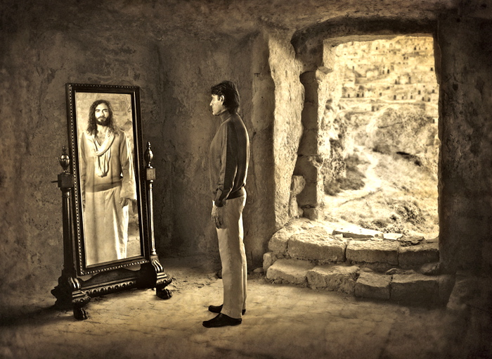
Be Christlike
Philippians
Dr. Rick Griffith • Crossroads International Church Singapore
BibleStudyDownloads.org

Slide 2

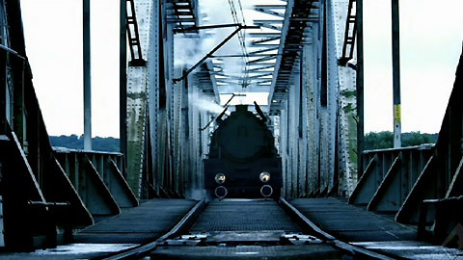
Most (The Bridge)
Notes:
“Most” (Czech for “The Bridge”) movie at https://www.wingclips.com/movie-clips/most/the-bridge.
https://www.youtube.com/watch?v=6pVe6pBXk1A

Slide 3
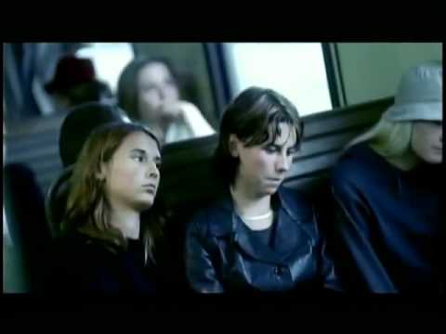
Most (The Bridge)
Notes:
The boy did not accidentally die, but he willingly risked his life for the apathetic passengers.
_________
“Most” (Czech for “The Bridge”) movie at https://www.wingclips.com/movie-clips/most/the-bridge.
https://www.youtube.com/watch?v=6pVe6pBXk1A

Slide 4
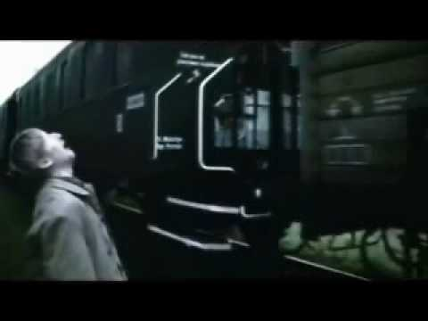
Most (The Bridge)
Notes:
The agony of the father can hardly be fathomed. What an example of sacrifice!
_____________
“Most” (Czech for “The Bridge”) movie at https://www.wingclips.com/movie-clips/most/the-bridge.
https://www.youtube.com/watch?v=6pVe6pBXk1A

Slide 5
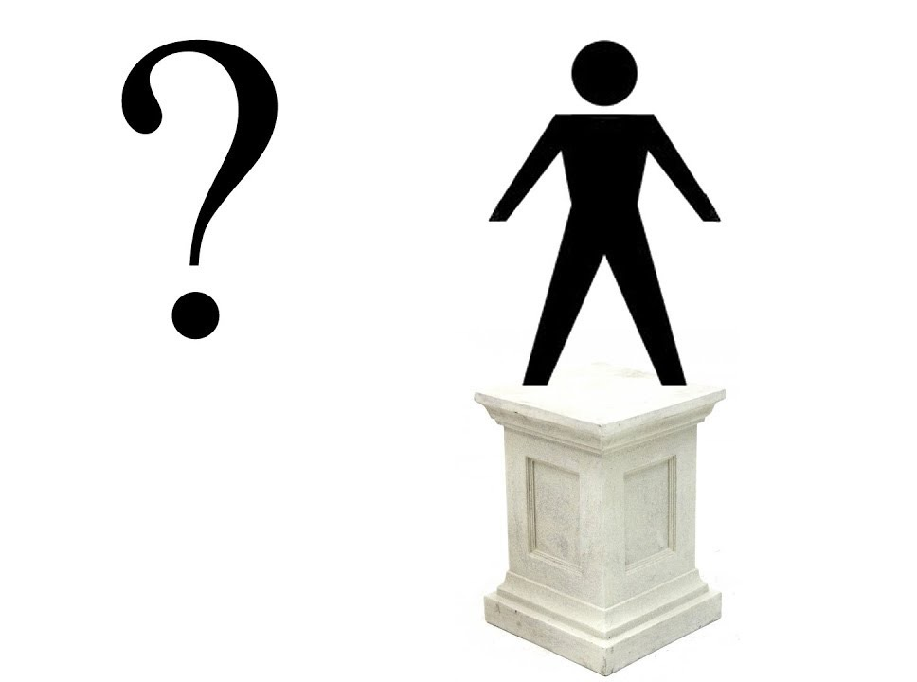
Who do you admire most?
Notes:
Who is your ultimate example in life? Who do you admire most? Who do you want to be like more than anyone else?
A century ago the most admired people were scientists.

Slide 6
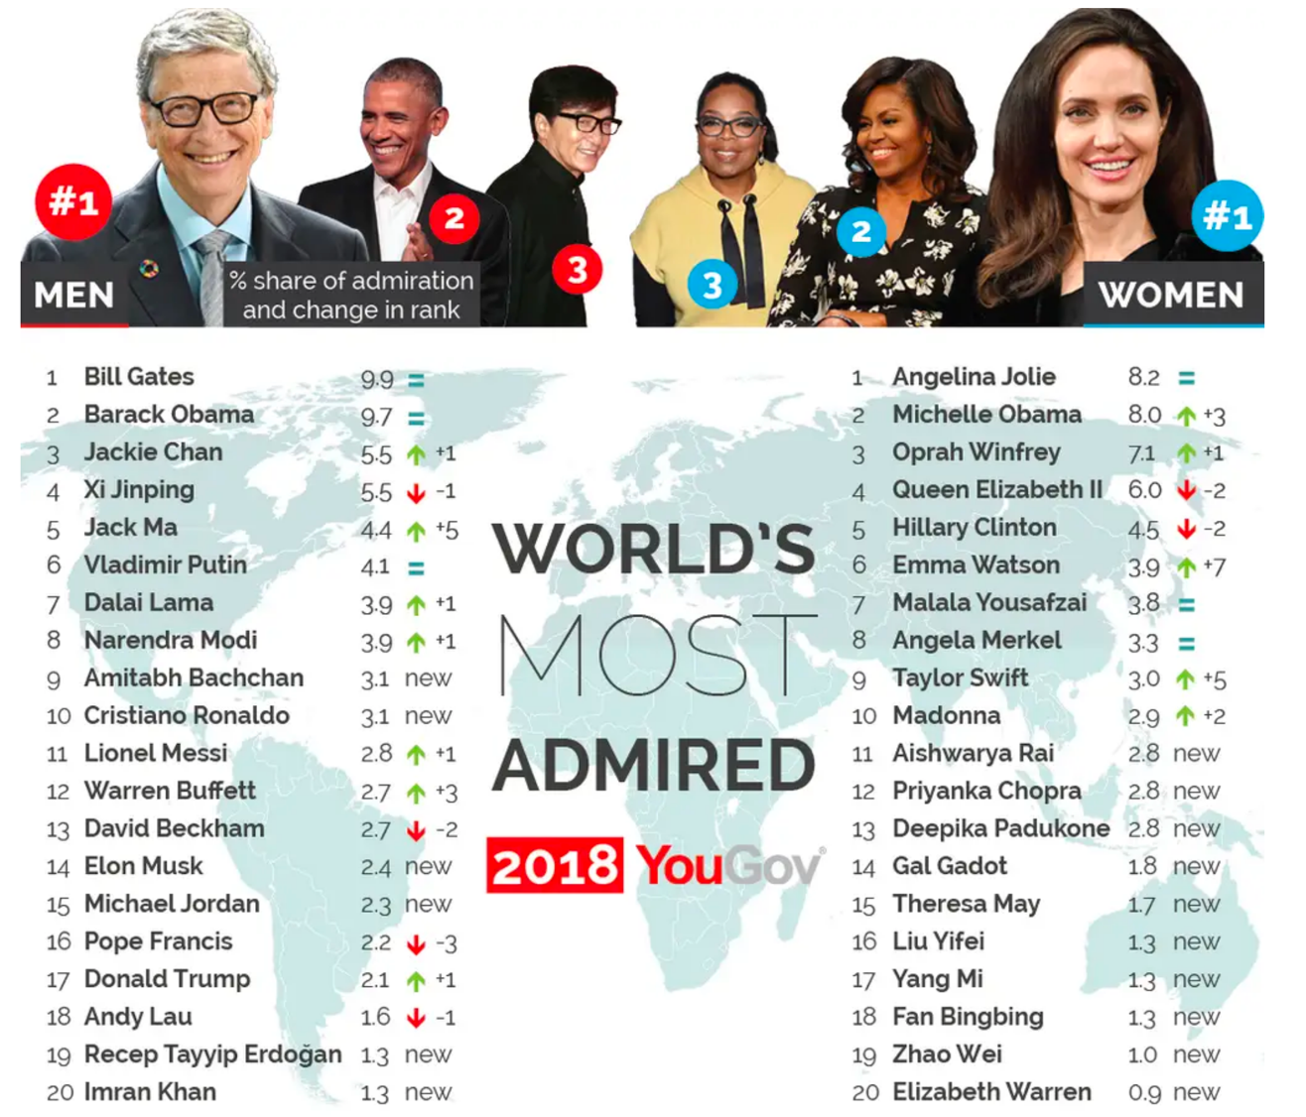
Most Admired People (2018)
Notes:
Today many of the most admired are actors who make a pretty good living by pretending to be someone else.
Actually, in 2018 the most admired man was Barack Obama and woman was Angelina Jolie.

Slide 7

Where is Jesus?
Notes:
But what I find amazing is that Jesus does not top every list. He—more than anyone—should be our example in life!

Slide 8
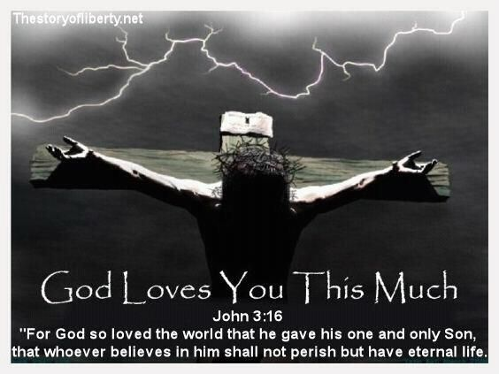
God Sacrificed His Only Son
Notes:
Who else left heaven to take on humanity?
Who else was completely innocent any sin but willingly gave his life for all?
Who else came back from the dead and appeared to over 500 people?
The son did not accidentally die, but he willingly risked his life for the apathetic passengers.
The agony of the Czech father to sacrifice his son aptly depicts God's grief to put Jesus to death even for apathetic people like us. What an example of sacrifice!

Slide 9
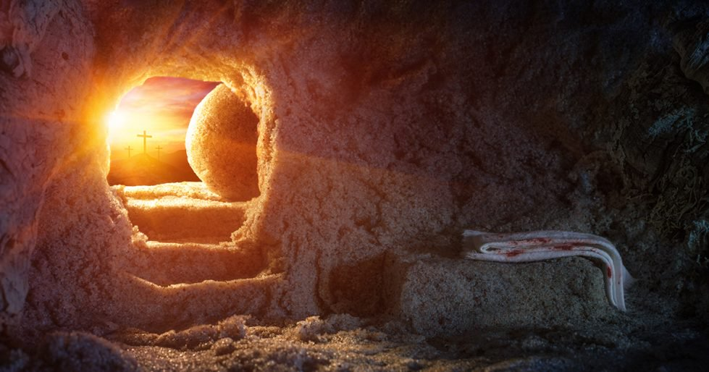
God Raised His Only Son
Notes:
Yet God also brought Jesus back to life. We worship a risen Savior!

Slide 10
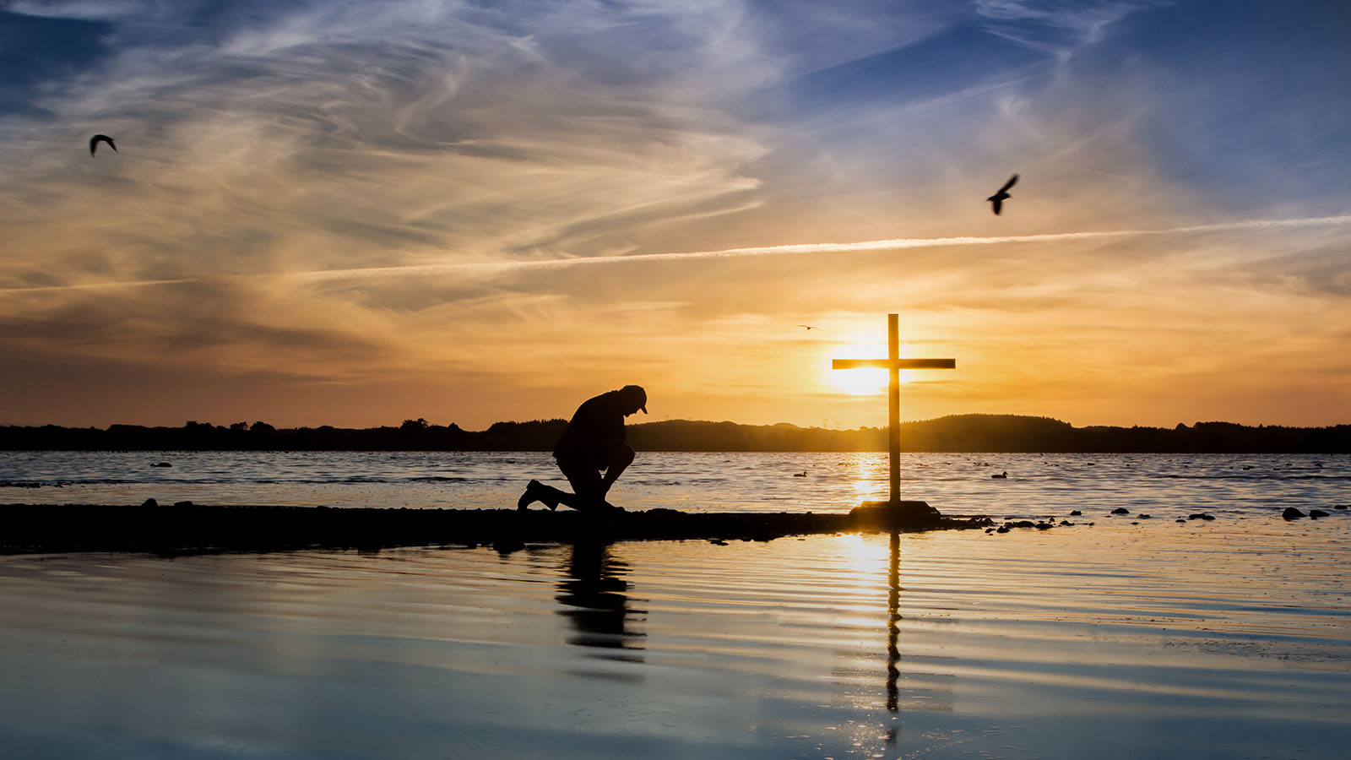
So how should we be like Jesus?
Notes:
Now none of us could ever imitate the actions of Jesus. He lived in a different time and place. He was single whereas God’s will for most of us is marriage. We are told WWJD? (What Would Jesus Do?).

Slide 11

JESUS TOOK
NAPS
BE LIKE JESUS
MARK 4:38
Notes:
Imitating Jesus can become ridiculous like the t-shirt that says “Jesus took naps. Be like Jesus—Mark 4:38.”

Slide 12
Key Word
181
Attitude
Philippians
Notes:
The reality is that we are told to mimic the attitude of Christ in the book of Philippians.

Slide 13
Key Verse
181
"Your attitude should be the same as that of Christ Jesus"
(Philippians 2:5).

Slide 14
Theme
23
Results of Imitating Christ's Attitude
Philippians

Slide 15
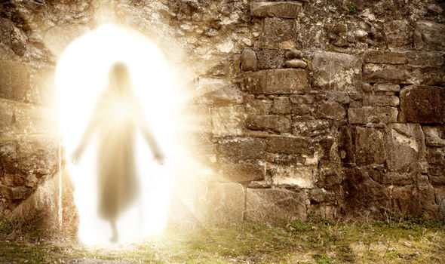
What happens when we imitate Christ’s resurrection attitude?
Notes:
Stated as a question, the letter of Philippians answers this question!
What are some results when we commit ourselves to respond to life with the same perspective that Jesus had—that kind of view or thinking that the risen Savior has?

Slide 16
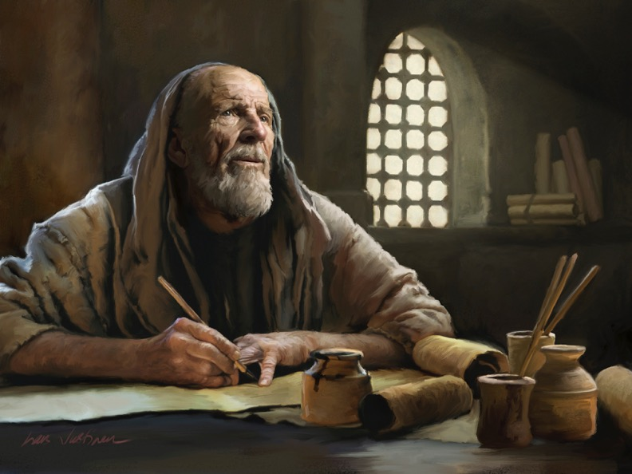
Background
Notes:
By the time Paul wrote the Philippian letter we will see today, he had spent the last four years in two prisons with a shipwreck between them!
If we need easy circumstances to show the attitude of Jesus, then Paul certainly would be no example!

Slide 17
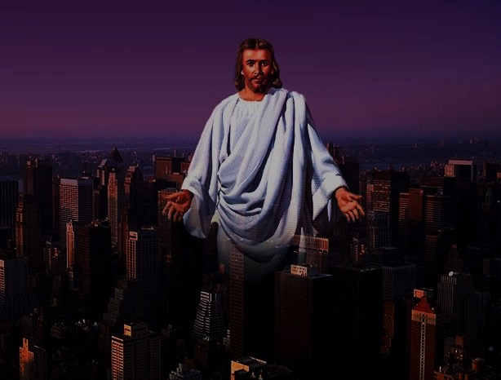
Christ is Prominent in Philippians
183
Characteristics
Chapter 1
Chapter 2
Chapter 3
Chapter 4
Gives Affection for Others
1:8
2:29
Gives Righteousness (Saints)
1:1, 10-11
3:9
4:21
Gives Encouragement
2:19
Gives Knowledge of Himself
3:8, 10
Christ is noted over 70 times in 4 chapters!
Gives Glory to God
1:11
Gives Grace
1:2
4:23
Gives Comfort to Us
2:1
Gives Comfort for Others
2:1
Gives Purpose for Ministry
2:16
Gives Life
1:21
Gives Ability to Do Everything
4:13
Gives Joy (Contentment)
1:18, 26
2:29
3:1
4:4, 10-13
Gives Confidence (Ability to Stand)
1:13-14
2:19, 24
4:1, 19
Gives Peace
1:2
4:2, 7
Gives Suffering
1:13, 29
3:10
Gives Rewards
1:21, 23
3:7-8, 14
Gives Humility
2:5
Gives Unity
1:15-17
2:1-2
4:21-22
Gives New Bodies (Resurrection)
3:11, 21
Gives Christlikeness (Exalts Himself in Us)
1:20, 27
2:5
3:10-14

Slide 18
Central Theme
183-184
Living the Christian Life
The Person of Christ
Imitating the
Attitude of Christ
Pastoral
Joy
Multipurpose

Slide 19
Slides on
Philippians 1

Slide 20
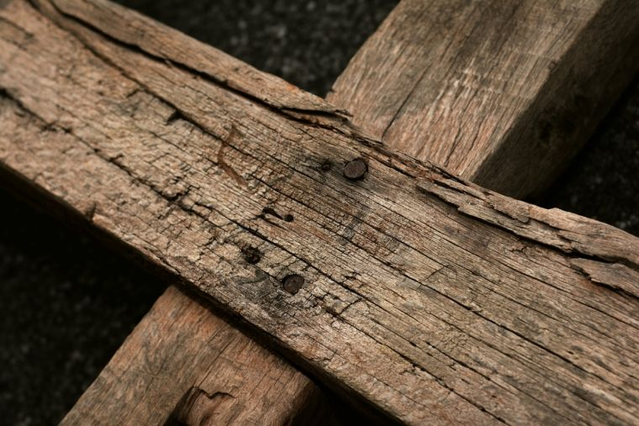
Results of Imitating Christ's Attitude
Joy
1
Notes:
Mimicking Jesus gives us the same joyfulness that Christ had.

Slide 21
Book Chart
181
Philippians: Results of Imitating Christ's Attitude
Joy |  |  | Humility |  | Protection |  | Peace
Chapter 1 |  |  | Chapter 2 |  | Chapter 3 |  | Chapter 4
Joy (5x) |  |  | Joy (7x) |  | Joy (1x) |  | Joy (4x)
Attitude (1x) |  |  | Attitude (7x) |  | Attitude (8x) |  | Attitude (4x)
Suffering |  |  | Submission |  | Salvation |  | Sanctification
Salu-tation 1:1-2 | Thanks & Prayer 1:3-11 | In Prison Ministry1:12-30 | Exhort-ed 2:1-4 | Exempli-fied 2:5-30 | From Legal-ism 3:1-16 | From Indulgence 3:17-21 | With Peo-ple 4:1-3 | With God 4:4-9 | Always 4:10-20 – Greet-ings 4:21-23
From Rome
Early Spring AD 62 (first Roman imprisonment)
17x
20x

Slide 22
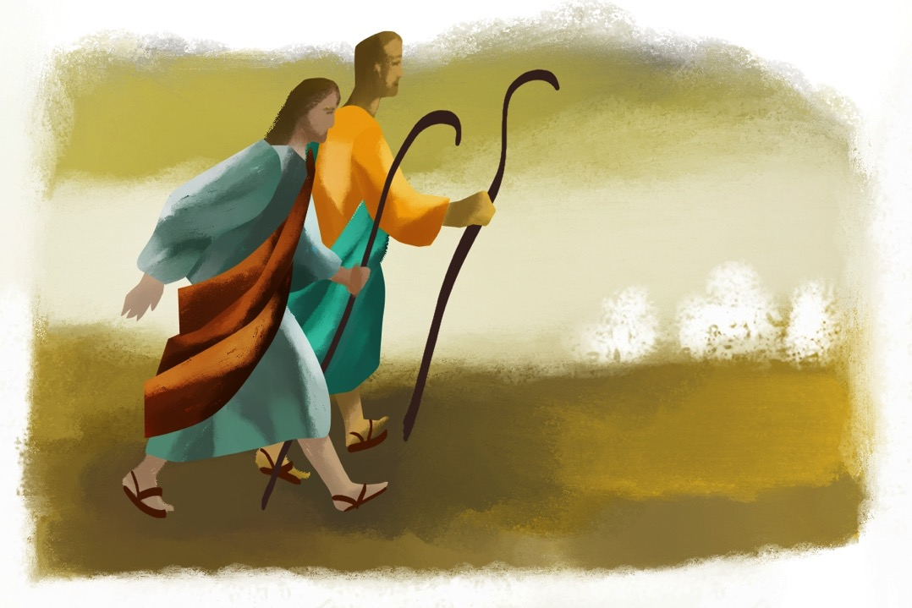
Paul overcame his prison hardships because he had the attitude of Christ (1:1-11).

Slide 23

A. Having Christ's attitude helped Paul see himself as a servant of Christ (1:1-2).
  "This letter is from Paul and Timothy, slaves of Christ Jesus" (NLT).

Slide 24
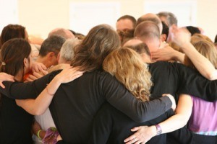
B. Having Christ's attitude helped Paul to give thanks and pray (1:3-11).
Paul's Thanksgiving (1:3-8)

Slide 25
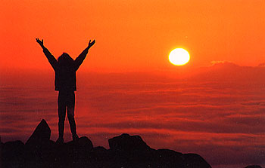
Paul's Thanks
³Every time I think of you, I give thanks to my God. ⁴Whenever I pray, I make my requests for all of you with joy, ⁵for you have been my partners in spreading the Good News about Christ from the time you first heard it until now. ⁶And I am certain that God, who began the good work within you, will continue his work until it is finally finished on the day when Christ Jesus returns (Phil. 1:3-6 NLT)

Slide 26
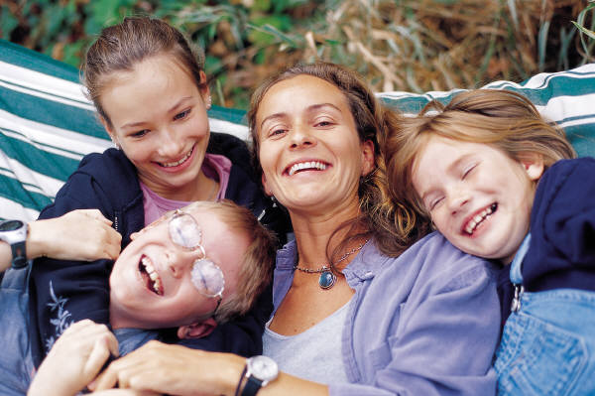
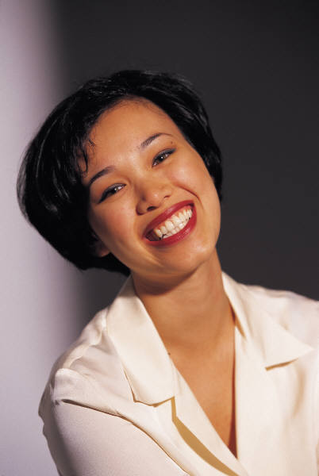
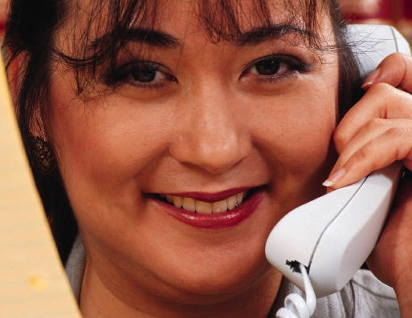

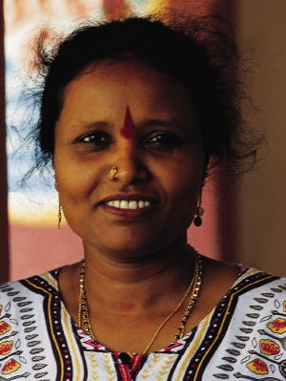
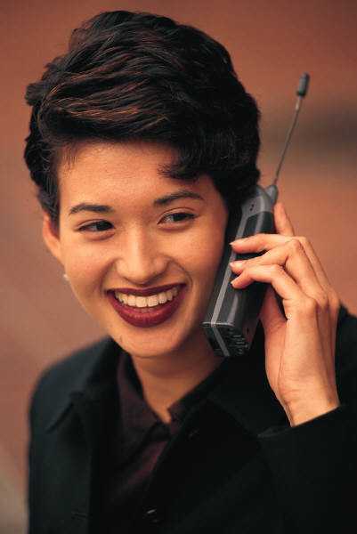
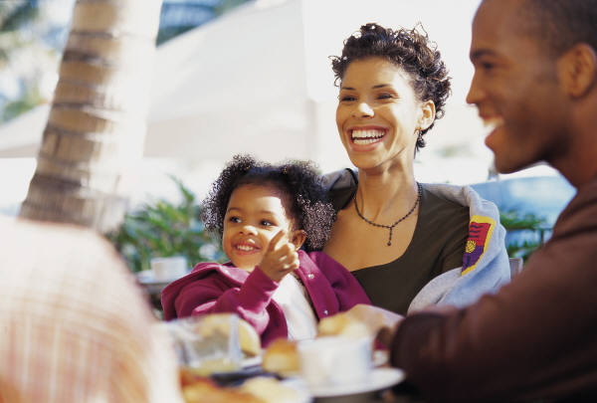
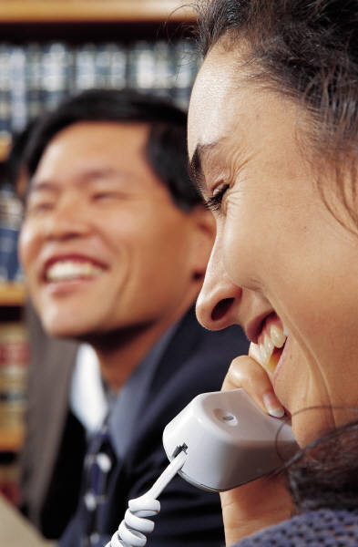
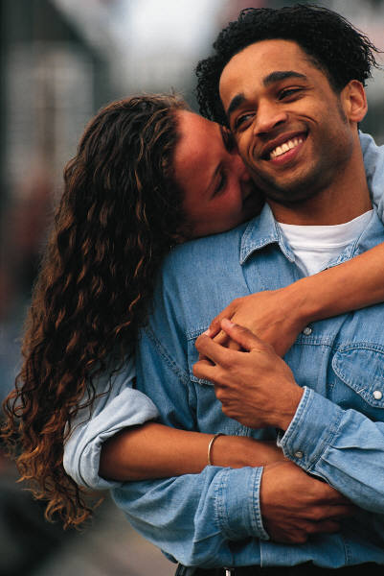
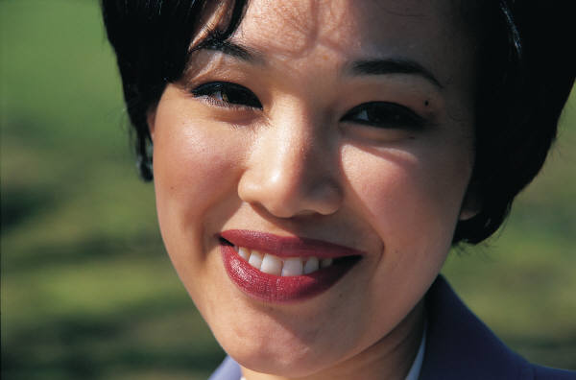

What do most people think it takes to be happy?
FRIENDS
MONEY
CLOTHES
FREEDOM
HOUSE
LOOKS
CAR
HEALTH
FAMILY
TRAVEL
Notes:
Get feedback from everyone and add up to these 10 issues.

Slide 27
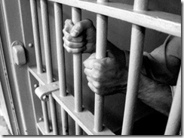
What if a joyful prisoner could give us some advice?

Slide 28
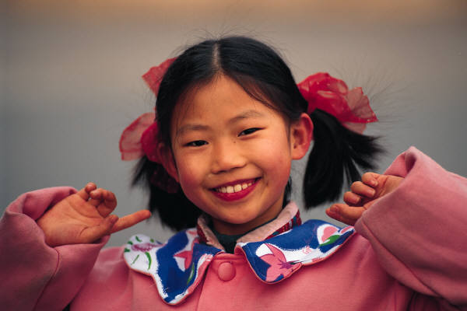
Happiness verses Joy
186c
Happiness
Joy
Joy
External
Internal
Dependent on circumstances
Independent of circumstances
Emotional response
Act of the will
Having what
you want
Wanting what
you have
Euphoria
Contentment
Effect
Cause
Result
Foundation
Inconsistent
Consistent
Temporary
Eternal

Slide 29
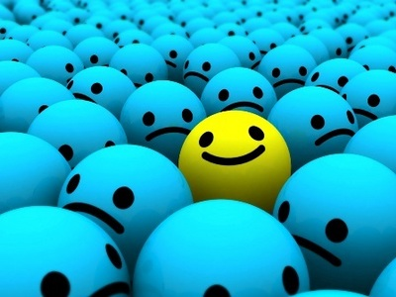
How can we live with JOY?

Slide 30
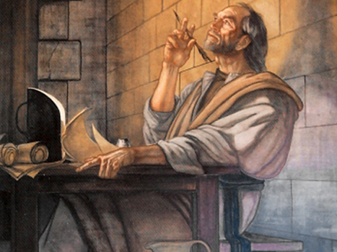
Paul modeled joy in his prison ministry by having the attitude of Christ (1:12-30).

Slide 31
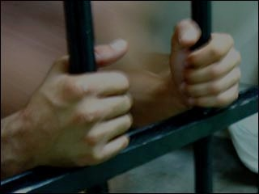
¹²And I want you to know, my dear brothers and sisters, that everything that has happened to me here has helped to spread the Good News
(1:12 NLT).

Slide 32

¹³For everyone here, including the whole palace guard, knows that I am in chains because of Christ. ¹⁴And because of my imprisonment, most of the believers here have gained confidence and boldly speak God's message without fear (1:13-14 NLT).

Slide 33
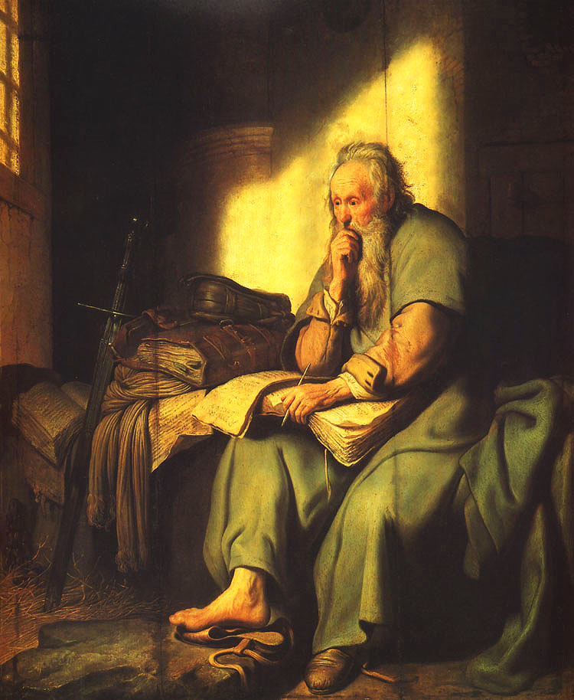
¹⁵It's true that some are preaching out of jealousy and rivalry. But others preach about Christ with pure motives. ¹⁶They preach because they love me, for they know I have been appointed to defend the Good News (1:15-16 NLT).

Slide 34
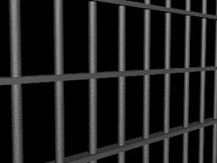
¹⁷Those others do not have pure motives as they preach about Christ. They preach with selfish ambition, not sincerely, intending to make my chains more painful to me. ¹⁸But that doesn't matter. Whether their motives are false or genuine, the message about Christ is being preached either way, so I rejoice (1:17-18a NLT).

Slide 35
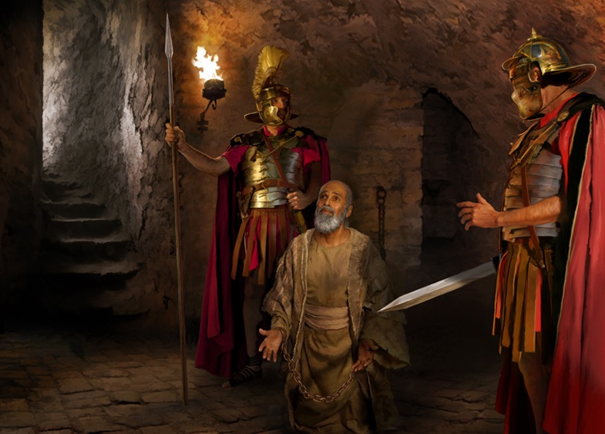
Who was really chained?

Slide 36
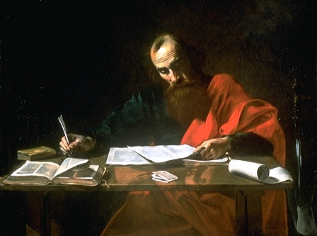
Paul rejoiced that whether he was executed or released from prison didn't matter since both had their advantages (1:18b-26)!

Slide 37
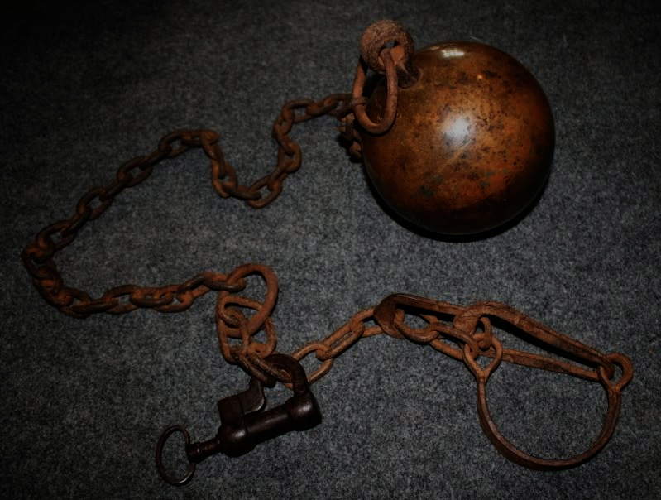
An Imaginary Dialogue…
Persecutors | Paul
"Aha! You like to share about Jesus? I'll imprison you!" | "Good! This will give me more time to pray, write letters to the churches, and share Christ with every soldier guarding me."
"Well, then, I'll torture you!" | "Thank you, for in this way I can share in the sufferings of my Master, Jesus."
"Oh yeah? Then I'll kill you!" | "This is the best option yet, for then you will usher me into his presence!"
185-186
Notes:
Translators, please move the six black rectangles to the side and translate the text underneath. Then return them to their original spots. You might need to resize them, so look at this slide in slide show view to see if the text fits correctly.

Slide 38

TO
LIVE
IS
CHRIST
TO DIE
IS GAIN
Notes:
Translators, please translate the text on the cross at the right.

Slide 39
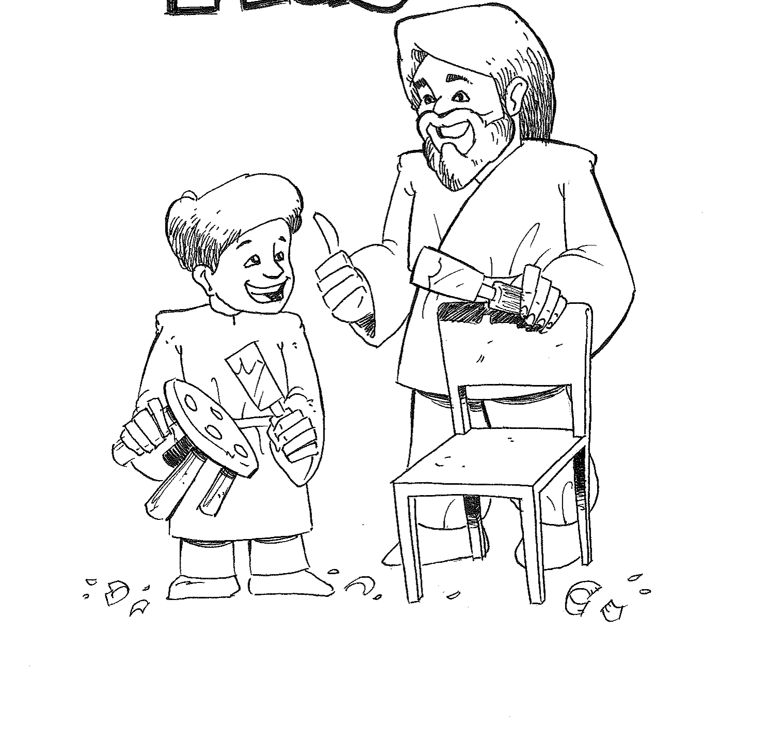

Mimicking the Master
Mimicking the Master enables you to live with joy!

Slide 40
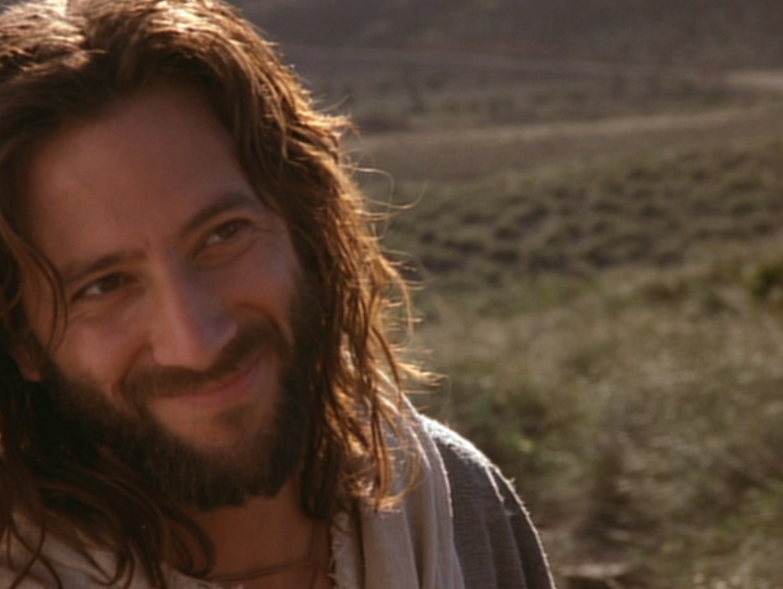
Jesus lived in a spirit of joy!
…Jesus, full of joy through the Holy Spirit, said, "I praise you, Father, Lord of heaven and earth, because you have hidden these things from the wise and learned, and revealed them to little children..."
Luke 10:21

Slide 41
Jesus lived in a spirit of joy!
I have told you this so that my joy may be in you and that your joy may be complete.
John 15:11

Slide 42
Slides on
Philippians 2

Slide 43
Results of Imitating Christ's Attitude
Joy
1
Humility
2
Notes:
Mimicking Jesus leads us to be meek.

Slide 44
Book Chart
181
Philippians: Results of Imitating Christ's Attitude
Joy |  |  | Humility |  | Protection |  | Peace
Chapter 1 |  |  | Chapter 2 |  | Chapter 3 |  | Chapter 4
Joy (5x) |  |  | Joy (7x) |  | Joy (1x) |  | Joy (4x)
Attitude (1x) |  |  | Attitude (7x) |  | Attitude (8x) |  | Attitude (4x)
Suffering |  |  | Submission |  | Salvation |  | Sanctification
Salu-tation 1:1-2 | Thanks & Prayer 1:3-11 | In Prison Ministry1:12-30 | Exhort-ed 2:1-4 | Exempli-fied 2:5-30 | From Legal-ism 3:1-16 | From Indulgence 3:17-21 | With Peo-ple 4:1-3 | With God 4:4-9 | Always 4:10-20 – Greet-ings 4:21-23
From Rome
Early Spring AD 62 (first Roman imprisonment)

Slide 45
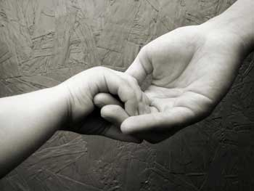
Selflessness Leads to Unity
Philippians 2:1-4

Slide 46
Attitude words in 2:1-4 (NASB)
Therefore
if there is any encouragement in Christ,
if there is any consolation of love,
if there is any fellowship of the Spirit,
if any affection and compassion,
make my joy complete by
being of the same mind,
maintaining the same love,
united in spirit,
intent on one purpose.
Do nothing from selfishness or empty conceit,
but with humility of mind regard one another
as more important than yourselves;
do not merely look out for your own personal interests, but also for the interests of others.

Slide 47
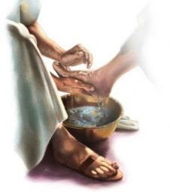
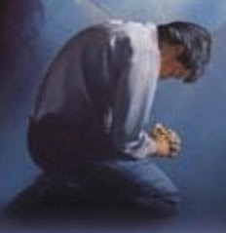
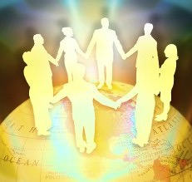
The Sequence
Selflessness
Humility
Unity

Slide 48
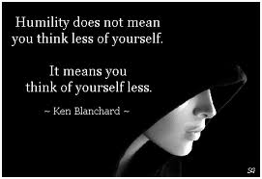
What is Humility?
Humility does not mean
you think less of yourself.
It means
you think of yourself less.
—Ken Blanchard—

Slide 49
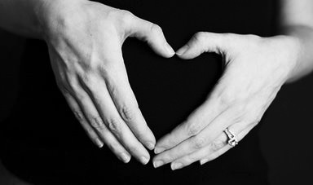
Don'ts and Do's
of Upside Down Living
³Do nothing from selfishness or empty conceit,
but with humility of mind regard one another as more important than yourselves;
⁴do not merely look out for your own personal interests,
but also for the interests of others.
Notes:
Some translations add "merely" (NASB) or "only" (NIV, NKJV, NCV, NET)

Slide 50
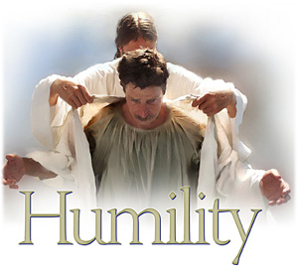
Main Idea of 2:5-30
We can be truly united only as long as we are truly humble

Slide 51
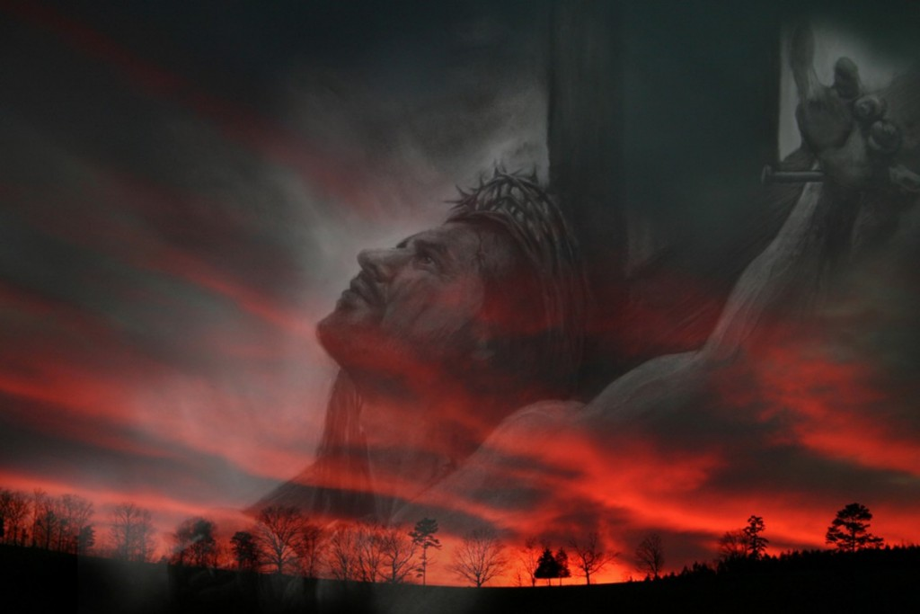
1. Christ modeled humility as our best example since he refused his rights as God (2:5-11).

Slide 52
Mimicking the Master
Key Verse
"Your attitude should be the same as that of Christ Jesus"
(Phil. 2:5).

Slide 53

The Kenosis ("Emptying") Passage
Philippians 2:5-11

Slide 54
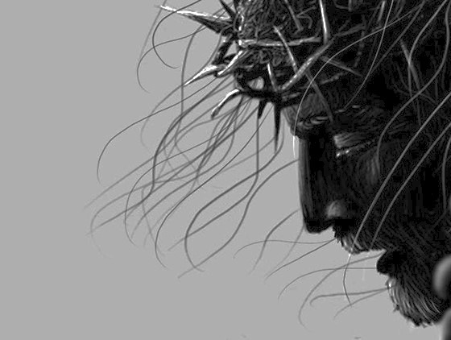
Phil 2:5-8
⁵You must have the same attitude that Christ Jesus had.
⁶Though he was God,
he did not think of equality with God as something to cling to.
⁷Instead, he gave up his divine privileges [Greek "he emptied himself"]; he took the humble position of a slave and was born as a human being.
When he appeared in human form, ⁸he humbled himself in obedience to God and died a criminal's death on a cross
(Phil. 2:5-8 NLT).

Slide 55
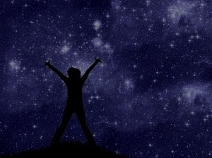
Phil 2:9-11
⁹Therefore, God elevated him to the place of highest honor
and gave him the name above all other names,
¹⁰that at the name of Jesus every knee should bow,
in heaven and on earth and under the earth,
¹¹and every tongue confess that Jesus Christ is Lord,
to the glory of God the Father.
(Phil. 2:9-11 NLT)

Slide 56
Philippians 2:6-11
186
Lordship will be Acknowledged!
Glory
Glory
Always existed as God
Decided not to hold to divine rights
Emptied Himself of these equal rights
Became a slave by being born a man
Humbled himself in obedience
Died by crucifixion
2:6-8
Humiliation
2:9-11
Exaltation

Slide 57
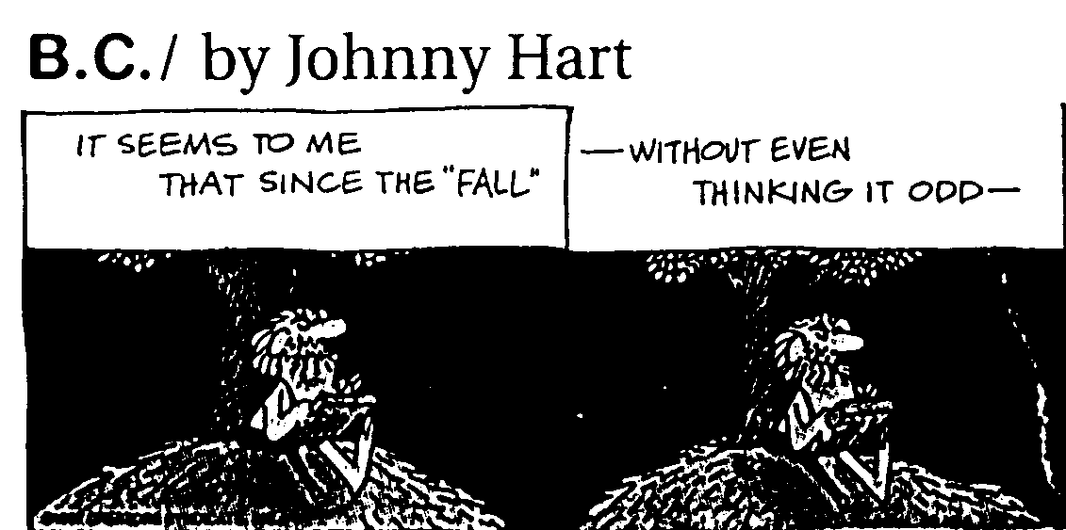
B.C. by Johnny Hart 1 of 4
IT SEEMS TO ME
THAT SINCE THE "FALL"
—WITHOUT EVEN
THINKING IT ODD—

Slide 58
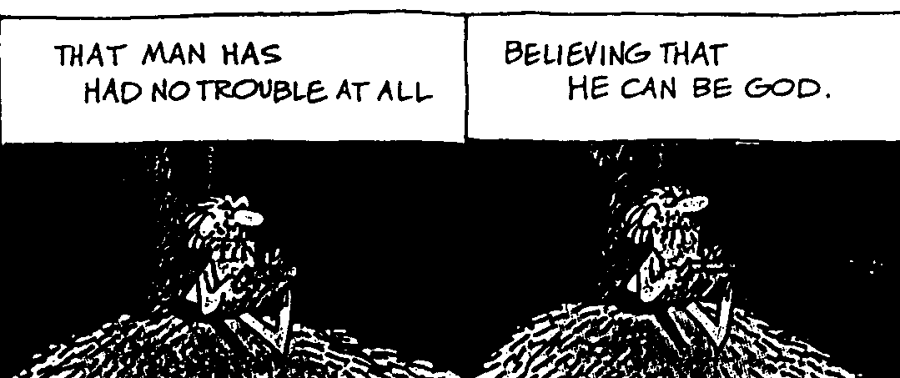
B.C. by Johnny Hart 2 of 4
THAT MAN HAS
HAD NO TROUBLE AT ALL
BELIEVING THAT
HE CAN BE GOD.

Slide 59
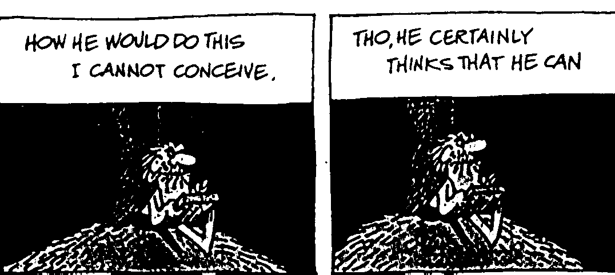
B.C. by Johnny Hart 3 of 4
HOW HE WOULD DO THIS
I CANNOT CONCEIVE.
THO, HE CERTAINLY
THINKS THAT HE CAN

Slide 60

B.C. by Johnny Hart 4 of 4
—AND YET, HE CANNOT
BRING HIMSELF TO BELIEVE
THAT GOD
CAN BECOME…A MAN.

Slide 61
Other examples of Christ-like humility
Paul served with humility (2:16-18)
  Paul spent his life for the Philippians ("poured out as a drink offering on the sacrifice")
Timothy served with humility (2:19-24)
  Timothy showed genuine interest for their welfare, not for his own interests
Epaphroditus served with humility (2:25-30)
  Epaphroditus risked his life to serve Paul

Slide 62




Do you show humility like Christ?

Slide 63
Slides on
Philippians 3

Slide 64
Results of Imitating Christ's Attitude
Joy
1
Humility
2
Protection
3
Notes:
Mimicking Jesus guards us from either starving or indulging our flesh.

Slide 65
Book Chart
181
Philippians: Results of Imitating Christ's Attitude
Joy |  |  | Humility |  | Protection |  | Peace
Chapter 1 |  |  | Chapter 2 |  | Chapter 3 |  | Chapter 4
Joy (5x) |  |  | Joy (7x) |  | Joy (1x) |  | Joy (4x)
Attitude (1x) |  |  | Attitude (7x) |  | Attitude (8x) |  | Attitude (4x)
Suffering |  |  | Submission |  | Salvation |  | Sanctification
Salu-tation 1:1-2 | Thanks & Prayer 1:3-11 | In Prison Ministry1:12-30 | Exhort-ed 2:1-4 | Exempli-fied 2:5-30 | From Legal-ism 3:1-16 | From Indulgence 3:17-21 | With Peo-ple 4:1-3 | With God 4:4-9 | Always 4:10-20 – Greet-ings 4:21-23
From Rome
Early Spring AD 62 (first Roman imprisonment)

Slide 66

Christ-likeness Frees Us From Legalism
Philippians 3:1-16

Slide 67

Balance is Key!
Legalism
(All Law)
Libertinism
(No Law)
Godly Balance
(Some Law)

Slide 68

1. Paul first warned the church against legalists (3:1-3).

Slide 69

"Beware of the dogs" (2a).
Notes:
"Hey! What's wrong with dogs?" you say. "I have a nice dog—he's affectionate, loyal, and he protects me." Well, I think you have a different concept of "dogs" than we have here.

Slide 70

"Beware of the dogs" (2a).
Notes:
Jewish legalists cared little for people—and in this way they were like packs of dogs

Slide 71

Man with shriveled man
Notes:
Jesus confronted these people who were incensed that he would heal a man's shriveled hand on the Sabbath.

Slide 72

What are legalists like?
A. They don't care for people (2a).
B. They have evil intent in their rules (2b).
C. They go way beyond the Law's intent (2c).
D. They put confidence in the flesh (3).

Slide 73

2. Paul used to put confidence in his pedigree (3:4-6).

Slide 74

Christ-likeness Frees Us From License
Philippians 3:17-21

Slide 75

THERE ARE NO RULES!

Slide 76



Pursuing Christ-likeness gives us balance
Legalism
Excessive
Rules
3:1-3
License
No
Rules
3:17-21

Slide 77




What's Your Extreme?
Legalism
Expecting
too much
3:1-3
License
Expecting
too little
3:17-21

Slide 78
Slides on
Philippians 4

Slide 79
Results of Imitating Christ's Attitude
Joy
1
Humility
2
Protection
3
Peace
4
Notes:
Mimicking Jesus leads to harmony with people and God.

Slide 80
Book Chart
181
Philippians: Results of Imitating Christ's Attitude
Joy |  |  | Humility |  | Protection |  | Peace
Chapter 1 |  |  | Chapter 2 |  | Chapter 3 |  | Chapter 4
Joy (5x) |  |  | Joy (7x) |  | Joy (1x) |  | Joy (4x)
Attitude (1x) |  |  | Attitude (7x) |  | Attitude (8x) |  | Attitude (4x)
Suffering |  |  | Submission |  | Salvation |  | Sanctification
Salu-tation 1:1-2 | Thanks & Prayer 1:3-11 | In Prison Ministry1:12-30 | Exhort-ed 2:1-4 | Exempli-fied 2:5-30 | From Legal-ism 3:1-16 | From Indulgence 3:17-21 | With Peo-ple 4:1-3 | With God 4:4-9 | Always 4:10-20 – Greet-ings 4:21-23
From Rome
Early Spring AD 62 (first Roman imprisonment)

Slide 81

After salvation, how do you have continued peace with God and man?

Slide 82

Philippians 4 Peace
With People (1-3)
With God (4-9)
With All Situations
(10-23)

Slide 83

A. Paul pleads for peace between two arguing women (4:1-3)
Therefore, my dear brothers and sisters, stay true to the Lord. I love you and long to see you, dear friends, for you are my joy and the crown I receive for my work.

Slide 84

4:2-3 NLT
²Now I appeal to Euodia and Syntyche. Please, because you belong to the Lord, settle your disagreement.
³And I ask you, my true partner, to help these two women, for they worked hard with me in telling others the Good News. They worked along with Clement and the rest of my co-workers, whose names are written in the Book of Life.

Slide 85

What's in a Name?
Euodia
Syntyche
"prosperous journey"
"pleasant acquaintance"

Slide 86

B. Paul promises peace with God by following some simple commands (4:4-9).
Christians.

Slide 87
Philippians 4:4-7 NLT
⁴Always be full of joy in the Lord. I say it again—rejoice! ⁵Let everyone see that you are considerate in all you do. Remember, the Lord is coming soon.
⁶Don't worry about anything; instead, pray about everything. Tell God what you need, and thank him for all he has done. ⁷Then you will experience God's peace, which exceeds anything we can understand. His peace will guard your hearts and minds as you live in Christ Jesus.

Slide 88

4:9 NLT
⁹Keep putting into practice all you learned and received from me—everything you heard from me and saw me doing. Then the God of peace will be with you.

Slide 89


What percentage of TV shows and movies fit this criteria?
⁸And now, dear brothers and sisters, one final thing. Fix your thoughts on what is true, and honorable, and right, and pure, and lovely, and admirable. Think about things that are excellent and worthy of praise.

Slide 90

4 Ways to Peace
Rejoice
Be Gentle
Pray
Wholesome Thoughts

Slide 91
What happens when we imitate Christ’s resurrection attitude?
Notes:
Stated as a question, the letter of Philippians answers this question!
What are some results when we commit ourselves to respond to life with the same perspective that Jesus had—that kind of view or thinking that the risen Savior has?

Slide 92
Main Idea of Philippians
Imitating Christ's resurrection attitude brings joy, humility, protection and peace.

Slide 93
JESUS TOOK
NAPS
BE LIKE JESUS
MARK 4:38
Notes:
Imitating Jesus can become ridiculous like the t-shirt that says “Jesus took naps. Be like Jesus—Mark 4:38.”

Slide 94

T-Shirts
ALWAYS
BE YOURSELF
— UNLESS —
YOU CAN BE LIKE JESUS
— THEN —
ALWAYS
BE LIKE JESUS
Notes:
A better t-shirt says this…

Slide 95

Summary Statement & Application
Philippians
181
Summary Statement
Paul exhorts the Philippian believers to imitate Christ's attitude that they may experience joy, humility, and peace to be protected from false teachers and disunity in the church.
Application
How do you need to show a more Christ-like attitude during difficulty?

Slide 96


Philippians 4
Synthesis
184-185
Results of imitating Christ's attitude
1 Joy
2 Humility
3 Protection
4 Peace

Slide 97
Philippians 4:13
I can do
EVERYTHING
through HIM
who gives me
STRENGTH
Notes:
You can mimic Jesus in any of these areas with his help.

Slide 98
Black

Slide 99


NT Preaching • BibleStudyDownloads.org
Get this presentation and script for free!

