Slide 1
Example of Christian Living
Philippians 2
Preached by Matt Lyle at Crossroads International Church Singapore • CICFamily.com Uploaded by Dr. Rick Griffith • Jordan Evangelical Theological Seminary Files in many languages for free download at BibleStudyDownloads.org
Notes:
Today’s sermon, on Philippians chapter 2 is called “Example of Christian Living.”
And the example of, or evidence for Christian living is humility.

Slide 2
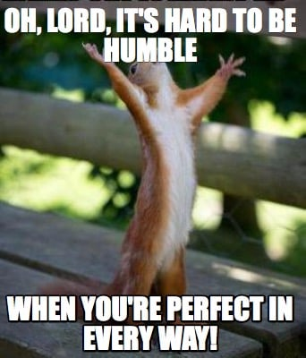
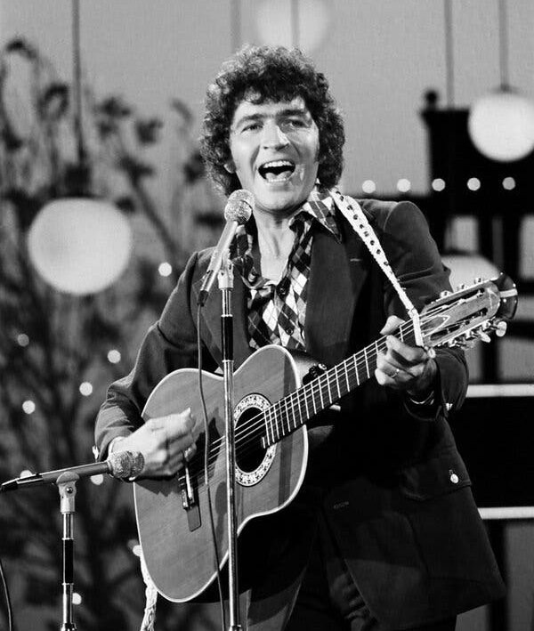
Notes:
You may be familiar with the phrase, it’s hard to be humble
In 1980, American country music artist Mac Davis, wrote a song with the lyrics O Lord, it’s hard to be humble, when you’re perfect in everyway

Slide 3
Oh Lord it's hard to be humble
When you're perfect in every way
I can't wait to look in the mirror
Cause I get better looking each day
Notes:
Mac Davis’ song was obviously tongue in cheek, as it contains lyrics such as
I can’t wait to look in the mirror, cause I get better looking each day
or
I guess you could say I'm a loner
A cowboy out lone, tough, and proud
I could have lots of friends if I wanted
But then I wouldn't stand out from the crowd
Although the song lyrics are lighthearted, they bring up a good point,
IT IS HARD to be humble. But the reason is NOT because we are already perfect

Slide 4
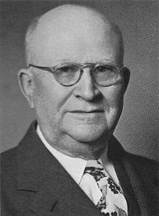
8th Grade Education (S2)
Age 11 taught Sunday School
Age 16: 500 sermons/year
Lead Pastor Moody Church in Chicago
Honorary doctorate from Wheaton College and Bob Jones University
Harry Ironside
1876 - 1951
Notes:
There is a story about Harry Ironside that illustrates just how hard it is to be humble.
Harry quit school after the 8th grade, that is the equivalent to secondary 2 in Singapore.
But even with his limited education, he was a prolific preacher, teacher, and even writer.
He was once convicted about his lack of humility. A friend suggested that he make a sandwich board with the plan of salvation in Scripture on it and to wear it as he walked through the business and shopping district of downtown Chicago for one entire day.
He did it and found it to be a humiliating experience. As he was taking the sandwich board off, however, he caught himself thinking: “There’s not another person in Chicago who would be willing to do a thing like that.”

Slide 5
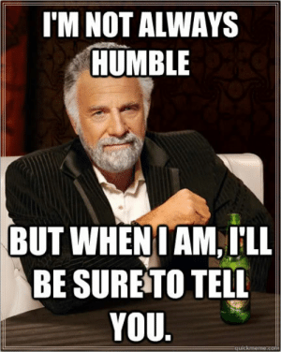
Humility
is
Difficult
Notes:
Humility is difficult! Just when you think you have it, you lose it.
Humility may be difficult, but it is also essential.
It is essential for human relationships, and
it is essential for a relationship with God.
Today we will look at Philippians chapter 2 and see
why we need humility and
what humility looks like and
how we can have humility.
The result of humility is something we already saw when we looked at Philippians chapter 1 a few weeks back. The result of humility is that
it promotes unity and
it spreads joy.

Slide 6
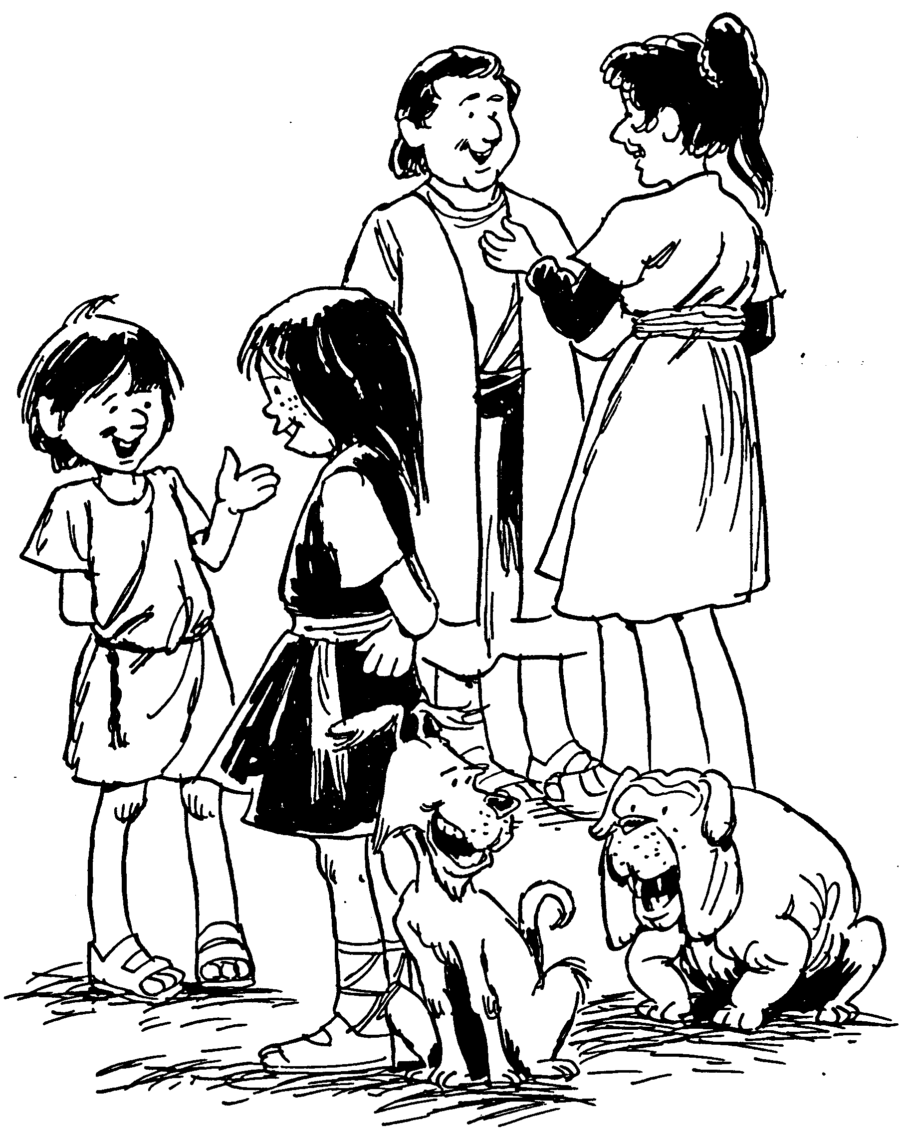
PHILIPPIANS
1. Joy of Christian fellowship
2. Outward evidences of humility
3. Your focus is Christ
4. Secret of God’s peace
Barry Huddleston, The Acrostic Bible
Notes:
Joy is a prominent theme that is often emphasized in many studies on Philippians.
Barry Huddleston uses acrostics as a tool to know what is in every chapter of the Bible.
He uses a word or phrase that that highlights the “overall” theme of the book.
In addition, each letter of that overall theme relates to the specific chapter.
He uses joys, J – O – Y – S as the theme for Philippians.
For chapter 1, J is for Joy of Christian fellowship
For chapter 2, O is for Outward evidences of humility

Slide 7
Joyful Christian Living
Philippians 1
1. Joy of Christian fellowship
2. Outward evidences of humility
3. Your focus is Christ
4. Secret of God’s peace
Notes:
A few weeks ago, I called my sermon on Philippians ch 1: Joyful Christian living.
That is very similar to Huddleston’s statement “Joy of Christian Fellowship”

Slide 8
How Can You Experience Joyful Christian Living?
Notes:
In that sermon, I tried to answer the question how can you experience joyful Christian living.
We saw that Paul was in prison because he was proclaiming the gospel.
The powers wanted him to stop speaking about Jesus.
Instead, they gave him another platform to tell others about the Good News.
Not only that, he emboldened others to share what Jesus had done in their lives.
The conclusion was chapter 1 tells us that

Slide 9
By reading and growing in God’s word, believers can overcome adversity from sharing the Gospel and experience Joyful Christian Living
Philippians Chapter 1
Notes:
By reading and growing in God’s word, believers can overcome adversity from sharing the Gospel and experience Joyful Christian Living

Slide 10
Example of Christian Living
Philippians 2
1. Joy of Christian fellowship
2. Outward evidences of humility
3. Your focus is Christ
4. Secret of God’s peace
Notes:
Today’s sermon, on Philippians chapter 2 is called “Example of Christian Living.”
And the example of, or evidence for Christian living is humility.

Slide 11
¹ So if there is any encouragement in Christ, any comfort from love, any participation in the Spirit, any affection and sympathy, ² complete my joy by being of the same mind, having the same love, being in full accord and of one mind. ³ Do nothing from selfish ambition or conceit, but in humility count others more significant than yourselves. ⁴ Let each of you look not only to his own interests, but also to the interests of others
Phil 2:1-4
Notes:
The first section, Phil 1-4, can be seen as one long sentence in Greek. Fortunately, the English translations break it up into multiple sentences to make it easier to read.
Read vs 1-4

Slide 12
Complete my Joy
Why we need humility
Phil 2:1-4
Notes:
The central clause in this section is “complete my joy” and answers the question of why we need humility.
As we dig deeper in this section, I want show you a simple way to take a closer look at the scriptures.

Slide 13
paragraph
sentence
clause
phrase
word
Notes:
When we look at writing, we see words, phrases, clauses, and sentences
We understand words. We speak using words. But scholars will tell you that meaning does not reside in the individual word but in the larger collection of words, such as in a phrase, clause, sentence, or even paragraph.
A phrase is a group of related words that specifically does not contain both a subject and a verb
for example: prepositional phrases: in the room, on the table
A clause is a group of related words that contain a subject and a predicate.
But so does a sentence, the difference is that a sentence conveys a complete thought. Whereas a clause is incomplete in some way
Then you have a paragraph, which consists of multiple sentences that work together to create an overall thought or impression.
As you can see, there is considerable overlap in how we see these units today.
The more literal translations, such as ESV, NASB, LEB will translate at the clause level. That is because that is the basic level of thought, and it works well when trying to understand a passage.
Sometimes, these clauses are put together in such a way that is awkward in today’s English, it’s not how we would put it together. That is where the dynamic translations such as NLT and NIV come in, they smooth out the flow.

Slide 14
¹ So if there is any encouragement in Christ,
any comfort from love,
any participation in the Spirit,
any affection and sympathy,
² complete my joy
by being of the same mind,
having the same love,
being in full accord
and of one mind.
Phil 2:1-4
Notes:
The writings of the Apostle Paul can be complicated. Therefore, I break it into small groups and see how the groups are put together.

Slide 15
¹ So if there is any encouragement in Christ,
any comfort from love,
any participation in the Spirit,
any affection and sympathy,
² complete my joy
by being of the same mind,
having the same love,
being in full accord
and of one mind.
Why we need humility
Phil 2:1-4
Notes:
The first four clauses mean nothing when they stand alone. Instead, they point to what comes next,
which is the command to complete my joy.
It can be helpful to use arrows to show what the indented clauses are modifying.
Especially in this when the main phrase follows the dependent clause.
The clauses that follow this command follow the normal English pattern by following the main point that they explain.
The main point is complete my joy. This answers the question of why we need humility.

Slide 16
¹ So if there is any encouragement in Christ,
any comfort from love,
any participation in the Spirit,
any affection and sympathy,
² complete my joy
by being of the same mind,
having the same love,
being in full accord
and of one mind.
³ Do nothing from selfish ambition or conceit,
but in humility count others more significant than yourselves.
⁴ Let each of you look not only to his own interests,
but also to the interests of others
Why we need humility
Phil 2:1-4
Notes:
When we continue with verse 3 and 4, we see that they also point back to the command to complete my joy.
Now that we have diagramed this section, let's look closer.

Slide 17
If any encouragement in Christ,
If any comfort from (his) love,
If any participation in the Spirit,
If any affection and sympathy,
¹
Four clauses recall the blessings of being in a Christian community
Phil 2:1-4
Notes:
In verse 1, Paul asks a series of questions
These questions remind the Philippians what it is that makes them a church,
what is that draws them together.
In the Greek, each statement begins with “if any” if any …
Encouragement in Christ is translated as
encouragement from belonging to Christ in the NLT or
encouragement from being united with Christ in the NIV
As Christians we know we have encouragement from belonging to Christ
As Christians we know we have comfort from his love
As Christians, we know we have fellowship with the Holy Spirit
And finally, as Christians, we experience affection and sympathy, our hearts are tender and compassionate because of the mercies shown to us by the Lord.

Slide 18
¹ So if there is any encouragement in Christ,
any comfort from love,
any participation in the Spirit,
any affection and sympathy,
² complete my joy
by being of the same mind,
by having the same love,
by being in full accord
and of one mind.
why
what
Phil 2:1-4
Notes:
Paul likes to use symmetry in his writing. Since he uses 4 questions to ask why we should complete his joy, he uses four statements to show WHAT completing his joy looks like.
These are statements of attitude. This is the attitude the Philippians need to have.
They need to be of the same mind, …

Slide 19
φρονέω - "think, form opinion, set one's mind on…“ 1:7; 2:2a, 2b, 5; 3:15a, 15b, 16, 19; 4:2, 10a, 10b
¹ So if there is any encouragement in Christ,
any comfort from love,
any participation in the Spirit,
any affection and sympathy,
² complete my joy
by being of the same mind,
having the same love,
being in full accord
and of one mind.
what
having one purpose (NASB, NLT)
Phil 2:1-4
Notes:
These words of attitude are prevalent throughout this letter.
The word that the ESV translates as mind is from the Greek root froneo and is found 11 times in this letter. The root is the same but it is used with different forms. This is why you see the phrase “having one purpose” in translations such as the NASB or the NLT.

Slide 20
³ Do nothing from selfish ambition or conceit,
but in humility count others more significant than yourselves.
⁴ Let each of you look not only to his own interests,
but also to the interests of others
how
Phil 2:1-4
Notes:
Although the overall main point of this section, which is to complete my joy, answers the question of why we need to show humility, the individual parts have been shown to answer why, what, and now how we can show humility.
How do you show humility? Read …..
The problem is that this is hard to do. The world tells us to look to our own interests.

Slide 21
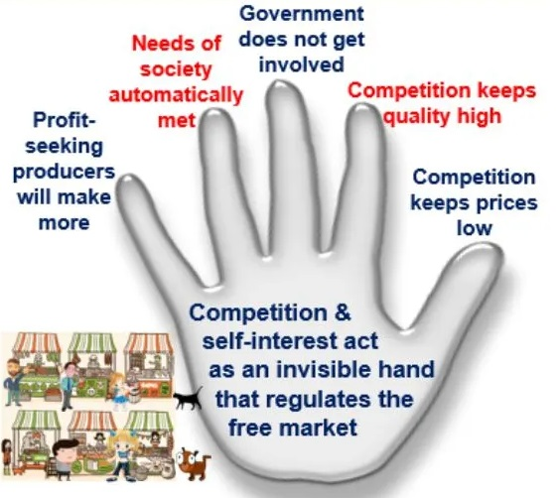
Invisible Hand Principle
Laissez-faire
Western world view
each of you look not only to his own interests,
Notes:
An example of this can be found in a theory of economics.
Adam Smith, in his book Wealth of Nations, talks about an invisible hand principle. This is also known as laissez-faire economics.
This has become a staple of the classic western world view and capitalism.
The problem is that these economic principles do not account for greed or corruption.
So what is the answer?

Slide 22
You should have the same attitude toward one another that Christ Jesus had (NET)
⁵ Have this mind among yourselves,
which is yours in Christ Jesus,
Notes:
Read these verses in both ESV and NET
The answer is to look to Jesus. See the example that Jesus sets and imitate him.

Slide 23
Jesus’ example of humility challenges Christians to live a life of unselfishness and unity.
Philippians 2
Notes:
When we look to Jesus, we see “Jesus’ example of humility challenges Christians to live a life of unselfishness and unity.”
That is the main idea of Philippians 2. Why should we be humble? Not just to make Paul’s joy complete, but because we are imitating Jesus.
We want our lives to look like his life.

Slide 24
You should have the same attitude toward one another that Christ Jesus had (NET)
⁵ Have this mind among yourselves,
which is yours in Christ Jesus,
⁶ who, though he was in the form of God,
did not count equality with God a thing to be grasped,
⁷ but emptied himself,
by taking the form of a servant,
being born in the likeness of men.
⁸ And being found in human form,
he humbled himself
by becoming obedient to the point of death,
even death on a cross.
Notes:
Before we continue and see what did Jesus’ life look like, I want to point out that we see the word mind for the third time.
And yes, it is from the same Greek word froneo. First it was a subjunctive verb, then a participle, here it is an imperative verb, a command. We are commanded to have the same attitude toward one another that Christ Jesus had.
What follows in vs 6-11 is sometimes known as the Christ hymn. This is believed to be an existing poem or liturgy recited by the church that Paul used. What is significant is that this shows that the early church had a very high view of who Jesus was.
Although it took several hundred years for the church to develop the the word and doctrine of the trinity, these early writings demonstrate the early Christians knew Jesus was God. They just didn’t have a creed or statement of beliefs that we have today.

Slide 25
4.2 Jesus Christ – Jesus Christ is the unique Son of God who is at the same time very God and very man. He was conceived by the Holy Spirit and born of the Virgin Mary, lived a sinless life but suffered and died in the place of sinful man, was buried, resurrected, ascended bodily into heaven, and will return one day in power and authority to earth to establish His earthly kingdom
(John 1:1-14; 14:1-3; Philippians 2:5-11; Revelation 5:10; 19:11–20:6).
www.cicfamily.com

Slide 26
You should have the same attitude toward one another that Christ Jesus had (NET)
⁵ Have this mind among yourselves,
which is yours in Christ Jesus,
⁶ who, though he was in the form of God,
did not count equality with God a thing to be grasped,
⁷ but emptied himself,
by taking the form of a servant,
being born in the likeness of men.
⁸ And being found in human form,
he humbled himself
by becoming obedient to the point of death,
even death on a cross.
Notes:
Back to the Christ hymn,

Slide 27
⁹ Therefore God has
highly exalted him and
bestowed on him the name that is above every name,
¹⁰ so that at the name of Jesus
every knee should bow,
in heaven and on earth and under the earth,
¹¹ and every tongue confess that Jesus Christ is Lord,
to the glory of God the Father.
Jesus | God | Result
Emptied | Exalted | Knee Bow
Humbled | Bestowed | Tongue Confess

Slide 28
⁹ Therefore God has
highly exalted him and
bestowed on him the name that is above every name,
¹⁰ so that at the name of Jesus
every knee should bow,
in heaven and on earth and under the earth,
¹¹ and every tongue confess that Jesus Christ is Lord,
to the glory of God the Father.
Why humble ourselves?
Notes:
Why do we humble ourselves? Is it so that we will be exalted just as Jesus was exalted?
CERTAINLY NOT!
We humble ourselves to the glory of God the Father.
We humble ourselves because Jesus’ example of humility challenges us to live not for ourselves, but for others.

Slide 29
¹² Therefore, my beloved,
as you have always obeyed,
so now, not only as in my presence
but much more in my absence,
Phil 1:27
Only let your manner of life be worthy of the gospel of Christ, so that whether I come and see you or am absent,
Notes:
No notes until the last slide

Slide 30
¹² Therefore, my beloved,
as you have always obeyed,
so now, not only as in my presence
but much more in my absence,
work out your own salvation

Slide 31
4.7 Salvation – Salvation is God’s act of forgiving sin based on the shed blood of Christ, reconciling people to Him, and giving eternal life to those who believe in Jesus. To be saved from the power and eternal penalty of sin, a person must admit that he/she is a sinner, repent and believe that Jesus died and rose again, and receive the Lord Jesus Christ personally as the only Savior. As a result, that person receives a new nature and becomes a true born-again Christian. Salvation is not a reward for good works but a free gift of God received by faith in Jesus Christ (Ephesians 2:1-10; John 3:3-8; 1 John 5:11-13).
www.cicfamily.com

Slide 32
¹² Therefore, my beloved,
as you have always obeyed,
so now, not only as in my presence
but much more in my absence,
work out your own salvation
with fear and trembling,
¹³ for it is God who works in you,
both to will
and to work
for his good pleasure.
Phil 1:6
And I am sure of this, that he who began a good work in you will bring it to completion at the day of Jesus Christ.

Slide 33
¹⁴ Do all things without grumbling or disputing,
¹⁵ that you may be blameless and innocent,
children of God without blemish in the midst of a crooked and twisted generation,
among whom you shine as lights in the world,
World | God’s Children
Crooked and twisted | Blameless and innocent
Selfish ambition & conceit | Count others more significant
Look after own interests | Also look after interest of others

Slide 34
¹⁴ Do all things without grumbling or disputing,
¹⁵ that you may be blameless and innocent,
children of God without blemish in the midst of a crooked and twisted generation,
among whom you shine as lights in the world,
Matt 5:14-16
¹⁴ “You are the light of the world. A city set on a hill cannot be hidden. ¹⁵ Nor do people light a lamp and put it under a basket, but on a stand, and it gives light to all in the house. ¹⁶ In the same way, let your light shine before others, so that they may see your good works and give glory to your Father who is in heaven.
Notes:
As Christians, our light is often seen as the fruit of our labor, as a visible sign or a work of faith,
but it can also be seen as our humble attitude, counting others as significant, putting others before ourselves.

Slide 35
¹⁴ Do all things without grumbling or disputing,
¹⁵ that you may be blameless and innocent,
children of God without blemish in the midst of a crooked and twisted generation,
among whom you shine as lights in the world,
¹⁶ holding fast to the word of life,
so that in the day of Christ I may be proud
Phil 1:6
And I am sure of this, that he who began a good work in you will bring it to completion at the day of Jesus Christ.

Slide 36
¹⁴ Do all things without grumbling or disputing,
¹⁵ that you may be blameless and innocent,
children of God without blemish in the midst of a crooked and twisted generation,
among whom you shine as lights in the world,
¹⁶ holding fast to the word of life,
so that in the day of Christ I may be proud
that I did not run in vain or labor in vain.
¹⁷ Even if I am to be poured out as a drink offering upon the sacrificial offering of your faith,
I am glad and rejoice with you all.
¹⁸ Likewise you also should be glad and rejoice with me.
Phil 1:21
For to me to live is Christ, and to die is gain.

Slide 37
Jesus’ example of humility challenges Christians to live a life of unselfishness and unity.
Philippians 2
Notes:
Humility is essential for human relationships.
With humble attitudes and acts of love, we can repair the strained relationships in our lives.
Humility is also essential for a relationship with God.
Paul writes in Romans, "I am not ashamed of the gospel, for it is the power of God for salvation to everyone who believes… If you confess with your mouth that Jesus is Lord and believe in your heart that God raised him from the dead, you will be saved."
But then he warns that "… the wrath of God is revealed from heaven against all ungodliness and unrighteousness of men, who by their unrighteousness suppress the truth."
So what is it that keeps people from bending their knee and proclaiming that Jesus is Lord?
PRIDE! Pride says that I am good enough as I am.
Pride says that I am responsible for all the good things in my life, I did it all on my own.
Pride says that I don’t need any help.
But humility acknowledges that we are nothing without God,
Humility knows that we exist for his glory.
Humility allows us to fulfill the great commandment, to love others as we love ourselves.
Have you humbled yourself before God?
Have you repented, admitting you are a sinner, and turning too God, turning away form the world
Have you believed that Jesus died, and rose again?
If you have, you can stand on the promises of God, promises that will not fail, promises that we are cleansed by the blood of Christ, and that we will spend eternity with the God of glory.
If not, I ask that today you bend your knee and confess that you need Jesus as Lord of your life
Let us Pray:

Slide 38
Black

Slide 39
NT Preaching link at BibleStudyDownloads.org
Get this presentation and script for free!
Notes:
NT Preaching (np)

