Slide 1
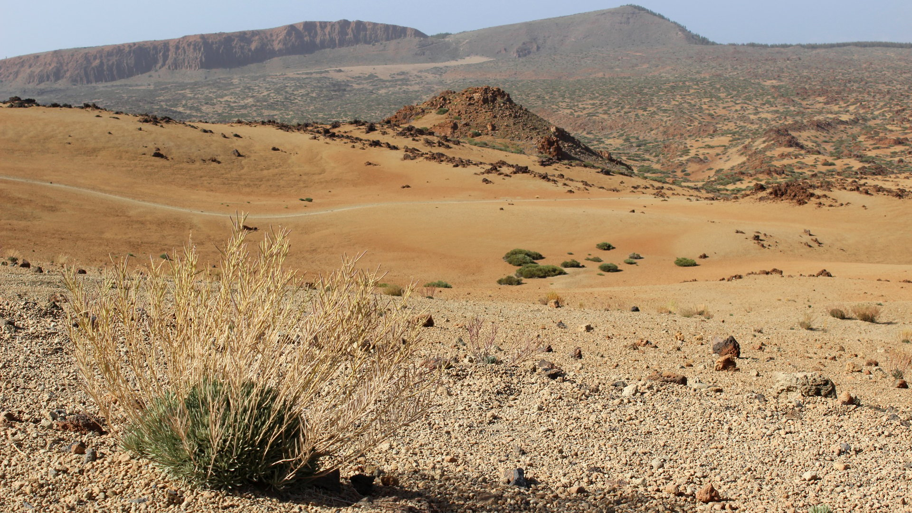
Philippians 4:10 - 13
Learning Contentment
Dr Rick Griffith Redeemer Bible Church, Fort Worth, TX & JETS Uploaded by Dr. Rick Griffith • Jordan Evangelical Theological Seminary (JETS) Files in many languages for free download at BibleStudyDownloads.org

Slide 2
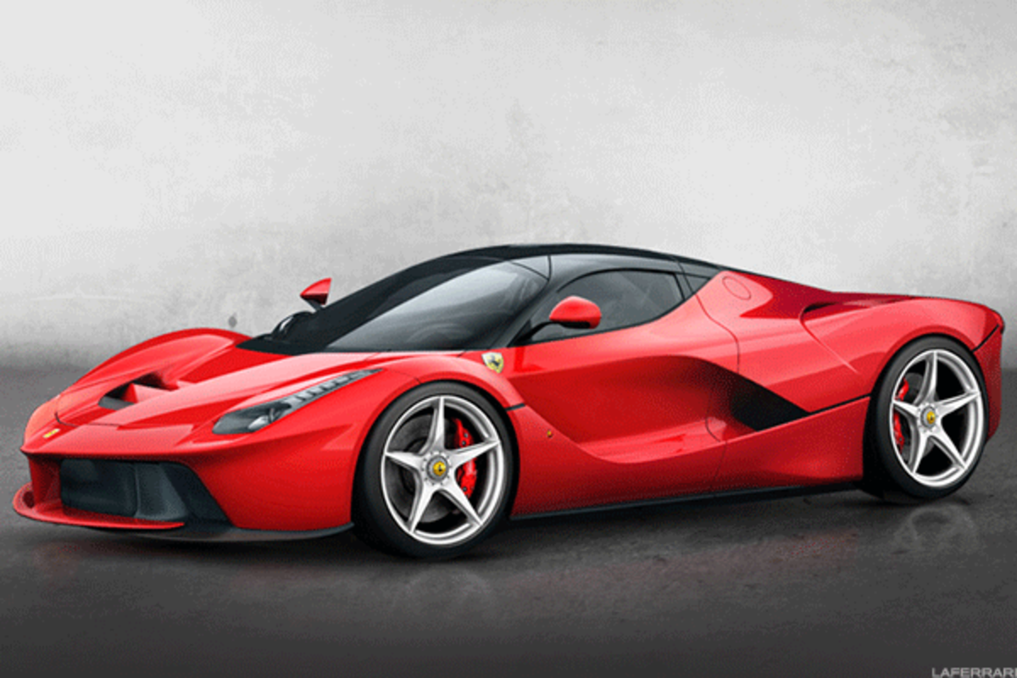
Everything around us tells us we don’t have everything we need to be happy!
Notes:
I wonder if you would agree with me that most people aren’t content. Are most of us satisfied with our possessions or situation in life?
We compare ourselves with others. It seems that others always have more things or more likes on Facebook or more views on YouTube.
Our ambition makes us never feel we have enough. Whoever said that they don’t need more money?
We want to please others and feel that they will never be happy with us.
So, how are you doing today? Is your contentment related to how much appreciation you receive?

Slide 3
Are you content?
Notes:
Are you happy with how others drive?
Do you wish others would change their behavior?
Would those who know you best say that you are content?

Slide 4
What are we often discontent about?
Financial situation
Not being married
Our kids
Our jobs
Foreign culture
Our looks
Our teachers
Traffic
Possessions
Spouse
Sexual fulfillment
Our ministries
Our friends
Our abilities
Our students
Being busy

Slide 5
What is Contentment?
Definition:
Being confident that you have all that you need for whatever you're facing
Therefore, being at peace (satisfied) with your current situation
Notes:
Do you want to live like this? I do!

Slide 6
That Vital Question:
What is the secret of contentment?
Notes:
How can we live with optimism above life’s circumstances?

Slide 7
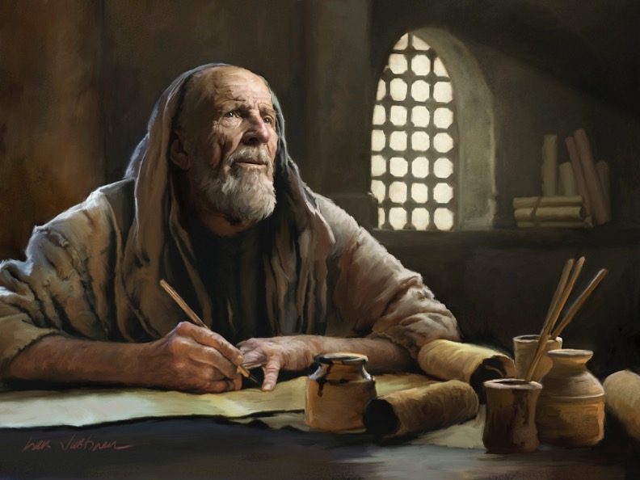
Background
Notes:
What if we found a letter written to a prisoner to cheer him up? Would that help us learn contentment?
Now switch it around. Today we will look at a letter written by the content prisoner and sent to discontented free people.
Paul was content in prison writing to discontent people who were free.

Slide 8
NT Overview (Paul's Letters)
38 124 39-41
"To the remotest part of the earth" (Acts 1:8)
Acts 9 13 14 15 16 18 21 27 28
Apr 48- Sep 49
1 Galatia
Apr 50- Sep 52
2 Aegean
Spr 53- May 57
3 Asia
Feb 60- Mar 62
1 Rome
Spr 62- Fall 67
4 Spain
Aut 67- Spr 68
2 Rome
Summer 35- 37
Damascus Antioch
May 57- Aug 59
Trials
Fall 49
The
Council
Spring 68
Expansion of Church
35 48 49 50 52 53 57 60 62 67 68 95
Matt
Luke
Acts
Mark
John
Gal
1 Thess
1 Cor
Eph
1 Tim
2 Tim
2 Thess
2 Cor
Col
Titus
Missionary
Pastoral
Romans
Philem
Gospels & Acts
Phil
Pauline Epistles
1234
Journeys
Prison
Rome
Imprisonments
Pauline
Notes:
Paul had already written six missionary letters and three prison letters. Philippians was written near the end of Paul's 2-year Roman imprisonment. He wasn't sure which way it should end—release or death—but he knew he would soon be free either way!

Slide 9
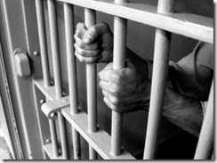
What if a joyful prisoner could give us some advice?
Notes:
Today we will see what a joyful prisoner can tell us about contentment.

Slide 10
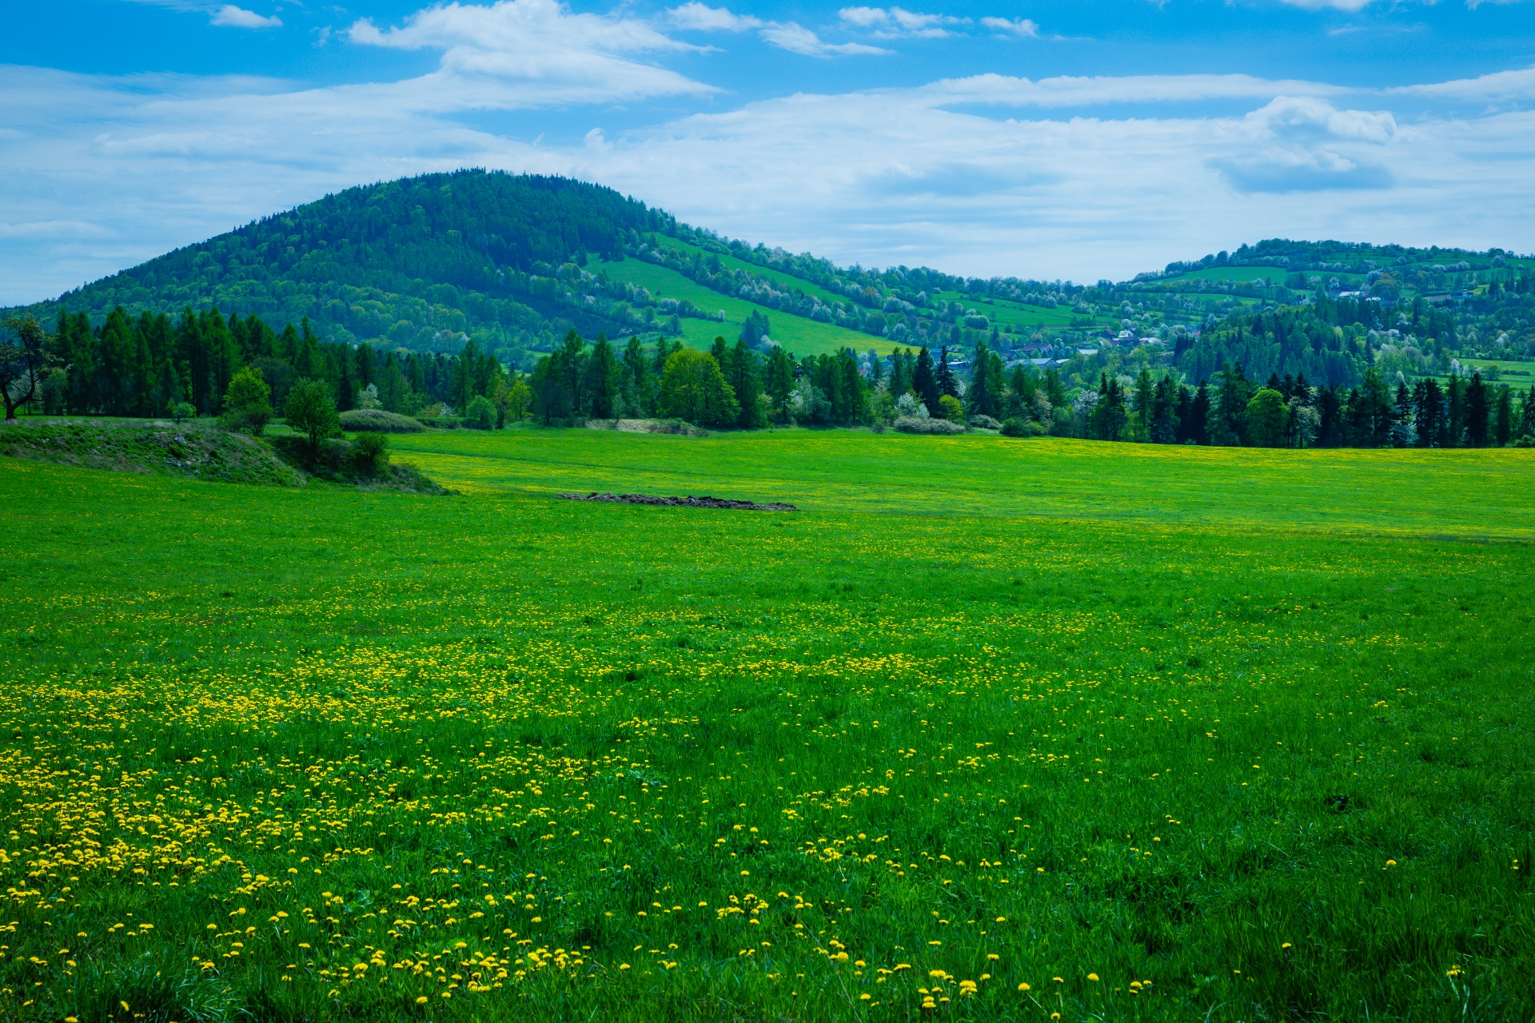
How I praise the Lord that you are concerned about me again. I know you have always been concerned for me, but you didn’t have the chance to help me. Not that I was ever in need, for I have learned how to be content with whatever I have.
Philippians 4:10-11 NLT
Notes:
Let’s read Phil 4:10-13. These verses will answer how we can be content…

Slide 11
I know how to live on almost nothing or with everything. I have learned the secret of living in every situation, whether it is with a full stomach or empty, with plenty or little. For I can do everything through Christ, who gives me strength.
Philippians 4:12-13 NLT
Notes:
(Paul does not immediately tell us contentment’s secret but he does say that…)

Slide 12
I. It’s good to thank God and people —even though that’s not the secret (10).
¹⁰ I rejoiced in the Lord greatly that now at length you have revived your concern for me. You were indeed concerned for me, but you had no opportunity.
It had been a long time since they had shown their concern for Paul
Paul had “rejoiced greatly” at their gift
Notes:
Be a grateful person.

Slide 13
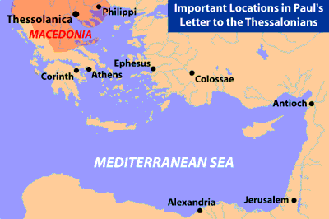
Philippians Supported Paul in Thessalonica
腓利比
腓利比人在帖撒罗尼迦 支持保罗
帖撒罗尼迦
Thessalonica
马其顿
以弗所
哥林多
雅典
歌罗西
安提阿
地中海
亚历山大
耶路撒冷
Notes:
The church had supported him during a time of great need in nearby Thessalonica.
He didn’t just thank the church, but he credited God for putting it on their hearts to help him.
I think people need to know that they have been an answer to prayer.

Slide 14
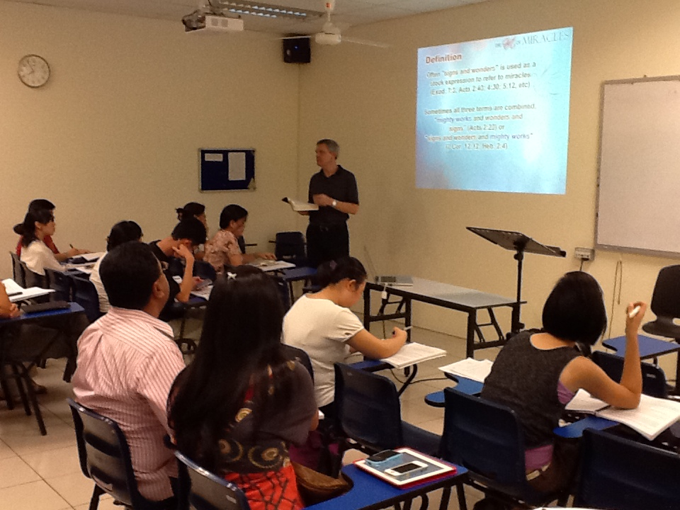
Singapore Bible College
9
Notes:
We thank God for his faithful support over the past 43 years on support!
He faithfully provided for us for 30 years while we were in Singapore.
We thank God for the many that supported us!

Slide 15
Are you grateful?
Notes:
Are you a grateful person?
What percentage of the statements that you make every day are positive? I know some people that make over 90% of their speech negative.
“Contentment is simply gratitude, appreciation, and acceptance for the way things are right now.”
If you can be thankful for how things are right now, then your gratefulness will always be current!
_________
Julie Rosenberg, “Sustainable Happiness: How to Find Contentment That Will Last,” https://www.happify.com/hd/sustainable-happiness-how-to-find-contentment-that-will-last/

Slide 16
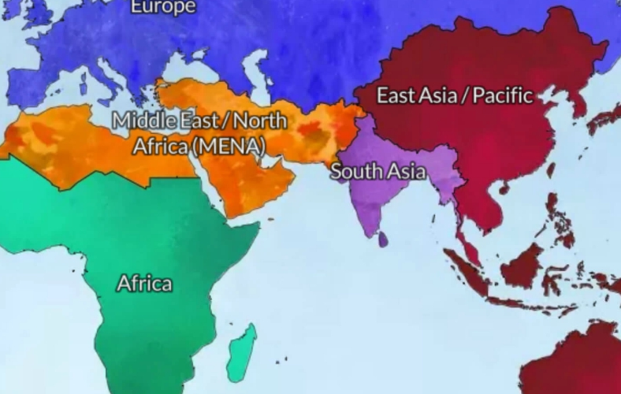
From East to West
Jordan
Singapore
Notes:
It is a refreshing change from the Chinese world to the Arab world.
___________
Common-117

Slide 17
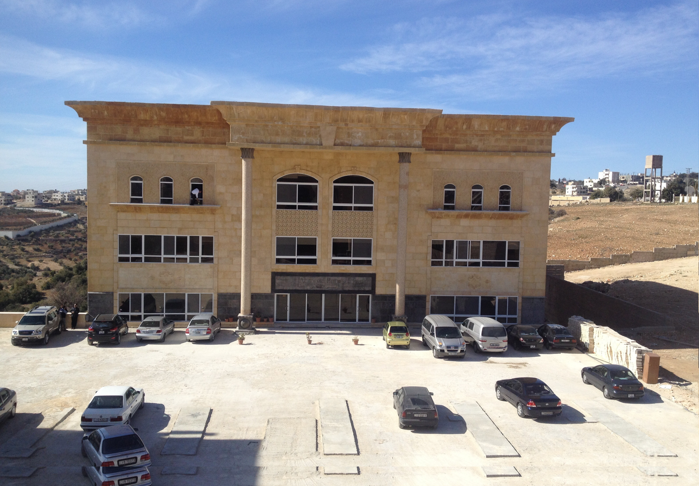
Jordan Evangelical Theological Seminary (JETS)
Notes:
We are grateful to be at JETS

Slide 18
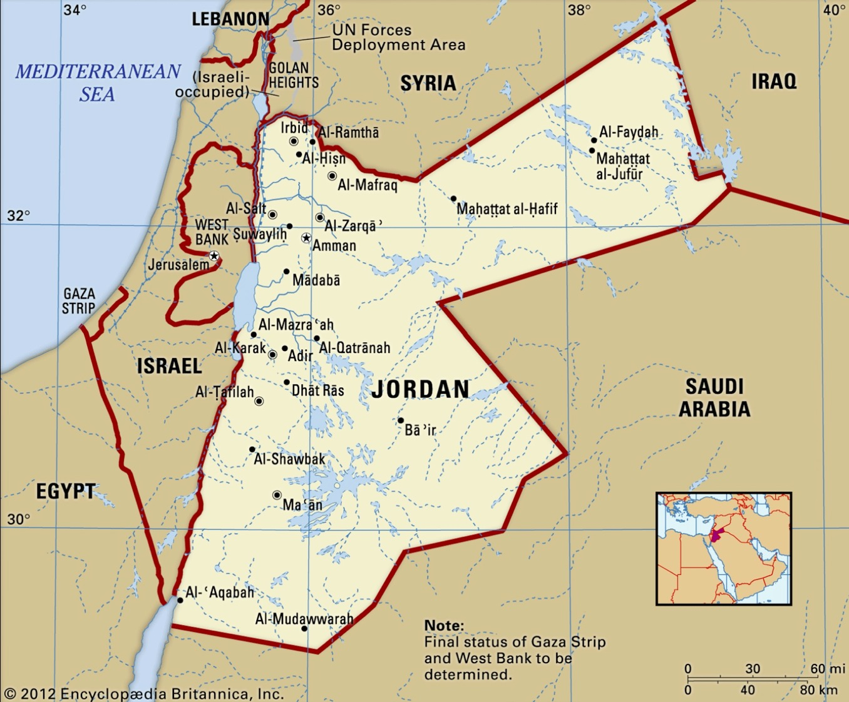
60 Jordan Evangelical Churches
JETS Lead Pastors
Other Seminaries
Notes:
We knew that shifting to Jordan would require more support and that Jordan has more water issues than nearly any nation with the falling level of the Sea of Galilee, the Jordan River, and the Dead Sea. But we could move to join a school providing 50% of Jordan’s pastors!

Slide 19
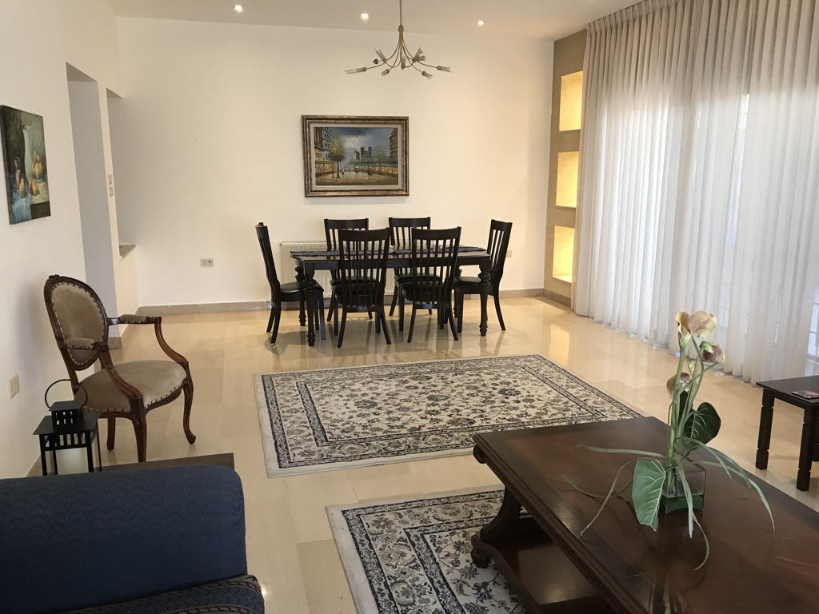
Our Jordan Apartment
Notes:
But we just thanked God in advance for meeting our needs—and our Singapore church sent us out with the commitment to pay our rent, plus we ended up getting an apartment with a freshwater well underneath—no water issues!
(Before telling us the secret of contentment, Paul tells us where it is NOT found…)

Slide 20
II. Don’t think that contentment comes from having your needs met (11a).
¹¹ Not that I am speaking of being in need...
Clarification: Paul’s joy had not been at his needs being met by their gift.
Paul had not seen himself as being “in need” because he had learned to be content.
Notes:
Satisfaction isn’t found in getting your way.
Paul needed food, clothes, and shelter just like we all do.
But he trusted God whether these needs were met or not.

Slide 21
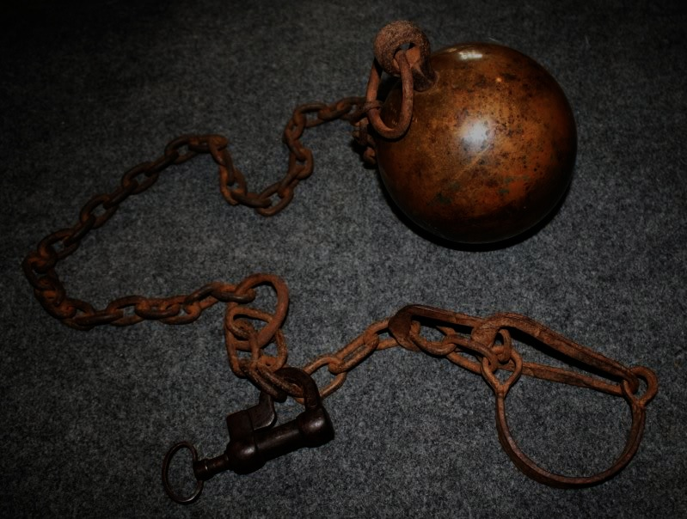
An Imaginary Dialogue…
Persecutors
Paul
185-186
"Aha! You like to share about Jesus? I'll imprison you!"
"Good! This will give me more time to pray, write letters to the churches, and share Christ to each soldier guarding me."
"Well, then, I'll torture you!"
"Thank you, for in this way I can share in the sufferings of my Master, Jesus."
"Oh yeah? Then I'll kill you!"
"This is the best option yet, for then you'll usher me into his presence!"
Notes:
Imagine Paul’s conversation with his persecutors where they couldn’t stop him from being thankful…

Slide 22
Who was really chained?
Notes:
There are miserable billionaires and grateful poor folks.
My experience is to see more appreciation from the poor than from the rich.
We find more contentment in poor Jordan than in rich Singapore.
(Is there a simple way to the secret of contentment? Not really. In verses 11b-12 Paul says that…)

Slide 23
III. Contentment is a learned trait (11b-12).
…for I have learned in whatever situation I am to be content. ¹² I know how to be brought low, and I know how to abound. In any and every circumstance, I have learned the secret of facing plenty and hunger, abundance and need.
Paul had “learned the secret” of being content regardless of (and through) his circumstances!
Notes:
[We all have to grow in contentment.]
The reason Paul could be content was because he had learned the secret of contentment despite his circumstances (11b-12).
Even the great Apostle Paul had to learn contentment!
You can see this progression in his letters, beginning with his dissatisfaction with the Galatians in his first letter.
By the time he wrote this letter to the Philippians, he had been in prison the past four years—two years in prison in Caesarea, interrupted by a shipwreck, and then two years under house arrest in Rome.
But he said that learning contentment for him was a process.

Slide 24
What does it mean to "be content" (4:11-12)?
autarkes = autos ("self") + arkeo ("sufficient")
Notes:
The Greek word literally means “self-sufficient.”

Slide 25
Explaining autarkes...
"The Stoics used this word (which occurs only here in the NT) to mean human self-reliance and fortitude, a calm acceptance of life's pressures. But Paul used it to refer to a divinely bestowed sufficiency, whatever the circumstances."
Robert Lightner, in The Bible Knowledge Commentary, 2:664 (emphasis his)
Notes:
But Paul applied it to divine sufficiency…
___________
John F. Walvoord, Roy B. Zuck and Dallas Theological Seminary., The Bible Knowledge Commentary : An Exposition of the Scriptures (Wheaton, IL: Victor Books, 1983-c1985), 2:664.

Slide 26
Understanding the Secret – How do we Get It?
¹² I know how to be brought low, and I know how to abound. In any and every circumstance, I have learned the secret of facing plenty and hunger, abundance and need.
There are no short cuts! Life is the classroom. It is through wrestling through life’s circumstances that we learn contentment!

Slide 27
Experiences God Used to Teach Paul
Brought low – humbled; poor and needy
Abound – to be in excess; to overflow
Plenty – to be filled or satisfied (with food)
Hunger – To be famished; without food
Abundance – to be in excess; to overflow
Need – To be destitute
Notes:
Paul applied contentment to three contrasts.

Slide 28
Learn...
CONTENTMENT
"And having food and clothing, with these we shall be content" 1 Timothy 6:8
Notes:
Paul later applied it only to food and clothing.

Slide 29
We start out discontent.
Notes:
We start out discontent as babies and have to learn contentment.
Is contentment a choice? If we think it is something that happens to us, then we have confused it with happiness.
Happiness is based on happenings, so anyone can be happy. There is no virtue in enjoying the easy things happening to you.

Slide 30
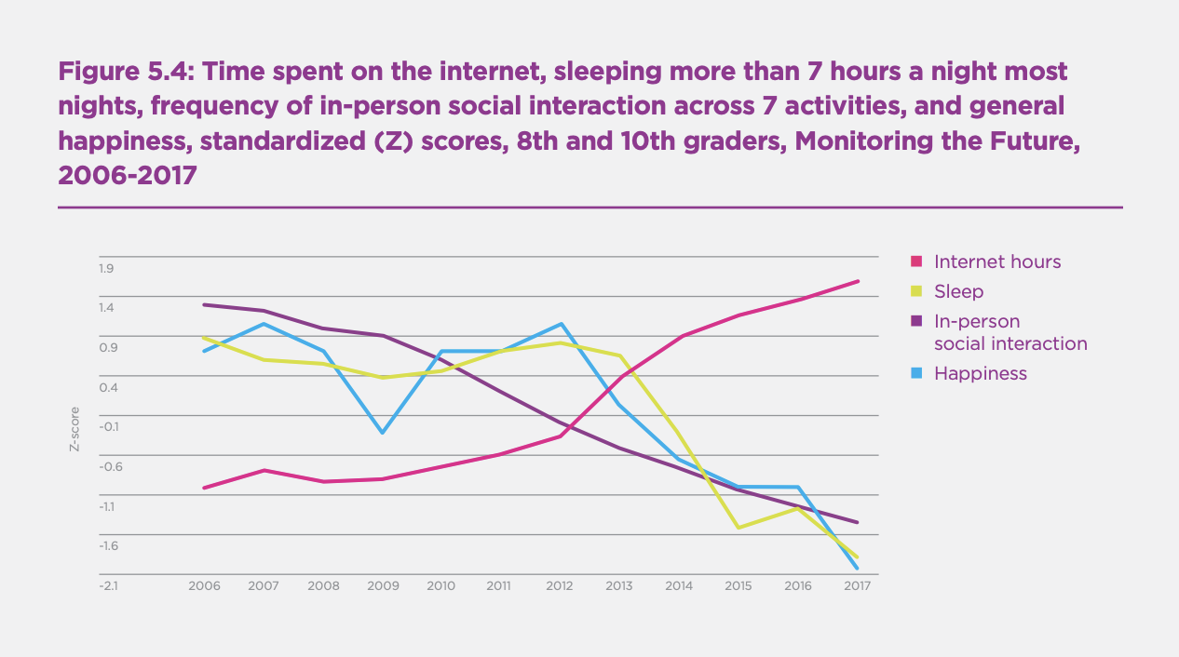
More Internet = Less Happiness
Internet hours
Sleep
In-person social interaction
Happiness
Notes:
But contentment can be learned—isn’t that encouraging? One study shows that the more internet, the less sleep, in-person social interaction, and less happiness.
One of my goals is to be increasingly content in each of the remaining years of my life.
Susan and I seek to be easy to take in as guests. We don’t want our hosts to sigh when they close the door after we leave.
I think it would be great to be the most content when I take my last breath!
_____________
https://www.tampabay.com/data/2019/03/20/us-falls-in-world-happiness-report-finland-named-happiest-country/

Slide 31
That Vital Question:
What is the secret of contentment?
Notes:
(So what is the secret of contentment? Where can we find it? The climax is in verse 13 where Paul reveals that…)

Slide 32
IV. Contentment comes by trusting in Christ’s strength (13).
¹³ I can do all things through him who strengthens me.
It was Christ who enabled Paul to be content
Notes:
[You can’t be satisfied in your own power—only in the power of Jesus.]

Slide 33
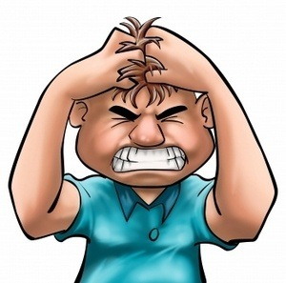
"He makes me so mad!"
"He makes me so happy!"
Notes:
The secret of contentment for Paul was Christ’s strength (13).
As an example, Jesus gives us the strength to control anger.
• Sometimes we say, “He makes me so mad!” But do we really think about what this reveals about us? Is our anger in the hands of someone else? Maybe so! Maybe our contentment is controlled by somebody other than us.
• So we also depend on someone else to make us happy as well.
Really? Your anger or contentment is based on somebody else?!!

Slide 34
Philippians 4:13
I can do EVERYTHING through HIM who gives me STRENGTH
Notes:
It is much better to find that Christ gives us the strength and power to control our temper. How much better to have our contentment in him.

Slide 35
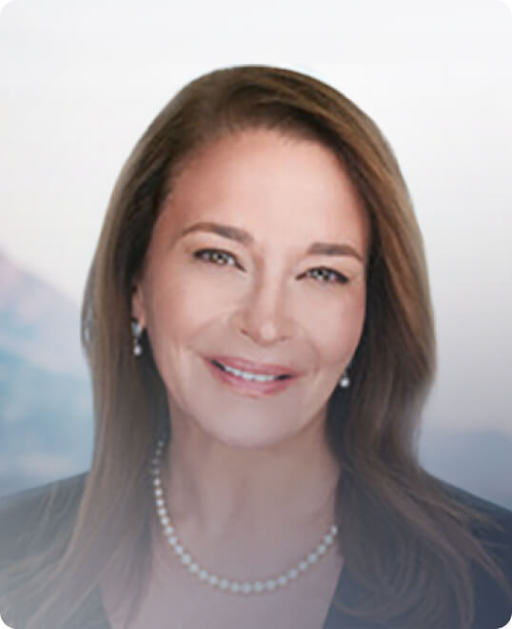
“Most of us have been taught to believe that happiness is linked to our accomplishments. We think, ‘I’ll be happy when I get married’ or ‘I’ll be more satisfied at work when I get a promotion.’ We are convinced we’ll find joy when we finally run a marathon or buy that luxury car. The truth is that we can create a feeling of happiness right now, regardless of our circumstances.”
Yoga teacher Julie Rosenberg
Notes:
How are you trying to be content in your own strength?
[Read quote]
Really? Do we create it?
• This is the worldly philosophy of yoga teacher Julie Rosenberg.
________________________
Julie Rosenberg, “Sustainable Happiness: How to Find Contentment That Will Last,” https://www.happify.com/hd/sustainable-happiness-how-to-find-contentment-that-will-last/

Slide 36
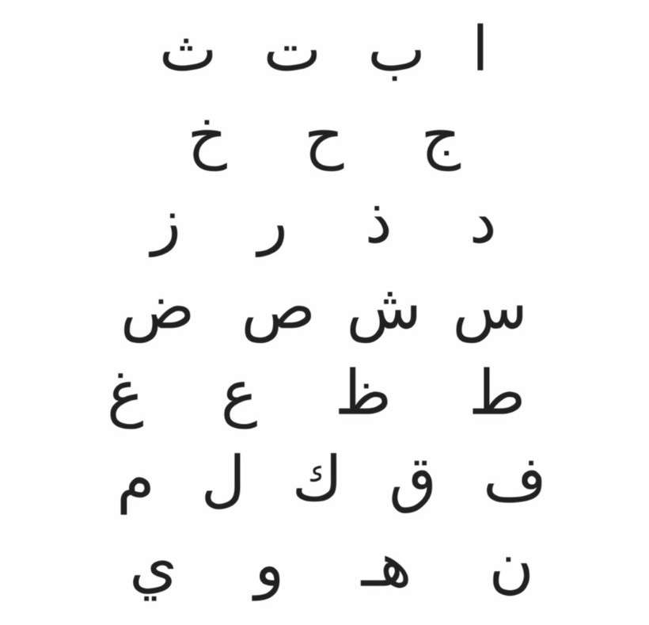
Arabic
د. ريك غريفيث
Dr. Rick Griffith
Notes:
Many times we claim that we cannot do something—I cannot learn Arabic in my 60s, I cannot move to the Middle East, I cannot… you fill in the blank for you! For me, I was tempted to say, “I can’t learn these 28 consonants that can each be written four different ways!”
• But God helped me learn to read this.
• It means “Dr Rick Griffith.”

Slide 37
…can't…
…won't…
…can…
Notes:
Philippians 4:13 reveals that when we say, “I can’t do this,”
• we are really saying, “I won’t do this.”
• In fact, learning this truth years ago has stopped me from saying “I can’t” because I know that contentment and ability are found in Christ, in whom I can do everything.

Slide 38
That Vital Question:
What is the secret of contentment?
Notes:
(So what is the secret of contentment? How can we live with optimism above life’s circumstances? Where can we find it? How can we sum up what Paul is saying in today’s text? Simply this…)

Slide 39
Main Idea
Learn contentment by relying on Christ’s strength.
Notes:
The secret of our contentment despite our circumstances is growing in trusting the power of Jesus (restatement).

Slide 40
Learning Contentment
What are you often discontent about?
Financial situation
Not being married
Our kids
Our jobs
Foreign culture
Our looks
Our teachers
Traffic
Possessions
Spouse
Sexual fulfillment
Our ministries
Our friends
Our abilities
Our students
Being busy
Where would God have you start?

Slide 41
Think About It: How to Learn Contentment
Where have you been trusting in your own strength to be content?
Admit to Jesus that he is stronger than you.
Trust Jesus with that specific area where your contentment is challenged.

Slide 43
NT Preaching link at BibleStudyDownloads.org
Get this presentation for free!
Notes:
NT Preaching (np)

