Slide 1
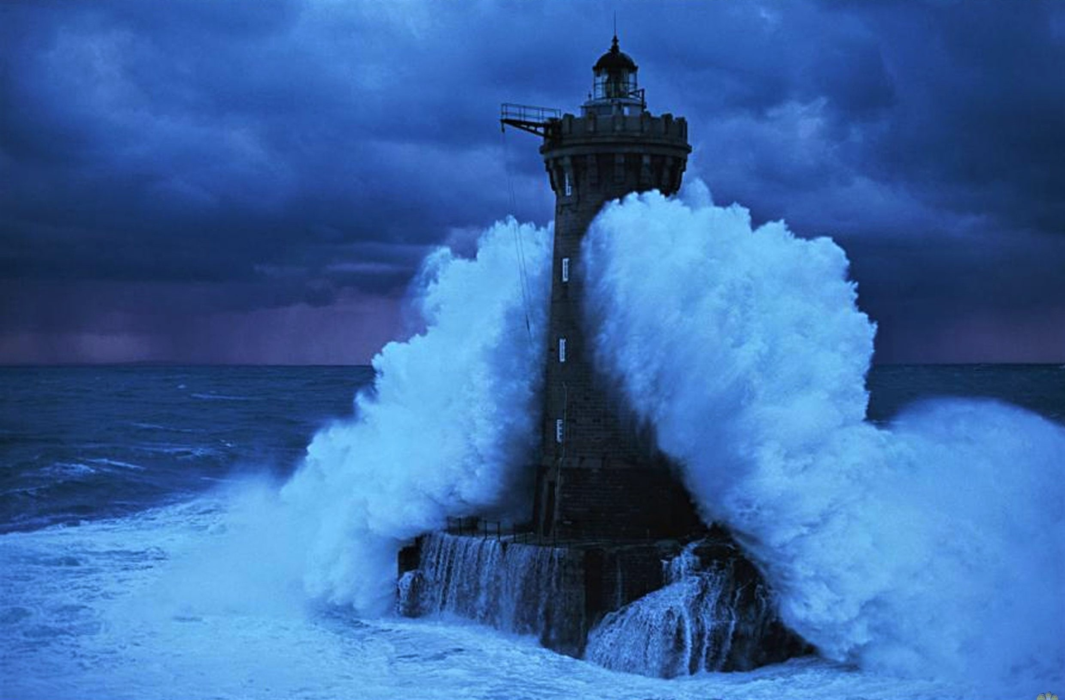
Philippians 3:17-4:1
Standing Firm for the Cross!
Dan Bridges Amman International Church, Jordan (AmmanChurch.org) Uploaded by Dr. Rick Griffith • Jordan Evangelical Theological Seminary Files in many languages for free download at BibleStudyDownloads.org

Slide 2
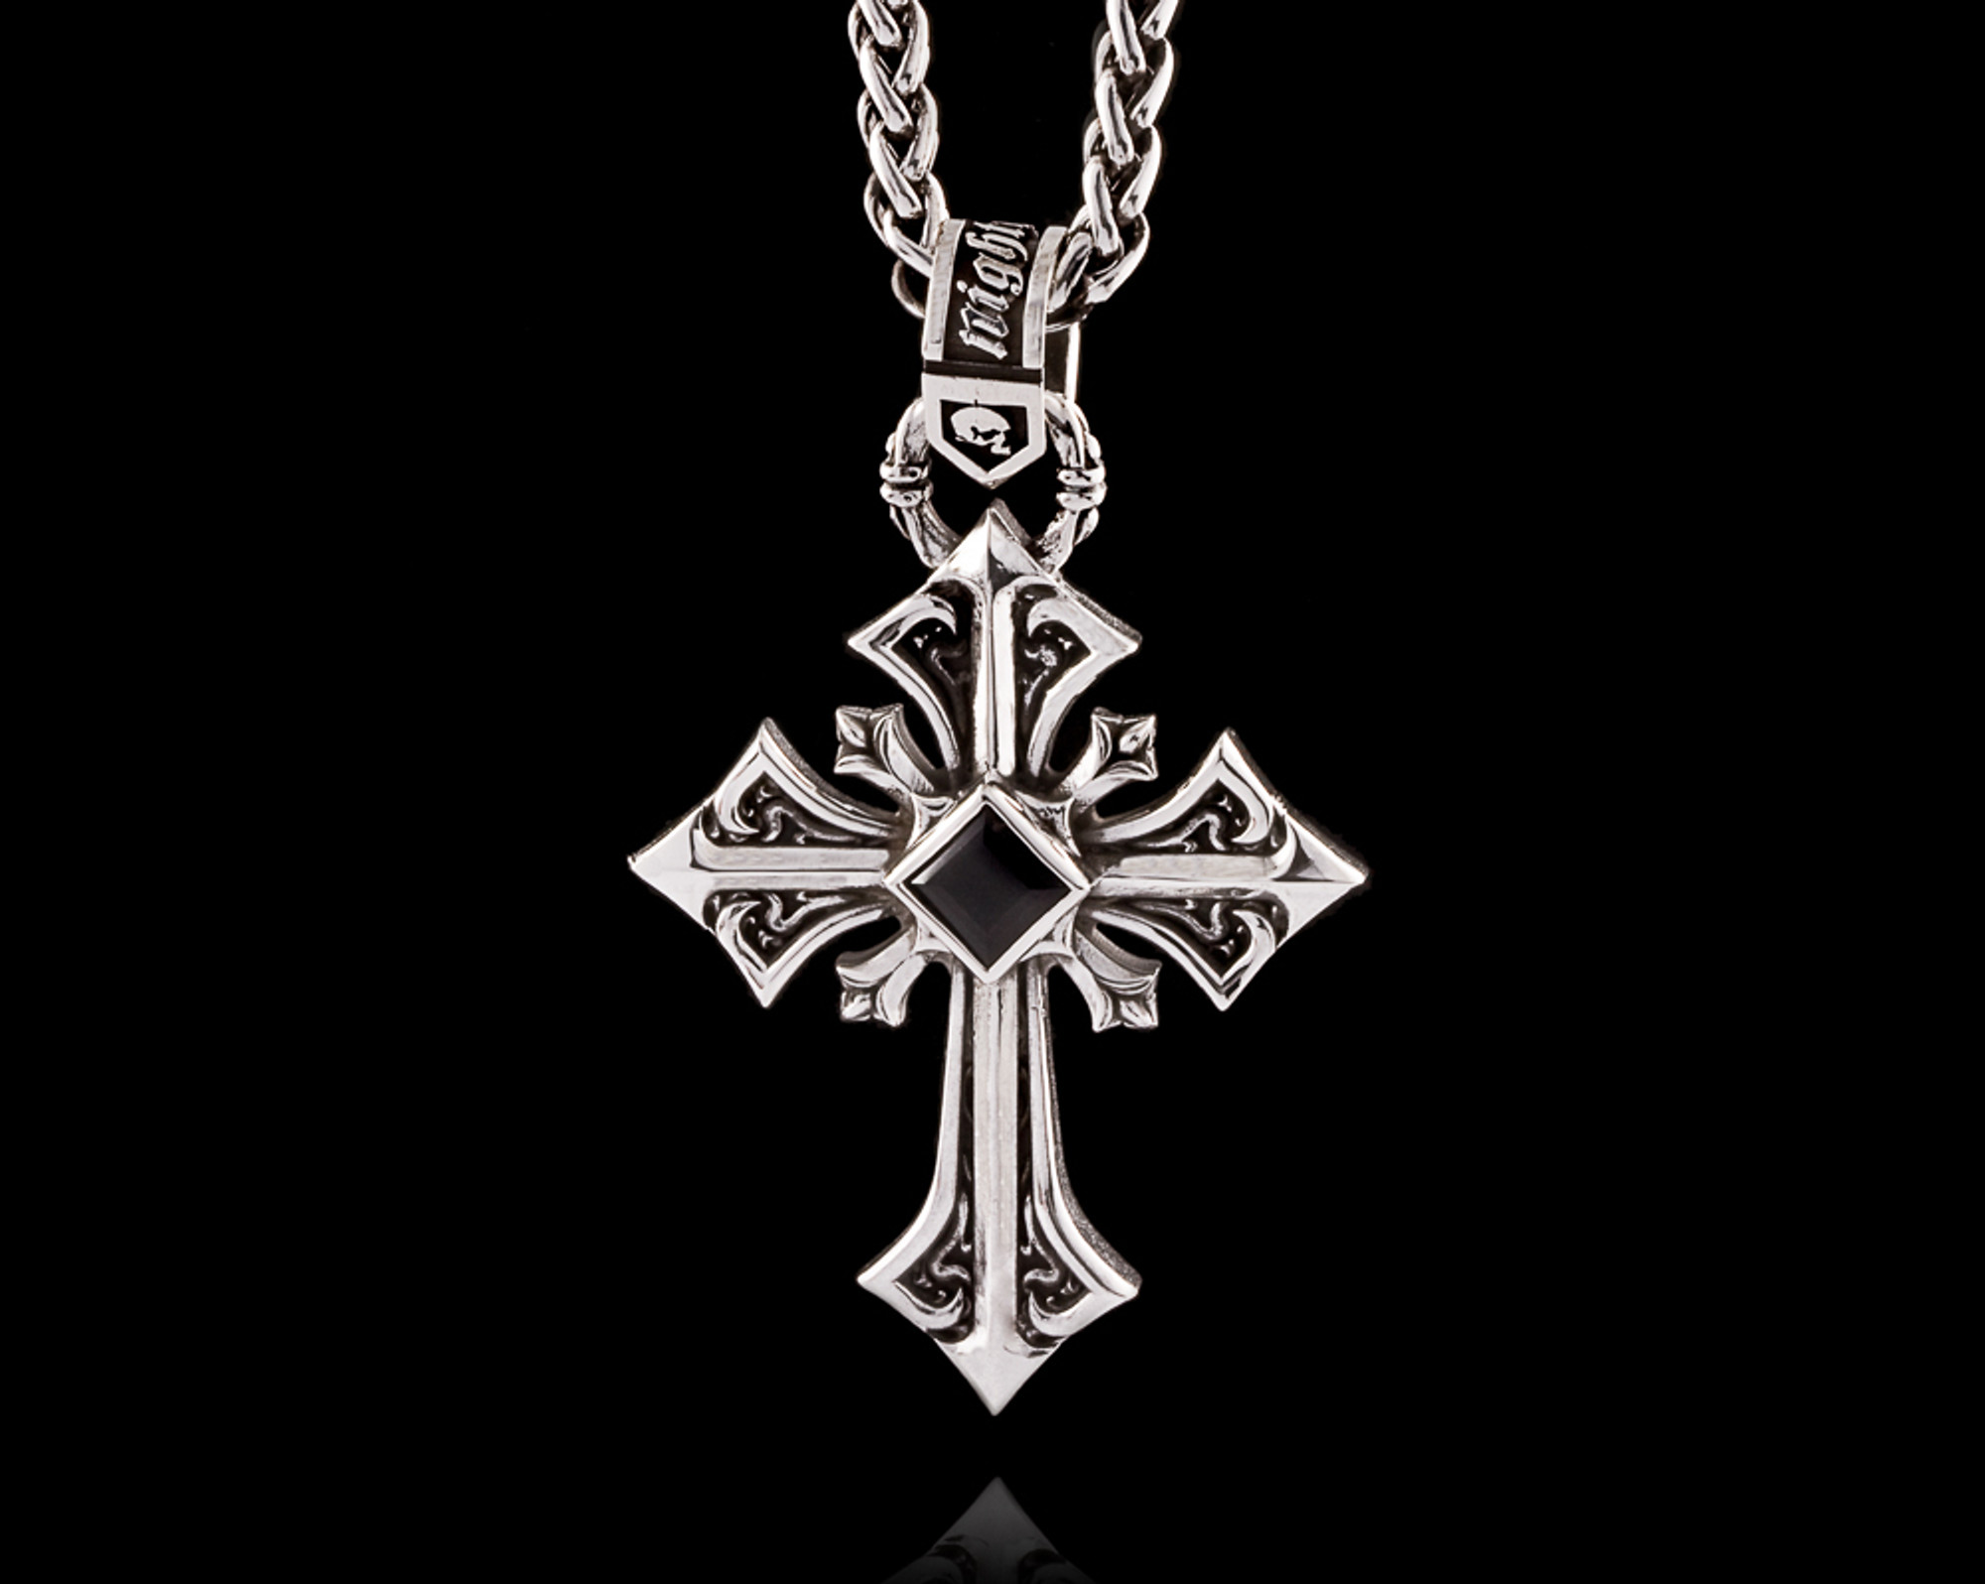
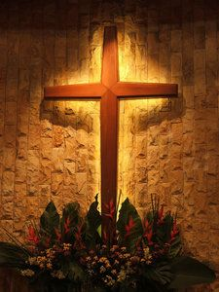
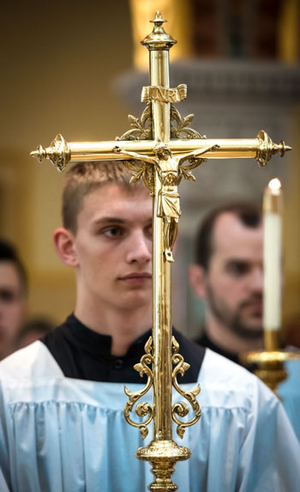
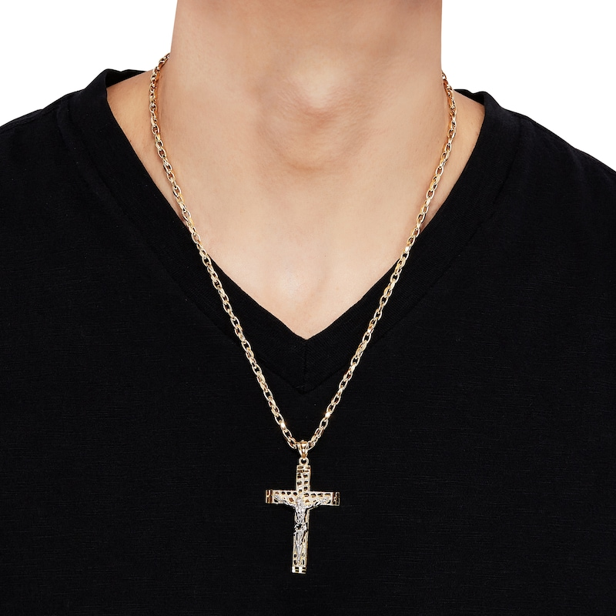
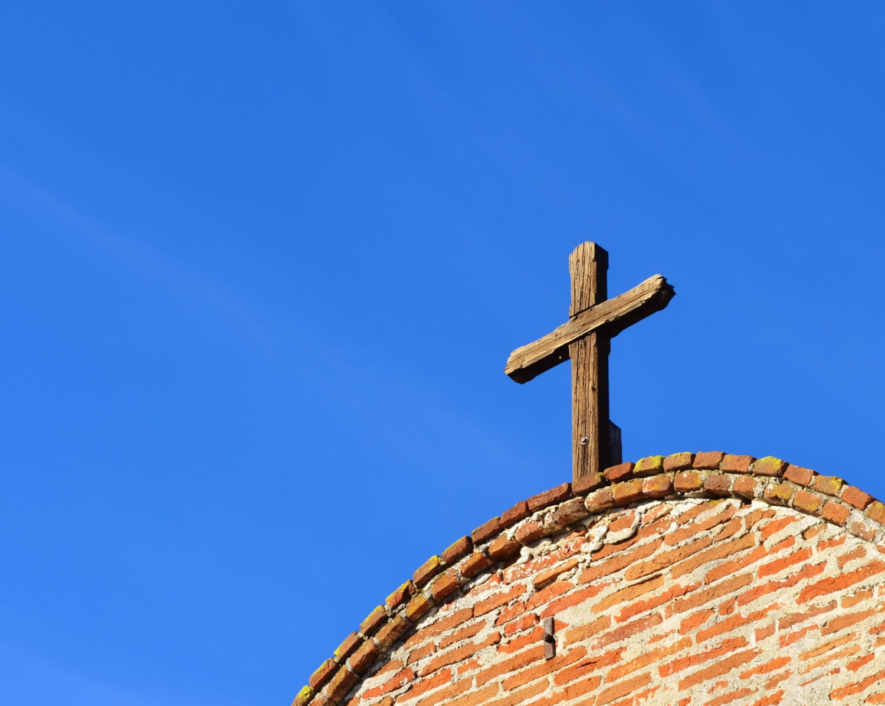
What does the cross mean to you?

Slide 3
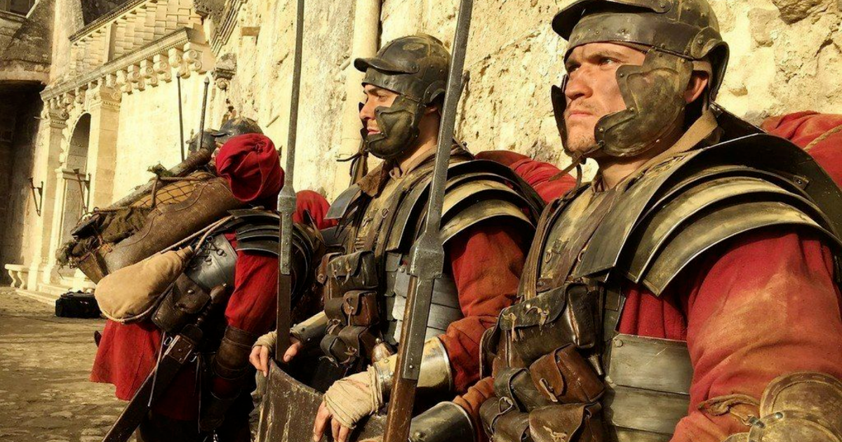
What did the cross mean in Jesus’ Day?

Slide 4
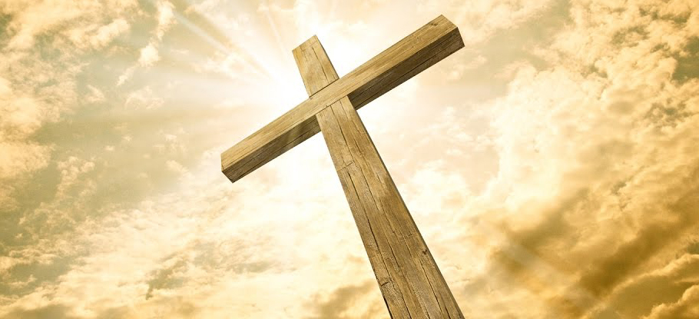
Biblical Meaning of the Cross…
The death of Jesus
The death of self

Slide 5
¹⁷ Brethren, join in following my example, and observe those who walk according to the pattern you have in us. ¹⁸ For many walk, of whom I often told you, and now tell you even weeping, that they are enemies of the cross of Christ, ¹⁹ whose end is destruction, whose god is their appetite, and whose glory is in their shame, who set their minds on earthly things. Philippians 3:17-19

Slide 6
²⁰ For our citizenship is in heaven, from which also we eagerly wait for a Savior, the Lord Jesus Christ; ²¹ who will transform the body of our humble state into conformity with the body of His glory, by the exertion of the power that He has even to subject all things to Himself.
¹ Therefore, my beloved brethren whom I long to see, my joy and crown, in this way stand firm in the Lord, my beloved.
Philippians 3:20 - 4:1

Slide 7
Therefore, my beloved brethren whom I long to see, my joy and crown, in this way stand firm in the Lord, my beloved. Philippians 4:1

Slide 8
Standing Firm
What’s the threat?

Slide 9
¹⁷ Brethren, join in following my example, and observe those who walk according to the pattern you have in us. ¹⁸ For many walk, of whom I often told you, and now tell you even weeping, that they are enemies of the cross of Christ, ¹⁹ whose end is destruction, whose god is their appetite, and whose glory is in their shame, who set their minds on earthly things. Philippians 3:17-19
Follow the example of godly people

Slide 10
¹⁷ Brethren, join in following my example, and observe those who walk according to the pattern you have in us. ¹⁸ For many walk, of whom I often told you, and now tell you even weeping, that they are enemies of the cross of Christ, ¹⁹ whose end is destruction, whose god is their appetite, and whose glory is in their shame, who set their minds on earthly things. Philippians 3:17-19
Follow the example of godly people…
because many potential examples are actually
enemies of the cross of Christ!

Slide 11
Standing Firm
What’s the threat?
Many of our potential examples are actually “enemies of the cross”!

Slide 12
Who are these people?
¹⁷ Brethren, join in following my example, and observe those who walk according to the pattern you have in us. ¹⁸ For many walk, of whom I often told you, and now tell you even weeping, that they are enemies of the cross of Christ, ¹⁹ whose end is destruction, whose god is their appetite, and whose glory is in their shame, who set their minds on earthly things. Philippians 3:17-19
Paul (godly example), those who walk… (godly examples), many others (ungodly examples)
The ungodly examples seem to be people claiming to be followers of Christ!

Slide 13
Are they really Followers of Christ?
¹⁷ Brethren, join in following my example, and observe those who walk according to the pattern you have in us. ¹⁸ For many walk, of whom I often told you, and now tell you even weeping, that they are enemies of the cross of Christ, ¹⁹ whose end is destruction, whose god is their appetite, and whose glory is in their shame, who set their minds on earthly things. Philippians 3:17-19

Slide 14
Standing Firm
What’s the threat?
Many of our potential examples are actually “enemies of the cross”!
These people claim to be believers (but they really aren’t)

Slide 15
How are they “Enemies of the Cross”?
¹⁷ Brethren, join in following my example, and observe those who walk according to the pattern you have in us. ¹⁸ For many walk, of whom I often told you, and now tell you even weeping, that they are enemies of the cross of Christ, ¹⁹ whose end is destruction, whose god is their appetite, and whose glory is in their shame, who set their minds on earthly things. Philippians 3:17-19

Slide 16
The Purpose of the Cross:
The Atonement (payment) for sin

Slide 17
The Cross as the Atonement for Sin
¹³ And you, who were dead in your trespasses and the uncircumcision of your flesh, God made alive together with him, having forgiven us all our trespasses, ¹⁴ by canceling the record of debt that stood against us with its legal demands. This he set aside, nailing it to the cross.
Colossians 2:13-14

Slide 18
The Purpose of the Cross:
The Atonement (payment) for sin
Example / pattern of how we are to live

Slide 19
The Cross as the Example/Pattern for Life
²³ And he said to all, “If anyone would come after me, let him deny himself and take up his cross daily and follow me. ²⁴ For whoever would save his life will lose it, but whoever loses his life for my sake will save it.
Luke 9:23-24
The Mindset of the Cross:
Self-Denial, Humility, Sacrifice, Obedience

Slide 20
The Cross: Under Attack!
Enemies
Atonement
Enemies
Pattern for Life

Slide 21
How are they “Enemies of the Cross”?
¹⁷ Brethren, join in following my example, and observe those who walk according to the pattern you have in us. ¹⁸ For many walk, of whom I often told you, and now tell you even weeping, that they are enemies of the cross of Christ, ¹⁹ whose end is destruction, whose god is their appetite, and whose glory is in their shame, who set their minds on earthly things. Philippians 3:17-19

Slide 22
The Cross: Under Attack from Inside the Church!
Legalism
Atonement
Phil. 3:2
Sensualism
Pattern for Life
Phil. 3:18-19

Slide 23
Standing Firm
What’s the threat?
Many of our potential examples are actually “enemies of the cross”!
These people claim to be believers
These people were denying humility, selflessness, sacrifice and obedience as the normal pattern for life.

Slide 24
Standing Firm for the Cross
What’s the threat?
How can we stand firm against this?
By intentionally following godly examples (17)
By focusing on our heavenly citizenship (20-21)

Slide 25
Intentionally Following Godly Examples
¹⁷ Brethren, join in following my example, and observe those who walk according to the pattern you have in us.
Philippians 3:17

Slide 26
Intentionally Following Godly Examples
Can’t we just follow Jesus?
God has created us as “imitating creatures”
The God-given pattern by which we learn is through example
We need examples of non-perfect people to see how godliness deals with fallenness!
Notes:
When climbing a mountain, I’d rather have the help of a fellow climber who is ahead of me than someone who has “arrived” at the top via a helicopter!

Slide 27
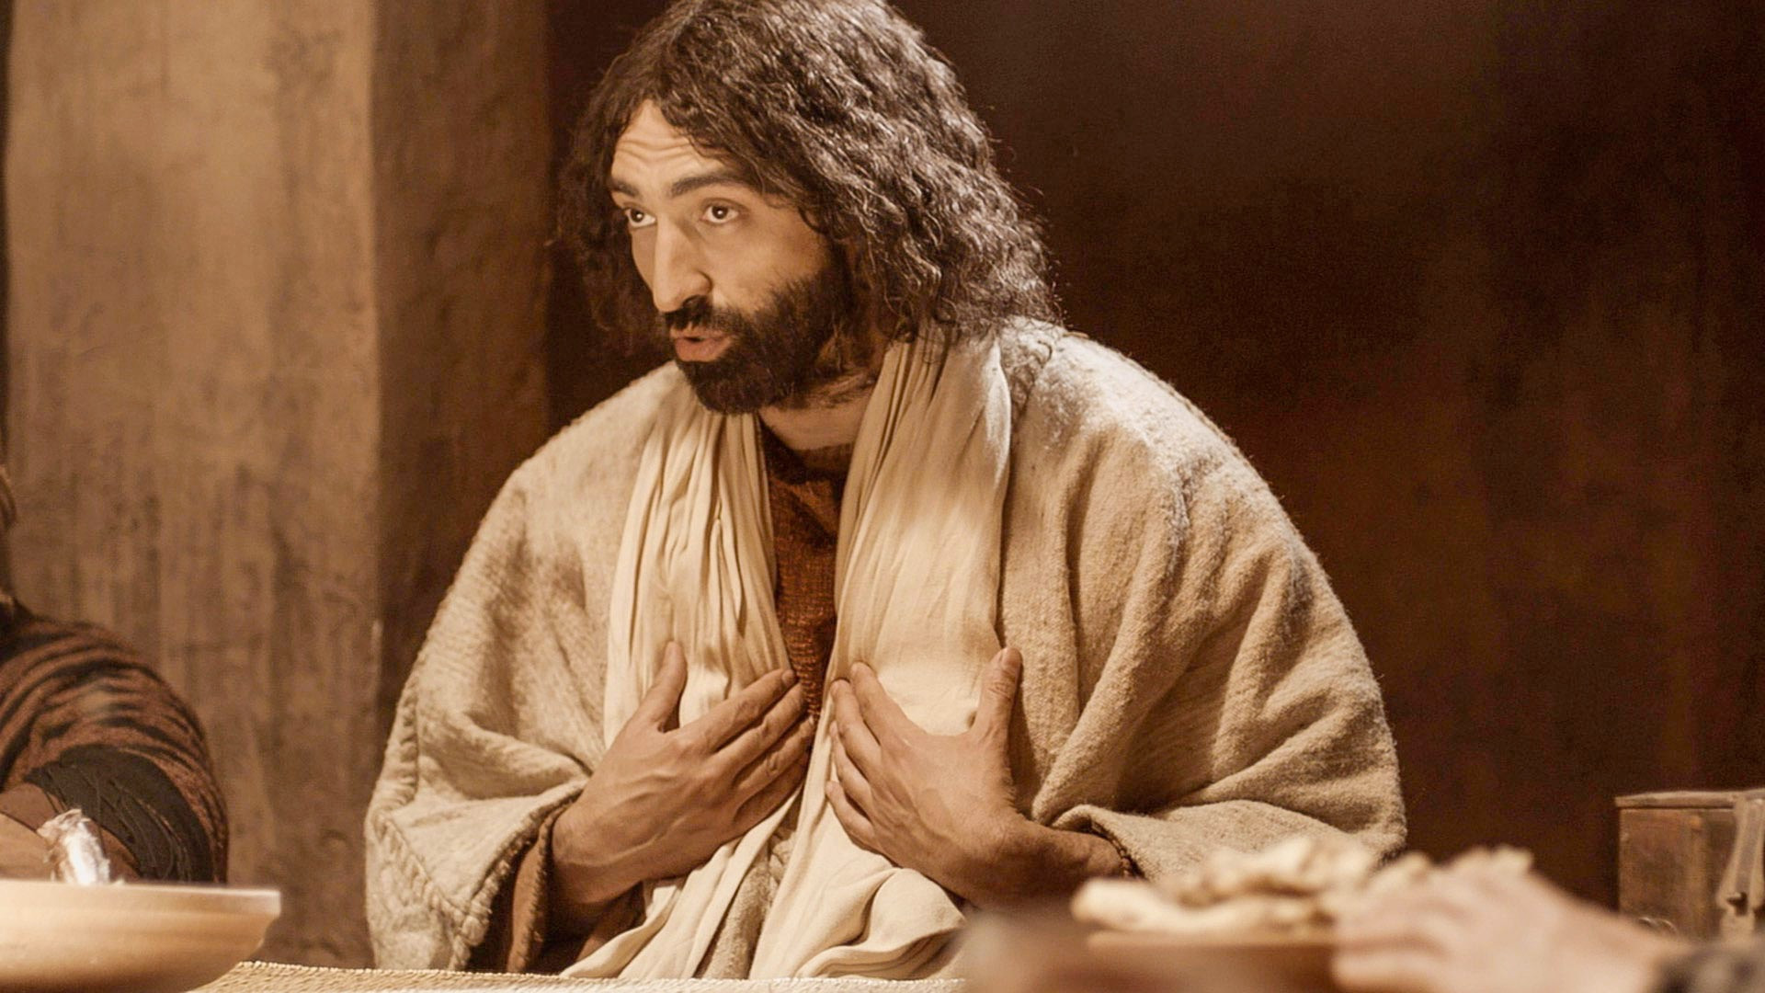
Jesus is our Model
Through the Word, we follow Jesus
Through the Word, we follow Paul and others
We also need to follow flesh and blood leaders

Slide 28
We all follow others…
The question is WHO are we following?
Who are your friends?
What are you watching or listening to?
What are you reading?

Slide 29
How do we Find Godly Leaders?
DON’T Look for people who are:
Charismatic / entertaining / popular
Strong leadership personality
Gifted / talented speaker
Good looking / Successful

Slide 30
How do we Find Godly Leaders?
DO Look for people who are:
Selfless and humble – yet confident
Sacrificial servants
Pressing on toward Christlikeness
Living as you think Jesus would!

Slide 31
Responsibility of Biblical Leadership
Let no one despise you for your youth, but set the believers an example in speech, in conduct, in love, in faith, in purity.
1 Timothy 4:12
Notes:
Any of us who lead other people in any context have a huge responsibility to lead in godly ways! Many lose their way on the path to Christlikeness due to the failure of leaders to set a good example.

Slide 32
Standing Firm for the Cross
What’s the threat?
How can we stand firm against this?
By intentionally following godly examples (17)
By focusing on our heavenly citizenship (20-21)

Slide 33
²⁰ For our citizenship is in heaven, from which also we eagerly wait for a Savior, the Lord Jesus Christ; ²¹ who will transform the body of our humble state into conformity with the body of His glory, by the exertion of the power that He has even to subject all things to Himself.
Philippians 3:20 - 21

Slide 34
Living as Citizens of Heaven!
²³ And he said to all, “If anyone would come after me, let him deny himself and take up his cross daily and follow me. ²⁴ For whoever would save his life will lose it, but whoever loses his life for my sake will save it.
Luke 9:23-24
The Mindset of the Cross:
Self-Denial, Humility, Sacrifice, Obedience

Slide 35
Living as Citizens of Heaven!
Are you sharing in the sufferings of Christ?
Others focused?
Loving without being loved in return?
Forgiving?
Using your time to serve Christ & others?
Using your resources to serve Christ & others?
These are the values of citizens of heaven!

Slide 36
Standing Firm for the Cross
What’s the threat?
How can we stand firm against this?
By intentionally following godly examples (17)
By focusing on our heavenly citizenship (20-21)

Slide 37
How are We Doing in Standing Firm?
How would you say the church is doing in regard to standing firm against worldliness?

Slide 38
Attacks on the Cross from Within
We do not reflect Jesus’ value of generosity. In a recent study, over a year-long period:
20% of US evangelicals did not give a penny to church or charities
50% of US evangelicals gave less than 1% of their income to church or charities

Slide 39
Attacks on the Cross from Within
We do not reflect Jesus’ value of loyalty first and foremost to his kingdom
Valuing nationality or political party more than the kingdom of God
Accepting society’s values of entertainment, sports, music and movies

Slide 40
Attacks on the Cross from Within
We do not reflect Jesus’ value of suffering and sacrifice.
We often encourage others to leave difficult relationships rather than to forgive and love unconditionally
Very few take the gospel to hard places
Very few care for poor, widows, orphans

Slide 41
Are you ready to do your part in standing firm for the Cross?

Slide 43
NT Preaching link at BibleStudyDownloads.org
Get this presentation for free!
Notes:
NT Preaching (np)

