Slide 1

Christ-likeness Frees Us From Legalism
Philippians 3:1-16
Rick Griffith, Crossroads International Church
www.biblestudydownloads.com

Slide 2
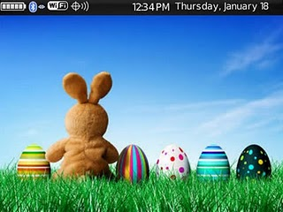
Happy Easter!

Slide 3
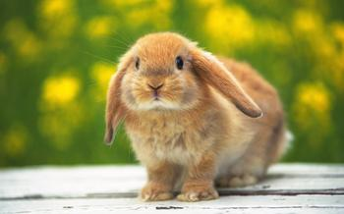
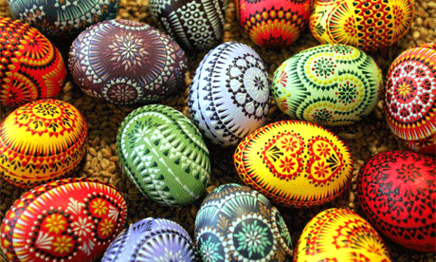
“The Spring Bunny”
“Spring Spheres”

Slide 4
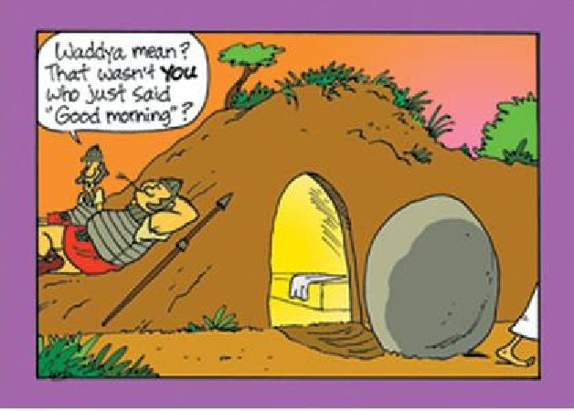
Happy Easter!
Waddya mean? That wasn't YOU who just said, “Good morning”?

Slide 5
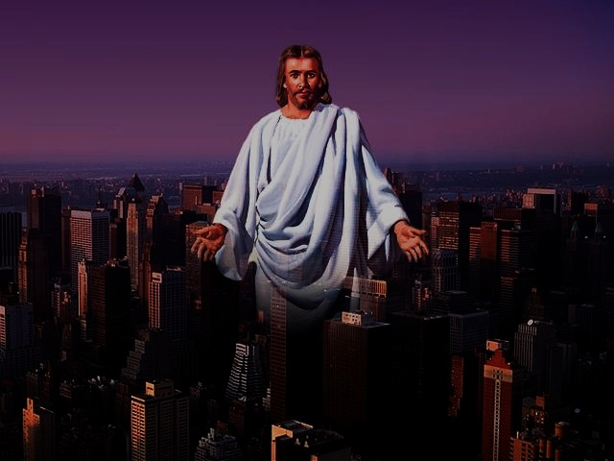
Book Chart
181
Philippians: Results of Imitating Christ's Attitude
Joy |  |  | Humility |  | Protection |  | Peace
Chapter 1 |  |  | Chapter 2 |  | Chapter 3 |  | Chapter 4
Joy (5x) |  |  | Joy (7x) |  | Joy (1x) |  | Joy (4x)
Attitude (1x) |  |  | Attitude (7x) |  | Attitude (8x) |  | Attitude (4x)
Suffering |  |  | Submission |  | Salvation |  | Sanctification
Salu-tation 1:1-2 | Thanks & Prayer 1:3-11 | In Prison Ministry1:12-30 | Exhort-ed 2:1-4 | Exempli-fied 2:5-30 | From Legal-ism 3:1-16 | From Indulgence 3:17-21 | With Peo-ple 4:1-3 | With God 4:4-9 | Always 4:10-20 – Greet-ings 4:21-23
From Rome
Early Spring AD 62 (first Roman imprisonment)
17x
20x

Slide 6
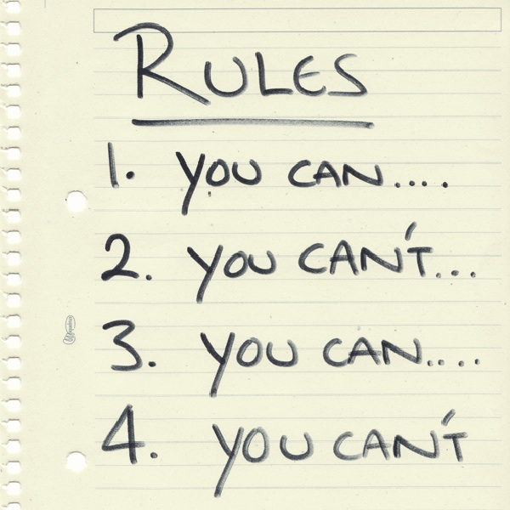
Rules

Slide 7

Righteousness is Internal

Slide 8

Balance is Key!
Legalism
(All Law)
Libertinism
(No Law)
Godly Balance
(Some Law)

Slide 9
Balance in the Christian Life
186g
Legalism
A Godly Balance
Libertinism
Phil. 3:1-3
Phil. 3:4-16
Phil. 3:17-20
Legal = Law Only
Standards and Liberty
Liberty = No Law
Excessive Rules
Only Biblical Rules
License for Everything
Actions are Everything
Actions are Something
Actions are Unimportant
Highly Structured
Some Structure
No Structure
How can having the attitude of Christ protect us from false teaching?
Pharisee-like
Christ-like
Glutton-like
“god” is their Traditions
God is Christ
“god” is their Stomach
Starves the Flesh
Controls the Flesh
Indulges the Flesh
Claim of Perfectionism
In Process (3:12-13)
Practice of Fatalism
Christ-likeness sets us free from legalism based on self-righteousness (Main Idea).
Think they've Arrived
Know they Haven't
Don't Care if they Do
Confidence in Flesh (3:3)
Confidence in Christ (3:7)
Confidence in Shame (3:19c)
Righteousness from the Law (3:9a)
Righteousness by Faith (3:9b)
Righteousness Not Pursued (3:19d)
No Movies
Wholesome Movies
All Movies
No TV
Wholesome TV
All TV
No Music
Wholesome Music
All Music
No Wine for Merit
No Wine/Moderation
Drunkenness
Unclean Foods
Moderation
Gluttony
“Christian Sabbath”
Rest
Frivolity
Celibacy Required
Celibacy for Ministry
Sexual Immorality
Salvation can be Lost
Eternal Security
Salvation can't be Gained

Slide 10

Philippians 3
Synthesis
184-185
Results of imitating Christ's attitude
1 Joy
2 Humility
3 Protection

Slide 11
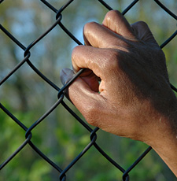
I. Paul first warned the church against legalists (3:1-3).

Slide 12

What are legalists like?
A. They don't care for people (2a).

Slide 13
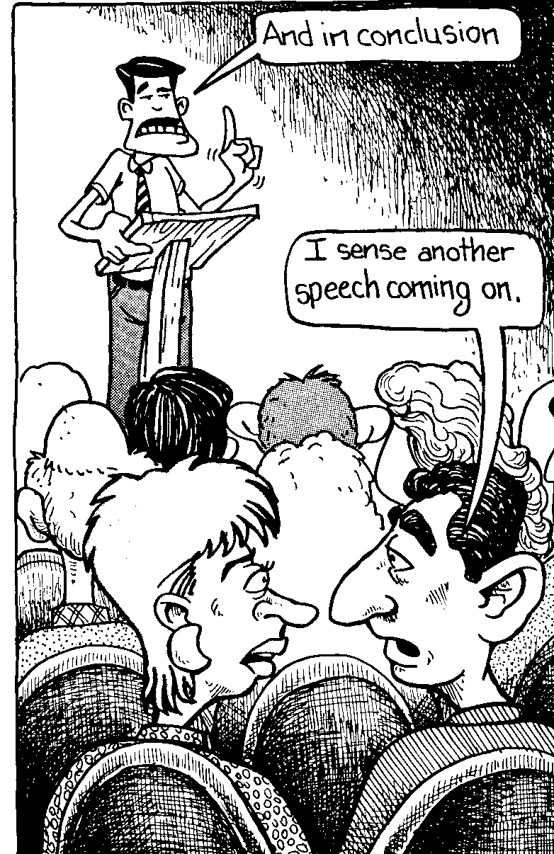
A new subject
Finally, my brothers...
I sense another speech coming on.
Paul was half-way through his letter

Slide 14
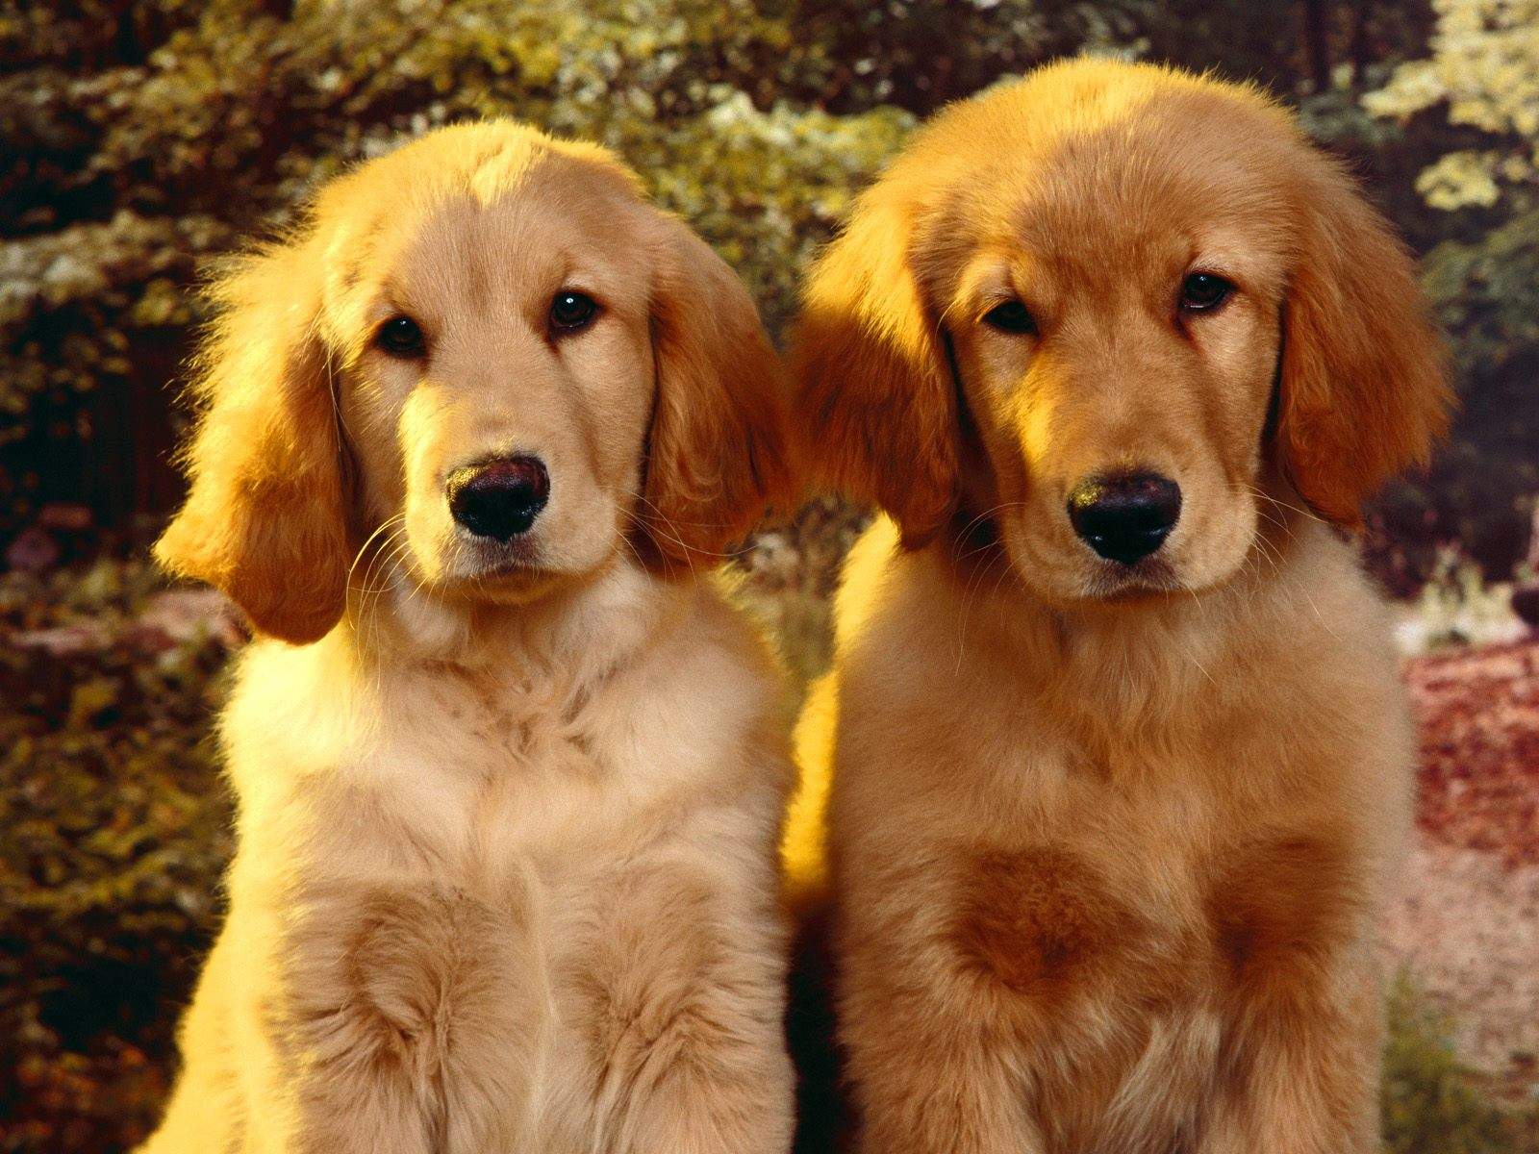
“Beware of the dogs” (2a).

Slide 15
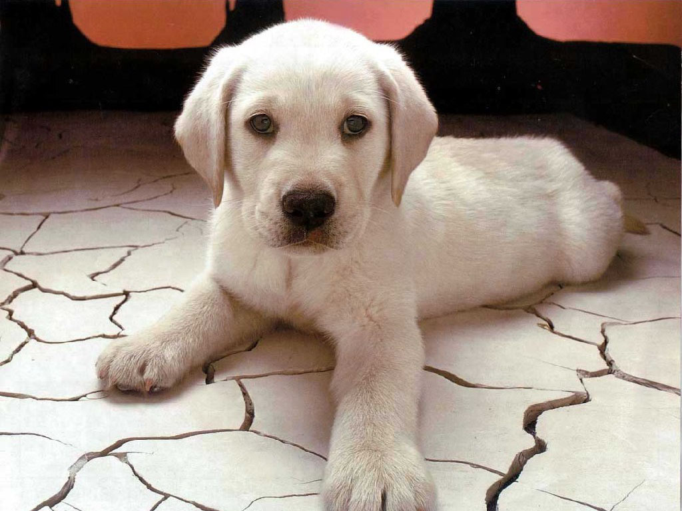
“Beware of the dogs” (2a).

Slide 16
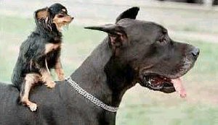
“Beware of the dogs” (2a).

Slide 17
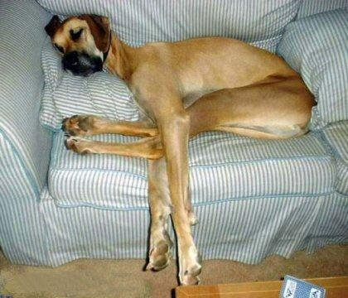
“Beware of the dogs” (2a).

Slide 18
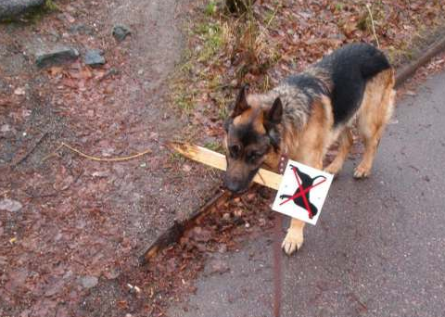
“Beware of the dogs” (2a).

Slide 19


“Beware of the dogs” (2a).

Slide 20
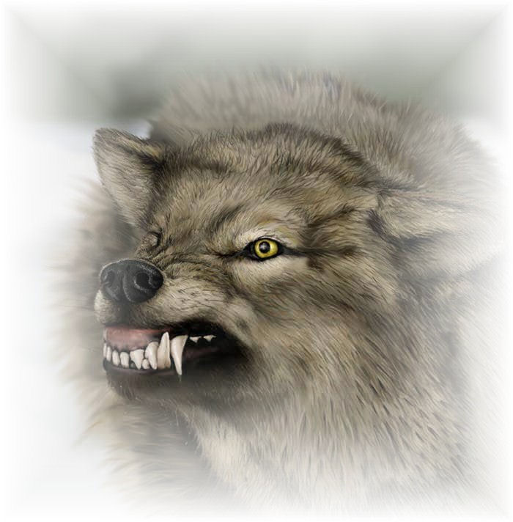
“Beware of the dogs” (2a).

Slide 21
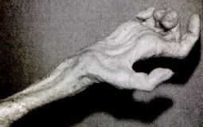
Man with shriveled man

Slide 22
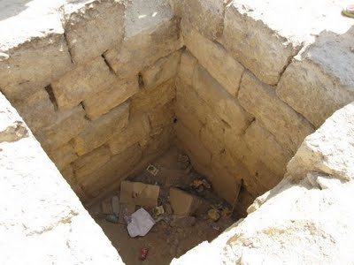
When a sheep falls into a pit...

Slide 23
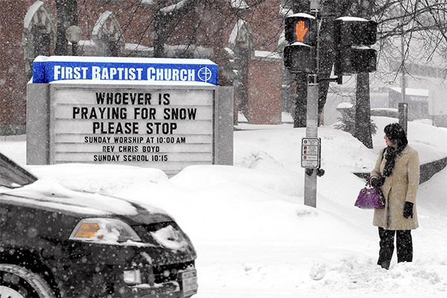
How to get to church?

Slide 24
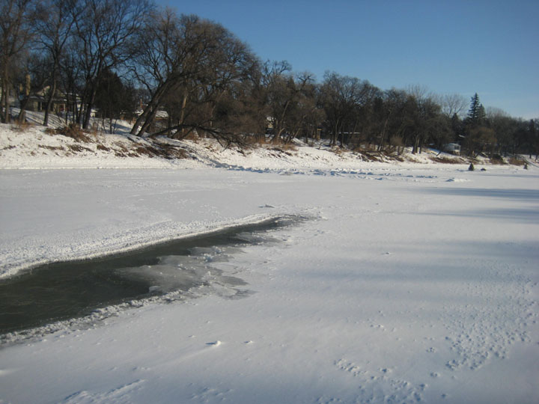
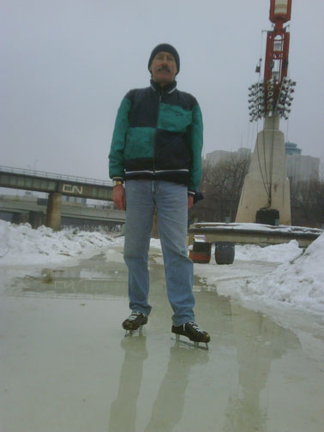
Ice Stating Pastor

Slide 25
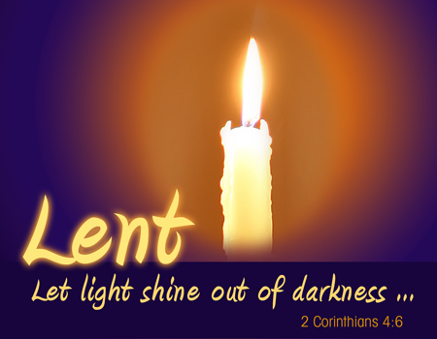
Lent

Slide 26
What are legalists like?
A. They don't care for people (2a).
B. They have evil intent in their rules (2b).

Slide 27
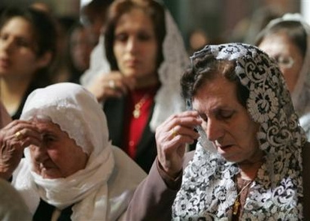
Invited to Church...

Slide 28
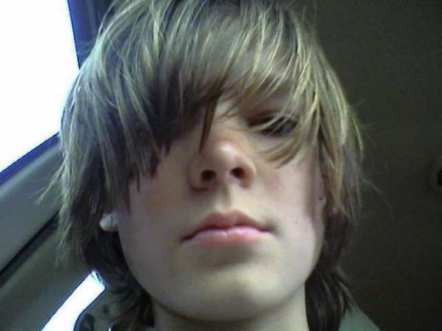
Boy with long hair

Slide 29
What are legalists like?
A. They don't care for people (2a).
B. They have evil intent in their rules (2b).
C. They go way beyond the Law's intent (2c).

Slide 30
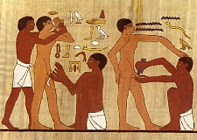
Beware of the
“mutilators of the flesh” (NIV) or the “false circumcision” (NAU)
“those mutilators who say you must be circumcised to be saved” (NLT)

Slide 31
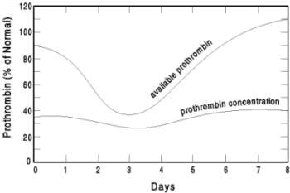
Circumcision, Vitamin K & Prothrombin

Slide 32
Hebrew Writing

Slide 33
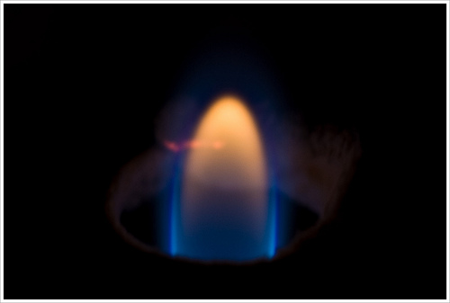
The Pilot Light

Slide 34
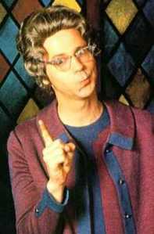

Christian Legalists

Slide 35
What are legalists like?
A. They don't care for people (2a).
B. They have evil intent in their rules (2b).
C. They go way beyond the Law's intent (2c).
D. They put confidence in the flesh (3).

Slide 36
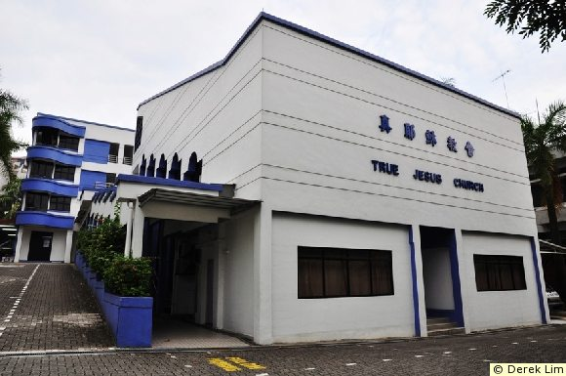
True Jesus Church, Adam Road
200

Slide 37

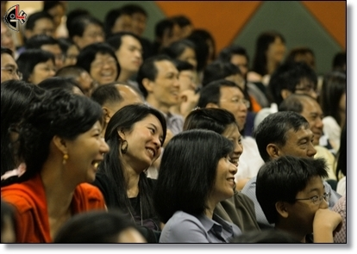
What Does the True Jesus Church Believe?
Identification with TJC
200
+
Baptism in TJC (Head Bowed)
+
Footwashing by TJC Minister
+
Communion (Transubstantiation)
+
Reception of the Holy Spirit
+
Speaking in Tongues
+
(Faith in Christ? No!)
=
Salvation ! ? ! ?

Slide 38
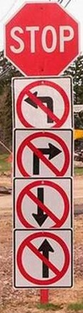
Why do people like legalism?
It gives us a tangible measure of where we stand.
It puts confidence into our hands so we can get credit for our deeds.
It makes decision-making easier with nearly everything being right or wrong.

Slide 39
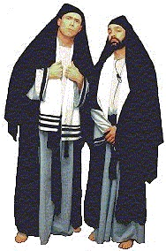
II. Paul used to put confidence in his pedigree (3:4-6).

Slide 40
Paul's Pedigree (Phil. 3:4-6)
186h
Circumcised the 8th day
This sign of participation in the Abrahamic Covenant separated Paul from pagans and was performed on him the exact day the OT prescribed (Gen. 17:11-12)
Of the people of Israel
Paul was a pure-blooded member of this race chosen by God himself (not even a proselyte, who were often viewed as “second class”)
Of the tribe of Benjamin
This tribe was one of the smallest, yet it boasted Israel's first king (Saul)—so Paul was not from a disreputable tribe like Dan, Reuben, etc.
A Hebrew of Hebrews
Paul did not adopt Greek ways even though he grew up in a Greek city (Tarsus)
In regard to the law,
a Pharisee
This sect adhered more strictly to the Mosaic law than any sect in mainstream society
As for zeal,
persecuting the church
Even most Pharisees did not actively seek to do away with Messianic believers
As for legalistic righteousness, faultless
Paul followed all 613 Pharisaical laws without exception

Slide 41

Paul's Pedigree
186h
Text
Meaning
Circumcised day 8
Separated, exact
Of Israel
Chosen of God
Of Benjamin
Smallest tribe but still first king
A Hebrew of Hebrews
No pagan leanings (even in Tarsus)

Slide 42
Paul's Pedigree
186h
Text
Meaning
Pharisee
Strict on the Law
Persecuted the church
Most zealous Pharisee of all
As for legalistic righteousness, faultless
Followed all 613 Pharisaical laws

Slide 43
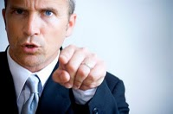
What's Your Pedigree?

Slide 44

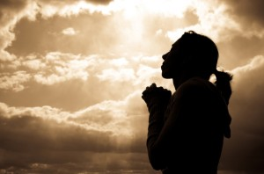
III. Paul said
“no” to self-righteousness
“yes” to Christ-likeness (3:7-16).
and

Slide 45
Philippians 3:7-9a NLT
⁷I once thought these things were valuable, but now I consider them worthless because of what Christ has done. ⁸Yes, [I consider] everything else... worthless when compared with the infinite value of knowing Christ Jesus my Lord. For his sake I have discarded everything else, counting it all as garbage, so that I could gain Christ ⁹and become one with him.

Slide 46
Philippians 3:9b-11 NLT
I no longer count on my own righteousness through obeying the law; rather, I become righteous through faith in Christ. For God's way of making us right with himself depends on faith. ¹⁰I want to know Christ and experience the mighty power that raised him from the dead. I want to suffer with him, sharing in his death, ¹¹so that one way or another I will experience the resurrection from the dead!

Slide 47
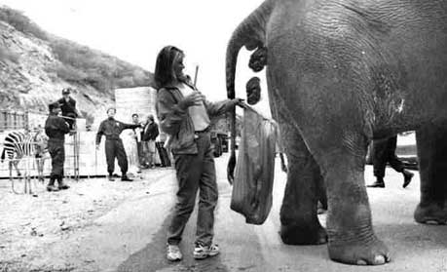
“Rubbish” (NIV, NASB), “Garbage” (NLT)?
“Dung” (KJV)!

Slide 48

What should you consider excrement?
(in comparison to knowing Christ)

Slide 49

What's your goal?

Slide 50
Philippians 3:12-14 NLT
¹²I don't mean to say that I have already achieved these things or that I have already reached perfection. But I press on to possess that perfection for which Christ Jesus first possessed me. ¹³No, dear brothers and sisters, I have not achieved it, but I focus on this one thing: Forgetting the past and looking forward to what lies ahead, ¹⁴I press on to reach the end of the race and receive the heavenly prize for which God, through Christ Jesus, is calling us.

Slide 51

“Not that I have already obtained it...” (2:14)

Slide 52
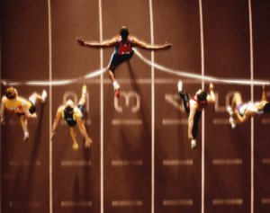
The goal is Christ-likeness!

Slide 53
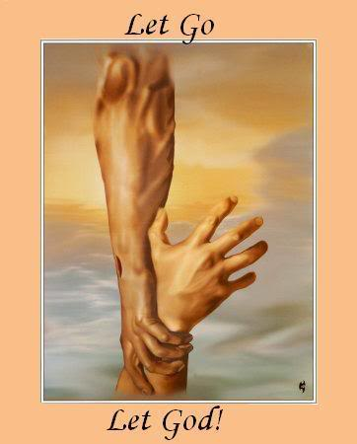
Let go, Let God

Slide 54
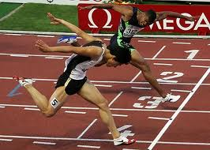
“I strive towards the goal!”

Slide 55
Philippians 3:15-16 NLT
¹⁵Let all who are spiritually mature agree on these things. If you disagree on some point, I believe God will make it plain to you. ¹⁶But we must hold on to the progress we have already made.

Slide 56
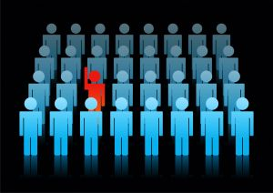
–– Main Idea ––
Christ-likeness sets us free from legalism based on
self-righteousness!

Slide 57

Paul's Pursuit: To be like Christ
Paul warned the church against legalists (3:1-3).
Paul used to place confidence in his pedigree (3:4-6).
III. Paul said “no” to self-righteousness and “yes” to Christ-likeness (3:7-16).

Slide 58
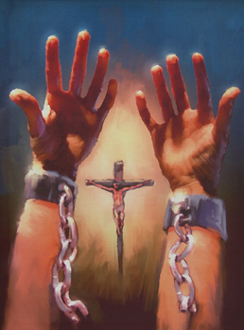
Do you need to be set free from legalism?

Slide 59
Worthless Compared to Christ (Phil. 3:7-8)
186i
Paul considered his life's best accomplishments “dung” (KJV) compared to knowing Christ. Which of the following is a source of pride in your life?
Personal
Occupation
Title
Income
Power
Education
Degree(s)
Others
Spiritual
Church position/title
Tithes, offerings, gifts
Church membership
Ministry experience or gifts
Bible knowledge
Humility
Others
Social
Social position
Friends
Spouse
House
Car
Neighborhood
Country club
Golf/sports
Children
Others
Physical
Appearance
Strength
Health
Abilities
Others
Is your attitude toward these things like Paul's? Are they “rubbish” to you?

Slide 60
Black

Slide 61


NT Preaching link at BibleStudyDownloads.org
Get this presentation and script for free!
Notes:
NT Preaching (np)

