Slide 1
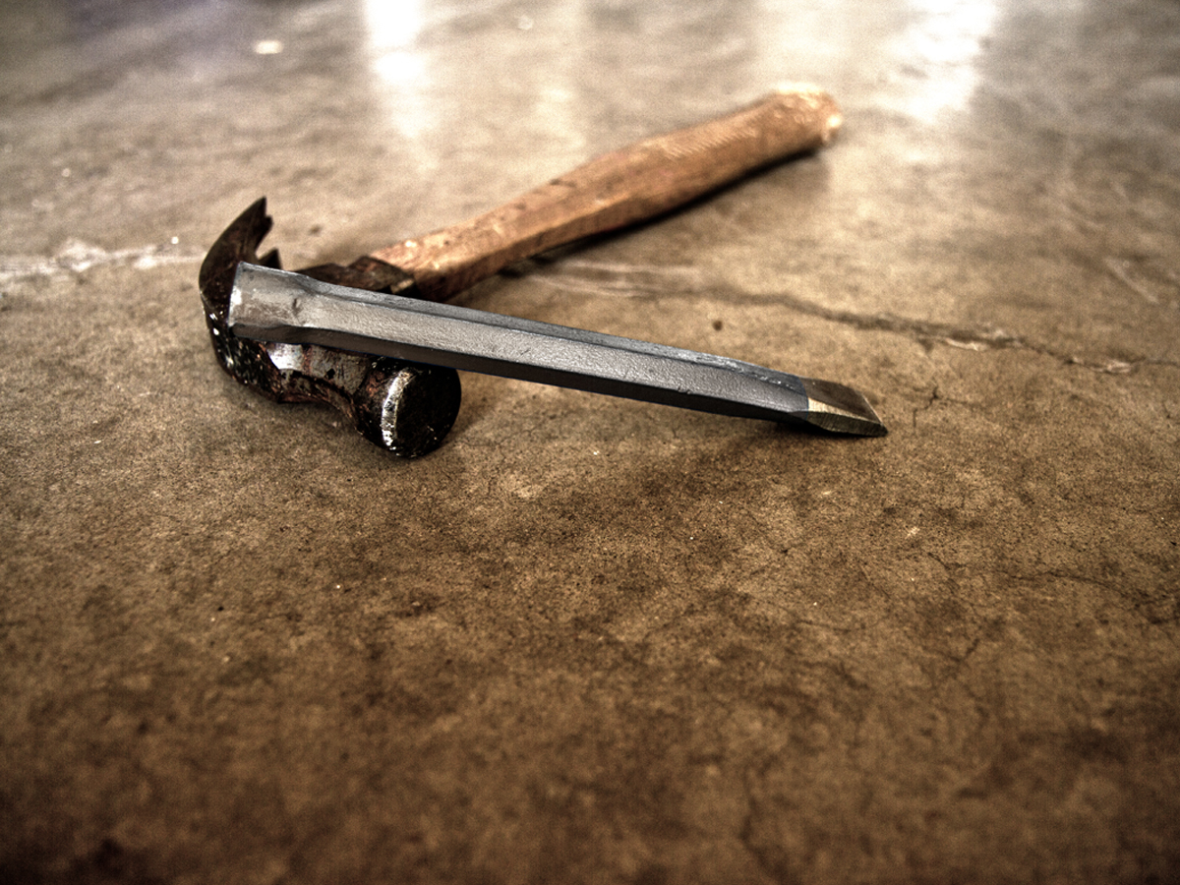
Christ-like Humility
Philippians 2:5-30
Rick Griffith, Crossroads International Church
BibleStudyDownloads.org

Slide 2

Conquerors Rode Horses

Slide 3
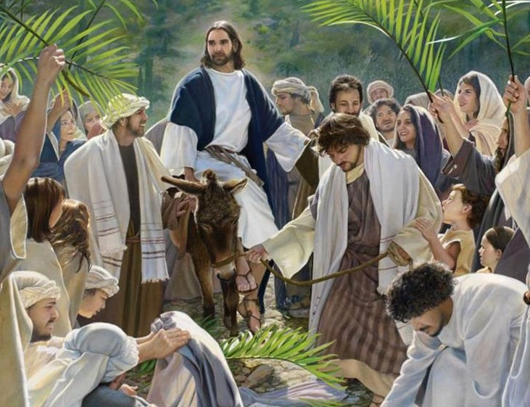
Welcomed Leaders Rode Donkeys
Triumphal Entry
Zech. 9:9

Slide 4
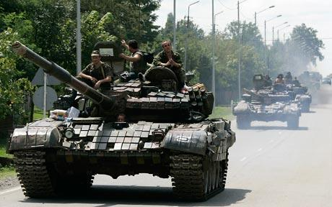
Conquerors Ride Tanks Today

Slide 5
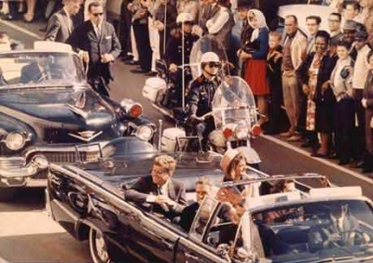
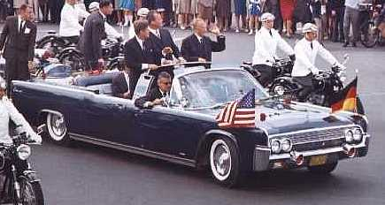
Welcomed Leaders Ride Limos

Slide 6
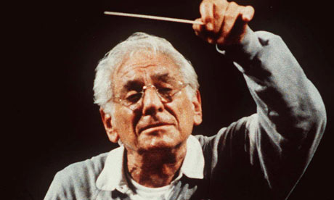
Question to Leonard Bernstein:
"What is the most difficult instrument to play?"

Slide 7
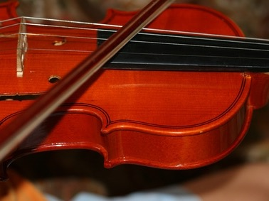
Leonard Bernstein
"The second fiddle. I can get plenty of first violinists, but to find someone who can play the second fiddle with enthusiasm—that's a problem. And if we have no second fiddle, we have no harmony."

Slide 8
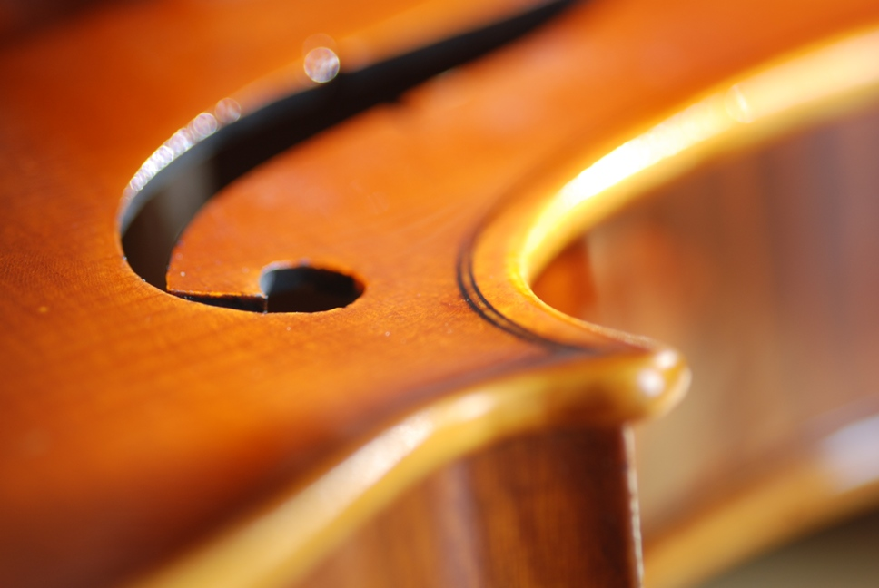
Spurgeon
“It takes more skill than I can tell
to play the second fiddle well”
––Charles Spurgeon

Slide 9
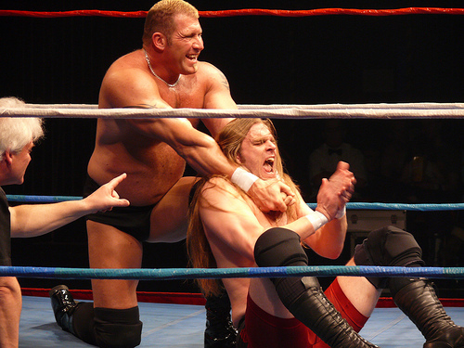

World Wrestling
All-Stars

Slide 10
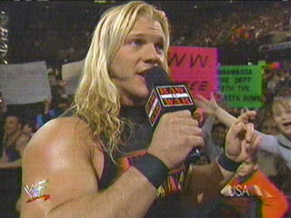
Curly Locks

Slide 11
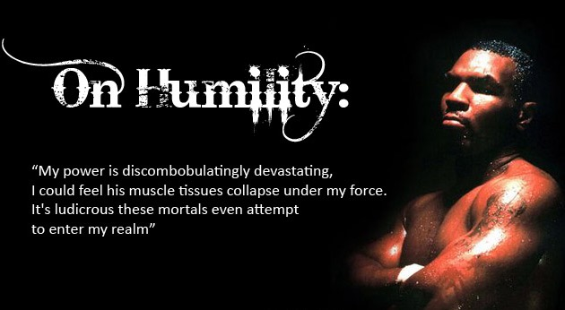
Mike Tyson
"My power is discombobulatingly devastating. I could feel his muscle tissues collapse under my force. It's ludicrous these mortals even attempt to enter my realm.”

Slide 12
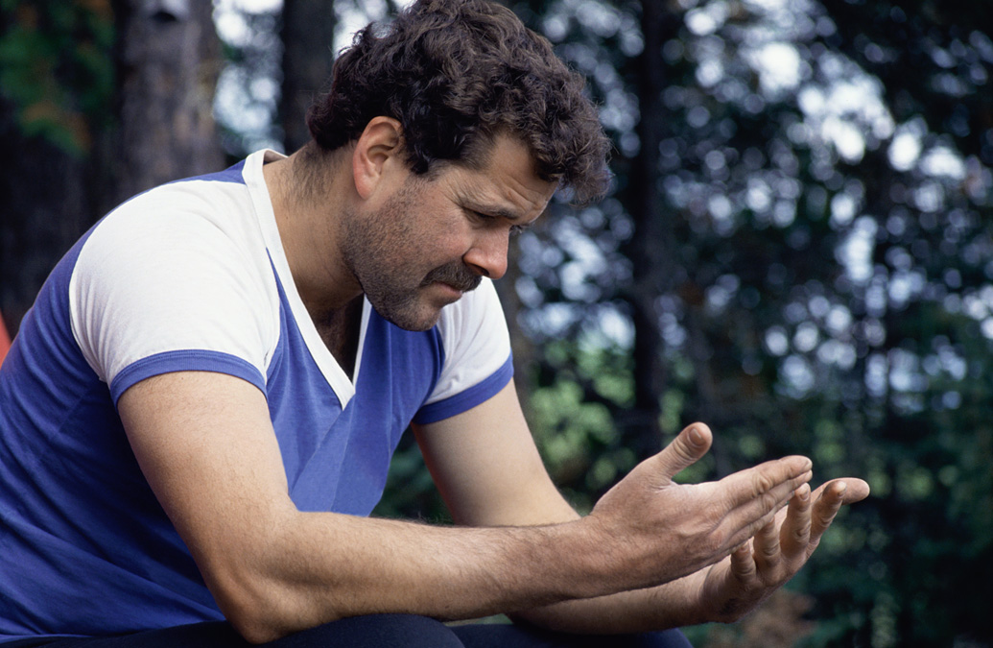
Humility is Rare

Slide 13

Humility Badge

Slide 14

Humility is the only flower which, when put on display, will whither.
Humility is the only flower which, when put on display, will whither.

Slide 15
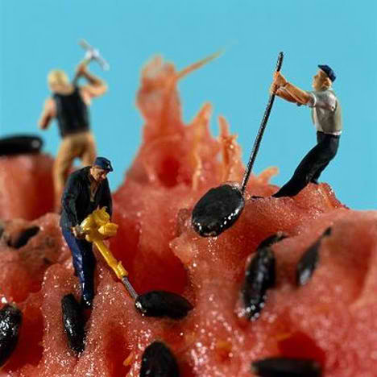
Watermelon Seed

Slide 16

True Humility
Is humility thinking poorly of yourself?

Slide 17

What is Humility?
“Humility is perfect quietness of heart.
It is
to expect nothing,
to wonder at nothing that is done to me,
to feel nothing done against me.”
—Andrew Murray

Slide 18

True Humility
“True humility is not to think low of oneself but to think rightly, truthfully of oneself.”

Slide 19

Romans 12:3 (NIV)
"Do not think of yourself more highly than you ought, but rather think of yourself with sober judgment, in accordance with the measure of faith God has given you."

Slide 20

Why is humility so vital?

Slide 21

Synthesis
184-185
Results of imitating Christ's attitude
1 Joy
2 Humility

Slide 22
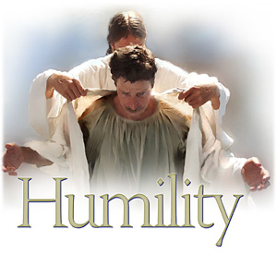
Main Idea of 2:1-4:
We can be truly united only as long as we are truly humble

Slide 23
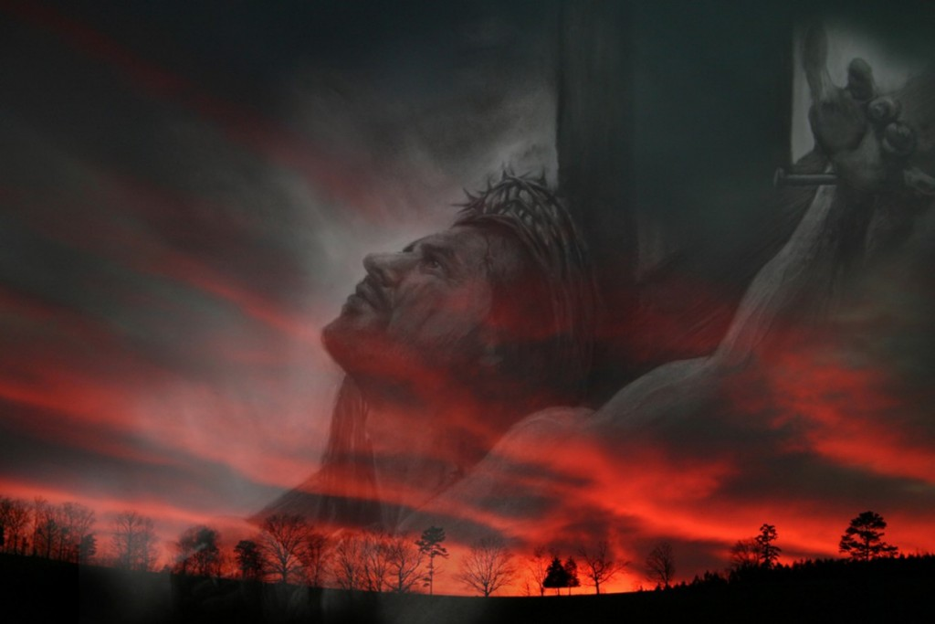
I. Christ is the supreme example of humility in His selfless giving of Himself (2:5-11).

Slide 24


Key Word & Verse
181
Philippians
Key Word
Attitude
Key Verse
“Your attitude should be the same as that of Christ Jesus”
(Philippians 2:5).

Slide 25
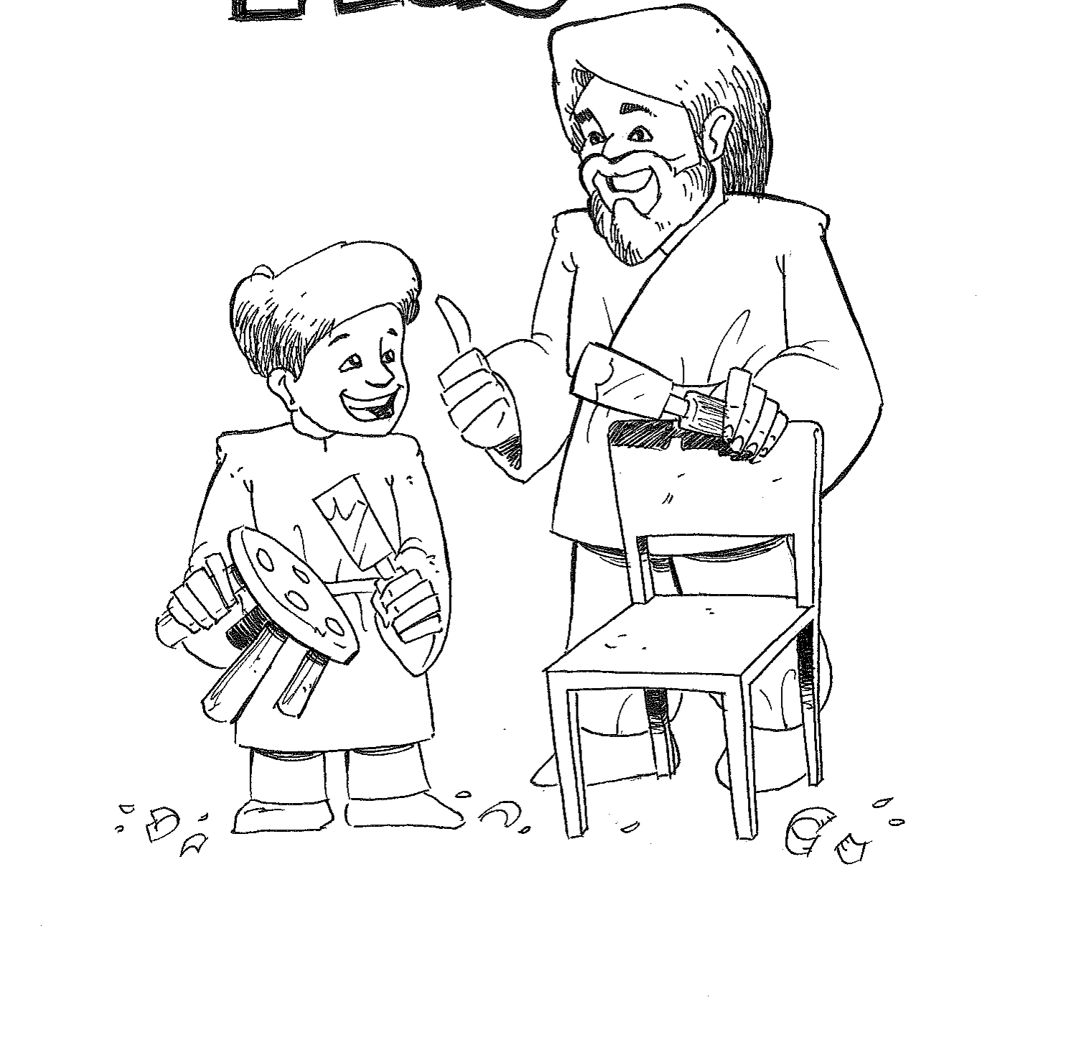

Mimicking the Master
Key Verse
“Your attitude should be the same as that of Christ Jesus”
(Phil. 2:5).

Slide 26

The Kenosis (“Emptying”) Passage
Philippians 2:5-11

Slide 27
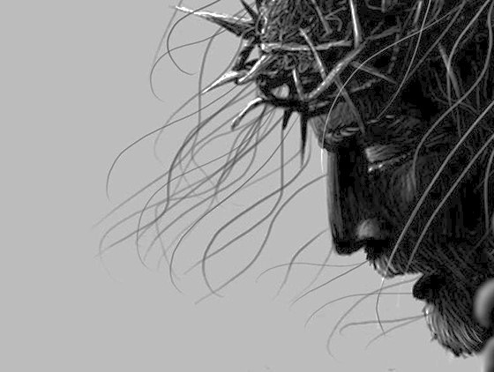
Phil 2:5-8
⁵You must have the same attitude that Christ Jesus had.
⁶Though he was God,
he did not think of equality with God as something to cling to.
⁷Instead, he gave up his divine privileges [Greek “he emptied himself”]; he took the humble position of a slave and was born as a human being.
When he appeared in human form, ⁸he humbled himself in obedience to God and died a criminal's death on a cross
(Phil. 2:5-8 NLT).

Slide 28

Phil 2:9-11
⁹Therefore, God elevated him to the place of highest honor
and gave him the name above all other names,
¹⁰that at the name of Jesus every knee should bow,
in heaven and on earth and under the earth,
¹¹and every tongue confess that Jesus Christ is Lord,
to the glory of God the Father.
(Phil. 2:9-11 NLT)

Slide 29
Philippians 2:6-11
186
Lordship will be Acknowledged!
Glory
Glory
Always existed as God
Decided not to hold to divine rights
Emptied Himself of these equal rights
Became a slave by being born a man
Humbled himself in obedience
Died by crucifixion
2:6-8
Humiliation
2:9-11
Exaltation

Slide 30
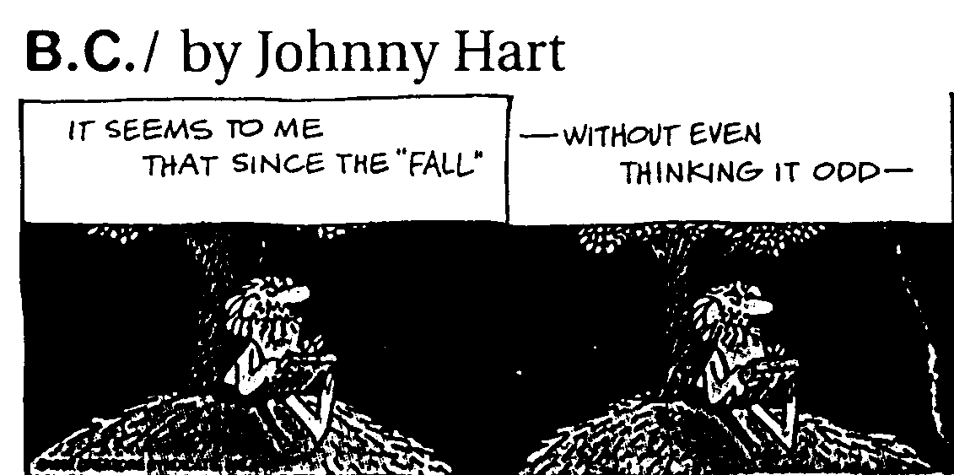
B.C. by Johnny Hart 1 of 4

Slide 31
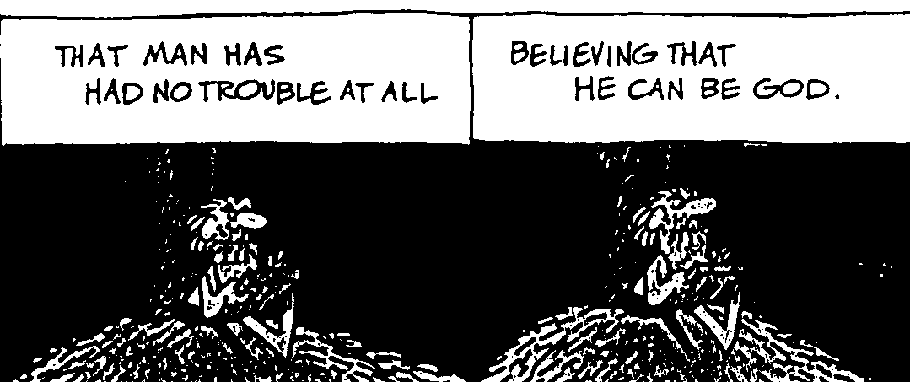
B.C. by Johnny Hart 2 of 4

Slide 32
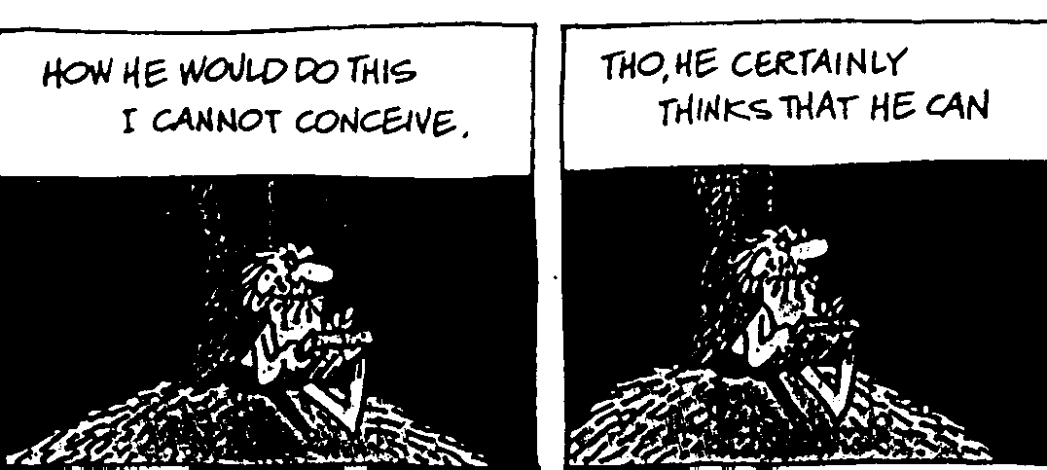
B.C. by Johnny Hart 3 of 4

Slide 33
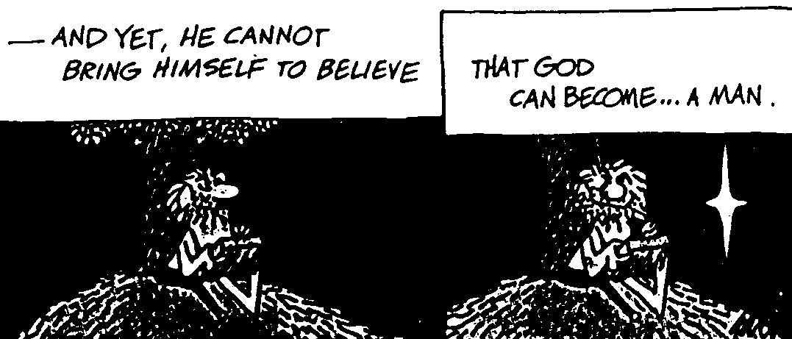
B.C. by Johnny Hart 4 of 4

Slide 34

Christ did NOT lay aside His deity!
He laid aside His rights to use all of His divine attributes.

Slide 35
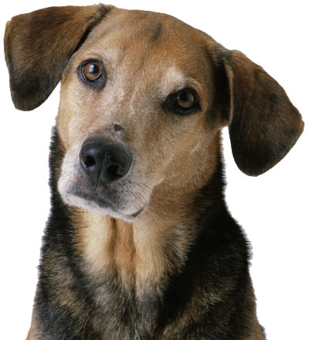
C.S. Lewis on Your Dog...
Notes:
C.S. Lewis in a radio broadcast brought an interesting interpretation to the meaning of the incarnation:
“Lying at your feet is your dog. Imagine, for the moment, that your dog and every dog is in deep distress. Some of us love dogs very much. If it would help all the gods in the world to become like men, would you be willing to become a dog? Would you put down your human nature, leave your loved ones, your job, hobbies, your art and literature and music, and choose instead of the intimate communion with your beloved, the poor substitute of looking into the beloved's face and wagging your tail, unable to smile or speak? Christ by becoming man limited the thing which to him was the most precious thing in the world—his unhampered, unhindered communion with the Father” (L.D. Weatherhead, The Plain Man Looks At the Cross).

Slide 36
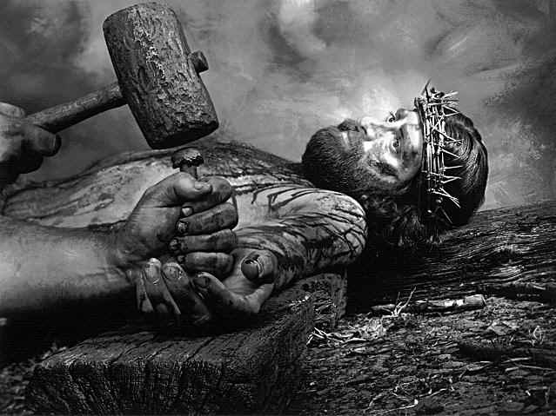
Crucifixion

Slide 37
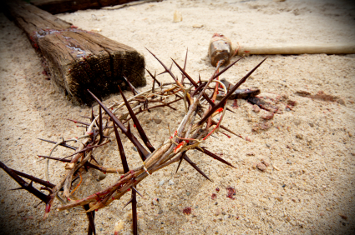
“All kings send out their subjects to die for them.
Only one King died for his subjects”
––Chuck Colson

Slide 38
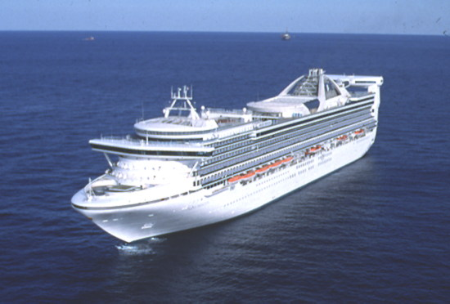
Cruise Ship

Slide 39
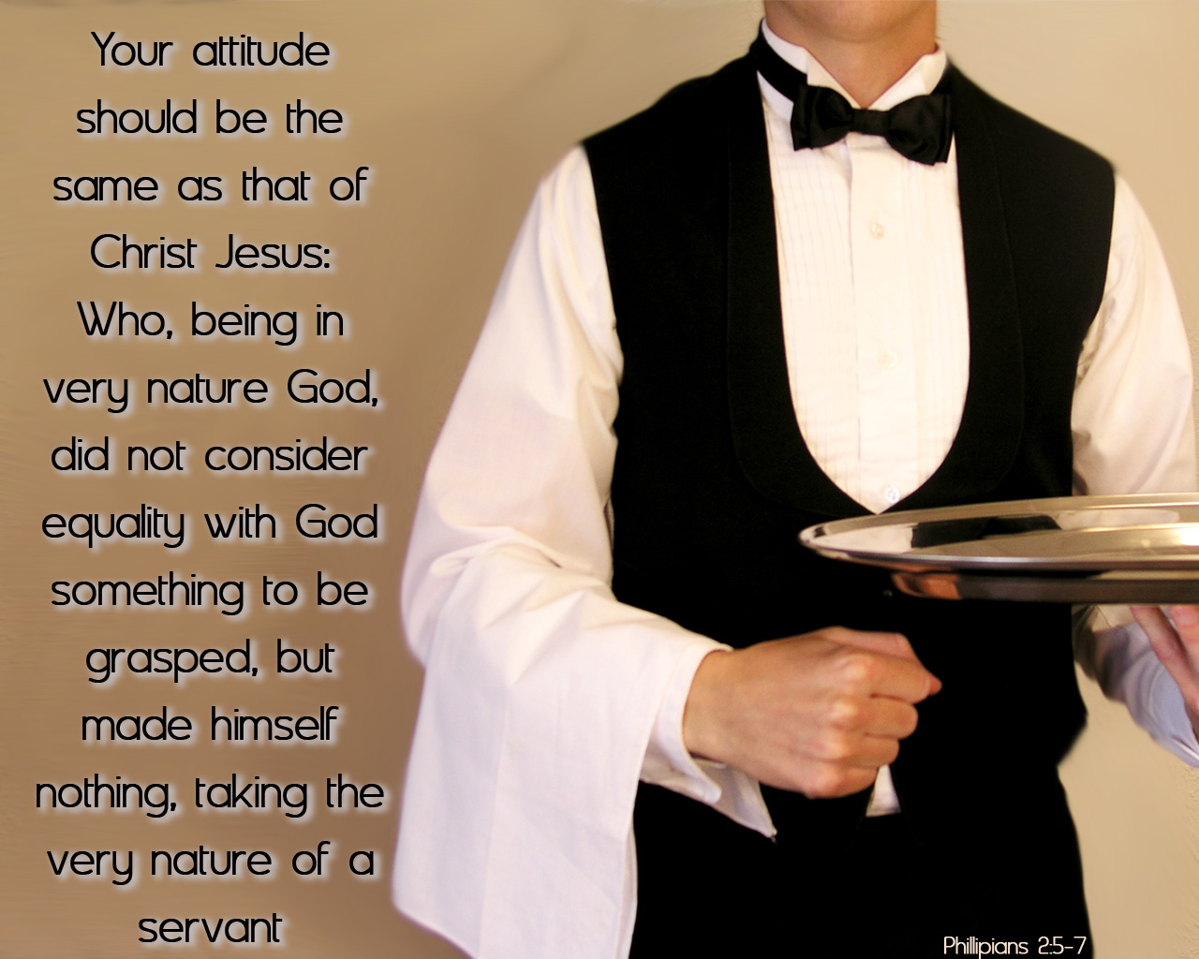
If Jesus could serve, can't we?

Slide 40

The Life of Christ

Slide 41
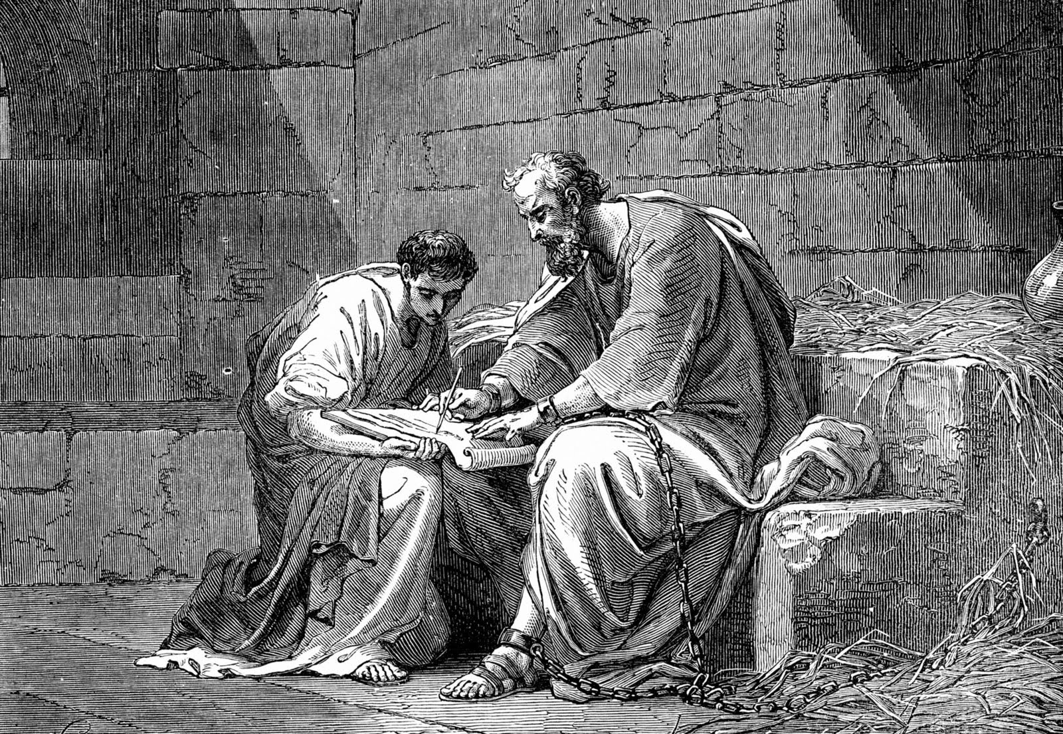
II. Other examples of humility show us what selflessness is really like (2:12-30).
Paul (2:12-18)

Slide 42
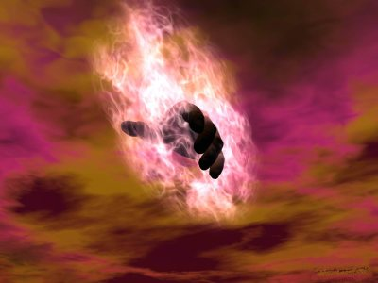
Let God work through you (2:12-13 NLT)
¹² Dear friends, you always followed my instructions when I was with you. And now that I am away, it is even more important. Work hard to show the results of your salvation, obeying God with deep reverence and fear. ¹³ For God is working in you, giving you the desire and the power to do what pleases him."

Slide 43
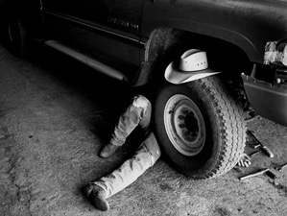
Should we take pride in our work?

Slide 44

"Do everything without complaining and arguing"
(2:14)

Slide 45
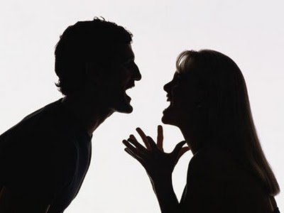
Results of a Bad Attitude
Philippians 2:14-16
186e
If we complain and argue
We won't be blameless & innocent
We won't stand out with a positive impact
Those who invested in us will wish they had invested in others

Slide 46

Results of a Good Attitude
Philippians 2:14-16
186f
Those who invested in us will rejoice that their efforts had been worth it
We will shine like stars in the universe
We will be blameless & innocent, children of God above reproach
If we do everything without complaining & arguing

Slide 47
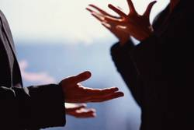
Complaining = ﻿γογγυσμῶν
goggusmoan
John 7:12 Jesus
Acts 6:1 Food
1 Pet 4:9 Hospitality
Notes:
﻿[GING] goggusmo,j goggusmo,j, ou/, o` grumbling, complaint, displeasure Ac 6:1 ; Phil 2:14; 1 Pt 4:9; secret talk, whispering J 7:12.* [pg 40]

Slide 48
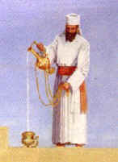

Paul's Example
¹⁷But I will rejoice even if I lose my life, pouring it out like a liquid offering to God, just like your faithful service is an offering to God. And I want all of you to share that joy. ¹⁸Yes, you should rejoice, and I will share your joy
(Phil. 2:17-18).

Slide 49
Other examples of Christ-like humility
Paul served with humility (2:16-18)
  Paul spent his life for the Philippians (“poured out as a drink offering on the sacrifice”)
Timothy served with humility (2:19-24)
  Timothy showed genuine interest for their welfare, not for his own interests
Epaphroditus served with humility (2:25-30)
  Epaphroditus risked his life to serve Paul

Slide 50
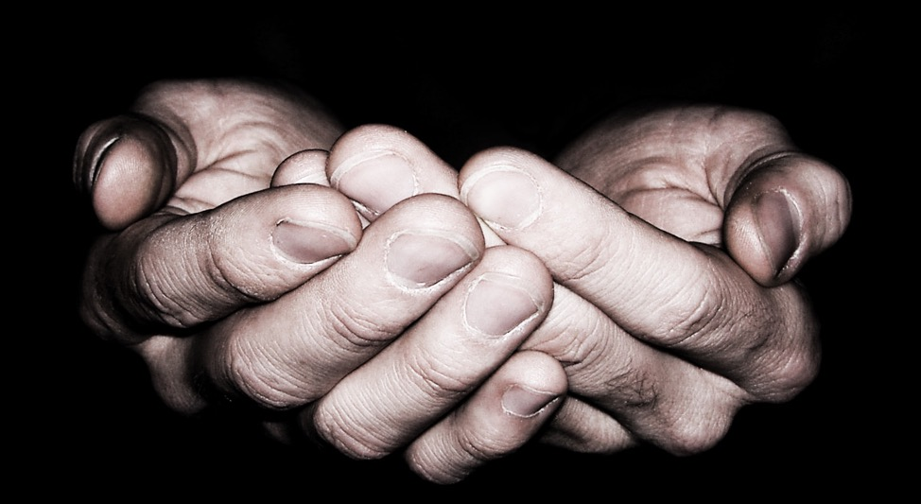
Humility is necessary for Christ-likeness
= The Main Idea of Philippians 2

Slide 51
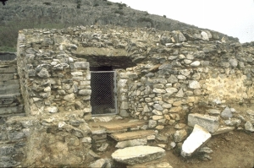
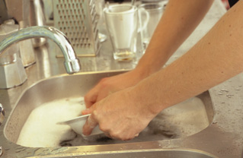


Do you show humility like Christ?

Slide 52
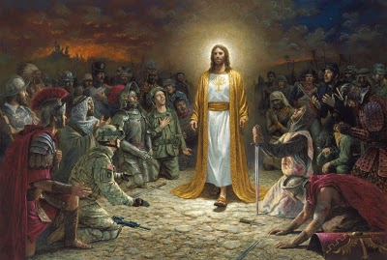
"Every knee will bow"

Slide 53
Black

Slide 54


NT Preaching link at BibleStudyDownloads.org
Get this presentation and script for free!
Notes:
NT Preaching (np)

