Slide 1
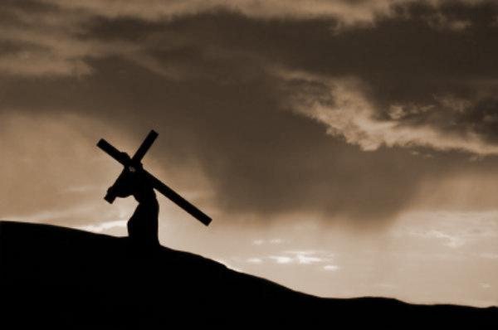
Philippians 1:27-30
Gospel Loyalty
Preached by Dan Bridges Amman International Church, Jordan (AmmanChurch.org) Uploaded by Dr. Rick Griffith • Jordan Evangelical Theological Seminary Files in many languages for free download at BibleStudyDownloads.org

Slide 2
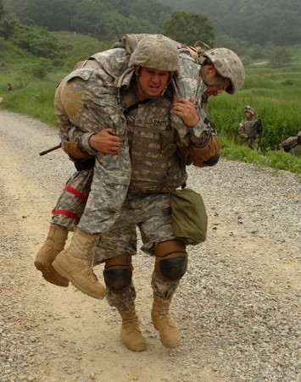
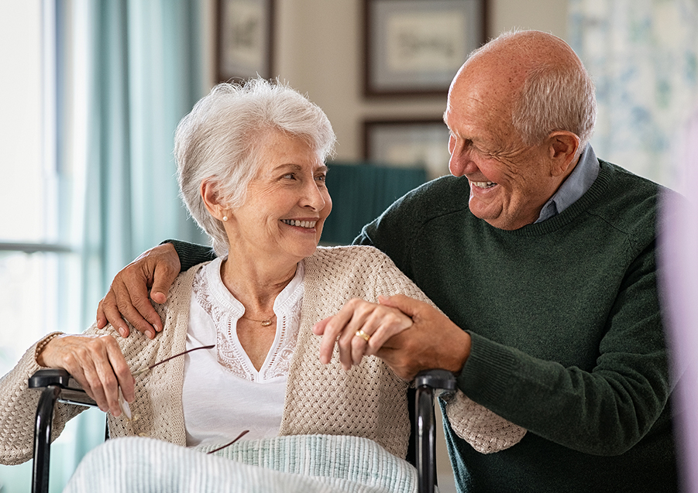
What emotions does the word “loyalty” stir up in your heart?

Slide 3
The Gospel in Philippians
God intends for the gospel to transform:
Our Identity (1-2)
Our Relationships (3-8)
Our Prayer (9-11)
How we face difficulty (12-18)
How we see the future (18-26)
Our loyalty (27-30)

Slide 4
Overall Context:
1:12-26: Paul’s personal update
1:27-2:16: Exhortations
Based on Epaphroditus’ update
Based on his love and concern for them
1:27 is the transition

Slide 5
²⁷ Only let your manner of life be worthy of the gospel of Christ, so that whether I come and see you or am absent, I may hear of you that you are standing firm in one spirit, with one mind striving side by side for the faith of the gospel, ²⁸ and not frightened in anything by your opponents. This is a clear sign to them of their destruction, but of your salvation, and that from God.
Philippians 1:27-28

Slide 6
²⁹ For it has been granted to you that for the sake of Christ you should not only believe in him but also suffer for his sake, ³⁰ engaged in the same conflict that you saw I had and now hear that I still have.
Philippians 1:29-30

Slide 7
²⁷ Only let your manner of life be worthy of the gospel of Christ, so that whether I come and see you or am absent, I may hear of you that you are standing firm in one spirit, with one mind striving side by side for the faith of the gospel, ²⁸ and not frightened in anything by your opponents. This is a clear sign to them of their destruction, but of your salvation, and that from God.
Philippians 1:27-28
Politeuomai:
to be a citizen of a state, to live as a good citizen, to conduct oneself according to the laws and customs of a state

Slide 8
²⁷ Only let your manner of life be worthy of the gospel of Christ, so that whether I come and see you or am absent, I may hear of you that you are standing firm in one spirit, with one mind striving side by side for the faith of the gospel, ²⁸ and not frightened in anything by your opponents. This is a clear sign to them of their destruction, but of your salvation, and that from God.
Philippians 1:27-28

Slide 9
What is the Gospel?
For the grace of God has appeared, bringing salvation for all people, ¹² training us to renounce ungodliness and worldly passions, and to live self-controlled, upright, and godly lives in the present age, ¹³ waiting for our blessed hope, the appearing of the glory of our great God and Savior Jesus Christ, ¹⁴ who gave himself for us to redeem us from all lawlessness and to purify for himself a people for his own possession who are zealous for good works.
Titus 2:11-14
Jesus gave his life to save us from our sin!

Slide 10
What is the Gospel?
¹⁴ …Jesus came into Galilee, proclaiming the gospel of God, ¹⁵ and saying, “The time is fulfilled, and the kingdom of God is at hand; repent and believe in the gospel.”
Mark 1:14-15
The gospel is
Something we must respond to – by repentance and belief.
A change of allegiance – of kingdoms

Slide 11
²⁷ Only let your manner of life be worthy of the gospel of Christ, so that whether I come and see you or am absent, I may hear of you that you are standing firm in one spirit, with one mind striving side by side for the faith of the gospel, ²⁸ and not frightened in anything by your opponents. This is a clear sign to them of their destruction, but of your salvation, and that from God.
Philippians 1:27-28
Politeuomai:
This passage is about what it means to be a loyal citizen of the Kingdom of God!

Slide 12
God’s call to all ordinary
believers is to live as loyal
Citizens of his Kingdom!

Slide 13
Living as Loyal Citizens of God’s Kingdom:
Standing together to protect the integrity of the gospel
Working together to spread the faith of the gospel
Living courageously in the truth of the gospel

Slide 14
Standing together to protect the integrity of the gospel
²⁷ Only let your manner of life be worthy of the gospel of Christ, so that whether I come and see you or am absent, I may hear of you that you are standing firm in one spirit, with one mind striving side by side for the faith of the gospel,

Slide 15
Standing together to protect the integrity of the gospel
Standing firm – defensive picture; implies there is opposition
In one spirit – implies the involvement of everyone!

Slide 16
Standing together to protect the integrity of the gospel
What was the opposition to the gospel in Paul’s day?
The Roman religious order (Christians were viewed as “atheists”)
The immorality around them
The Jewish religious order

Slide 17
Standing together to protect the integrity of the gospel
What is the opposition to the gospel in our day?
Relativism/Secularism – no definition of sin
The immorality around us
Western materialism and hedonism
Non-Christian religious orders
What does it look like to stand firm in one Spirit?

Slide 18
Standing together to protect the integrity of the gospel
What does it look like to do this?
Personal commitment to God’s holiness rather than the ever-changing cultural norms
Corporate commitment to God’s holiness
Commitment to a true gospel message
Living on guard – with the assumption that these things are being attacked!
Notes:
We are deeply influenced by culture around us… We want godliness – not culture that is 20 years behind secular culture.

Slide 19
Living as Loyal Citizens of God’s Kingdom:
Standing together to protect the integrity of the gospel
Working together to spread the faith of the gospel
Living courageously in the truth of the gospel

Slide 20
Working together to spread the faith of the gospel
²⁷ Only let your manner of life be worthy of the gospel of Christ, so that whether I come and see you or am absent, I may hear of you that you are standing firm in one spirit, with one mind striving side by side for the faith of the gospel,

Slide 21
Working together to spread the faith of the gospel
with one mind striving side by side – language of Greek athletics; picture of a group of athletes working in perfect coordination against another team
for the faith of the gospel – for the spread of the gospel

Slide 22
Working together to spread the faith of the gospel
What are the biggest challenges to the spread of the gospel in our day?
We’d like to blame external factors / opposition
The lifestyles of Christians!
Lack of priority on spreading the gospel
Unwillingness to engage/befriend the lost
Fear (of rejection, loss of relationships, suffering)
Cultural / religious rejection of the message

Slide 23
Working together to spread the faith of the gospel
How do we work together in this way?
Personal and corporate repentance
Partner together in praying for and engaging the lost
Main priority: Love!
Who? Family members, friends, co-workers, sometimes crossing cultural/religious boundaries

Slide 24
Living as Loyal Citizens of God’s Kingdom:
Standing together to protect the integrity of the gospel
Working together to spread the faith of the gospel
Living courageously in the truth of the gospel

Slide 25
Living courageously in the truth of the gospel
²⁸ and not frightened in anything by your opponents. This is a clear sign to them of their destruction, but of your salvation, and that from God. ²⁹ For it has been granted to you that for the sake of Christ you should not only believe in him but also suffer for his sake, ³⁰ engaged in the same conflict that you saw I had and now hear that I still have.

Slide 26
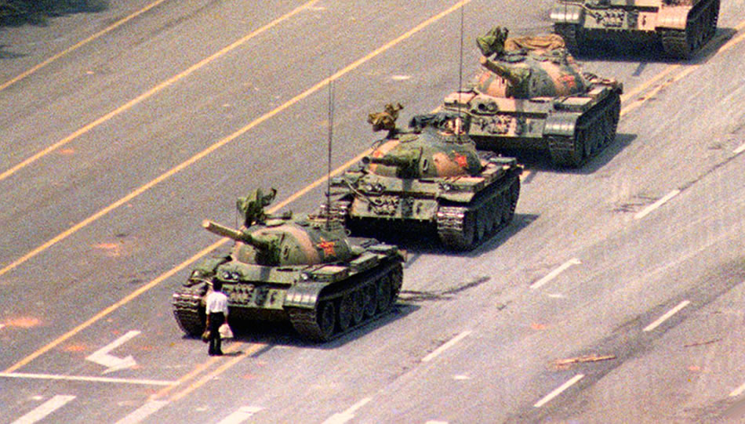
Living courageously in the truth of the gospel
Not frightened in anything by your opponents – This is standing courageously in the midst of opposition because you know what you stand for is right!

Slide 27
Living courageously in the truth of the gospel
Who are our opponents?
Those who belittle us for our faith
Those who have the power to affect our jobs or make life generally difficult for us
Those who have the power to imprison, harm or kill us

Slide 28
Living courageously in the truth of the gospel
What does it mean to live courageously?
It means to “stay the course” (not change) based on opposition that we encounter.
It means being willing to suffer for our faith.

Slide 29
Living courageously in the truth of the gospel
What do we believe about suffering?

Slide 30
Living courageously in the truth of the gospel
²⁹ For it has been granted to you that for the sake of Christ you should not only believe in him but also suffer for his sake…
Granted – graciously conferred favor

Slide 31
Living courageously in the truth of the gospel
²⁹ For it has been granted to you that for the sake of Christ you should not only believe in him but also suffer for his sake…
Granted – graciously conferred favor
Believing granted by God (God brought it about)

Slide 32
Living courageously in the truth of the gospel
²⁹ For it has been granted to you that for the sake of Christ you should not only believe in him but also suffer for his sake…
Granted – graciously conferred favor
Believing granted by God (God brought it about)
Suffering granted by God (God brought it about)

Slide 33
Living courageously in the truth of the gospel
²⁹ For it has been granted to you that for the sake of Christ you should not only believe in him but also suffer for his sake…
Granted – graciously conferred favor
Believing granted by God (God brought it about)
Suffering granted by God (God brought it about)
It is for Jesus’ sake (because of our attachment to him)

Slide 34
Living courageously in the truth of the gospel
²⁸ and not frightened in anything by your opponents. This is a clear sign to them of their destruction, but of your salvation, and that from God. ²⁹ For it has been granted to you that for the sake of Christ you should not only believe in him but also suffer for his sake, ³⁰ engaged in the same conflict that you saw I had and now hear that I still have.
The ultimate source of suffering: God!

Slide 35
Living as Loyal Citizens of God’s Kingdom:
Standing together to protect the integrity of the gospel
Working together to spread the faith of the gospel
Living courageously in the truth of the gospel
Where does our loyalty lie?

Slide 36
Living as Loyal Citizens of God’s Kingdom:
Standing together to protect the integrity of the gospel
Working together to spread the faith of the gospel
Living courageously in the truth of the gospel
Has God spoken to you about one of these?

Slide 38
NT Preaching link at BibleStudyDownloads.org
Get this presentation for free!
Notes:
NT Preaching (np)

