Slide 1
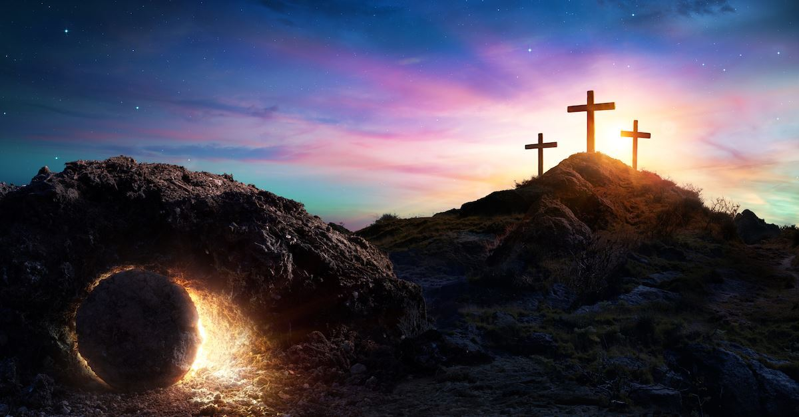
A Walk Through
Passion Week
Easter 2026
Led by Dan Bridges
Amman International Church, Jordan (AmmanChurch.org)
Uploaded by Dr. Rick Griffith • Jordan Evangelical Theological Seminary
Files in many languages for free download at BibleStudyDownloads.org

Slide 2
He is Risen! He is Risen Indeed!
Wishing you a blessed Easter!

Slide 3
المسيح قام! حقا قام!
كل عام و انتم بالف خير!

Slide 4
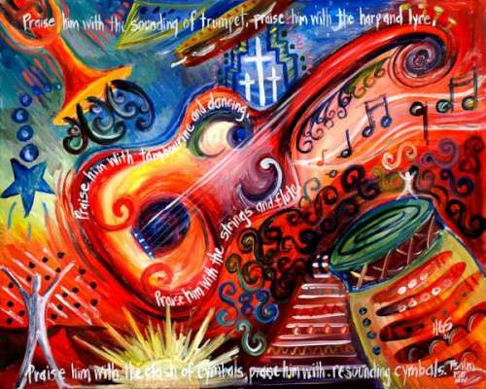
Resurrection Worship!
Join us for a Special Easter Worship Service!
“A Multi-Lingual Walk Through Passion Week”
Saturday, April 11 at 5:30pm.
Triumphal Entry
Last Supper (with communion)
Gethsemane
Jesus’ Crucifixion and Death
Jesus’ Resurrection!
Jesus’ Glorification!
Readings, Singing, Dancing and more!
Opportunitues for kids to participate!
Praise him with trumpet sound;
praise him with lute and harp!
Praise him with tambourine and dance;
praise him with strings and pipe!
Praise him with sounding cymbals;
praise him with loud clashing cymbals!
Let everything that has breath praise the Lord!
Praise the Lord! Psalm 150:3-6

Slide 5
Resurrection Worship!
Praise him with trumpet sound;
praise him with lute and harp!
Praise him with tambourine and dance;
praise him with strings and pipe!
Praise him with sounding cymbals;
praise him with loud clashing cymbals!
Let everything that has breath praise the Lord!
Praise the Lord! Psalm 150:3-6

Slide 6
Resurrection Worship!
Singing in Worship:
“Praise the Lord!
For it is good to sing praises to our God;
for it is pleasant, and a song of praise is fitting.”
Psalm 147:1

Slide 7
Resurrection Worship!
Raising Hands in Worship:
“Let my prayer be counted as incense before you,
and the lifting up of my hands as the evening sacrifice!”
Psalm 141:2

Slide 8
Resurrection Worship!
Kneeling in Worship:
“Oh come, let us worship and bow down;
let us kneel before the Lord, our Maker!”
Psalm 95:6

Slide 9
Resurrection Worship!
Dancing in Worship:
“Let them praise his name with dancing,
making melody to him with tambourine and lyre!”
Psalm 149:3

Slide 10
Resurrection Worship!
Banners / Flags in Worship:
“May we shout for joy over your salvation,
and in the name of our God set up our banners!
May the Lord fulfill all your petitions!”
Psalm 20:5

Slide 11
Resurrection Worship!
Let’s put our hearts, our voices and our bodies into worship tonight!

Slide 12
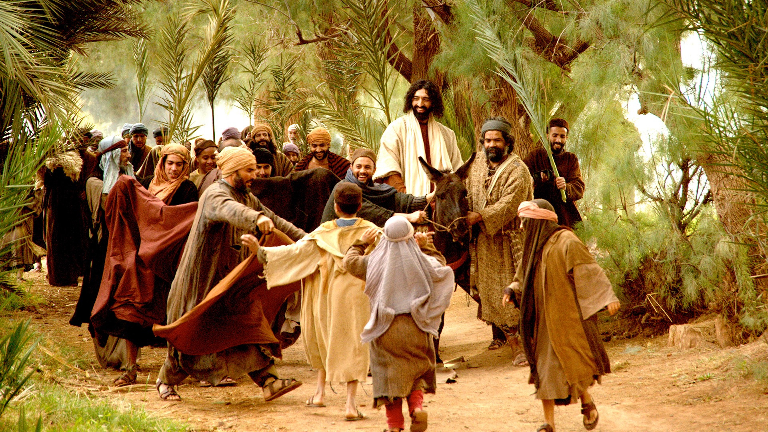
Triumphal Entry – Matthew 21:7-9
⁷ The disciples brought the donkey and the colt and put on them their cloaks, and he sat on them. ⁸ Most of the crowd spread their cloaks on the road, and others cut branches from the trees and spread them on the road. ⁹ And the crowds that went before him and that followed him were shouting, “Hosanna to the Son of David! Blessed is he who comes in the name of the Lord! Hosanna in the highest!”

Slide 13
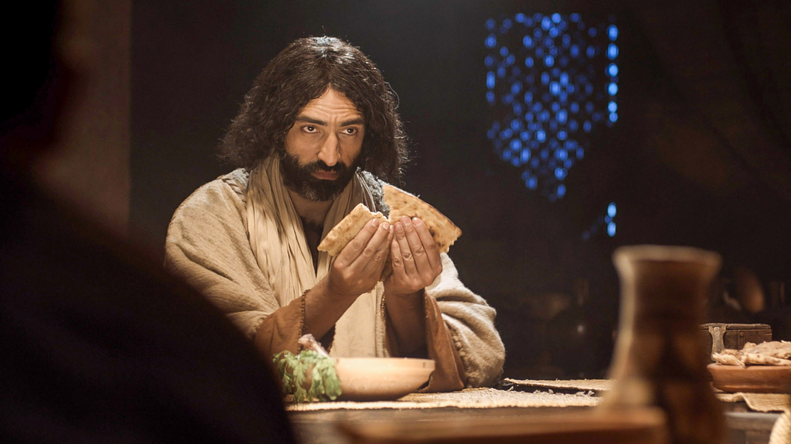
Last Supper – Matthew 26:26-29
²⁶ Now as they were eating, Jesus took bread, and after blessing it broke it and gave it to the disciples, and said, “Take, eat; this is my body.” ²⁷ And he took a cup, and when he had given thanks he gave it to them, saying, “Drink of it, all of you, ²⁸ for this is my blood of the covenant, which is poured out for many for the forgiveness of sins. ²⁹ I tell you I will not drink again of this fruit of the vine until that day when I drink it new with you in my Father's kingdom.”

Slide 14
A Reinterpretation of the Passover
^{“7} Cleanse out the old leaven that you may be a new lump, as you really are unleavened. For Christ, our Passover lamb, has been sacrificed. ⁸ Let us therefore celebrate the festival, not with the old leaven, the leaven of malice and evil, but with the unleavened bread of sincerity and truth.”
1 Corinthians 5:7-8

Slide 15
The Bread – Christ’s Body
²⁶ Now as they were eating, Jesus took bread, and after blessing it broke it and gave it to the disciples, and said, “Take, eat; this is my body.” ²⁷ And he took a cup, and when he had given thanks he gave it to them, saying, “Drink of it, all of you, ²⁸ for this is my blood of the covenant, which is poured out for many for the forgiveness of sins. ²⁹ I tell you I will not drink again of this fruit of the vine until that day when I drink it new with you in my Father's kingdom.”

Slide 16
The Cup – Christ’s Blood
²⁶ Now as they were eating, Jesus took bread, and after blessing it broke it and gave it to the disciples, and said, “Take, eat; this is my body.” ²⁷ And he took a cup, and when he had given thanks he gave it to them, saying, “Drink of it, all of you, ²⁸ for this is my blood of the covenant, which is poured out for many for the forgiveness of sins. ²⁹ I tell you I will not drink again of this fruit of the vine until that day when I drink it new with you in my Father's kingdom.”

Slide 17
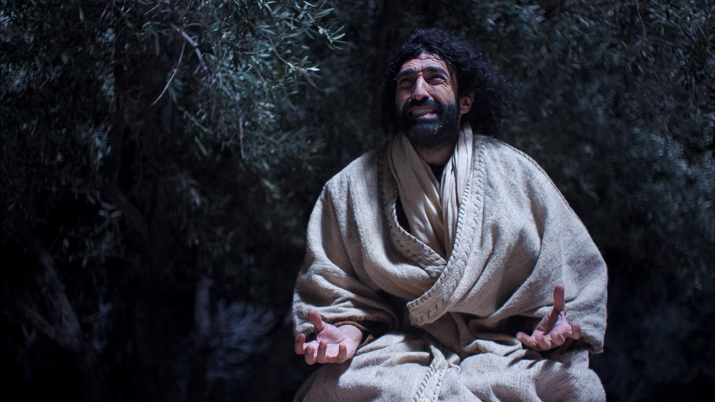
Gethsemane – Matthew 26:36-39
³⁶ Then Jesus went with them to a place called Gethsemane, and he said to his disciples, “Sit here, while I go over there and pray.” ³⁷ And taking with him Peter and the two sons of Zebedee, he began to be sorrowful and troubled. ³⁸ Then he said to them, “My soul is very sorrowful, even to death; remain here, and watch with me.” ³⁹ And going a little farther he fell on his face and prayed, saying, “My Father, if it be possible, let this cup pass from me; nevertheless, not as I will, but as you will.”

Slide 18
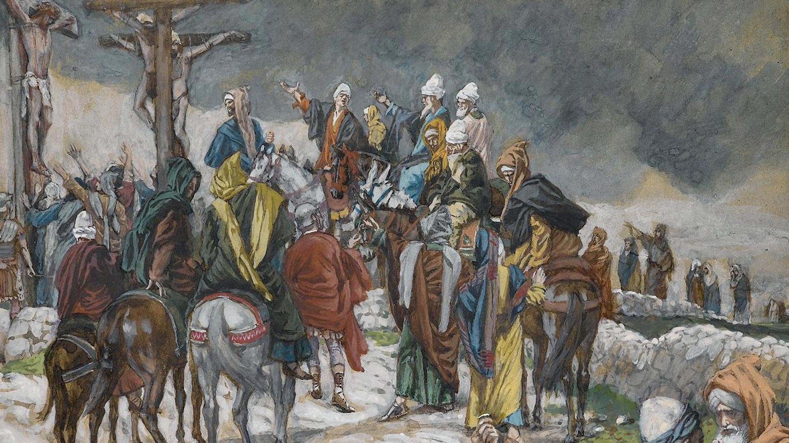
Crucifixion – Matthew 27:32-43
³³ And when they came to a place called Golgotha ³⁴ they offered him wine to drink, mixed with gall, but when he tasted it, he would not drink it. ³⁵ And when they had crucified him, they divided his garments among them by casting lots. ³⁶ Then they sat down and kept watch over him there. ³⁷ And over his head they put the charge against him, which read, “This is Jesus, the King of the Jews.”… ³⁹ And those who passed by derided him, wagging their heads

Slide 19
Crucifixion – Matthew 27:32-43
⁴⁰ and saying, “You who would destroy the temple and rebuild it in three days, save yourself! If you are the Son of God, come down from the cross.” ⁴¹ So also the chief priests, with the scribes and elders, mocked him, saying, ⁴² “He saved others; he cannot save himself. He is the King of Israel; let him come down now from the cross, and we will believe in him. ⁴³ He trusts in God; let God deliver him now, if he desires him. For he said, ‘I am the Son of God.’”

Slide 20
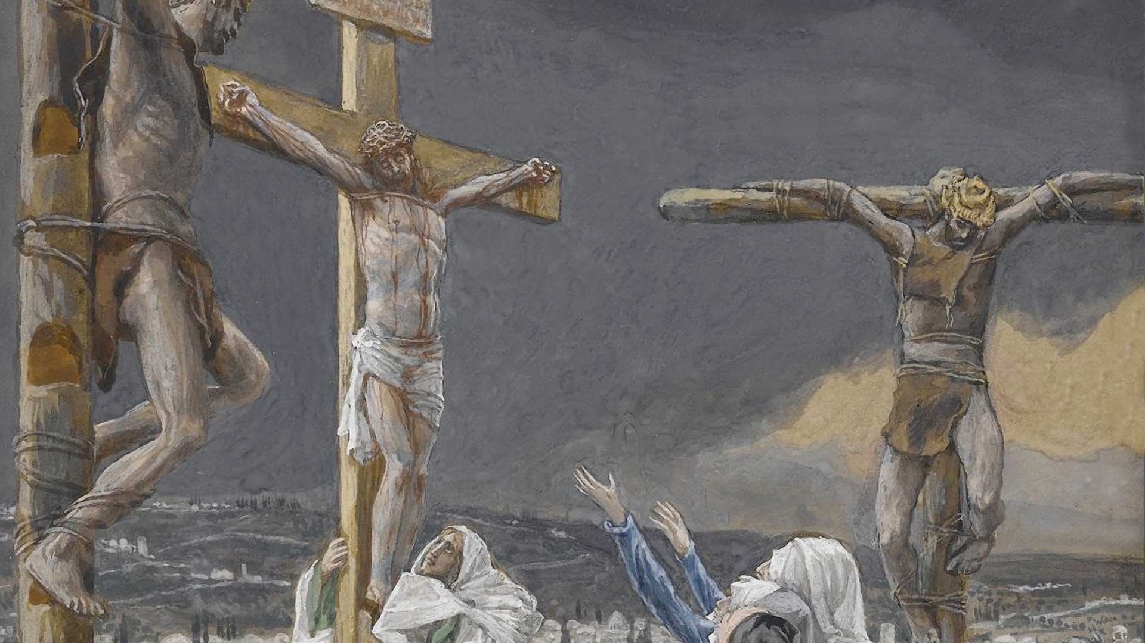
Death – Matthew 27:45-54
⁴⁵ Now from the sixth hour there was darkness over all the land until the ninth hour. ⁴⁶ And about the ninth hour Jesus cried out with a loud voice, saying, “Eli, Eli, lema sabachthani?” that is, “My God, my God, why have you forsaken me?” ⁴⁷ And some of the bystanders, hearing it, said, “This man is calling Elijah.” … ⁵⁰ And Jesus cried out again with a loud voice and yielded up his spirit.

Slide 21
Death – Matthew 27:45-54
⁵¹ And behold, the curtain of the temple was torn in two, from top to bottom. And the earth shook, and the rocks were split. ⁵² The tombs also were opened. And many bodies of the saints who had fallen asleep were raised, ⁵³ and coming out of the tombs after his resurrection they went into the holy city and appeared to many. ⁵⁴ When the centurion and those who were with him, keeping watch over Jesus, saw the earthquake and what took place, they were filled with awe and said, “Truly this was the Son of God!”

Slide 22
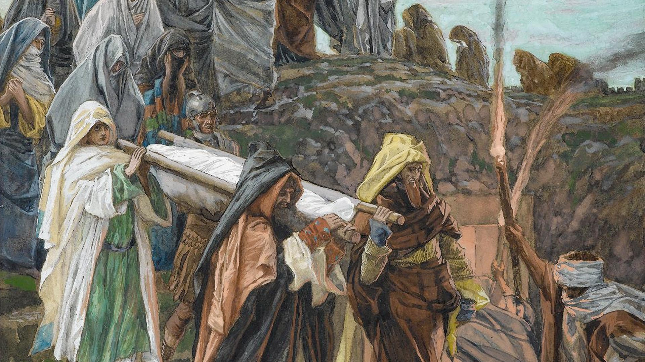
Burial – Matthew 27:57-61
⁵⁷ When it was evening, there came a rich man from Arimathea, named Joseph, who also was a disciple of Jesus. ⁵⁸ He went to Pilate and asked for the body of Jesus. Then Pilate ordered it to be given to him. 59 And Joseph took the body and wrapped it in a clean linen shroud ⁶⁰ and laid it in his own new tomb, which he had cut in the rock. And he rolled a great stone to the entrance of the tomb and went away. ⁶¹ Mary Magdalene and the other Mary were there, sitting opposite the tomb.

Slide 23
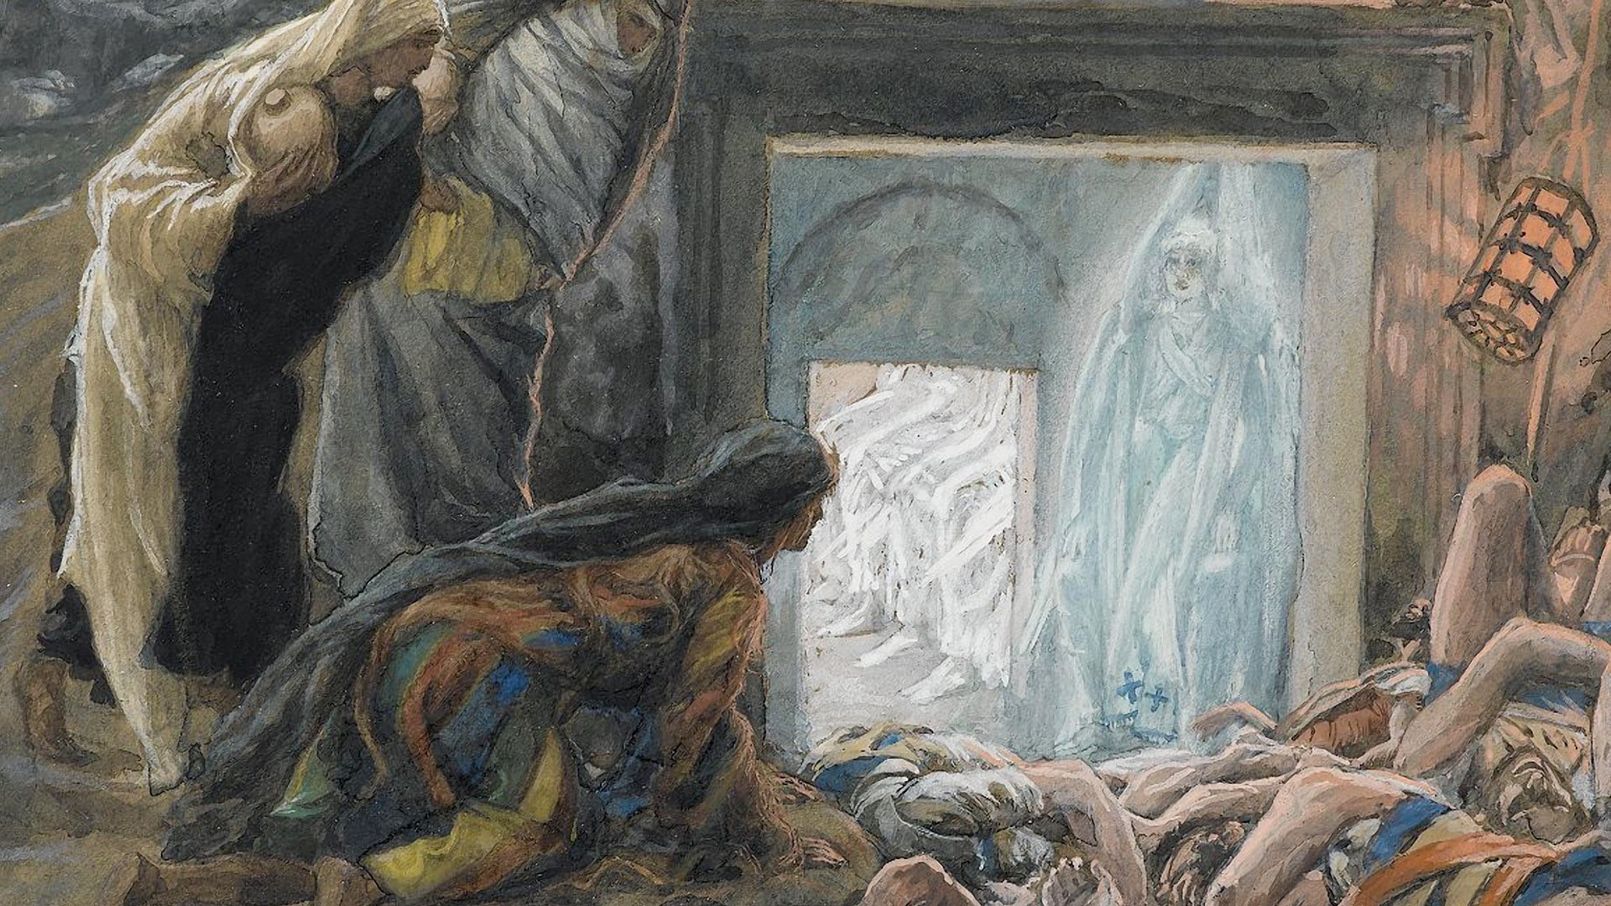
Resurrection – Matthew 28:1-10
¹ Now after the Sabbath, toward the dawn of the first day of the week, Mary Magdalene and the other Mary went to see the tomb. ² And behold, there was a great earthquake, for an angel of the Lord descended from heaven and came and rolled back the stone and sat on it. ³ His appearance was like lightning, and his clothing white as snow. ⁴ And for fear of him the guards trembled and became like dead men.

Slide 24
Resurrection – Matthew 28:1-10
⁵ But the angel said to the women, “Do not be afraid, for I know that you seek Jesus who was crucified. ⁶ He is not here, for he has risen, as he said. Come, see the place where he lay. ⁷ Then go quickly and tell his disciples that he has risen from the dead, and behold, he is going before you to Galilee; there you will see him. See, I have told you.”

Slide 25
Resurrection – Matthew 28:1-10
8 So they departed quickly from the tomb with fear and great joy, and ran to tell his disciples. 9 And behold, Jesus met them and said, “Greetings!” And they came up and took hold of his feet and worshiped him. 10 Then Jesus said to them, “Do not be afraid; go and tell my brothers to go to Galilee, and there they will see me.”

Slide 26
Resurrection Worship!
Praise him with trumpet sound;
praise him with lute and harp!
Praise him with tambourine and dance;
praise him with strings and pipe!
Praise him with sounding cymbals;
praise him with loud clashing cymbals!
Let everything that has breath praise the Lord!
Praise the Lord!

Slide 27
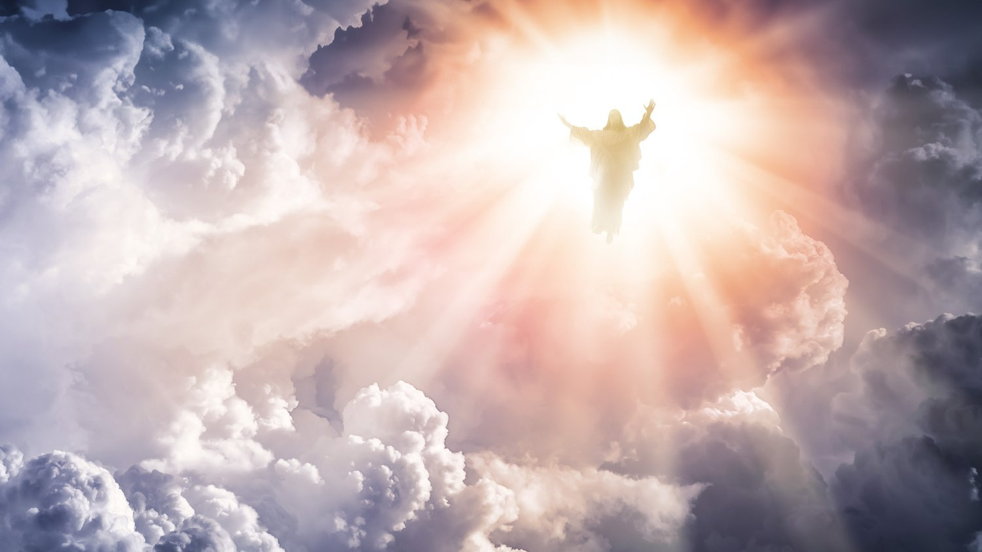
Glorification – Philippians 2:9-11
9 Therefore God has highly exalted him and bestowed on him the name that is above every name, 10 so that at the name of Jesus every knee should bow, in heaven and on earth and under the earth, 11 and every tongue confess that Jesus Christ is Lord, to the glory of God the Father.

Slide 28
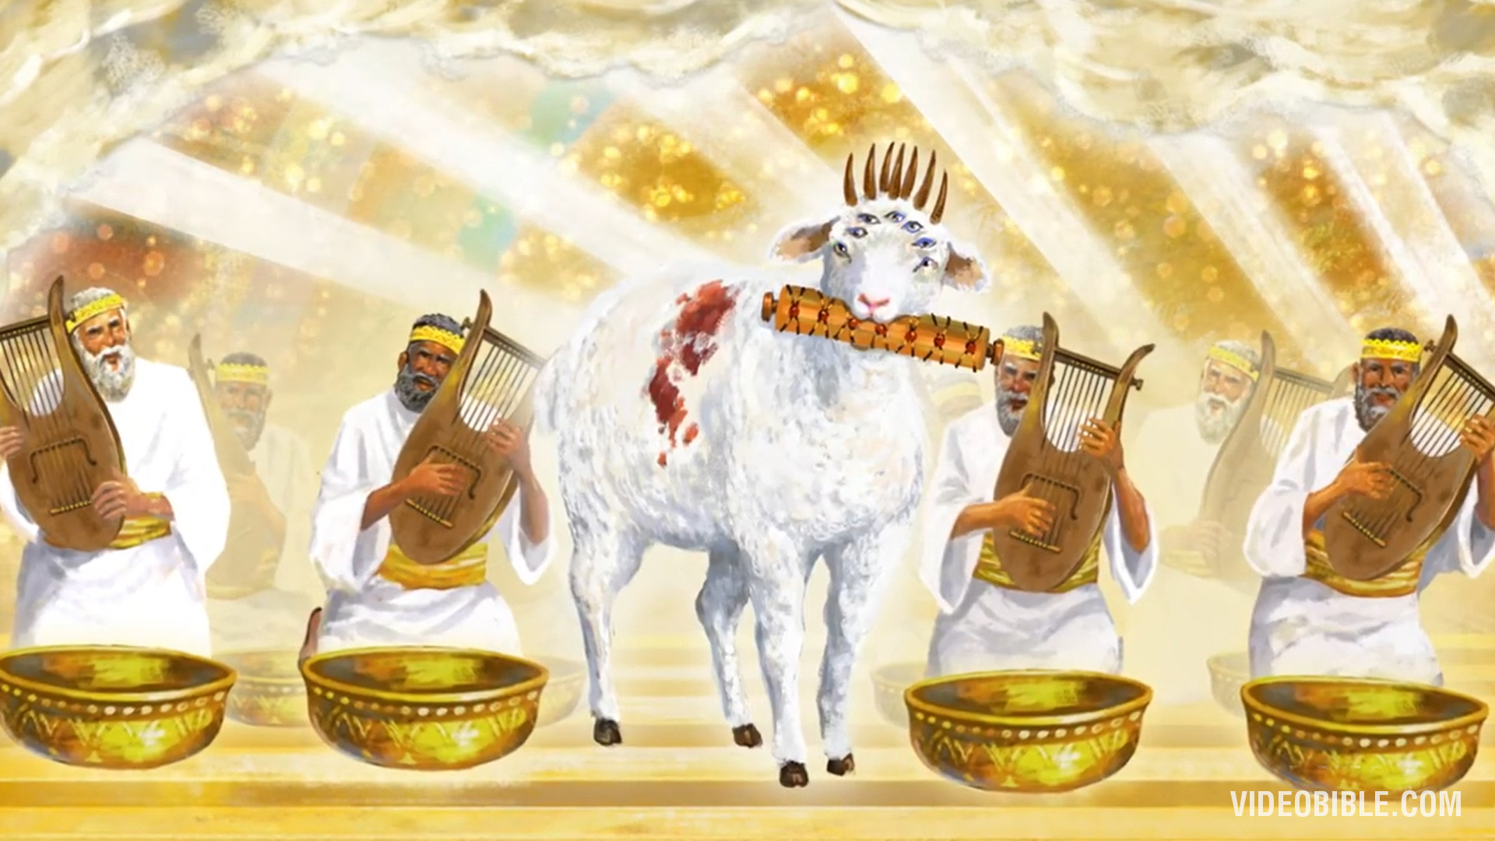
Glorification – Revelation 5:6-12
6 And between the throne and the four living creatures and among the elders I saw a Lamb standing, as though it had been slain…
8 And when the lamb had taken the scroll, the four living creatures and the twenty-four elders fell down before the Lamb, each holding a harp, and golden bowls full of incense, which are the prayers of the saints. 9 And they sang a new song, saying,

Slide 29
Glorification – Revelation 5:6-12
9 “Worthy are you to take the scroll and to open its seals,
for you were slain,
and by your blood you ransomed people for God
from every tribe and language and people and nation,
10 and you have made them a kingdom and priests to our
God, and they shall reign on the earth.”

Slide 30
Glorification – Revelation 5:6-12
11 Then I looked, and I heard … the voice of many angels, numbering myriads of myriads and thousands of thousands, 12 saying with a loud voice,
“Worthy is the Lamb who was slain,
to receive power and wealth and wisdom and might
and honor and glory and blessing!”

Slide 32


NT Preaching link at BibleStudyDownloads.org
Get this presentation and script for free!
Notes:
NT Preaching (np)

