Slide 1
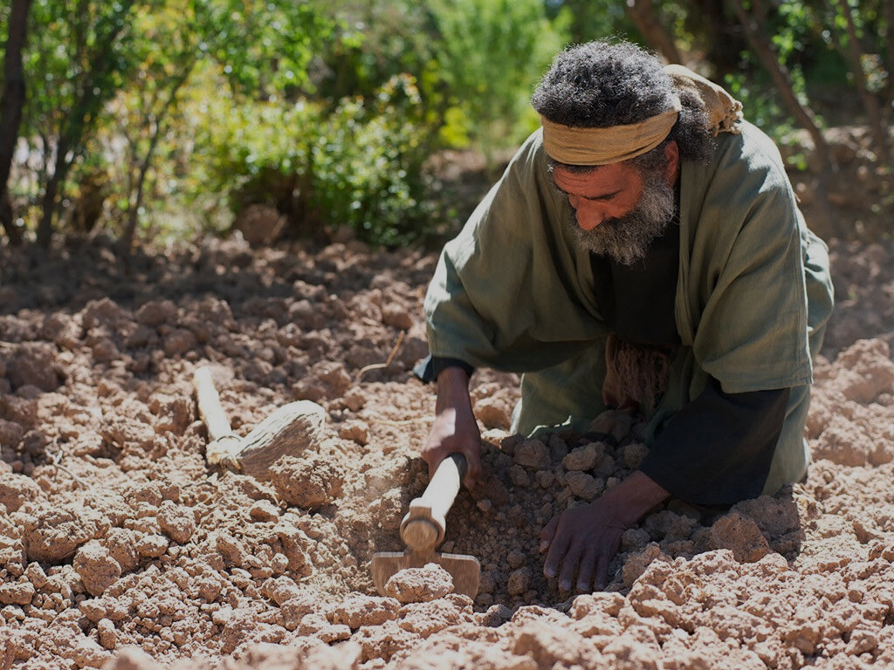
The Hidden Treasure
Matthew 13:44
The Pearl of Great Value
Matthew 13:45-46
Dr. David Martin • Amman International Church AmmanChurch.org • BibleStudyDownloads.org

Slide 2
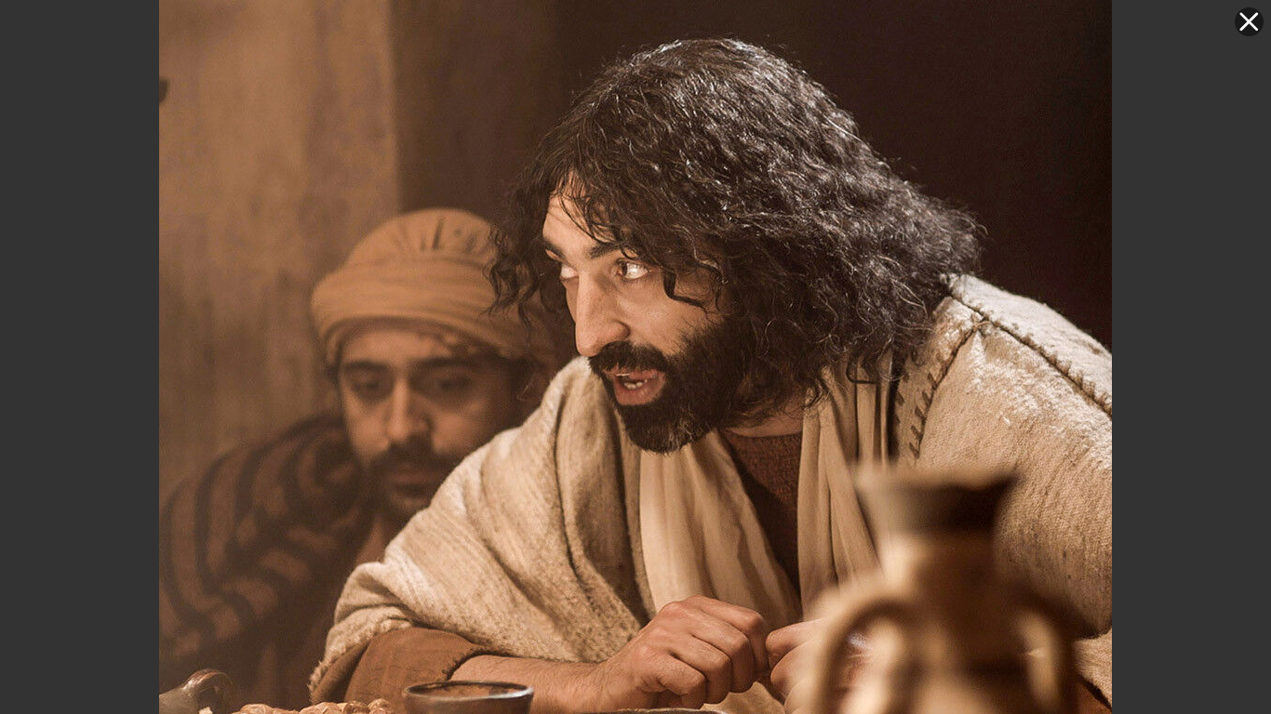
Explaining the “mysteries” of the Kingdom (Matthew 13)
Issue: The surpassing joy and value of the Kingdom
The Kingdom of God:
1) “Already”
(spiritual)
Luke 11:20; 17:20-21
2) “Not yet”
(earthly)
Luke 11:2; 22:17-18

Slide 3
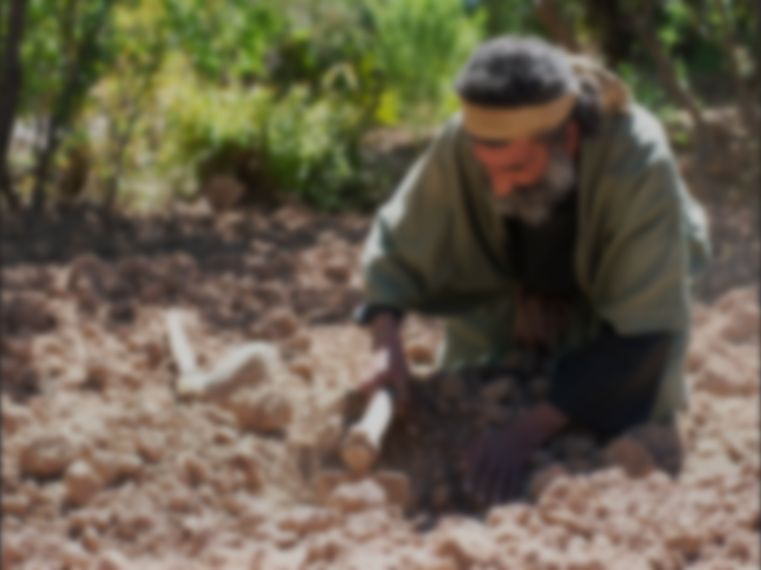
Parable of the Hidden Treasure (Matthew 13:44)
“The kingdom of heaven is like a treasure hidden in the field, which a man found and hid again; and from joy over it he goes and sells all that he has
and buys that field.”

Slide 4
✓Why were treasures hidden in fields? (Matt. 6:19; 25:18)

Slide 5
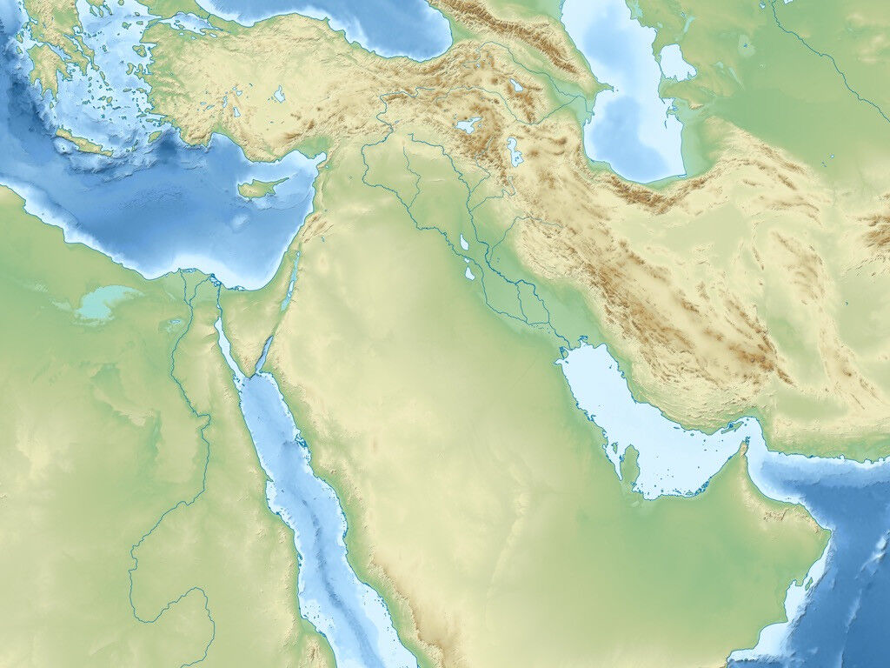
Greece and Rome
Assyria
Babylon
Egypt

Slide 6
✓Why were treasures hidden in fields? (Matt. 6:19; 25:18)
✓What were the rules for finding such treasure?
✓It clearly did not belong to the landowner

Slide 7
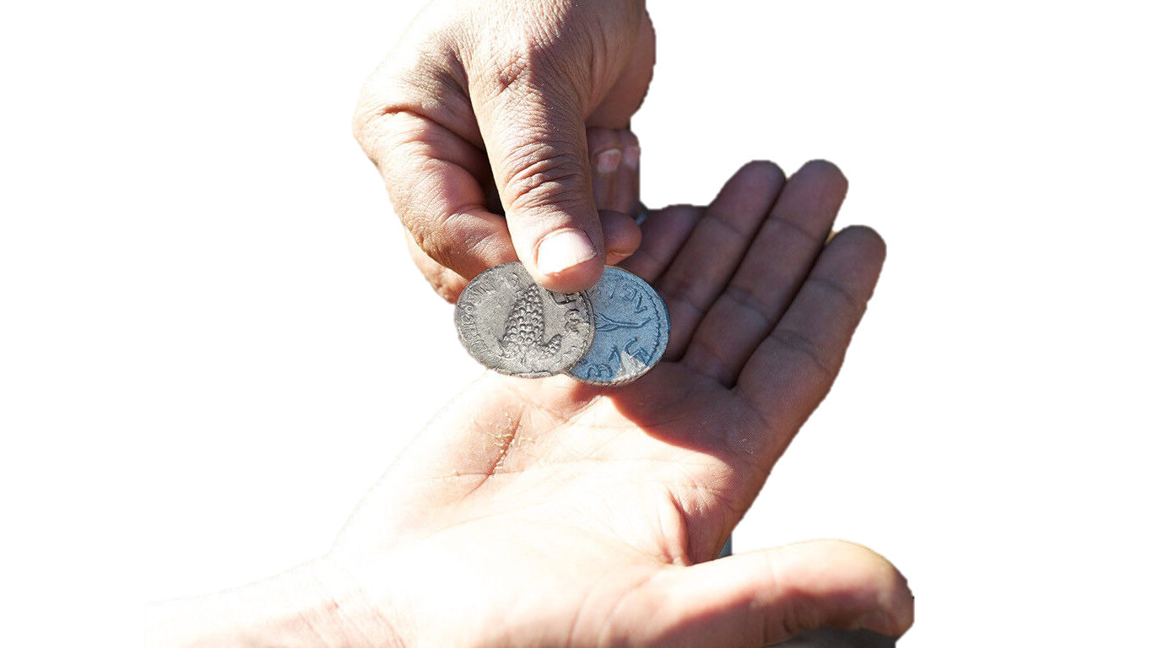
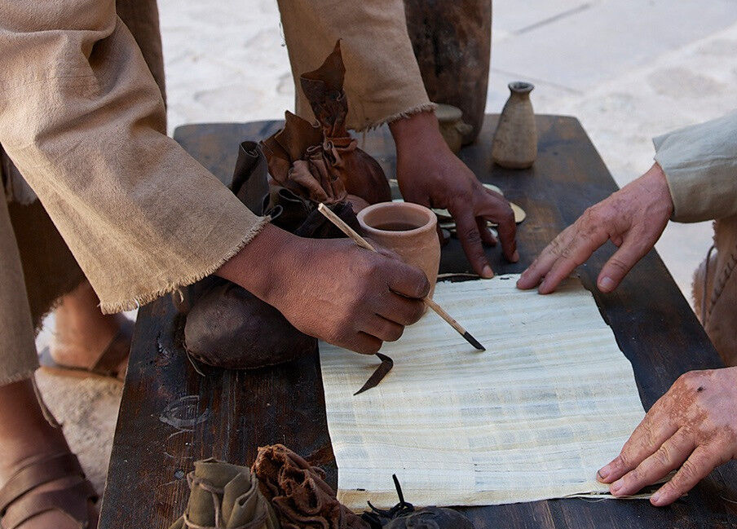
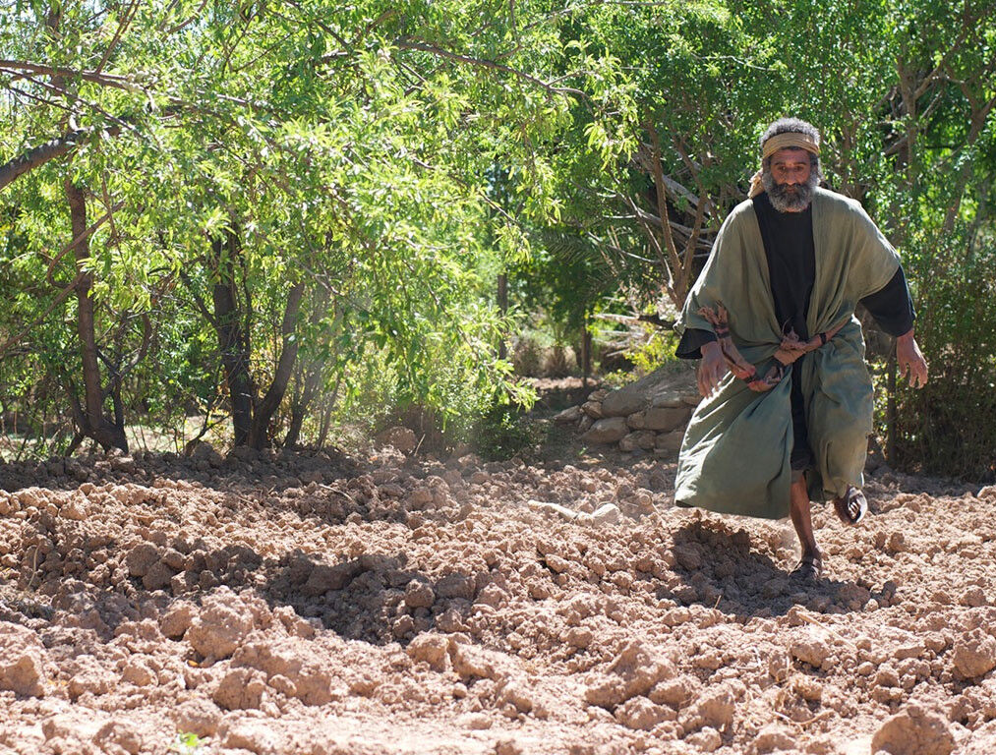
He was so overwhelmed by the value of his unexpected discovery that he joyfully surrendered all that he had in order to gain that treasure!

Slide 8
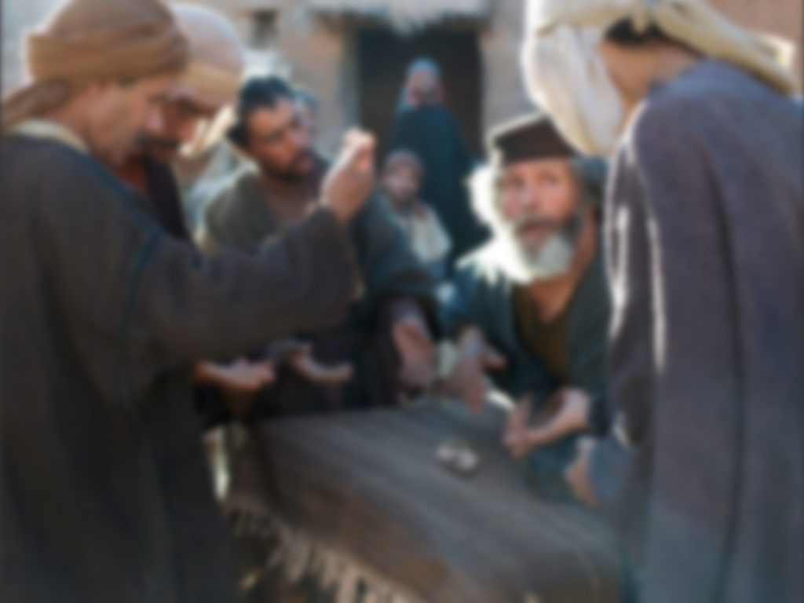
The Pearl of Great Value (Matthew 13:45-46)
“Again, the kingdom of heaven is like a merchant seeking fine pearls, and upon finding one pearl of great value, he went and sold all that he had and bought it.”

Slide 9
✓The merchant was a traveling wholesaler
✓He specialized in fine pearls
(Red Sea, Persian Gulf, Indian Ocean)
✓Pearls were valued above gold at that time

Slide 10
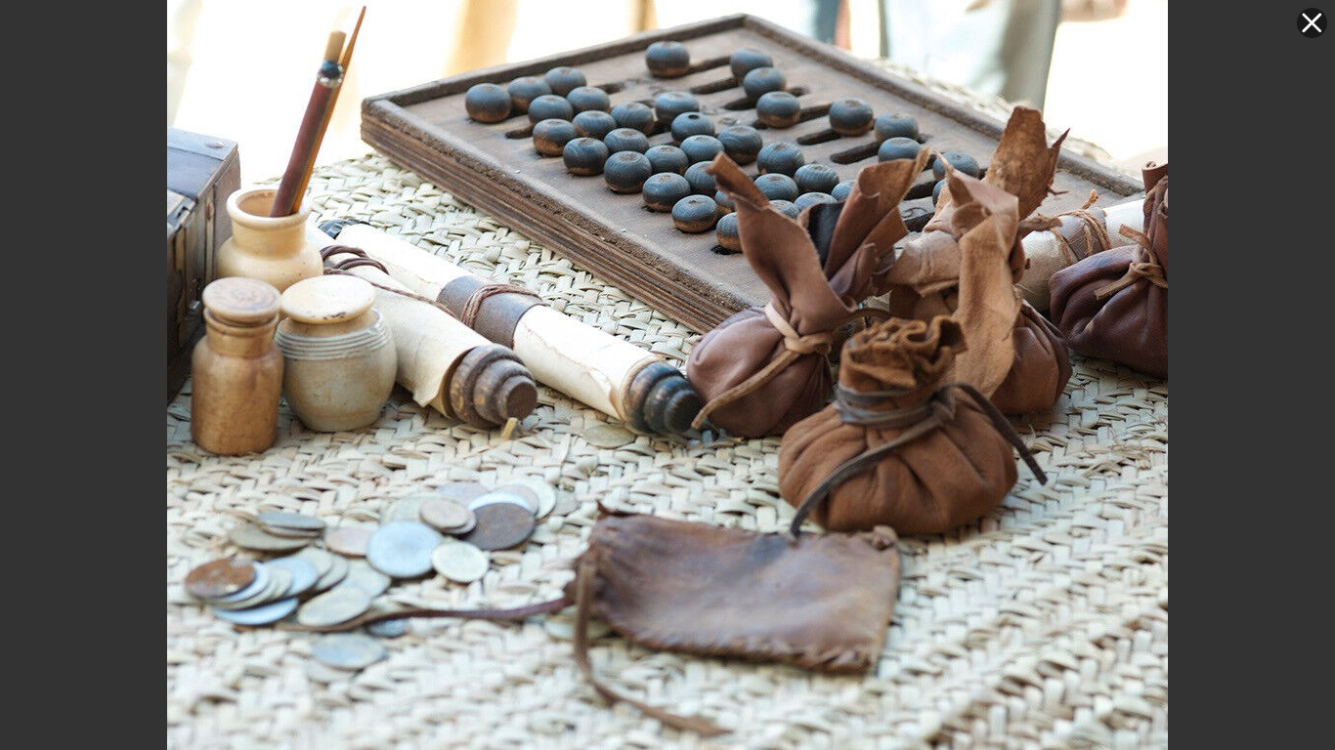
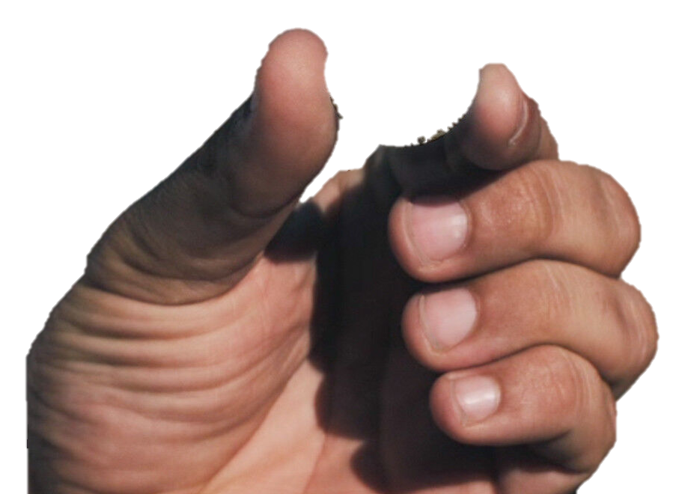

Slide 11
1. The Kingdom of God and the salvation it brings is priceless in value!
John 3:3
1 Peter 1:4
“The Kingdom of God is the realm where Christ rules over and eternally blesses His loving subjects who in faith, joyfully embrace Him as their Lord and Savior.” (John MacArthur)
What do
we learn?

Slide 12
2. The Kingdom of God and its salvation must be personally received through faith.
John 8:39,44
John 1:12-13 Ephesians 2:8-9
What do
we learn?

Slide 13
3. People enter the Kingdom of God through different circumstances.
Those who stumble onto hidden treasure Acts 9 → John 4 →
The Apostle Paul
The woman at the well
Those who are looking for fine pearls Acts 8 → Acts 10 →
The Ethiopian eunuch
Cornelius
What do
we learn?

Slide 14
4. Genuine Kingdom citizens are willing to joyfully surrender all they have to serve their King.
Romans 14:8 Matthew 16:24-26 Philippians 3:7-8
“He is no fool who gives what he cannot keep to gain what he cannot lose.” —Jim Elliot
What do
we learn?

Slide 15
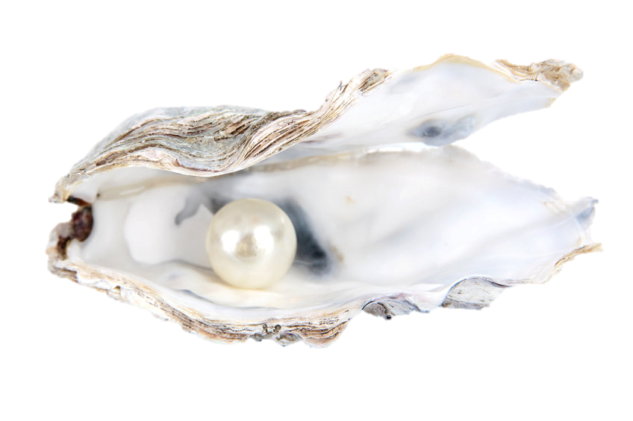
I am a child of God
“To all who did receive him, who believed in his name, he gave the right to become children of God.” (John 1:12)

Slide 16
I have peace with God
“Therefore, since we have been justified by faith, we have peace with God through our Lord Jesus Christ.” (Romans 5:1)

Slide 17
The Holy Spirit lives in me
“Do you not know that you are God’s temple and that God’s Spirit dwells in you?” (1 Corinthians 3:16)

Slide 18
I am helped by God
“Let us then with confidence draw near to the throne of grace, that we may receive mercy and find grace to help in time of need.”
(Hebrews 4:16)

Slide 19
I am reconciled to God
“We also rejoice in God through our Lord Jesus Christ, through whom we have now received reconciliation.”
(Romans 5:11)

Slide 20
I have Christ’s righteousness
“For our sake he made him to be sin who knew no sin, so that in him we might become the righteousness of God.”
(2 Corinthians 5:21)

Slide 21
I am justified
“Therefore, since we have been justified by faith, we have peace with God through our Lord Jesus Christ.”
(Romans 5:1)

Slide 22
I am Christ’s ambassador
“Therefore, we are ambassadors for Christ,
God making his appeal through us . . .”
(2 Corinthians 5:20)

Slide 23
I am completely forgiven
“He has delivered us from the domain of darkness and transferred us to the kingdom of his beloved Son, in whom we have redemption, the forgiveness of sins.”
(Colossians 1:13-14)

Slide 24
I am tenderly loved by God
“For God so loved the world, that he gave his only Son, that whoever believes in him should not perish but have eternal life.”
(John 3:16)

Slide 25
I am a temple in which God dwells
“Do you not know that you are God’s temple and that God’s Spirit dwells in you?”
(1 Corinthians 3:16)

Slide 26
I am Christ’s friend
“No longer do I call you servants, for the servant does not know what his master is doing; but I have called you friends, for all that I have heard from my Father I have made known to you.”
(John 15:15)

Slide 27
I am chosen by Christ to bear fruit
“You did not choose me, but I chose you and appointed you that you should go and bear fruit and that your fruit should abide, so that whatever you ask the Father in my name, he may give it to you.”
(John 15:16)

Slide 28
I am a branch on Christ’s vine
“I am the vine; you are the branches. Whoever abides in me and I in him, he it is that bears much fruit, for apart from me you can do nothing.”
(John 15:5)

Slide 29
I am a joint heir with Christ
“The Spirit himself bears witness with our spirit that we are children of God, and if children, then heirs— heirs of God and fellow heirs with Christ . . .”
(Romans 8:16-17)

Slide 30
I am a member of Christ’s body
“Now you are the body of Christ and individually members of it”
(1 Corinthians 12:27)

Slide 31
I am chosen by God, holy and dearly loved
“Put on then, as God’s chosen ones, holy and beloved, compassionate hearts, kindness, humility, meekness, and patience.”
(Colossians 3:12)

Slide 32
I am holy and I share in God’s heavenly calling
“Therefore, holy brothers, you who share in a heavenly calling, consider Jesus, the apostle and high priest of our confession.”
(Hebrews 3:1)

Slide 33
I am sanctified
“For he who sanctifies and those who are sanctified all have one source.”
(Hebrews 2:11)

Slide 34
I am one of God’s living stones
“You yourselves like living stones are being built up as a spiritual house, to be a holy priesthood to offer spiritual sacrifices acceptable to God through Jesus Christ.”
(1 Peter 2:5)

Slide 35
I am a member of a chosen race, a royal priesthood, a holy nation, a people for God’s own possession
“But you are a chosen race, a royal priesthood, a holy nation, a people for his own possession, that you may proclaim the excellencies of Him who called you out of darkness into his marvelous light.”
(1 Peter 2:9)

Slide 36
I am firmly rooted and built up in Christ
“Therefore, as you received Christ Jesus the Lord, so walk in him, rooted and built up in him and established in the faith . . .”
(Colossians 2:6-7)

Slide 37
I have the mind of Christ
“For who has understood the mind of the Lord so as to instruct him? But we have the mind of Christ.”
(1 Corinthians 2:16)

Slide 38
I may approach God with boldness, freedom, and confidence
“This was according to the eternal purpose that he has realized in Christ Jesus our Lord, in whom we have boldness and access with confidence through our faith in him.”
(Ephesians 3:11-12)

Slide 39
I am born of God and the evil one cannot touch me
“We know that everyone who has been born of God does not keep on sinning but he who was born of God protects him, and the evil one does not touch him.”
(1 John 5:18)

Slide 40
I have been rescued from Satan’s domain
“He has delivered us from the domain of darkness and transferred us to the kingdom of his beloved Son.”
(Colossians 1:13)

Slide 41
I have been made complete in Christ
“And you have been filled in him, who is the head of all rule and authority.”
(Colossians 2:10)

Slide 42
I have been given a spirit of power, love and self-discipline
“For God gave us a spirit not of fear but of power and love and self-control.”
(2 Timothy 1:7)

Slide 43
I have been given great and precious promises by God
“By which he has granted to us his precious and very great promises, so that through them you may become partakers of the divine nature, having escaped from the corruption that is in the world because of sinful desire.”
(2 Peter 1:4)

Slide 44
My needs are met by God
“And my God will supply every need of yours according to his riches in glory in Christ Jesus.”
(Philippians 4:19)

Slide 45
I have been bought with a price, and I belong to God
“. . . You are not your own, for you were bought with a price. So glorify God in your body.”
(1 Corinthians 6:19-20)

Slide 46
I am assured that all things are working together for good
“And we know that for those who love God all things work together for good.”
(Romans 8:28)

Slide 47
I am free from any condemning charges against me
“Who shall bring any charge against God’s elect?”
(Romans 8:33)

Slide 48
I cannot be separated from the love of God
“Who shall separate us from the love of Christ? Shall tribulation, or distress, or persecution, or famine, or nakedness, or danger, or sword?”
(Romans 8:35)

Slide 49
I have direct access to God through the Holy Spirit
“For through him we both have access in one Spirit to the Father.”
(Ephesians 2:18)

Slide 50
I have been established, anointed and sealed by God
“It is God who establishes us with you in Christ, and has anointed us, and who has also put his seal on us and given us his Spirit in our hearts as a guarantee.”
(2 Corinthians 1:21-22)

Slide 51
I am confident the good work God has begun in me will be completed
“I am sure of this, that he who began a good work in you will bring it to completion at the day of Jesus Christ.”
(Philippians 1:6)

Slide 52
I am a citizen of heaven
“But our citizenship is in heaven, and from it we await a Savior, the Lord Jesus Christ.”
(Philippians 3:20)

Slide 53
I am God’s co-worker
“We are God’s fellow workers, You are God’s field, God’s building.”
(1 Corinthians 3:9)

Slide 54
I am seated with Christ in the heavenly realm
“Even when we were dead in our trespasses, made us alive together with Christ—by grace you have been saved—and raised us up with him and seated us with him in the heavenly places in Christ Jesus.”
(Ephesians 2:5-6)

Slide 55
I am God’s workmanship
“For we are his workmanship, created in Christ Jesus for good works, which God prepared beforehand,
that we should walk in them.”
(Ephesians 2:10)

Slide 56
Christ gives me the strength I need
“I can do all things through him who strengthens me.”
(Philippians 4:13)

Slide 57
I have been adopted as God’s child
“He predestined us for adoption to himself as sons through Jesus Christ, according to the purpose of his will.”
(Ephesians 1:5)

Slide 59
Parables of Jesus • BibleStudyDownloads.org
Get this presentation for free!
Notes:
Parables of Jesus (pj) link

