Slide 1
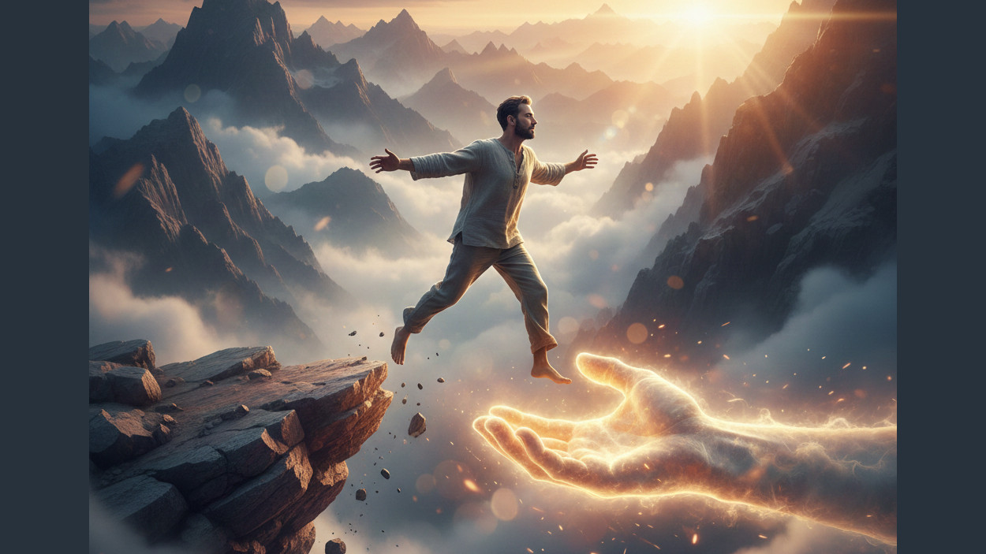
Trusting God
Matthew 6:24-28
Trusting God in My Obedience
Preached by Dan Bridges
Amman International Church, Jordan (AmmanChurch.org)
Uploaded by Dr. Rick Griffith • Jordan Evangelical Theological Seminary
Files in many languages for free download at BibleStudyDownloads.org

Slide 2
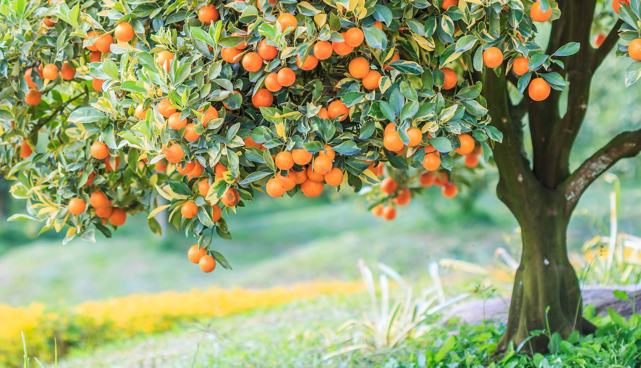
What is the fruit that differentiates true believers from unbelievers?
“No good tree bears bad fruit, nor again does a bad tree bear good fruit, for each tree is known by its own fruit… The good person out of the good treasure of his heart produces good, and the evil person out of his evil treasure produces evil…” Luke 6:43 – 45

Slide 3
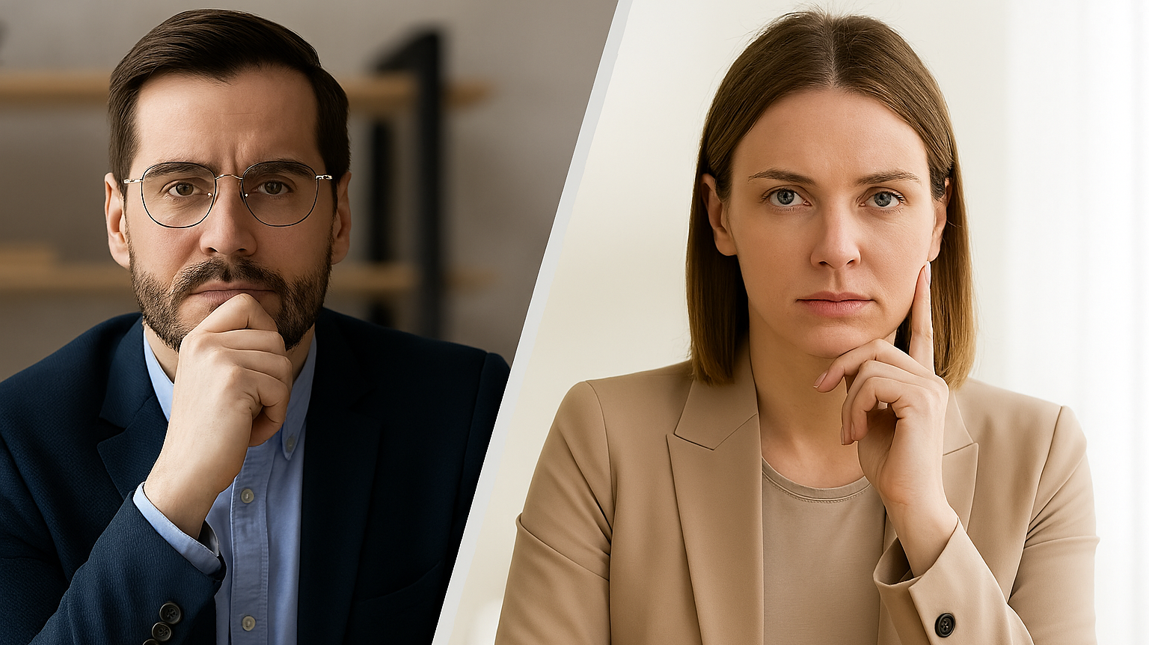
How do we respond when we don’t get what we “need”?
I Need Respect!
I Need Love!

Slide 4

We need to be treated justly and with dignity!

Slide 5
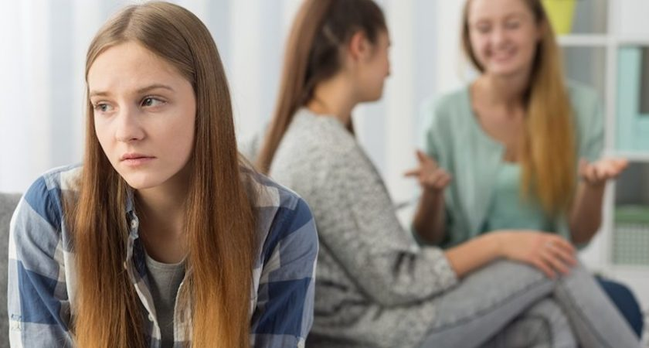
I need to be accepted / included!

Slide 6
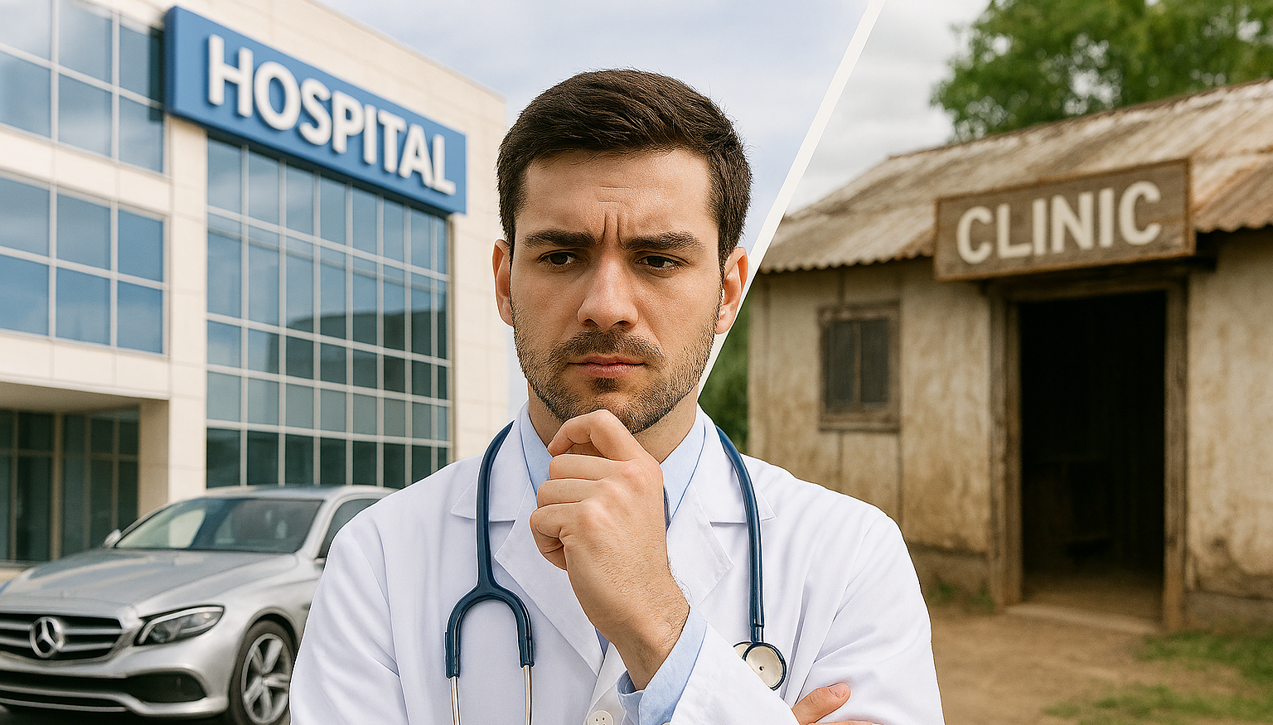
I need to feel significant in my career!

Slide 7
What do these scenarios
have in common?
Opportunities for
Radical Trust-Based Obedience!

Slide 8
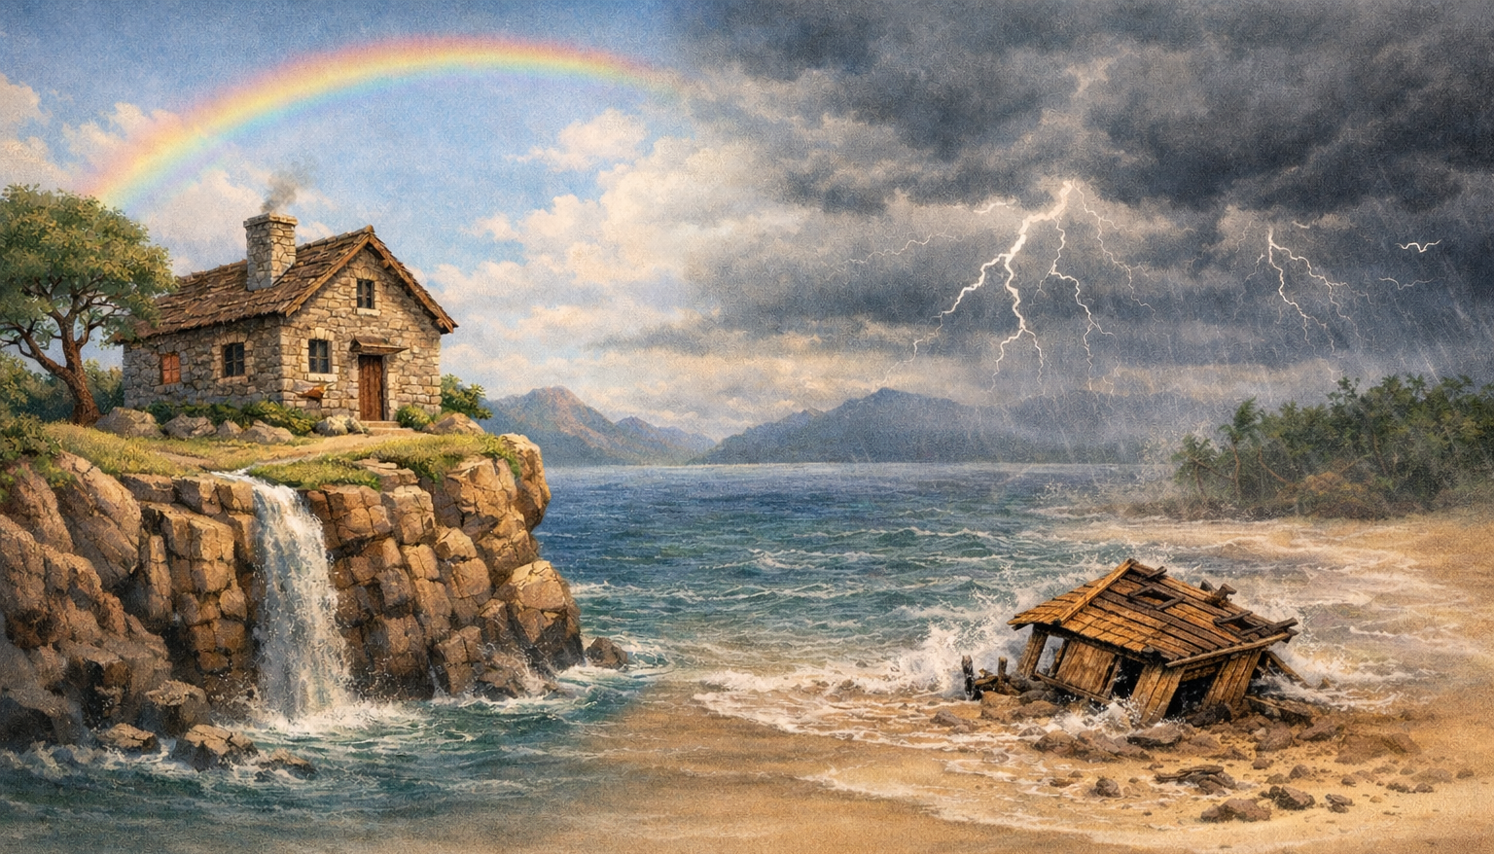
Trusting God in My Obedience
A Simple Story
Radical Implications
Embracing "Wisdom”

Slide 9
A Simple Story:
The Wise Man…
And the Foolish Man

Slide 10
Matthew 7:24-27
“Everyone then who hears these words of mine and does them will be like a wise man who built his house on the rock. And the rain fell, and the floods came, and the winds blew and beat on that house, but it did not fall, because it had been founded on the rock.”

Slide 11
Matthew 7:24-27
“And everyone who hears these words of mine and does not do them will be like a foolish man who built his house on the sand. And the rain fell, and the floods came, and the winds blew and beat against that house, and it fell, and great was the fall of it.”

Slide 12
The Wise Man…
“Everyone then who hears these words of mine and does them will be like a wise man who built his house on the rock. And the rain fell, and the floods came, and the winds blew and beat on that house, but it did not fall, because it had been founded on the rock.”

Slide 13
The Wise Man…
“Everyone then who hears these words of mine and does them will be like a wise man who built his house on the rock. And the rain fell, and the floods came, and the winds blew and beat on that house, but it did not fall, because it had been founded on the rock.”

Slide 14
The Wise Man…
“Everyone then who hears these words of mine and does them will be like a wise man who built his house on the rock. And the rain fell, and the floods came, and the winds blew and beat on that house, but it did not fall, because it had been founded on the rock.”

Slide 15
The Wise Man…
“Everyone then who hears these words of mine and does them will be like a wise man who built his house on the rock. And the rain fell, and the floods came, and the winds blew and beat on that house, but it did not fall, because it had been founded on the rock.”

Slide 16
The Wise Man…
“Everyone then who hears these words of mine and does them will be like a wise man who built his house on the rock. And the rain fell, and the floods came, and the winds blew and beat on that house, but it did not fall, because it had been founded on the rock.”

Slide 17
The Wise Man…
“Everyone then who hears these words of mine and does them will be like a wise man who built his house on the rock. And the rain fell, and the floods came, and the winds blew and beat on that house, but it did not fall, because it had been founded on the rock.”

Slide 18
The Foolish Man…
“And everyone who hears these words of mine and does not do them will be like a foolish man who built his house on the sand. And the rain fell, and the floods came, and the winds blew and beat against that house, and it fell, and great was the fall of it.”

Slide 19
The Foolish Man…
“And everyone who hears these words of mine and does not do them will be like a foolish man who built his house on the sand. And the rain fell, and the floods came, and the winds blew and beat against that house, and it fell, and great was the fall of it.”

Slide 20
The Foolish Man…
“And everyone who hears these words of mine and does not do them will be like a foolish man who built his house on the sand. And the rain fell, and the floods came, and the winds blew and beat against that house, and it fell, and great was the fall of it.”

Slide 21
The Foolish Man…
“And everyone who hears these words of mine and does not do them will be like a foolish man who built his house on the sand. And the rain fell, and the floods came, and the winds blew and beat against that house, and it fell, and great was the fall of it.”

Slide 22
The Foolish Man…
“And everyone who hears these words of mine and does not do them will be like a foolish man who built his house on the sand. And the rain fell, and the floods came, and the winds blew and beat against that house, and it fell, and great was the fall of it.”

Slide 23
The Foolish Man…
“And everyone who hears these words of mine and does not do them will be like a foolish man who built his house on the sand. And the rain fell, and the floods came, and the winds blew and beat against that house, and it fell, and great was the fall of it.”

Slide 24
The Wise Man…
“Everyone then who hears these words of mine and does them...”
The one difference that makes people either wise or foolish…
The Foolish Man…
“And everyone who hears these words of mine and does not do them...”

Slide 25
The Wise Man…
“…it did not fall, because it had been founded on the rock...”
What is at stake in this story?
The Foolish Man…
“…it fell, and great was the fall of it...”

Slide 26
A person’s life
Instabilities of life and
God’s ultimate judgment
State of a person’s life and
Eternal destiny
The house represents:
The storms represent:
The end result represents:

Slide 27
“Not everyone who calls out to me, ‘Lord! Lord!’ will enter the Kingdom of Heaven. Only those who actually do the will of my Father in heaven will enter. On judgment day many will say to me, ‘Lord! Lord! We prophesied in your name and cast out demons in your name and performed many miracles in your name.’ But I will reply, ‘I never knew you. Get away from me, you who break God’s laws.’” Matthew 7:21 – 23

Slide 28
Trusting God in My Obedience
A Simple Story
Radical Implications
Embracing "Wisdom”

Slide 29
“Everyone then who hears these words of mine and does them...”
What words was Jesus talking about?
The Sermon on the Mount!

Slide 30
Wise Person
Foolish Person
Meek
Arrogant, Self-Assertive
Is this a realistic way to live?
Living like this is not difficult…
It is impossible without God’s power!
Does not resist an evil person
Fights against an evil person
Loves their enemies
Hates their enemies
Forgives because God has forgiven them
Does not forgive
Pursues heavenly treasure
Confidence in wealth
Trusts God’s provision
Anxious about life
Treats others as they want to be treated
Looks after self first

Slide 31
How does the “wise” person respond when they don’t get what they “need”?
The “wise” person gives the other love/respect even if they don’t get what they “need”!
I Need Respect!
I Need Love!

Slide 32
How does the “wise” person respond when they’re not treated with justice and dignity?
The “wise” person still works diligently and faithfully regardless of how they are treated.
We need to be treated justly and with dignity!

Slide 33
How does the “wise” person respond when they’re not accepted / included?
They still treat others as they want to be treated!
I need to be accepted / included!

Slide 34
How does the “wise” person make decisions regarding their career?
God’s will, rather that earthly treasure or success, is the deciding factor
I need to feel significant in my career!

Slide 35
Trusting God in My Obedience
A Simple Story
Radical Implications
Embracing "Wisdom”

Slide 36
Our needs are real… How can we do this?
The “wise” person gives the other love/respect even if they don’t get what they “need”!
I Need Respect!
I Need Love!

Slide 37
I must trust God to provide the respect or love that I really do need!
The “wise” person gives the other love/respect even if they don’t get what they “need”!
I Need Respect!
I Need Love!

Slide 38
How is this possible?
The “wise” person still works diligently and faithfully regardless of how they are treated.
We need to be treated justly and with dignity!

Slide 39
It is only in finding our dignity in God and trusting that our reward is eternal!
The “wise” person still works diligently and faithfully regardless of how they are treated.
We need to be treated justly and with dignity!

Slide 40
Is this realistic?
They still treat others as they want to be treated!
I need to be accepted / included!

Slide 41
Only with a deep trust that “I’m okay”!
They still treat others as they want to be treated!
I need to be accepted / included!

Slide 42
How is it possible to simply walk away from earthly success or financial gain?
God’s will, rather that earthly treasure or success, is the deciding factor
I need to feel significant in my career!

Slide 43
Only when we trust deep down that our reward is in heaven!
God’s will, rather that earthly treasure or success, is the deciding factor
I need to feel significant in my career!

Slide 44
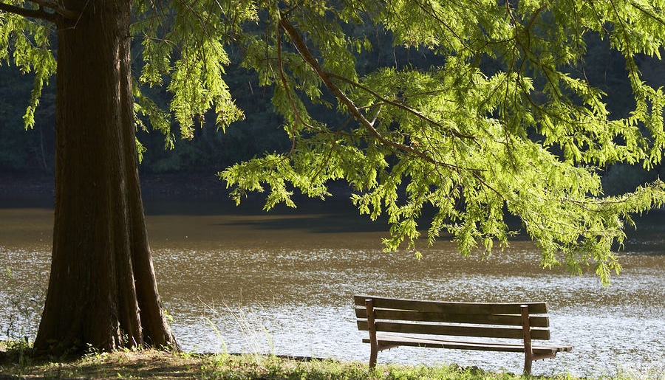
What the secret that drives everything
in this “wise” person’s life?
A deep trust in God to supply all their needs!

Slide 45
“You have given me greater joy
than those who have abundant harvests of grain and new wine.”
Psalm 4:7

Slide 46
“You make known to me the path of life;
in your presence there is fullness of joy;
at your right hand are pleasures forevermore.”
Psalm 16:11

Slide 47
“What is more, I consider everything a loss compared to the surpassing greatness of knowing Christ Jesus my Lord, for whose sake I have lost all things.” Philippians 3:8

Slide 48
Trusting God in My Obedience
A Simple Story
Radical Implications
Embracing "Wisdom”

Slide 49
What is the fruit that differentiates true believers from unbelievers?
The “Fruits of the Spirit” – when life is NOT okay!
Love – When love is not returned – even enemies!
Joy, Peace – In the midst of life’s worst circumstances
Kindness, Gentleness – Even when people are rude
Faithfulness – Even in unjust or hopeless circumstances

Slide 50
If your obedience can be done in your own strength, it is not complete!
The “Fruits of the Spirit” – when life is NOT okay!
Love – When love is not returned – even enemies!
Joy, Peace – In the midst of life’s worst circumstances
Kindness, Gentleness – Even when people are rude
Faithfulness – Even in unjust or hopeless circumstances

Slide 51
“Blessed is the man who trusts in the LORD,
whose trust is the LORD.
He is like a tree planted by water,
that sends out its roots by the stream,
and does not fear when heat comes,
for its leaves remain green,
and is not anxious in the year of drought,
for it does not cease to bear fruit.”
Jeremiah 17:7-8

Slide 52
Sermon by Dan Bridges
Amman International Church (AIC)
Amman, Jordan
This and most other AIC sermons can be found on the church website:
ammanchurch.org

Slide 53
Black

Slide 54


NT Preaching link at BibleStudyDownloads.org
Get this presentation and script for free!
Notes:
NT Preaching (np)

