Slide 1

Trusting God
Trusting God as My Provider
Preached by Dan Bridges Amman International Church, Jordan (AmmanChurch.org) Uploaded by Dr. Rick Griffith • Jordan Evangelical Theological Seminary Files in many languages for free download at BibleStudyDownloads.org

Slide 2

How has God provided for you?
Notes:
So a couple years after Lisa and I got married, God led me to leave my full-time engineering job. There was a ministry opportunity that had opened up that I needed more time during the day. And so God provided a part-time job teaching at a university in the evenings, but it wasn't enough to cover our expenses. A close friend of ours said, well, how much are you short? I told him,This is what he did every month for the next four or five months. Until God provided, that job kind of changed into more of a full-time thing. Still gave me a lot of flexibility time-wise. But this friend of mine just literally gave us money every month to finish providing for our needs.

Slide 3
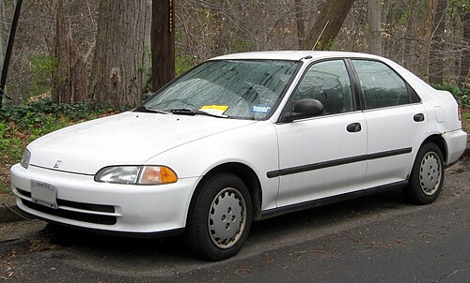
How has God provided for you?
Notes:
As part of that changing jobs, Lisa and I had come into our marriage. Each of us had a car, so we had two cars. But we went down to one car.And so normally I was taking that car to work. Well, God led Lisa to start a master's degree program in teaching English for speakers of other languages. And she needed to drive about 45 minutes to get to the campus where she was doing that work. And we needed another car. And we prayed about it, and we didn't know what God was going to do.And out of the blue, some friends of ours called and said, God has caused our company to ask us to go to Japan for two years for work, and we're looking for someone to take care of our Honda Civic for us for the next couple of years. Would you be willing to do that? Yeah, I think we could do that.

Slide 4
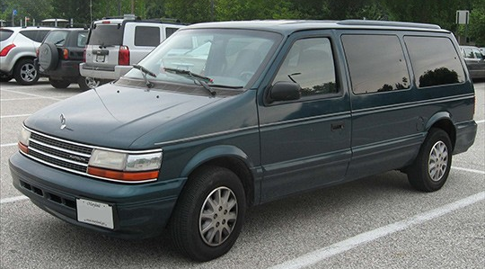
Our Next Transportation Need…
Notes:
We moved here to Jordan in 2003 and we started going back to the US every other year for about two to three months. And as part of that two to three months, it involved a lot of travel. In any given summer we were driving anywhere between five and ten thousand miles.And we obviously needed a car to do that. Now, when we first started going, we had a family of four and then a family of five. And so oftentimes we could find a car to borrow or something. But then starting when we went back in 2009, we had a family of six. And you can no longer fit in a regular car. And we looked at what it would cost to rent a van. And it just wasn't going to work. It was very, very expensive to rent a van, especially for 10 or 12 weeks.So again, what do we do? God, how do you want to provide for us? Well, God gave us the idea that maybe we could buy an older van, like 12 to 15 years old, and use it for the summer and then sell it. But can you find a seller or a buyer at the end of the summer? We didn't know.But we decided to try it. And so God had provided, I think it was maybe $2,500 or $3,000. And we went and we bought an old used van. It was a little clunky, but it lasted us the whole summer. And at the end of the summer, God provided a buyer for it.

Slide 5
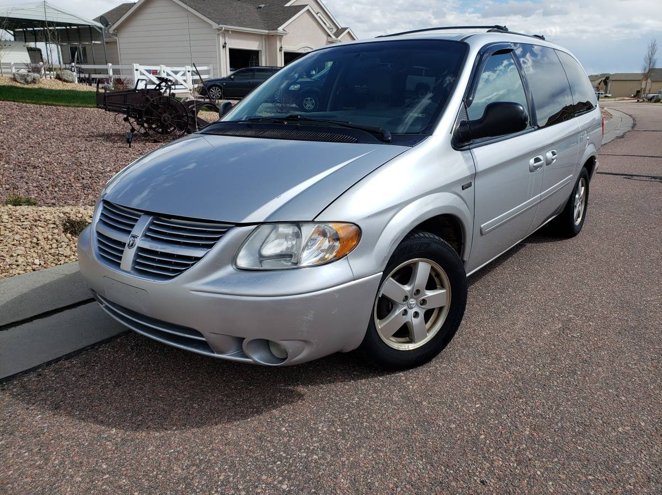
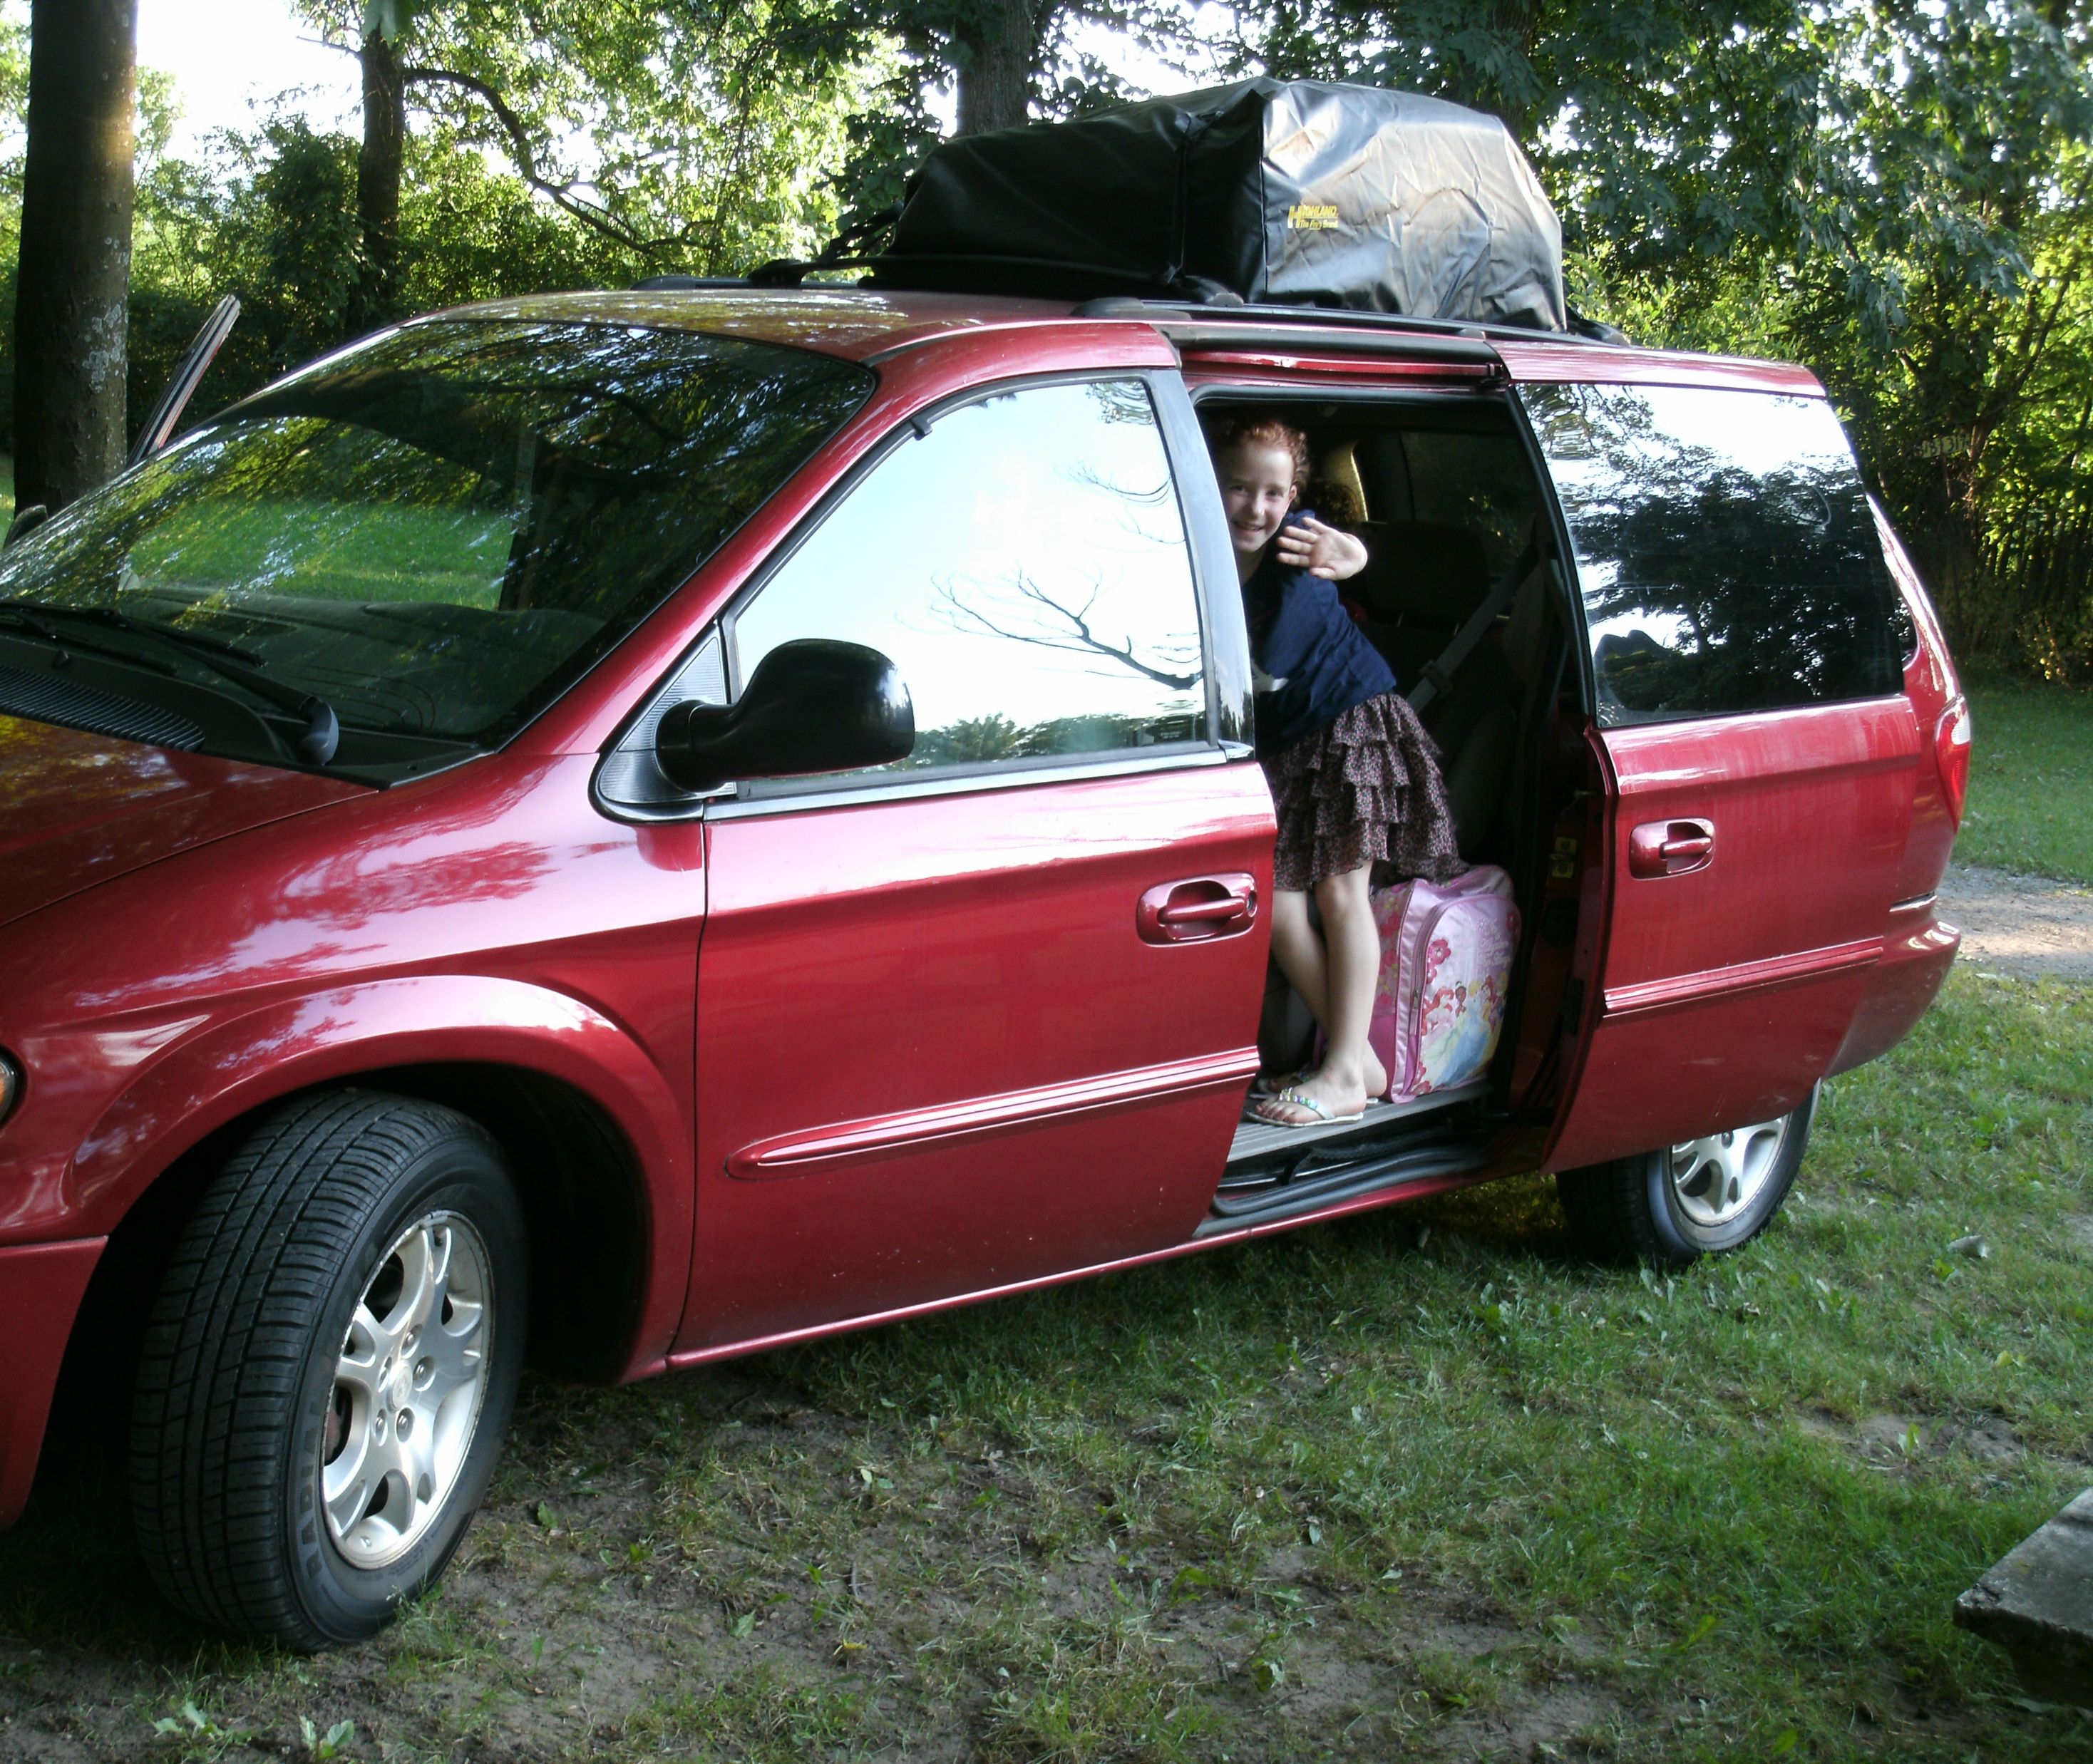
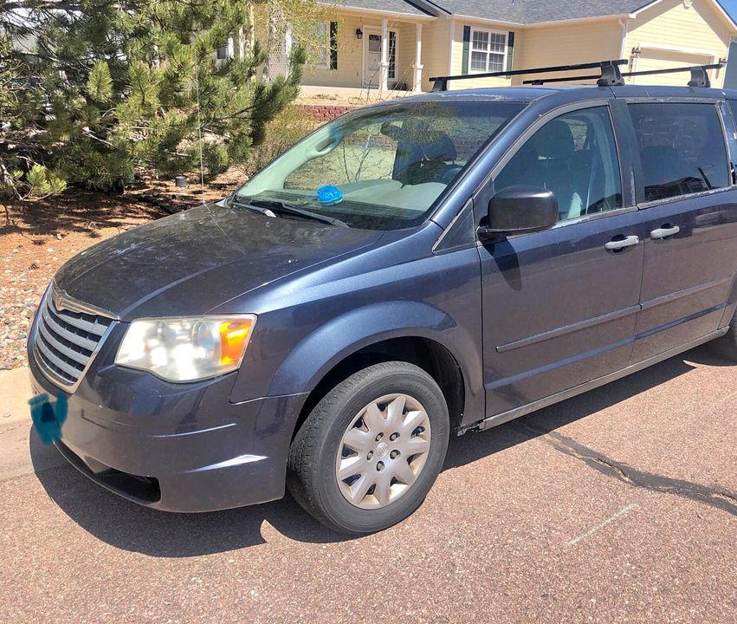
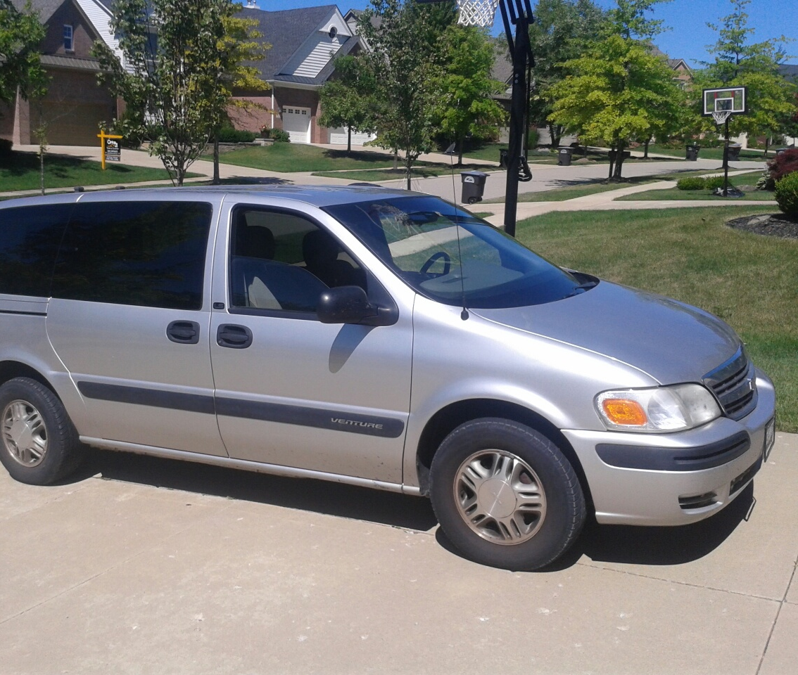
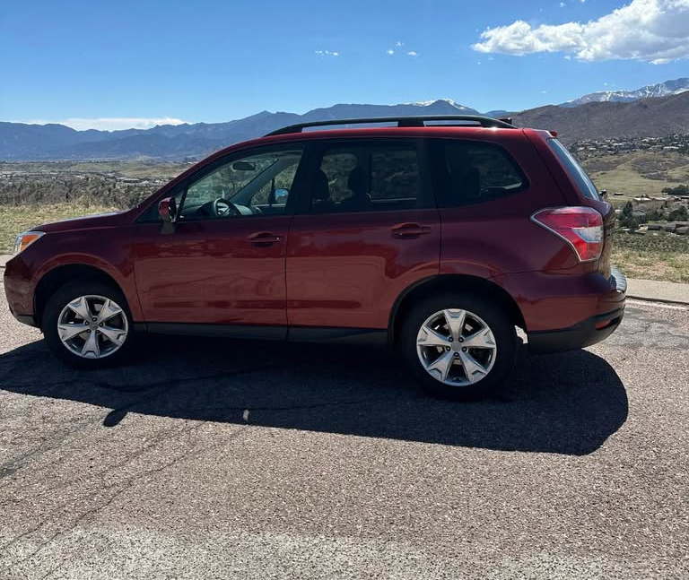
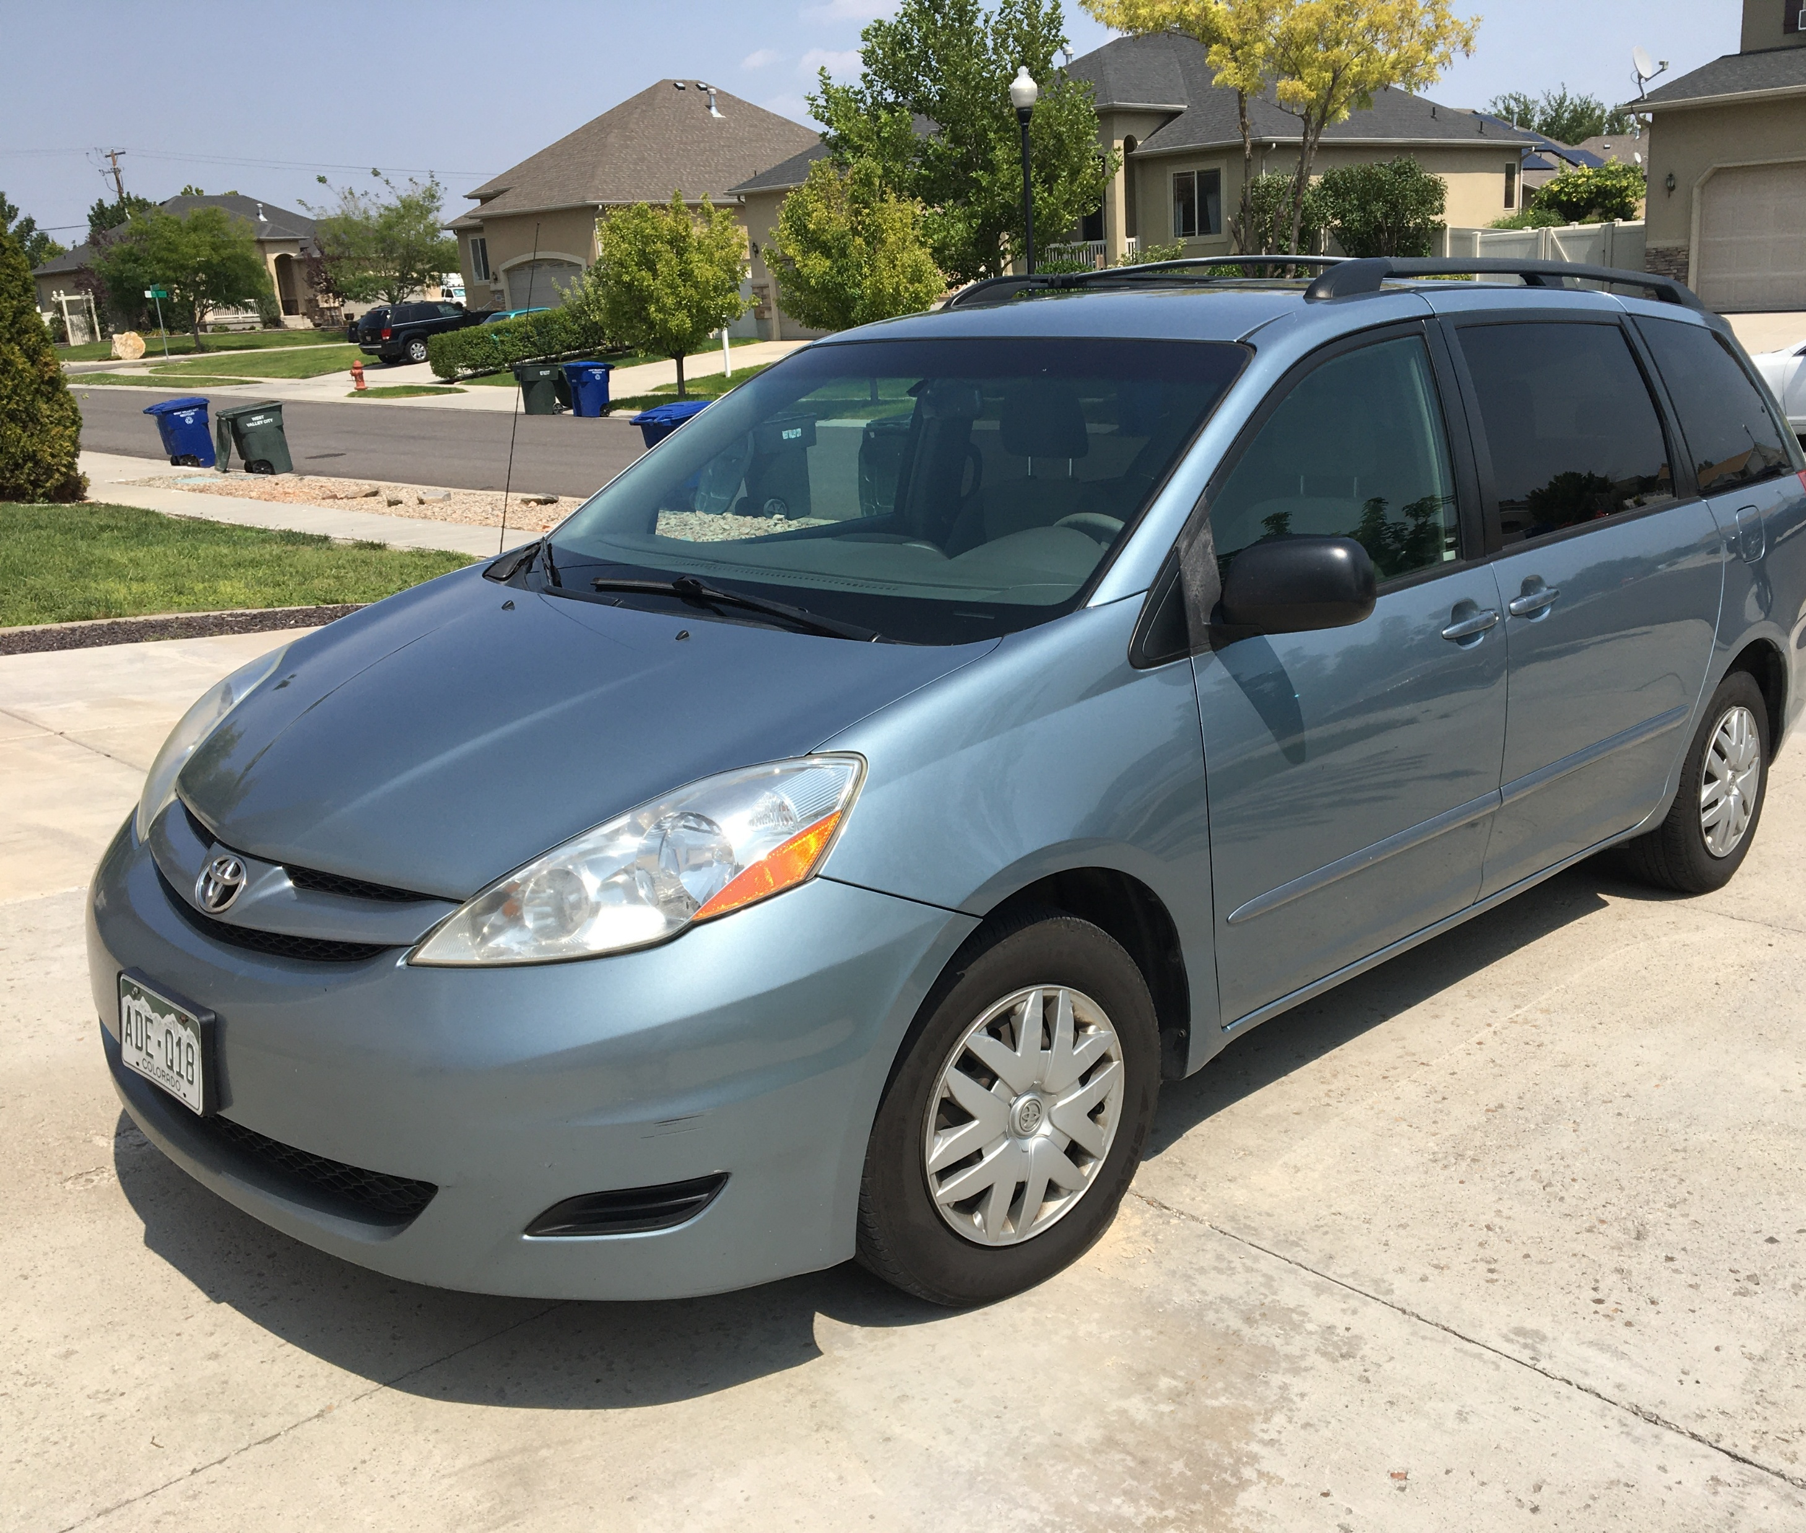
Our “fleet” of cars since 2014!
Notes:
Well, here we are 23 years later. These are some of the vehicles we've owned for two to three months at a time. They've all been 12 to 15 years old.But God has provided, this is just since 2014, there were several cars before that, I think it's eight or nine times. Every time God has kept them going mechanically, because a 12 to 15 year old car, you never know, right? But he's always kept them going mechanically, and he's always provided a buyer at the end of the summer.

Slide 6
Since 2003:
13 Extended (2-3 month) visits to the US
Every time, God has provided:
Money to pay for the trip
Housing – often in places of our own
Car sufficient for our family
(and buyer for car at end of visit!)
Care for our house and pets here
Notes:
Lisa and I had a good time this week just going back and thinking about the ways that God has provided for us over the years. We’ve 13 visits to the U.S. Every time God has provided money to pay for our round trip, he's provided housing, because we don't have a house in the U.S., but sometimes it's staying with family, but most of the time he's actually provided a place of our own.He's provided a car that is sufficient for our size of family and a buyer for the car at the end of the visit. And he's even provided people to care for our house here and our pets here. And every one of those 13 times, I've been anxious about how God's going to provide.And this last summer, when actually God had finished providing a car for us, I literally broke down and cried because it was such an amazing story. And I was so ashamed of how anxious I had been.

Slide 7

But what “normal life”?
How does God provide when we work “ordinary” jobs?

Slide 8
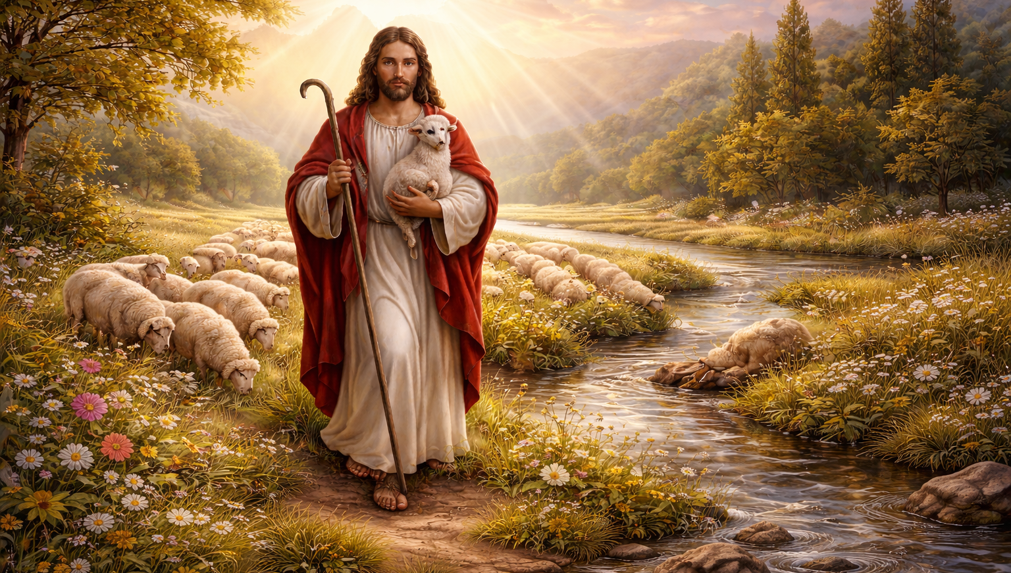
To “want” is to lack.
Do we trust that He knows and will provide what we need?
“The LORD is my shepherd; I shall not want.” Psalm 23:1

Slide 9


It’s not enough to simply say, “Do not be anxious!”
What were Jesus’ reasons for saying this?
“Therefore I tell you, do not be anxious about your life, what you will eat or what you will drink, nor about your body, what you will put on.” Matthew 6:25

Slide 10
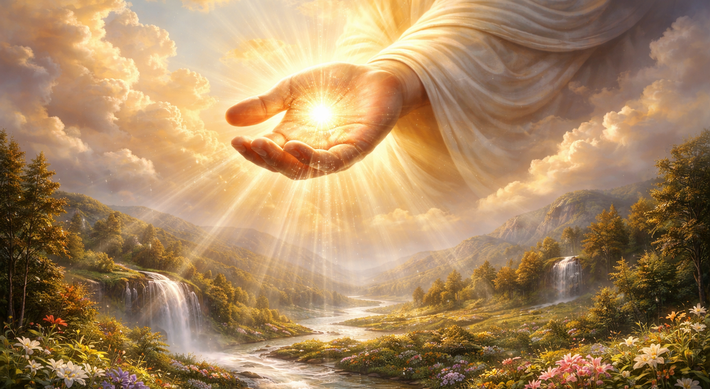
Trusting God as My Provider
How can we trust God to provide for us?
It’s by having a biblical approach to…
Treasure
Life, Food and Prosperity
Priorities

Slide 11
Matthew 6:25-33
“Therefore I tell you, do not be anxious about your life, what you will eat or what you will drink, nor about your body, what you will put on. Is not life more than food, and the body more than clothing?” Matthew 6:25

Slide 12

“Look at the birds of the air: they neither sow nor reap nor gather into barns, and yet your heavenly Father feeds them. Are you not of more value than they? And which of you by being anxious can add a single hour to his span of life?” Matthew 6:26-27

Slide 13

“And why are you anxious about clothing? Consider the lilies of the field, how they grow: they neither toil nor spin, yet I tell you, even Solomon in all his glory was not arrayed like one of these. But if God so clothes the grass of the field, which today is alive and tomorrow is thrown into the oven, will he not much more clothe you, O you of little faith?” Matthew 6:28-30

Slide 14
“Therefore do not be anxious, saying, ‘What shall we eat?’ or ‘What shall we drink?’ or ‘What shall we wear?’ For the Gentiles seek after all these things, and your heavenly Father knows that you need them all. But seek first the kingdom of God and his righteousness, and all these things will be added to you.” Matthew 6:31-33

Slide 15
A Biblical Approach to Treasure
“Therefore I tell you, do not be anxious about your life, what you will eat or what you will drink, nor about your body, what you will put on. Is not life more than food, and the body more than clothing?” Matthew 6:25

Slide 16

A Biblical Approach to Treasure
A connection between treasure and anxiety about God’s provision!
“Do not lay up for yourselves treasures on earth, where moth and rust destroy and where thieves break in and steal, but lay up for yourselves treasures in heaven, where neither moth nor rust destroys and where thieves do not break in and steal. For where your treasure is, there your heart will be also.” Matthew 6:19-21

Slide 17
A Biblical Approach to Treasure
Why do we store up earthly treasure?
It makes us feel secure!
In our comfort, our reputation, our financial well-being…

Slide 18
A Biblical Approach to Treasure
How does storing up earthly treasure affect our hearts?
Our hearts follow our treasure…
We depend on ourselves for wealth & possessions
We become anxious, stingy, selfish!

Slide 19
How do we store up treasures in heaven?
Align my life with God’s Kingdom purposes
Including education, career, friends, finances, leisure time, ministry, marriage, parenting…
Pursue righteousness
Personal godly character
Caring for the needy and disadvantaged
Focus on eternal values
Serving others, sharing the gospel, pursuing my own relationship with Christ
A Christ-centered life!

Slide 20
A Biblical Approach to Treasure
Don’t be anxious…
How does storing up heavenly treasure affect our hearts?
Our hearts follow our treasure…
We focus on God’s Kingdom – On eternal values
This produces peace, generosity, dependence on God!

Slide 21
Trusting God as My Provider
How can we trust God to provide for us?
It’s by having a biblical approach to…
Treasure
Life, Food and Prosperity
Priorities

Slide 22
What did Jesus mean by,
“Is not life more than food?”
“Therefore I tell you, do not be anxious about your life, what you will eat or what you will drink, nor about your body, what you will put on. Is not life more than food, and the body more than clothing?” Matthew 6:25

Slide 23
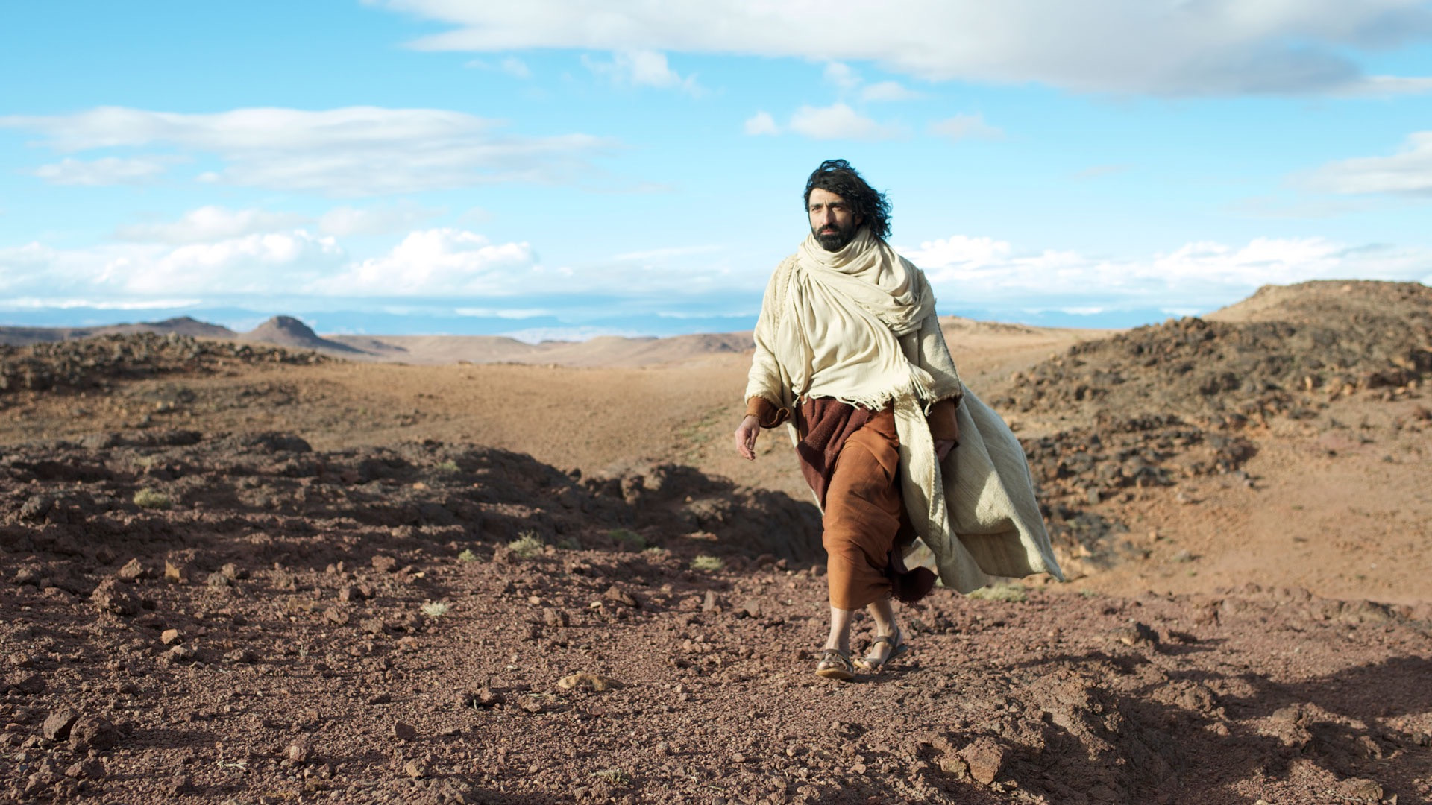
Jesus Tempted in the Wilderness
From where did Jesus get this idea?
“And the tempter came and said to him, ‘If you are the Son of God, command these stones to become loaves of bread.’ But he answered, ‘It is written,
“Man shall not live by bread alone,
but by every word that comes from the mouth of God.”’”
Matthew 4:3-4

Slide 24
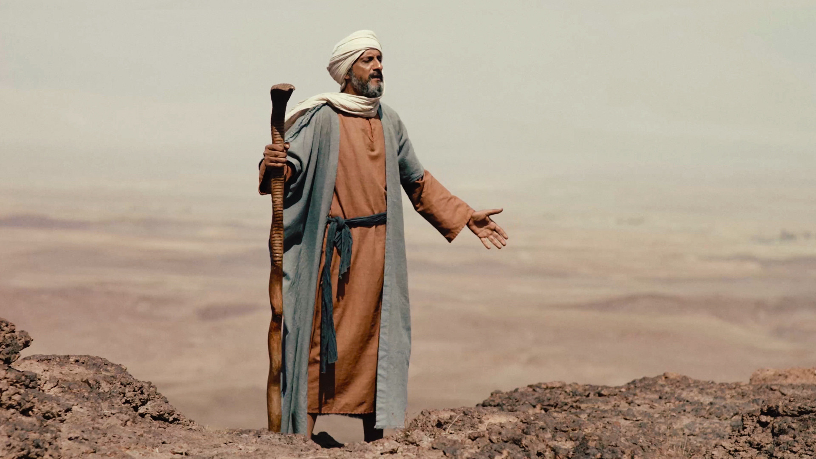
“And he humbled you and let you hunger and fed you with manna, which you did not know, nor did your fathers know, that he might make you know that man does not live by bread alone, but man lives by every word that comes from the mouth of the LORD.” Deuteronomy 8:3

Slide 25
God made them realize they were helpless.
“And he humbled you and let you hunger and fed you with manna, which you did not know, nor did your fathers know, that he might make you know that man does not live by bread alone, but man lives by every word that comes from the mouth of the LORD.” Deuteronomy 8:3

Slide 26
Then he provided for them…
“And he humbled you and let you hunger and fed you with manna, which you did not know, nor did your fathers know, that he might make you know that man does not live by bread alone, but man lives by every word that comes from the mouth of the LORD.” Deuteronomy 8:3

Slide 27
So they could see that the answer was not food – but God!
“And he humbled you and let you hunger and fed you with manna, which you did not know, nor did your fathers know, that he might make you know that man does not live by bread alone, but man lives by every word that comes from the mouth of the LORD.” Deuteronomy 8:3

Slide 28
“The manna was designed to teach the Israelites a fundamental principle of their existence as the covenant people of God.
The basic source of life was God and the words of God to his people;
every utterance of the mouth of the Lord was more basic to Israelite existence than was food.” Peter Craigie

Slide 29
God commands his people to do something or go somewhere.
He expects…
Are lack of food, water, strength, etc. valid excuses to not obey?
“The command of God contains within
it the provision of God!” Peter Craigie
obedience

Slide 30
Prosperity is from God!
It is HIS provision!
“the LORD your God is bringing you into a good land, a land of brooks of water, of fountains and springs… a land of wheat and barley, of vines and fig trees… a land in which you will eat bread without scarcity, in which you will lack nothing.” Deuteronomy 8:7-9

Slide 31
Beware of forgetting God!
God and his words… the basic source of life!
“[When you have prosperity] beware lest you say in your heart, ‘My power and the might of my hand have gotten me this wealth.’ You shall remember the LORD your God, for it is he who gives you power to get wealth…” Deuteronomy 8:17-18

Slide 32
God and his words… the basic source of life!
“Therefore I tell you, do not be anxious about your life, what you will eat or what you will drink, nor about your body, what you will put on. Is not life more than food, and the body more than clothing?” Matthew 6:25

Slide 33
Why are the birds fed?
“Look at the birds of the air: they neither sow nor reap nor gather into barns, and yet your heavenly Father feeds them. Are you not of more value than they? And which of you by being anxious can add a single hour to his span of life?” Matthew 6:26-27
God’s commands contain his provision!
They are living the life God designed for them!

Slide 34
“And why are you anxious about clothing? Consider the lilies of the field, how they grow: they neither toil nor spin, yet I tell you, even Solomon in all his glory was not arrayed like one of these. But if God so clothes the grass of the field, which today is alive and tomorrow is thrown into the oven, will he not much more clothe you, O you of little faith?” Matthew 6:28-30
Why are the lilies clothed?
They are fulfilling the role God created for them!

Slide 35
Why does God provide for us?
Because his commands contain his provision!
“Therefore do not be anxious, saying, ‘What shall we eat?’ or ‘What shall we drink?’ or ‘What shall we wear?’ For the Gentiles seek after all these things, and your heavenly Father knows that you need them all. But seek first the kingdom of God and his righteousness, and all these things will be added to you.” Matthew 6:31-33

Slide 36
So, under what circumstances can we be confident in God’s provision for us?
When we’re living the life that he has called us to live!
“Therefore do not be anxious, saying, ‘What shall we eat?’ or ‘What shall we drink?’ or ‘What shall we wear?’ For the Gentiles seek after all these things, and your heavenly Father knows that you need them all. But seek first the kingdom of God and his righteousness, and all these things will be added to you.” Matthew 6:31-33

Slide 37
Trusting God as My Provider
How can we trust God to provide for us?
It’s by having a biblical approach to…
Treasure
Life, Food and Prosperity
Priorities

Slide 38
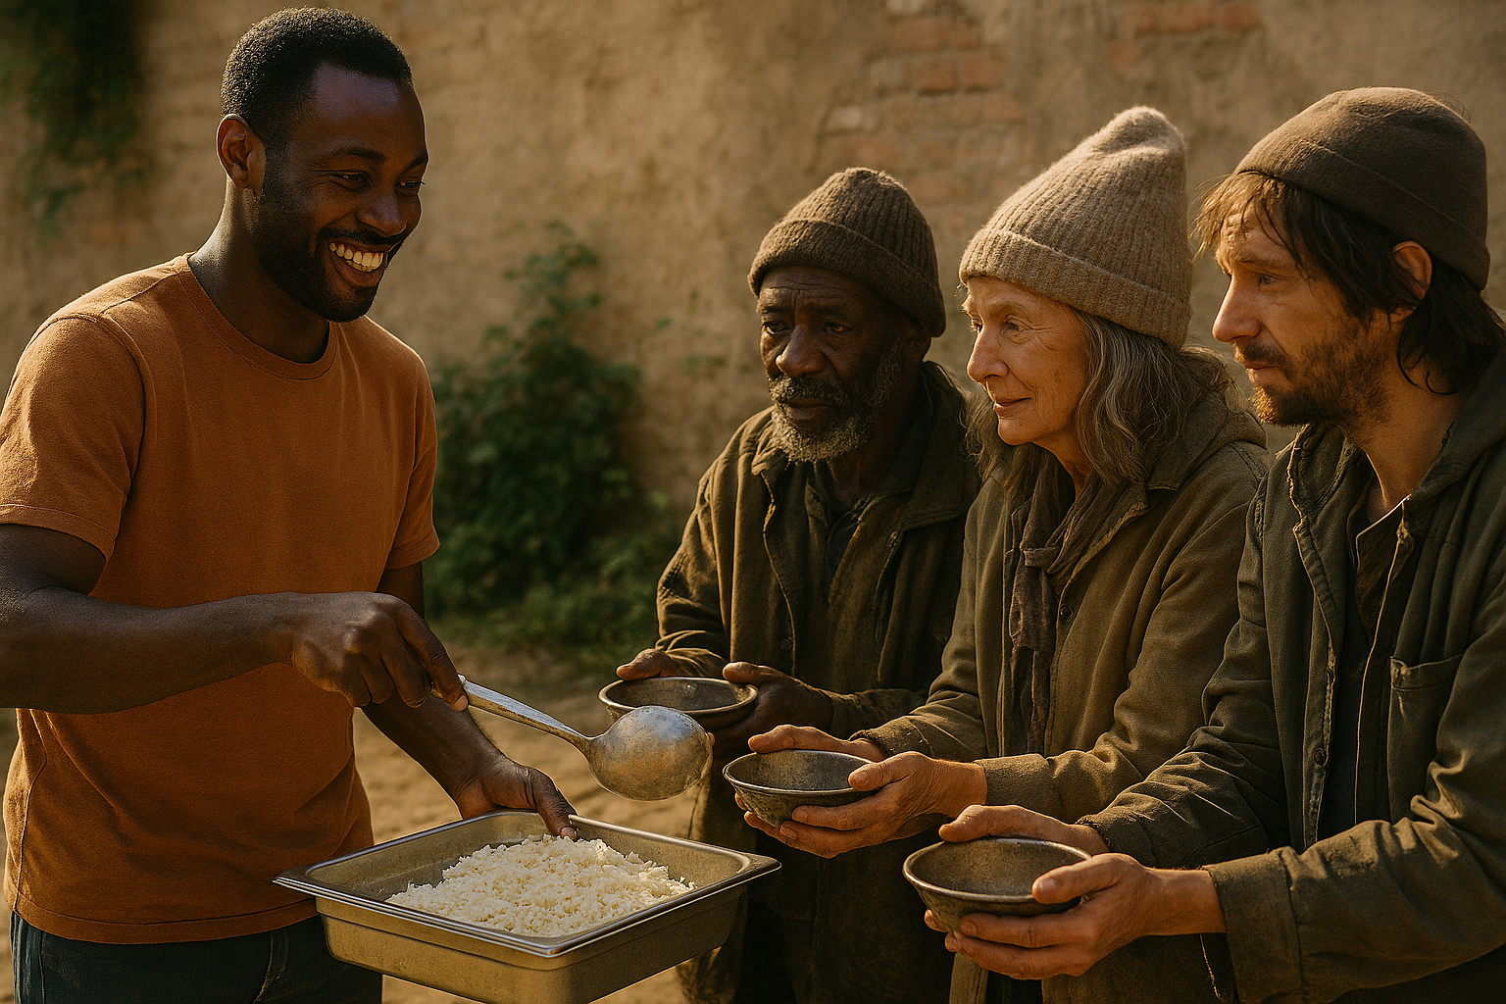
How do we do this?
“But seek first the kingdom of God and his righteousness…”

Slide 39
How do we seek first the kingdom of God?
Align my life with God’s Kingdom purposes
Including education, career, friends, finances, leisure time, ministry, marriage, parenting…
Pursue righteousness
Personal godly character
Caring for the needy and disadvantaged
Focus on eternal values
Serving others, sharing the gospel, pursuing my own relationship with Christ
Just like storing up treasures in heaven!

Slide 40

My Tax Story…
Notes:
I'll tell you my tax story. In the U.S., if you have a business expense, you can submit that business expense to your company.And the company can legally pay you back, give you that money, and it's not considered part of your income according to the government when they count your money for tax purposes. And so the government has said that you have 60 daysFrom the time that you spend the money till the time that you report the money. And if you report it within that 60 days, then your company can pay you back that money and it's not considered taxable money. Well, last year, I had a pretty significant business expense. It was over $200, but I forgot to report it.What I remember to report it, it was about 65 days after I had spent the money. $200, that's a lot of money. Scratching my head, what do I do? Here's what I did. This particular expense, I didn't have to submit a receipt for. I changed the date.I altered, I just told my company I spent the money on this day rather than this day. I mean, I figured, you know, I legitimately am owed this money. It's a legitimate business expense. I think I can justify doing that. I felt a little bad about it, but I did it. There have been several times since then when God kind of brought that back to my mind and I kind of pushed it away. But when I was studying this this week, God said, you lied, didn't you?Yeah, I got it. I confessed that to God. I said, I'm willing to make it right, but what do I need to do? So I went online and I started researching this 60-day law and so forth. And I discovered that if you report it after that 60 days, instead of being just a reimbursement of the business expense, it becomes part of your paycheck.It becomes income that gets reported to the government, and you have to pay taxes on it. I thought, okay. Well, God, I was pursuing earthly treasures. I wasn't honest because I was pursuing earthly treasures. And I'm getting ready to report my taxes for the year. And so I said, okay, God, I'm going to take that $200, and I'm going to report it as part of my taxable income. I'm just going to go ahead and pay the taxes on it.And I'm also going to tell everybody what happened. So that you guys understand that I'm not some holy, perfect person. I also sin. I also give in to temptation.

Slide 41
Trusting God as My Provider
How can we trust God to provide for us?
It’s by having a biblical approach to…
Treasure
Life, Food and Prosperity
Priorities

Slide 42
Does this mean that, if we’re living the life God wants, we’ll never go hungry?

Slide 43
How can this be?
“…all these things will be added to you.”
“Who shall separate us from the love of Christ? Shall tribulation, or distress, or persecution, or famine, or nakedness, or danger, or sword?” Romans 8:35

Slide 44
What God promises in Matthew 6:33 is adequate provision to live the Christ-centered life he has called us to. His sufficient provision does not prevent hunger, suffering, or even death!

Slide 45
Are you willing…
to focus on eternal treasure (God’s Kingdom) instead of chasing earthly treasure?
to accept, in faith, that God’s level of provision is adequate for the life he has for you?
to give up anxiety for a confidence that you are totally safe in his loving hands?

Slide 46
Sermon by Dan Bridges
Amman International Church (AIC)
Amman, Jordan
This and most other AIC sermons can be found on the church website:
ammanchurch.org

Slide 47
Black

Slide 48


NT Preaching link at BibleStudyDownloads.org
Get this presentation and script for free!
Notes:
NT Preaching (np)

