Slide 1
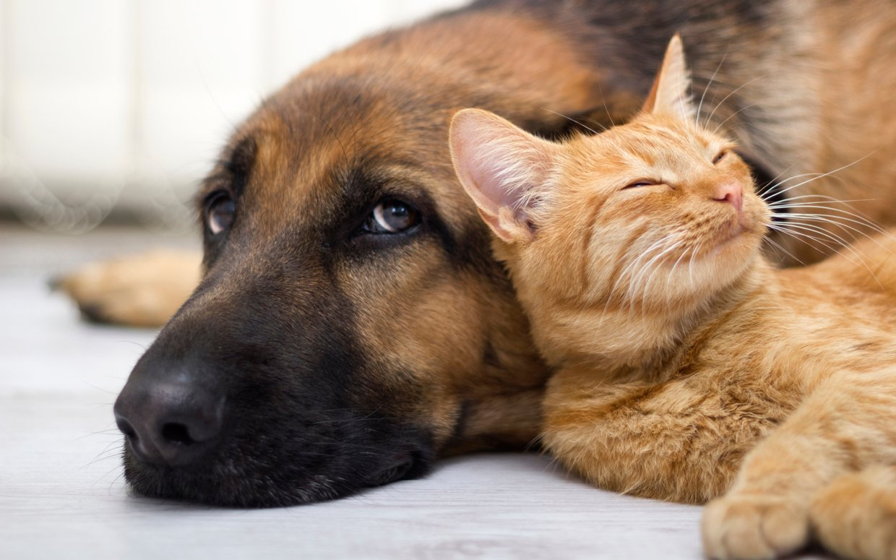
Love Your Enemies
Matthew 5:43-48
Dr. Rick Griffith, Crossroads International Church
www.BibleStudyDownloads.org

Slide 2
How would you respond to a man if you knew he was going to kill you this Friday?
How would you respond to a man if you knew he was going to kill you this Friday?

Slide 3
Palm Sunday
Notes:
On Palm Sunday…

Slide 4
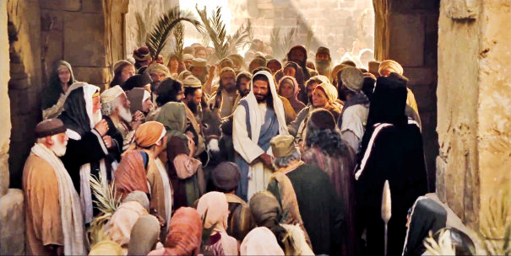
Triumphal Entry
Notes:
… Jesus rode into Jerusalem and offered peace to his enemies.

Slide 5
Palms to Cross
Notes:
Those tree palms were but a prelude to the cross. Today we remember his love for enemies as he offered his life for his enemies on Friday just a few days later.

Slide 6
My “Enemy.”
Notes:
Years ago I had to deal with a guy who I didn’t really like. I was 20 and singing for the summer on an evangelistic music team called The Continental Singers. We traveled 32 states in the USA for the summer and then flew to Amsterdam and traveled Holland, France, Belgium and Poland.
With 40 young people on the tour for 10 weeks, you can image there were issues. Mine were largely with our drummer named Kip.
I remember one time sitting in the middle of the bus. Kip came onto the bus and walked up the aisle, whispered into the ear of the girl in front of me, and proceeded to the back of the bus.
She immediately burst out crying, so I asked her what he said. “He just told me, ‘I hate you!’”

Slide 7
Any enemies?
Notes:
Do you have any enemies? Who is opposing you right now? Right now in your life, who is your enemy? Let’s not move on until we identify that person or persons.

Slide 8
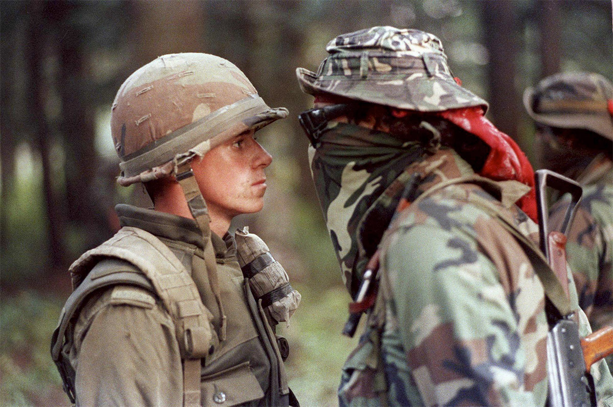
In your face.
Notes:
Who is in your face?

Slide 9
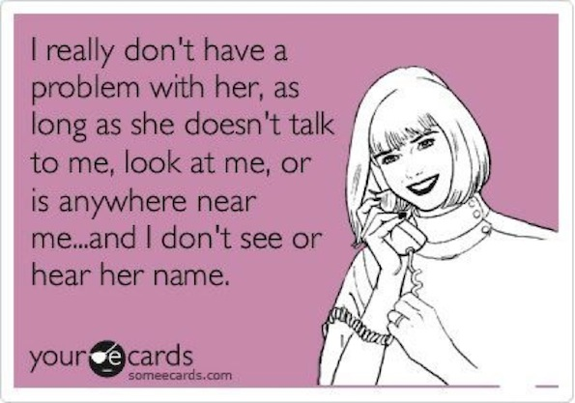
Any enemies?
Notes:
Who is avoiding you right now? Or maybe you are avoiding that person?

Slide 10
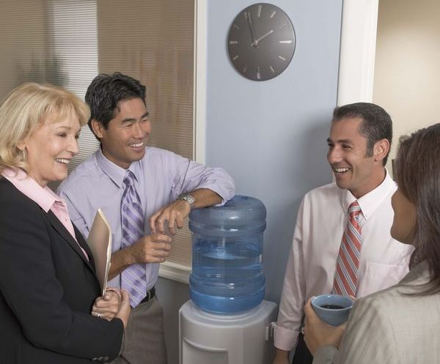
Work enemies?
Notes:
Who seeks to undercut you?

Slide 11
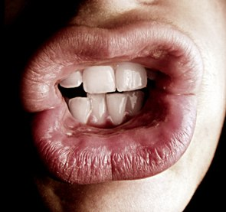
Other enemies?
Notes:
Who distrusts you?

Slide 12
Love your enemies.
Notes:
Who sends emails about you but never copies to you?

Slide 13
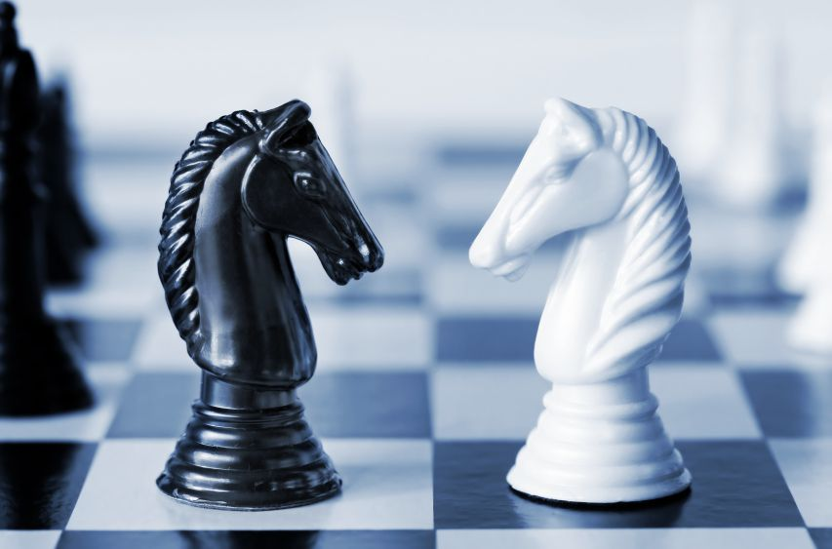
How should you treat your enemy?
Notes:
Now, keep that person in mind. Have you identified someone? Raise you hand if you can think of someone who opposes you. Now, how should you treat this enemy? What’s God’s way for you to respond to that person who opposes you?

Slide 14
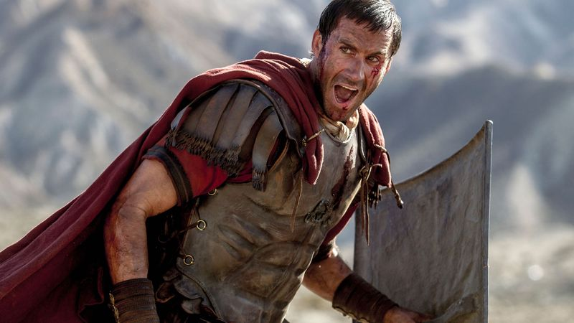
The Despised Romans
Notes:
Jesus’ listeners hated their enemies.
There was plenty of opportunity to love enemies in the Roman occupation of Israel.
Jesus preached to a Jewish audience who had been under pagan rulers for more than 400 years—the last 100 of them under the cruel Romans who crushed any and all who opposed them.

Slide 15
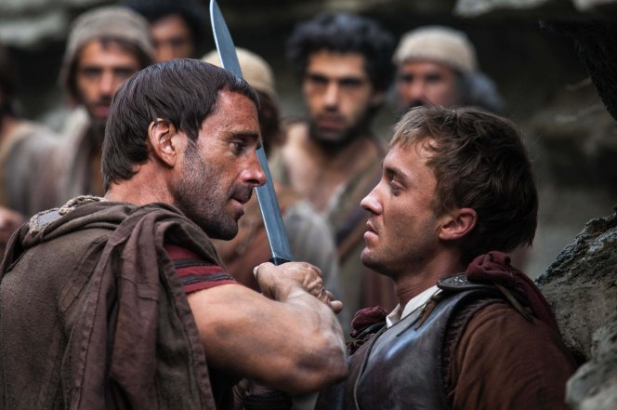
Pax Romana (Roman Peace)
Notes:
Yes, there was the Pax Romana, the “Roman peace,” but they brought peace by killing everyone that opposed them!
In fact, the key reason so many wanted the Messiah to come was not so they could have spiritual salvation. It was so they could finally conquer their enemies, like the OT said the Messiah would do. In their day, that meant the despised Romans.

Slide 16
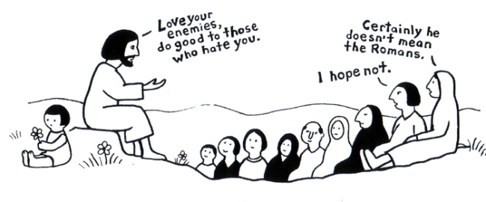
Love your enemies. Do good to those who hate you.
Certainly he doesn't mean the Romans.
I hope not.

Slide 17
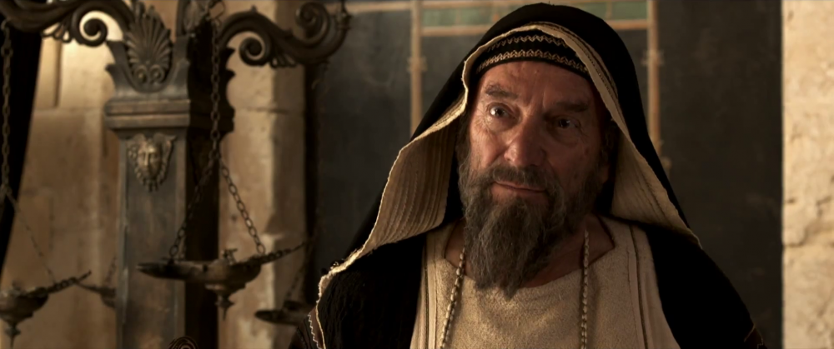
The Despised Jewish Leaders
Notes:
Besides hatred towards the Romans, the listeners had racial, religious, and social barriers among them.
Judean Jews hated Galilean Jews.
Galilean Jews hated Judean Jews.
Jews hated Samaritans.
The rich hated the poor and the poor hated the rich.

Slide 18
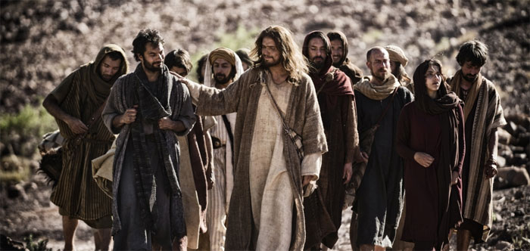
Enemies: The How and Why
How to treat your enemy (43-44)
Why treat your enemy like that (45-48)
Notes:
Today we’ll see how to treat your enemy and then why you should treat this person that way.

Slide 19
How should you treat your enemy?

Slide 20
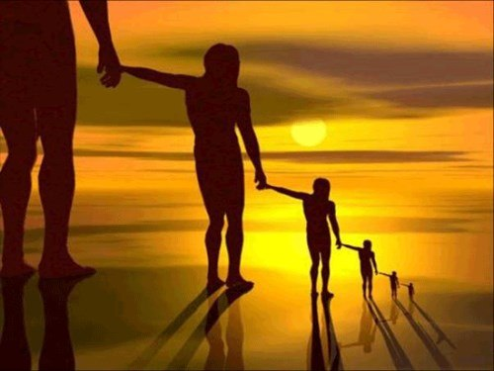
I. Love and pray for your enemy (5:43-44).
Notes:
Have a heart for the one who is heartless towards you.

Slide 21
"You have heard the law that says, 'Love your neighbor' and hate your enemy" (5:43 NLT).
Notes:
Human tradition says to love your friends and hate your enemy (5:43).
What saying was Jesus quoting by saying to love neighbors but hate enemies (43)?

Slide 22
Leviticus 19:18 (NLT) “Do not seek revenge or bear a grudge against a fellow Israelite, but love your neighbor as yourself. I am the LORD.”
Notes:
The first part of the saying might be quoting Leviticus 19:18…
Is it natural to love your neighbor (43a)?
Yes, we typically love those who are like us.
Jesus says to love our neighbor is our normal modus operand a (46a, 47a).

Slide 23
"You have heard the law that says, 'Love your neighbor' and hate your enemy" (5:43 NLT).
Notes:
But what about the “hate your enemies”?
Yes, we typically hate those who hate us.
Jesus says to hate our neighbor is our normal modus operand a (46b, 47b).
The OT doesn’t command that! So where does it come from?

Slide 24
The Qumran Community
179
Notes:
The Dead Sea Scrolls comprises 870 manuscripts found east of Jerusalem.

Slide 25
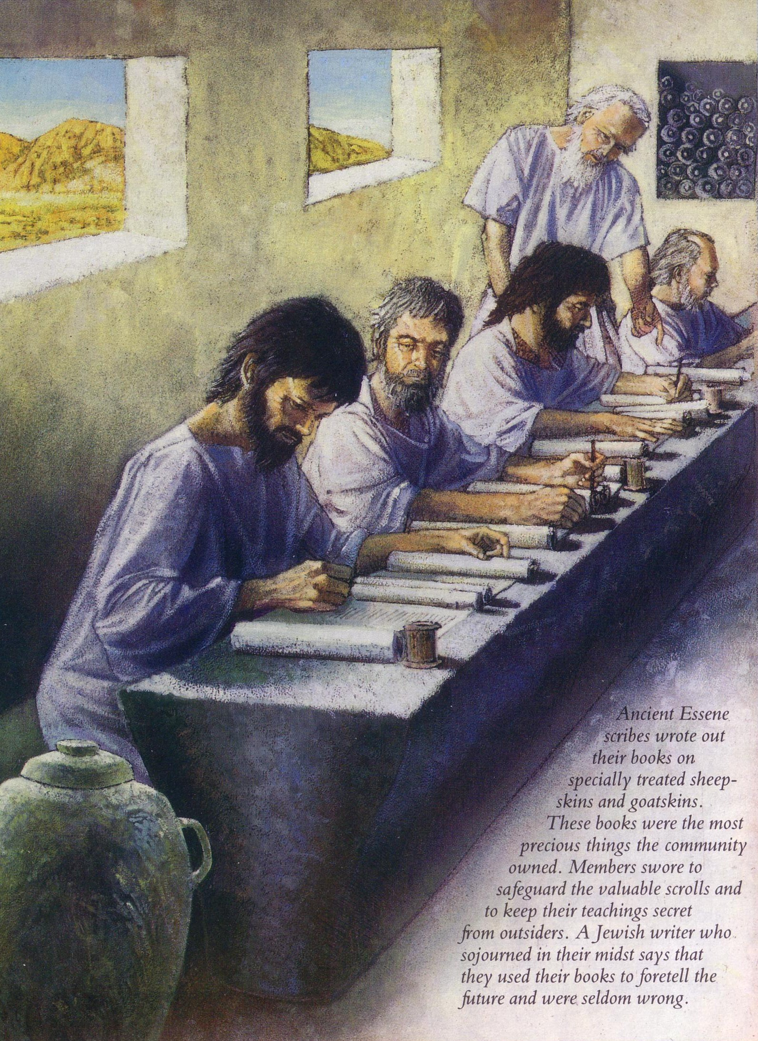
Who were the Essenes?
180
Notes:
They were written by the Essenes, a monastic sect stemming from 200 years before Christ.

Slide 26
Jesus versus Tradition
Qumran
Jesus (Matt. 5)
"[God] shall admit into the Covenant of Grace all… that love all the sons of light… and hate all the sons of darkness…"
Rule of the Community (1QS 1:4; cf. 9:21)
"You have heard that it was said, 'Love your neighbor and hate your enemy'" (5:43)
"But I tell you, 'Love your enemies and pray for those who persecute you'" (5:44)
Notes:
One of their sayings reads very similar to this command.
It seems likely that Jesus was quoting a Jewish nationalistic saying of his time coined to fight the Romans or any other enemy of Israel.

Slide 27
Jesus’ higher law says to love and pray for your enemy (5:44).

Slide 28
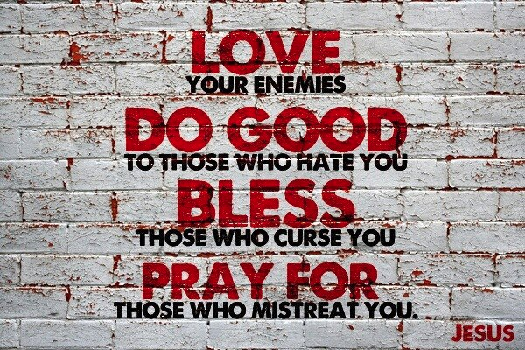
Love your enemies.
Notes:
Is it natural to pray for your enemy (44b)?

Slide 29
Interest
Notes:
Hardly! Maybe we pray imprecatory psalms for our enemy: “Lord, get them!”
But we don’t typically pray for our enemy’s welfare! That would only encourage them to despise us more.

Slide 30
Love your enemies.
"But I say, love your enemies! Pray for those who persecute you!" (5:44 NLT).
Notes:
Jesus did that which was not natural but supernatural—by loving his enemies.

Slide 31
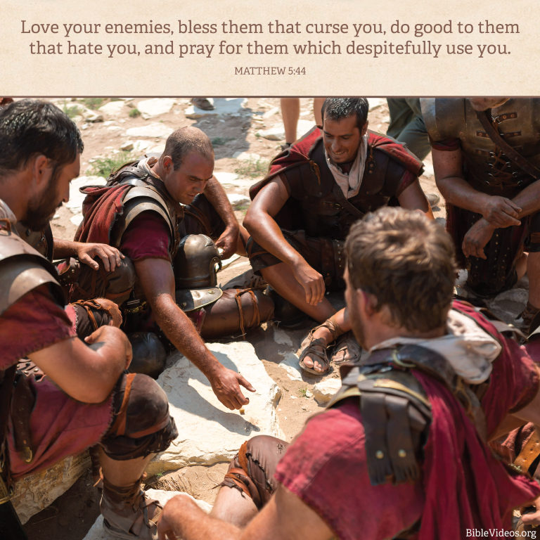
Love your enemies.
Notes:
Jesus prayed that God would forgive the people who gambled for his clothes and nailed him to the cross.
Jesus died for his enemies, which includes all of us (Romans 5:8).

Slide 32
How should you treat your enemy?
Notes:
So how should you treat your enemy?

Slide 33
I. Love and pray for your enemy (5:43-44).
Notes:
In verses 43-44, Jesus said to love and pray for that enemy of yours! But why bless your enemy? What could be the reason for blessing your enemy like that? Why would you follow such a counterintuitive practice to actually treat your enemy with a blessing? This is because…

Slide 34
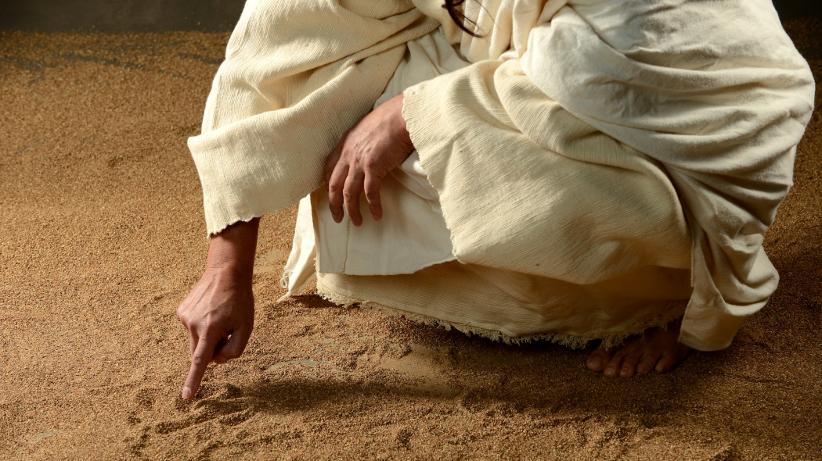
II. Blessing your enemy shows Christ's higher law (5:45-48).
Notes:
Loving and praying for that rival shows God’s doing his good work in you.

Slide 35
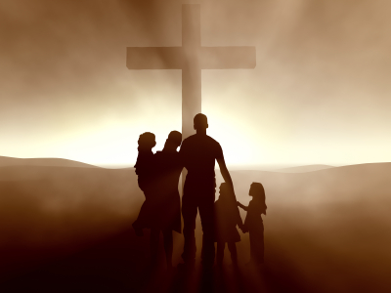
"In that way, you will be acting as true children of your Father in heaven" (5:45a NLT).
Notes:
Blessing your enemy shows that you are God’s child (45a).
A true son or daughter acts like his or her father. Like father, like son.
Since God himself loves your enemy, should you do any less?

Slide 36
"For he gives his sunlight to both the evil and the good, and he sends rain on the just and the unjust alike" (5:45b NLT).
Notes:
Blessing your enemy shows that you also don’t deserve God’s grace (45b).
We distinguish ourselves from our enemies in many ways, but actually, think about how much we have in common.
We gain heat and light from the same sun.
We drink from the same water supply.
That water produces food for your enemy and for you.
This is called general revelation—that God gives to all the same planet, the same seas, trees, peas and bees.
When you don’t harbor hatred in your heart towards the person who opposes you, you see that God blesses you both.

Slide 37
"If you love only those who love you, what reward is there for that? Even corrupt tax collectors do that much. ⁴⁷If you are kind only to your friends, how are you different from anyone else? Even pagans do that" (5:46-47 NLT).
Notes:
Blessing your enemy shows that you live on a higher plane (46-47).
Loving only the lovable isn’t rewarded (46). The tax collectors partied with other tax collectors, sharing their food and drink and jokes and laughter.
Even crooks work together with other crooks.
Kindness only to the kind isn’t unique (47).
Who deserves your kindness? If that person deserves your kindness, then there is nothing special about being kind to that person!
When we only treat our fellow church members with kindness but hate our foes, there’s nothing really unique about us!

Slide 38
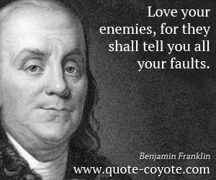
Love your enemies.
Notes:
But responding with grace towards people who mistreat us, well, that’s the work of God in us. It also shows us our own faults, as Ben Franklin said.

Slide 39
"But you are to be perfect, even as your Father in heaven is perfect" (5:48 NLT).
Notes:
Blessing your enemy shows that you strive for perfection (48).
I think the biggest challenge of the Christian life is to have a perfect example to live up to! You will never be like Jesus in this life, which could be discouraging, but rather, let it make you ever growing.

Slide 40
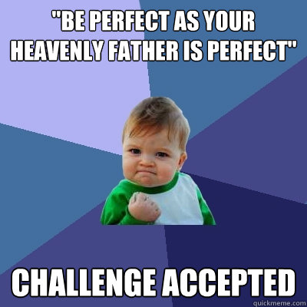
Be perfect.
Notes:
But does God really expect us to be perfect? Isn’t that a bit high and unreasonable?
God expects perfection for anyone who will be with him in heaven.
That would be quite unfair of God to require us humans to be perfect—if he never gave us any help.

Slide 41
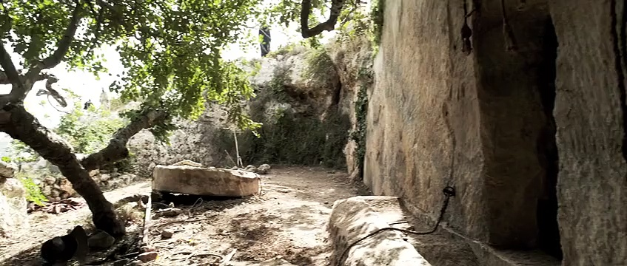
The only way you can be perfect is to trust Christ’s death and resurrection for you that forgives your sin. Have you done that?
Notes:
But he did give us help. The only way you can be perfect is to trust Christ’s death and resurrection for you that forgives your sin. Have you done that?

Slide 42
How should you treat your enemy?
Notes:
(Lest we forget the forest by looking only at the trees, let’s get back to our central question: Why bless your enemy? What’s the answer?)

Slide 43
Main Idea
Blessing your enemy shows Christ's higher law

Slide 44
I. Love and pray for your enemy (5:43-44).

Slide 45
II. Blessing your enemy shows Christ's higher law (5:45-48).

Slide 46
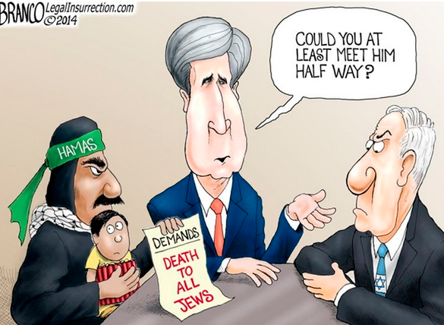
Love your enemies.

Slide 47
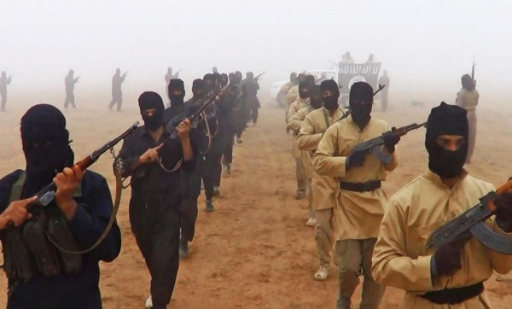
Love your enemies.

Slide 48
Love your enemies.
Notes:
Does 'Love Your Enemies' Include ISIS? — Ask a Pastor, Dr. Joel C. Hunter

Slide 49
Love your enemies.

Slide 50
Is that true?

Slide 51
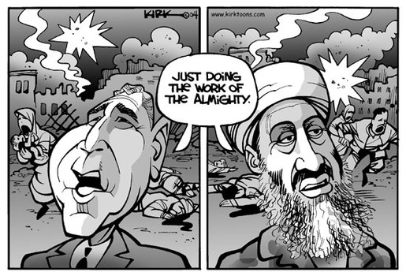
Is there a just war?

Slide 52
How might you be despising your enemy?
Notes:
Do you avoid this person who avoids you?
Do you slander the one who speaks badly of you?
Do you oppose this person who opposes you?
Do you despise the one who despises you?

Slide 53
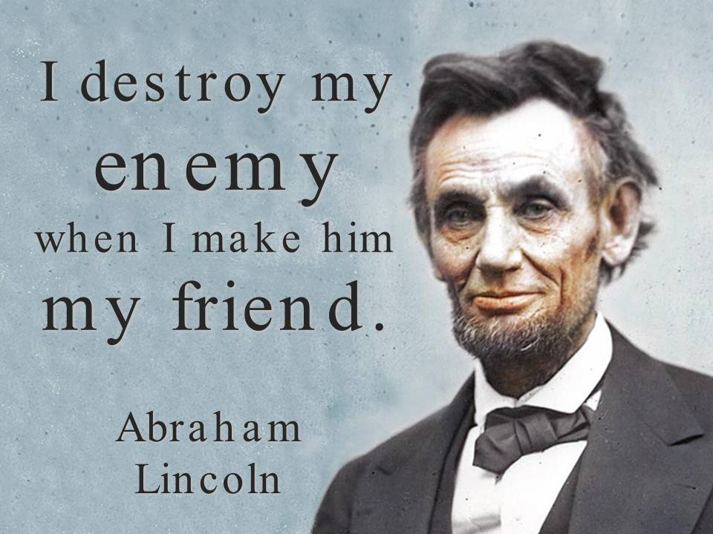
Love your enemies.

Slide 54
How can you bless your enemy?
Avoid
Engage
Slander
Praise
Oppose
Pray
Despise
Love
Notes:
Do you avoid this person who avoids you?
Do you slander the one who speaks badly of you?
Do you oppose this person who opposes you?
Do you despise the one who despises you?

Slide 55
Black

Slide 56
NT Sermons link at biblestudydownloads.org
Get this presentation and script for free!

