Slide 1
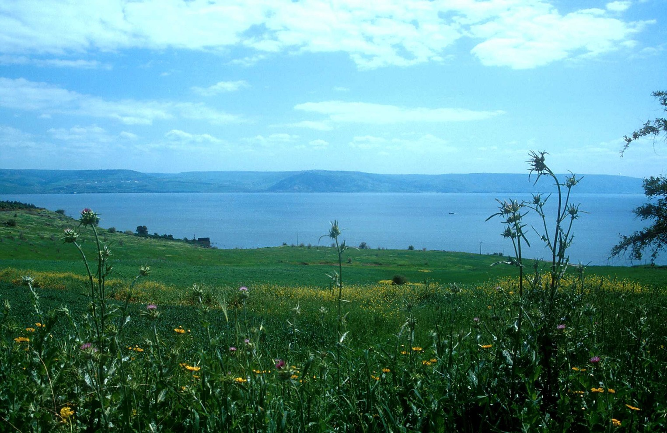
When Jesus is King…
An Introduction to Matthew 5–7
Dr. Rick Griffith, Crossroads International Church
www.biblestudydownloads.org

Slide 2

The Sermon on the Mount
(Matthew 5–7)
Notes:
Today I decided to preach "The Best Sermon Ever." Maybe you thought I had totally lost any sense of humility—but actually, I was referring to Christ's message in Matthew 5–7, which is called "The Sermon on the Mount."

Slide 3
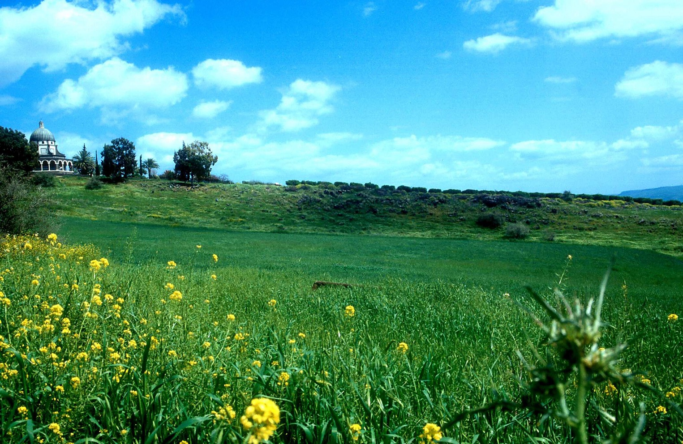
Mount of Beatitudes (Matthew 5–7)
Notes:
He preached this on what is now called the Mount of Beatitudes. You can visit this actual location today if you visit Israel. It is a beautiful setting.

Slide 4

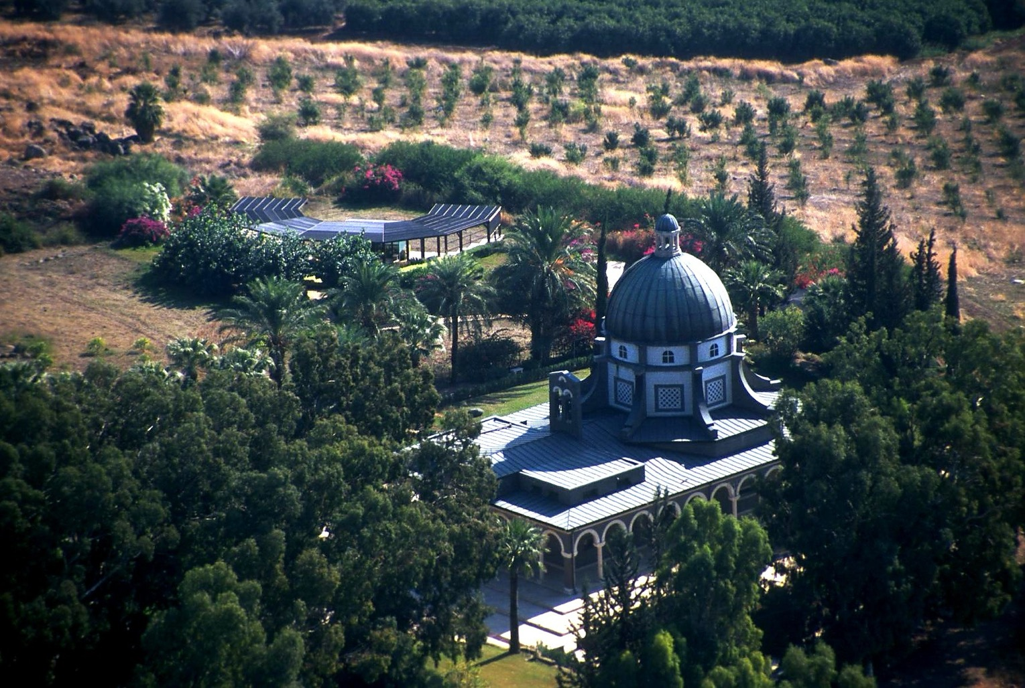
Purpose of the Sermon (Matthew 5–7)
How to be saved?
An ethic for those saved?
Notes:
So for the next 20 Sundays we will dig into this most significant sermon ever. But what was Jesus actually saying in these three chapters?
• Was he giving an evangelistic message to a mixed crowd of believers and unbelievers?
• Or, was he sharing with his disciples and a believing multitude how they should show their faith in their lifestyle?
The text supports this latter view. In fact, verses 1-2 specifically say that he addressed his disciples.
"One can also see that the intended audience of the Sermon was true believers by the way in which Jesus characterizes them as regenerate people.867 He tells them, for example, that when they are persecuted they will be rewarded in heaven (5:12). He calls them “salt of the earth,” and the “light of the world” (5:13-14).868
He says to them that “theirs is the kingdom of heaven,” “they shall see God,” and “Blessed869 are you when people insult you, persecute you and falsely say all kinds of evil against you because of me” (Matthew 5:11). This is not the gospel to a mixed multitude. Furthermore, He speaks of their “reward in heaven.” His disciples have been so impacted by Jesus’ message that He exhorts them saying, “Let your light shine before men, that they may see your good deeds, and praise your Father in heaven” (v. 16).
Does one give nonbelievers instruction on prayer, rewards, almsgiving and fasting (6:16-18), and then tell them these are conditions for personal salvation?"
—Joseph Dillow, Final Destiny, 267

Slide 5
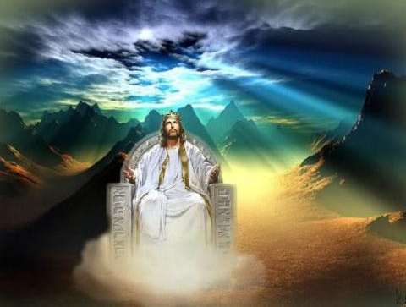
When Jesus is King…
(Matthew 5–7)
What would your life look like if Christ was truly the boss of your life?
Notes:
Initially I was going to call the series "The Sermon on the Mount." But that only gives the location.
So then I thought about calling it "The Best Sermon Ever." But that could be misconstrued.
• Finally, I decided to call this "When Jesus is King…" as this gives the real meaning of the Sermon.
• Have you thought about this question, "What would your life look if Christ was truly the boss of your life?" We’ll discuss this in the coming weeks!

Slide 6

Matthew:
Jesus is King
But why believe this?

Slide 7


I. Jesus fulfilled all the requirements to be Israel's king.

Slide 8


When I Think They Were Written…
51a
1
MATTHEW
2
MARK
TO:
JEWS
TO:
ROMANS
The A.D.40s
A.D. 64-68
AS:
KING
AS:
SERVANT
WHAT
HE:
WHAT
HE:
SAID
DID
3
LUKE
4
JOHN
GREEKS
CHURCH
A.D. 57-59
A.D. 69 AFTER THE SYNOPTICS
TO:
TO:
AS:
GOD/MAN
AS:
GOD
WHAT
HE:
WHAT
HE:
FELT
MEANT
27
4
Notes:
Now…what about the dates of the writing of these crucial documents? And here we are left to our best scholarly guesses. There will ALWAYS be argument here. But some of the best guesses, based on decades of academic research and study are these – in suggested order…
//// MATTHEW…composed sometime during the A.D. 40s…
//// LUKE is suggested as next, between the years A.D. 57 and 59 A.D…
//// Mark…in the next decade…between 64 and 68…
//// and finally…John's Gospel…around A.D. 69….but certainly after the Synoptics were set down. Again, you will always find disagreement on these dates. However, these dates are from the research of well-known Christian scholars and teachers.

Slide 9
NT Overview (History)
38
124
39-41
"To the remotest part of the earth" (Acts 1:8)
Acts 9 13 14 15 16 18 21 27 28
Apr 48-
Sep 49
1
Galatia
Apr 50-
Sep 52
2
Aegean
Spr 53-
May 57
3
Asia
Feb 60-
Mar 62
1
Rome
Spr 62-
Fall 67
4
Spain
Aut 67-
Spr 68
2
Rome
Summer 35-
37
Damascus
Antioch
May 57-
Aug 59
Trials
Fall 49
The
Council
Spring 68
Expansion of Church
35 48 49 50 52 53 57 60 62 67 68 95
Matthew
Israel
40s
Kingdom
Gospels & Acts
1234
Journeys
Rome
Imprisonments
Gospels & Acts

Slide 10
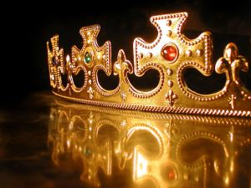
In your small group…
Matthew presents Christ as King of Israel. Do you think Christians today have a hard time thinking of Christ as King?
Why or why not?

Slide 11
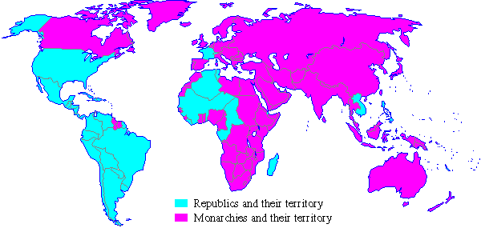
Monarchies in 1900
Republics and their territory
Monarchies and their territory
Notes:
A quick look at the world map a century ago shows that most of the world was ruled by kings in 1900.
________
Common-495
OS-09-1 Samuel-93
OS-10-Davidic Covenant-04
NS-01-Matt1-14-slide 61

Slide 12
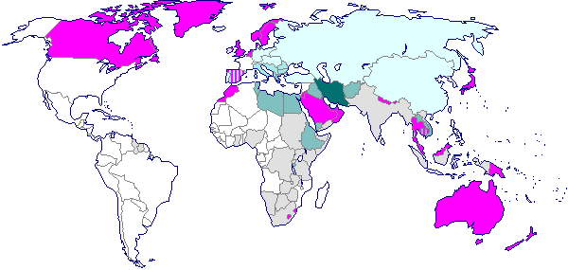
Monarchies in 2000
Monarchies Abolished:
1900-1925
1925-1950
1950-1975
1975-2000
Still Monarchies
Colonies Which Became Republics Upon Independence
Notes:
However, a century later, few monarchies are left. Even Britain, Japan, Canada, Australia and perhaps Scandinavian countries are not monarchies in the practical sense.
________
Common-496
OS-09-1 Sam-94
OS-10-Davidic Covenant-05
NS-01-Matt1-14-slide 62

Slide 13
The Demise of Monarchies
Monarchies in 1900
Monarchies in 2000
Republics and their territory
Monarchies and their territory
Monarchies Abolished:
1900-1925
1925-1950
1950-1975
1975-2000
Still Monarchies
Colonies Which Became Republics Upon Independence
Notes:
Do you see the vast difference between the two world maps? I wonder if the demise of monarchies affects the way we look at Jesus in terms of him being king.
________
Common-497
OS-09-1 Sam-95
OS-10-Davidic Covenant-06
NS-01-Matt1-14-slide 63

Slide 14

Matthew: Christ as King
"Judah, my son, is a young lion that has finished eating its prey. Like a lion he crouches and lies down; like a lioness—who dares to rouse him?
¹⁰The scepter will not depart from Judah, nor the ruler's staff from his descendants, until the coming of the one to whom it belongs, the one whom all nations will honor" (NLT).
Since Jacob's blessing in Genesis 49:9-10, the lion has depicted a king…

Slide 15
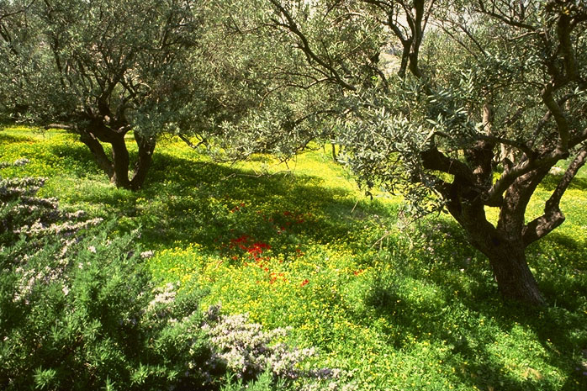
The Kingdom
JESUS
Life
Cross
Church
Gospels
Acts
Epistles
Revelation
The Garden of Gethsemane,
Mount of Olives, Jerusalem
64
1

Slide 16
Matt. 3:1-2 NLT
"In those days John the Baptist came to the Judean wilderness and began preaching. His message was, 'Repent of your sins and turn to God, for the kingdom of heaven is near' "
JESUS
Life
Cross
Church
Gospels
Acts
Epistles
Revelation
65

Slide 17
Matt. 4:17, 23
"…Jesus began to preach and say: 'Repent, for the kingdom of heaven is at hand…Jesus was going throughout all Galilee, teaching in their synagogues and proclaiming the gospel of the kingdom…' "
JESUS
Life
Cross
Church
Gospels
Acts
Epistles
Revelation
65
Notes:
What was Jesus saying to us? In Matthew's fourth chapter, we are told that "Jesus began to preach and say: 'Repent, for the kingdom of heaven is at hand…Jesus was going throughout all Galilee, teaching in their synagogues and proclaiming the gospel of the Kingdom…'"
What is that Kingdom? What did he mean?

Slide 18
Matt. 6:33
"But seek first His Kingdom and His righteousness, and all these things will be added to you."
JESUS
Life
Cross
Church
Gospels
Acts
Epistles
Revelation
66
Notes:
Two chapters later, Matthew reports Jesus saying, "But seek first His Kingdom and His righteousness, and all these things will be added to you."

Slide 19
Matt. 10:5-7
"Jesus sent out the twelve apostles with these instructions: 'Don't go to the Gentiles or the Samaritans, ⁶ but only to the people of Israel—God's lost sheep. ⁷ Go and announce to them that the kingdom of heaven is near'"
65
Notes:
What was Jesus saying to us? In Matthew's fourth chapter, we are told that "Jesus began to preach and say: 'Repent, for the kingdom of heaven is at hand…Jesus was going throughout all Galilee, teaching in their synagogues and proclaiming the gospel of the Kingdom…'"
What is that Kingdom? What did he mean?

Slide 20

Matthew 6:9-10 (NKJV)
⁹ In this manner, therefore, pray:
Our Father in heaven,
Hallowed be Your name.
¹⁰ Your kingdom come.
Your will be done
On earth as it is in heaven.

Slide 21
¹¹ Give us this day our daily bread.
¹² And forgive us our debts,
As we forgive our debtors.
¹³ And do not lead us into temptation,
But deliver us from the evil one.
For Yours is the kingdom and the power and the glory forever.
Amen.

Slide 22

"Thy Kingdom Come"
Matthew 6:10

Slide 23
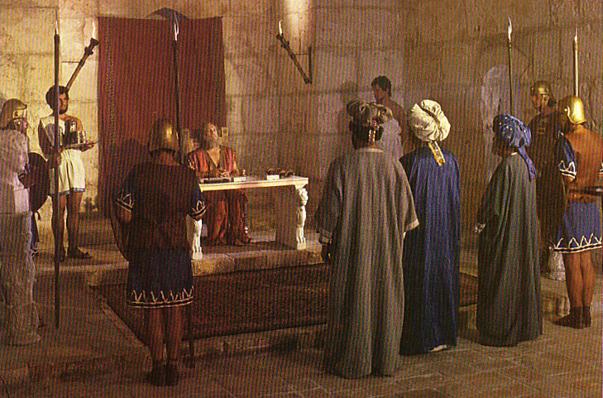
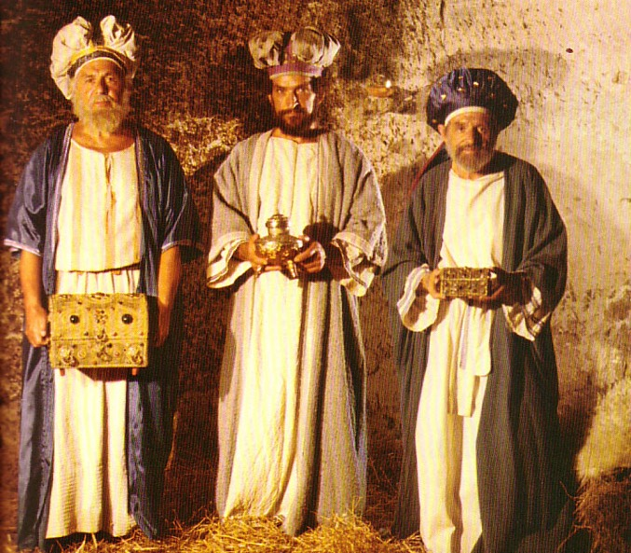
What Kind of Kingdom Did Isaiah
(and Matthew) Envision?
78b
Political
Physical
Emotional
Intellectual
Spiritual

Slide 24

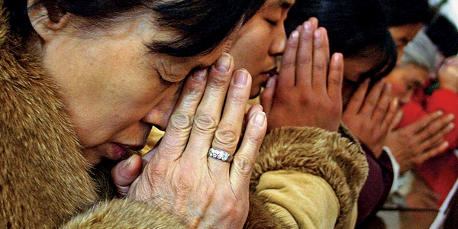
What does it mean to pray…
"Thy Kingdom come"?
Is the kingdom of a different nature than Israel's in the OT?

Slide 25
Not a new idea!
"Many passages speak of the second coming of Christ being followed by a reign of righteousness on earth (Pss. 2; 24; 72; 96; Isa. 2; 9:6-7; 11-12; 63:1-6; 65-66; Jer. 23:5-6; 30:8-11; Dan. 2:44; 7:13-14; Hosea 3:4-5; Amos 9:11-15; Micah 4:1-8; Zeph. 3:14-20; Zech. 8:1-8; 14:1-9; Matt. 19:28; 25:31-46; Acts 15:16-18; Rom. 11:25-27; Jude 14-15; Rev. 2:25-28; 19:11-20:6)."
—John Walvoord, "Revelation," in The Bible Knowledge Commentary, 2:978

Slide 26
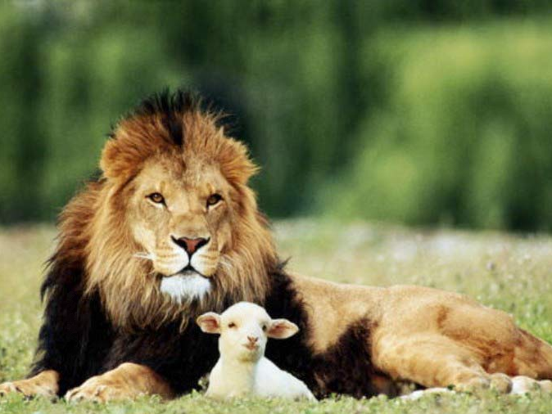
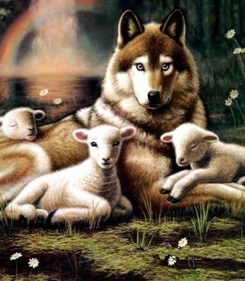
Isaiah 11:6-9
NTS 434
"And the wolf will dwell with the lamb, and the leopard will lie down with the young goat, and the calf and the young lion and the fatling together."
Isa. 11:6
Notes:
26

Slide 27
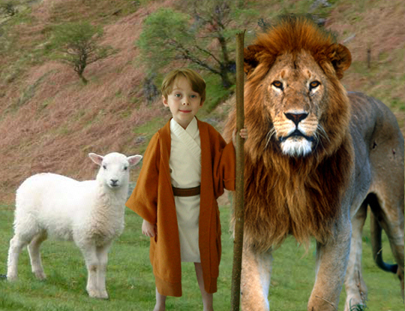
Isaiah 11:6-9
434
"And the wolf will dwell with the lamb, and the leopard will lie down with the young goat, and the calf and the young lion and the fatling together; and a little boy will lead them."
Notes:
27

Slide 28
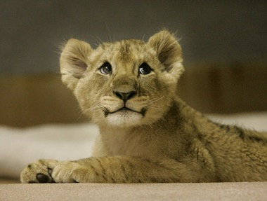
Isaiah 11:6-9
434
⁷ Also the cow and the bear will graze, their young will lie down together, and the lion will eat straw like the ox.
Notes:
28

Slide 29
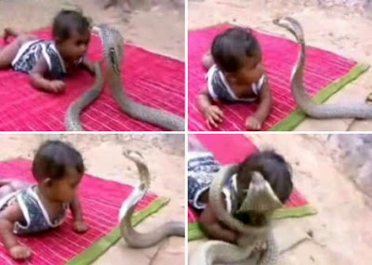
Isaiah 11:6-9
434
⁸ The nursing child will play by the hole of the cobra, and the weaned child will put his hand on the viper's den.
⁹ They will not hurt or destroy in all My holy mountain, for the earth will be full of the knowledge of the LORD as the waters cover the sea.
Notes:
29
http://dailybuzzlive.com/archives/5613
Snake Tries to Eat Baby. Watch Video Before Reading! Now you may be outraged by this video and think that the parents need to have their child taken away for child abuse, but before you jump to any conclusions take a second to read about a culture that most of us know nothing about. - See more at: http://dailybuzzlive.com/archives/5613#sthash.m31WN86t.dpuf
You may think that this baby is some type of super human, being able to withstand sharp poisonous snake bites, it would pretty awesome if this were true. The snake in the video is actually defanged and has no poison whatsoever. In India, as well as Nepal, some Hindus actually worship snakes. This is called Nag Panchami and many children from this culture grow up with and around snakes. Some people even keep and feed them as though they were their children. - See more at: http://dailybuzzlive.com/archives/5613#sthash.m31WN86t.dpuf

Slide 30
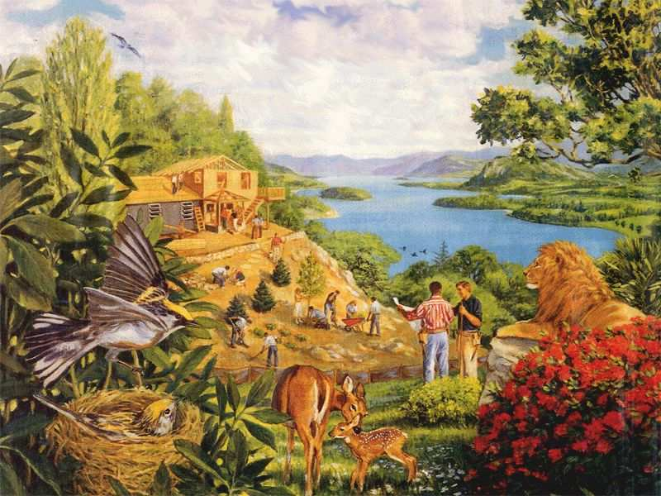
Rebuilding brings…
434
Notes:
30

Slide 31
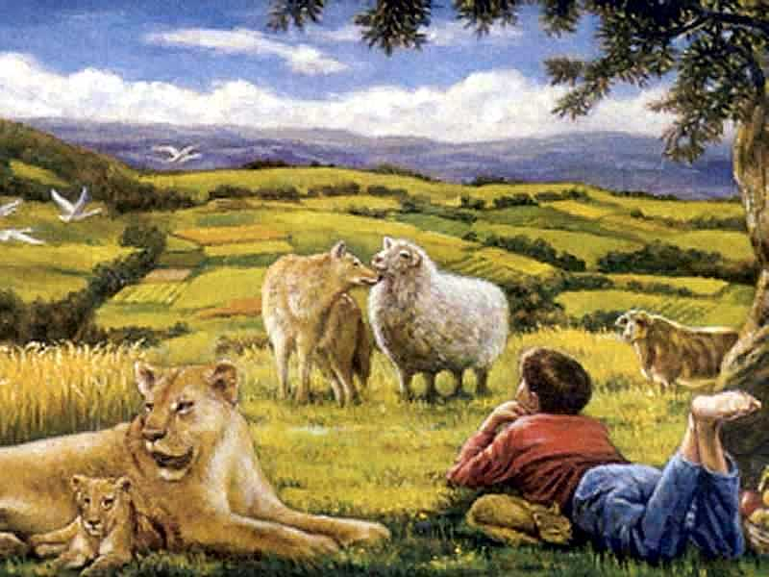
…a totally renewed earth!
434
Notes:
31

Slide 32

Romans 8:19-21
"The creation waits in eager expectation for the sons of God to be revealed. . . The creation itself will be liberated from its bondage to decay and brought into the glorious freedom of the children of God."
434
Notes:
32

Slide 33
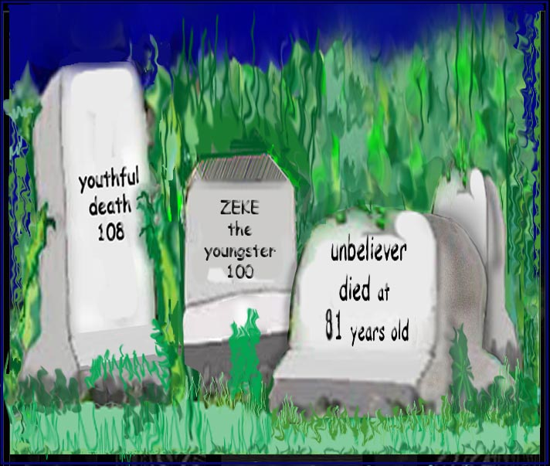
Incredibly Long Life!
Isaiah 65:20 "Never again will there be in [Jerusalem] an infant who lives but a few days, or an old man who does not live out his years; he who dies at a hundred will be thought a mere youth; he who fails to reach a hundred will be considered accursed."
Notes:
33

Slide 34

Millennial Jerusalem
434
"The law will go out from Zion,
the word of the LORD from Jerusalem"
— Isaiah 2:3
Notes:
34
BSD 420

Slide 35
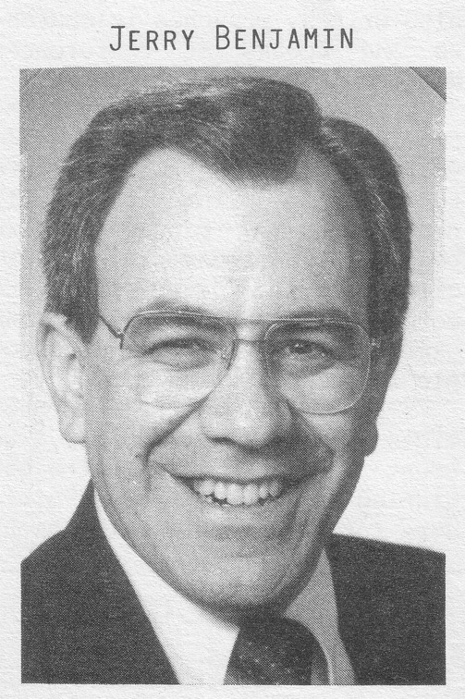
A boring way to begin a book?
ESV Matthew 1:1 The book of the genealogy of Jesus Christ, the son of David, the son of Abraham. 2 Abraham was the father of Isaac, and Isaac the father of Jacob, and Jacob the father of Judah and his brothers, 3 and Judah the father of Perez and Zerah by Tamar, and Perez the father of Hezron, and Hezron the father of Ram, 4 and Ram the father of Amminadab, and Amminadab the father of Nahshon, and Nahshon the father of Salmon, 5 and Salmon the father of Boaz by Rahab, and Boaz the father of Obed by Ruth, and Obed the father of Jesse, 6 and Jesse the father of David the king. And David was the father of Solomon by the wife of Uriah, 7 and Solomon the father of Rehoboam, and Rehoboam the father of Abijah, and Abijah the father of Asaph, 8 and Asaph the father of Jehoshaphat, and Jehoshaphat the father of Joram, and Joram the father of Uzziah, 9 and Uzziah the father of Jotham, and Jotham the father of Ahaz, and Ahaz the father of Hezekiah, 10 and Hezekiah the father of Manasseh, and Manasseh the father of Amos, and Amos the father of Josiah, 11 and Josiah the father of Jechoniah and his brothers, at the time of the deportation to Babylon. 12 And after the deportation to Babylon: Jechoniah was the father of Shealtiel, and Shealtiel the father of Zerubbabel, 13 and Zerubbabel the father of Abiud, and Abiud the father of Eliakim, and Eliakim the father of Azor, 14 and Azor the father of Zadok, and Zadok the father of Achim, and Achim the father of Eliud, 15 and Eliud the father of Eleazar, and Eleazar the father of Matthan, and Matthan the father of Jacob, 16 and Jacob the father of Joseph the husband of Mary, of whom Jesus was born, who is called Christ.
Jeremiah Benjamin
"The first verse stunned me," Jerry recalls. "It said that Jesus was related to my forefathers."
Notes:
Most of us, if we are honest, find that the first few verses of the NT are boring. They may be good for getting us to sleep if we have insomnia, but they aren't generally appreciate as literature [read 1:1-3 with a yawn].
While I was a student at Dallas Seminary, I had the privilege of meeting Jeremiah Benjamin—a true Jewish name if you ever heard one! Jerry was from such a strictly orthodox Jewish family that the New Testament was forbidden in his home. However, a Christian student once gave him a NT and challenged him to read it. So he snuck into his room, climbed into bed, pulled the sheets over him and took out his flashlight.
[Animation] "The first verse stunned me," Jerry later recalled. "It said that Jesus was related to my forefathers."
My experience with Jerry helped me to see that Matthew's beginning didn't interest me because I am a Gentile who wasn't looking for Israel's king. I didn't even know what questions to ask or what to look for. But Matthew was written for the Jewish heart and mind. Therefore, he starts off with a bang: Jesus was actually a direct descendant of King David and therefore fulfilled the lineage necessary to be Israel's king!

Slide 36
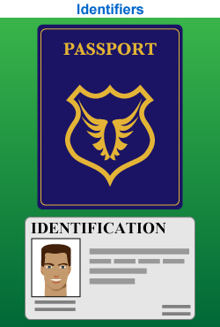
Proof That Jesus is King
Notes:
"Persons traveling by plane to another country must identify themselves. Picture identification, like a driver's license and a passport, are usually required. These identifiers are carefully examined to ensure that all the passengers are safe from harm. A man who identifies himself as the Messiah also needs the correct identification. For instance, He must be descended from the line of David, be born in the right city, be born at the right time, and be able to perform amazing works" (Rick Griffith, "Advanced Studies in the NT," Lesson 1, Topic 3, internetseminary.org accessed 17 Jan 2016).

Slide 37
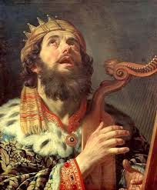
David Listed Before Abraham
"This is a record of the ancestors of Jesus the Messiah, a descendant of David and of Abraham"
(Matt. 1:1 NLT)

Slide 38
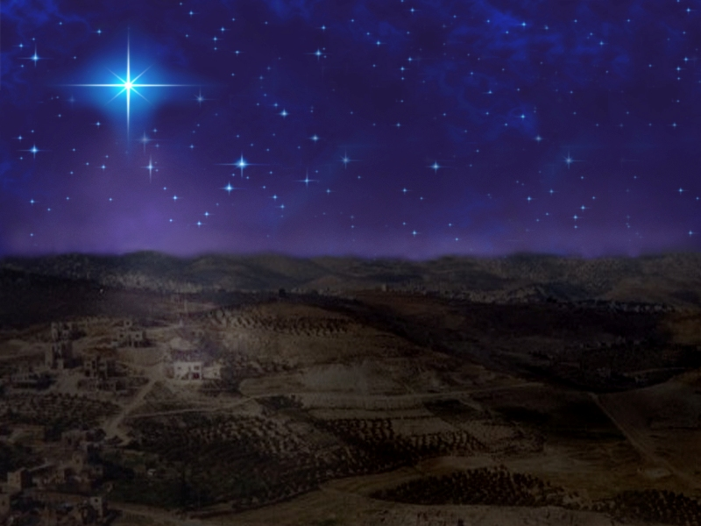
Bethlehem
"And you, O Bethlehem in the land of Judah, are not least among the ruling cities of Judah, for a ruler will come from you who will be the shepherd for my people Israel"
(Micah 5:2 quoted in Matthew 2:6 NLT)

Slide 39
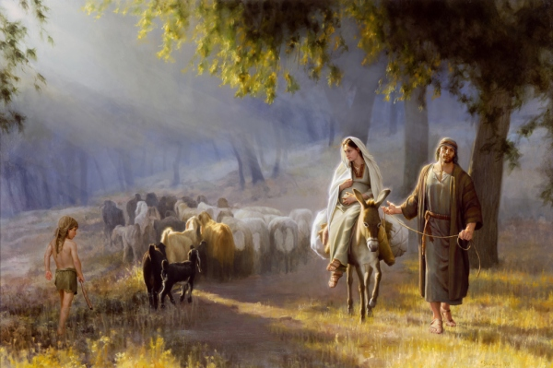
Journey to Bethlehem

Slide 40
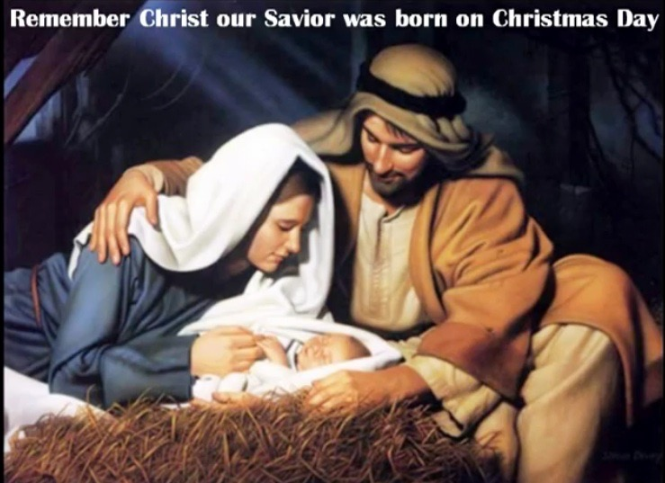
One King 19/30
Jesus was easily identifiable

Slide 41
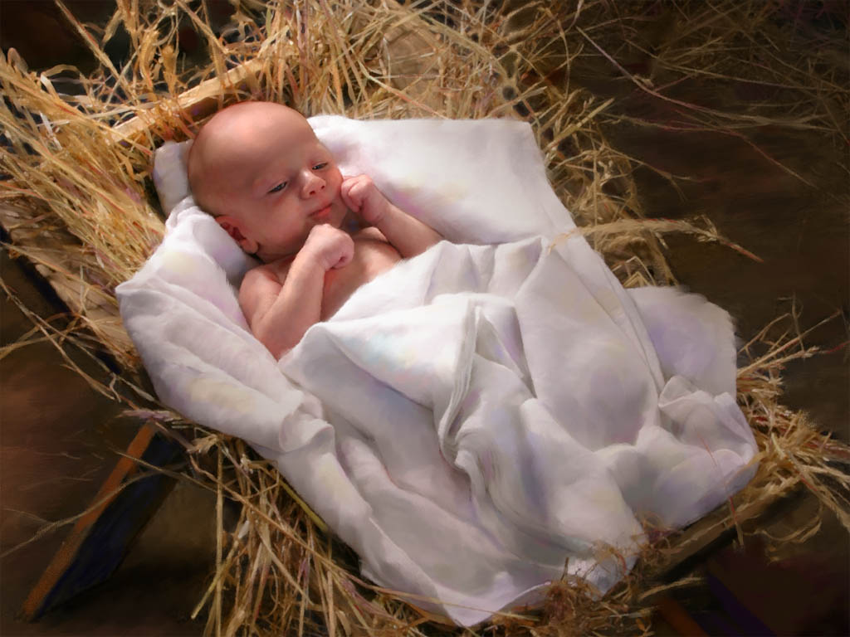
Jesus was God made flesh

Slide 42
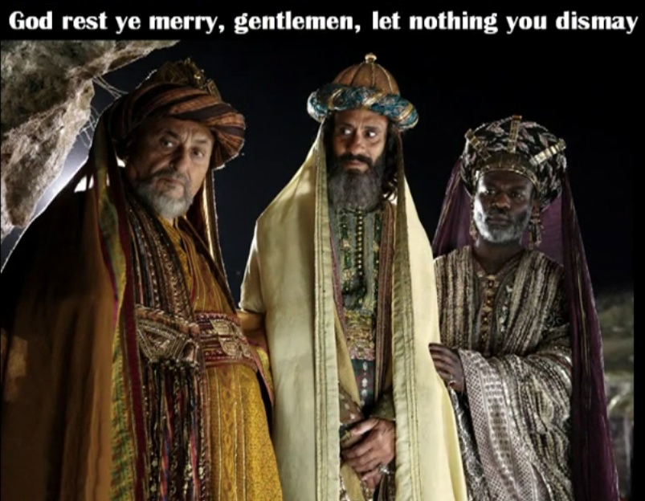
One King 18/30
Wise men came from the East

Slide 43
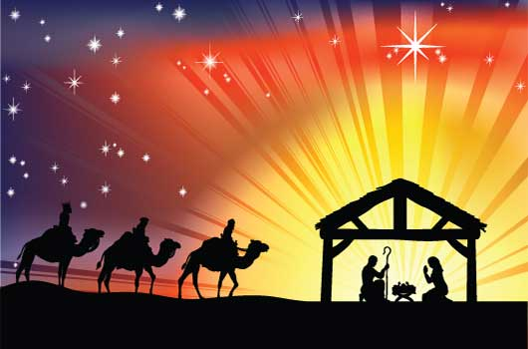

Proof Jesus is King
(Matt 1:1–4:11)
Advent
Approvals
• Right lineage
• by John
• Virgin born
• by Father
• Magi worship
• by Spirit
• Humble origins
Notes:
Matthew 1–4 provide proofs that Jesus should be accepted as Israel's king. Jesus has the right physical line and is approved by key witnesses to be the King of Israel.
Both John (3:1) and Jesus (4:17) declare, "Repent, for the kingdom of heaven is at hand!" Repentance means a change of mind regarding who Jesus is. But what are the fruits of such a change of thinking?

Slide 44
Matthew in Three Sections
67
Messiah with Authority over the Church
Preliminary Evidence that Christ is Messiah
Rejections and
Interadvent Age
Final Evidence that
Christ is Messiah
Chapters 1–10
Chapters 11–27
Chapter 28
The King Rejected
The King Re-offered
The King Offered
Teaches Droves
Teaches Disciples
Topical
Chronological

Slide 45
Matthew in Nine Sections
67
Bethlehem & Nazareth
1:1–4:11
Galilee
4:12–16:12
Judea
16:13–28:15
Galilee
28:16-20
Advent
&
Approvals
1:1–4:11
Early Ministry & Proclamation
4:12–7:29
Miracles
&
Authority
8–10
Rejection & Postpone-ment
11:1–16:12
Prepares Disciples
16:13–
20:34
Official Presentation & Rejection
21–27
Empty Tomb
28:1-10
False Report
28:11-15
Great Commission
28:16-20
Prelude
Preaching
Power
Postponed
Prepares
Presented
Proof
Perjury
Plan
Palestine
Written in AD 40s
Covers 5 BC–AD 33

Slide 46
Key Word & Verses
67
Key Word
Kingdom
Key Verse
"Say to the daughter of Zion, 'See, your king comes to you, gentle and riding on a donkey, on a colt, the foal of a donkey'"
(Matthew 21:5)
Matthew
Key Verse
"Simon Peter answered, 'You are the Christ, the Son of the living God.' Jesus replied, '…you are Peter, and on this rock I will build my church, and the gates of Hades will not overcome it'"
(Matthew 16:16-18)

Slide 47
25
67
Message Statements for the New Testament Books
Subject + Purpose = Message
What the book says Why it says it Main (Big) Idea (Theme) (Reason) (Summary Statement)
Matthew
Matthew proves Jesus is the Messiah so that the unbelieving Jews will trust Him.
Matthew also explains that the earthly kingdom is delayed because Israel rejected Christ as their king.
This explanation is to convince the believing Jews that Christ's present kingdom authority resides in the church.

Slide 48

A Literal, Political Kingdom
"Jesus replied,
'I assure you that when the world is made new and the Son of Man sits upon his glorious throne, you who have been my followers will also sit on twelve thrones, judging the twelve tribes of Israel'"
(Matt. 19:28 NLT)

Slide 49
The Interadvent Age
76
First Advent
Second Advent
Second
=
Coming
Interadvent Age
(Church Age)
Millennium
Eternal Kingdom
1000 years
Judgment
Judgment

Slide 50
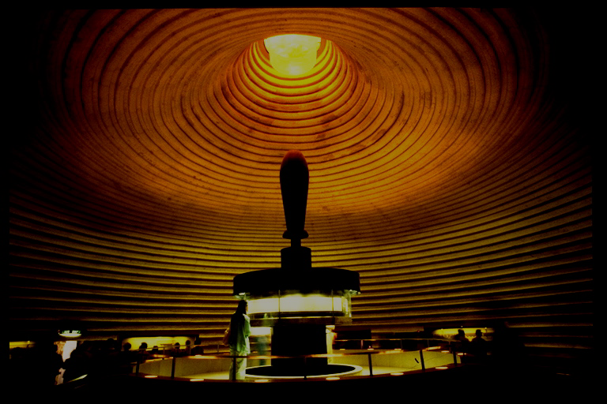
ABRAHAMIC COVENANT
The Call to Abraham Gen. 12:1-3
The Covenant to Abraham Gen. 15:9-18
ETERNAL
LITERAL
UNCONDITIONAL
Gen. 13:15
Gen. 13:14-16
Gen. 15:9-18
LAND
SEED
BLESSING
Gen. 12:1
Gen. 12:2
Gen. 12:3
The Amplified Subcovenants
Land
Davidic
Deut. 30:1-10
2 Sam. 7:4-16
The Very "Backbone" of Biblical Revelation
18
©2004 TBBMI
7.2.05B.

Slide 51
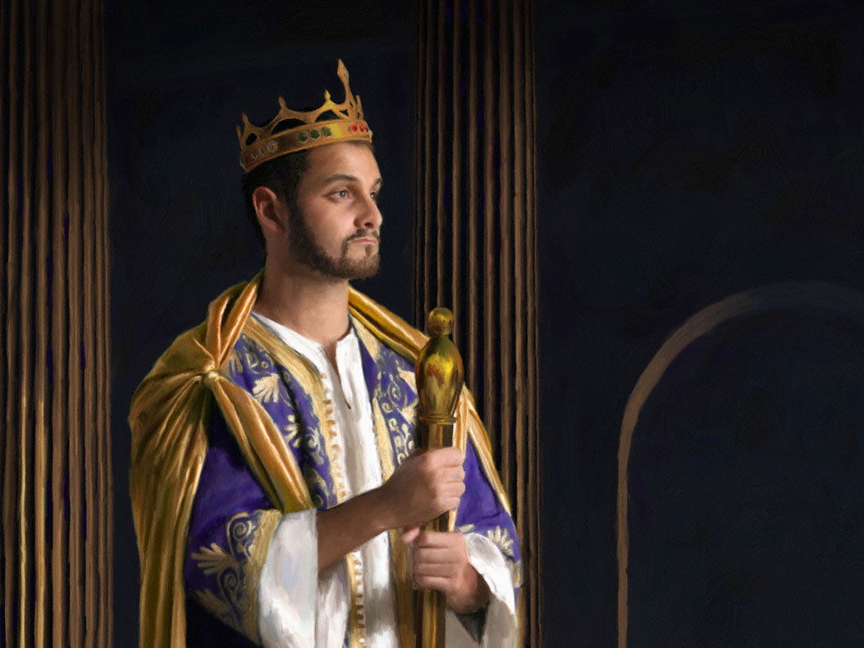
KEY VERSE:
2 Samuel 7:12-13
209
"For when you (David) die, I will raise up one of your descendants, and I will make his kingdom strong. He is the one who will build a house—a temple—for my name. And I will establish the throne of his kingdom forever."

Slide 52

THE DAVIDIC COVENANT
ITS THREE GUARANTEES
2 Samuel 7
¹⁶ Your house and your kingdom will endure forever before me; your throne will be established forever.
forever
forever
19
6
©2004 TBBMI
8.0.05B.

Slide 53
So, then, the question must be asked:
Who is qualified to sit on that Davidic throne?
20
©2004 TBBMI
8.0.05B.

Slide 54
STUDY HELP #16
THE DAVIDIC DYNASTY
The Royal Genealogy of Jesus Christ
21
1
©2004 TBBMI
8.0.05B.

Slide 55
THE LINE OF DAVID: The Royal Genealogy of Jesus Christ*
*VASTLY ABBREVIATED
22
1
Notes:
What about the genealogy of the Lord Jesus Christ, out of that line of David, according to Scripture? What do the scriptures have to say about all that? We are given a long and complex genealogy...
/// so this one will be vastly abbreviated.

Slide 56
THE LINE OF DAVID: The Royal Genealogy of Jesus Christ*
ADAM EVE
Scripture Location:
Genesis 3:20
*VASTLY ABBREVIATED
23
Notes:
We begin with Adam and Eve, first recounted in Genesis 3:20...

Slide 57
THE LINE OF DAVID: The Royal Genealogy of Jesus Christ*
ADAM EVE
Scripture Location:
Genesis 4:1-2; 4:8
CAIN ABEL
*VASTLY ABBREVIATED
24
1
Notes:
From their union came the brothers Cain and Abel.
//// And we know that Cain slew Abel because of Cain's jealousy of the gifts Abel made in sacrifice to the Lord. As a replacement for that murdered brother who was more favored by God, another son was born to Adam and Eve...

Slide 58
THE LINE OF DAVID: The Royal Genealogy of Jesus Christ*
ADAM EVE
Scripture Location:
Genesis 4:25
CAIN ABEL SETH
*VASTLY ABBREVIATED
25
Notes:
He was Seth, the beginning of a godly line of men. AND RIGHT HERE is where the royal genealogy of Jesus Christ gets underway.

Slide 59
THE LINE OF DAVID: The Royal Genealogy of Jesus Christ*
ADAM EVE
Scripture Location:
Genesis 5:29
CAIN ABEL SETH
NOAH
*VASTLY ABBREVIATED
26
Notes:
From Seth...followed Noah. By the way...dotted lines represent an abbreviation of all the Biblical names that actually occur during the long lines of descent. Scripture tells us the names of each one.

Slide 60
THE LINE OF DAVID: The Royal Genealogy of Jesus Christ*
ADAM EVE
Scripture Location:
Genesis 11:26
CAIN ABEL SETH
NOAH
ABRAHAM
*VASTLY ABBREVIATED
27
Notes:
Eventually through this line...we arrive at Abraham.

Slide 61
THE LINE OF DAVID: The Royal Genealogy of Jesus Christ*
ADAM EVE
Scripture Location:
Matthew 1:2-6
CAIN ABEL SETH
NOAH
ABRAHAM (Sarah)
*VASTLY ABBREVIATED
DAVID
28
Notes:
And from Abraham, a thousand years later, appears David..

Slide 62
THE LINE OF DAVID: The Royal Genealogy of Jesus Christ*
ADAM EVE
Scripture Location:
2 Samuel 12:24
CAIN ABEL SETH
NOAH
ABRAHAM
*VASTLY ABBREVIATED
DAVID BATHSHEBA
29
Notes:
And...among other of David's several wives...appears Bathsheba.

Slide 63
THE LINE OF DAVID: The Royal Genealogy of Jesus Christ*
ADAM EVE
Scripture Location:
2 Samuel 5:14
CAIN ABEL SETH
NOAH
ABRAHAM
*VASTLY ABBREVIATED
DAVID BATHSHEBA
NATHAN SOLOMON
30
Notes:
Among the children of David and Bathsheba are these two sons: Nathan and Solomon. And here the line splits. Note that. It's a crucial place.

Slide 64
THE LINE OF DAVID: The Royal Genealogy of Jesus Christ*
ADAM EVE
Scripture Location:
Luke 3:23
Plus Others
CAIN ABEL SETH
NOAH
ABRAHAM
*VASTLY ABBREVIATED
DAVID BATHSHEBA
NATHAN SOLOMON
LUKE 3:23 (see other references)
MARY
31
Notes:
From the line of son Nathan, eventually appears Mary, the mother of Jesus.

Slide 65
THE LINE OF DAVID: The Royal Genealogy of Jesus Christ*
LUKE 3:23 (see other references)
Luke 3:23: "Now Jesus himself was about 30 years old when He began His ministry. He was the son, so it was thought, of Joseph." (NIV)
"Luke was tracing the line of Mary. Many interpreters [among varied positions…] argue that Luke was giving the genealogy of Mary, showing that she also was in the line of David and that therefore Jesus was qualified as the Messiah, not only through Joseph (since he was the oldest legal heir) but also through Mary."
Louis Barbieri, The Bible Knowledge Commentary, eds. John Walvoord & Roy Zuck (Victor Books, 1983), 212.
32
1
Notes:
Luke wrote about this in his Gospel. In his third chapter, verse 23: "Now Jesus himself was about 30 years old when He began His ministry. He was the son, SO IT WAS THOUGHT, of Joseph."
//// This further explanation from two eminent Bible scholars: "Luke was tracing the line of Mary. Many interpreters [among varied other positions…] argue that Luke was giving the genealogy of Mary, showing that she also was in the line of David and that therefore Jesus was qualified as the Messiah, not only through Joseph (since he was the oldest legal heir) but also through Mary."

Slide 66
THE LINE OF DAVID: The Royal Genealogy of Jesus Christ*
ADAM EVE
Scripture Location:
Matthew 1:16
CAIN ABEL SETH
NOAH
ABRAHAM
*VASTLY ABBREVIATED
DAVID BATHSHEBA
NATHAN SOLOMON
MARY JOSEPH
33
Notes:
And from Solomon's side...the line of descent leads directly to Joseph, Jesus' FOSTER-father. And then the climactic event of the ages...from Joseph and Mary, through the intervention of the Holy Spirit in Mary's womb…

Slide 67
THE LINE OF DAVID: The Royal Genealogy of Jesus Christ*
ADAM EVE
Scripture Location:
Matthew 1:16
CAIN ABEL SETH
NOAH
ABRAHAM
*VASTLY ABBREVIATED
DAVID BATHSHEBA
NATHAN SOLOMON
MARY JOSEPH
JESUS CHRIST
34
Notes:
…the Lord Jesus Christ enters the earth. And, you might say, "well…we all know that. What is the importance of such an emphasis on it?" Answer: earthly kingship presents two requirements...

Slide 68
THE LINE OF DAVID: The Royal Genealogy of Jesus Christ*
ADAM EVE
CAIN ABEL SETH
NOAH
ABRAHAM
DAVID BATHSHEBA
NATHAN SOLOMON
BLOOD SUCCESSION
LEGAL SUCCESSION
The FAMILY Right
Luke 3:23-38
The LEGAL Right
Matt 1:1-17
MARY JOSEPH
JESUS CHRIST
35
3
Notes:
FIRST…a family qualification by right of a bloodline succession.
//// SECOND…there must also be a legal qualification by right of traditional succession.
//// The family right and blood line through Mary – the mother of Jesus – as it is laid out in Luke's gospel, third chapter, verses 23-38,
//// While the legal line of Jesus' father – Joseph -- appears in detail in Matthew's Gospel, chapter 1, verses 1-17.
Much has been written all about this...far more than can be described here. So you are encouraged to dig into these ideas. They are rich with meaning, significance and credibility toward establishing the Lord's place in the great Plan of the Ages.

Slide 69
THE LINE OF DAVID: The Royal Genealogy of Jesus Christ*
ADAM EVE
CAIN ABEL SETH
NOAH
ABRAHAM
DAVID BATHSHEBA
NATHAN SOLOMON
The FAMILY Right
Luke 3:23-38
The LEGAL Right
Matt 1:1-17
BLOOD
RIGHT
MARY JOSEPH
JESUS CHRIST
36
Notes:
So...to sum up...
Mary, Jesus' birth mother, supplies his bloodline directly back to the throne of David...and beyond.

Slide 70
THE LINE OF DAVID: The Royal Genealogy of Jesus Christ*
ADAM EVE
CAIN ABEL SETH
NOAH
ABRAHAM
DAVID BATHSHEBA
NATHAN SOLOMON
The FAMILY Right
Luke 3:23-38
The LEGAL Right
Matt 1:1-17
BLOOD
RIGHT
LEGAL
RIGHT
MARY JOSEPH
JESUS CHRIST
37
Notes:
...and Joseph…as the foster-father and a descendant of King Solomon… has the right of legal succession to bestow upon his foster son, Jesus. A remarkable evidence of the credibility and reliability of the Scriptural record.

Slide 71

HAVE YOU EVER CONSIDERED THE INCREDIBLE PROBABILITIES OF THE BIRTH AND LIFE OF JESUS CHRIST?
JUST AN ACCIDENT OF BIRTH?
STUDY HELP #17
39
2
©2006 TBBMI
9.65.05B.
Notes:
With Study Help #17 in hand…place yourself here in a rocky field outside Bethlehem where a shepherd tends his flock –– as it has been for thousands of years on this same land…just outside that ancient little town where Jesus was born. From here you could have seen and heard the angelic announcement of his miraculous birth! Which leads to another another question…
//// Have you ever considered the astonishing statistical probabilities of the birth and life of Jesus Christ?
//// Was it just an accident of birth?

Slide 72
HAVE YOU EVER CONSIDERED THE INCREDIBLE PROBABILITIES OF THE BIRTH AND LIFE OF JESUS CHRIST?
*
JUST AN ACCIDENT OF BIRTH?
IN THE OLD TESTAMENT: MORE THAN 300 REFERENCES TO A COMING MESSIAH WERE FULFILLED UPON THE BIRTH, LIFE AND CRUCIFIXION OF JESUS CHRIST. WITH THAT SAID…
STUDY HELP #17
*Source: Josh McDowell, Evidence That Demands A Verdict, 1972, page 175; Peter Stoner, Science Speaks, Moody Press, 1963.
40
Notes:
In the Old Testament…more than 300 references to a coming Messiah were fulfilled upon the birth, life and crucifixion of Jesus Christ. So then, with that said, according to established scientific techniques of probability and statistics.

Slide 73
THAT SAID…
WHAT ARE THE CHANCES OF ONLY 8 PREDICTIONS BEING FULFILLED IN THE LIFE OF ANY ONE INDIVIDUAL BETWEEN THEN AND NOW?
_{ANSWER: ONE CHANCE IN}
_{100 QUADRILLION (10} ¹⁷₎
_{1:100,000,000,000,000,000}
*Source: Josh McDowell, Evidence That Demands A Verdict, 1972, page 175; Peter Stoner, Science Speaks, Moody Press, 1963.
41
2
Notes:
What, then, are the chances of only EIGHT predictions being fulfilled in the life of any one individual between then and now?
//// The answer: one chance in 100 quadrillion…or…10 to the 17th!
//// and here is what that number looks like typed out!
If you think that is incredible…here comes another one.

Slide 74
TAKE IT A STEP FURTHER…
WITH JUST 48 (OF THE 300) PREDICTIONS BEING FULFILLED IN THE LIFE OF ANY ONE INDIVIDUAL BETWEEN THEN AND NOW:
_{ANSWER: one chance in 10}¹⁵⁷
1:10,000,000,000,000,000,000,000,000,000,000,000,000,000, 000,000,000,000,000,000,000,000,000,000,000,000,000,000, 000,000,000,000,000,000,000,000,000,000,000,000,000,000, 000,000,000,000,000,000,000,000,000,000,000,000
*Source: Josh McDowell, Evidence That Demands A Verdict, 1972, page 175; Peter Stoner, Science Speaks, Moody Press, 1963.
42
3
Notes:
Another measure of scientific probability…
//// Then…with just 48 of the 300 predictions being fulfilled in the life of any one individual between then and now:
//// The answer: one chance in 10 to the 157th!
//// Typed out…here you are!
Before your very eyes…statistical probabilities produced by a world-renowned scientist…according to established scientific procedures of statistics and probability.

Slide 75
Three-Part Genealogy of Christ Through Joseph (1:1-17)
From Abraham to David
– 14 generations
From David to Captivity in Babylon
– 14 generations
From Captivity to Christ
– 14 generations

Slide 76

The Kingdom in Matthew 1
Fall of the Kingdom
Establishing the Eternal Kingdom
ABRAHAM
Solomon
Shealtiel
Isaac
Rehoboam
Zerubbabel
Jacob
Abijah
Abiud
Judah
Asa
Eliakim
Perez
Jehoshaphat
Azor
"Thus there were fourteen generations in all from Abraham to David, fourteen from David to the exile to Babylon, and fourteen from the exile to Christ."
Matthew 1:17
Hezron
Jehoram
Zadok
Ram
Uzziah
Akim
Amminadab
Jotham
Eliud
Nahshon
Ahaz
Eleazar
Salmon
Hezekiah
Matthan
Boaz
Manasseh
Jacob
Obed
Amon
Joseph +
Mary
Rise of the Kingdom
Jesse
Josiah
KING DAVID
JECONIAH (EXILE)
JESUS CHRIST

Slide 77
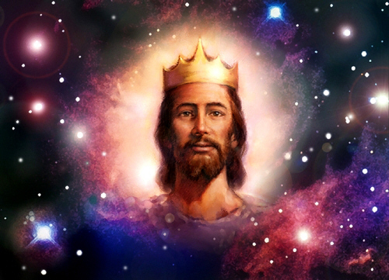
Matthew proves Jesus is King!

Slide 78
I. Jesus fulfilled all the requirements to be Israel's king.

Slide 79
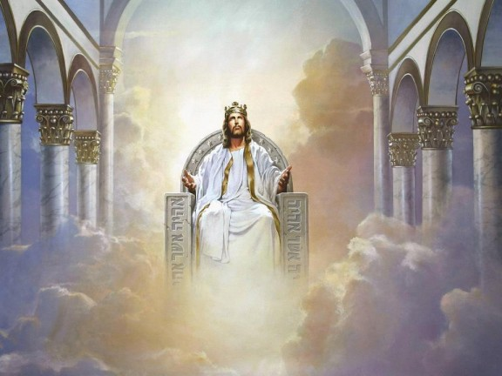
II. Since Jesus is king, then believers will rule with him!

Slide 80
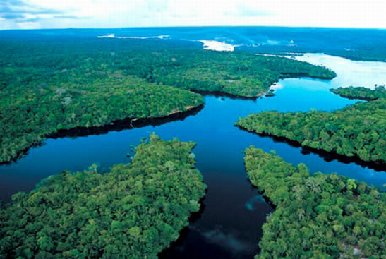
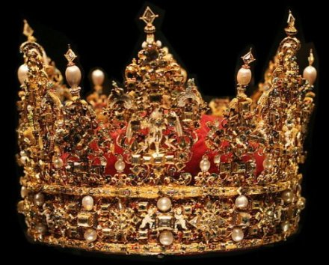
Believers will rule the earth
(Rev. 5:10 NLT).
"And you have caused them to become a Kingdom of priests for our God. And they will reign on the earth."

Slide 81


Revelation 20:4-6 Diagrammed
424
^{4b}and they came to life and reigned with Christ for a thousand years.
^{4a}Then I saw thrones, and they sat on them, and judgment was given to them. And I saw the souls of those who had been beheaded because of their testimony of Jesus and because of the word of God, and those who had not worshiped the beast or his image, and had not received the mark on their forehead and on their hand…
1000 years
^{5b}This is the first resurrection. ^{6a}Blessed and holy is the one who has a part in the first resurrection; over these the second death has no power…
^{6b}but they will be priests of God and of Christ and will reign with Him for a thousand years.
^{5a}The rest of the dead did not come to life until the thousand years were completed.

Slide 82
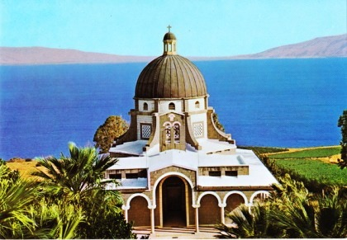
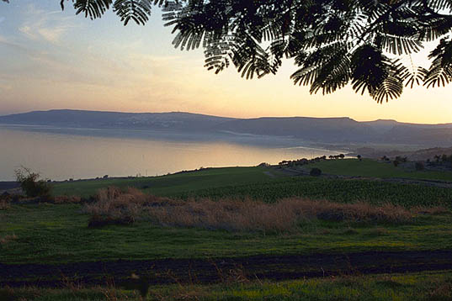
Mount of Beatitudes (Matthew 5–7)
Notes:
Israel calls it the "Mount of Beatitudes" even though this describes only the first 12 verses of this sermon.
• Likewise, a chapel to commemorate the event is called the "Mount Beatitudes Church."

Slide 83
Since Jesus fulfilled all the requirements to be Israel’s king, we will rule with him!
Main Idea

Slide 84
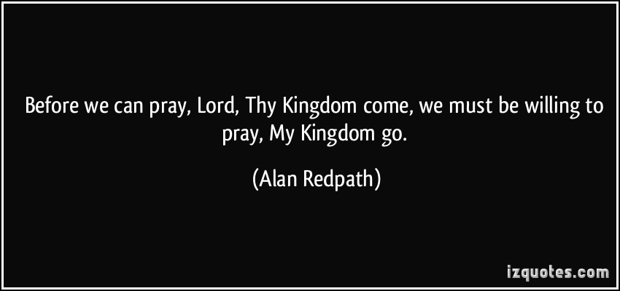

Do you trust the King right now?
Before we can pray, "Lord, Thy kingdom come," we must be willing to pray, "My kingdom go."

Slide 85
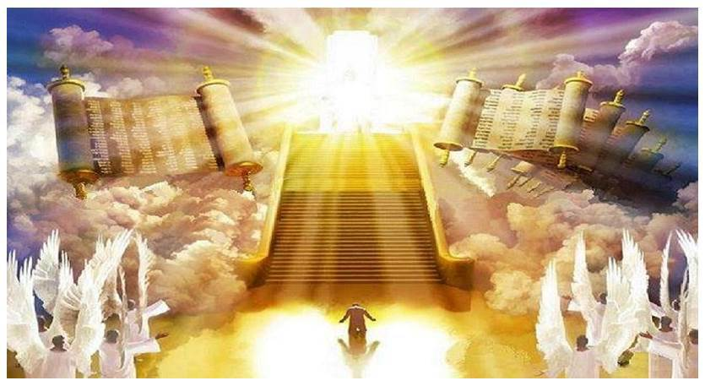
Will you stand?

Slide 86
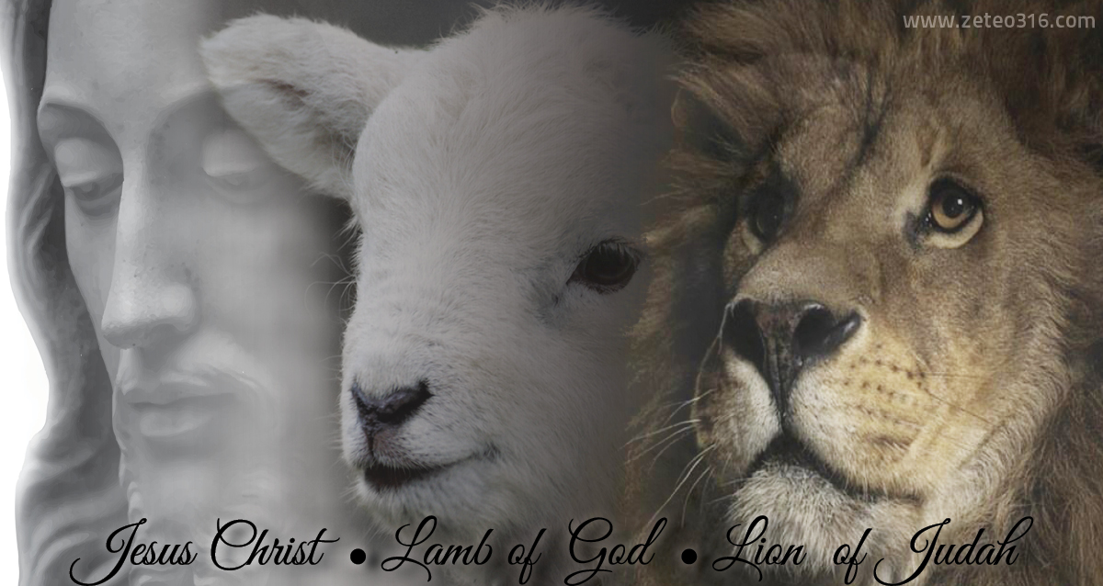
Jesus is both Lamb and Lion

Slide 87
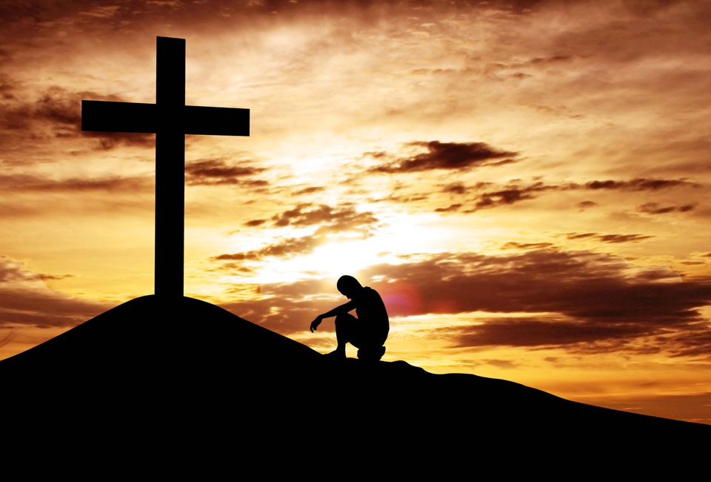
"I trust in your death for me."

Slide 88

Are you ready to rule?

Slide 89
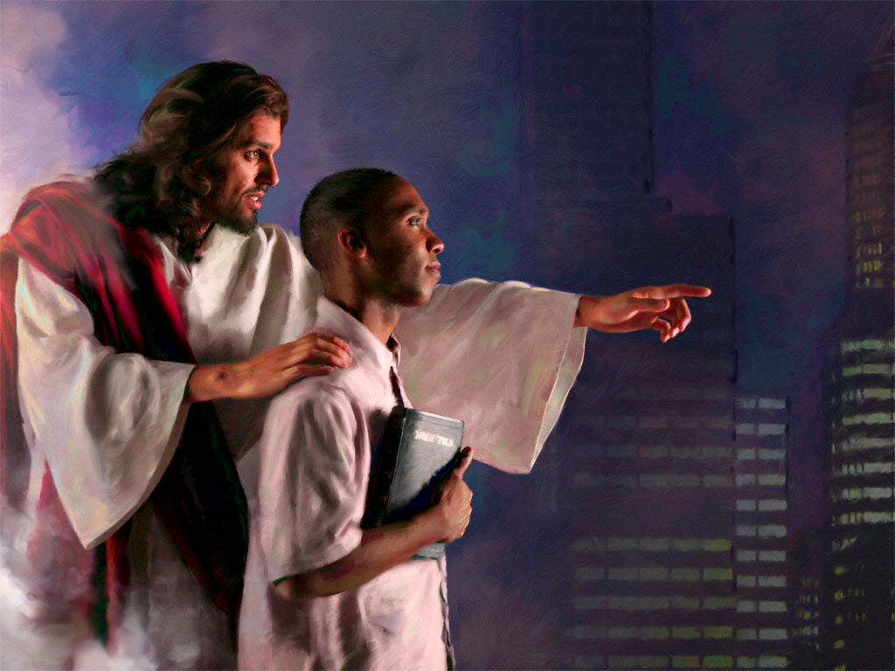
Be faithful NOW

Slide 90
Applications
67
Matthew
Unbelievers: Have you trusted Christ as Savior? If not, what qualification does He need to meet before you will accept Him?
Believers: Whom do you need to prove Jesus as King worthy of faith and obedience?

Slide 91
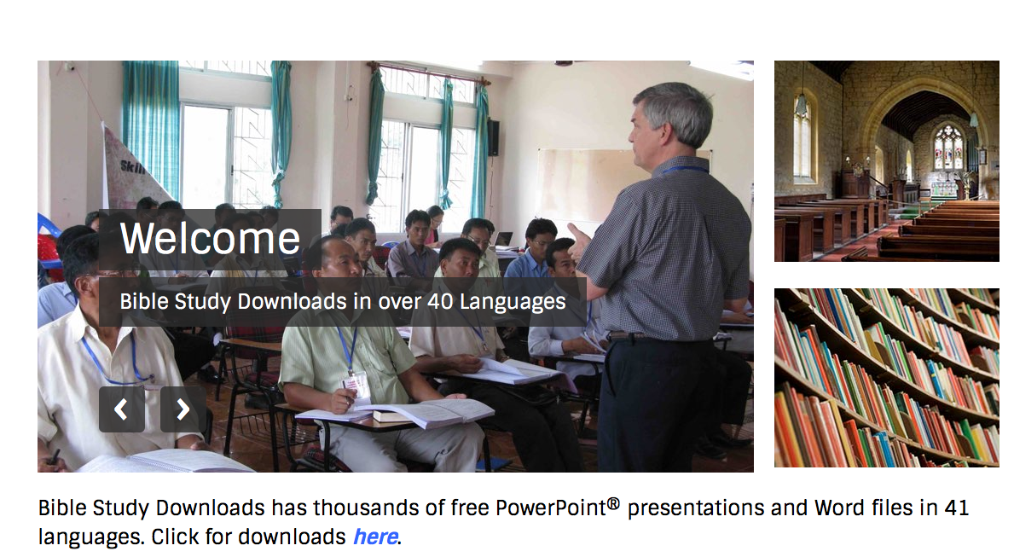
NT Sermons link at biblestudydownloads.org
Get this presentation and script for free!

Slide 92
Black

