Slide 1
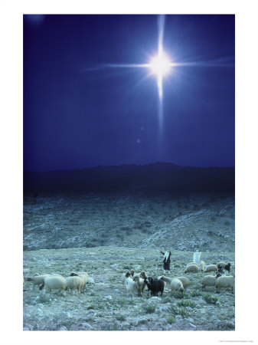
HOW FAR IS IT TO BETHLEHEM?
Matthew 1:18-24
Luke 2:1-20
Matthew 2:1-12
Jeff Palmer
Baptist Global Relief

Slide 2
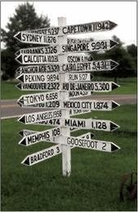
Skullbone, Tennessee…
Claim to fame = “…the center of the universe.”
Reason – “You can get to anywhere in the world starting from Skullbone”

Slide 3
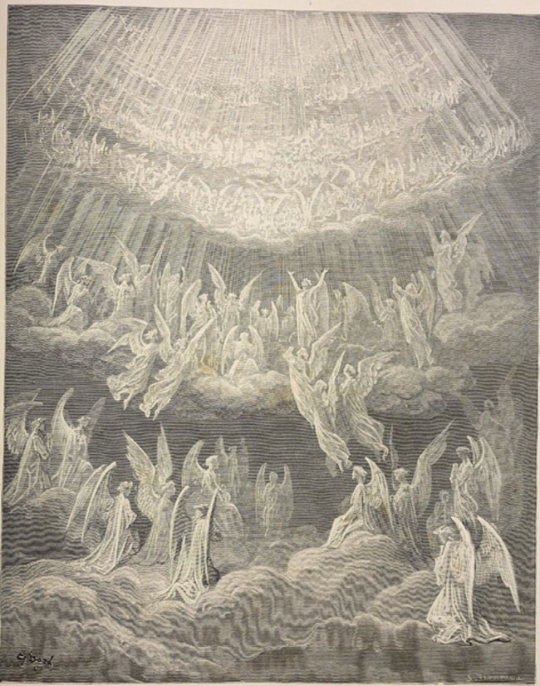
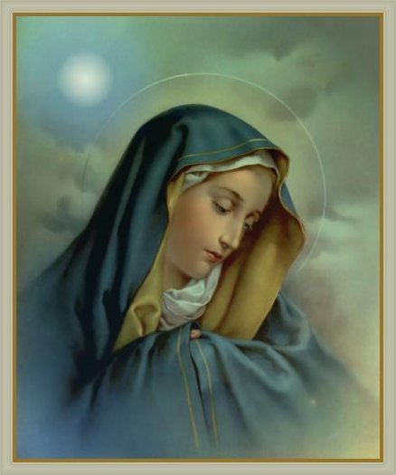
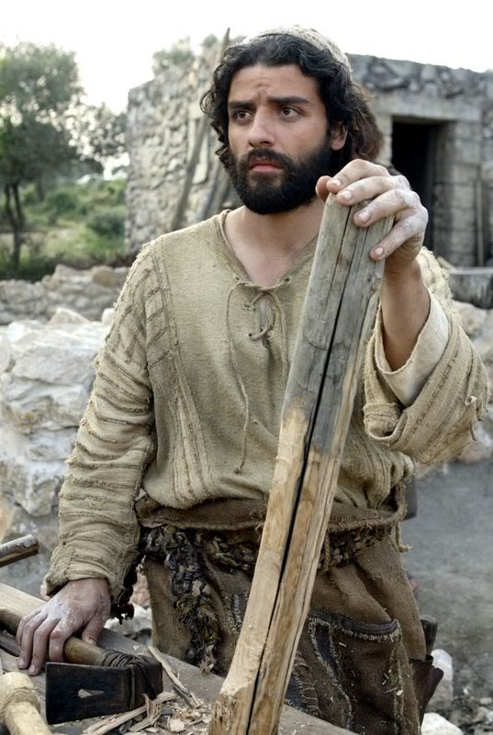
REACTIONS TO THE BIRTH OF CHRIST…
1. There were those who wondered/were confused…
Mary (Luke 1:26-29)
Joseph (Matthew 1:18-19)
The Angels (1 Peter 1:10-12)

Slide 4
Birth of Christ…still confusing today….
Informal survey of Singaporeans this week…
Story of Karma Tenzin…

Slide 5
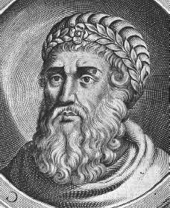
REACTIONS TO THE BIRTH OF CHRIST (Cont.)…
2. There were those (one in particular) who wanted to kill Him/kill the story…
History of Herod (the Great)…
Insanely jealous and paranoid…
Killed thousands during his lifetime including own wife and sons…
Had boy children of Bethlehem under 2 years put to death
At death, had prominent Jewish people slaughtered so there would be “mourning” at his death…
Died around 3 BC…
Herod (Matthew 2:1-12)…

Slide 6
There are still those trying to “kill” the story today…
* Story of Vietnamese tribal man in village…

Slide 7
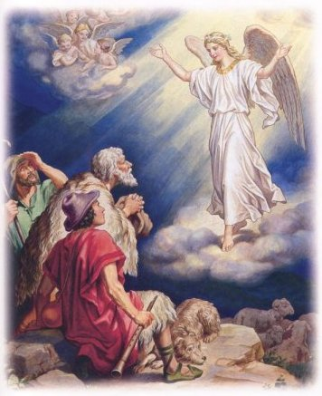
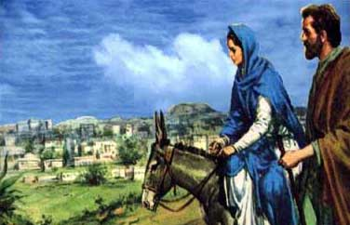
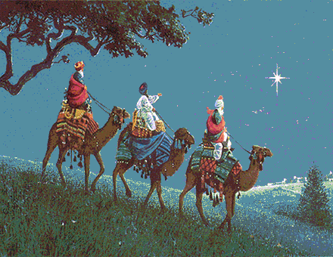
REACTIONS TO THE BIRTH OF CHRIST (Cont.)…
3. There were those who simply wanted to obey, to worship…
Mary and Joseph…
The Wise Men…
The shepherds…

Slide 8
* Story of Ben and Rosita Butaya…

Slide 9
HOW FAR IS IT TO BETHLEHEM?
Application – What is my reaction to the Christmas story?
Last Story – Ibu “Mobile”

