Slide 1
Who are we?
Mark 9:14-37
Preached by Matthew Lyle at Crossroads International Church Singapore • CICFamily.com Uploaded by Dr. Rick Griffith • Jordan Evangelical Theological Seminary Thousands of files in 54 languages for free at BibleStudyDownloads.org

Slide 2
Notes:
By Disney - Screenshot from Marvel Studios: Assembling a Universe, Public Domain, https://commons.wikimedia.org/w/index.php?curid=68457107

Slide 3
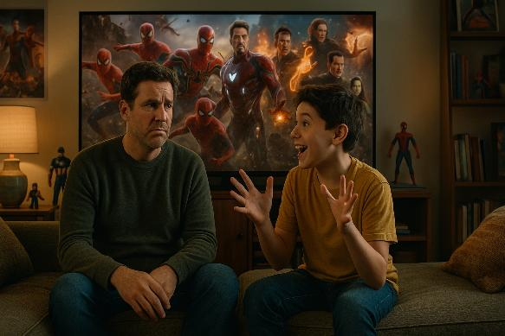

Slide 4
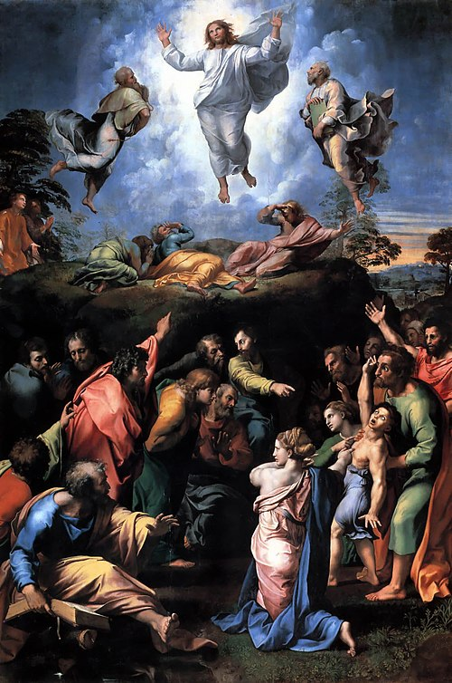
Notes:
By Raphael - Downloaded from Artist Hideout, Public Domain, https://commons.wikimedia.org/w/index.php?curid=379381

Slide 5
The Transfiguration
by
Raphael
From the late 16th century until the early 20th century, various commentators regarded it as the most famous oil painting in the world.
Notes:
By Raphael - Downloaded from Artist Hideout, Public Domain, https://commons.wikimedia.org/w/index.php?curid=379381

Slide 6
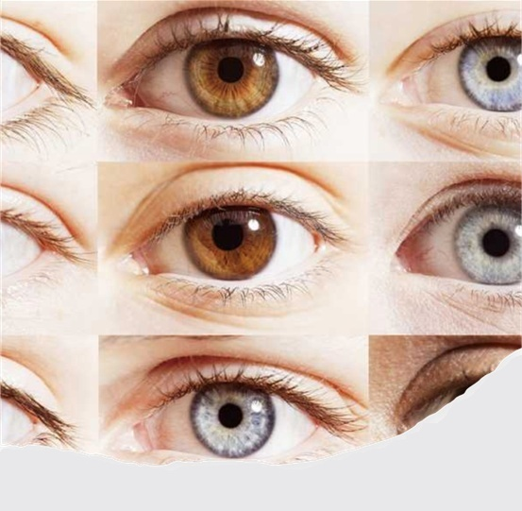
Clear Vision
Mark 8:1–26

Slide 7
Clear Vision
Story 1 – Divine Vision, 8:1–10
Story 2 – Unclear Visions, 8:11–21
Story 3 – Progressive Vision, 8:22–26

Slide 8
Who is he?
Mark 8:27–9:13

Slide 9
Who is he?
Story 1 – Peter’s Confession, 8:27–30
Story 2 – Jesus’s Confession, 8:31–9:1
Story 3 – The Father’s Confession, 9:2–13

Slide 10
Who are we?
Mark 9:14-37

Slide 11
Who are we?
Story 1 – Disciples Doubt 9:14–29
Story 2 – Disciples Confusion 9:30–9:32
Story 3 – Disciples Desire 9:33-37

Slide 12
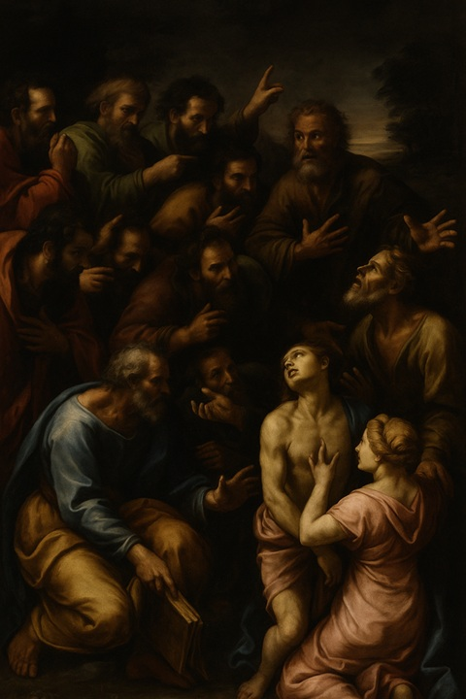
Story 1
Disciples Doubt
Mark 9:14–29
Jesus Heals a Demon-Possessed Boy

Slide 13
Jesus Heals a Boy with an Unclean Spirit
¹⁴ And when they came to the disciples, they saw a great crowd around them, and scribes arguing with them. ¹⁵ And immediately all the crowd, when they saw him, were greatly amazed and ran up to him and greeted him.

Slide 14
Jesus Heals a Boy with an Unclean Spirit
¹⁶ And he asked them, “What are you arguing about with them?” ¹⁷ And someone from the crowd answered him, “Teacher, I brought my son to you, for he has a spirit that makes him mute. ¹⁸ And whenever it seizes him, it throws him down, and he foams and grinds his teeth and becomes rigid. So I asked your disciples to cast it out, and they were not able.”

Slide 15
Jesus Heals a Boy with an Unclean Spirit
¹⁶ And he asked them, “What are you arguing about with them?” ¹⁷ And someone from the crowd answered him, “Teacher, I brought my son to you, for he has a spirit that makes him mute. ¹⁸ And whenever it seizes him, it throws him down, and he foams and grinds his teeth and becomes rigid. So I asked your disciples to cast it out, and they were not able.”

Slide 16
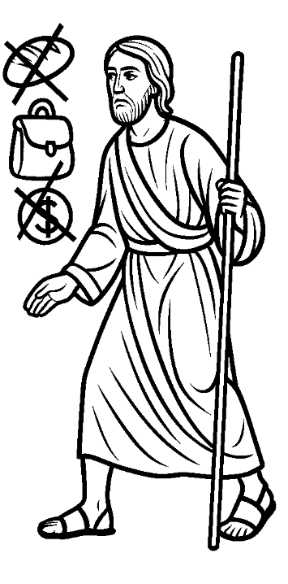
Mark 6:7-13 Jesus Sends Out the Twelve Apostles
⁷ And he called the twelve and began to send them out two by two, and gave them authority over the unclean spirits.
. . . ¹³ And they cast out many demons and anointed with oil many who were sick and healed them.

Slide 17
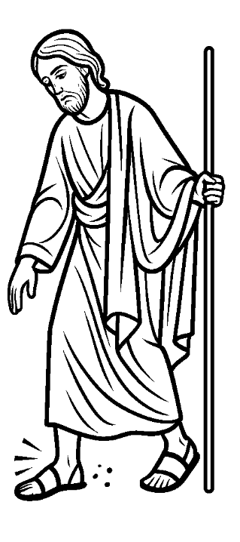
Mark 6:7-13 Jesus Sends Out the Twelve Apostles
¹¹ And if any place will not receive you and they will not listen to you, when you leave, shake off the dust that is on your feet as a testimony against them.”

Slide 18
Jesus Heals a Boy with an Unclean Spirit
. . .So I asked your disciples to cast it out, and they were not able.”
¹⁹ And he answered them, “O faithless generation, how long am I to be with you? How long am I to bear with you? Bring him to me.” ²⁰ And they brought the boy to him.
faithless generation

Slide 19
Who is the ?
faithless generation
The Disciples
They had just failed to cast out the demon (Mark 9:14–18).
The Crowd and Scribes
The scribes were arguing (v.14).
The father also expresses weak faith:
“I believe; help my unbelief!” (v.24).

Slide 20
Who is the ?
faithless generation
Israel as a whole
Similar to Deuteronomy 32:5, 20 where Israel is called "a perverse and crooked generation."
The entire generation reflects spiritual blindness, resistance, and lack of trust.

Slide 21
Who is the ?
faithless generation
Even Now: The World’s Ongoing Faithlessness
Cultural unbelief: Many reject God’s authority, replacing it with self-made truth.
Superficial religion: Like the disciples, people can profess faith while lacking true dependence on God.
Prayerlessness: In a world of technology, wealth, and human solutions, many minimize or neglect prayer and spiritual disciplines.

Slide 22
Jesus Heals a Boy with an Unclean Spirit
And when the spirit saw him, immediately it convulsed the boy, and he fell on the ground and rolled about, foaming at the mouth. ²¹ And Jesus asked his father, “How long has this been happening to him?” And he said, “From childhood. ²² And it has often cast him into fire and into water, to destroy him. But if you can do anything, have compassion on us and help us.”
σπλαγχνίζομαι
splagchnizomai

Slide 23
M
A
R
K
The Gospel According to
COMPASSION
UNVEILED

Slide 24
Jesus Heals a Boy with an Unclean Spirit
²³ And Jesus said to him, “‘If you can’! All things are possible for one who believes.” ²⁴ Immediately the father of the child cried out and said, “I believe; help my unbelief!” ²⁵ And when Jesus saw that a crowd came running together, he rebuked the unclean spirit, saying to it, “You mute and deaf spirit, I command you, come out of him and never enter him again.” ²⁶ And after crying out and convulsing him terribly, it came out,

Slide 25
Jesus Heals a Boy with an Unclean Spirit
²³ And Jesus said to him, “‘If you can’! All things are possible for one who believes.” ²⁴ Immediately the father of the child cried out and said, “I believe; help my unbelief!” ²⁵ And when Jesus saw that a crowd came running together, he rebuked the unclean spirit, saying to it, “You mute and deaf spirit, I command you, come out of him and never enter him again.” ²⁶ And after crying out and convulsing him terribly, it came out,

Slide 26
If you can?… Everything is possible for him who believes
Jesus did not mean that miracles depend on the strength of a person’s faith. We must pray always with God’s will in mind.
Cooper, R. L. (2000). Mark (Vol. 2, p. 149). Nashville, TN: Broadman & Holman Publishers.

Slide 27
Jesus Heals a Boy with an Unclean Spirit
²³ And Jesus said to him, “‘If you can’! All things are possible for one who believes.” ²⁴ Immediately the father of the child cried out and said, “I believe; help my unbelief!” ²⁵ And when Jesus saw that a crowd came running together, he rebuked the unclean spirit, saying to it, “You mute and deaf spirit, I command you, come out of him and never enter him again.” ²⁶ And after crying out and convulsing him terribly, it came out,

Slide 28
Jesus Heals a Boy with an Unclean Spirit
²⁶ And after crying out and convulsing him terribly, it came out,
and the boy was like a corpse, so that most of them said, “He is dead.” ²⁷ But Jesus took him by the hand and lifted him up, and he arose. ²⁸ And when he had entered the house, his disciples asked him privately, “Why could we not cast it out?” ²⁹ And he said to them, “This kind cannot be driven out by anything but prayer.
“Why could we
not cast it out?”

Slide 29
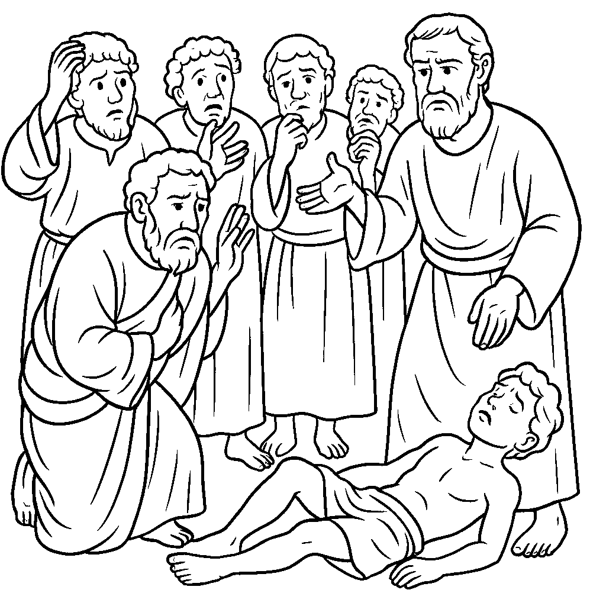
“Why could we
not cast it out?”

Slide 30
Demons: Early NT vs. Late NT
Early NT (Gospels, Acts)
Casting out demons shows Christ’s power (Luke 10:17)
Disciples given authority to cast out (Matt 10:1)
Reveals disciples’ faith or unbelief (Matt 17:14-21)
Exorcism part of ministry
Late NT (Epistles)
Emphasis on resisting, not casting out
No command to cast out demons
Faith shown by standing firm (Eph 6:10-18)
Focus on spiritual armor, alertness (James 4:7; 1 Pet 5:8)

Slide 31
Story 1
Disciples Doubt
Mark 9:14–29
Jesus Heals a Demon-Possessed Boy

Slide 32
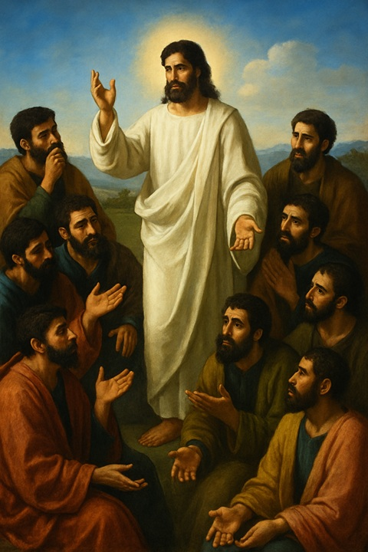
Story 2
Disciples Confusion
Mark 9:30–32
Jesus Again Predicts His Death

Slide 33
Jesus Again Foretells Death, Resurrection
³⁰ They went on from there and passed through Galilee. And he did not want anyone to know, ³¹ for he was teaching his disciples, saying to them, “The Son of Man is going to be delivered into the hands of men, and they will kill him. And when he is killed, after three days he will rise.”

Slide 34
Jesus predicts His death 3x
Each time MORE DETAIL
Each time DISCIPLES STRUGGLE

Slide 35
Jesus Again Foretells Death, Resurrection
³⁰ They went on from there and passed through Galilee. And he did not want anyone to know, ³¹ for he was teaching his disciples, saying to them, “The Son of Man is going to be delivered into the hands of men, and they will kill him. And when he is killed, after three days he will rise.” ³² But they did not understand the saying, and were afraid to ask him.

Slide 36
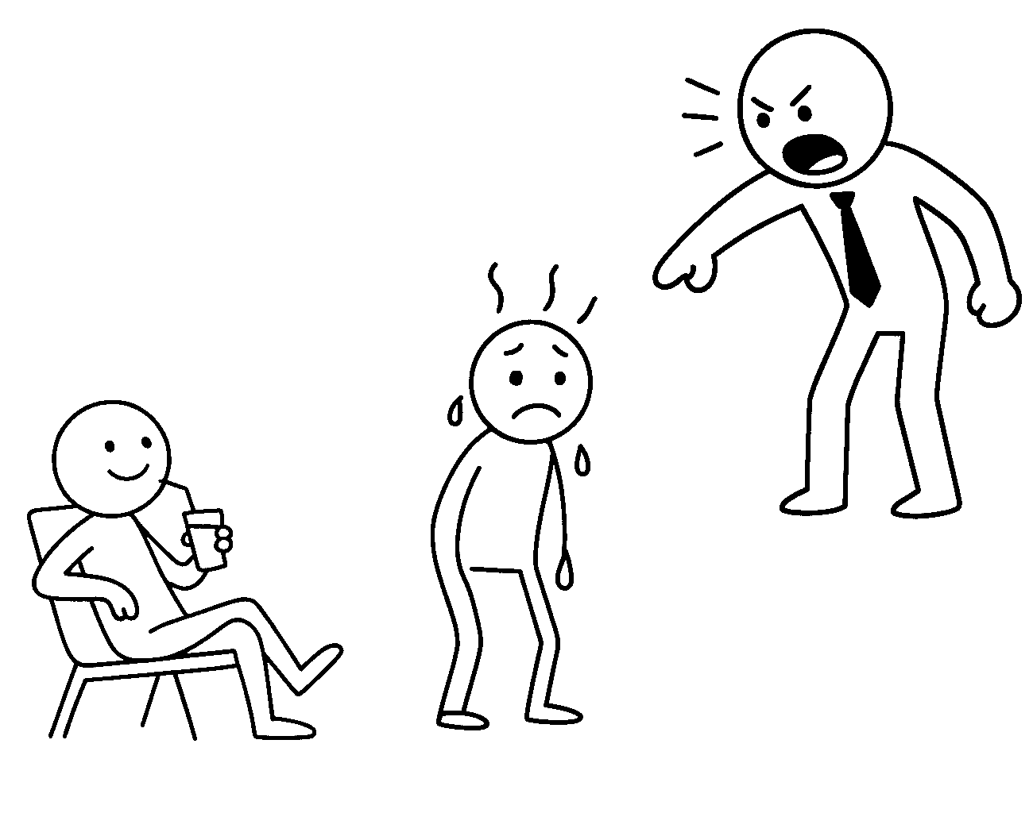
The 4th Law of Thermodynamics
"when the heat is on somebody else it's not on you,"
heat shield

Slide 37
What do you do when you don’t understand something?
Read it again
Read a different English Translation
Look at a trusted commentary
Cell Group / Small Group
Internet?
www.gotquestions.org

Slide 38
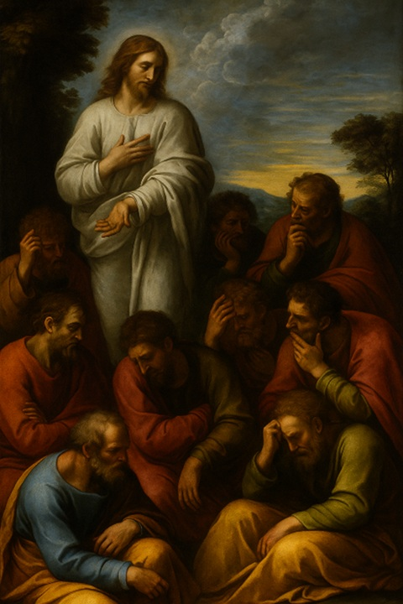
Story 3
Disciples Desire
Mark 9:33–37
The Greatest in the Kingdom

Slide 39
Who Is the Greatest?
³³ And they came to Capernaum. And when he was in the house he asked them, “What were you discussing on the way?” ³⁴ But they kept silent, for on the way they had argued with one another about who was the greatest.
³⁵ And he sat down and called the twelve. And he said to them, “If anyone would be first, he must be last of all and servant of all.”
“servant” (diakonos) depicts one who attends to the needs of others freely, not one in a servile position (as a doulos, a slave).

Slide 40
Who Is the Greatest?
³³ And they came to Capernaum. And when he was in the house he asked them, “What were you discussing on the way?” ³⁴ But they kept silent, for on the way they had argued with one another about who was the greatest.
³⁵ And he sat down and called the twelve. And he said to them, “If anyone would be first, he must be last of all and servant of all.” ³⁶ And he took a child and put him in the midst of them, and taking him in his arms, he said to them, ³⁷ “Whoever receives one such child in my name receives me, and whoever receives me, receives not me but him who sent me.”

Slide 41
The disciples struggle
with doubt, disorientation, and selfish desire
reveal their immaturity and faithlessness
despite divine revelation.

Slide 42
Immaturity highlights their spiritual underdevelopment:
They’re sincere but slow to understand,
revealing a lack of growth
Faithlessness points to their active failure to trust,
Especially in the face of Jesus’ power and promises,
revealing a lack of trust

Slide 43
Spiritual Immaturity
Weak faith
Prideful
9
Who are we?
Mark 9:14-37

Slide 44
We are called to reject spiritual immaturity and pursue deeper faith and humility
9
Who are we?
Mark 9:14-37

Slide 45
Divine revelation doesn’t eliminate our struggles,
but exposes them.
Even after seeing Jesus glorified, the disciples still doubted and misunderstood.

Slide 46
True faith
requires dependence,
not self-reliance.
The disciples’ failure to cast out the demon reveals that spiritual power comes through prayer and dependence on God, not technique or past experience.

Slide 47
The way of Jesus
is the way of the cross.
Jesus again predicts His suffering and death, showing that following Him means embracing sacrifice, not worldly status.

Slide 48
Humility is the posture
of true greatness.
While the disciples argued about greatness, Jesus taught that true greatness is found in serving others and welcoming the least.

Slide 49
Challenge / Application
1. Acknowledge the gap between knowledge and maturity.
2. Cultivate prayerful dependence.
3. Accept that following Jesus will cost us.
4. Embrace humility over ambition.
5. Let divine revelation lead to transformation.

Slide 50
Black

Slide 51
NT Preaching link at BibleStudyDownloads.org
Get this presentation for free!
Notes:
NT Preaching (np)

