Slide 1
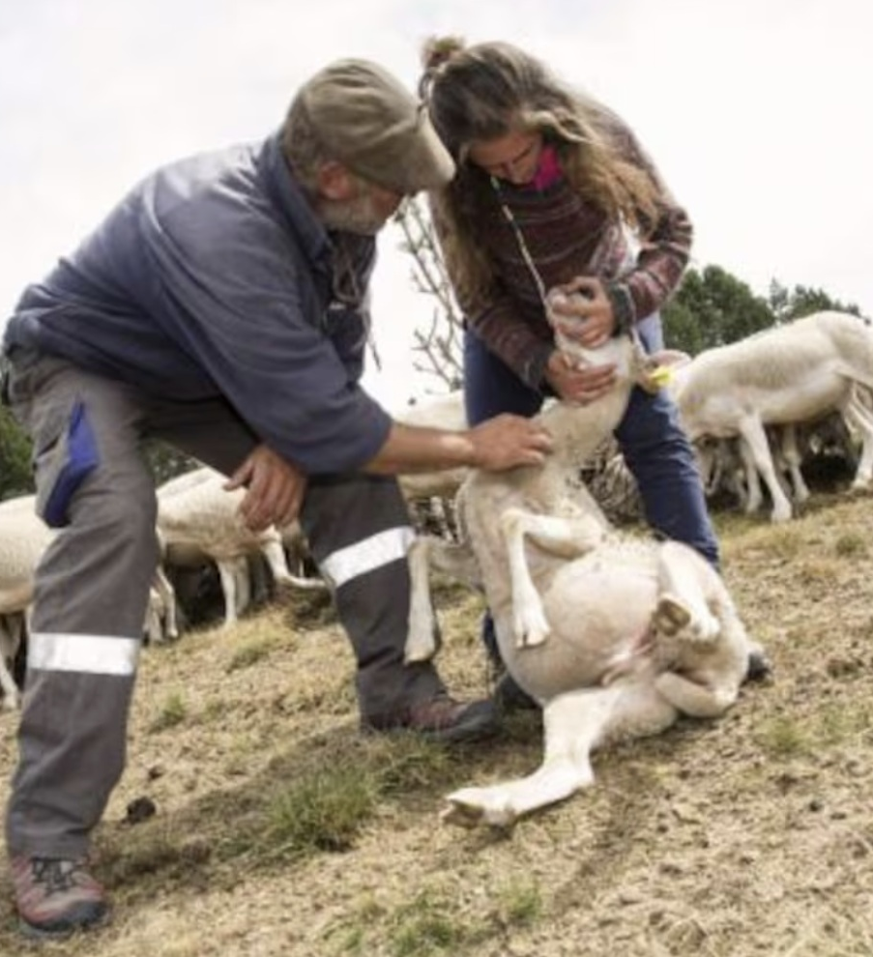

Shepherding Apprenticeship
Mark 6:32–56
Preached by Dr. Andrew Spurgeon
at Crossroads International Church Singapore • CICFamily.com
Uploaded by Dr. Rick Griffith • Jordan Evangelical Theological Seminary
Thousands of files in 54 languages for free at BibleStudyDownloads.org

Slide 2


Slide 3
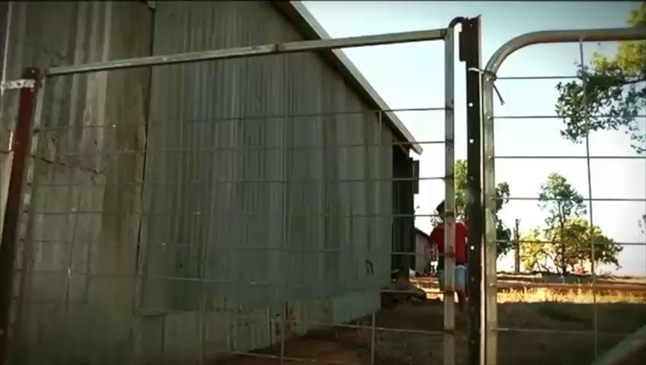
Shepherding Apprenticeship

Slide 4
Shepherding Apprenticeship
“Sheep without a shepherd” = People lack direction without proper leaders (e.g., Moses and Joshua, Num 27:15–21).
Some people are born with leadership abilities. Others are prepared (and sometimes pushed) to become leaders with a servant’s heart.

Slide 5
Shepherding Apprenticeship
Jesus prepares the disciples to feed the people (6:32–44)
Jesus helps the disciples in difficult circumstances (6:45–51)
Jesus demonstrates compassion by his actions (6:53–56)

Slide 6
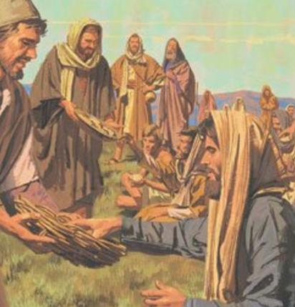
Story #1 – Feeding the 5000 (6:32–44)
Jesus had compassion on the people because they were like sheep without a shepherd, meaning they were directionless because they didn’t have leaders.
So, he gave the disciples tasks to make them leaders: “You give them food to eat” (6:37), “You go and see” (6:38), “You seat them in groups” (6:39), and “You distribute the food to them” (6:41).

Slide 7
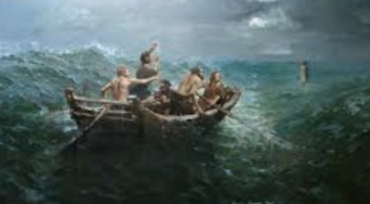
Story #2 – Helping the Disciples (6:45–51)
Sending them off from the crowd (6:45).
“Between 3–6 a.m., seeing them being tortured in their rowing because the wind was against them, he came to them by walking on the sea and wanting to assist them” (6:48).
“Be courageous. It is I. Don’t be afraid” (6:50).

Slide 8
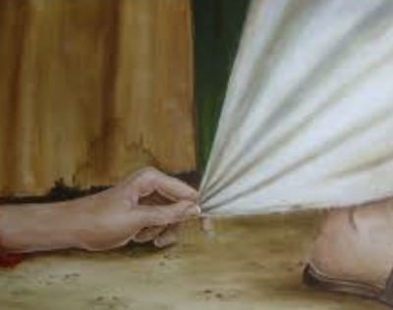
Story #3 – Healing Everyone (6:53–56)
Touch and healing

Slide 9

Lessons we’ve learned today
When people didn’t have leaders, Jesus taught and showed the disciples they could be leaders and helped them.
When they were struggling even in their familiar territory, he came to their help.
And he helped anyone in need.

Slide 10

Question for us
Is Jesus calling us to be leaders/guides, and what stops us?
What help do we need from him — food, strength, healing (emotional, physical, spiritual, etc.)? Reach out and ask.

Slide 11
Black

Slide 12


NT Preaching link at BibleStudyDownloads.org
Get this presentation for free!
Notes:
NT Preaching (np)

