Slide 1
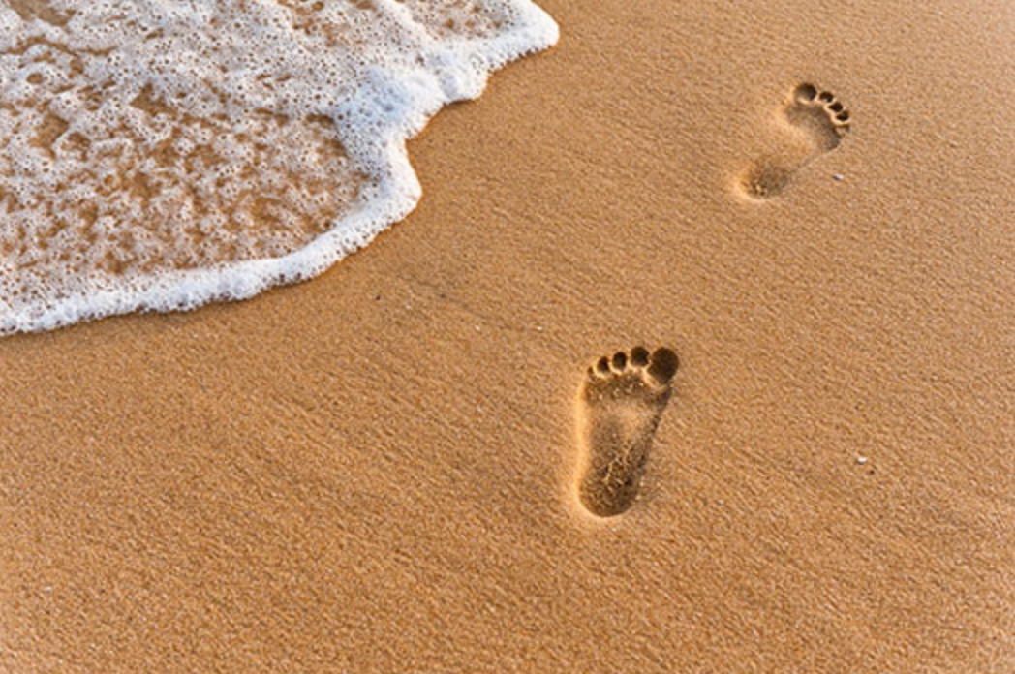
The Gospel of Mark
Walking with Jesus
The Present Provider
Mark 6:30-51
Preached by Dr. Andrew Spurgeon at Crossroads International Church Singapore • cicfamily.com Uploaded by Dr. Rick Griffith • Singapore Bible College Thousands of files in 49 languages for free at BibleStudyDownloads.org

Slide 2
Walking with Jesus
Jesus’s Message:
“The time is up. God’s rule is here. So, change your ways and trust God for your salvation” (Mark 1:15)

Slide 3
Walking with Jesus
Theme
The Present Provider
Mark 6:30–51

Slide 4
Walking with Jesus
Jacob’s Test
Genesis 28:11–21

Slide 5
Walking with Jesus
^{Genesis 28:11} At a place called Harran, Jacob stopped for the night because the sun had set. He then took a stone, placed it under his head, and slept in that place.
^{28:12} And he dreamed: A ladder went up from earth to heaven and God’s angels were ascending and descending on it.

Slide 6
Walking with Jesus
^{28:13} The Lord stood above it and said, “I am the Lord, the God of Abraham your father, and the God of Isaac. Don’t be afraid. This land where you are sleeping, I will give this to you and your descendants . . .
^{28:15} Behold I am with you, guarding you in the path you’ll go.”

Slide 7
Walking with Jesus
^{28:16} Jacob woke up from his sleep and said, “Surely the Lord is in this place and I didn’t know that.”
^{28:19} He called the place Bethel = House of God.

Slide 8
Walking with Jesus
^{28:20} Jacob made a vow: “If the Lord God
(1) be with me and guard me in my journey . . . (2) give me food to eat and clothes to wear, and
^{28:21} (3) return me safely to my father’s house, then the Lord will be my God.”

Slide 9
Walking with Jesus
Jacob’s Test

Slide 10
Walking with Jesus
Jacob’s test . . .
The Lord’s presence
The Lord’s provision
The Lord’s protection

Slide 11
Walking with Jesus
Story 1
Mark 6:30–45

Slide 12
Walking with Jesus
^{Mark 6:30} The apostles gathered around Jesus and told him everything they taught and did.
^{6:31} Jesus said to them: “Come to an isolated place and rest a while.” He said this because many were coming and going that they didn’t even have time to eat.

Slide 13
Walking with Jesus
^{6:32} So they went in a boat to an isolated place to be by themselves.
^{6:33} But many saw them leaving and ran on foot, from many surrounding places, and got there before them.

Slide 14
Walking with Jesus
^{6:34} Landing on the shore and going out of the boat, Jesus saw a large crowd. He had compassion on them. They were like sheep without a shepherd. So he taught them many things.

Slide 15
Walking with Jesus
^{6:35} It was already very late. So, the disciples came and said to him, “This is a desert, and it’s already very late.”
^{6:36} “Send them away so they may enter fields and villages surrounding this place and find something to eat.”

Slide 16
Walking with Jesus
^{6:37} Jesus replied, “You give them food to eat.” They said to him, “Shall we go and buy food for 200 denarii and give it to them to eat?”
^{6:38} He said to them, “Go and see, how many bread you have.” After calculating, they said, “Five.” “Also two fish.”

Slide 17
Walking with Jesus
^{6:39} He instructed them, “Sit all of them in group-by-group upon the green grass.”
^{6:40} They sat them group-by-group, hundreds and fifties.

Slide 18
Walking with Jesus
^{6:41} Taking the five bread and the two fish, and looking towards the heaven, he blessed them and broke the bread and gave to the disciples so they may place them before the people. Likewise he divided the two fish for everyone.
^{6:42} All of them ate and were satisfied.

Slide 19
Walking with Jesus
^{6:43} Then the disciples collected twelve baskets full of leftover bread and fish.
^{6:44} The total number of people who ate was five thousand.
^{6:45} Then Jesus compelled his disciples to get into a boat and go to Bethsaida on the other side. He stayed back and dismissed the crowd.

Slide 20
Walking with Jesus
Jacob’s test . . .
The Lord’s presence
The Lord’s provision
The Lord’s protection

Slide 21
Walking with Jesus
Story 2
Mark 6:46–51

Slide 22
Walking with Jesus
^{6:46} After the people left, Jesus went on a mountain to pray.
^{6:47} It was evening and the boat with the disciples was in the middle of the sea. Jesus alone was on the seashore.

Slide 23
Walking with Jesus
^{6:48} Jesus saw the disciples were straining to row the boat since a heavy wind was against them. At midnight, he drew near them, walking on the sea, wanting to pass by them.
^{6:49} Those who saw him walking on the sea thought he was a phantom and they shrieked.

Slide 24
Walking with Jesus
^{6:50} Then everyone saw him and were terrified. So he said, “Be brave. It’s me. Don’t be afraid.”
^{6:51} Then he climbed into the boat with them, and the wind stopped. They were amazed.

Slide 25
Walking with Jesus
Jacob’s test . . .
The Lord’s presence
The Lord’s provision
The Lord’s protection

Slide 26
Walking with Jesus
With Abraham, his presence was always with him, he provided what he needed, and he protected him from their enemies.

Slide 27
Walking with Jesus
With Jacob, his presence was always with him, he provided what he needed, and he protected him from their enemies.

Slide 28
Walking with Jesus
Even in the wilderness wandering of the Israelites, his presence was always with them, he provided what they needed, and he protected them from their enemies.

Slide 29
Walking with Jesus
And the Lord Jesus’s presence was with his disciples, he provided for their needs, and he protected them.

Slide 30
Walking with Jesus
Application
He will do the same for us.
He is our present provider!

Slide 31
Black

Slide 32
NT Preaching link at BibleStudyDownloads.org
Get this presentation for free!

