Slide 1

Families: Love Them Regardless
Mark 6:1–31
Preached by Dr. Andrew Spurgeon
at Crossroads International Church Singapore • CICFamily.com
Uploaded by Dr. Rick Griffith • Jordan Evangelical Theological Seminary
Thousands of files in 54 languages for free at BibleStudyDownloads.org

Slide 2

Mark’s Gospel
Mark is a Gospel of action; Jesus is like a Marvel comic character.

Slide 3
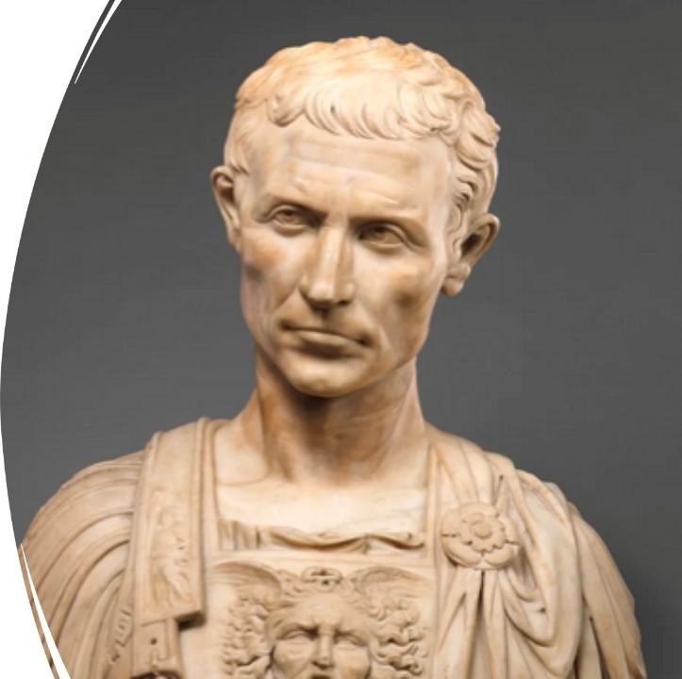
Purpose
To present Jesus as God’s anointed king (Messiah and Son of God) in opposition to Caesar, the other Son of God.
1:1; 8:29; 12:35; 14:61; 15:32, 39.

Slide 4
Families: Love them Regardless
Jesus’s family (6:1–13)
Herod’s family (6:14–29)
Jesus’s spiritual family (6:30–31)

Slide 5
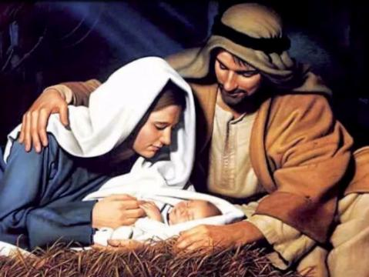
Story #1 – Jesus’s Family (6:1–13)
At hometown, Jesus wasn’t accepted.
“He marveled at their unbelief” (v. 6)
But he plodded on!

Slide 6
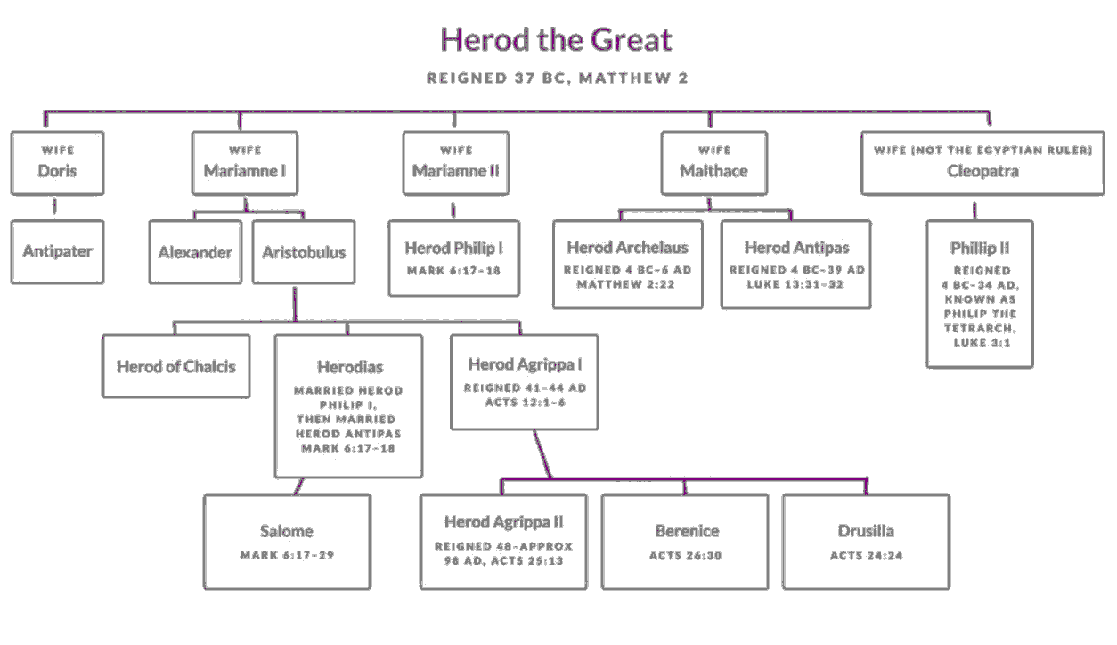
Story #2 – Herod’s Family (6:14–)
Very dysfunctional
John was killed;
the next chapter in ministry

Slide 7
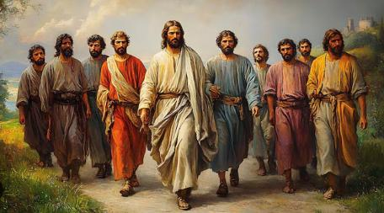
Story #3 – Jesus’s Spiritual Family (6:30–31)
Successful but unrested
Jesus invites them to rest

Slide 8

Lessons we’ve learned today
We plod on with our families, while loving them . . . Many of Jesus’s family became believers and wrote books in the Bible (James and Jude).
When families are dysfunctional, we don’t compromise on our beliefs as did Herod. Yet, if we fail, we grieve and know God is in control.
With families . . . Rest! (Put away phones!)

Slide 9

Question for us
What have we decided to do with our families today?
How will we show God to them with our lives and actions?

Slide 10
Black

Slide 11


NT Preaching link at BibleStudyDownloads.org
Get this presentation for free!
Notes:
NT Preaching (np)

