Slide 1
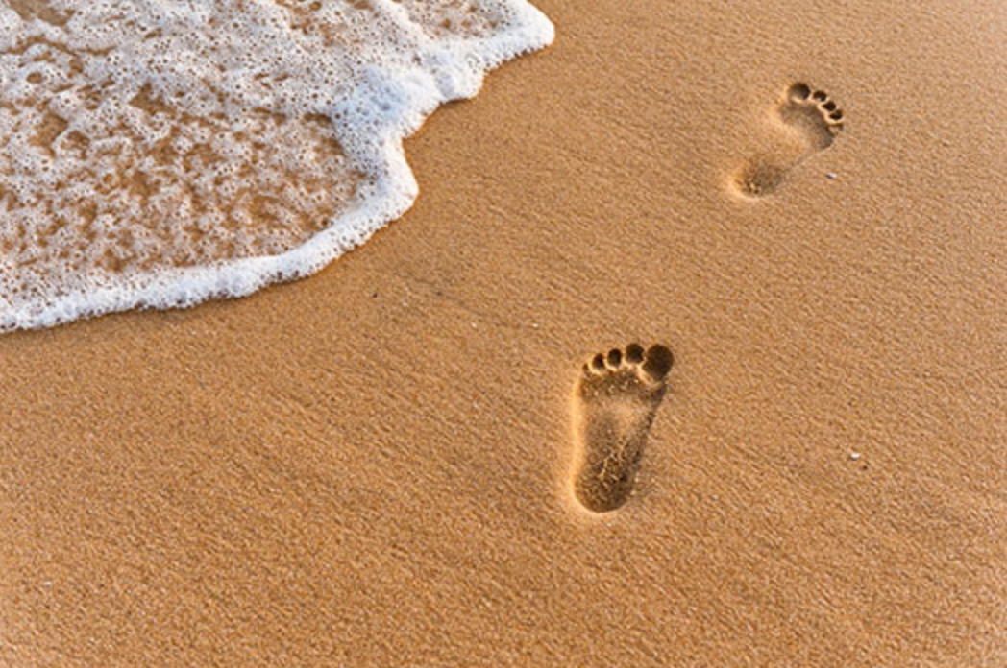
The Gospel of Mark
Walking with Jesus
The Unappreciated God
Mark 6:1-13
Preached by Dr. Andrew Spurgeon at Crossroads International Church Singapore • cicfamily.com Uploaded by Dr. Rick Griffith • Singapore Bible College Thousands of files in 49 languages for free at BibleStudyDownloads.org

Slide 2
Walking with Jesus
Jesus’s Message:
“The time is up. God’s rule is here. So, change your ways and trust God for your salvation” (Mark 1:15)

Slide 3
Walking with Jesus
Theme
The Unappreciated God

Slide 4
Walking with Jesus
Mark 6:1–13
Him, the Mason?

Slide 5
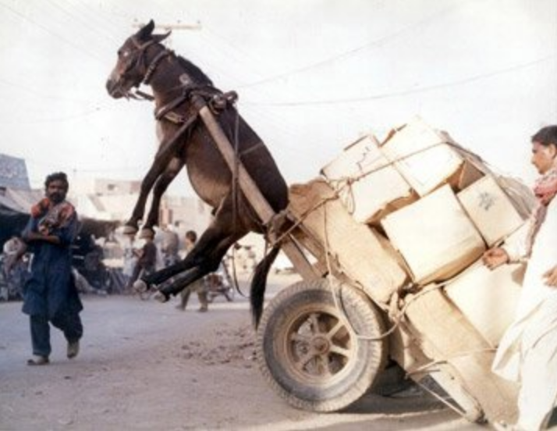
Walking with Jesus

Slide 6
Walking with Jesus
Story 1
Mark 6:1–6

Slide 7
Walking with Jesus
^{6:1} Jesus went from where he was and came to his father’s village. His disciples followed him. When Sabbath came, he began to teach in the Synagogue.
^{6:2} Many, hearing him, were amazed and said, “Where did he get these teachings? Who gave him this wisdom and the miracles he performs with his hands?”

Slide 8
Walking with Jesus
^{6:3} “Is he not the craftsman (tekton), the son of Mary and the brother of Jacob, Jose, Judas, and Simon? Aren’t his sisters here with us?”
And, they were outraged because of him.
^{6:4} Jesus said to them, “A prophet is not without honor except in his father’s place, among his relatives, and in his house.”

Slide 9
Walking with Jesus
^{6:5} He was unable to do any miracles there except to heal a few sickly ones. He healed them by laying his hands on them.
^{6:6} He marveled at their lack of faith and went to the surrounding villages to teach.

Slide 10
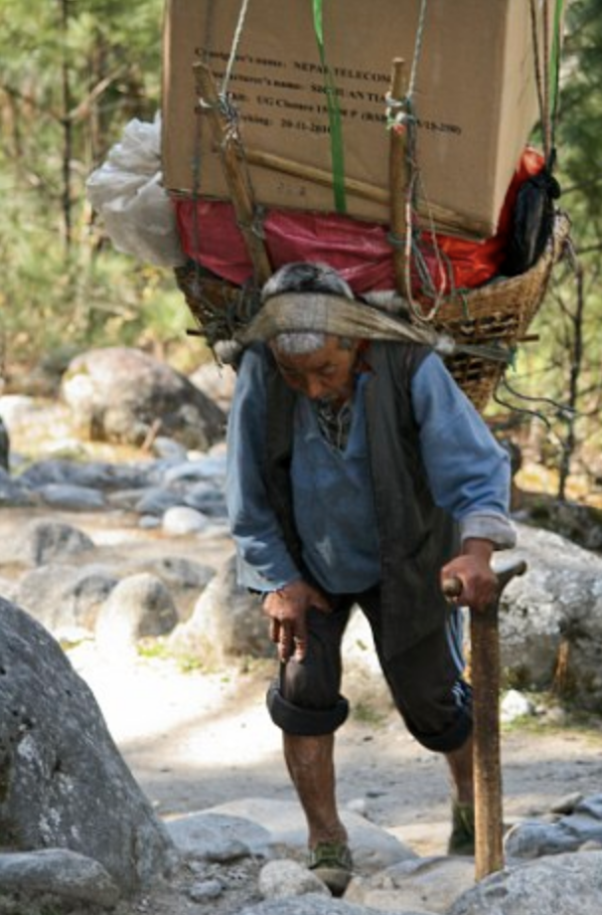
Walking with Jesus

Slide 11
Walking with Jesus
Story 2
Mark 6:7–6

Slide 12
Walking with Jesus
^{6:7} He, then, called the twelve disciples and sent them two-by-two, after giving them authority over unclean spirits.
^{6:8–9} He instructed them not to take anything for the journey—no bread, no bag, no coins in their leather sac, or extra clothes—except a rod and to wear sandals.

Slide 13
Walking with Jesus
^{6:10} He said to them, “When you enter a house, remain in that house until you leave that village.”
^{6:11} “And if a place does not welcome you or the people don’t listen to you, leave that place and shake off the dust beneath your feet as a testimony against them.”

Slide 14
Walking with Jesus
^{6:12} The disciples, going from there, preached, “Repent.”
^{6:11} And they cast out many demons. They rubbed olive oil on many sick people and healed them.

Slide 15
Walking with Jesus
The Lord Jesus’s village didn’t appreciate his worth. So he couldn’t do any miracles there.

Slide 16
Walking with Jesus
He didn’t give up; instead, he trained the others — who too were unappreciated — so they will be equipped for their work.

Slide 17
Walking with Jesus
Principles for Us
People don’t always appreciate us
We move on
We should appreciate and prepare others who go unappreciated

Slide 18
Black

Slide 19
NT Preaching link at BibleStudyDownloads.org
Get this presentation for free!

