Slide 1
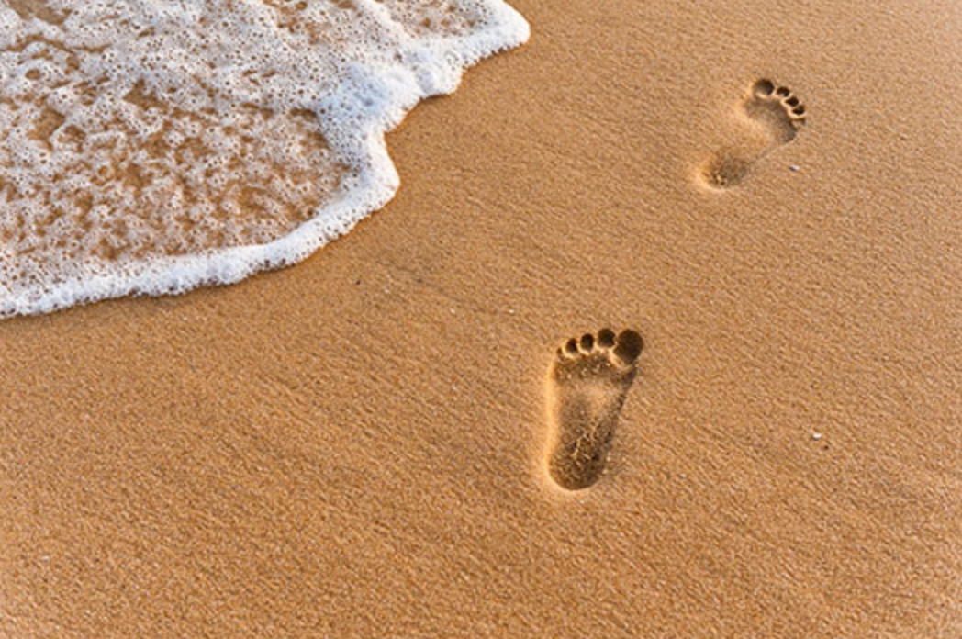
The Gospel of Mark
Walking with Jesus
The Problems of the Daughters
Mark 5:21-34
Preached by Dr. Andrew Spurgeon at Crossroads International Church Singapore • cicfamily.com Uploaded by Dr. Rick Griffith • Singapore Bible College Thousands of files in 49 languages for free at BibleStudyDownloads.org

Slide 2
Walking with Jesus
Jesus’s Message:
“The time is up. God’s rule is here. So, change your ways and trust God for your salvation” (Mark 1:15)

Slide 3
Walking with Jesus
Mark 5:21–43
The Problems of the Daughters

Slide 4
Walking with Jesus
Globally, it is estimated that up to 1 billion children aged 2–17 years, have experienced physical, sexual, or emotional violence or neglect in the past year
(World Health Organization)

Slide 5
Walking with Jesus
1 in 3 (35%) of women worldwide have experienced either physical and/or sexual violence from intimate partner or non-partner sexual in their lifetime (World Health Organization)

Slide 6
Walking with Jesus

Slide 7
Walking with Jesus
Mark 5:21–43
The Problems of the Daughters

Slide 8
Walking with Jesus
Story 1, Part A
Mark 5:21–24

Slide 9
Walking with Jesus
^{Mark 5:21}Jesus, going on the sea in a boat, came again to the other side. A large crowd gathered with him and was on the seashore. ²²Then, Jairus, one of the synagogue-leaders, came. Seeing Jesus, he fell at his feet ²³and begged him many times saying, “My little daughter is at the end of her life. Come and lay your hands on her so that she will be delivered and live.” ²⁴So, Jesus went with him. And the large crowd followed him, crowding him.

Slide 10
Walking with Jesus
Story 2
Mark 5:25–34

Slide 11
Walking with Jesus
^{Mark 5:25}Now, a woman — having unstoppable blood flow for twelve years ²⁶and enduring much hardship under many physicians, and having spent all her wealth and not having any benefit but coming to a worse state — ²⁷heard about Jesus. So, she came from behind the crowd and grabbed his garment ²⁸because she said to herself: “If only I grab even his garment, I will be delivered” ²⁹Immediately, her unstoppable bleeding stopped. And she knew, in her body, she was healed from her affliction/illness.

Slide 12
Walking with Jesus
The Jews considered discharge of blood or bodily fluid as impure
Lev 15:19–33

Slide 13
Walking with Jesus
Leviticus 15:19–33
Anyone who touches her will be unclean till evening (15:19)
Anything she lies on or sits on will be unclean (15:20)
Whoever touches her bed must wash his clothes and bathe with water, and he will be unclean till evening (15:21)

Slide 14
Walking with Jesus
Leviticus 15:19–33
Whoever touches anything she sits on must wash his clothes and bathe with water, and he will be unclean till evening (15:22)
If her monthly flow touches anyone, he will be unclean for seven days; any bed he lies on will be unclean (15:24)

Slide 15
Walking with Jesus
Leviticus 15:19–33
A woman who has a discharge that continues beyond her period, she will be unclean as long as she has the discharge, just as in the days of her period (15:25)

Slide 16
Walking with Jesus
Leviticus 15:19–33
When she is cleansed from her discharge, she must count off seven days, and after that she will be ceremonially clean (15:28)

Slide 17
Walking with Jesus
Leviticus 15:19–33
On the eighth day she must take two doves or two young pigeons and bring them to the priest at the entrance to the Tent of Meeting. The priest is to sacrifice one for a sin offering and the other for a burnt offering. In this way he will make atonement for her before the LORD for the uncleanness of her discharge (15:29–30)

Slide 18
Walking with Jesus
Leviticus 15:19–33
These are the regulations for a man with a discharge, for anyone made unclean by an emission of a bodily fluid (15:32)
Luke 10:31–32

Slide 19
Walking with Jesus
^{Mark 5:30}Immediately, Jesus, knew in him his power had gone out. So, he turned to the crowd and said, “Who grabbed my garment?” ³¹His disciples said to him, “You see this crowd swarming you. And you say, ‘Who grabbed me?’” ³²But, he looked-around for the woman who did this. ³³The woman, fearing and trembling because she knew what had happened to her, came and fell before him and told him the entire truth. ³⁴And he said to her, “Daughter, your faith delivered you. Go in peace and remain healthy from your affliction.”

Slide 20
Walking with Jesus
Story 1, Part B
Mark 5:35–43

Slide 21
Walking with Jesus
A little Greek
Thugatrion–Little Daughter
Thugater – Daughter
Paidion–Child (pediatrics)
Korasion–Little Daughter

Slide 22
Walking with Jesus
^{Mark 5:35}While he was speaking, the synagogue-leader’s men came and said, “Your daughter is dead. Why do you still trouble the teacher?” ³⁶Jesus, hearing their conversation, said to the synagogue-leader, “Do not fear, only believe.” ³⁷Then, Jesus didn’t let anyone to follow him except for Peter, James, and his brother John. ³⁸He approached the house of the synagogue-leader and saw a commotion—people crying and wailing much.

Slide 23
Walking with Jesus
³⁹Entering the house, Jesus said to them, “Why are you causing this commotion and why are you crying? The child is not dead but she is sleeping.” ⁴⁰They laughed at him. He chased away everyone. Then he took the child’s father and mother and those with him and went where the child was. ⁴¹Then, taking the child’s hand, he said, “Talitha Koum”—which is translated, “Little girl, I say to you, ‘Arise!’” ⁴²Immediately the little girl got up and walked. By the way, she was twelve years old. And they were greatly amazed. ⁴³He ordered them repeatedly, “No one should know this” and to give her [food] to eat.

Slide 24
Walking with Jesus
Leviticus 19:11–22
Whoever touches the dead body of anyone will be unclean for seven days (19:11)
He must purify himself with the water on the third day and on the seventh day; then he will be clean. But if he does not purify himself on the third and seventh days, he will not be clean (19:12)

Slide 25
Walking with Jesus
Leviticus 19:11–22
Whoever touches the dead body of anyone and fails to purify himself defiles the LORD’S tabernacle. That person must be cut off from Israel. Because the water of cleansing has not been sprinkled on him, he is unclean; his uncleanness remains on him (19:13)

Slide 26
Walking with Jesus
Leviticus 19:11–22
The man who is clean is to sprinkle the unclean person on the third and seventh days, and on the seventh day he is to purify him. The person being cleansed must wash his clothes and bathe with water, and that evening he will be clean (19:19)

Slide 27
Walking with Jesus
Leviticus 19:11–22
But if a person who is unclean does not purify himself, he must be cut off from the community, because he has defiled the sanctuary of the LORD. The water of cleansing has not been sprinkled on him, and he is unclean (19:20)

Slide 28
Walking with Jesus
In these stories, Jesus healed/saved/delivered two “daughters” — one ill for 12 years and the other dead at age 12.
Both were ritually “unclean.”

Slide 29
Walking with Jesus
Although Jesus touched both the daughters — one with unceasing flow and the other dead — he didn’t become unclean; instead, he imparted life in them, social/ritual and physical.

Slide 30
Walking with Jesus
Similarly, when we seek him and reach out to him, he purifies us and restores us of our impurities.

Slide 31
Black

Slide 32
NT Preaching link at BibleStudyDownloads.org
Get this presentation and notes for free!

