Slide 1
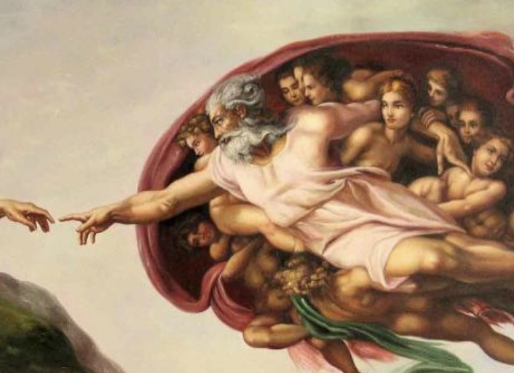
Power over Creation
Mark 4:35–5:43
Preached by Dr. Andrew Spurgeon
at Crossroads International Church Singapore • CICFamily.com
Uploaded by Dr. Rick Griffith • Jordan Evangelical Theological Seminary
Thousands of files in 54 languages for free at BibleStudyDownloads.org

Slide 2

Mark’s Gospel
Mark is a Gospel of action; Jesus is like a Marvel comic character.

Slide 3
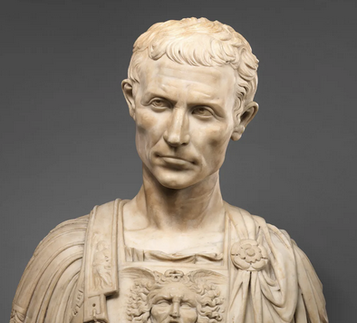
Purpose
To present Jesus as God’s anointed king (Messiah and Son of God) in opposition to Caesar, the other Son of God.
1:1; 8:29; 12:35; 14:61; 15:32, 39.

Slide 4
Today’s Triplet – Power over Creation
Calming the storm (4:35–41)
Commanding the spirits (5:1–20)
Confronting deaths (5:21–43)

Slide 5
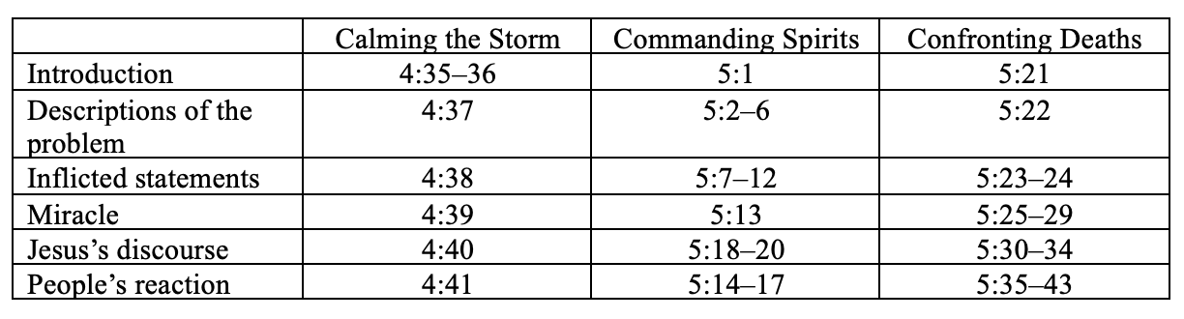

Slide 6
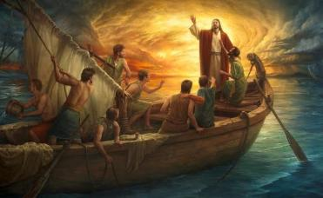
Miracle #1 – Calming the Storm (4:35–41)
The storm in the sea
Jesus’s question, “Why are you awed, alarmed, or afraid? Don’t you yet have faith?” (4:40)
Deos [awed, alarmed) = theos [God]

Slide 7
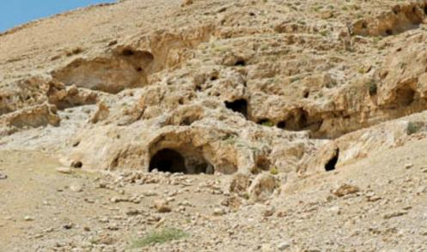
Miracle #2 – Commanding Spirits (5:1–20)
The demoniac
The legion’s confession: “Why me, Jesus the Son of the highest God? Are you going to torture me?” (5:7)
Jesus: “Go to your house and your people and tell them how much the Lord did for you and how much mercy he had shown you” (5:19)

Slide 8
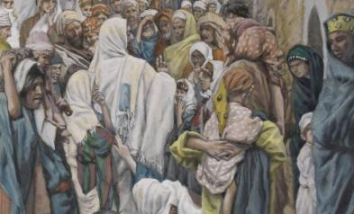
Miracle #3 – Confronting Deaths (5:21–43)
Double miracles
  A woman with an unceasing blood flow
  A child who has died
Jesus: “Daughter, your faith has saved you. Go in peace and be healed from your torment” (5:34)
Jesus: “Do not fear, only believe” (5:36)

Slide 9

Lessons we’ve learned today
Jesus is powerful over his earthly creation.
Jesus is powerful over his heavenly creatures.
Jesus is powerful over the enemy of his creation.
Faith alone draws people to understand Jesus as this supreme creator and savior.

Slide 10

Question for us
What’s your biggest enemy – nature (e.g., natural disasters, prejudice), spiritual (depression, anxiety), or physical (poor health, constant pain)?
He is powerful over us to deliver us or to enable us to endure them.

Slide 11
Black

Slide 12


NT Preaching link at BibleStudyDownloads.org
Get this presentation for free!
Notes:
NT Preaching (np)

