Slide 1
The Gospel of Mark
Walking with Jesus
Don’t You Care?
Mark 4:35–5:20
Preached by Dr. Andrew Spurgeon at Crossroads International Church Singapore • cicfamily.com Uploaded by Dr. Rick Griffith • Singapore Bible College Thousands of files in 49 languages for free at BibleStudyDownloads.org

Slide 2
Walking with Jesus
Jesus’ Message:
“The time is up. God’s rule is here. So, change your ways and trust God for your salvation” (Mark 1:15)

Slide 3
Walking with Jesus
Mark 4:35—5:20
“Don’t You Care?”

Slide 4
www.illusions.org

Slide 5
www.illusions.org

Slide 6
www.illusions.org

Slide 7
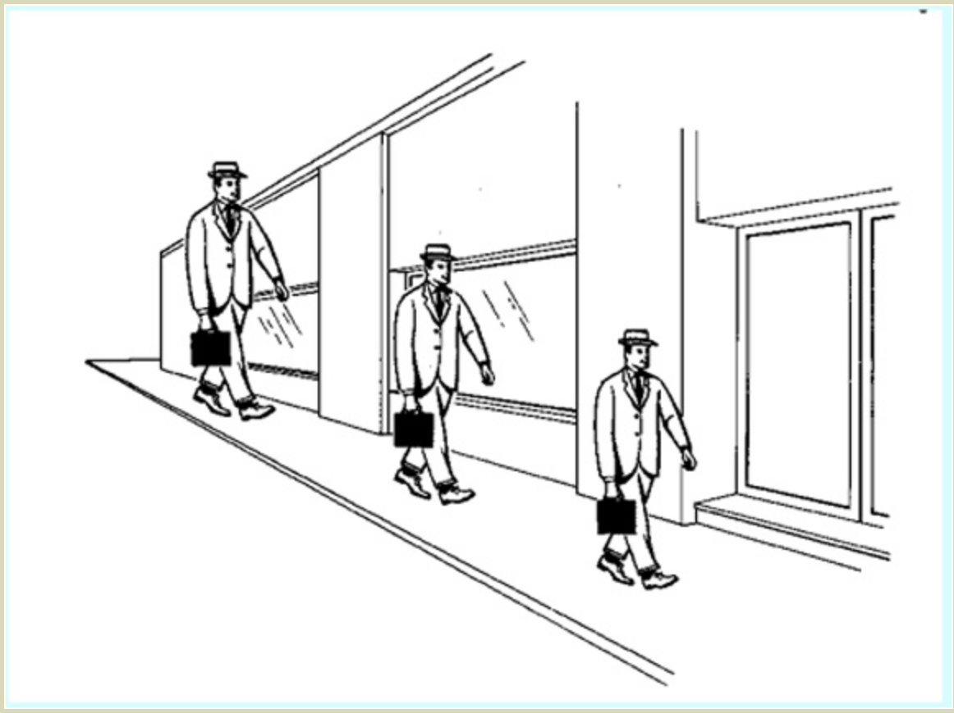
https://therealweeklyshow.wordpress.com

Slide 8
boyslife.org/hobbies-projects

Slide 9
boyslife.org/hobbies-projects

Slide 10
Walking with Jesus
Mark 4:35—5:20
“Don’t You Care?”

Slide 11
Walking with Jesus
Story 1
Mark 4:35–41

Slide 12
Walking with Jesus
Story 2
Mark 5:1–20

Slide 13
Walking with Jesus
When trials come, we lose perspective.

Slide 14
www.bigpictureeducation.com

Slide 15
Walking with Jesus
Psalm 142
Lament Psalm

Slide 16
Walking with Jesus
Mark 4:35—5:20
“Don’t You Care?”

Slide 17
Walking with Jesus
Yes, He Cares.
There are always two perspectives—human and divine!

Slide 18
www.bigpictureeducation.com

Slide 19
Walking with Jesus
Principles
1. It is okay to say, “Don’t You care?”
2. Know—God cares!
3. Remember God’s perspectives are different than ours.

Slide 20
Black

Slide 21
NT Sermons link at BibleStudyDownloads.org
Get this presentation and notes for free!

