Slide 1
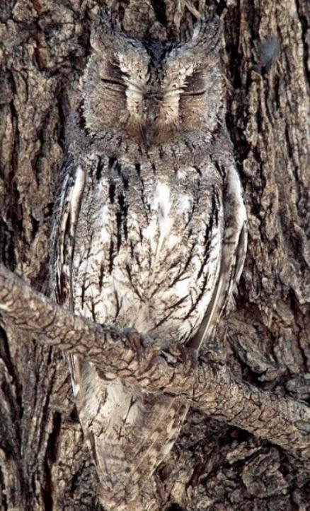
Parables – Hidden in Plain Sight
Mark 4:1–34
Preached by Dr. Andrew Spurgeon at Crossroads International Church Singapore • CICFamily.com Uploaded by Dr. Rick Griffith • Jordan Evangelical Theological Seminary Thousands of files in 54 languages for free at BibleStudyDownloads.org

Slide 2
Mark’s Gospel
Mark is a Gospel of action; Jesus is like a Marvel comic character.

Slide 3
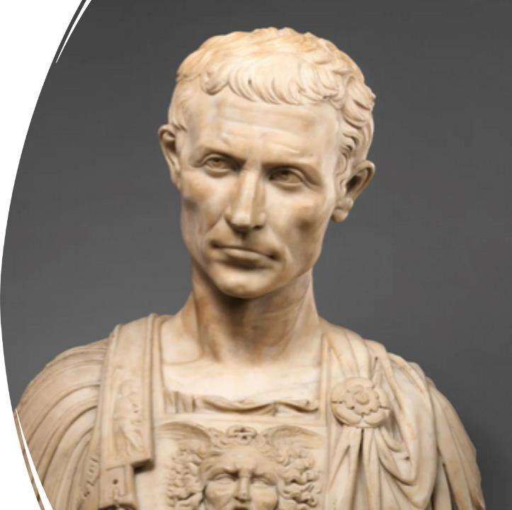
Purpose
To present Jesus as God’s anointed king (Messiah and Son of God) in opposition to Caesar, the other Son of God.
1:1; 8:29; 12:35; 14:61; 15:32, 39.

Slide 4
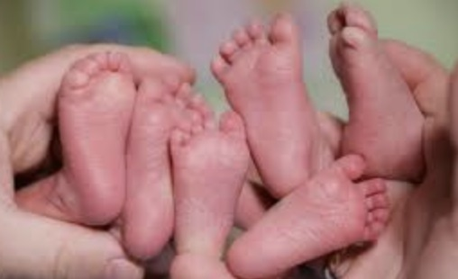
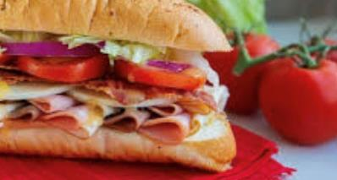
Structure
Triplets presented like a sandwich structure

Slide 5
Structure
Story 1
Story 2
Story 1
A Story Within A Story or Bracketed Stories

Slide 6
Today’s Triplet – Parables
The Sower and the Seed (4:1–20)
The Lamp, Its Placement, and the Exhortation (4:21–25)
The Plants and Their Growth (4:26–34)

Slide 7
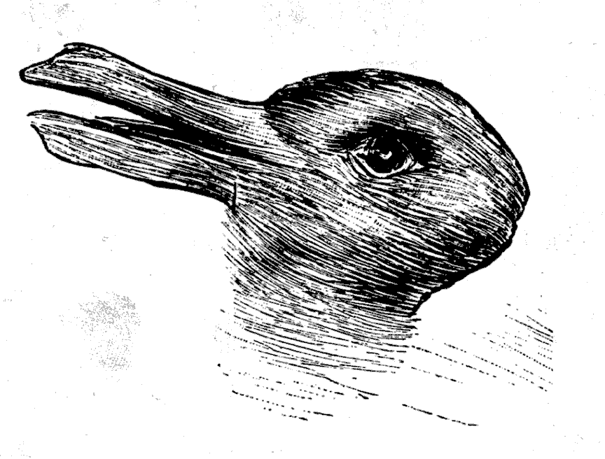
Parables: Hidden in Plain Sight

Slide 8
Parables: Hidden in Plain Sight

Slide 9
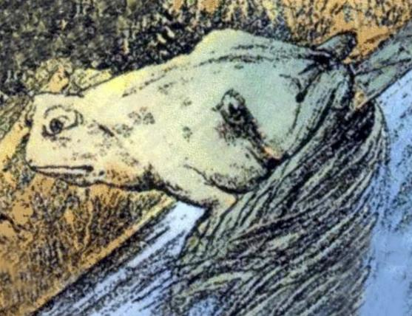
Parables: Hidden in Plain Sight

Slide 10
Parables: Hidden in Plain Sight
“Be ever hearing, but never understanding; be ever seeing, but never perceiving” (Isa 6:9, NIV).
“Otherwise, they might see with their eyes, hear with their ears, understand with their hearts, and turn and be healed” (6:10b).
“Until . . .” he has punished them for their sins (Isa 6:11–13).

Slide 11
Parables: Hidden in Plain Sight
“They may be ever seeing but never perceiving, and ever hearing but never understanding; otherwise, they might turn and be forgiven!” (Mark 4:12)
Parables’ purpose: Hide the truth in plain sight until people have been punished for their sins and have repented.

Slide 12
Parables: Hidden in Plain Sight
Nathan’s parable to David (2 Sam 12:1–7)
Jotham’s parable to the citizens of Shechem (Judges 9:7–16)
Joab’s parable to David through a woman from Tekoa (2 Sam 14)

Slide 13
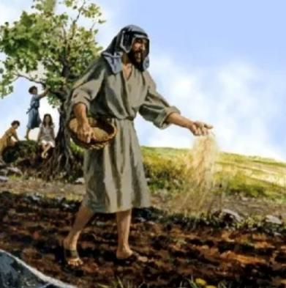
Parable #1 – Sower & Seed (4:1–20)
The parable (4:1–9)
The reason for the parable (4:10–12)
The explanation of the parable (4:13–20)
Jesus’s hearers were of various kinds: some gladly received his message while others did not (Isa 6)

Slide 14
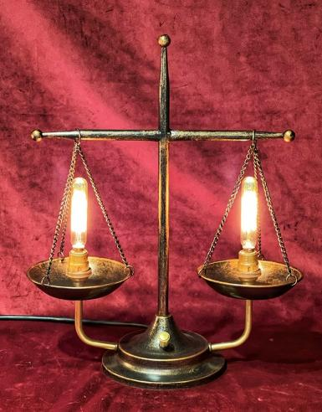
Parable #2 – Lamp & Place (4:21–25)
The parable (4:21–22)
The cautionary note (4:23–25)
The disciples were to discern (measure) what God was doing with proper lighting (understanding). If not, even what they understood would be taken away from them (e.g., Judas).

Slide 15
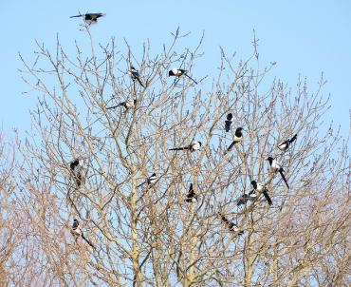
Parable #3 – Growing Plants (4:26–34)
Plant parable #1 (4:26–29)
Plant parable #2 (4:30–32)
God controls growth; His rule will grow (Ezek 17:23; 31:6 and Dan 4:11–12, 21)
Conclusion (4:33–34)

Slide 16
Lessons we’ve learned today
Parables open or close people’s eyes.
When God spoke, some ignored it, while others accepted it; it was part of God’s judgment (Isa 6).
The disciples must discern how God worked like a well-placed lamp, revealing what was hidden.
His rule would undoubtedly grow as he promised.

Slide 17
Questions for us
Have we received God’s word about Jesus Christ—in gladness or need of his intervention (often painful)?
Do we discern God’s ways, like a well-positioned lamp, or seek ours?

Slide 18
Black

Slide 19
NT Preaching link at BibleStudyDownloads.org
Get this presentation for free!
Notes:
NT Preaching (np)

