Slide 1
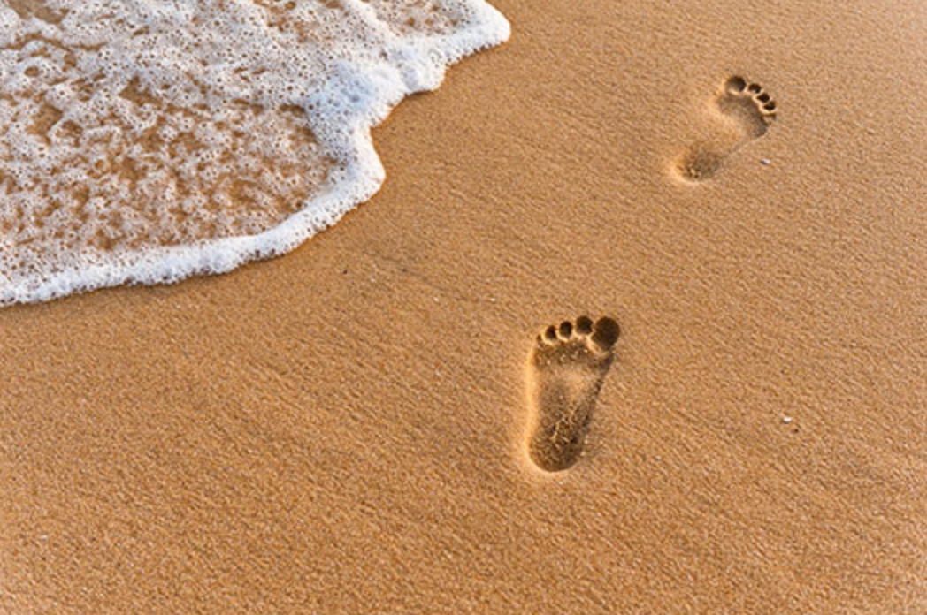
The Gospel of Mark
Walking with Jesus
Preached by Dr. Andrew Spurgeon at Crossroads International Church Singapore • cicfamily.com Uploaded by Dr. Rick Griffith • Singapore Bible College Thousands of files in 49 languages for free at BibleStudyDownloads.org

Slide 2
The Beginning of the Gospel of Jesus Christ (1:1)
As Isaiah prophesied, John prepares the way 1:2-13
Jesus calls his disciples
1:14-6:28
-Calling of four
--Miracles
-Calling of Levi
--Miracles
-Calling of the 12
--Miracles
John dies 6:29
Jesus predicts his death
6:30-10:34
--Miracles
-First Predication
--Miracles
-Second Prediction
--Miracles
-Third Prediction
Jesus will die 10:34
Jesus marches to his death
9:32-15:47
-Kingdom debate
--Miracles
-Triumphal entry
--Miracles
Temple cleansing
--Miracles
Jesus dies 15:47
"I didn't come to be served but to serve and to offer my life a ransom for many" (10:45)
“And they were afraid” (16:8)

Slide 3
Walking with Jesus
Jesus’s Message:
“The time is up. God’s rule is here. So, change your ways and trust God for your salvation” (Mark 1:15)

Slide 4
The Beginning of the Gospel of Jesus Christ (1:1)
As Isaiah prophesied, John prepares the way 1:2-13
Jesus calls his disciples
1:14-6:28
-Calling of four
--Miracles
-Calling of Levi
--Miracles
-Calling of the 12
--Miracles
John dies 6:29
Jesus predicts his death
6:30-10:34
--Miracles
-First Predication
--Miracles
-Second Prediction
--Miracles
-Third Prediction
Jesus will die 10:34
Jesus marches to his death
9:32-15:47
-Kingdom debate
--Miracles
-Triumphal entry
--Miracles
Temple cleansing
--Miracles
Jesus dies 15:47
"I didn't come to be served but to serve and to offer my life a ransom for many" (10:45)
“And they were afraid” (16:8)

Slide 5
Walking with Jesus
Mark 3:1–35
Why do we follow Jesus?

Slide 6
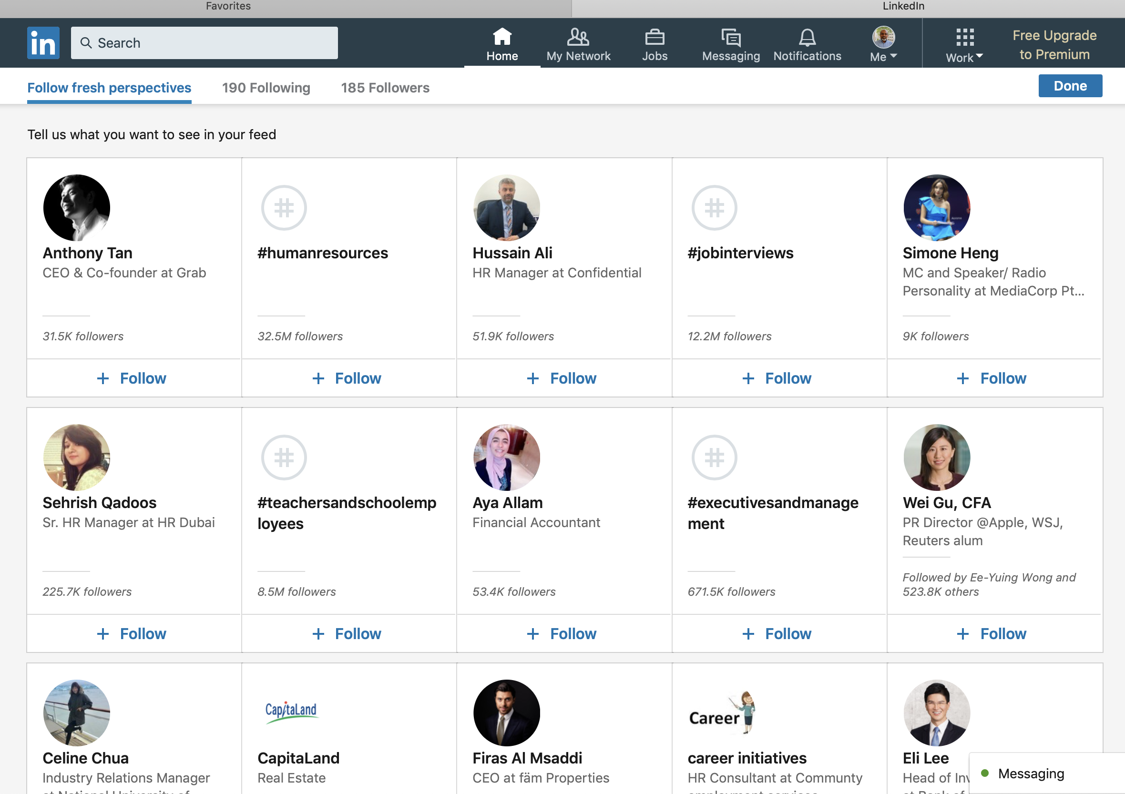
Walking with Jesus

Slide 7
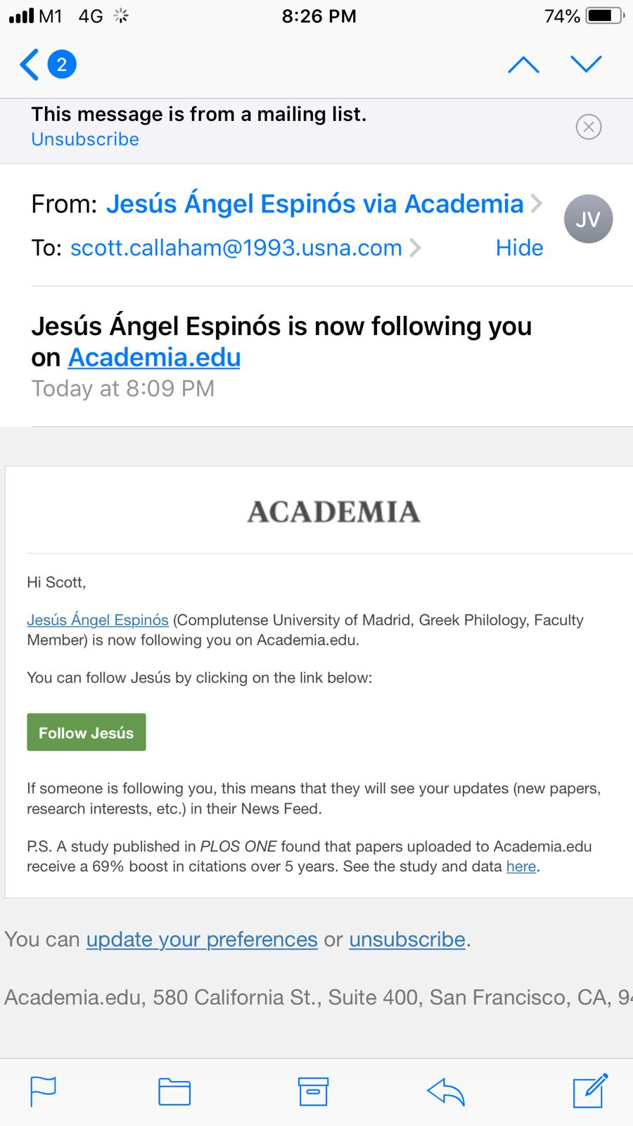
Walking with Jesus

Slide 8
Walking with Jesus
Mark 3:1–35
Why do we follow Jesus?

Slide 9
Walking with Jesus
He entered a synagogue. A man with a withered hand came in. The Pharisees watched Jesus if he would heal the man on a sabbath so they can charge him with rebellion. Jesus said to the man with the withered hand, “Stand in the middle.” Then he asked, “Is it permissible to do good or to do evil on sabbath—to save life or to destroy it?” They remained silent. Seeing their indifference and yet sympathizing with the hardness of their hearts, he said to the man, “Stretch out your hand.” As he did, his hand was restored. The Pharisees immediately went out with the Herodians and planned together how they’ll destroy him. (Mark 3:1–6)

Slide 10
Walking with Jesus
The first group followed him to destroy him.

Slide 11
Walking with Jesus
Jesus withdrew to the seashore, along with his disciples. And a large crowd from Galilee, Judea, Jerusalem, Idumea, beyond Jordan, Tyre, and Sidon came to him, hearing all that he had done. Since he healed many, whoever had an illness was rushing to him to touch him so they may be healed. And whenever the unclean spirits saw him, they fell before him and cried, “You are Son of God.” He rebuked them so that they might not make him known.
(Mark 3:7–12)

Slide 12
Walking with Jesus
The second group followed him for healing.

Slide 13
Walking with Jesus
Jesus climbed a mountain and invited those whom he selected. They followed. He appointed those twelve, naming them “apostles,” so they may be with him and he may sent them to preach and to have authority to cast out demons. And their names were Simon Peter, Jacob (Zebedee's son), John (Jacob’s brother) — these two he called, “Boanerges,” which means, “Thunder sons” — Andrew, Philip, Bartholomew, Matthew, Thomas, and Jacob (Alphaeus’s son), Thaddaeus, Simon the Cananaean, and Judas Iscariot the betrayer. (Mark 3:13–19)

Slide 14
Walking with Jesus
The third group followed him for positions and privileges.

Slide 15
Walking with Jesus
Jesus came into his house. Again, a crowd gathered so they couldn’t even eat. Hearing this, those who were with him came to take him away saying, “He is exhausted.” (Mark 3:20–21)

Slide 16
Walking with Jesus
The fourth group followed him to protect him.

Slide 17
Walking with Jesus
The Scribes from Jerusalem went to see him, saying, “He has Beelzebub, and he is casting demons by the authority of demons.” He asked, “How can Satan cast Satan?” If a kingdom is divided against itself, that kingdom will not stand. If a house is divided against itself, that house is unable to withstand opposition. If Satan stands against himself, he is divided; he cannot stand. Instead, he is overpowered. No one is able to enter the house of a strong-person and plunder his goods unless first he binds the strong-person. Then he can plunder his house. Truly I tell you, every sin and blasphemy will be forgiven except blasphemy against the Holy Spirit; he/she will not be forgiven for eternity; he/she is guilty of eternal sin. Jesus said this because they said he has an unclean spirit. (Mark 3:22–30)

Slide 18
Walking with Jesus
The fifth group followed him to discredit him.

Slide 19
Walking with Jesus
Then his mother and his brothers came. Standing outside, they sent people to him calling him. And a crowd was sitting around him. Those who came in said to him, “See, your mother, brothers, and sisters are seeking you outside.” (Mark 3:31–32)

Slide 20
Walking with Jesus
The sixth group followed him because they were concerned.

Slide 21
Walking with Jesus
He said to them, “Who is my mother? Who are my brothers?” Seeing those sitting around him in a circle, he said, “See, this is my mother and these are my brothers.” Whoever follows God’s will — he/she is my brother, sister, and mother. (Mark 3:31–35)

Slide 22
Walking with Jesus
The seventh group followed because they were his spiritual family.

Slide 23
Walking with Jesus
Mark 3:1–35
Why do we follow Jesus?

Slide 24
Walking with Jesus
to destroy him?
for healing?
for positions and privileges?
to protect him?
to discredit him?
because of concern?
because we are his spiritual family?

Slide 25
Walking with Jesus
Mark 3:1–35
Why do we follow Jesus?

Slide 26
The Beginning of the Gospel of Jesus Christ (1:1)
As Isaiah prophesied, John prepares the way 1:2-13
Jesus calls his disciples
1:14-6:28
-Calling of four
--Miracles
-Calling of Levi
--Miracles
-Calling of the 12
--Miracles
John dies 6:29
Jesus predicts his death
6:30-10:34
--Miracles
-First Predication
--Miracles
-Second Prediction
--Miracles
-Third Prediction
Jesus will die 10:34
Jesus marches to his death
9:32-15:47
-Kingdom debate
--Miracles
-Triumphal entry
--Miracles
Temple cleansing
--Miracles
Jesus dies 15:47
"I didn't come to be served but to serve and to offer my life a ransom for many" (10:45)
“And they were afraid” (16:8)

Slide 27
Black

Slide 28
NT Sermons link at BibleStudyDownloads.org
Get this presentation and notes for free!

