Slide 1
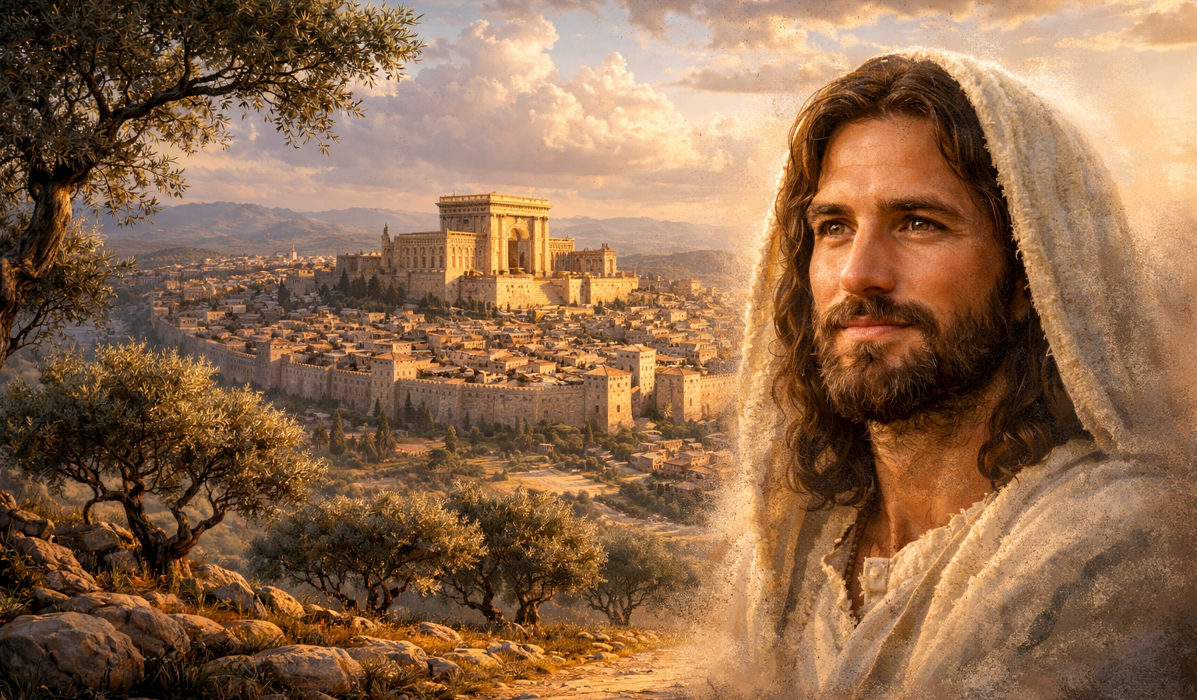
The Gospel of
Luke
Luke 5:12-26
Forgiveness and Cleansing!
Preached by Dan Bridges
Amman International Church, Jordan (AmmanChurch.org)
Uploaded by Dr. Rick Griffith • Jordan Evangelical Theological Seminary
Files in many languages for free download at BibleStudyDownloads.org

Slide 2
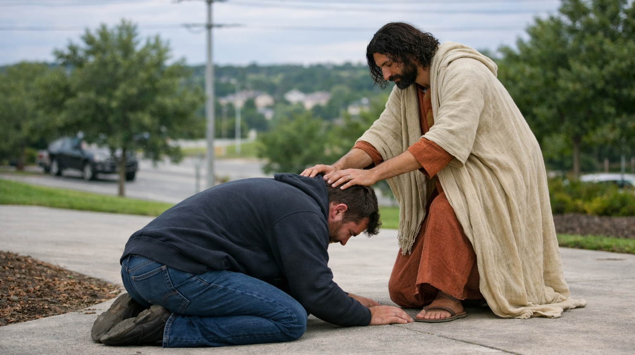
What is the difference between forgiveness and cleansing? Why do we need both?
“If we confess our sins, he is faithful and just to forgive us our sins and to cleanse us from all unrighteousness.”
1 John 1:9
Notes:
They camped at Rephidim …

Slide 3
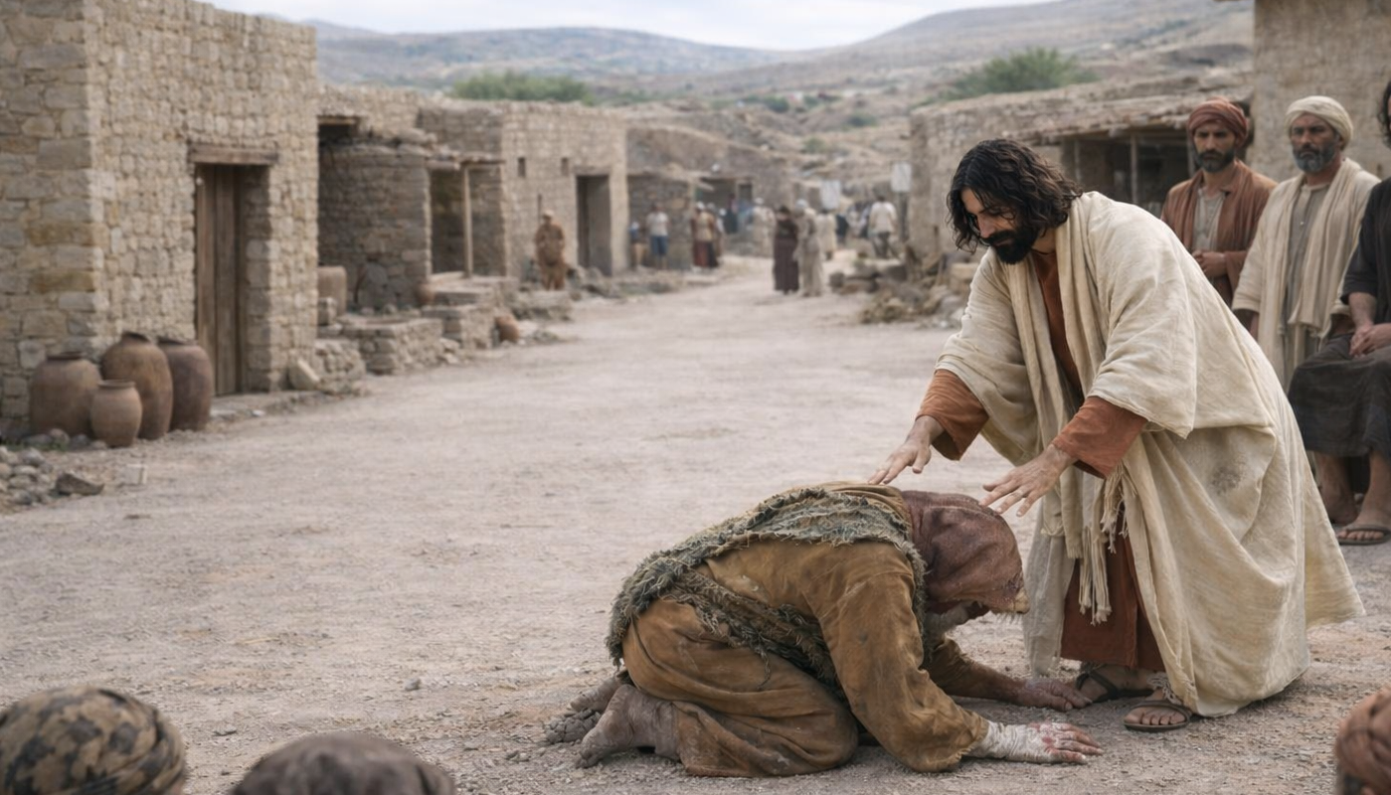
Luke 5:12-26
Forgiveness and Cleansing!
Authority to Cleanse (12-16)
Authority to Forgive (17-26)
The Need for Both

Slide 4
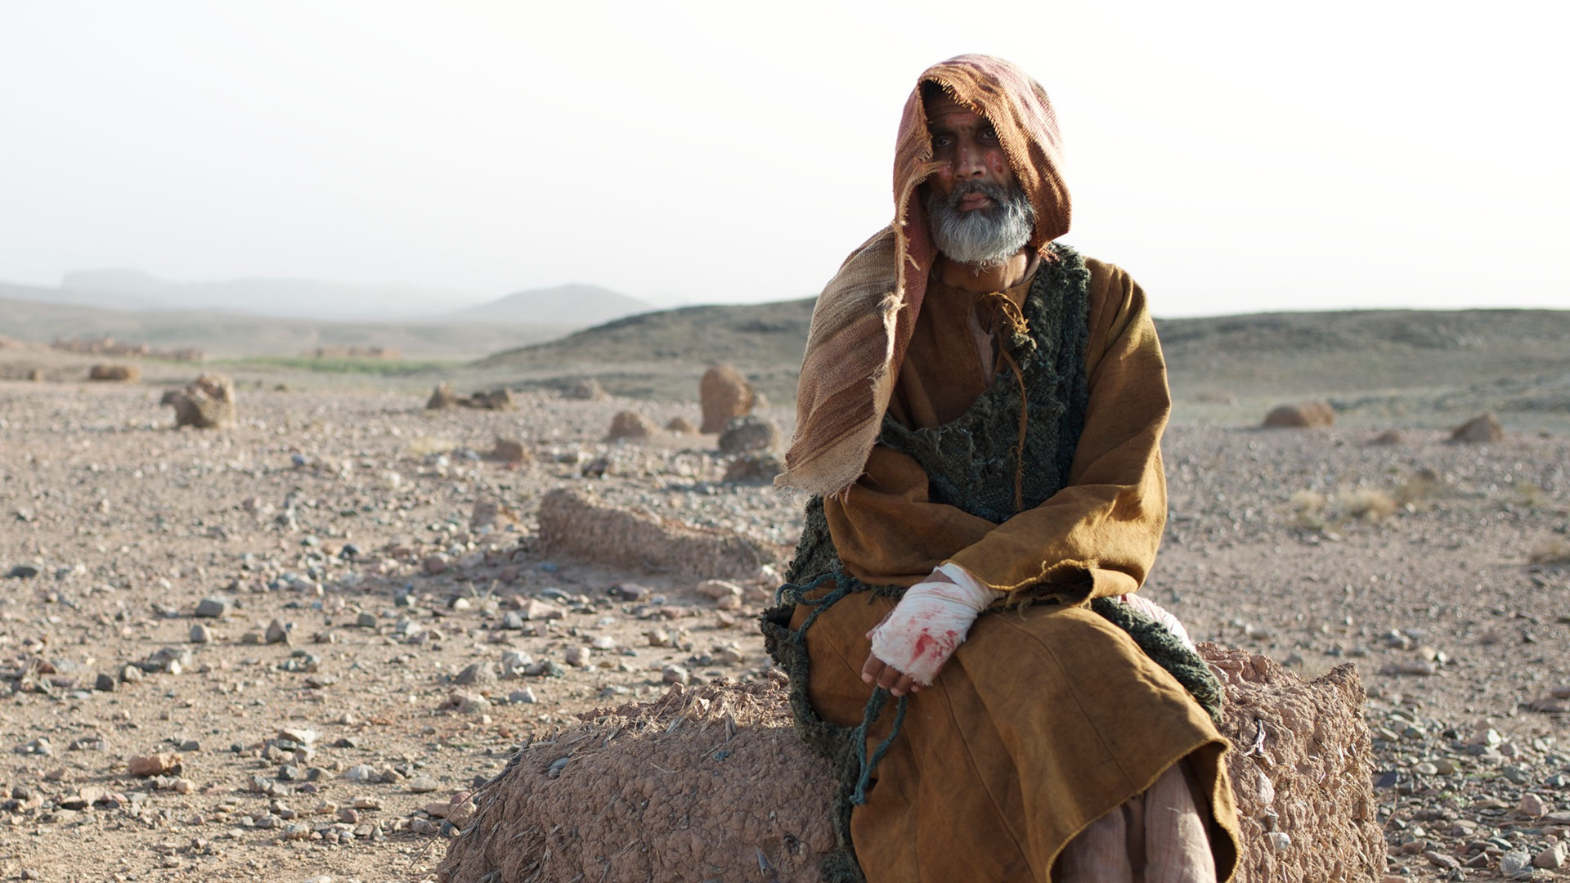
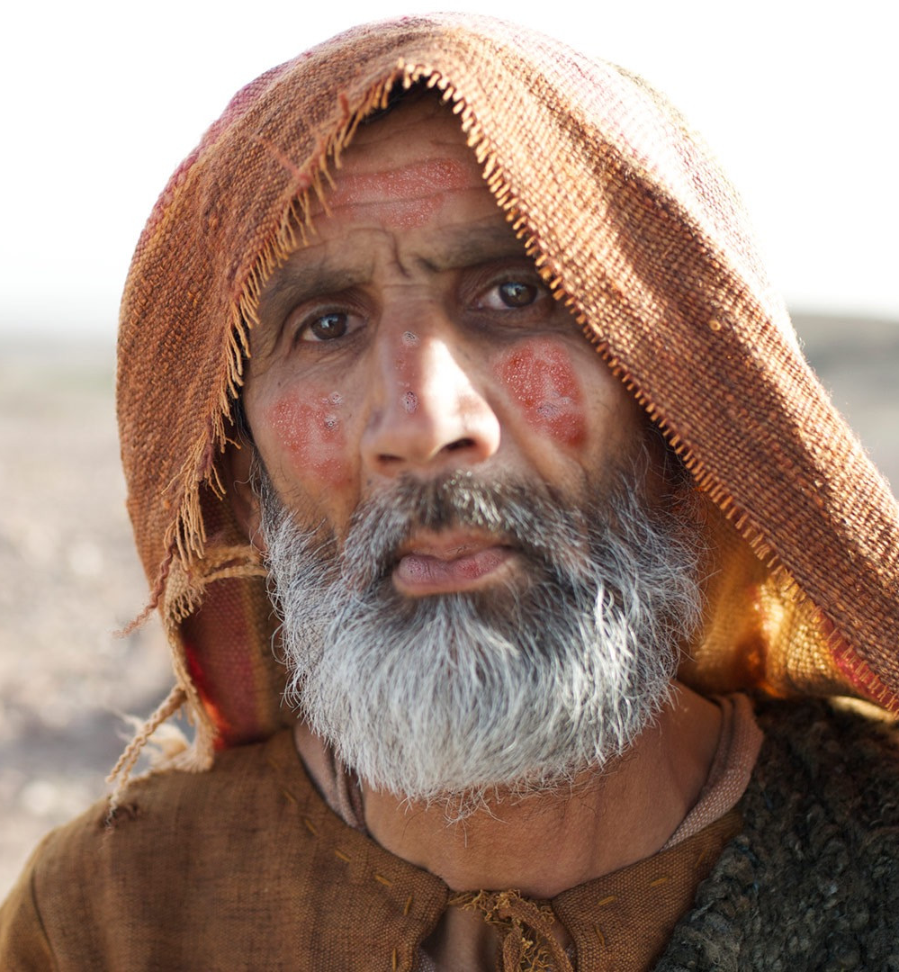
“While he was in one of the cities, there came a man full of leprosy.”
Luke 5:12a

Slide 5
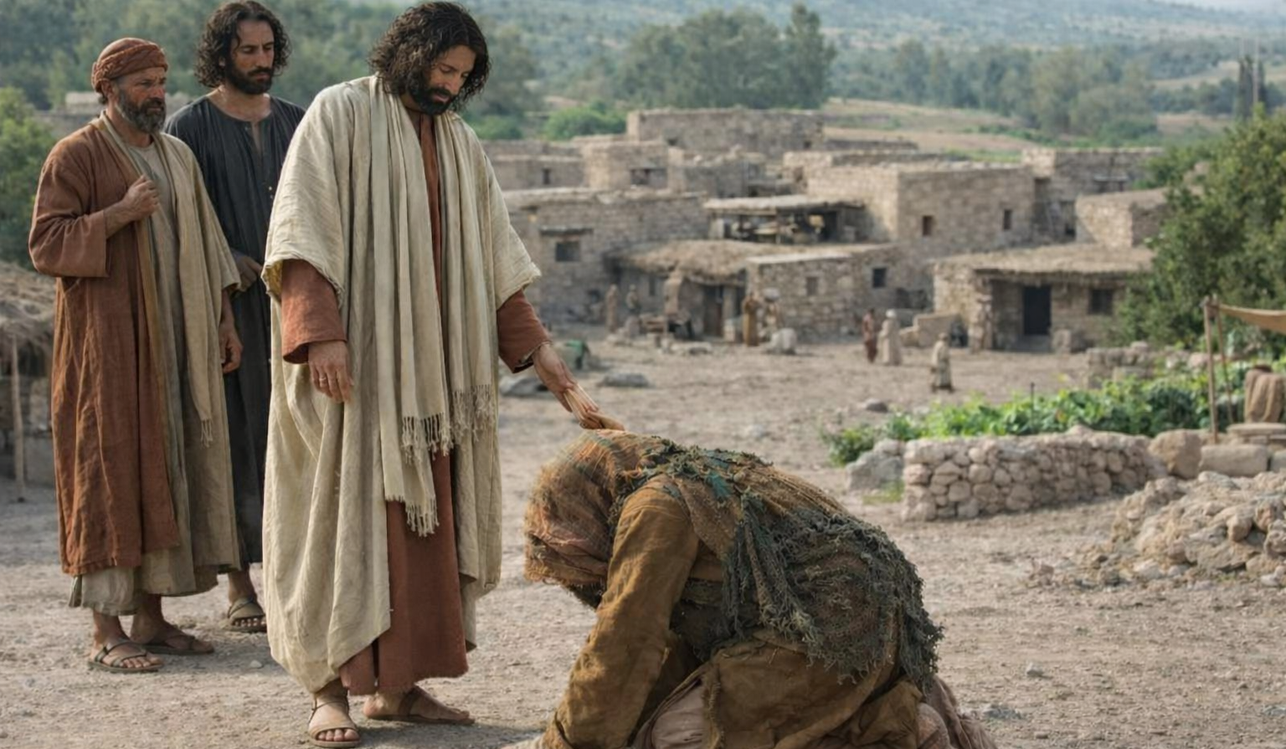
“And when he saw Jesus, he fell on his face and begged him, ‘Lord, if you will, you can make me clean.’” Luke 5:12b

Slide 6
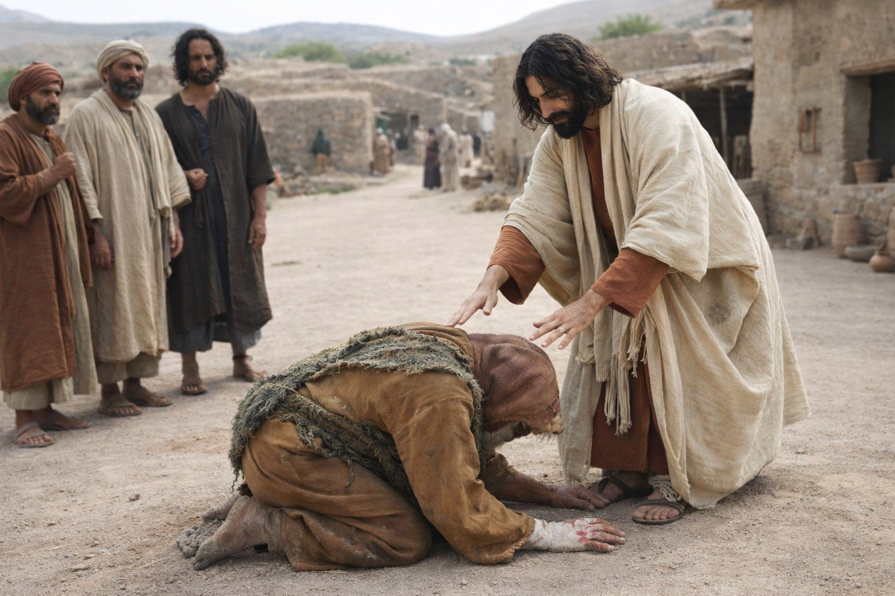
“And Jesus stretched out his hand and touched him, saying, ‘I will; be clean.’ And immediately the leprosy left him.”
Luke 5:13

Slide 7
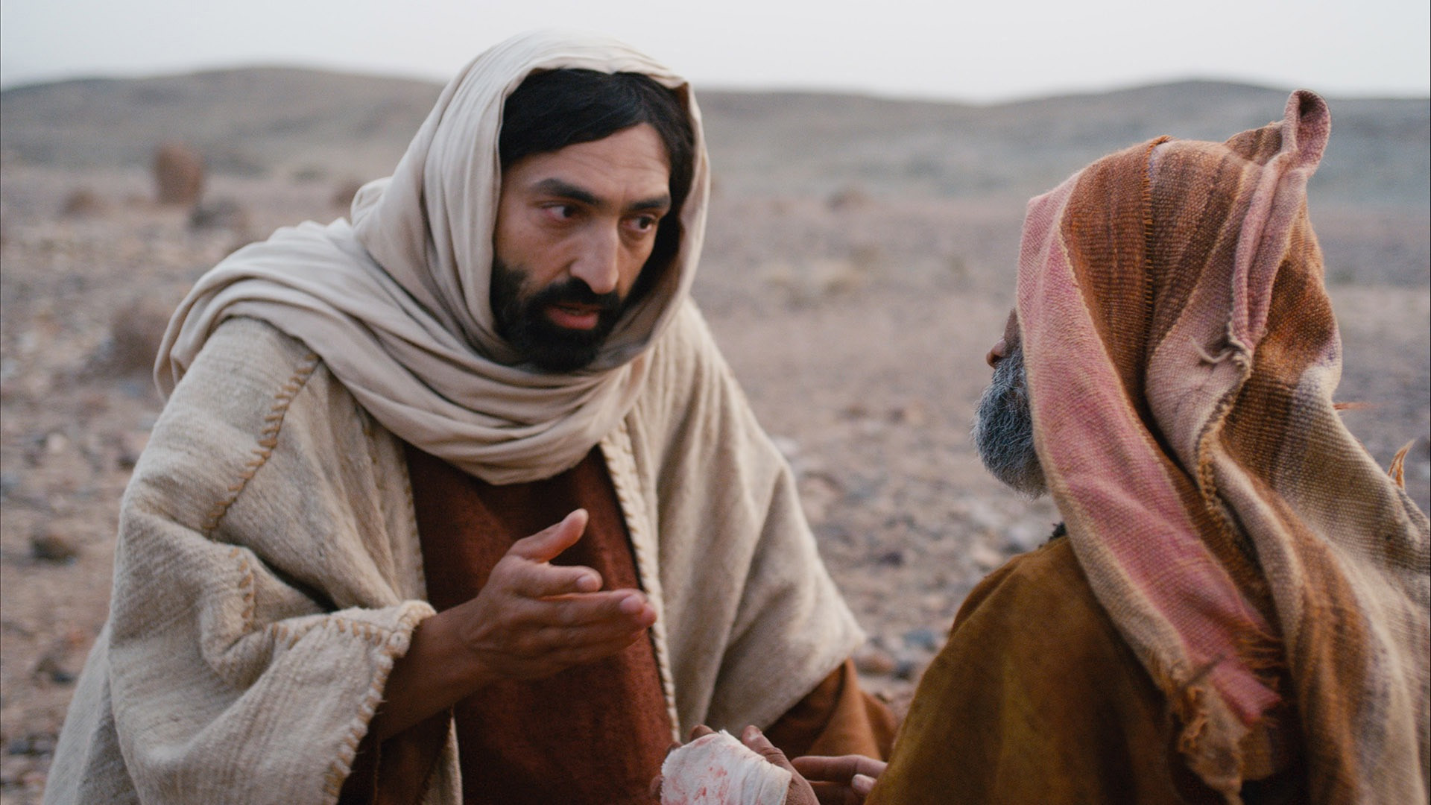
“And he charged him to tell no one, but ‘go and show yourself to the priest, and make an offering for your cleansing, as Moses commanded, for a proof to them.’”
Luke 5:14

Slide 8
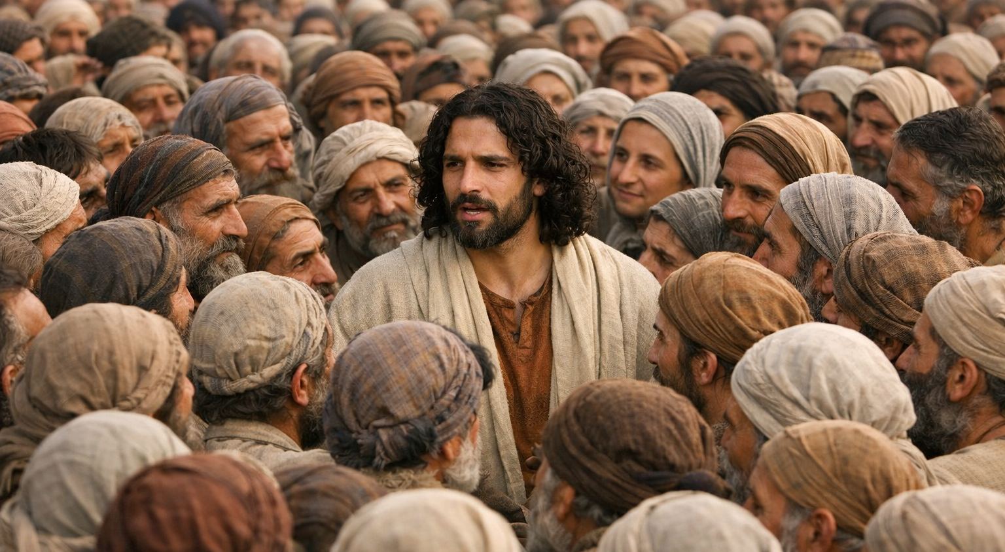
“But now even more the report about him went abroad, and great crowds gathered to hear him and to be healed of their infirmities.” Luke 5:15

Slide 9
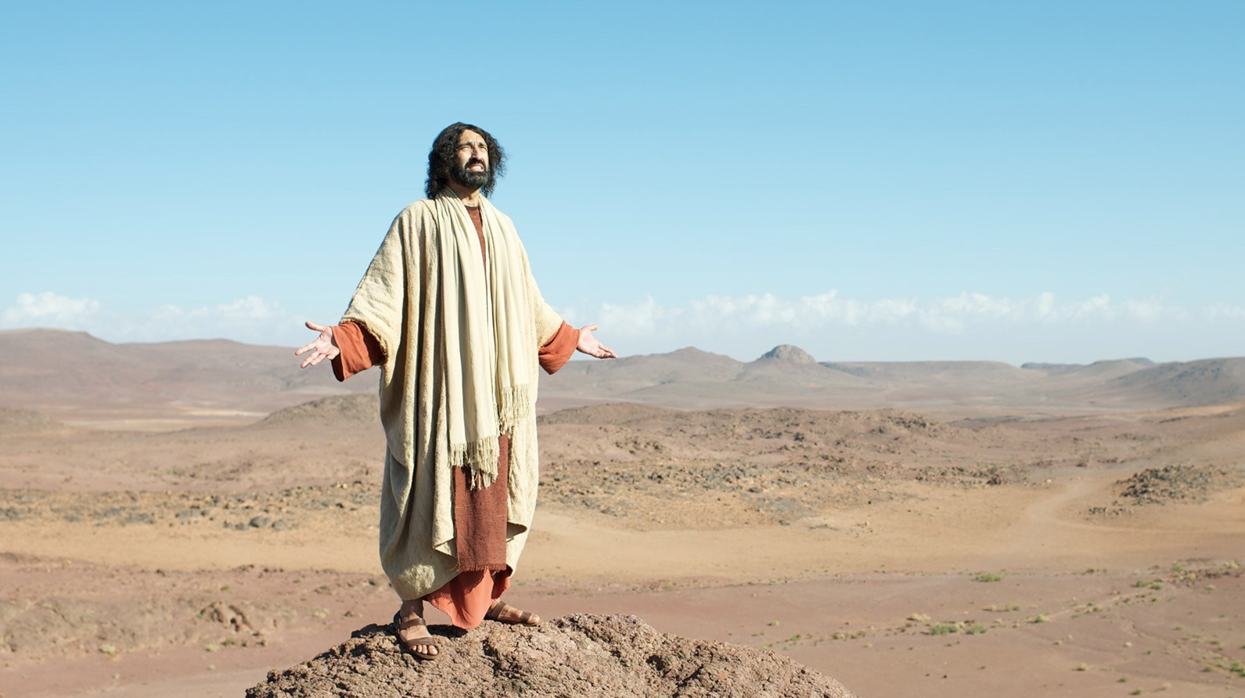
“But he would withdraw to desolate places and pray.”
Luke 5:16

Slide 10
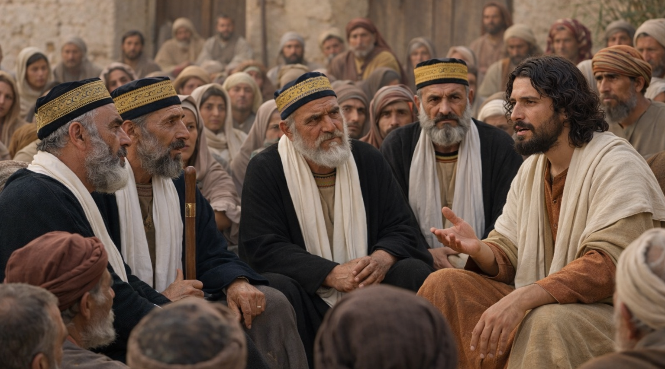
“On one of those days, as he was teaching, Pharisees and teachers of the law were sitting there, who had come from every village of Galilee and Judea and from Jerusalem. And the power of the Lord was with him to heal.” Luke 5:17

Slide 11
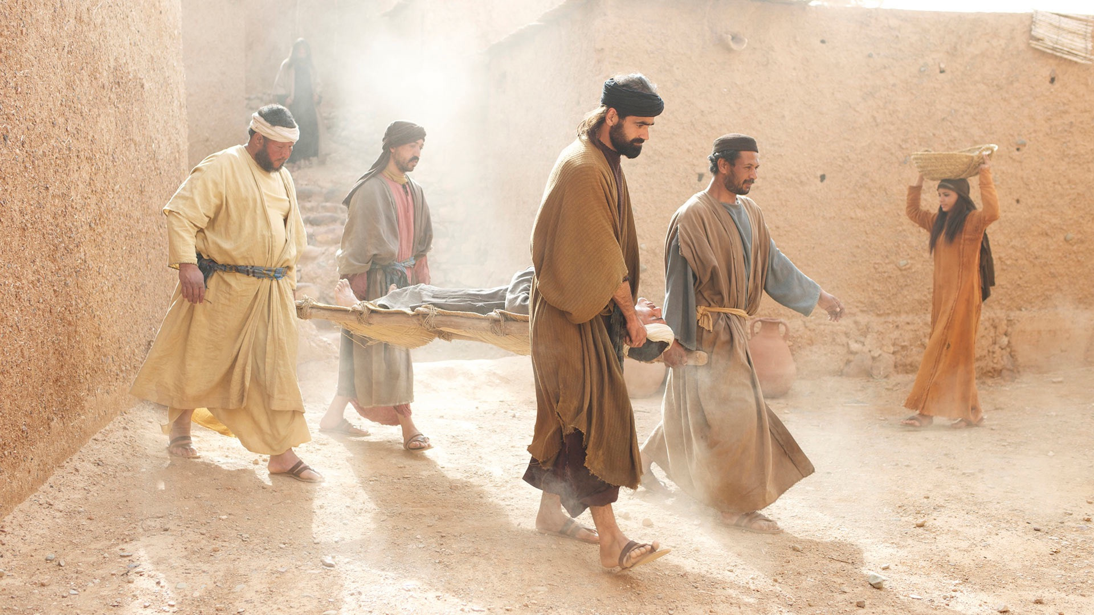
“And behold, some men were bringing on a bed a man who was paralyzed, and they were seeking to bring him in and lay him before Jesus,” Luke 5:18

Slide 12
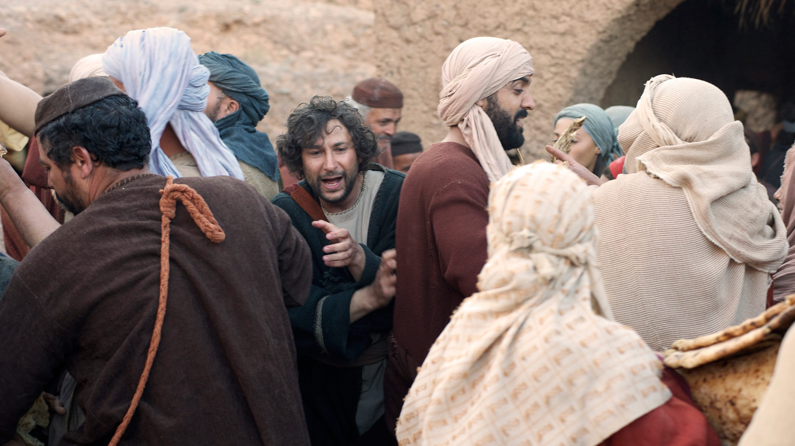
“but finding no way to bring him in, because of the crowd,” Luke 5:19a

Slide 13
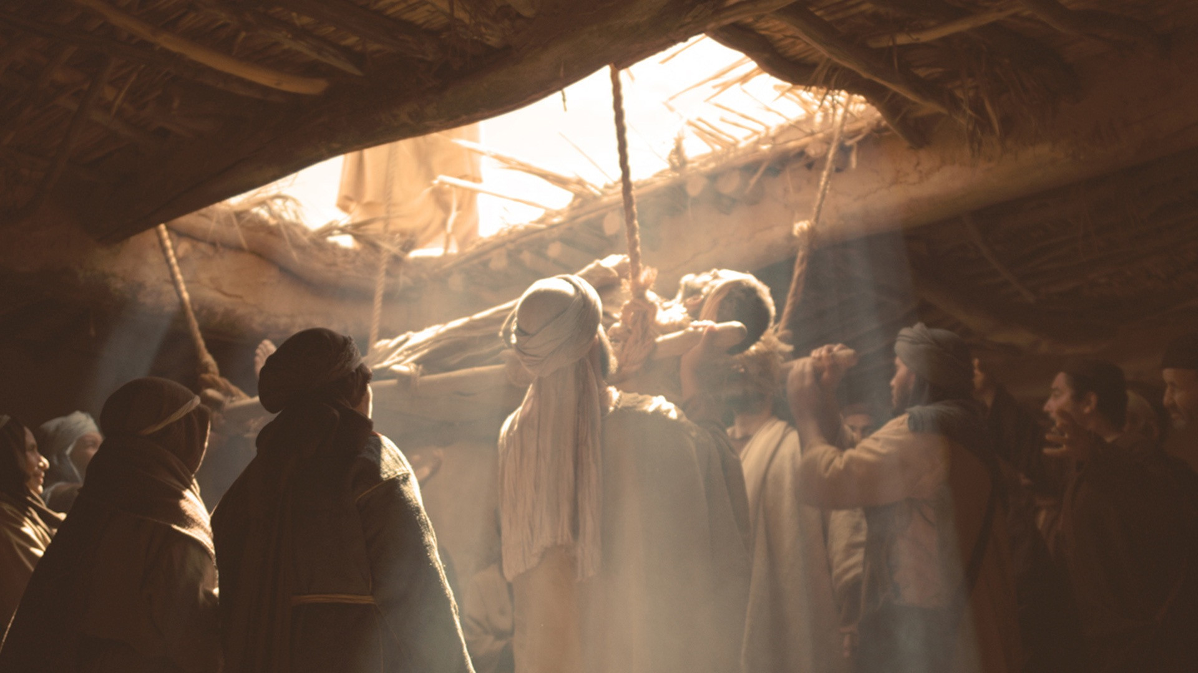
“they went up on the roof and let him down with his bed through the tiles into the midst before Jesus.”
Luke 5:19b

Slide 14
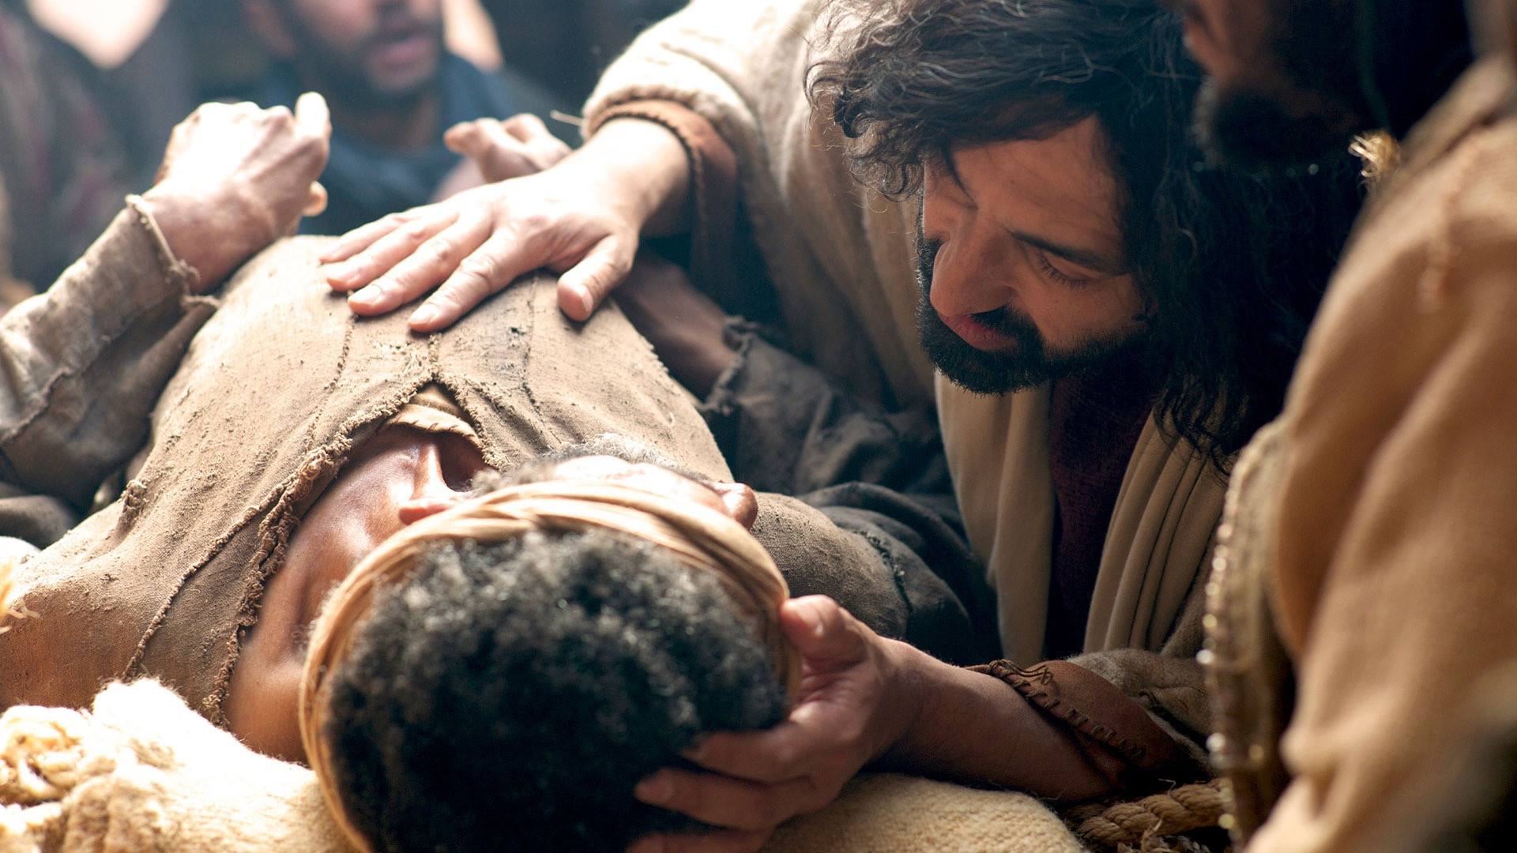
“And when he saw their faith, he said, ‘Man, your sins are forgiven you.’”
Luke 5:20

Slide 15
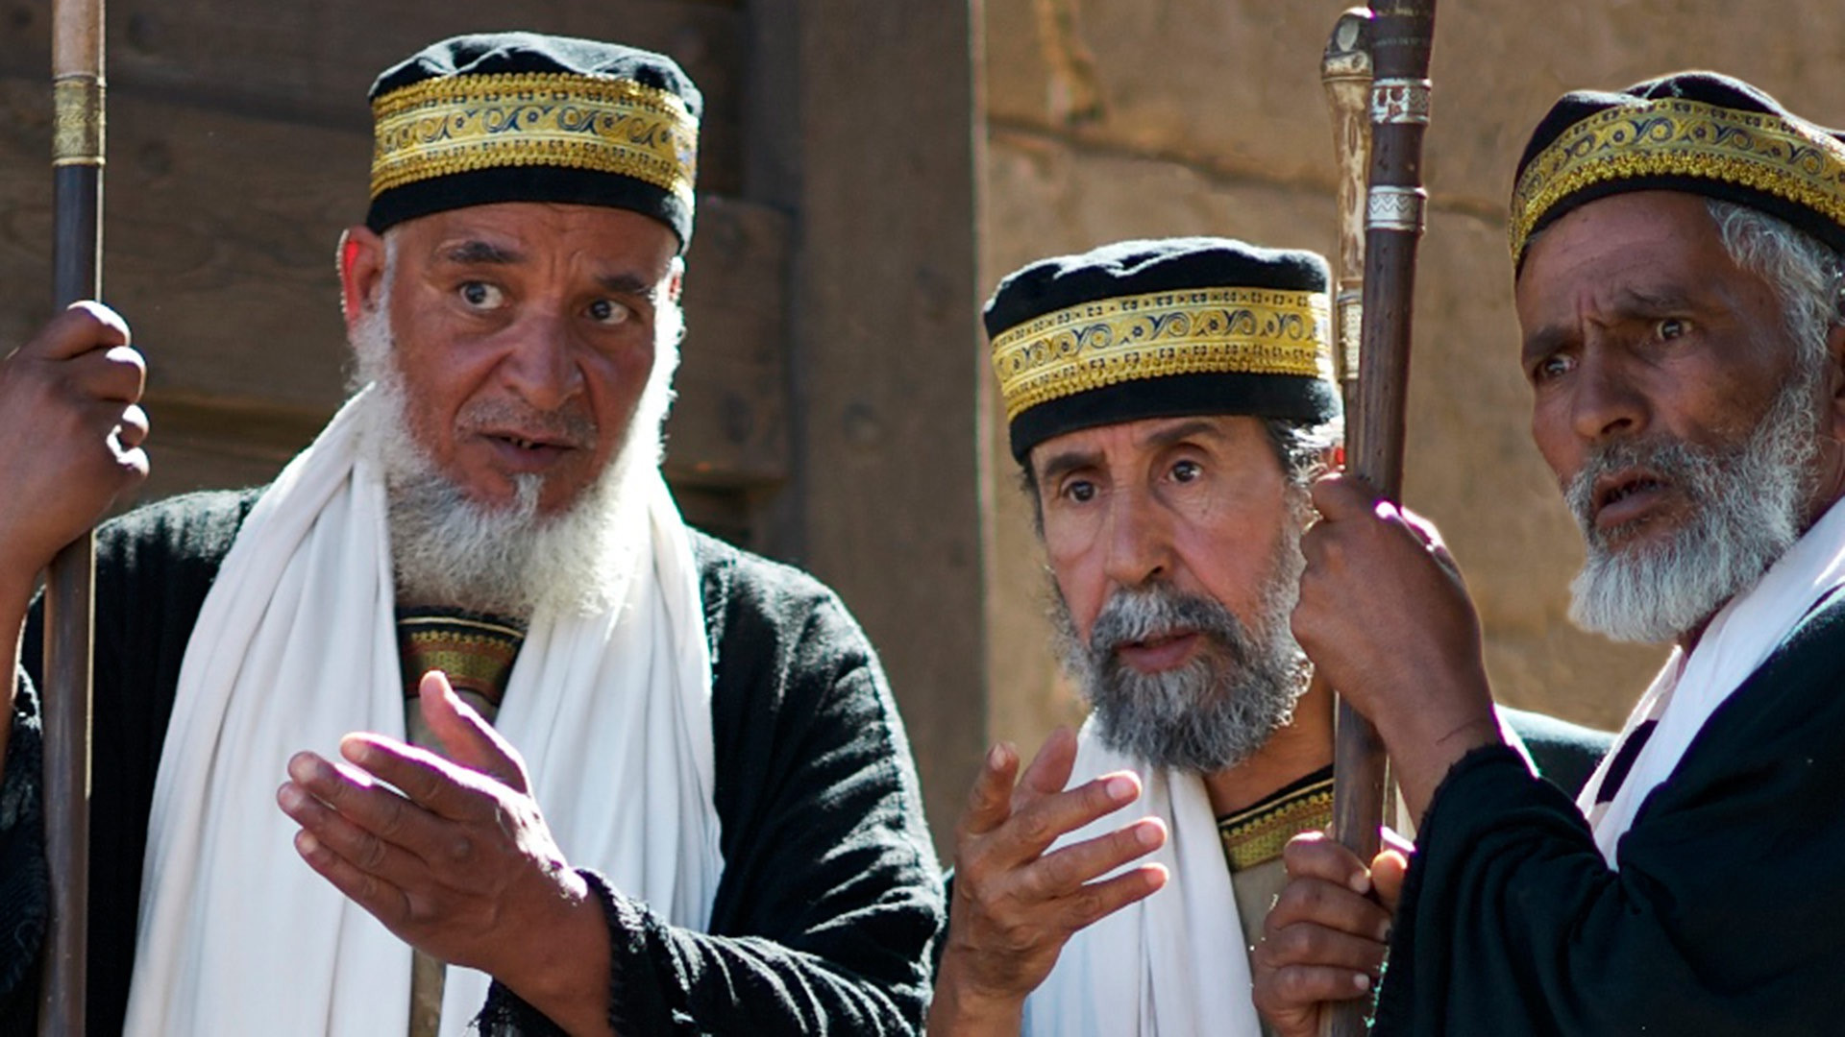
“And the scribes and the Pharisees began to question, saying, ‘Who is this who speaks blasphemies? Who can forgive sins but God alone?’” Luke 5:21

Slide 16
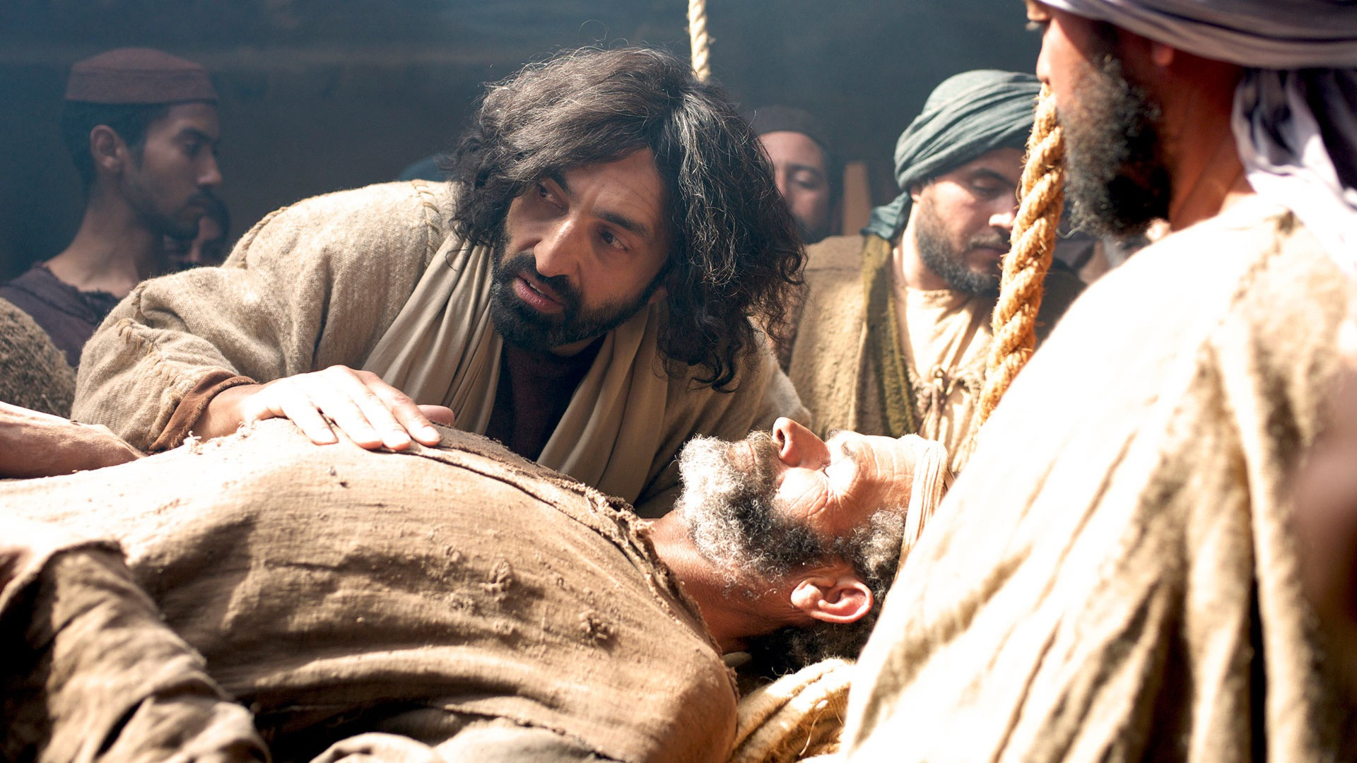
“When Jesus perceived their thoughts, he answered them, ‘Why do you question in your hearts? Which is easier, to say, “Your sins are forgiven you,” or to say, “Rise and walk”?’” Luke 5:22-23

Slide 17
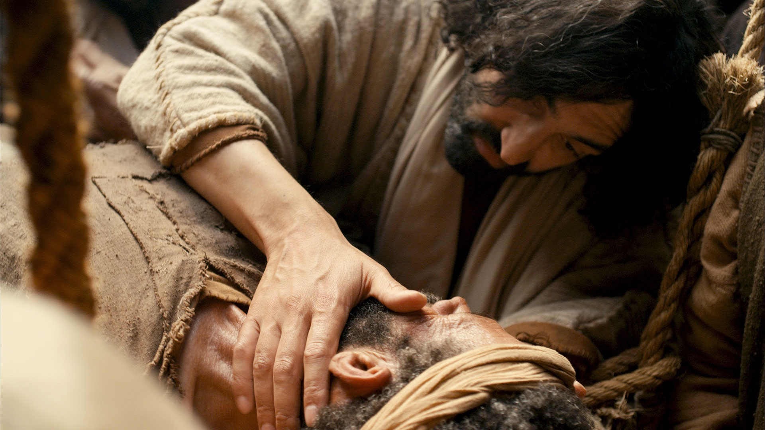
“‘But that you may know that the Son of Man has authority on earth to forgive sins’—he said to the man who was paralyzed— ‘I say to you, rise, pick up your bed and go home.’” Luke 5:24

Slide 18
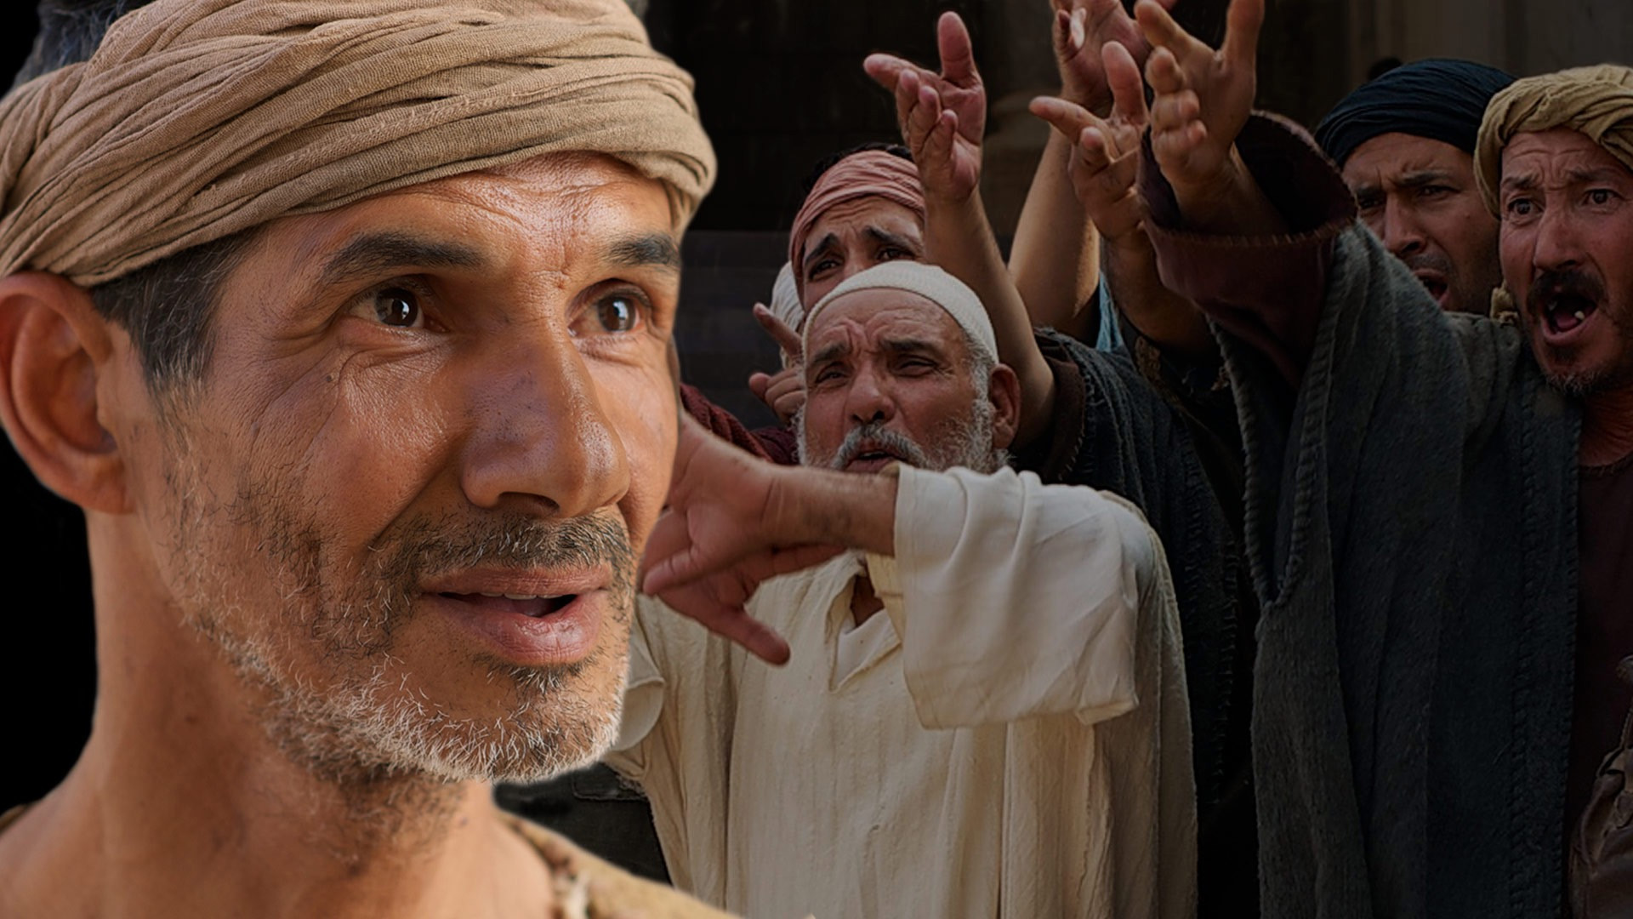
“And immediately he rose up before them and picked up what he had been lying on and went home, glorifying God.”
Luke 5:25

Slide 19
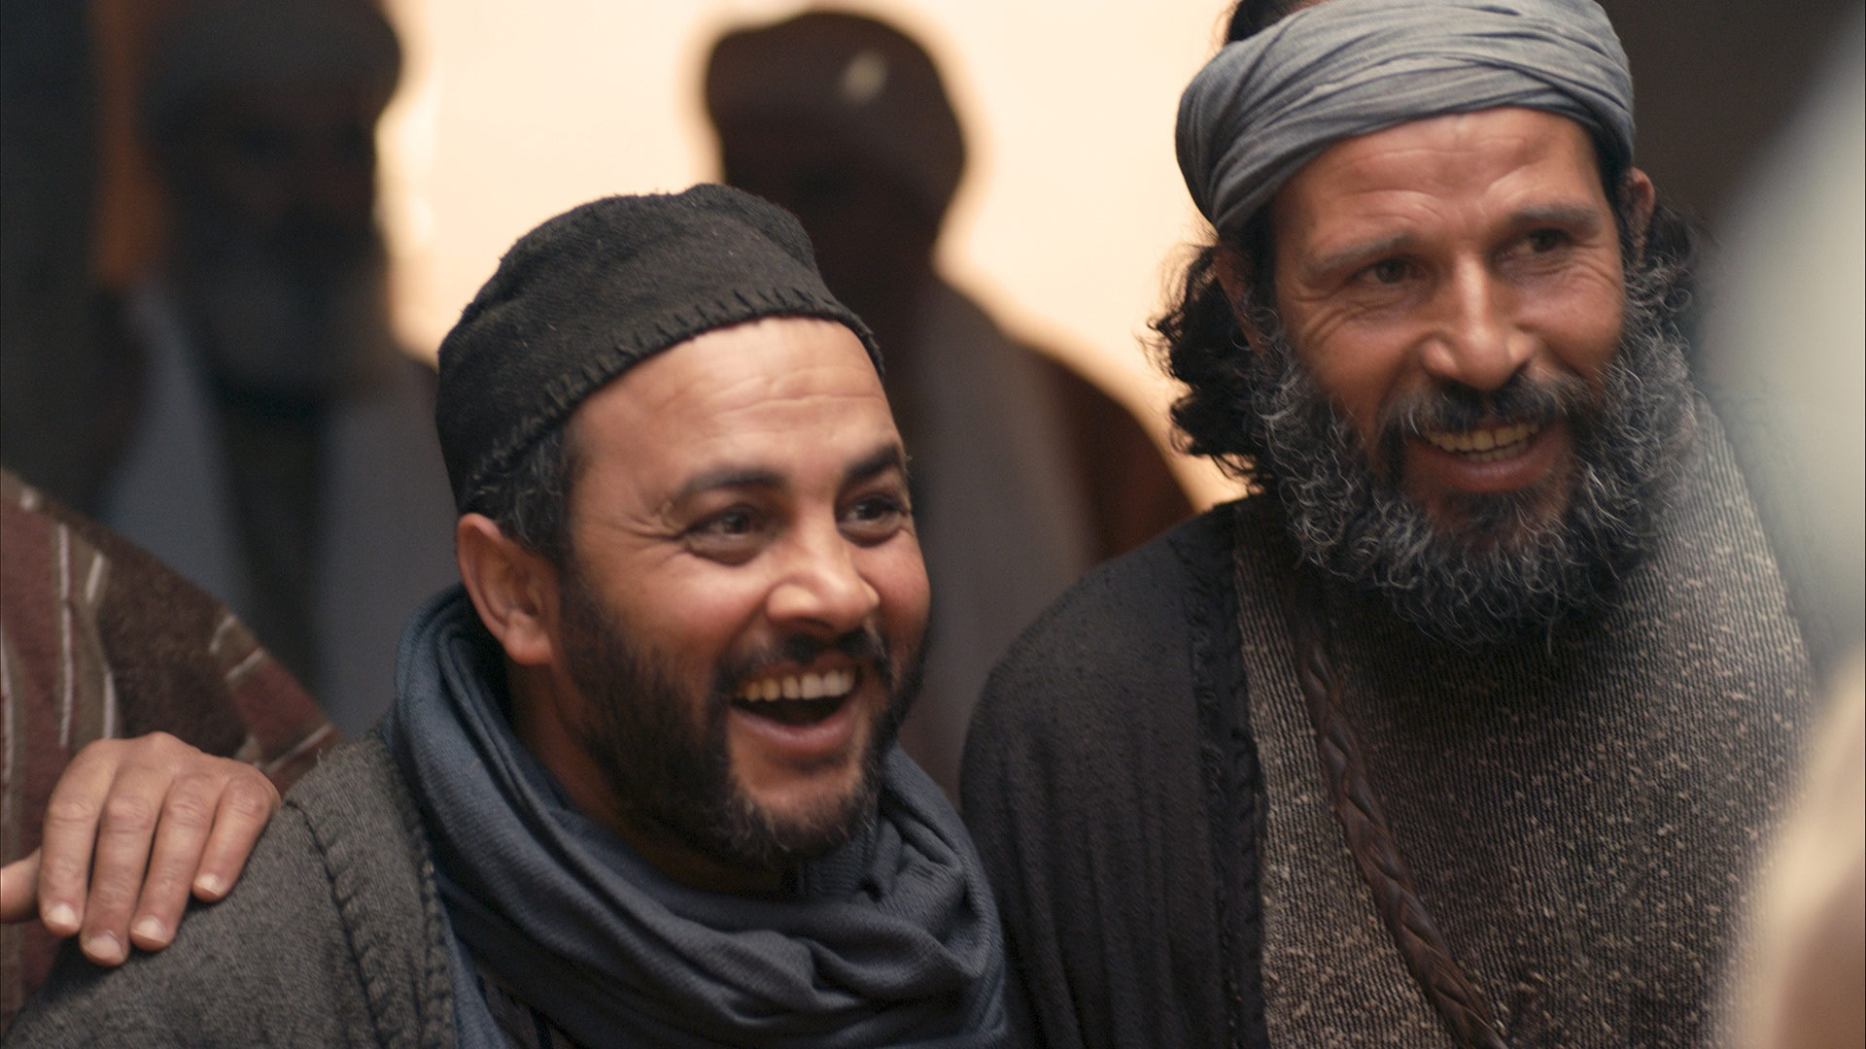
“And amazement seized them all, and they glorified God and were filled with awe, saying, ‘We have seen extraordinary things today.’” Luke 5:26

Slide 20
Luke 5:12-26
Forgiveness and Cleansing!
Authority to Cleanse (12-16)
Authority to Forgive (17-26)
The Need for Both

Slide 21
“While he was in one of the cities, there came a man full of leprosy.”
Luke 5:12a

Slide 22
Leprosy was not like other diseases and ailments… It was first and foremost a social disease!
What was it like to have leprosy?
“…he is a leprous man, he is unclean. The priest must pronounce him unclean; his disease is on his head. The leprous person who has the disease shall wear torn clothes and let the hair of his head hang loose, and he shall cover his upper lip and cry out, ‘Unclean, unclean.’ He shall remain unclean as long as he has the disease. He is unclean. He shall live alone. His dwelling shall be outside the camp.” Leviticus 13:44-46

Slide 23
Unclean… Defiled
Unable to participate in the community
Unable to participate in temple worship
Anything this person touched would become unclean… defiled

Slide 24
“And when he saw Jesus, he fell on his face and begged him, ‘Lord, if you will, you can make me clean.’” Luke 5:12b
Not just “well” but actually “clean”!

Slide 25
“And Jesus stretched out his hand and touched him, saying, ‘I will; be clean.’ And immediately the leprosy left him.”
Luke 5:13
This act should have made Jesus unclean!

Slide 26
“And Jesus stretched out his hand and touched him, saying, ‘I will; be clean.’ And immediately the leprosy left him.”
Luke 5:13
Jesus commanded the uncleanness – the defilement – to leave him!

Slide 27
“And Jesus stretched out his hand and touched him, saying, ‘I will; be clean.’ And immediately the leprosy left him.”
Luke 5:13
Instead of Jesus becoming defiled, the man was immediately cleansed!

Slide 28
“And Jesus stretched out his hand and touched him, saying, ‘I will; be clean.’ And immediately the leprosy left him.”
Luke 5:13
Jesus had the authority to make defiled people immediately clean!

Slide 29
Requirements: (Leviticus 14)
Guilt Offering
Sin Offering
Burnt Offering
Grain Offering
Atonement Needed
So was the man not yet “clean”?
“And he charged him to tell no one, but ‘go and show yourself to the priest, and make an offering for your cleansing, as Moses commanded, for a proof to them.’”
Luke 5:14

Slide 30
Jesus had made him clean! This step was for others to recognize that as well!
“And he charged him to tell no one, but ‘go and show yourself to the priest, and make an offering for your cleansing, as Moses commanded, for a proof to them.’”
Luke 5:14

Slide 31
Jesus recognized the source of his authority and power!
“But he would withdraw to desolate places and pray.”
Luke 5:16

Slide 32
Luke 5:12-26
Forgiveness and Cleansing!
Authority to Cleanse (12-16)
Authority to Forgive (17-26)
The Need for Both

Slide 33
“On one of those days, as he was teaching, Pharisees and teachers of the law were sitting there, who had come from every village of Galilee and Judea and from Jerusalem. And the power of the Lord was with him to heal.” Luke 5:17

Slide 34
“And behold, some men were bringing on a bed a man who was paralyzed, and they were seeking to bring him in and lay him before Jesus,” Luke 5:18

Slide 35
“but finding no way to bring him in, because of the crowd,” Luke 5:19a

Slide 36
Audacious Faith!
Boldly daring, Fearless
Willing to take risks
Certain of Jesus’ response!
“they went up on the roof and let him down with his bed through the tiles into the midst before Jesus.”
Luke 5:19b

Slide 37
“And when he saw their faith, he said, ‘Man, your sins are forgiven you.’”
Luke 5:20
What did Jesus see?
Reckless boldness to get him to Jesus
Faith of the man
Faith of the men who had brought him

Slide 38
“And when he saw their faith, he said, ‘Man, your sins are forgiven you.’”
Luke 5:20
He had not asked for anything…
Why ignore his most obvious need?
Why only the paralytic?

Slide 39
“And when he saw their faith, he said, ‘Man, your sins are forgiven you.’”
Luke 5:20
What do we see about Jesus?
He looks for faith…
Forgiveness of sin is foremost on his mind!
To some he says, “Your faith has healed you.”
To others he says, “Your faith has saved you!”
(He is able to read our hearts!)

Slide 40
“And when he saw their faith, he said, ‘Man, your sins are forgiven you.’”
Luke 5:20
What about his paralysis?
What about the sins of the men who brought him?
“As he passed by, he saw a man blind from birth. And his disciples asked him, ‘Rabbi, who sinned, this man or his parents, that he was born blind?’” John 9:1-2
Cultural assumption:
Serious physical issues were due to a sin problem…

Slide 41
“And when he saw their faith, he said, ‘Man, your sins are forgiven you.’”
Luke 5:20
What about the sins of the other men?
Jesus was publicly announcing that this man was forgiven before God!

Slide 42
“And the scribes and the Pharisees began to question, saying, ‘Who is this who speaks blasphemies? Who can forgive sins but God alone?’” Luke 5:21

Slide 43
Jesus didn’t forgive the sins to set up a confrontation…
“When Jesus perceived their thoughts, he answered them, ‘Why do you question in your hearts? Which is easier, to say, “Your sins are forgiven you,” or to say, “Rise and walk”?’” Luke 5:22-23

Slide 44
“‘But that you may know that the Son of Man has authority on earth to forgive sins’—he said to the man who was paralyzed— ‘I say to you, rise, pick up your bed and go home.’” Luke 5:24
Luke’s first usage of “Son of Man”

Slide 45
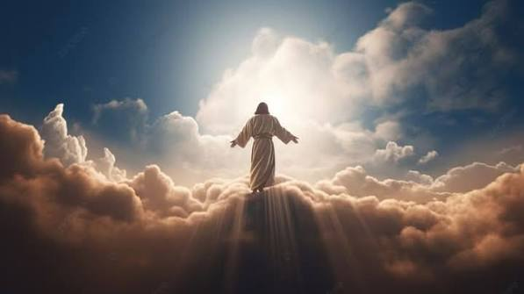
“I saw in the night visions, and behold, with the clouds of heaven
there came one like a son of man,
and he came to the Ancient of Days and was presented before him.
And to him was given dominion and glory and a kingdom,
that all peoples, nations, and languages should serve him;
his dominion is an everlasting dominion, which shall not pass away,
and his kingdom one that shall not be destroyed.” Daniel 7:13-14

Slide 46
“‘But that you may know that the Son of Man has authority on earth to forgive sins’—he said to the man who was paralyzed— ‘I say to you, rise, pick up your bed and go home.’” Luke 5:24
Authority to forgive sins!

Slide 47
“‘But that you may know that the Son of Man has authority on earth to forgive sins’—he said to the man who was paralyzed— ‘I say to you, rise, pick up your bed and go home.’” Luke 5:24
Commands the man (rather than rebuking the paralysis)

Slide 48
Healing was immediate and complete!
“And immediately he rose up before them and picked up what he had been lying on and went home, glorifying God.”
Luke 5:25

Slide 49
What Jesus commands us to do, he also enables!
“And immediately he rose up before them and picked up what he had been lying on and went home, glorifying God.”
Luke 5:25

Slide 50
“And amazement seized them all, and they glorified God and were filled with awe, saying, ‘We have seen extraordinary things today.’” Luke 5:26

Slide 51
Luke 5:12-26
Forgiveness and Cleansing!
Authority to Cleanse (12-16)
Authority to Forgive (17-26)
The Need for Both

Slide 52
What is the difference between forgiveness and cleansing? Why do we need both?
“If we confess our sins, he is faithful and just to forgive us our sins and to cleanse us from all unrighteousness.”
1 John 1:9
Notes:
They camped at Rephidim …

Slide 53
Leprosy is a Symbol in the Bible of Sin
What are characteristics of physical lepers?
Any leprosy makes a person unclean / defiled
Once a person has leprosy, it spreads
Leprosy separates the person from the community
Leprosy leads toward ruin and eventually death
A leper is unable to cleanse themselves

Slide 54
Leprosy is a Symbol in the Bible of Sin
What are characteristics of spiritual lepers?
Any sin makes a person unclean / defiled
Once a person has sin, it spreads
Sin separates the person from the community (and God)
Sin leads toward ruin and eventually death
A sinner is unable to cleanse themselves
This is why “good works” can never save us – they never take care of our corrupt hearts!

Slide 55
Leprosy is a Symbol in the Bible of Sin
What are characteristics of spiritual lepers?
Any sin makes a person unclean / defiled
Once a person has sin, it spreads
Sin separates the person from the community (and God)
Sin leads toward ruin and eventually death
A sinner is unable to cleanse themselves
Forgive – “to pardon, release, send away”
Guilt is removed; punishment is no longer needed

Slide 56
Leprosy is a Symbol in the Bible of Sin
What are characteristics of spiritual lepers?
Any sin makes a person unclean / defiled
Once a person has sin, it spreads
Sin separates the person from the community (and God)
Sin leads toward ruin and eventually death
A sinner is unable to cleanse themselves
Cleanse – “to purify or wash clean”
Hearts & consciences purified; Relationship restored

Slide 57
When we come to God in repentance and faith as unbelievers:
God forgives us and accepts Jesus’ death as our punishment – the penalty for our sin has been paid.
God cleanses us by giving us new, clean hearts instead of our sin-corrupted hearts.
“If we confess our sins, he is faithful and just to forgive us our sins and to cleanse us from all unrighteousness.”
1 John 1:9
Notes:
They camped at Rephidim …

Slide 58
When we come to God in repentance and faith as believers (context of 1 John 1:9):
Forgiveness means experiencing our father’s ongoing pardon of his children within a family relationship.
Cleansing means our fellowship with God is instantly restored.
“If we confess our sins, he is faithful and just to forgive us our sins and to cleanse us from all unrighteousness.”
1 John 1:9
Notes:
They camped at Rephidim …

Slide 59

In our human relationships, we may choose to forgive without working to fully restore the relationship.
Notes:
They camped at Rephidim …

Slide 60
With Jesus, forgiveness and cleansing / restoration always go together!
Notes:
They camped at Rephidim …

Slide 61
Do you experience this total ongoing restoration in your relationship with God?
When we have truly repented of and confessed our sin, there is no need for no need for penance, distance in our relationship with God or further feelings of guilt!
Notes:
They camped at Rephidim …

Slide 62
Sermon by Dan Bridges
Amman International Church (AIC)
Amman, Jordan
This and most other AIC sermons can be found on the church website:
ammanchurch.org

Slide 63
Black

Slide 64
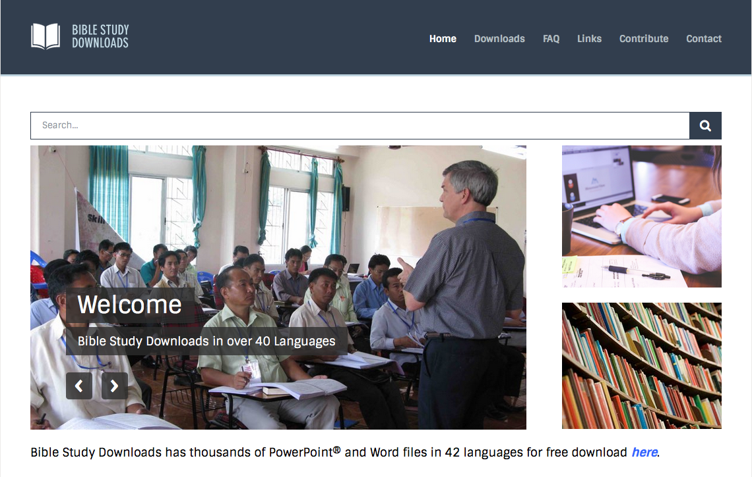

NT Preaching link at BibleStudyDownloads.org
Get this presentation for free!
Notes:
NT Preaching (np)

