Slide 1
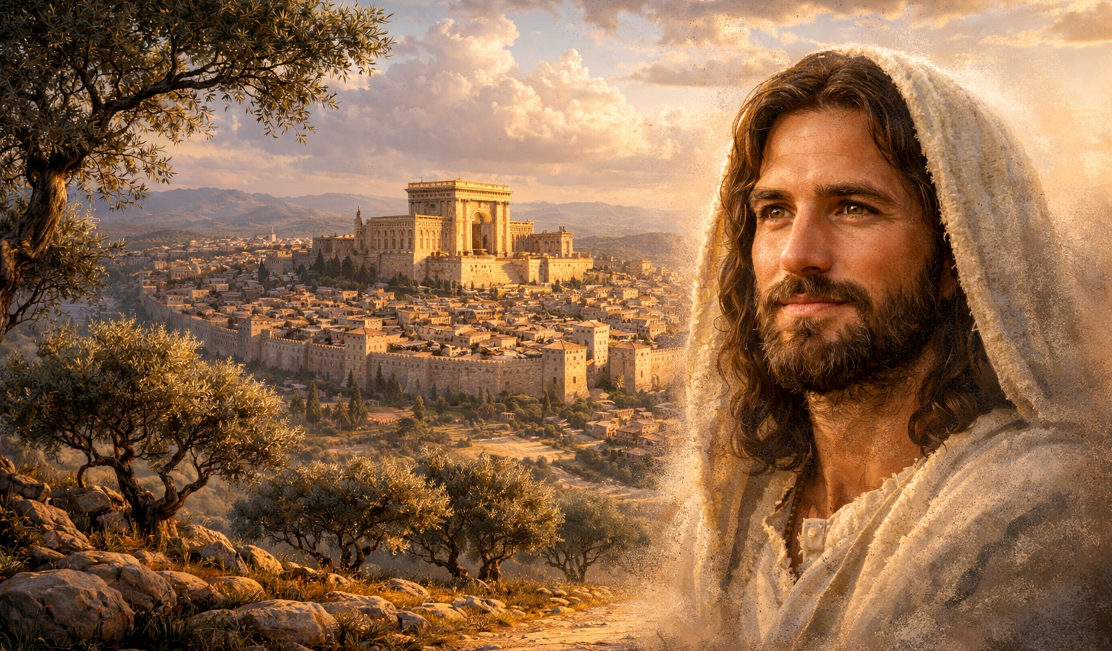
The Gospel of
Luke
Luke 5:1-11
Making Fishers of Men
Preached by Dan Bridges
Amman International Church, Jordan (AmmanChurch.org)
Uploaded by Dr. Rick Griffith • Jordan Evangelical Theological Seminary
Files in many languages for free download at BibleStudyDownloads.org

Slide 2
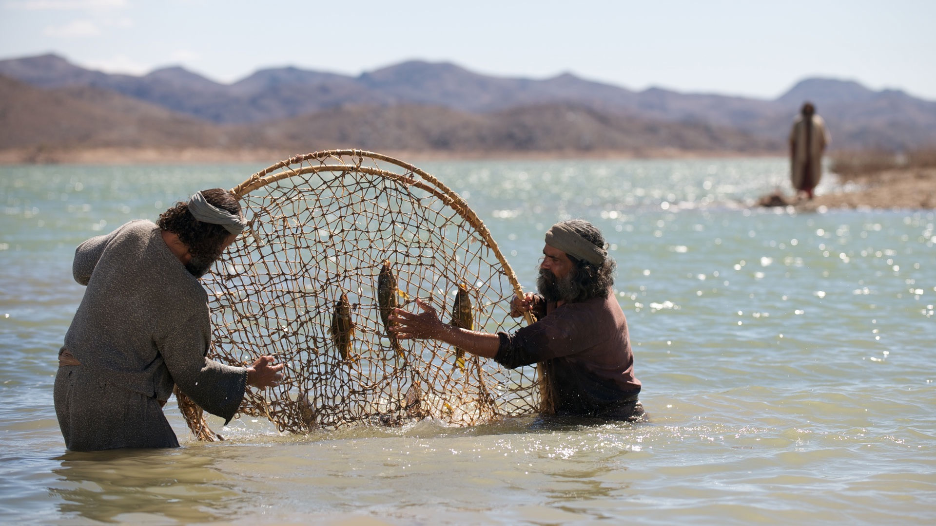
Making fishers of men… How did Jesus do this?
What did he teach them?
What did he model for them?
What practical experience did he give them?
“While walking by the Sea of Galilee, he saw two brothers, Simon and Andrew his brother, casting a net into the sea, for they were fishermen. And he said to them, “Follow me, and I will make you fishers of men.” Matthew 4:18-19
Notes:
They camped at Rephidim …

Slide 3
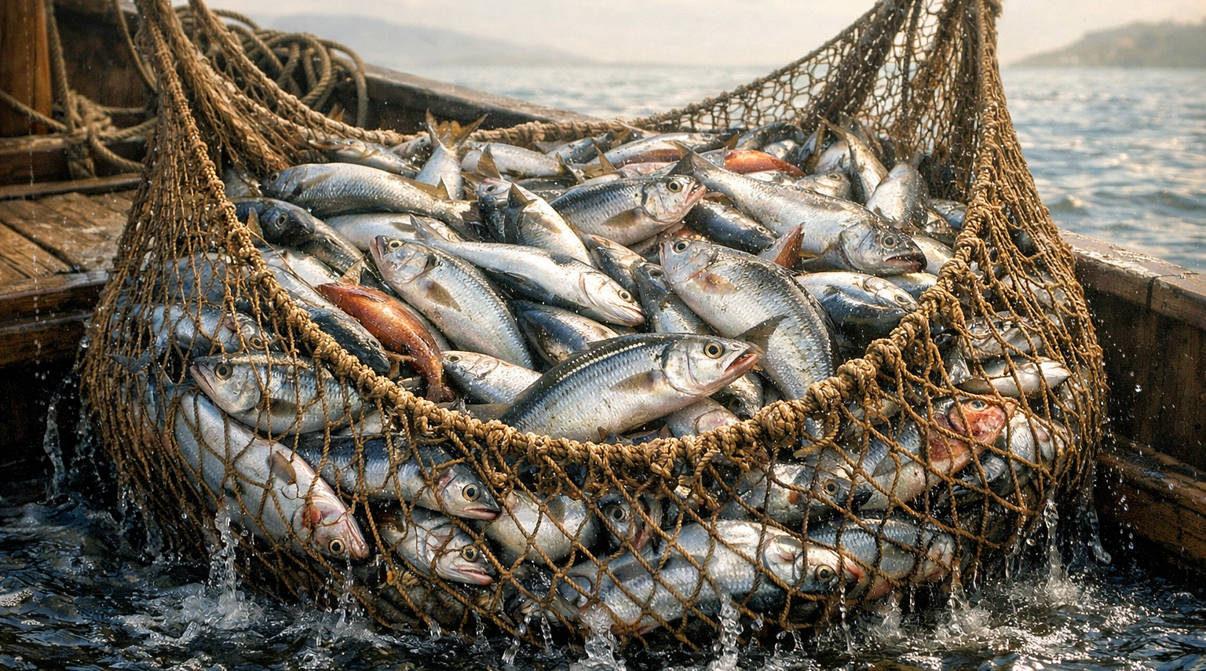
What important truths did Jesus want them to see?
Luke 5:1-11 is a living parable!
Jesus was giving them a picture of what it means to fish for men!

Slide 4
Luke 5:1-11 – Making Fishers of Men
The Role of Teaching (1-3)
The Role of Faith (4-7)
The Role of Brokenness (8-10)
The Role of Following (11)

Slide 5
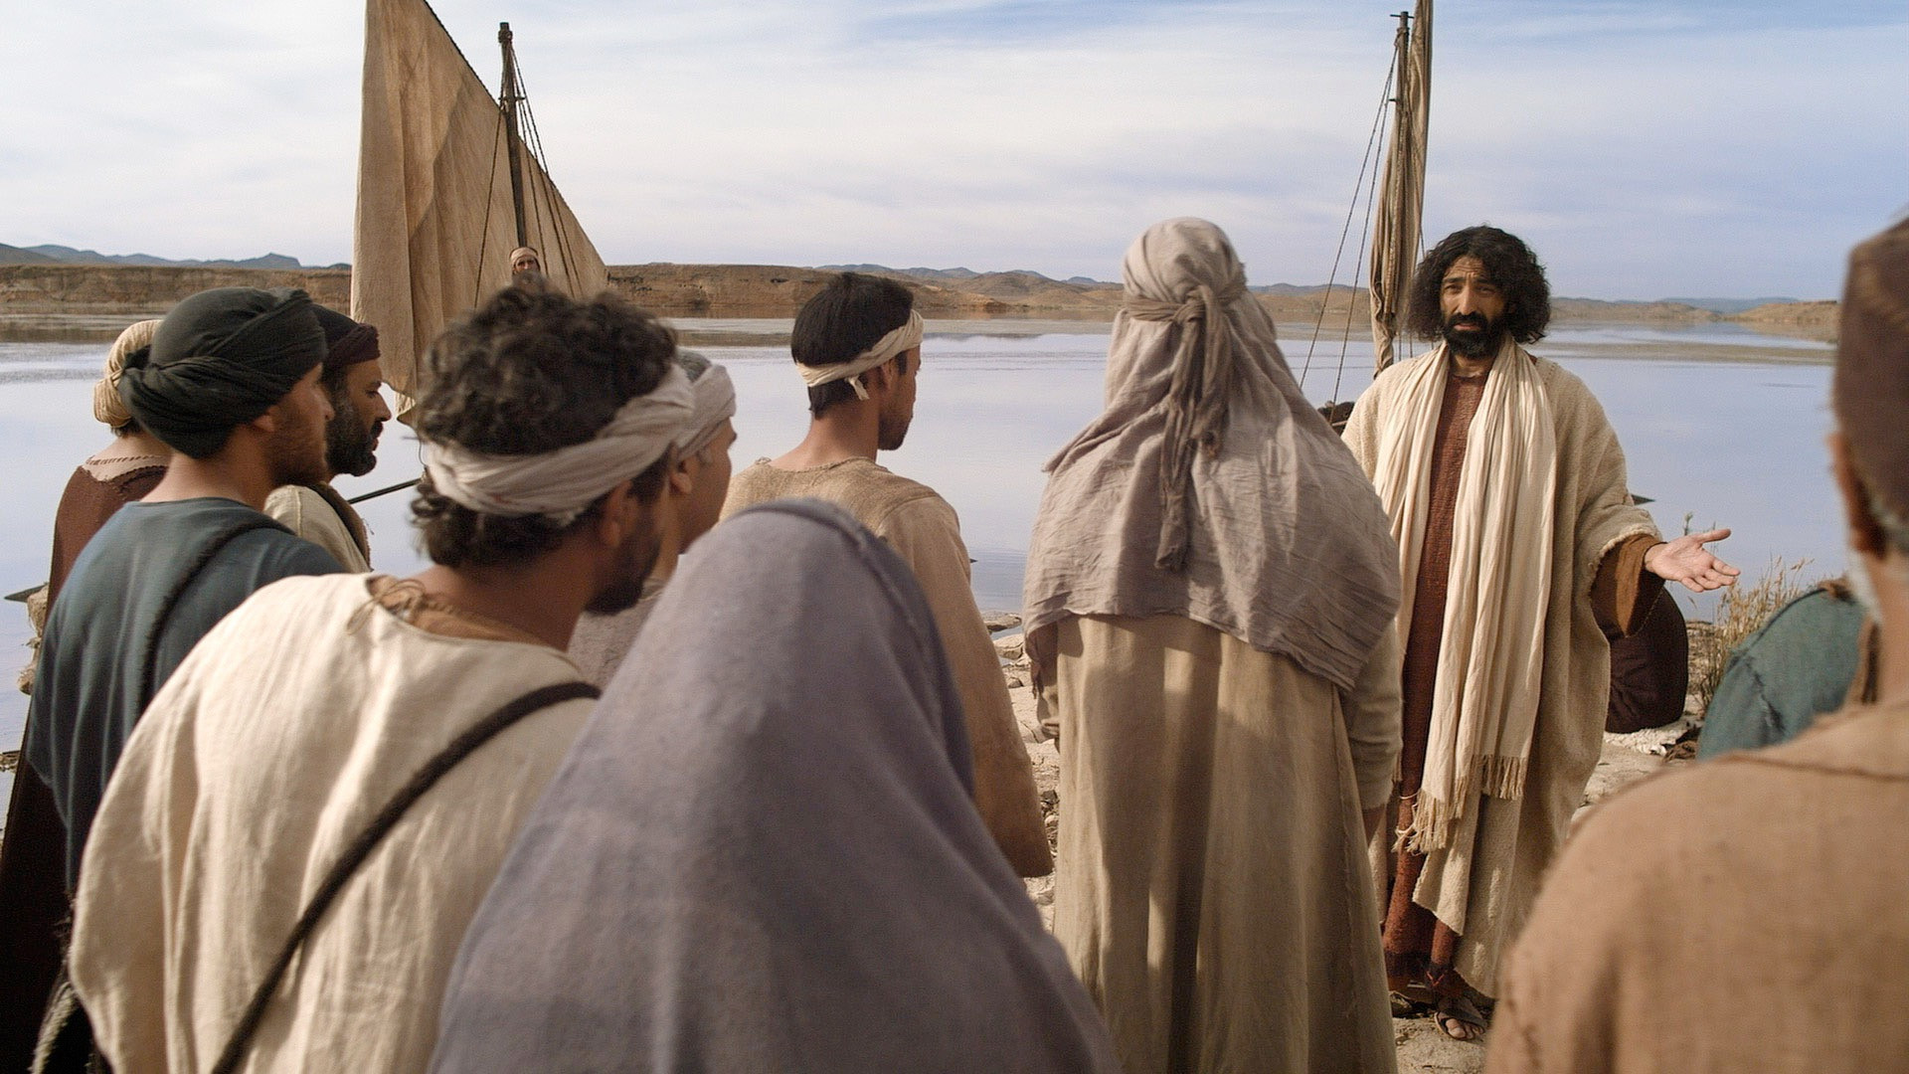
“On one occasion, while the crowd was pressing in on him to hear the word of God, he was standing by the lake of Gennesaret,” Luke 5:1

Slide 6
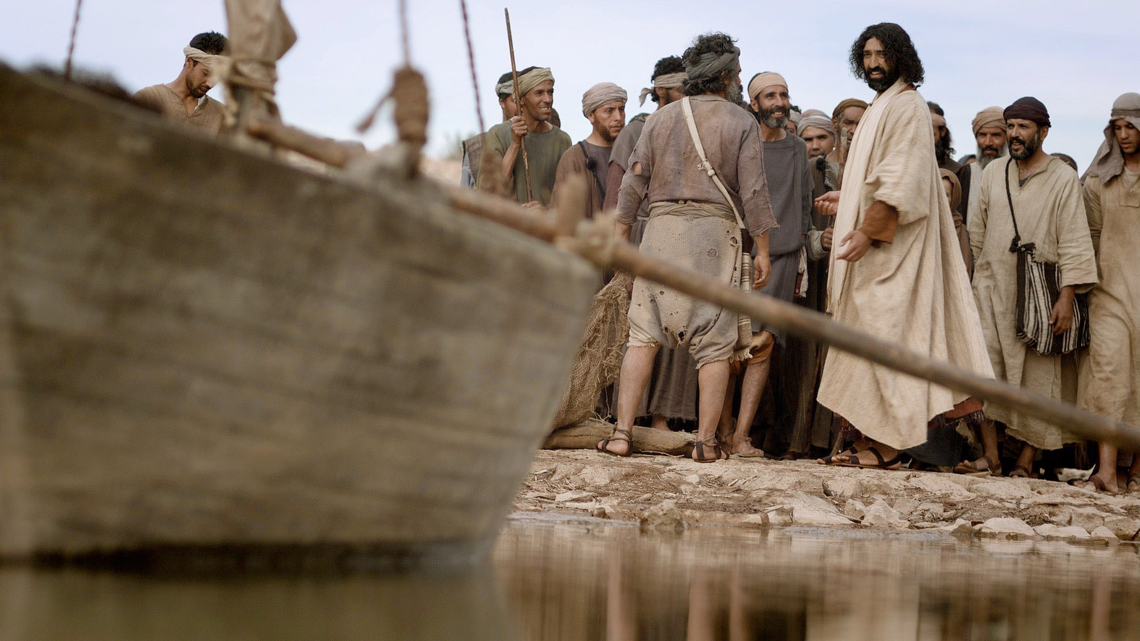
“and he saw two boats by the lake, but the fishermen had gone out of them and were washing their nets.”
Luke 5:2

Slide 7
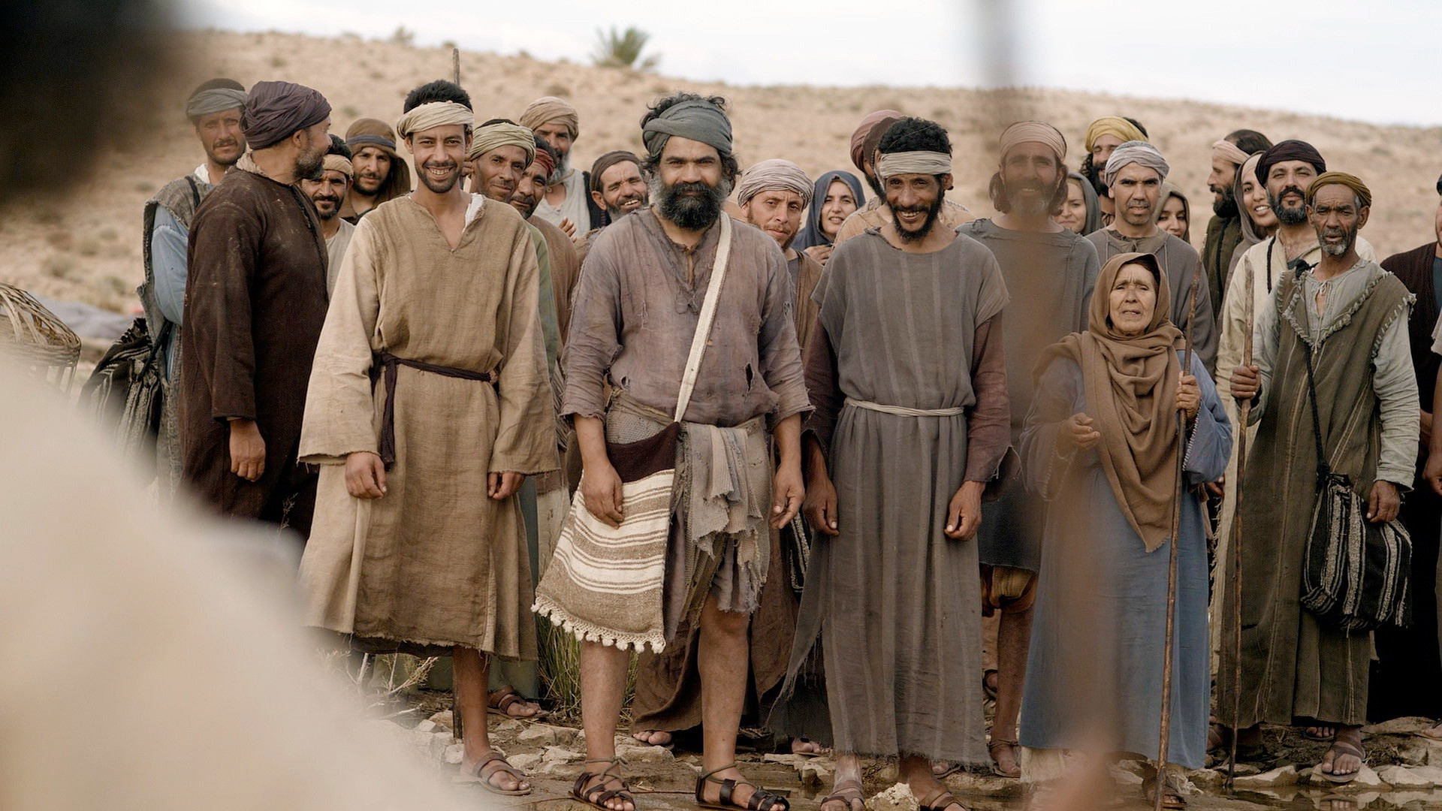
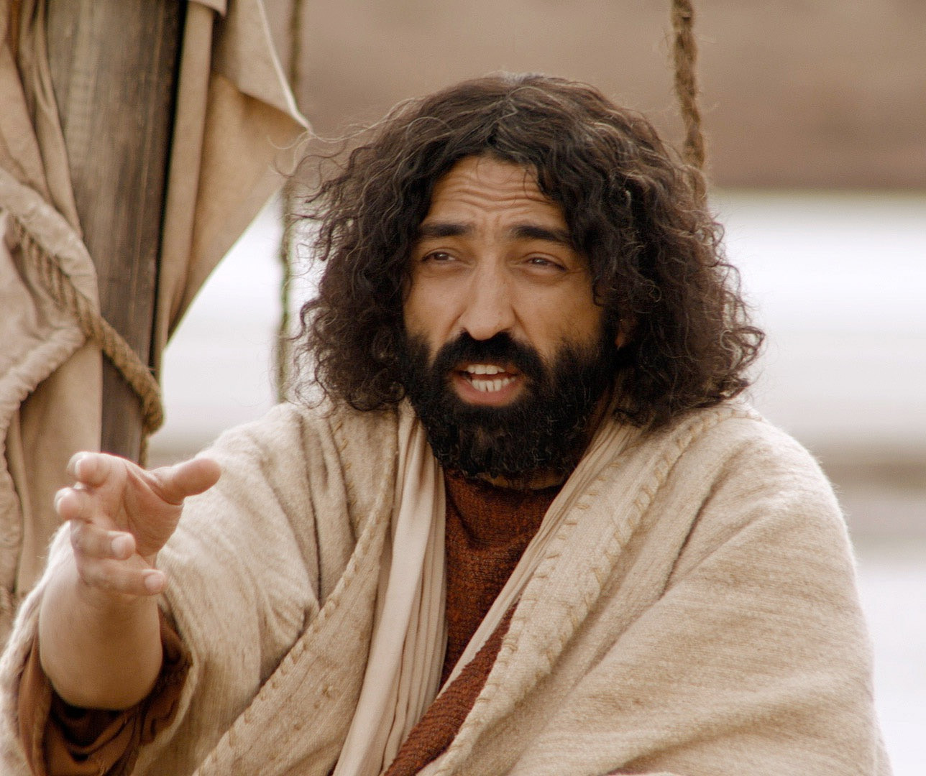
“Getting into one of the boats, which was Simon's, he asked him to put out a little from the land. And he sat down and taught the people from the boat.” Luke 5:3

Slide 8
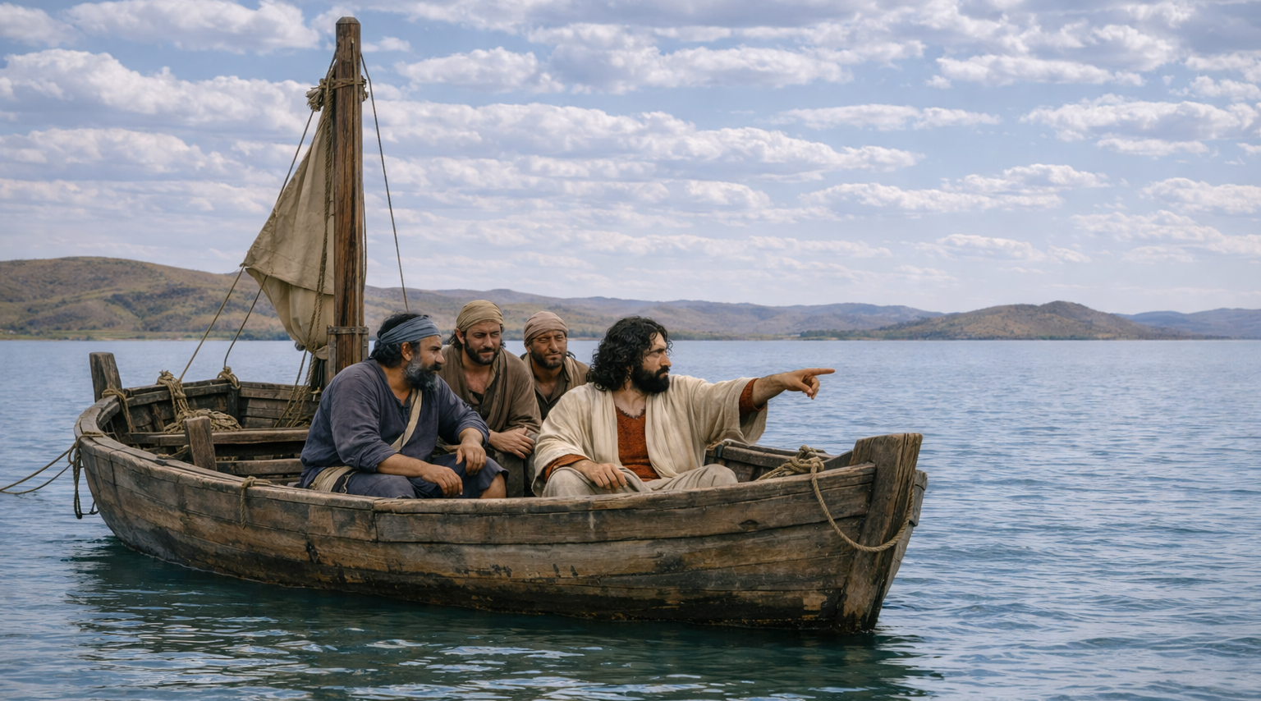
“And when he had finished speaking, he said to Simon, ‘Put out into the deep and let down your nets for a catch.’”
Luke 5:4

Slide 9
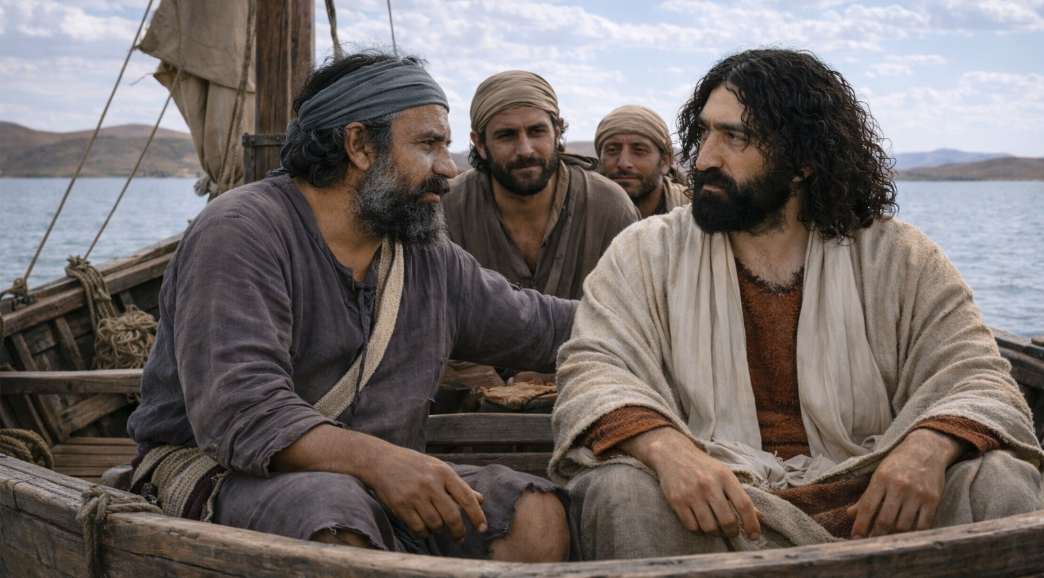
“And Simon answered, “Master, we toiled all night and took nothing! But at your word I will let down the nets.”
Luke 5:5

Slide 10
“And when they had done this, they enclosed a large number of fish, and their nets were breaking.” Luke 5:6

Slide 11
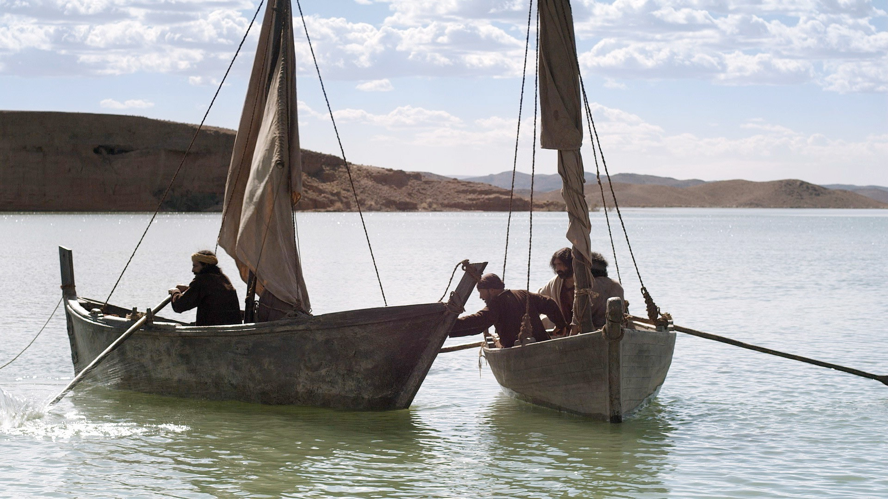
“They signaled to their partners in the other boat to come and help them. And they came and filled both the boats, so that they began to sink.” Luke 5:7

Slide 12
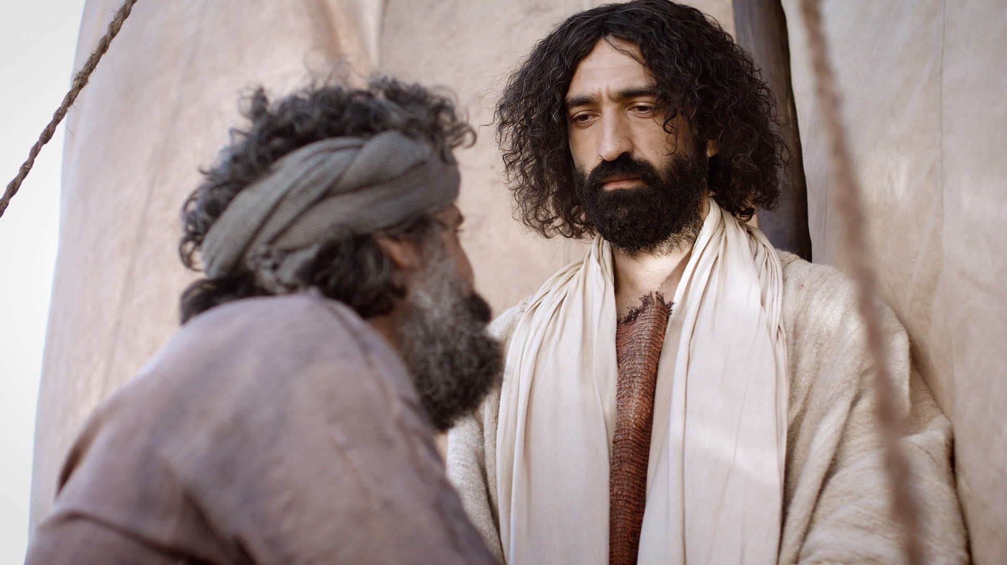
“But when Simon Peter saw it, he fell down at Jesus' knees, saying, ‘Depart from me, for I am a sinful man, O Lord.’” Luke 5:8

Slide 13
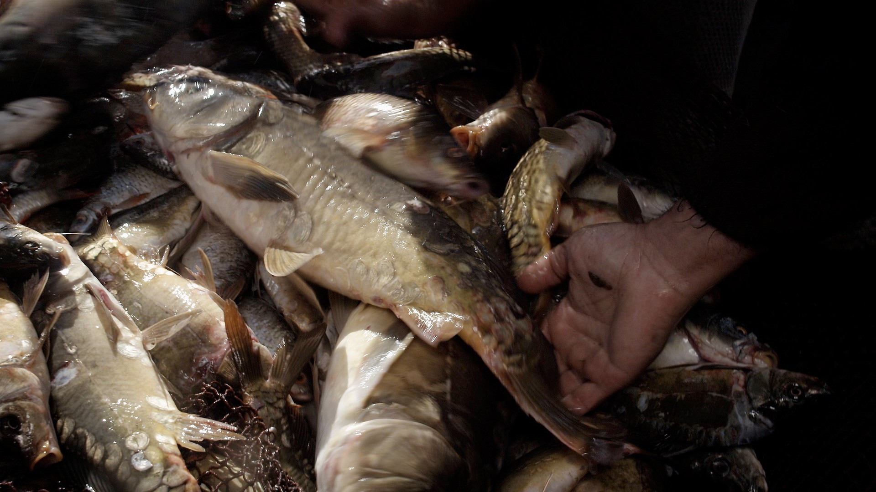
“For he and all who were with him were astonished at the catch of fish that they had taken, and so also were James and John, sons of Zebedee, who were partners with Simon.” Luke 5:9-10a

Slide 14
“And Jesus said to Simon, ‘Do not be afraid; from now on you will be catching men.’” Luke 5:10b

Slide 15
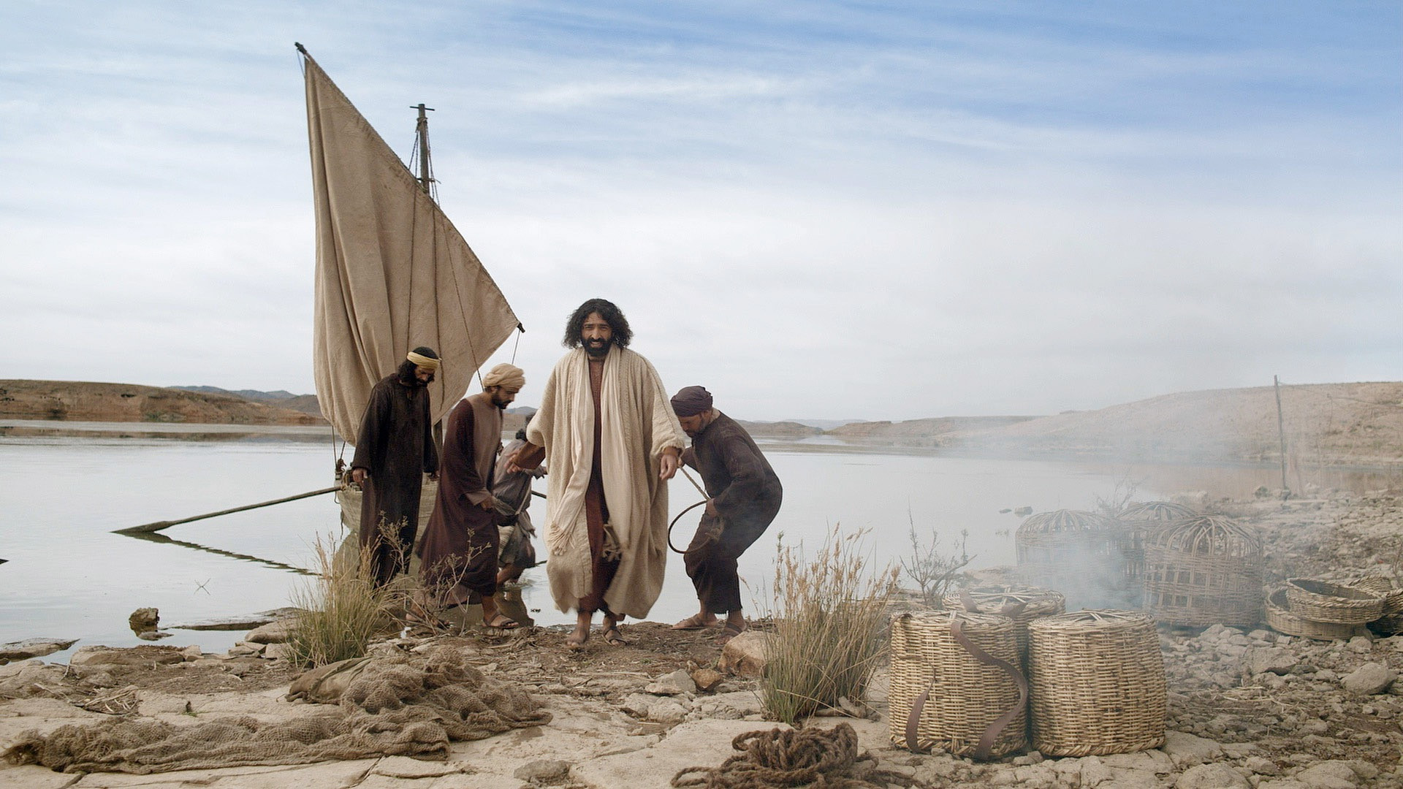
“And when they had brought their boats to land, they left everything and followed him.” Luke 5:11

Slide 16
Luke 5:1-11 – Making Fishers of Men
The Role of Teaching (1-3)
The Role of Faith (4-7)
The Role of Brokenness (8-10)
The Role of Following (11)

Slide 17
In Jesus’ mind, what was he doing at this point?
He was fishing for men!!!
“On one occasion, while the crowd was pressing in on him to hear the word of God, he was standing by the lake of Gennesaret,” Luke 5:1

Slide 18
He was out where the ordinary people were
He was teaching them God’s word
“On one occasion, while the crowd was pressing in on him to hear the word of God, he was standing by the lake of Gennesaret,” Luke 5:1

Slide 19
Where do we need to go to be with ordinary people today?
What does it look like to teach ordinary people today?

Slide 20
What truths about the Kingdom of God do the ordinary people around you need to hear?
They need to hear about Jesus – his teachings, his miracles, his forgiveness of sin, his death and resurrection
Bible stories and parables
Character of the God of the Bible – his power, his love, his faithfulness, his justice…
Inadequacy of our own “good works”

Slide 21
“and he saw two boats by the lake, but the fishermen had gone out of them and were washing their nets.”
Luke 5:2

Slide 22
Now Jesus is “fishing” from a boat! He’s setting up the living parable!
“Getting into one of the boats, which was Simon's, he asked him to put out a little from the land. And he sat down and taught the people from the boat.” Luke 5:3

Slide 23
Luke 5:1-11 – Making Fishers of Men
The Role of Teaching (1-3)
The Role of Faith (4-7)
The Role of Brokenness (8-10)
The Role of Following (11)

Slide 24
“Put down your nets for a catch!”
“And when he had finished speaking, he said to Simon, ‘Put out into the deep and let down your nets for a catch.’”
Luke 5:4

Slide 25
From Simon’s perspective, what did Jesus have “wrong”?
Best fishing was nearer the shore – not in the deep
Best fishing was at night
This followed the fruitless “all night long” attempts of experienced fishermen
“And when he had finished speaking, he said to Simon, ‘Put out into the deep and let down your nets for a catch.’”
Luke 5:4

Slide 26
Clearly, this was the wrong place, the wrong time and the wrong way to catch fish!
“And when he had finished speaking, he said to Simon, ‘Put out into the deep and let down your nets for a catch.’”
Luke 5:4

Slide 27
“And Simon answered, “Master, we toiled all night and took nothing! But at your word I will let down the nets.”
Luke 5:5

Slide 28
“With all due respect, this is never going to work!”
“And Simon answered, “Master, we toiled all night and took nothing! But at your word I will let down the nets.”
Luke 5:5

Slide 29
“I’ll do it – not because it’s going to work – but because it’s what you want…”
“And Simon answered, “Master, we toiled all night and took nothing! But at your word I will let down the nets.”
Luke 5:5

Slide 30
In spite of his weak faith, Peter experienced a blessing he could not have imagined – simply because he obeyed!
“And when they had done this, they enclosed a large number of fish, and their nets were breaking.” Luke 5:6

Slide 31
Why did they catch all these fish?
What made it work?
“And when they had done this, they enclosed a large number of fish, and their nets were breaking.” Luke 5:6

Slide 32
How about us? How do we respond when Jesus asks us to fish for people at times, places and settings where it “won’t work”?
“And Simon answered, “Master, we toiled all night and took nothing! But at your word I will let down the nets.”
Luke 5:5

Slide 33
Are there times you sense the Holy Spirit prompting you to engage with people or say something, but it doesn’t “make sense”?
“And Simon answered, “Master, we toiled all night and took nothing! But at your word I will let down the nets.”
Luke 5:5

Slide 34
Fishing for men means depending, in faith, on the power of Christ rather than on ourselves!
“And Simon answered, “Master, we toiled all night and took nothing! But at your word I will let down the nets.”
Luke 5:5

Slide 35
Luke 5:1-11 – Making Fishers of Men
The Role of Teaching (1-3)
The Role of Faith (4-7)
The Role of Brokenness (8-10)
The Role of Following (11)

Slide 36
If you simply think about how we tend to respond to God’s blessings, how would you have expected Simon to respond?
“And when they had done this, they enclosed a large number of fish, and their nets were breaking.” Luke 5:6

Slide 37
We tend to “focus on the fish”!
I now have financial security!
We’ve found a technique that works! Let’s develop it!
Jesus is a great asset to my plans!

Slide 38
Simon had seen Jesus…
Turn water into wine
Cast out demons
Heal his mother-in-law
Heal uncounted numbers of people
What was different this time?
“But when Simon Peter saw it, he fell down at Jesus' knees, saying, ‘Depart from me, for I am a sinful man, O Lord.’” Luke 5:8

Slide 39
Peter was confronted with the divinity of Jesus in a way that had never happened before – and it terrified him!
“But when Simon Peter saw it, he fell down at Jesus' knees, saying, ‘Depart from me, for I am a sinful man, O Lord.’” Luke 5:8

Slide 40
“Woe is me! For I am lost; for I am a man of unclean lips, and I dwell in the midst of a people of unclean lips; for my eyes have seen the King, the LORD of hosts!” Isaiah 6:5

Slide 41
“I had heard of you by the hearing of the ear,
but now my eye sees you;
therefore I despise myself,
and repent in dust and ashes.” Job 42:5-6

Slide 42
“Blessed are the poor in spirit, for theirs is the kingdom of heaven.” Matthew 5:3

Slide 43
Now that Simon saw himself for who he really was, he was ready to serve Jesus!
“And Jesus said to Simon, ‘Do not be afraid; from now on you will be catching men.’” Luke 5:10b

Slide 44
Spiritual brokenness is an essential part of becoming a fisher of men!
“And Jesus said to Simon, ‘Do not be afraid; from now on you will be catching men.’” Luke 5:10b

Slide 45
Luke 5:1-11 – Making Fishers of Men
The Role of Teaching (1-3)
The Role of Faith (4-7)
The Role of Brokenness (8-10)
The Role of Following (11)

Slide 46
What did they leave behind?
The miraculous catch of fish!
Their business, their boat, their lives as they knew them
“And when they had brought their boats to land, they left everything and followed him.” Luke 5:11

Slide 47
What would have motivated this?
Probably not their love of “the fish”!
Jesus had captivated and captured their hearts!
They realized, deep down, that nothing else in their lives compared with Jesus!
What seemed impossible now seemed doable!
“And when they had brought their boats to land, they left everything and followed him.” Luke 5:11

Slide 48
“So therefore, any one of you who does not renounce all that he has cannot be my disciple.” Luke 14:33
Does Jesus have your whole heart and life? Or are there some areas you are still maintaining control over?
“And when they had brought their boats to land, they left everything and followed him.” Luke 5:11

Slide 49
Luke 5:1-11 – Making Fishers of Men
The Role of Teaching (1-3)
The Role of Faith (4-7)
The Role of Brokenness (8-10)
The Role of Following (11)

Slide 50
What important truths did Jesus want them to see?
Luke 5:1-11 is a living parable!
Jesus was giving them a picture of what it means to fish for men!

Slide 51
Where are you in your journey of becoming a fisher of men?
Have you chosen to follow Jesus yourself?
Do you sense resistance within yourself? Identify why.
Are you facing challenges? How can you move forward?
How can we do this together?
Jesus called them to follow him.
Jesus modeled being with ordinary people.
Jesus modeled teaching – in many ways and settings.
Jesus called them to exercise faith – God brings fish!
Jesus revealed his divinity – exposing spiritual poverty.
Jesus showed them that God’s plan is for abundance!

Slide 52
Sermon by Dan Bridges
Amman International Church (AIC)
Amman, Jordan
This and most other AIC sermons can be found on the church website:
ammanchurch.org

Slide 53
Black

Slide 54


NT Preaching link at BibleStudyDownloads.org
Get this presentation for free!
Notes:
NT Preaching (np)

