Slide 1
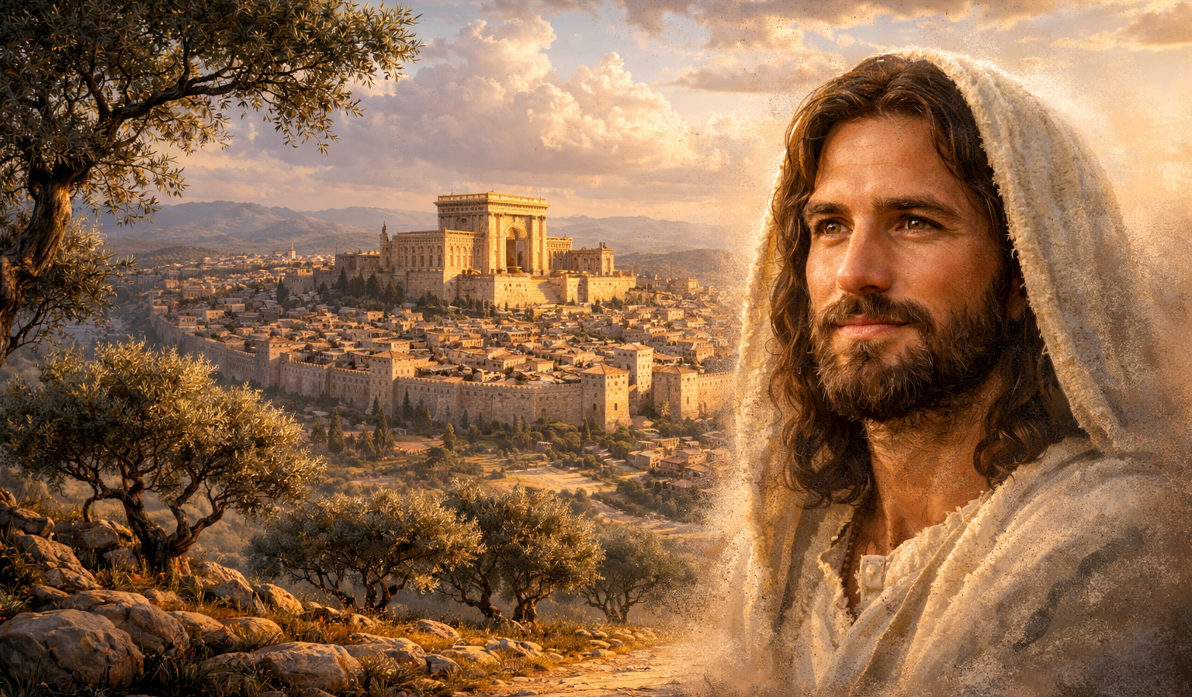
The Gospel of
Luke
Luke 3:23-4:4
Realities of Humanity!
Preached by Dan Bridges
Amman International Church, Jordan (AmmanChurch.org)
Uploaded by Dr. Rick Griffith • Jordan Evangelical Theological Seminary
Files in many languages for free download at BibleStudyDownloads.org

Slide 2
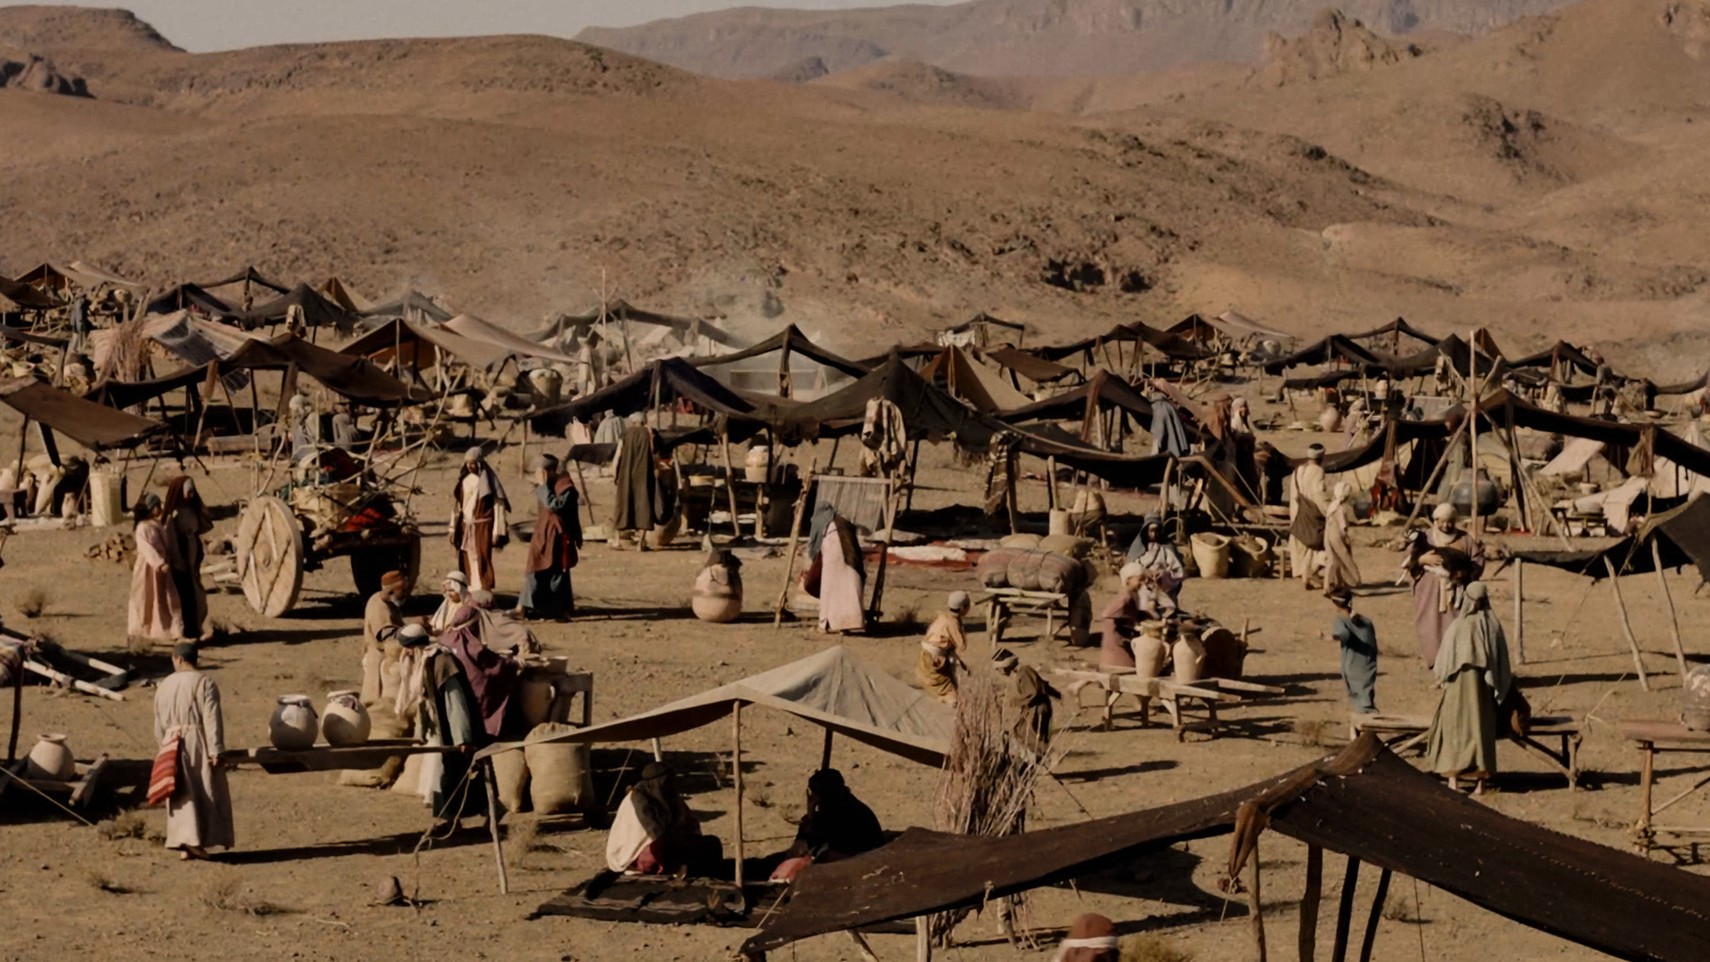
Why did the Israelites spend 40 years in the wilderness? What was their sin?

Slide 3
Refusal to enter the land… But why did they refuse?
“And the LORD said to Moses, ‘How long will this people despise me? And how long will they not believe in me, in spite of all the signs that I have done among them?’” Numbers 14:11
Unbelief – They didn’t trust God!

Slide 4
What about us?
Would you have entered the land?
What is our trust-level in God like?

Slide 5
Luke 1:5 – 4:13 – An Orderly Account!
 | John’s Story | Jesus’ Story
1:5-25
1:26-38
1:39-56
1:57-80
2:1-52
3:1-20
3:21-4:13
John’s Birth Foretold
Jesus’ Birth Foretold
Mary and Elizabeth Together
John’s Birth
Jesus’ Birth & Boyhood
John Prepares the Way
Jesus is Prepared

Slide 6
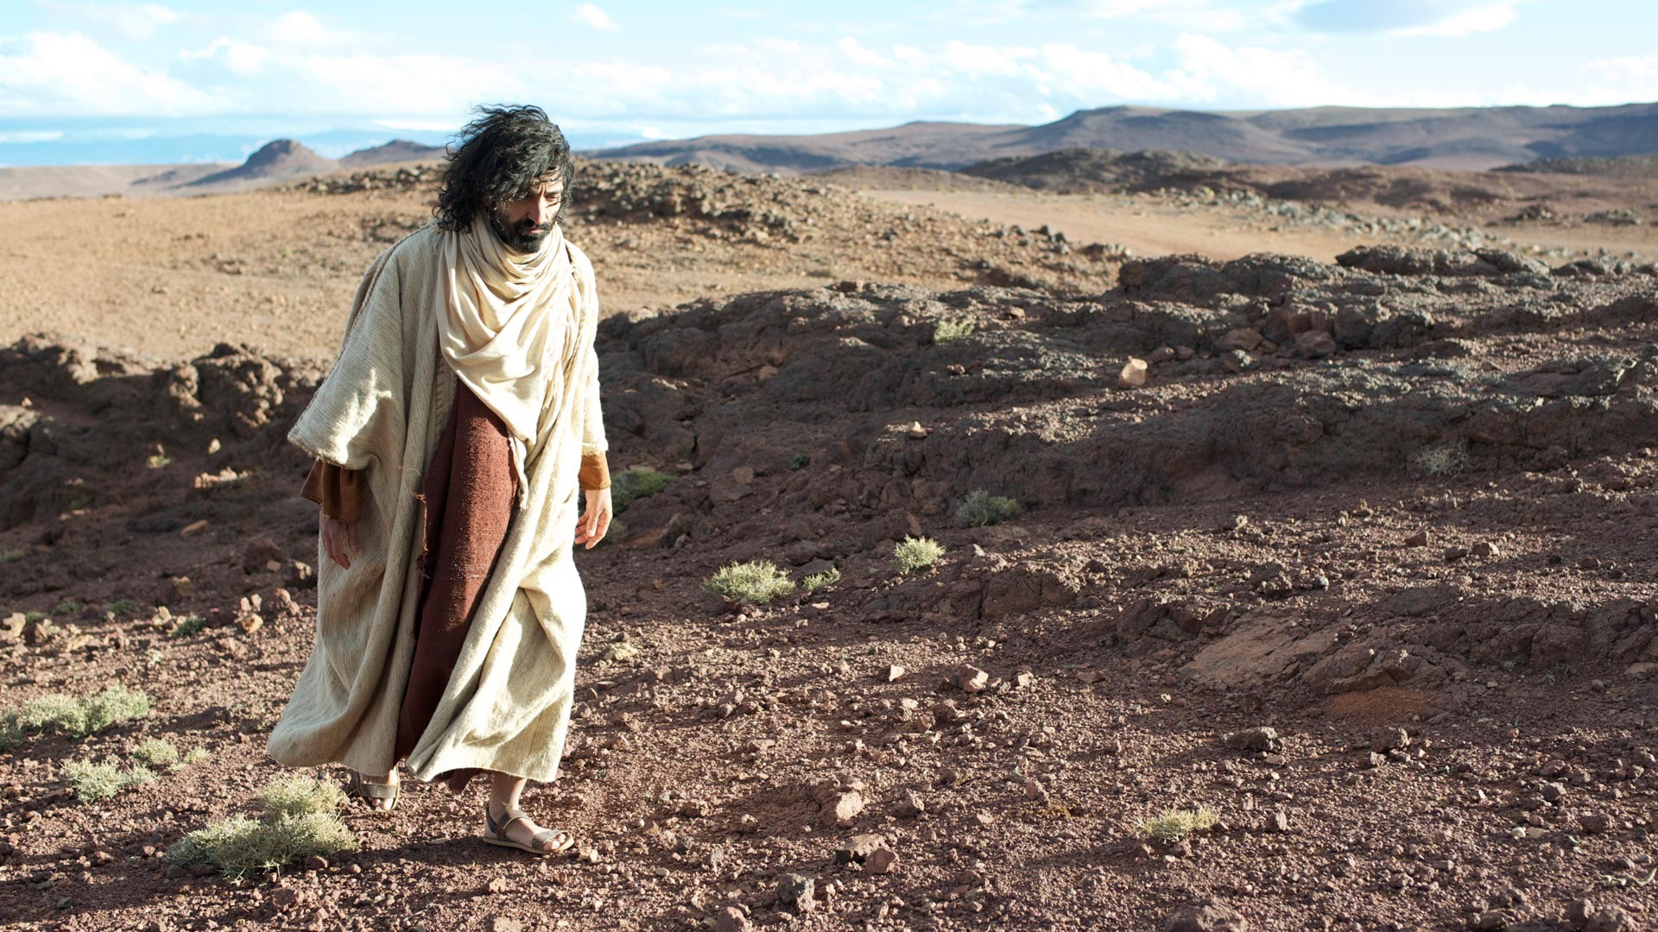
Realities of Humanity! – Luke 3:23-4:4
Jesus – the Son of Man (3:23-38)
Man Does not Live by Bread Alone (4:1-4)
How Man is Tempted

Slide 7
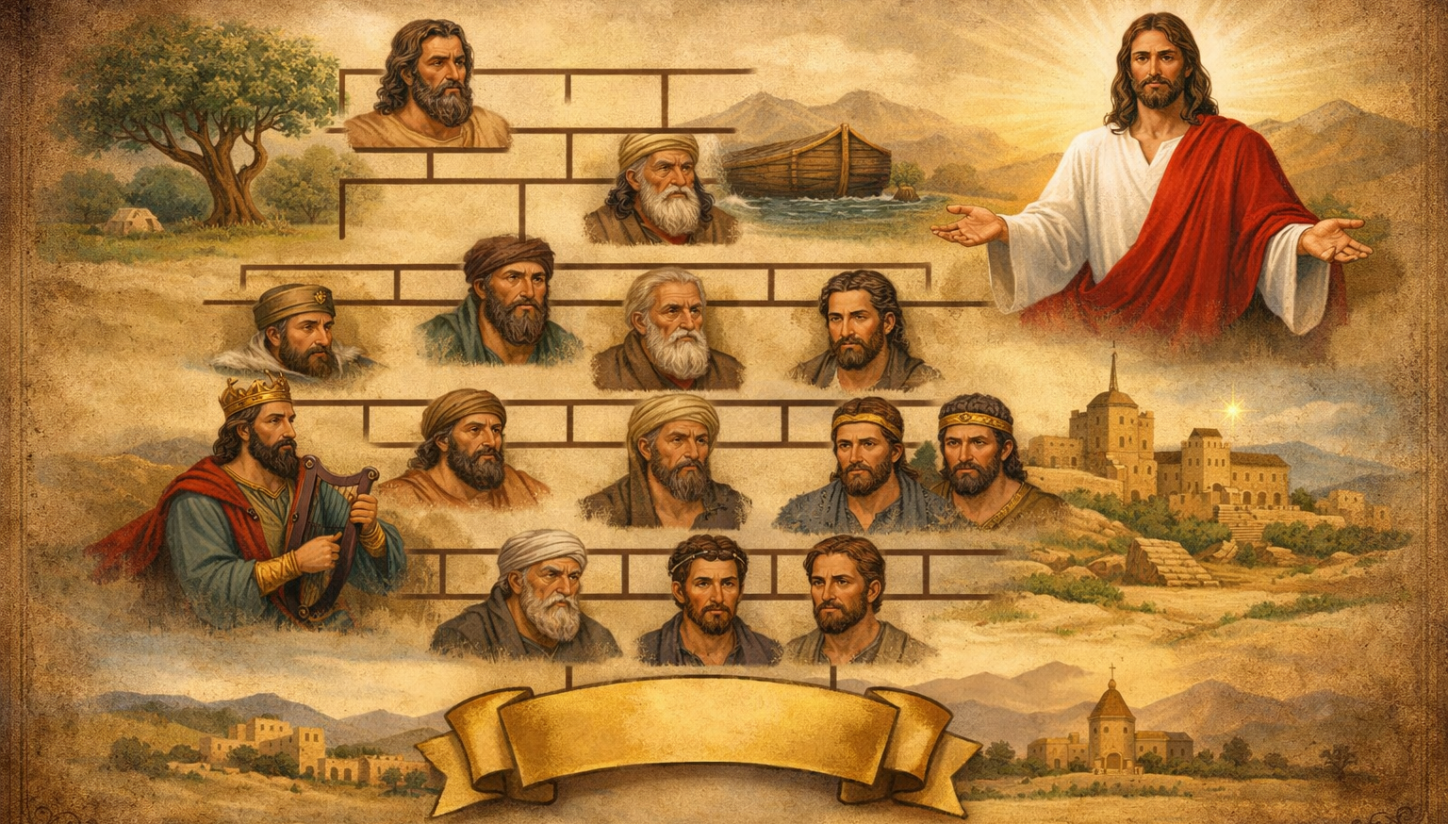
Adam
Luke 3:23-38 – The Genealogy of Jesus
Jesus

Slide 8
Adam
“Jesus, when he began his ministry, was about thirty years of age, being the son (as was supposed) of Joseph, the son of Heli, the son of Matthat…
…the son of Enos, the son of Seth, the son of Adam, the son of God.” Luke 3:23-38
Why a genealogy at this point?
Jesus

Slide 9
Adam
Luke 3:22 – Jesus is the Son of God (divine identity)
Luke 3:23-38 – Jesus is the Son of Adam (human identity)
Jesus

Slide 10
Adam
The Messianic Identity of Jesus:
Descendant of Adam
Descendant of Abraham
Descendant of David
Jesus

Slide 11
Adam
Why is this significantly different from the genealogy of Jesus in Matthew 1?
Jesus

Slide 12
Adam
“…Jacob the father of Joseph the husband of Mary, of whom Jesus was born, who is called Christ.” Matthew 1:16
“Jesus, when he began his ministry, was about thirty years of age, being the son (as was supposed) of Joseph, the son of Heli, the son of Matthat…” Luke 3:23
Jesus

Slide 13
Adam
Why is this significantly different from the genealogy of Jesus in Matthew 1?
Prominent view:
Matthew records genealogy of Joseph
Luke records genealogy of Mary
Jesus

Slide 14
Adam
“Jesus, when he began his ministry, was about thirty years of age, being the son (as was supposed) of Joseph, the son of Heli, the son of Matthat…
is read as…
“…being the son (as was supposed) of Joseph, [but was actually the grandson of Heli (Mary's father)]…”
Jesus

Slide 15
Realities of Humanity! – Luke 3:23-4:4
Jesus – the Son of Man (3:23-38)
Man Does not Live by Bread Alone (4:1-4)
How Man is Tempted

Slide 16
“And Jesus, full of the Holy Spirit, returned from the Jordan and was led by the Spirit in the wilderness for forty days, being tempted by the devil.” Luke 4:1-2a

Slide 17
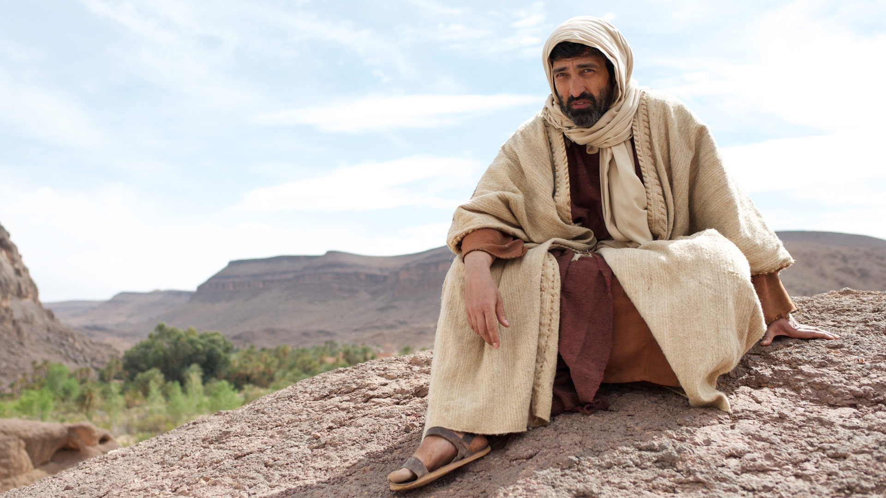
“And he ate nothing during those days. And when they were ended, he was hungry.” Luke 4:2b

Slide 18

“The devil said to him, ‘If you are the Son of God, command this stone to...’” Luke 4:3

Slide 19
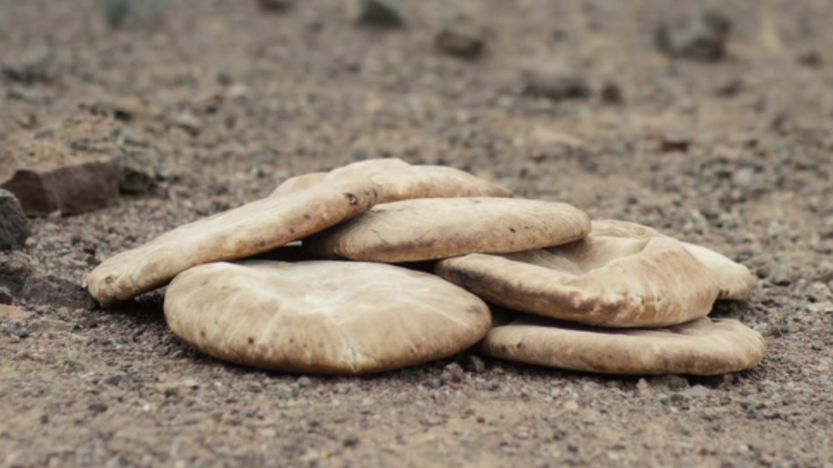
“The devil said to him, ‘If you are the Son of God, command this stone to become bread.’” Luke 4:3

Slide 20
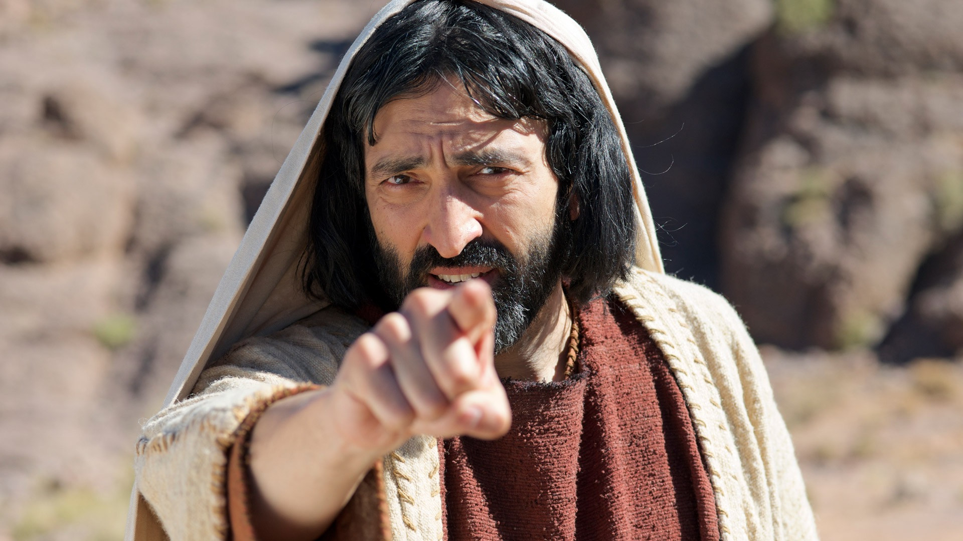
“And Jesus answered him, ‘It is written, “Man shall not live by bread alone.”’” Luke 4:4

Slide 21
As a human, Jesus needed the power of the Spirit!
“and the Holy Spirit descended on him in bodily form, like a dove; and a voice came from heaven, ‘You are my beloved Son; with you I am well pleased.’” Luke 3:22
“And Jesus, full of the Holy Spirit, returned from the Jordan and was led by the Spirit in the wilderness for forty days, being tempted by the devil.” Luke 4:1-2a

Slide 22
“you yourselves know what happened throughout all Judea, beginning from Galilee after the baptism that John proclaimed: how God anointed Jesus of Nazareth with the Holy Spirit and with power. He went about doing good and healing all who were oppressed by the devil, for God was with him.” Acts 10:37-38

Slide 23
As a human, Jesus lived his life under the guidance of the Spirit!
“And Jesus, full of the Holy Spirit, returned from the Jordan and was led by the Spirit in the wilderness for forty days, being tempted by the devil.” Luke 4:1-2a

Slide 24
“And Jesus, full of the Holy Spirit, returned from the Jordan and was led by the Spirit in the wilderness for forty days, being tempted by the devil.” Luke 4:1-2a

Slide 25
Why did he not eat?
He was following the leading of the Spirit – and the Spirit had not provided any food!
“And he ate nothing during those days. And when they were ended, he was hungry.” Luke 4:2b

Slide 26
Similarity to the Israelite’s wilderness wanderings?
God also led them into the wilderness without food or drink!
“And he ate nothing during those days. And when they were ended, he was hungry.” Luke 4:2b

Slide 27
This was a time of weakness for Jesus!
“And he ate nothing during those days. And when they were ended, he was hungry.” Luke 4:2b

Slide 28
Satan apparently actually appeared to Jesus
“The devil said to him, ‘If you are the Son of God, command this stone to...’” Luke 4:3

Slide 29
As with Eve, Satan’s goal was to create doubt!
“The devil said to him, ‘If you are the Son of God, command this stone to...’” Luke 4:3

Slide 30
“The devil said to him, ‘If you are the Son of God, command this stone to...’” Luke 4:3

Slide 31
Why would this have been sinful?
Jesus fed 5000 & 4000 in a similar way!
“The devil said to him, ‘If you are the Son of God, command this stone to become bread.’” Luke 4:3

Slide 32
Why did Jesus pick this verse?
“And Jesus answered him, ‘It is written, “Man shall not live by bread alone.”’” Luke 4:4

Slide 33
“The whole commandment that I command you today you shall be careful to do…
…the LORD your God has led you these forty years in the wilderness, that he might humble you, testing you to know what was in your heart, whether you would keep his commandments or not.
Deuteronomy 8:1-3
The purpose of the difficult time in the wilderness was to teach them trust and obedience!

Slide 34
“The whole commandment that I command you today you shall be careful to do…
…the LORD your God has led you these forty years in the wilderness, that he might humble you, testing you to know what was in your heart, whether you would keep his commandments or not.
And he humbled you and let you hunger and fed you with manna, which you did not know, nor did your fathers know, that he might make you know that man does not live by bread alone, but man lives by every word that comes from the mouth of the LORD.”
Deuteronomy 8:1-3
God intentionally let them hunger – that they would learn that their lives really depended on him!

Slide 35
Why would this have been sinful?
Jesus would have been bypassing dependence on God’s provision by providing for himself.
“The devil said to him, ‘If you are the Son of God, command this stone to become bread.’” Luke 4:3

Slide 36
Why would this have been sinful?
How could Jesus have told the disciples to go without money, extra clothes, etc. if he himself had not demonstrated trust in God’s provision?
“The devil said to him, ‘If you are the Son of God, command this stone to become bread.’” Luke 4:3

Slide 37
In what ways do we doubt God’s provision?
Finances – now or for the future
Giving time to God and people
Desire for love and relationships
“The devil said to him, ‘If you are the Son of God, command this stone to become bread.’” Luke 4:3

Slide 38
Realities of Humanity! – Luke 3:23-4:4
Jesus – the Son of Man (3:23-38)
Man Does not Live by Bread Alone (4:1-4)
How Man is Tempted

Slide 39
What can we learn about Satan’s temptations?
Satan starts with encouraging us to doubt God
“If God really loved you, you wouldn’t be in this ‘wilderness’!”
“God’s not going to provide for that need – you’ll have to take care of yourself!”
“If you were really a Christian, you’d be able to…”
“The devil said to him, ‘If you are the Son of God, command this stone to become bread.’” Luke 4:3
Notes:
ou

Slide 40
Why would this have been sinful?
Jesus would have been bypassing dependence on God’s provision by providing for himself.
We probably had to think about this question… Satan already knew how it would harm Jesus to do this!
“The devil said to him, ‘If you are the Son of God, command this stone to become bread.’” Luke 4:3

Slide 41
What can we learn about Satan’s temptations?
Satan knows better than us what God requires of us
and what will harm our relationship with him!
“The devil said to him, ‘If you are the Son of God, command this stone to become bread.’” Luke 4:3
Notes:
ou

Slide 42
What can we learn about Satan’s temptations?
Satan knows better than us what God requires of us
and what will harm our relationship with him!
Making decisions without seeking God’s will
More subtle sins like pride, complaining or discontent, unforgiveness
Justifying anger or ill-treatment of people by their actions toward us
“The devil said to him, ‘If you are the Son of God, command this stone to become bread.’” Luke 4:3
Notes:
ou

Slide 43
What can we learn about Satan’s temptations?
Satan knows our weaknesses better than us!
He used Jesus’ hunger – a potential weakness
He sees our tiredness, our anger, what makes us anxious, things we complain about
He knows human nature – the things we long for, feel insecure about – or are arrogant of
“The devil said to him, ‘If you are the Son of God, command this stone to become bread.’” Luke 4:3
Notes:
ou

Slide 44
What can we learn about Satan’s temptations?
Many times, temptations don’t seem blatantly
wrong – they actually seem to make sense!
He knows that, while I may not give in to murder, I may be open to small acts of revenge
He uses society to make sins seem “normal”
He encourages unbelief – distrust in God’s Word
“The devil said to him, ‘If you are the Son of God, command this stone to become bread.’” Luke 4:3
Notes:
ou

Slide 45
What can we learn about Satan’s temptations?
Satan starts with encouraging us to doubt God
Satan knows better than us what God requires of us
and what will harm our relationship with him!
Satan knows our weaknesses better than us!
Many times, temptations don’t seem blatantly
wrong – they actually seem to make sense!
“The devil said to him, ‘If you are the Son of God, command this stone to become bread.’” Luke 4:3
Notes:
ou

Slide 46
“Be sober-minded; be watchful. Your adversary the devil prowls around like a roaring lion, seeking someone to devour.” 1 Peter 5:8
“The devil said to him, ‘If you are the Son of God, command this stone to become bread.’” Luke 4:3
Notes:
ou

Slide 47
What chance do we have against an adversary like this – one who is far smarter and more powerful than we are?
“Submit yourselves therefore to God. Resist the devil, and he will flee from you.” James 4:7
Why? Jesus has already defeated him!
“The devil said to him, ‘If you are the Son of God, command this stone to become bread.’” Luke 4:3
Notes:
ou

Slide 48
Realities of Humanity! – Luke 3:23-4:4
Jesus – the Son of Man (3:23-38)
Man Does not Live by Bread Alone (4:1-4)
How Man is Tempted

Slide 49
What about us?
Would you have entered the land?
What is our trust-level in God like?

Slide 50
Refusal to enter the land… But why did they refuse?
“And the LORD said to Moses, ‘How long will this people despise me? And how long will they not believe in me, in spite of all the signs that I have done among them?’” Numbers 14:11
Unbelief – They didn’t trust God!
Unbelief – what seemed perfectly normal and natural to these people – was actually destroying them!

Slide 51
In what ways do we doubt God’s provision?
Finances – now or for the future
Giving time to God and people
Desire for love and relationships
“The devil said to him, ‘If you are the Son of God, command this stone to become bread.’” Luke 4:3

Slide 52
Let’s plead with God to open our eyes to our unbelief and to how Satan is successfully attacking us!

Slide 53
Sermon by Dan Bridges
Amman International Church (AIC)
Amman, Jordan
This and most other AIC sermons can be found on the church website:
ammanchurch.org

Slide 54
Black

Slide 55


NT Preaching link at BibleStudyDownloads.org
Get this presentation for free!
Notes:
NT Preaching (np)

