Slide 1
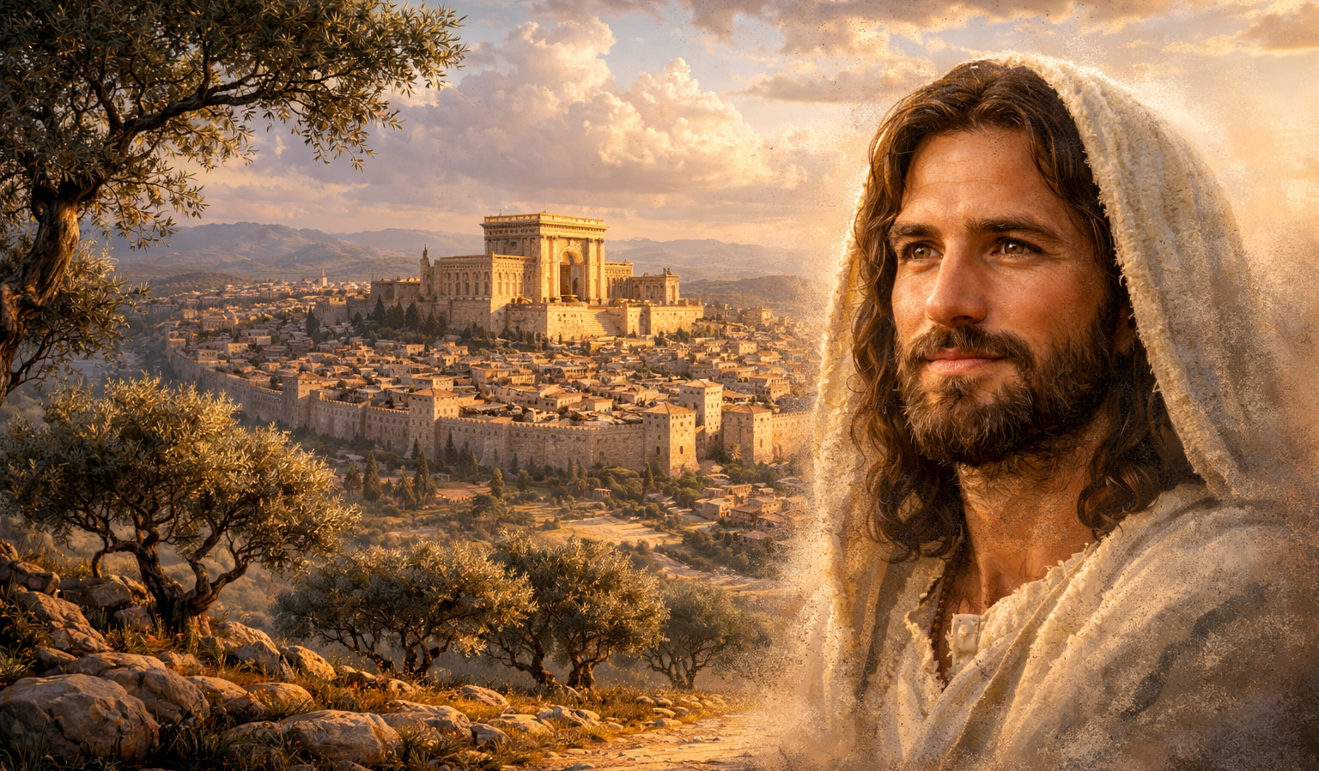
The Gospel of
Luke
Luke 3:15-22
The Messiah Revealed!
Preached by Dan Bridges
Amman International Church, Jordan (AmmanChurch.org)
Uploaded by Dr. Rick Griffith • Jordan Evangelical Theological Seminary
Files in many languages for free download at BibleStudyDownloads.org

Slide 2
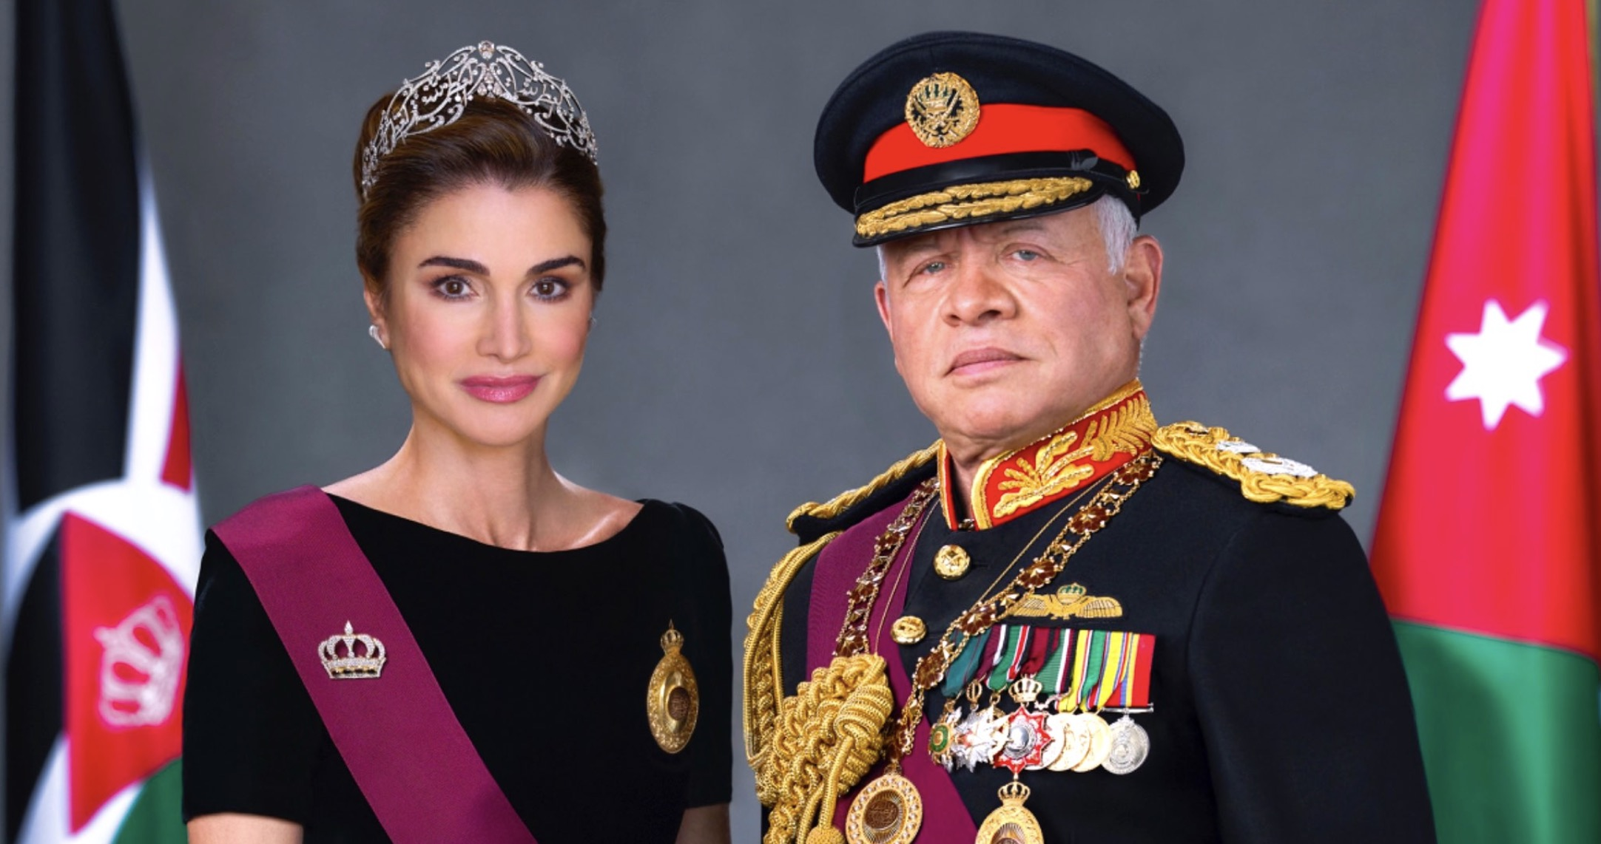
What they think of us matters to us!
Why is it that we tend to be on our “best behavior” when in the presence of royalty or important people?

Slide 3
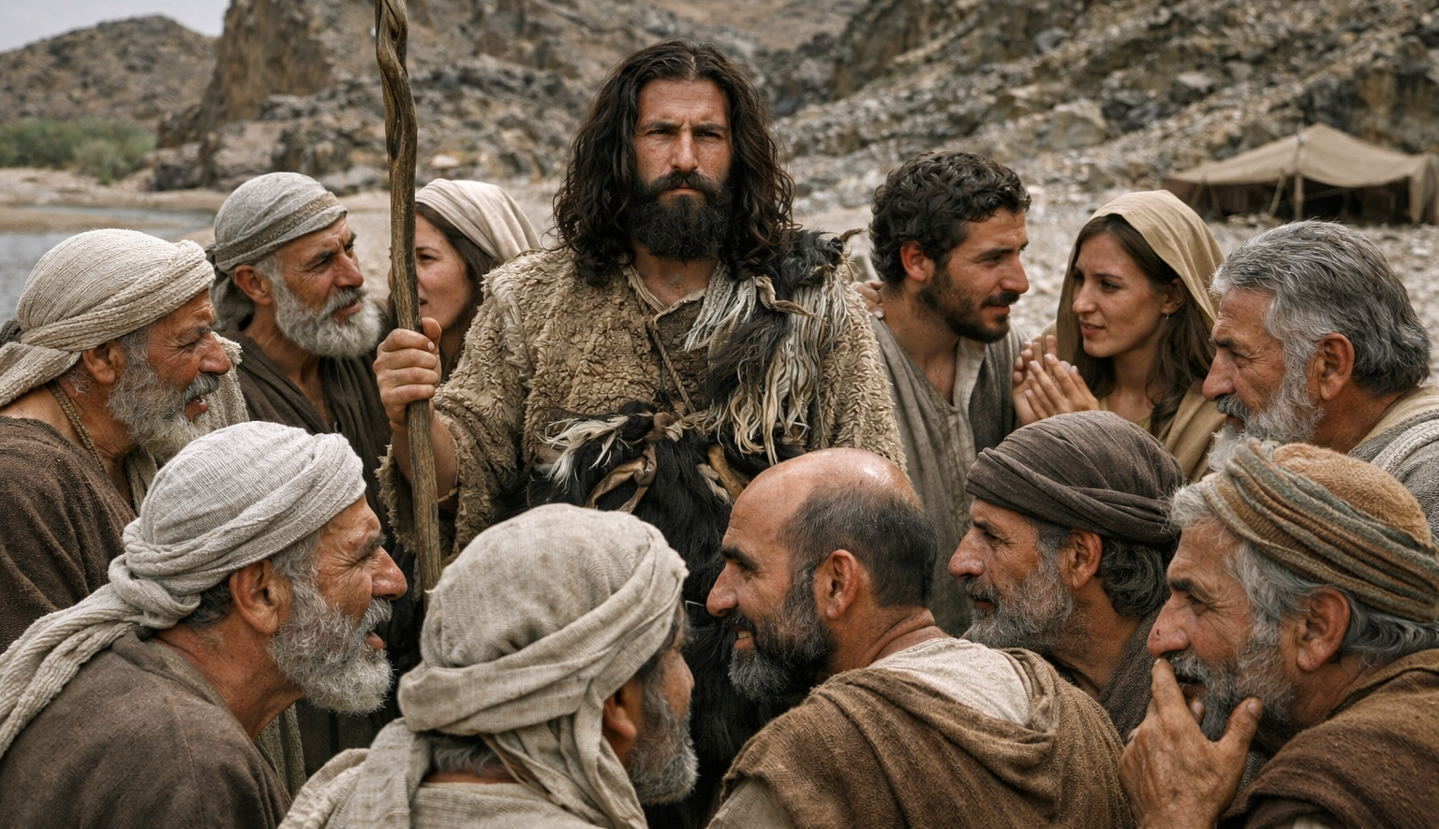
He had a very high view of the Messiah!
John the Baptist’s anticipation of the coming Messiah impacted his behavior. Why?

Slide 4
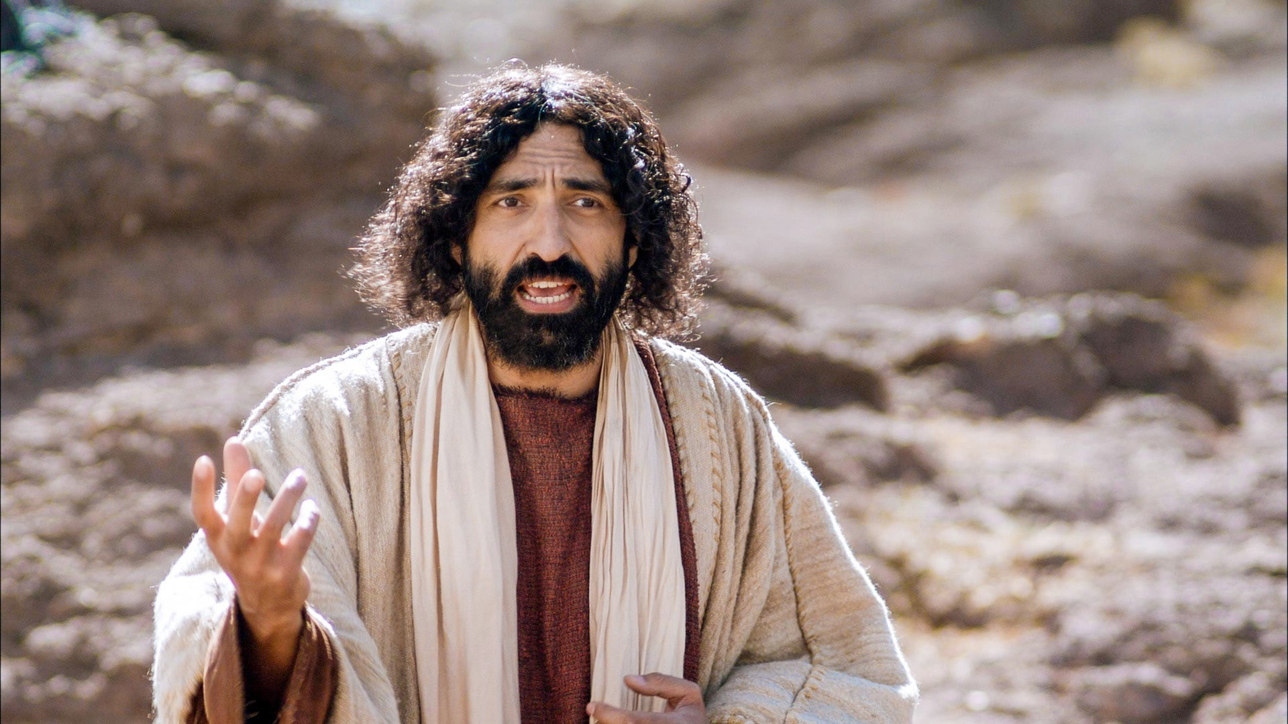
What about us? To what extent does the knowledge of who Jesus is and his presence with us affect our lives?

Slide 5
Luke 1:5 – 4:13 – An Orderly Account!
 | John’s Story | Jesus’ Story
1:5-25
1:26-38
1:39-56
1:57-80
2:1-52
3:1-20
3:21-4:13
John’s Birth Foretold
Jesus’ Birth Foretold
Mary and Elizabeth Together
John’s Birth
Jesus’ Birth & Boyhood
John Prepares the Way
3:15-22
Jesus is Prepared

Slide 6
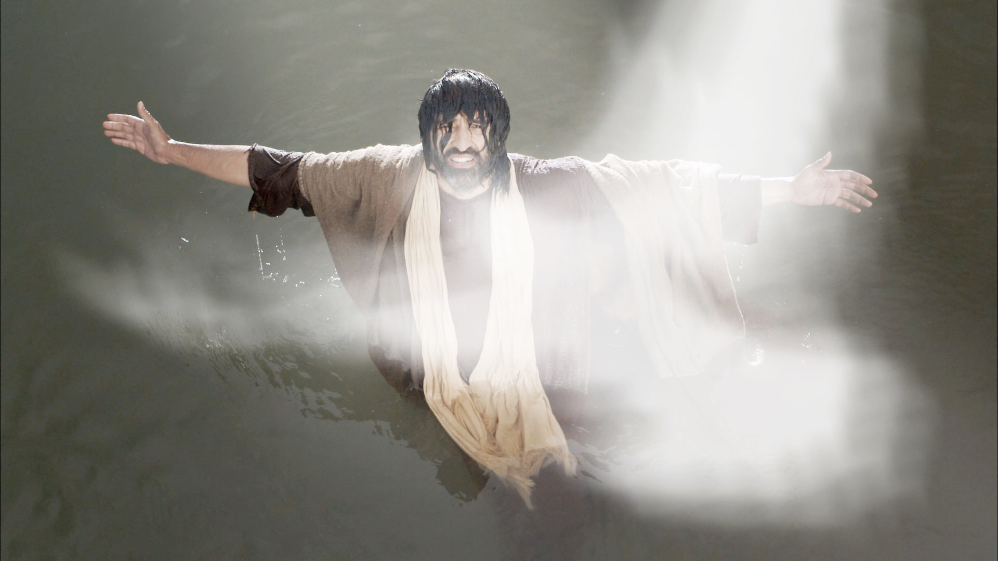
The Messiah Revealed – Luke 3:15-22
The Messiah Described (15-17)
The Preparation Complete (18-20)
The Messiah Revealed (21-22)

Slide 7
“As the people were in expectation, and all were questioning in their hearts concerning John, whether he might be the Christ,” Luke 3:15

Slide 8
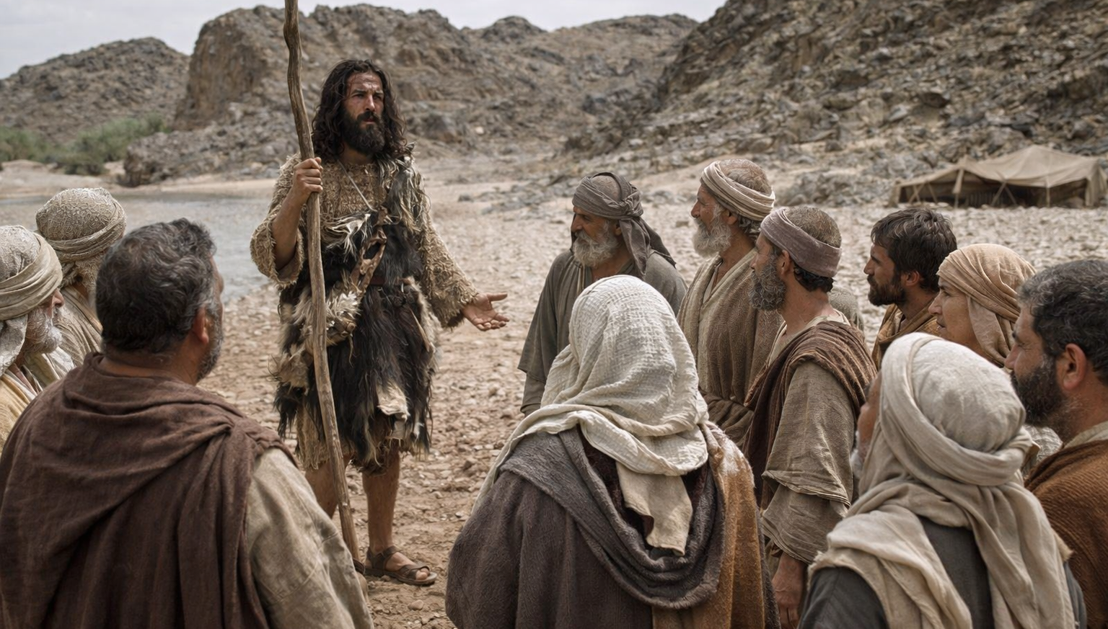
“John answered them all, saying, ‘I baptize you with water, but he who is mightier than I is coming’” Luke 3:16a

Slide 9
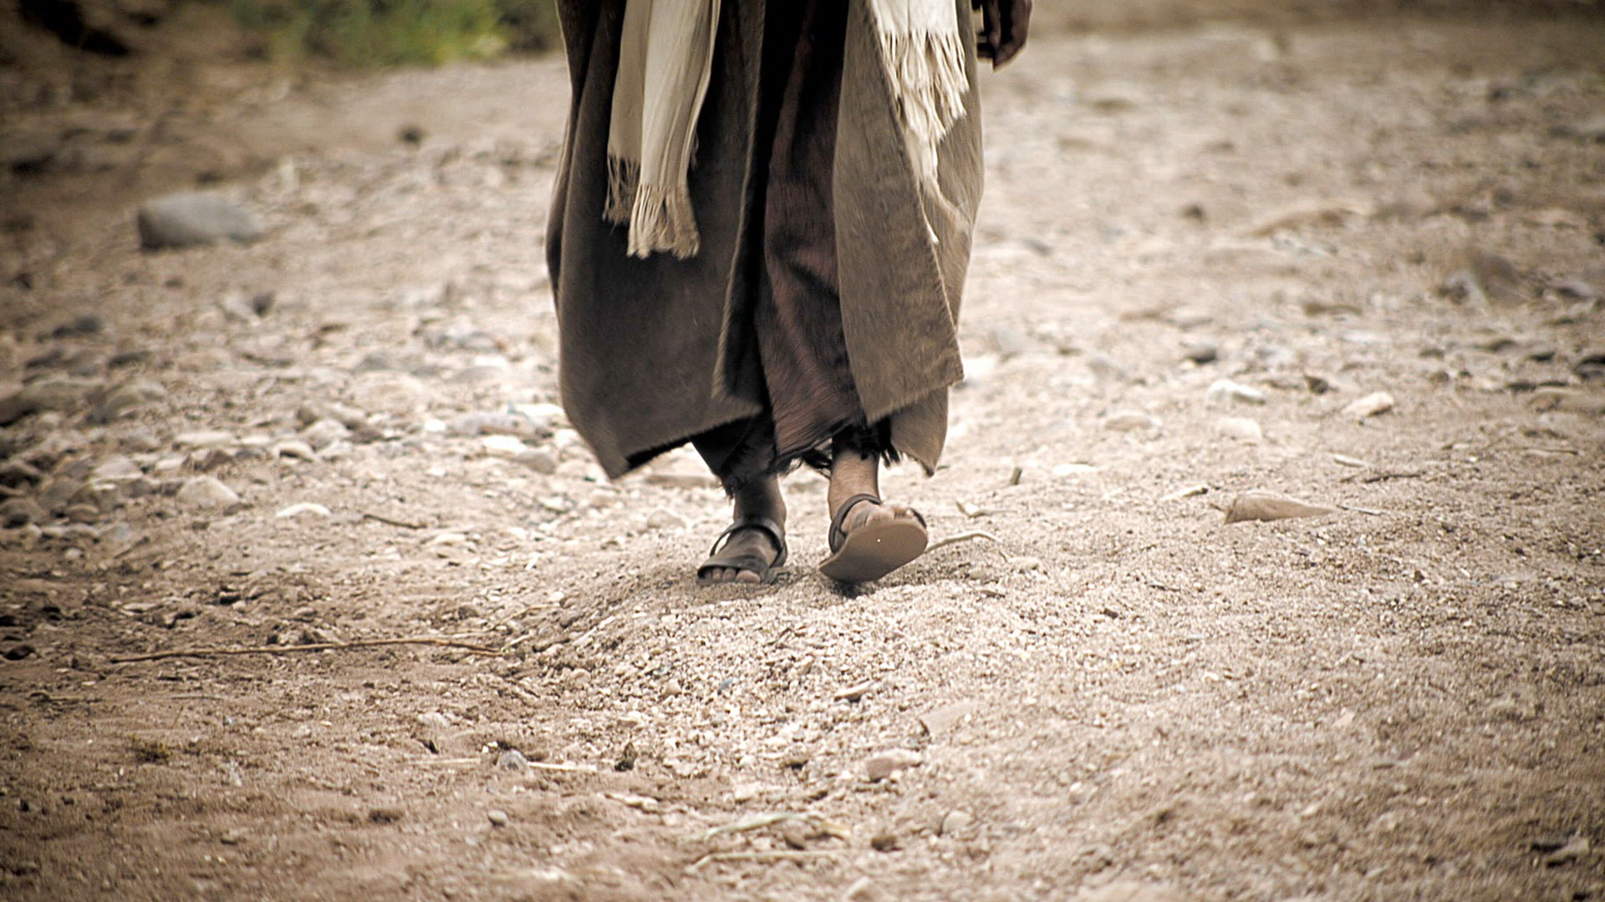
“‘…the strap of whose sandals I am not worthy to untie. He will baptize you with the Holy Spirit and fire.’”
Luke 3:16b

Slide 10
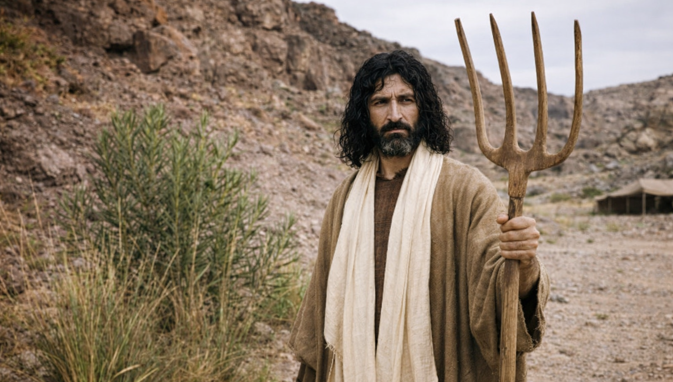
“His winnowing fork is in his hand, to clear his threshing floor and to gather the wheat into his barn, but the chaff he will burn with unquenchable fire.” Luke 3:17

Slide 11
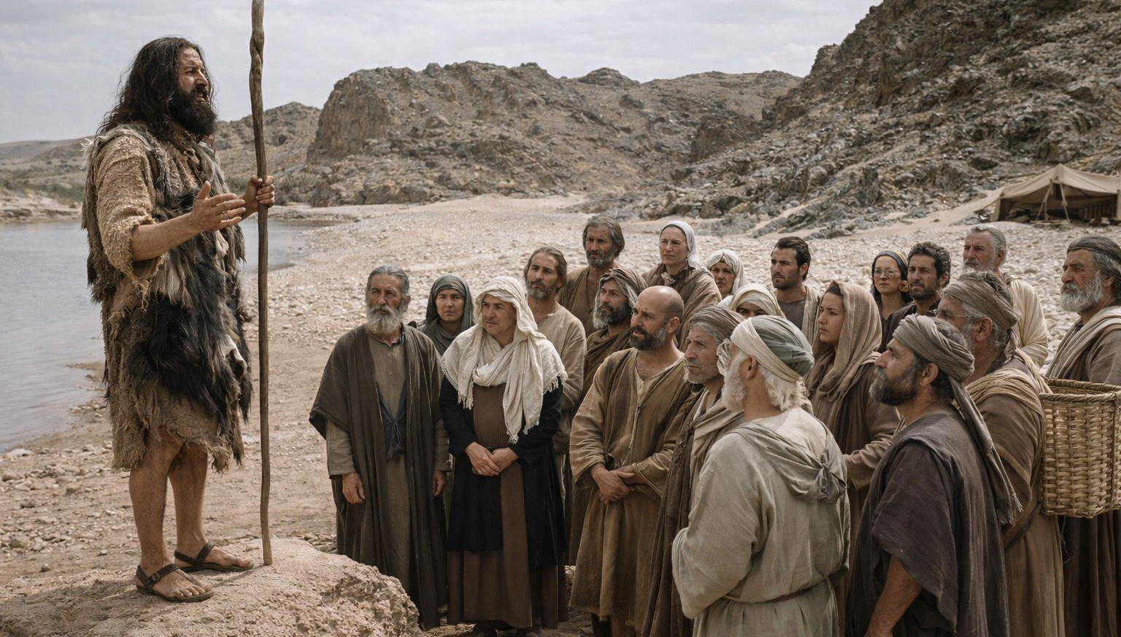
“So with many other exhortations he preached good news to the people.” Luke 3:18

Slide 12
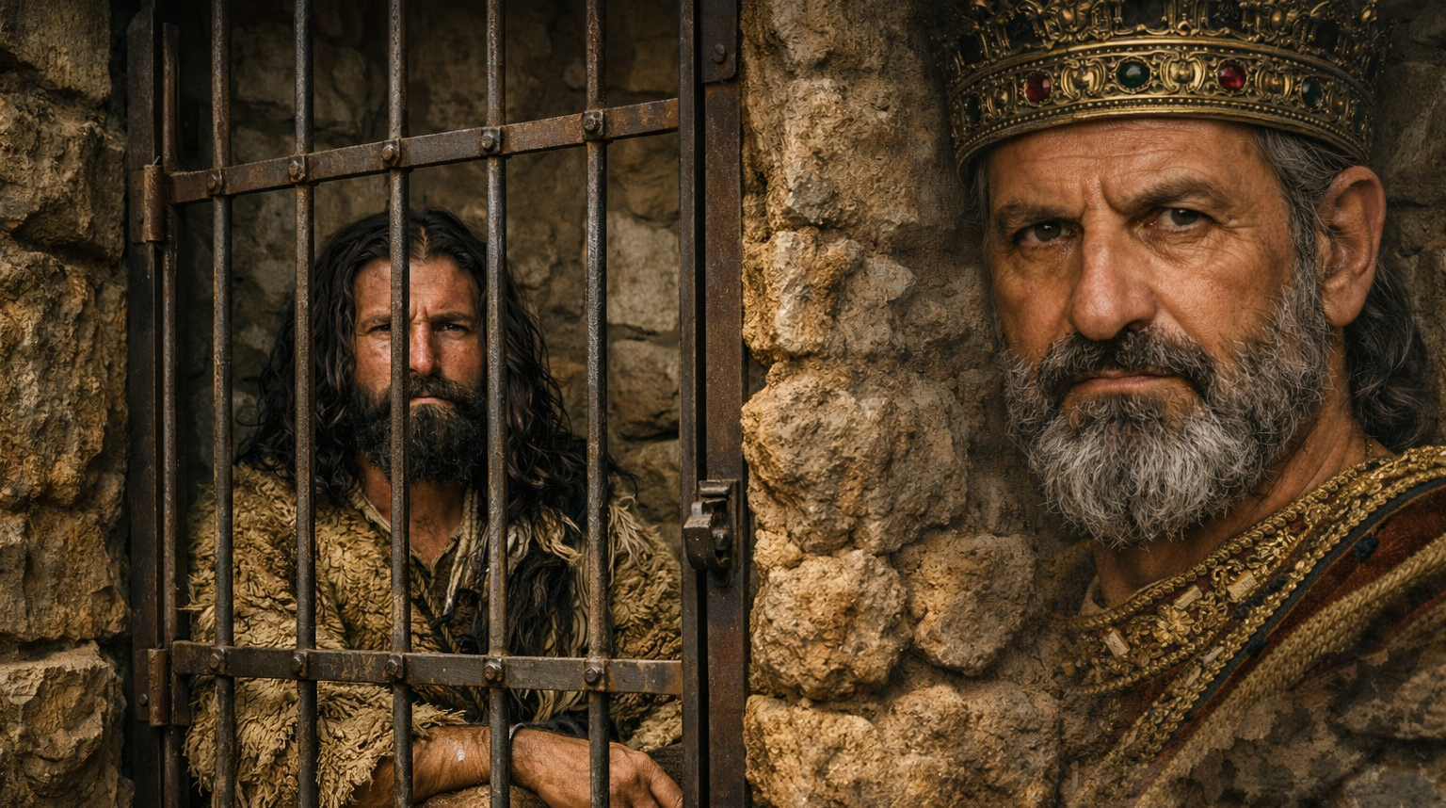
“But Herod the tetrarch, who had been reproved by him for Herodias, his brother's wife, and for all the evil things that Herod had done, added this to them all, that he locked up John in prison.” Luke 3:19-20

Slide 13
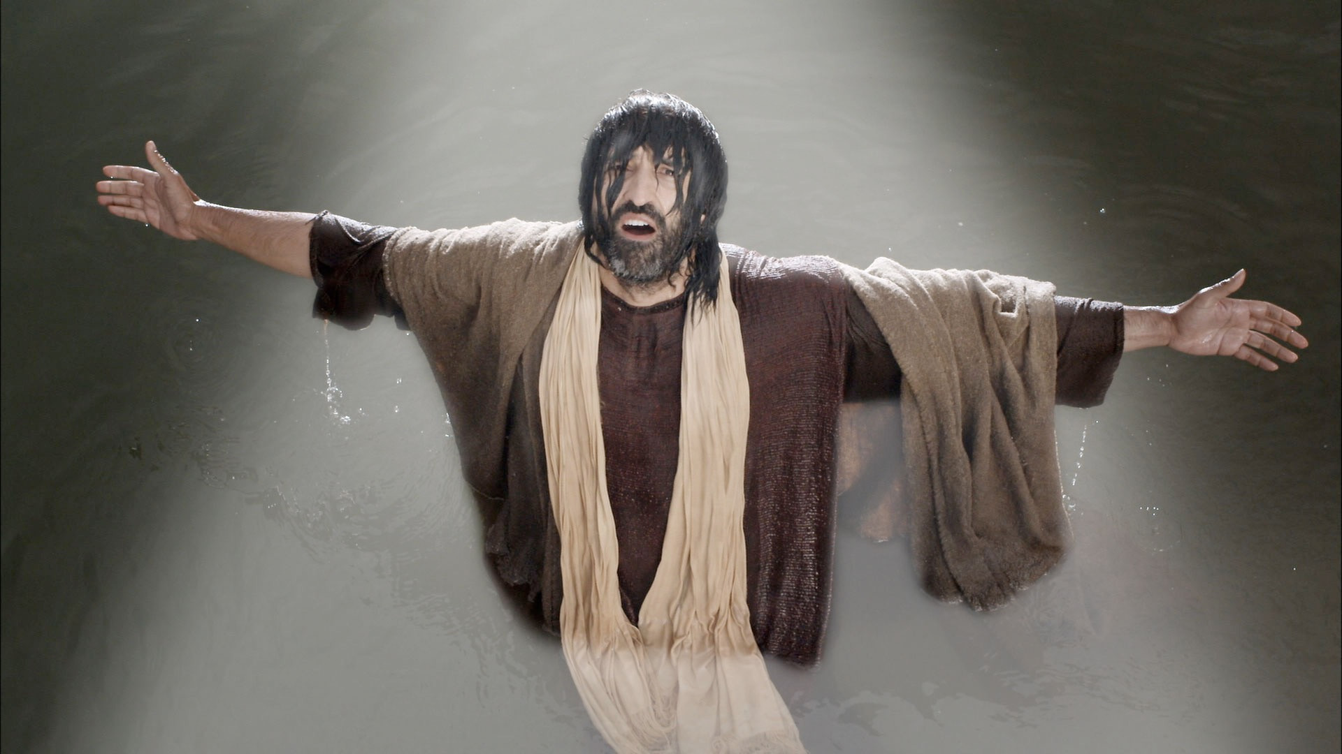
“ Now when all the people were baptized, and when Jesus also had been baptized and was praying, the heavens were opened” Luke 3:21

Slide 14
“and the Holy Spirit descended on him in bodily form, like a dove; and a voice came from heaven, ‘You are my beloved Son; with you I am well pleased.’” Luke 3:22

Slide 15
The Messiah Revealed – Luke 3:15-22
The Messiah Described (15-17)
The Preparation Complete (18-20)
The Messiah Revealed (21-22)

Slide 16
The momentum of John’s ministry is building!
“As the people were in expectation, and all were questioning in their hearts concerning John, whether he might be the Christ” Luke 3:15

Slide 17
John uses the building momentum to point people to the Messiah!
“John answered them all, saying, ‘I baptize you with water, but he who is mightier than I is coming’” Luke 3:16a

Slide 18
Four ways in which the true Messiah would be greater:
“John answered them all, saying, ‘I baptize you with water, but he who is mightier than I is coming,’” Luke 3:16a

Slide 19
Four ways in which the true Messiah would be greater:
Messiah will be mightier than John
“John answered them all, saying, ‘I baptize you with water, but he who is mightier than I is coming,’” Luke 3:16a

Slide 20
The job reserved for the lowest of the slaves!
“‘…the strap of whose sandals I am not worthy to untie. He will baptize you with the Holy Spirit and fire.’”
Luke 3:16b

Slide 21
Four ways in which the true Messiah would be greater:
Messiah will be mightier than John
Messiah will be far more worthy than John
“‘…the strap of whose sandals I am not worthy to untie. He will baptize you with the Holy Spirit and fire.’”
Luke 3:16b

Slide 22
What would John’s audience have understood?
The Old Testament promised a future pouring out of God’s Spirit
John is saying that the Messiah will be the one through whom the Spirit comes!
“‘…the strap of whose sandals I am not worthy to untie. He will baptize you with the Holy Spirit and fire.’”
Luke 3:16b

Slide 23
Why did John refer to the Messiah’s work as baptism?
John’s baptism was physical – it cleaned the outside of the body (representative)
Messiah’s baptism would be spiritual – it would bring salvation by actually cleaning the heart!
“‘…the strap of whose sandals I am not worthy to untie. He will baptize you with the Holy Spirit and fire.’”
Luke 3:16b

Slide 24
Four ways in which the true Messiah would be greater:
Messiah will be mightier than John
Messiah will be far more worthy than John
Messiah’s baptism will be far greater than John’s
“‘…the strap of whose sandals I am not worthy to untie. He will baptize you with the Holy Spirit and fire.’”
Luke 3:16b

Slide 25
Four ways in which the true Messiah would be greater:
Messiah will be mightier than John
Messiah will be far more worthy than John
Messiah’s baptism will be far greater than John’s
Messiah’s authority would include final judgment
“His winnowing fork is in his hand, to clear his threshing floor and to gather the wheat into his barn, but the chaff he will burn with unquenchable fire.” Luke 3:17

Slide 26
Four ways in which the true Messiah would be greater:
Messiah will be mightier than John
Messiah will be far more worthy than John
Messiah’s baptism will be far greater than John’s
Messiah’s authority would include final judgment
How do you think John’s understanding of the coming Messiah affected his day-to-day life?

Slide 27
Did Jesus meet John’s expectations?
“John the Baptist has sent us to you, saying, ‘Are you the one who is to come, or shall we look for another?’” Luke 7:20
What sort of Messiah was John picturing?
He would bring with him the Spirit
He would bring cleansing and salvation
He would execute final judgment

Slide 28
The Messiah Revealed – Luke 3:15-22
The Messiah Described (15-17)
The Preparation Complete (18-20)
The Messiah Revealed (21-22)

Slide 29
Laser-focused on preparing people for the Messiah!
“So with many other exhortations he preached good news to the people.” Luke 3:18

Slide 30
John even tried to prepare Herod!
“But Herod the tetrarch, who had been reproved by him for Herodias, his brother's wife, and for all the evil things that Herod had done, added this to them all, that he locked up John in prison.” Luke 3:19-20

Slide 31
Why did Luke include this detail before Jesus’ baptism?
“But Herod the tetrarch, who had been reproved by him for Herodias, his brother's wife, and for all the evil things that Herod had done, added this to them all, that he locked up John in prison.” Luke 3:19-20

Slide 32
John’s preparation work was done!
Luke took John off the scene before introducing Jesus.
“But Herod the tetrarch, who had been reproved by him for Herodias, his brother's wife, and for all the evil things that Herod had done, added this to them all, that he locked up John in prison.” Luke 3:19-20

Slide 33
The Messiah Revealed – Luke 3:15-22
The Messiah Described (15-17)
The Preparation Complete (18-20)
The Messiah Revealed (21-22)

Slide 34
Why was Jesus baptized?
Identification with sinful man
Commissioning for his work
“ Now when all the people were baptized, and when Jesus also had been baptized and was praying, the heavens were opened,” Luke 3:21

Slide 35
What did this mean?
“ Now when all the people were baptized, and when Jesus also had been baptized and was praying, the heavens were opened,” Luke 3:21

Slide 36
“…the heavens were opened, and I saw visions of God…”
Ezekiel 1:1
“…the heavens were opened to him, and he saw the Spirit of God descending like a dove…” Matthew 3:16
“I see the heavens opened, and the Son of Man standing at the right hand of God.” Acts 7:56
“[He] saw the heavens opened and something like a great sheet descending…” Acts 10:11
Heavens opened = Ability to see heavenly things

Slide 37
Jesus not only saw into the glory of heaven – God actually sent a physical dove down!
“and the Holy Spirit descended on him in bodily form, like a dove; and a voice came from heaven, ‘You are my beloved Son; with you I am well pleased.’” Luke 3:22

Slide 38
Jesus not only saw into the glory of heaven – God actually spoke in an audible voice!
“and the Holy Spirit descended on him in bodily form, like a dove; and a voice came from heaven, ‘You are my beloved Son; with you I am well pleased.’” Luke 3:22

Slide 39
What’s going on here?
“and the Holy Spirit descended on him in bodily form, like a dove; and a voice came from heaven, ‘You are my beloved Son; with you I am well pleased.’” Luke 3:22

Slide 40
What’s going on here?
Jesus was anointed with the Spirit for his ministry
“and the Holy Spirit descended on him in bodily form, like a dove; and a voice came from heaven, ‘You are my beloved Son; with you I am well pleased.’” Luke 3:22

Slide 41
What’s going on here?
Jesus was anointed with the Spirit for his ministry
Jesus was declared to be the Son of God (Psalm 2:7)
“and the Holy Spirit descended on him in bodily form, like a dove; and a voice came from heaven, ‘You are my beloved Son; with you I am well pleased.’” Luke 3:22

Slide 42
“I will tell of the decree:
The LORD said to me, ‘You are my Son;
today I have begotten you.
Ask of me, and I will make the nations your heritage,
and the ends of the earth your possession.
You shall break them with a rod of iron
and dash them in pieces like a potter's vessel.’”
Psalm 2:7-9

Slide 43
What’s going on here?
Jesus was anointed with the Spirit for his ministry
Jesus was declared to be the Son of God (Psalm 2:7)
Jesus was affirmed by God
“and the Holy Spirit descended on him in bodily form, like a dove; and a voice came from heaven, ‘You are my beloved Son; with you I am well pleased.’” Luke 3:22

Slide 44
Jesus was being commissioned for his ministry!
Jesus was anointed with the Spirit for his ministry
Jesus was declared to be the Son of God (Psalm 2:7)
Jesus was affirmed by God
“and the Holy Spirit descended on him in bodily form, like a dove; and a voice came from heaven, ‘You are my beloved Son; with you I am well pleased.’” Luke 3:22

Slide 45
The Messiah Revealed – Luke 3:15-22
The Messiah Described (15-17)
The Preparation Complete (18-20)
The Messiah Revealed (21-22)

Slide 46
What about us? To what extent does the knowledge of who Jesus is and his presence with us affect our lives?

Slide 47
How do you think our understanding of the Messiah can affect our day-to-day life?
Four ways in which the true Messiah would be greater:
Messiah will be mightier than John
Messiah will be far more worthy than John
Messiah’s baptism will be far greater than John’s
Messiah’s authority would include final judgment
The Commissioning of Jesus
Jesus was anointed with the Spirit for his ministry
Jesus was declared to be the Son of God (Psalm 2:7)
Jesus was affirmed by God

Slide 48
If King Abdullah risked his life to save yours, how would that affect your attitude toward him?

Slide 49
We have infinitely greater reason to love and serve Jesus than any human dignitary!
Let’s pray for a greater understanding of this!

Slide 50
Sermon by Dan Bridges
Amman International Church (AIC)
Amman, Jordan
This and most other AIC sermons can be found on the church website:
ammanchurch.org

Slide 51
Black

Slide 52


NT Preaching link at BibleStudyDownloads.org
Get this presentation for free!
Notes:
NT Preaching (np)

