Slide 1
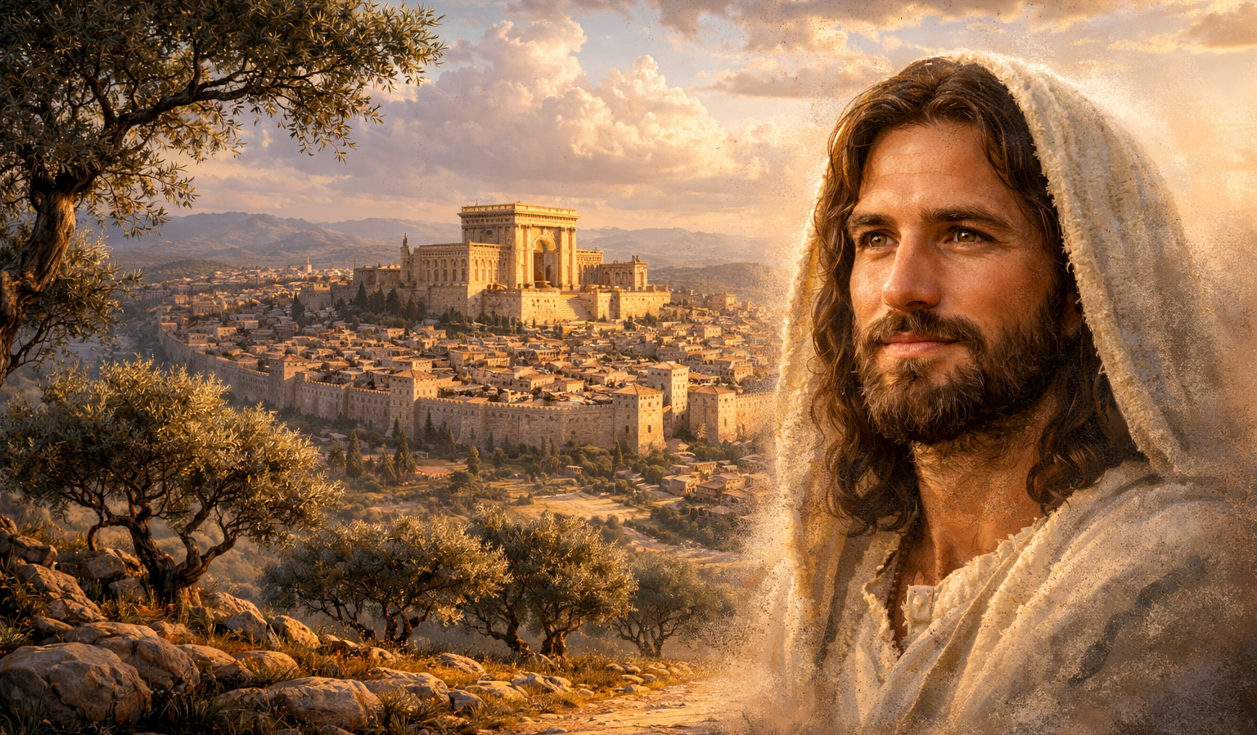
The Gospel of
Luke
Luke 3:1-14
Are You Prepared?
Preached by Dan Bridges
Amman International Church, Jordan (AmmanChurch.org)
Uploaded by Dr. Rick Griffith • Jordan Evangelical Theological Seminary
Files in many languages for free download at BibleStudyDownloads.org

Slide 2
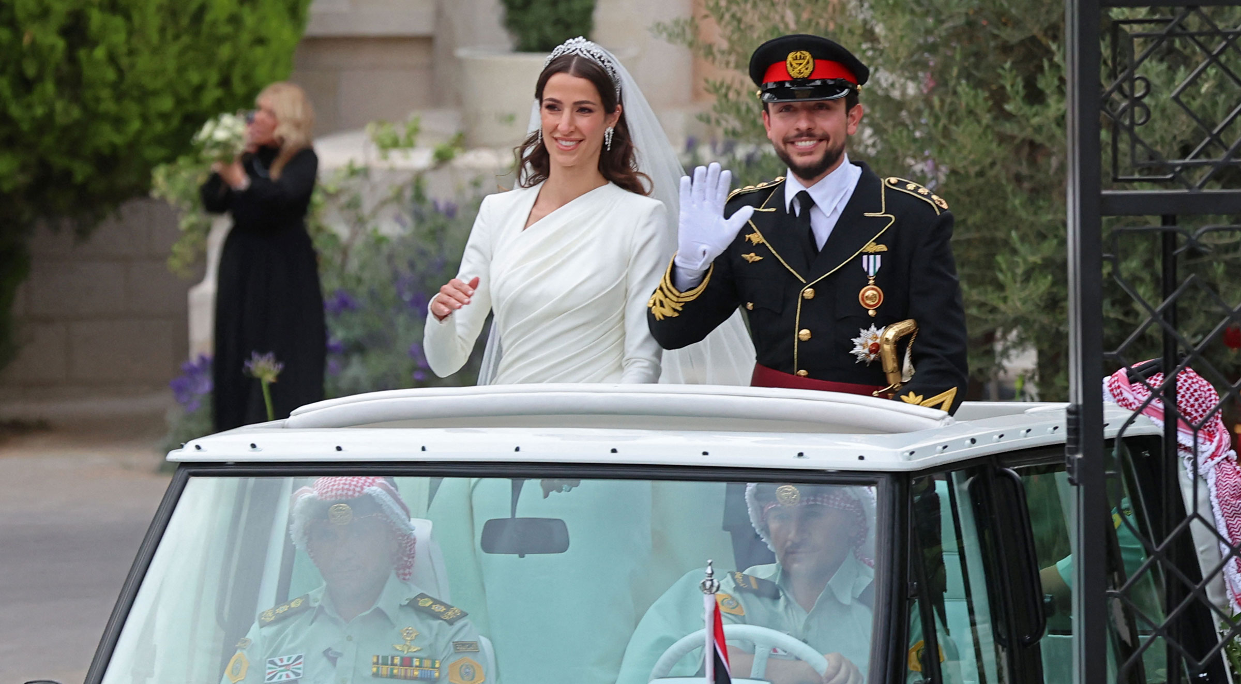
June 1, 2023

Slide 3
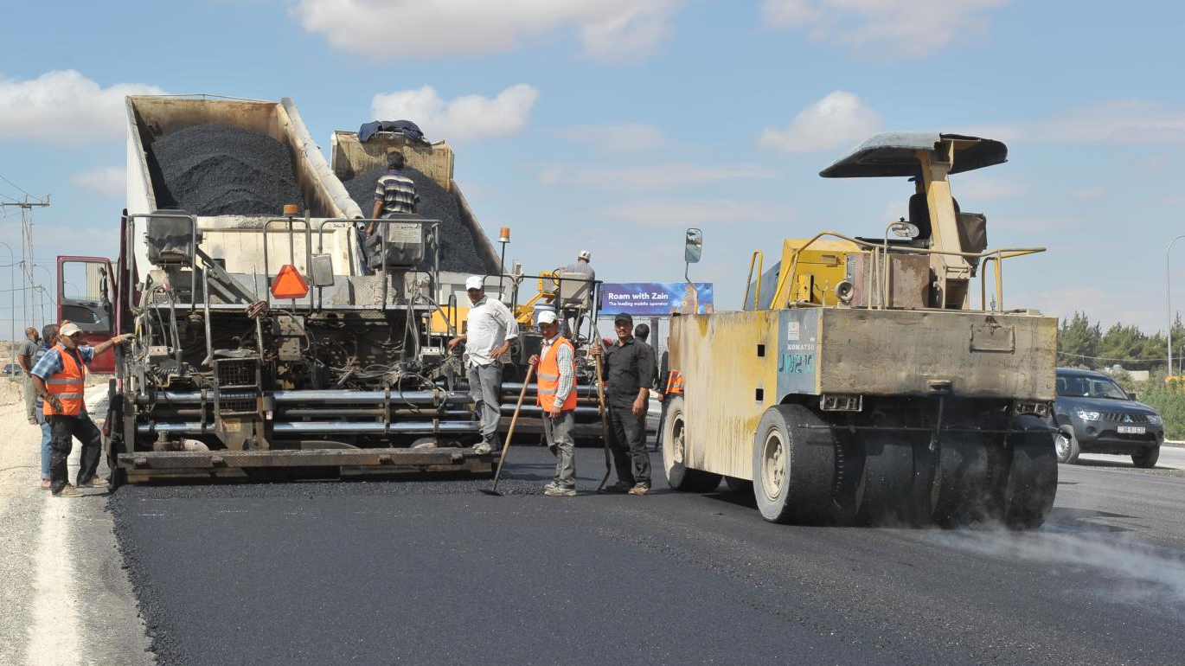
Preparing the way!

Slide 4
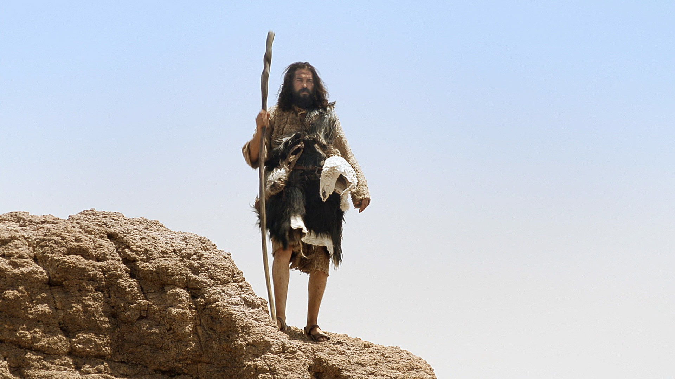
“He will go before him in the spirit and power of Elijah… to make ready for the Lord a people prepared.”
Luke 1:17

Slide 5
What would it have looked like for people to be prepared for Jesus?
Able to recognize Jesus as the Messiah
Ready to trust in Jesus as savior for their sin
Prepared to obey and serve Jesus

Slide 6

Are you prepared to respond to the call of Jesus for your life?

Slide 7
Luke 1:5 – 4:13 – An Orderly Account!
 | John’s Story | Jesus’ Story
1:5-25
1:26-38
1:39-56
1:57-80
2:1-52
3:1-20
3:21-4:13
John’s Birth Foretold
Jesus’ Birth Foretold
Mary and Elizabeth Together
John’s Birth
Jesus’ Birth & Boyhood
John Prepares the Way
Jesus is Prepared

Slide 8
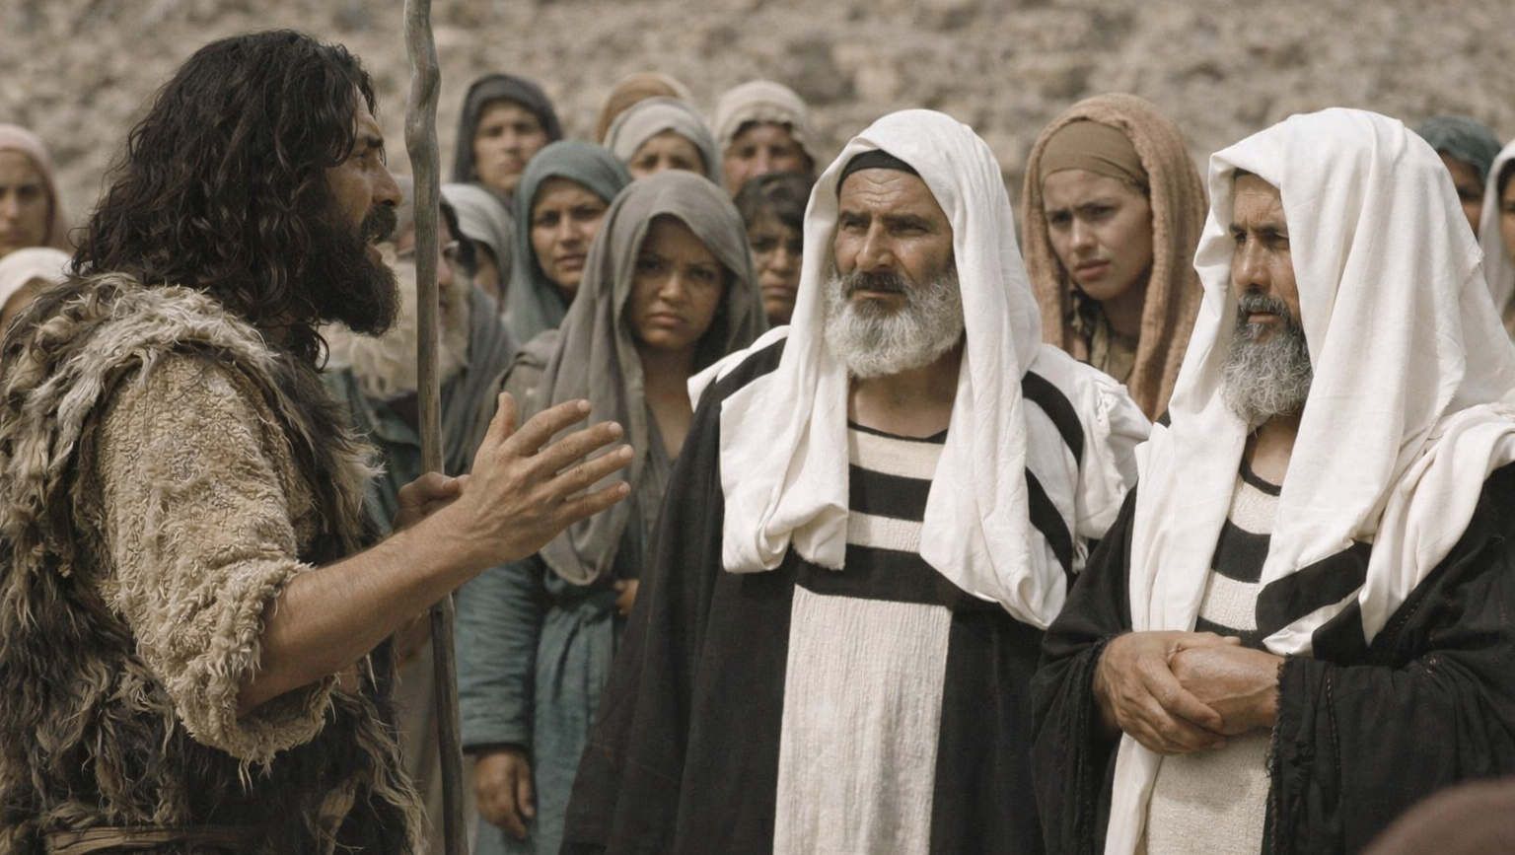
Are You Prepared?
Preparation is Initiated by God (vss. 1-6)
Preparation Involves Repentance (vss. 7-9)
Preparation is Very Practical (vss. 10-14)

Slide 9
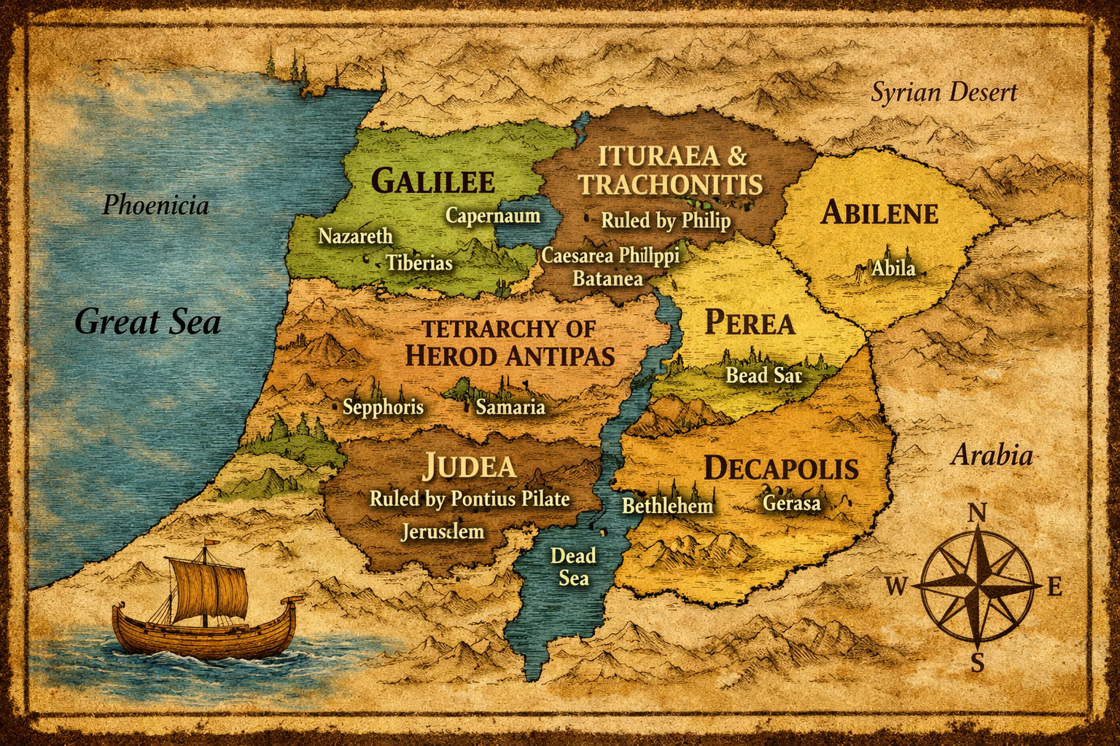
Herod the Great’s Kingdom Divided
“In the fifteenth year of the reign of Tiberius Caesar, Pontius Pilate being governor of Judea, and Herod being tetrarch of Galilee, and his brother Philip tetrarch of the region of Ituraea and Trachonitis, and Lysanias tetrarch of Abilene...” Luke 3:1

Slide 10
“…during the high priesthood of Annas and Caiaphas, the word of God came to John the son of Zechariah in the wilderness.” Luke 3:2

Slide 11
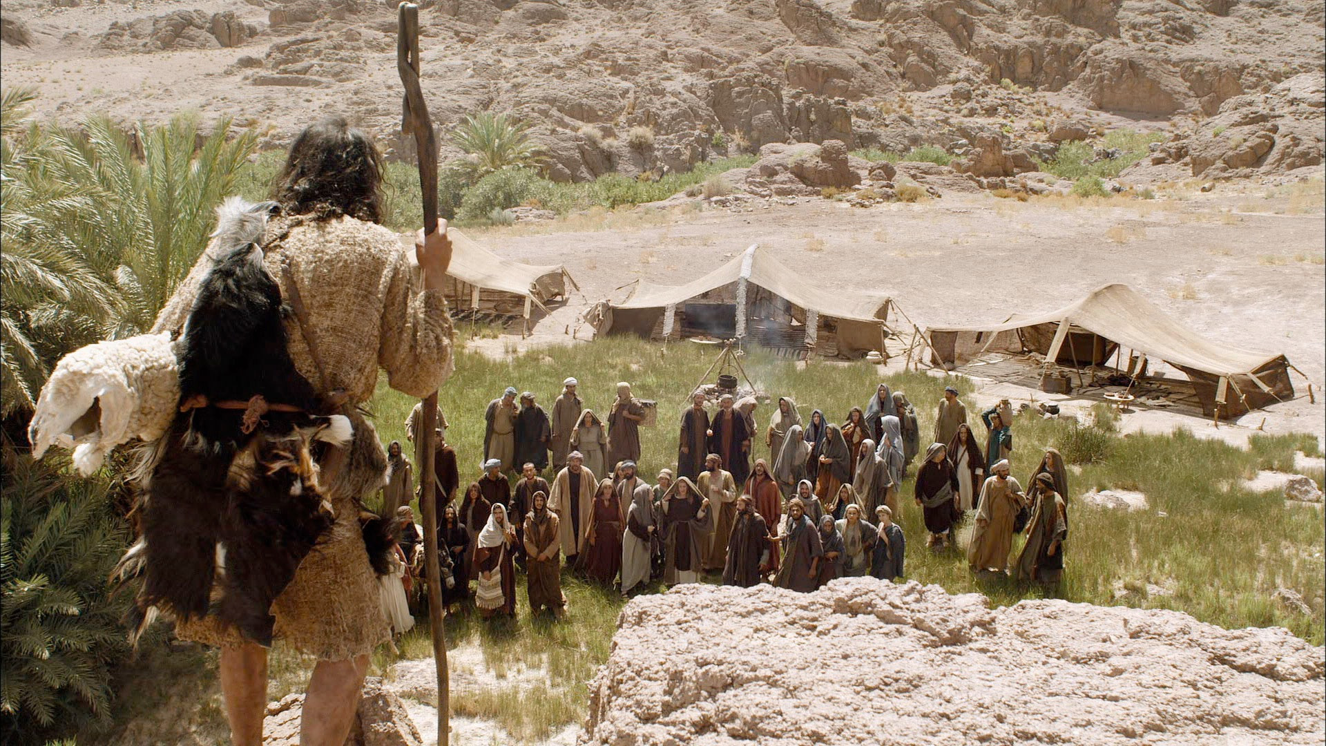
“And he went into all the region around the Jordan, proclaiming a baptism of repentance for the forgiveness of sins.” Luke 3:3

Slide 12
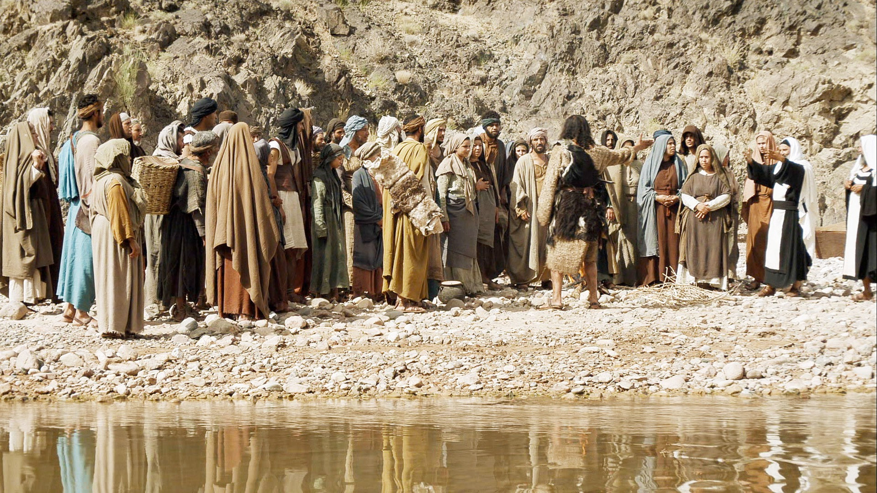
“As it is written in the book of the words
of Isaiah the prophet,
‘The voice of one crying in the wilderness:
“Prepare the way of the Lord,
make his paths straight.”’” Luke 3:4

Slide 13
“Every valley shall be filled,
and every mountain and hill shall be made low,
and the crooked shall become straight,
and the rough places shall become level ways,
and all flesh shall see the salvation of God.”
Luke 3:5-6

Slide 14
“He said therefore to the crowds that came out to be baptized by him, ‘You brood of vipers! Who warned you to flee from the wrath to come?’”
Luke 3:7

Slide 15
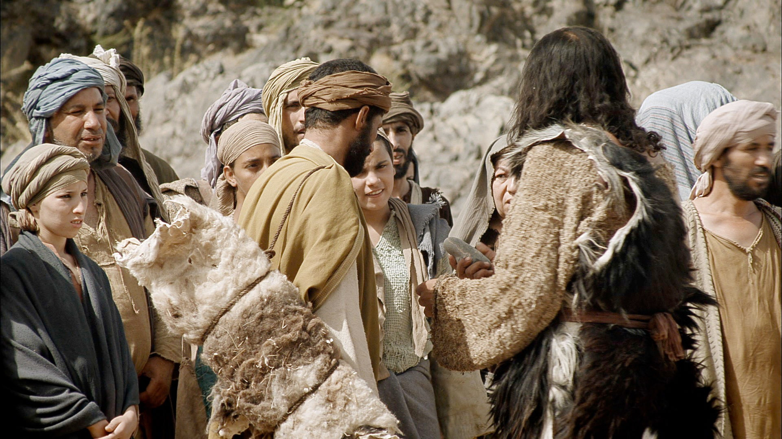
“‘Bear fruits in keeping with repentance. And do not begin to say to yourselves, “We have Abraham as our father.” For I tell you, God is able from these stones to raise up children for Abraham.’” Luke 3:8

Slide 16
“’Even now the axe is laid to the root of the trees. Every tree therefore that does not bear good fruit is cut down and thrown into the fire.’” Luke 3:9

Slide 17
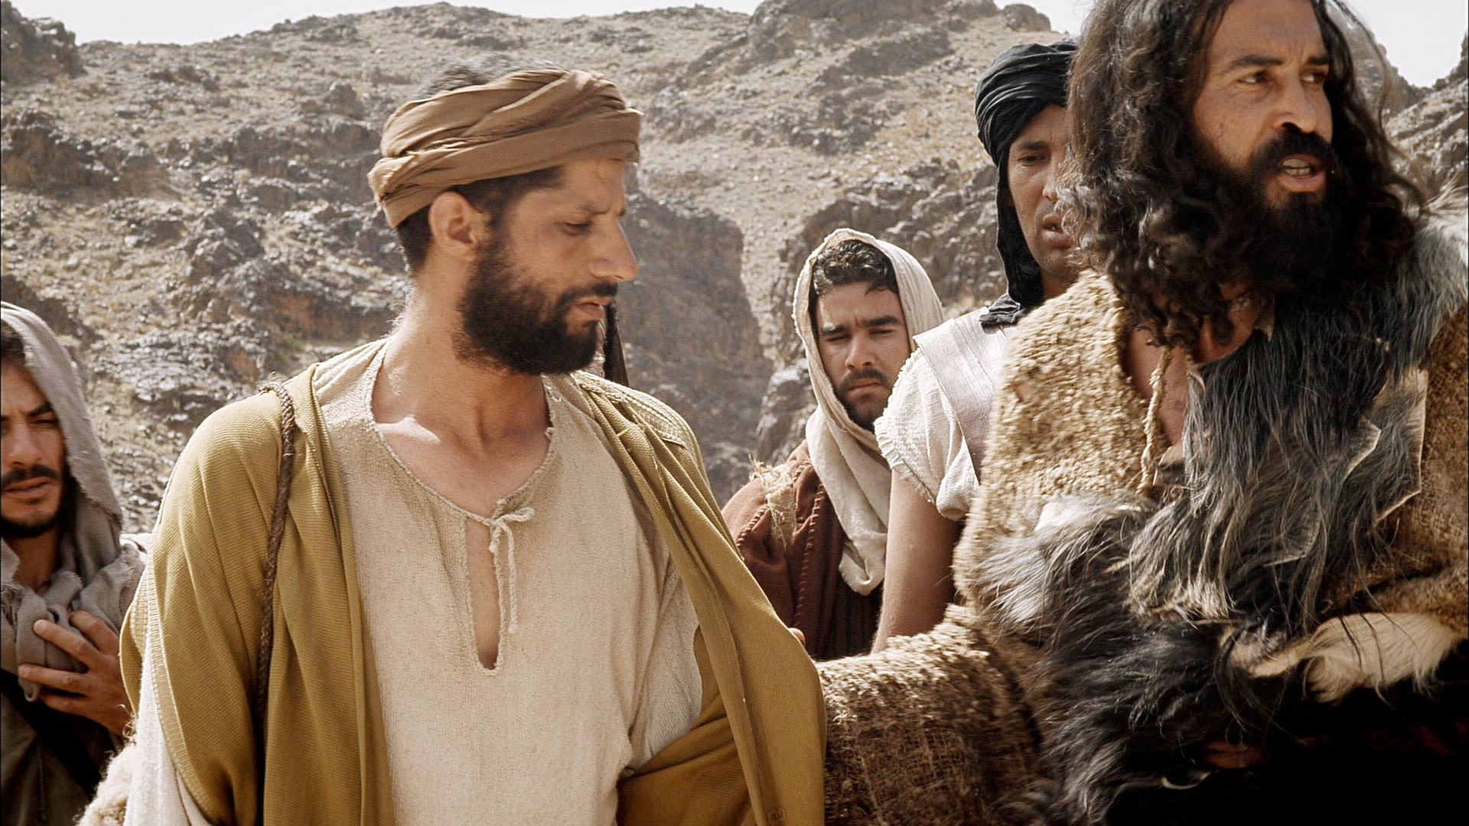
“And the crowds asked him, ‘What then shall we do?’ And he answered them, ‘Whoever has two tunics is to share with him who has none, and whoever has food is to do likewise.’” Luke 3:10-11

Slide 18
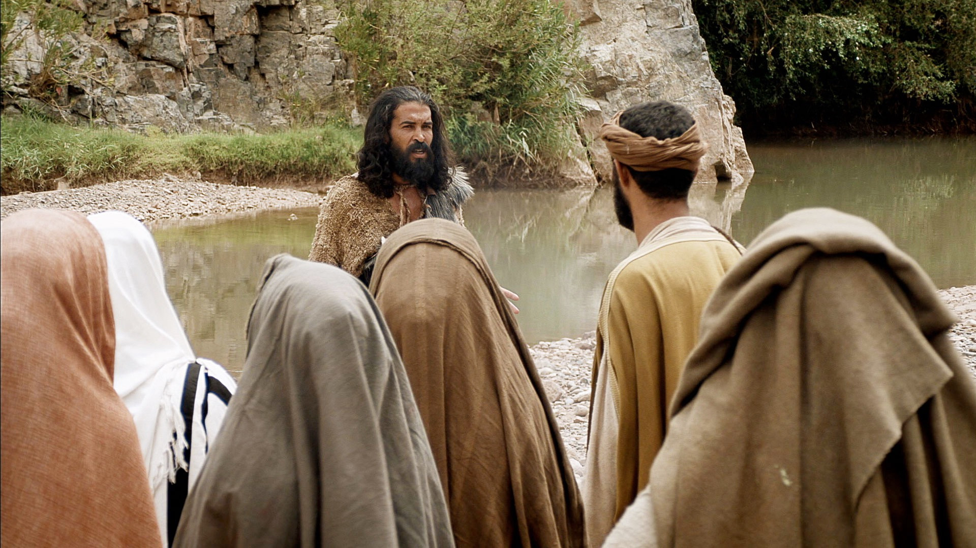
“Tax collectors also came to be baptized and said to him, ‘Teacher, what shall we do?’ And he said to them, ‘Collect no more than you are authorized to do.’” Luke 3:12-13

Slide 19
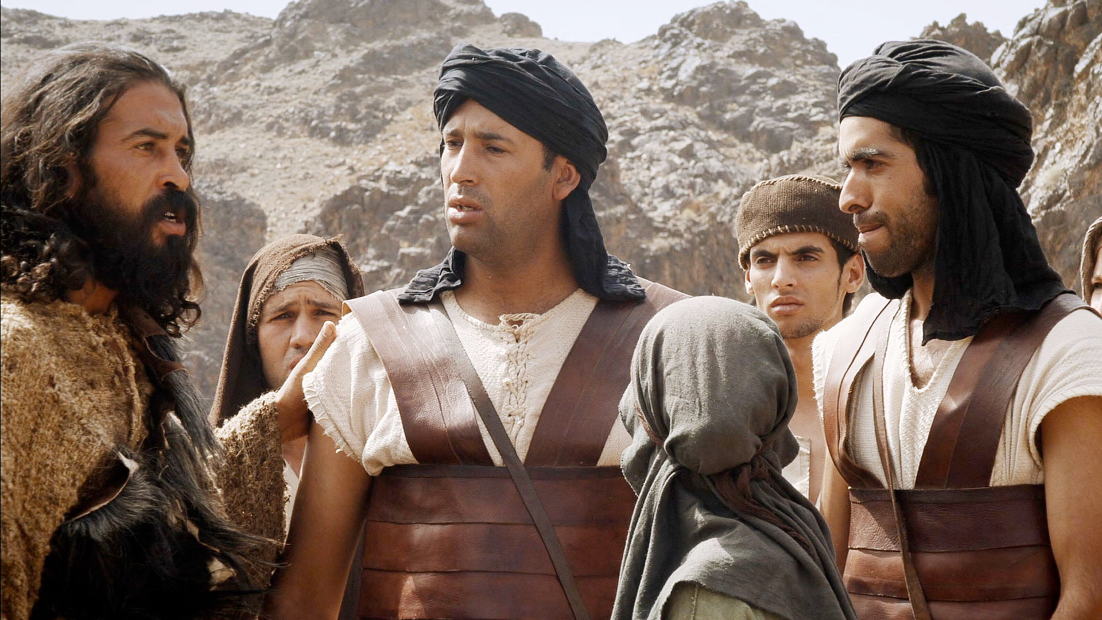
“Soldiers also asked him, ‘And we, what shall we do?’ And he said to them, ‘Do not extort money from anyone by threats or by false accusation, and be content with your wages.’” Luke 3:14

Slide 20
Are You Prepared?
Preparation is Initiated by God (vss. 1-6)
Preparation Involves Repentance (vss. 7-9)
Preparation is Very Practical (vss. 10-14)

Slide 21
Herod the Great’s Kingdom Divided
Why all this detail?
Real historical event!
Likely timeframe: AD 28 or 29
“In the fifteenth year of the reign of Tiberius Caesar, Pontius Pilate being governor of Judea, and Herod being tetrarch of Galilee, and his brother Philip tetrarch of the region of Ituraea and Trachonitis, and Lysanias tetrarch of Abilene...” Luke 3:1

Slide 22
God initiated this!
“…during the high priesthood of Annas and Caiaphas, the word of God came to John the son of Zechariah in the wilderness.” Luke 3:2

Slide 23
“The word of the LORD came to…”
Abram – Genesis 15:1
Samuel – 1 Samuel 15:10
Nathan – 2 Samuel 7:4
Solomon – 1 Kings 6:11
Elijah – 1 Kings 18:1
Isaiah – Isaiah 38:4
Jeremiah – Jeremiah 1:4
Ezekiel – Ezekiel 1:3
Jonah – Jonah 1:1
Haggai – Haggai 1:1
Zechariah – Zechariah 1:1

Slide 24
John was the last of the Old Testament prophets!
“…during the high priesthood of Annas and Caiaphas, the word of God came to John the son of Zechariah in the wilderness.” Luke 3:2

Slide 25
“And he went into all the region around the Jordan, proclaiming a baptism of repentance for the forgiveness of sins.” Luke 3:3
In this case, God’s method of preparation was proclamation and baptism.

Slide 26
“As it is written in the book of the words
of Isaiah the prophet,
‘The voice of one crying in the wilderness:
“Prepare the way of the Lord,
make his paths straight.
Every valley shall be filled,
and every mountain and hill shall be made low,
and the crooked shall become straight,
and the rough places shall become level ways,
and all flesh shall see the salvation of God.”’”
Luke 3:3-6
How did John’s preaching accomplish this?
John’s preaching exposed cultural blind spots and ways in which people were deceived.

Slide 27
“As it is written in the book of the words
of Isaiah the prophet,
‘The voice of one crying in the wilderness:
“Prepare the way of the Lord,
make his paths straight.
Every valley shall be filled,
and every mountain and hill shall be made low,
and the crooked shall become straight,
and the rough places shall become level ways,
and all flesh shall see the salvation of God.”’”
Luke 3:3-6
God prepares us by exposing blind spots in our lives. How does he do that?
Speaking through his Word
Rebuke from a friend or even an enemy
Hardship or suffering in our lives

Slide 28
Are You Prepared?
Preparation is Initiated by God (vss. 1-6)
Preparation Involves Repentance (vss. 7-9)
Preparation is Very Practical (vss. 10-14)

Slide 29
Why this language?
Matthew 3:7 – He said this to religious leaders
“He said therefore to the crowds that came out to be baptized by him, “You brood of vipers! Who warned you to flee from the wrath to come?” Luke 3:7

Slide 30
Brood of Vipers…
“Son of…” indicated characteristics of a person
Vipers could be a reference to Satan
“He said therefore to the crowds that came out to be baptized by him, “You brood of vipers! Who warned you to flee from the wrath to come?” Luke 3:7

Slide 31
It also is a picture of snakes running from a fire…
This question could be rephrased as “Why are you coming to be baptized?”
“He said therefore to the crowds that came out to be baptized by him, “You brood of vipers! Who warned you to flee from the wrath to come?” Luke 3:7

Slide 32
Why would arrogant religious leaders come to be baptized?
“He said therefore to the crowds that came out to be baptized by him, “You brood of vipers! Who warned you to flee from the wrath to come?” Luke 3:7

Slide 33
Fire Insurance!
“He said therefore to the crowds that came out to be baptized by him, “You brood of vipers! Who warned you to flee from the wrath to come?” Luke 3:7

Slide 34
What keeps us from being prepared for God’s work?
Self-centered view of salvation and life in Christ
“He said therefore to the crowds that came out to be baptized by him, “You brood of vipers! Who warned you to flee from the wrath to come?” Luke 3:7

Slide 35
What keeps us from being prepared for God’s work?
Self-centered view of salvation and life in Christ
Reliance on our “religious heritage”
“Bear fruits in keeping with repentance. And do not begin to say to yourselves, ‘We have Abraham as our father.’ For I tell you, God is able from these stones to raise up children for Abraham.” Luke 3:8

Slide 36
What prepares us to respond to God’s work?
True repentance – repentance that leads to a changed life!
“Bear fruits in keeping with repentance. And do not begin to say to yourselves, ‘We have Abraham as our father.’ For I tell you, God is able from these stones to raise up children for Abraham.” Luke 3:8

Slide 37
What keeps us from being prepared for God’s work?
Self-centered view of salvation and life in Christ
Reliance on our “religious heritage”
No sense of urgency – Delaying our repentance
“Even now the axe is laid to the root of the trees. Every tree therefore that does not bear good fruit is cut down and thrown into the fire.” Luke 3:9

Slide 38
God measures our repentance by the fruit!
“Even now the axe is laid to the root of the trees. Every tree therefore that does not bear good fruit is cut down and thrown into the fire.” Luke 3:9

Slide 39
Is this works-based righteousness?
“Even now the axe is laid to the root of the trees. Every tree therefore that does not bear good fruit is cut down and thrown into the fire.” Luke 3:9

Slide 40
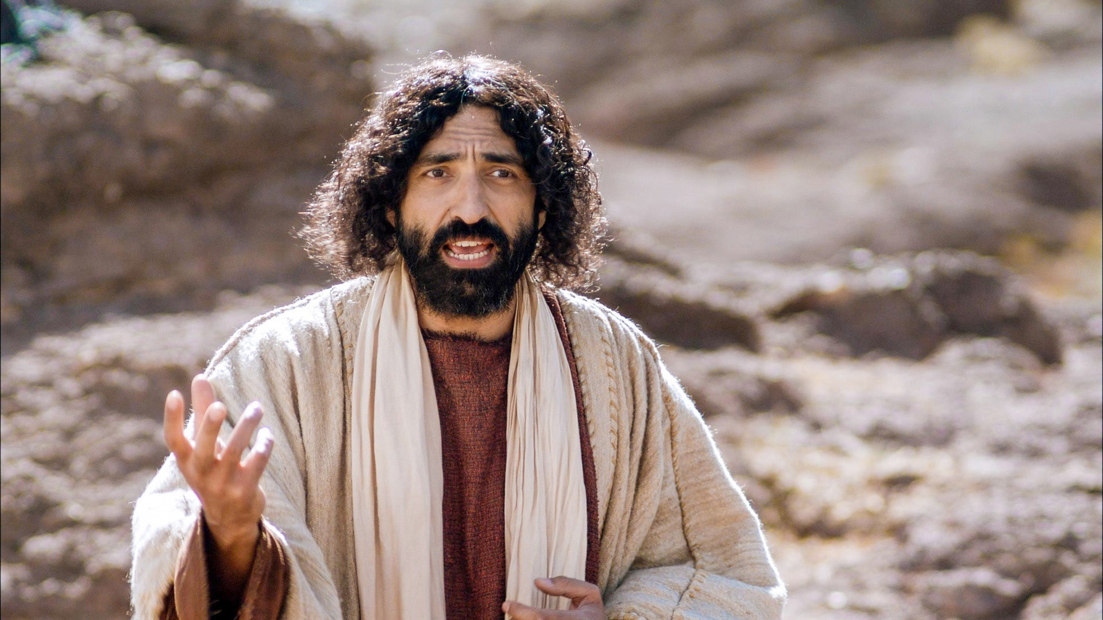
“So, every healthy tree bears good fruit, but the diseased tree bears bad fruit. A healthy tree cannot bear bad fruit, nor can a diseased tree bear good fruit. Every tree that does not bear good fruit is cut down and thrown into the fire. Thus you will recognize them by their fruits.” Matthew 7:17-20

Slide 41
Fruit is the evidence of what’s in our hearts!
“So, every healthy tree bears good fruit, but the diseased tree bears bad fruit. A healthy tree cannot bear bad fruit, nor can a diseased tree bear good fruit. Every tree that does not bear good fruit is cut down and thrown into the fire. Thus you will recognize them by their fruits.” Matthew 7:17-20

Slide 42
Are You Prepared?
Preparation is Initiated by God (vss. 1-6)
Preparation Involves Repentance (vss. 7-9)
Preparation is Very Practical (vss. 10-14)

Slide 43
“And the crowds asked him, ‘What then shall we do?’ And he answered them, ‘Whoever has two tunics is to share with him who has none, and whoever has food is to do likewise.’” Luke 3:10-11
Fruit example #1: Sharing with those in need

Slide 44
Where did this idea of caring for the poor come from?
“…you shall not harden your heart or shut your hand against your poor brother, but you shall open your hand to him and lend him sufficient for his need, whatever it may be. Take care lest there be an unworthy thought in your heart and… your eye look grudgingly on your poor brother, and you give him nothing, and he cry to the LORD against you, and you be guilty of sin…
I command you, ‘You shall open wide your hand to your brother, to the needy and to the poor, in your land.’”
Deuteronomy 15:7-9,11

Slide 45
Why should we share with the poor?
“As the LORD your God has blessed you, you shall give to him. You shall remember that you were a slave in the land of Egypt, and the LORD your God redeemed you; therefore I command you this today.” Deuteronomy 15:14-15

Slide 46
Fruit example #2: Honesty in collecting money
“Tax collectors also came to be baptized and said to him, ‘Teacher, what shall we do?’ And he said to them, ‘Collect no more than you are authorized to do.’” Luke 3:12-13

Slide 47
Fruit example #3: Contentment with money
“Soldiers also asked him, ‘And we, what shall we do?’ And he said to them, ‘Do not extort money from anyone by threats or by false accusation, and be content with your wages.’” Luke 3:14

Slide 48
In what way are these examples different?
Specific to each person’s life
Fruit example #1: Sharing with those in need
Fruit example #2: Honesty in collecting money
Fruit example #3: Contentment with money

Slide 49
What do they have in common?
Money and possessions!
Fruit example #1: Sharing with those in need
Fruit example #2: Honesty in collecting money
Fruit example #3: Contentment with money

Slide 50
“No one can serve two masters…
You cannot serve God and money.”
Matthew 6:24
Fruit example #1: Sharing with those in need
Fruit example #2: Honesty in collecting money
Fruit example #3: Contentment with money

Slide 51
Fruit is the evidence of what’s in our hearts!
How we use our money is one of the clearest signs of true repentance!
“So, every healthy tree bears good fruit, but the diseased tree bears bad fruit. A healthy tree cannot bear bad fruit, nor can a diseased tree bear good fruit. Every tree that does not bear good fruit is cut down and thrown into the fire. Thus you will recognize them by their fruits.” Matthew 7:17-20

Slide 52
Fruit is the evidence of what’s in our hearts!
Love of money can be one of the greatest barriers to being prepared to respond to God’s work in our lives…
“So, every healthy tree bears good fruit, but the diseased tree bears bad fruit. A healthy tree cannot bear bad fruit, nor can a diseased tree bear good fruit. Every tree that does not bear good fruit is cut down and thrown into the fire. Thus you will recognize them by their fruits.” Matthew 7:17-20

Slide 53
Are You Prepared?
Preparation is Initiated by God (vss. 1-6)
Preparation Involves Repentance (vss. 7-9)
Preparation is Very Practical (vss. 10-14)

Slide 54
Are you prepared to respond to the call of Jesus for your life?

Slide 55
Have you truly repented and submitted your life to Christ as your saviour?
Given up reliance on religious performance
Given up reliance on religious heritage
Trusted in Jesus and his death alone for acceptance with God
Is the fruit of repentance clear in your life?

Slide 56
Have you surrendered your money and possessions to God?
How about your time?

Slide 57
God continues to prepare you so he can use your life for his purposes.
Are you continuing to respond in true repentance?

Slide 58
Sermon by Dan Bridges
Amman International Church (AIC)
Amman, Jordan
This and most other AIC sermons can be found on the church website:
ammanchurch.org

Slide 59
Black

Slide 60


NT Preaching link at BibleStudyDownloads.org
Get this presentation for free!
Notes:
NT Preaching (np)

